Slide 1
Semiconductor Switch Designs
M.J. Barnes
Acknowledgements
W. Bartmann, L. Ducimetière, B. Goddard,
J. Holma, A. Lechner, T. Fowler, T. Kramer,
M. Meddahi, R. Schmidt
FCC week, 23th-27th March 2015

Slide 2
Outline
Requirements for FCC injection kickers;
An existing kicker system at CERN;
The need for developments of semiconductor (solid-state) switches;
Possible semiconductor switch topologies for injection;
Requirements for FCC extraction (dump) kickers;
Possible semiconductor switch topologies for extraction;
Other R&D required;
Timeline and tasks for R&D;
Summary.

Slide 3
FCC injection kicker system requirements
 |  | FCC Injection
Magnet technology |  | Delay line
Kinetic Energy | TeV | 3.3
Kick | mrad | 0.29
B.dl | T.m | 3.2
Aperture height | mm | 18 + 17 = 35
Aperture width | mm | 18 + 17 = 35
Field rise/fall time | µs | 0.28
Field flattop length | µs | 2.25
Field flattop ripple | % | ±0.5
System impedance | Ω | 5
Assumed system magnetic length | m | ~30
Magnet current | kA | ~0.31 to ~3.1
Pulse voltage range | kV | 1.8 to 18
Approximate number of injection kicker systems |  | 40

Slide 4
An existing kicker system at CERN
Line Type Modulator:
I
Max. pulse length = 2τ_{p}
LHC Injection PFN
In general, line type modulators are used with a main switch and a dump switch;
  switch is typically a thyratron (closing switch);
Impedance matched Pulse Forming Line/Network (PFL/PFN), to minimise reflections, but requires the PFL/PFN to be charged to twice the load voltage;
PFL is probably most appropriate for FCC injection.

Slide 5
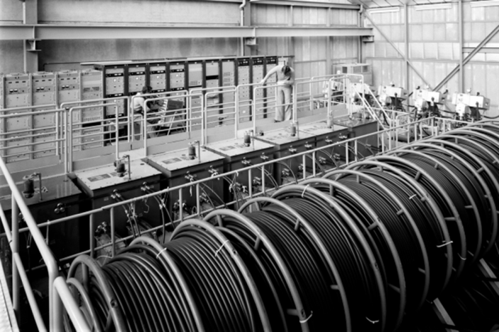
The need for new developments
Require a reliable kicker system, for
FCC, to avoid mis-kicking beam:
BUT….
Injected beam
Kicker magnet
Internal dump
Kicked circ.
Circulating beam
Thyratrons:
  pre-fire (self turn-on without a trigger signal) is a concern;
  long-term availability is a real concern;
  have limitations with regard to dynamic range and repetition rate;
  is only a closing switch ⇨ need for PFN/PFL for energy storage.
Unkicked inj.
CERN PS PFLs
Pulse Forming Line:
PFL has limitations: it should be matched to the load impedance, but coaxial transmission lines are commercially available only with certain impedances;
It is increasingly difficult to source coaxial transmission line for the highest voltage (~80 kV) kicker systems.
Suitable semiconductor switch topologies can help to solve the above problems.

Slide 6
Semiconductor Switches
Generally reliable and are not prone to self-triggering;
Allow a wide dynamic range of operation;
Maintenance is significantly reduced compared to gas switches;
Series and parallel connection of power semiconductor switches can potentially achieve designs with very high pulse power.
Examples of suitable switch technologies are:
  Marx Generator;
  Inductive Adder;
Depending upon the switch technology, solid-state modulators can be opened when conducting full load current, hence;
  only a portion of the stored energy is delivered to the load during the pulse (therefore a PFL or PFN is not required);
  potentially limit fault current in the event of a magnet (load) electrical breakdown;
  source impedance can be low, hence source voltage does not need to be doubled.

Slide 7
FCC Injection: Marx Generator
Operation: Capacitors charged in parallel (shown: even # switches on), and discharged in series (odd # switches on)
⇨ high voltage output.
Low source impedance;
No output transformer ⇨ maximum pulse length limited by capacitor values and load;
Modularity: same design can be used for different voltage (and current) specifications;
Switches and control electronics are not referenced to ground;
An international collaboration has been proposed between CERN and ISEL, Portugal, to investigate Marx Generators as a potential replacement for thyratrons (in existing systems at CERN too).

Slide 8
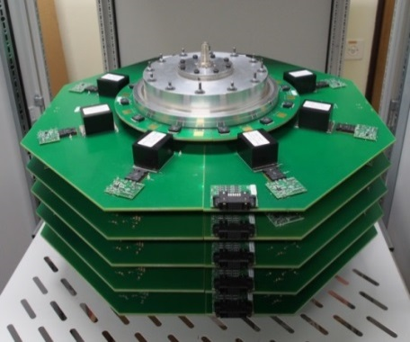
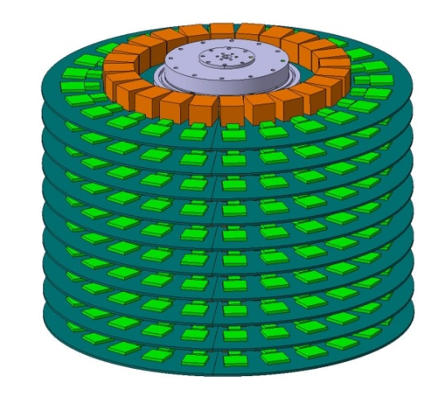
FCC Injection: Inductive Adder
Load
Adder originally developed at SLAC/LLNL;
Extremely high precision prototype built at CERN, for CLIC, based on MOSFETs (fast switching).
Modularity: the same design can be used for different voltage and current specifications;
Short rise time can be achieved (< 10 ns);
Potentially interesting for consolidation
of existing (short pulse) systems too;
Switches and control electronics are referenced to ground;
Promising technology for FCC injection;
Output pulse voltage can be modulated;
Redundancy easy to build-in;
Output transformer ⇨ maximum pulse length limited to typically ~3 μs;
Analogue Modulation Layer
Gate drive circuit
Trigger
Primary loop inductance
Capacitors
Leakage inductance
Constant Voltage Layers
Semiconductor switches
(N-1)
layers
Gate drive circuits
Fast diode clamp
Magnetizing inductance
Trigger
Primary current
1:1 coaxial transformer
5 layer CLIC prototype
Semiconductor switch (x8)
Capacitor (x8)

Slide 9
FCC extraction kicker system requirements
 |  | FCC Extraction
Magnet technology |  | Lumped inductance
Kinetic Energy | TeV | 3.3 to 50
Kick | mrad | 0.15
B.dl | T.m | 1.6 to 25
Aperture height | mm | 36
Aperture width | mm | 36
Field rise/fall time | µs | ≤3
Field flattop length | µs | 350
Field flattop ripple | % | 10
System impedance | Ω
Assumed system magnetic length | m | ~90
Magnet current | kA·Turns | ~0.55 to ~8.3
Output pulse voltage range | kV
Approximate number of extraction kicker systems |  | 300

Slide 10
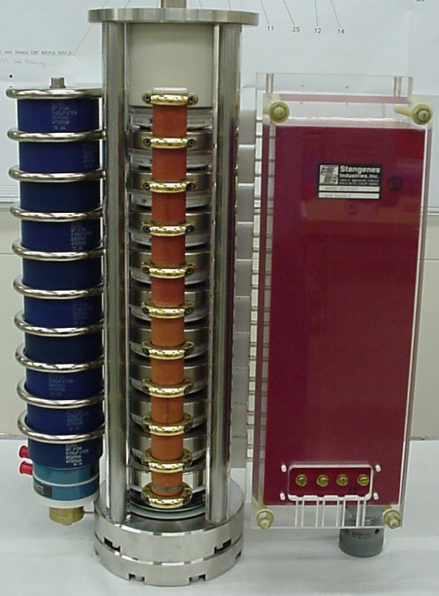
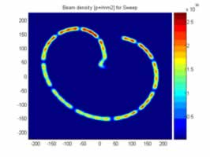
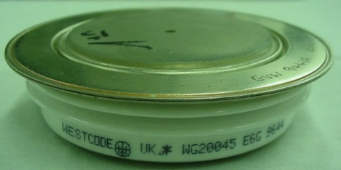
Existing LHC Extraction System
  Generator voltage must track the beam energy and have a low pre-fire rate.
Gate Turn-Off Thyristor’s, modified to be fast turn-on devices, are connected in series ⇨ high di/dt;
Allows a wide dynamic range of operation;
Fourteen extraction kicker systems per beam:
  for safety reasons, in case of pre-fire of one generator, all are triggered ⇨ asynchronous dump.
Two parallel generators (redundancy).
LHC dump – beam sweep:
Voltage: 2.2kV – 30kV;
Current: 1.3kA – 18.5kA;
Current flat top: 95μs.

Slide 11
FCC Extraction System
System must be ULTRA RELIABLE
Consider an highly segmented system:
  hence pre-fire of one generator does unduly influence beam;
  not necessary to trigger other generators ⇨ doesn’t give an asynchronous dump;
  redundancy..
Several switch topologies under investigation:
  Scale existing LHC extraction generator for FCC (for segmented system ⇨ reduced current compared to LHC generator);
  Brainstorming ⇨ idea based on an opening semiconductor switch:
    switch is normally closed (conducting current) during inj. and ramp;
    switch opened to switch off current and extract beam;
    current proportional to kinetic energy of beam;
    “fail safe” (no current ⇨ beam extracted);
    BUT high losses, maybe superconductivity can be used???
Talk by W. Bartmann (Tuesday)

Slide 12
Other R&D Required (Inj. & Ext.)
Study performance of various semiconductors, e.g. SiC, MOSFETS, IGBTs, …. (now & 10-20 years time???);
Magnetic materials;
Ultra reliable triggering/controls;
Other ideas for switch topologies;
Failure mode analysis;
Redundancy;
Fault tolerance;
Reliability;
Possibility of locating generator in tunnel, under magnet;
  Shielding of electronics;
  Radiation tolerant components;
Low source impedance may result in high fault current;
  Controls must detect fault current and limit magnitude;
Triggering method(s), e.g. fibre optics;
…….

Slide 13
Timeline and tasks
2015:
Task 1: Complete proposal (objectives, timeline, identify lab space, secure resources, secure budget, and establish formal collaborations).
Task 2: Study overall concepts and kicker system options, and define key parameters for FCC injection and/or extraction kicker generators.
2016 - 2017:
  Task 3: Test and select individual components (switches and magnetic materials for cores), design of the prototype for FCC injection. [collaborations sought]
2018:
  Task 4: Document results and CDR write-up.
  Task 5: Construct the prototype system (generator, transmission lines, load).
2019:
  Task 6: Test the prototype.
Note: timeline is dependent upon resources and budget availability…..
Collaborations very welcome!

Slide 14
Summary
Very challenging requirements;
High reliability kicker systems are required for FCC;
Parallel and series arrays of semiconductor switches are promising for both FCC and consolidation of existing kicker systems;
  eliminate pre-fire associated with thyratrons;
  eliminate need for very high voltage rating coaxial cable;
  built in redundancy;
  modularity.
Closing and opening capability eliminates the need for a PFL/PFN;
  Source impedance can be low, allowing a relatively small number of series connected power semiconductors. BUT requires a careful consideration of fault conditions;
Redundancy, fault tolerance, radiation tolerance,…

Slide 15
Thank you for your attention!
Comments and suggestions are VERY welcome.

Slide 16
Spare Slides

Slide 17
Line type modulator example waveforms

Slide 18
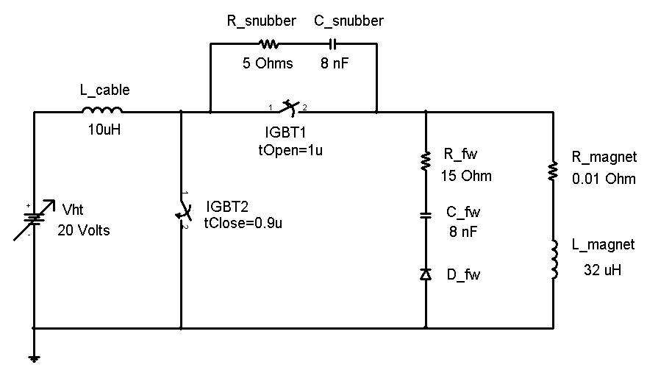
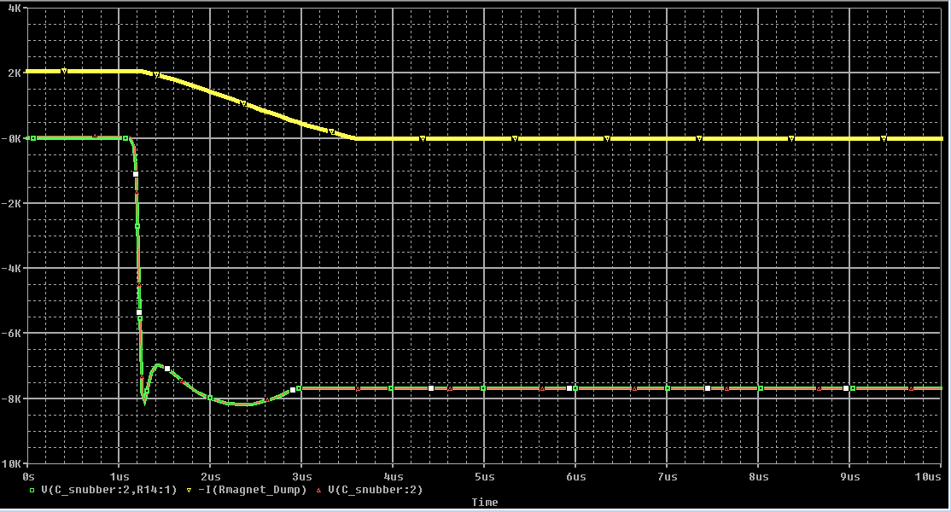
FCC Extraction System: opening switch possibility
Simulation:
2k
Magnet current
0
-2k
-4k
-6k
Switch voltage
-8k
0
1μs
2μs
3μs
4μs
5μs

Slide 19
Example of normal and fault currents

