Slide 1
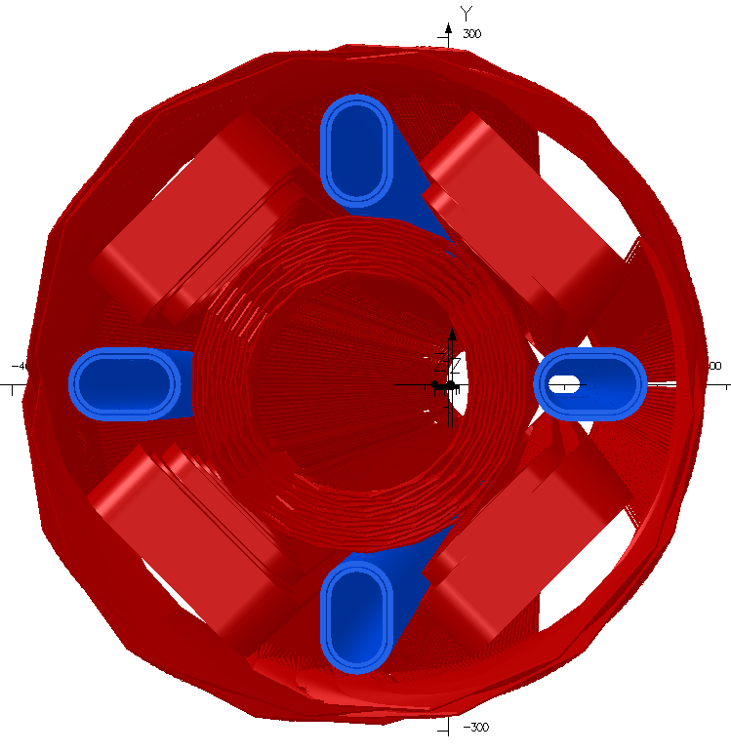
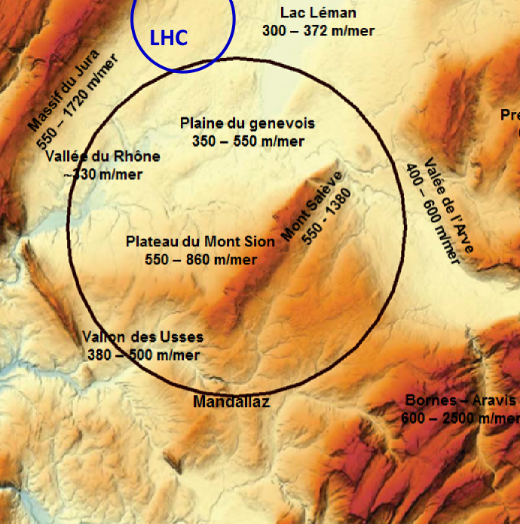
Magnetic Sweet Spots and the eh Machine Detector Interface
Brett Parker, BNL/SMD
?
eRHIC Q1 Sweet Spot Septum Quadrupole
Schematic of an 80-100 km Long FCC Tunnel at CERN

Slide 2
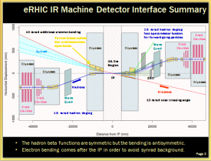
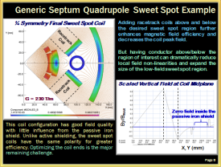
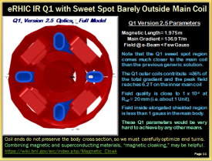
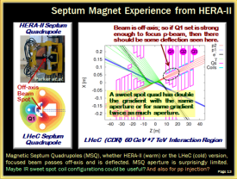
Magnetic Sweet Spots & Machine Detector Interface
Review of eRHIC IR design challenges.
Demonstrate the creation of a generic sweet spot coil in a few simple steps.
Review the eRHIC Q1 and B1 magnets as two specific design examples.
Finish up with discussion of some eh IR design challenges / opportunities.
3
5
2
2
Note to cover these slides in 15 minutes means having to gloss over many details.
Offline discussion is most welcome if this material is of interest to you. ☺

Slide 3
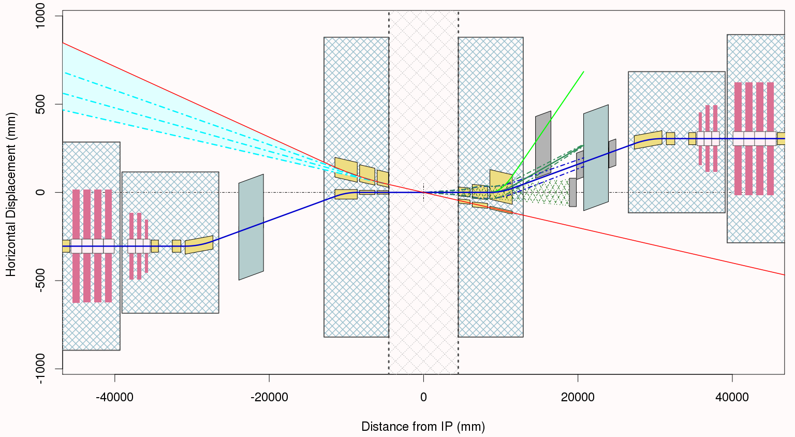
eRHIC IR Machine Detector Interface Summary
10 mrad additional electron bending
16 mrad hadron dogleg has spectrometer function for forward going particles
Crab Cavities
Yellow boxes outline the cold beam tube apertures.
Warm Quad
Crab Cavities
Cryostat
Cryostat
Synrad
Cryostat
±4.5m Region
Cryostat
Cryostat
IP
ZDC
Cryostat
Hadrons
Electrons
Crab Cavities
Warm Quad
10 mrad total crossing angle
Crab Cavities
16 mrad hadron dogleg
The hadron beta functions are symmetric but the bending is antisymmetric.
Electron bending comes after the IP in order to avoid synrad background.

Slide 4
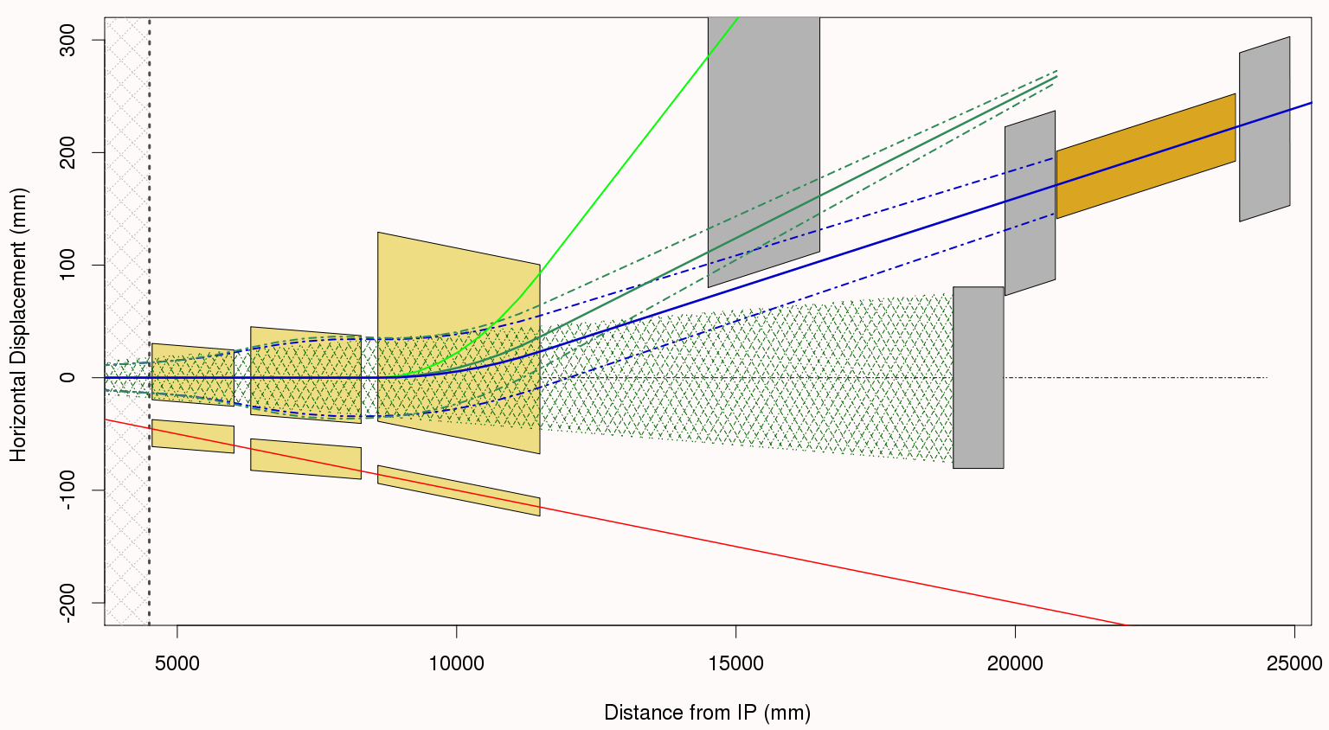
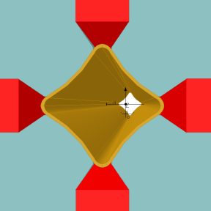
eRHIC IR Forward Region Layout Details
Δp/p = 20% P_{o}
±3 mrad
Forward
Detector
Roman
Pots
Δp/p = 50% P_{o}
Q2, has HERA style “butterfly shape chamber”
B1
Q1
Q0
4 mrad neutron cone
ZDC
Main Beam ±3 mrad
Q2 Front
Measure as much as possible before the next cold accelerator region.
Note that the coordinate system in these figures is aligned with the center of the 4 mrad neutron cone (neutral vector) indicated by the hatched region on the plot.

Slide 5
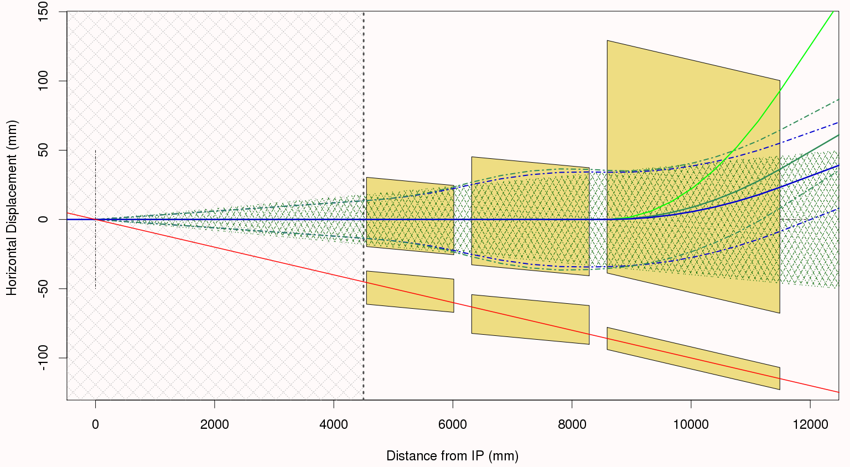
eRHIC IR, Version 2.5, Forward Layout Details
Strong dipole bending in this B1 aperture
Strong quadrupole focusing takes place in these, Q1 & Q2 apertures
4 mrad neutron cone acceptance
Low field “sweet spot” shielded
regions for incoming electrons in these apertures.
Note that the coordinate system in these figures is aligned with the center of the 4 mrad neutron cone (neutral vector) indicated by the hatched region on the plot.

Slide 6
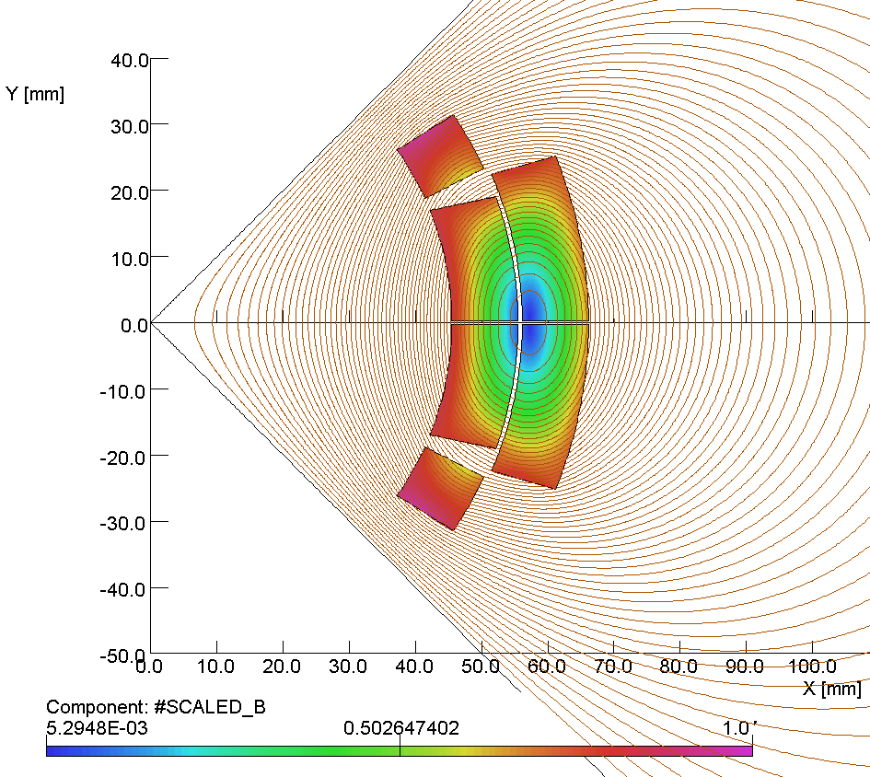
Generic Septum Quadrupole Sweet Spot Example
¼ Symmetry Bare Quadrupole Coil
The longest range field external field component from a quadrupole falls off as (R_{coil}/R)³.
So the external field “remembers” the size of the coil structure.
Higher order harmonics cause the field magnitude in the vicinity of the coil to be even larger.
The quadrupole coil thickness grows according to ln(R_{outer}/R_{inner}) gradient dependence (high field = thick coil).
For yoke fields more than say 2 T, the yoke saturates and field will leak into cutout regions (cannot hide there).
However, note that there is a zero in the coil field distribution close to the middle of the coil structure.
G = 230 T/m for this coil & later plots
B_{max} Spot
B≈0 Region
Average R = 55.5 mm
R = 100 mm
TQS03 Inspired Coil Geometry
For this figure we plot |#Scaled_B|, the field distribution in the coil structure divided by the maximum field in the coil. At the 100 mm indicated spot #Scaled_B is about -0.2.

Slide 7
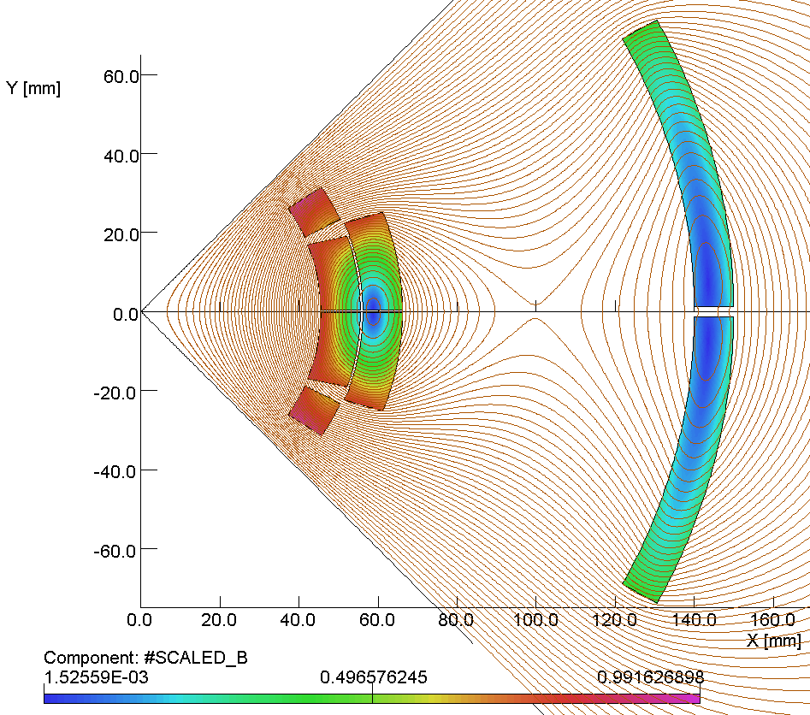
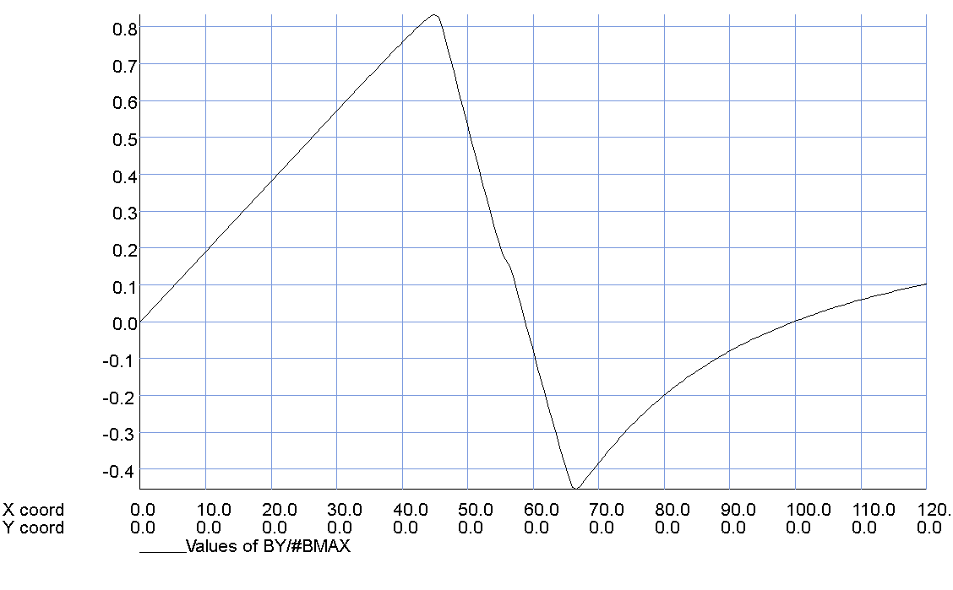
Generic Septum Quadrupole Sweet Spot Example
¼ Symmetry Simple Sweet Spot Coil
Adding the second outer quadrupole coil show here contributes an additional 11% to overall magnetic field efficiency and slightly decreases the peak field.
But now we have created a field reversal “sweet spot” at the desired, X = 100 mm, location.
High field coil
Low field coil
R = 100 mm
Scaled Vertical Field at Coil Midplane
Linear on the
inside
G = 230 T/m
By/B_{MAX}
Now have zero at X=100 mm
The field magnitude grows with distance from the zero crossing sweet spot point. It depends on how large the electron region we must shield as to whether or not we can use a passive iron shield for the final field reduction.
Reversed in the coil
X, Y (mm)

Slide 8
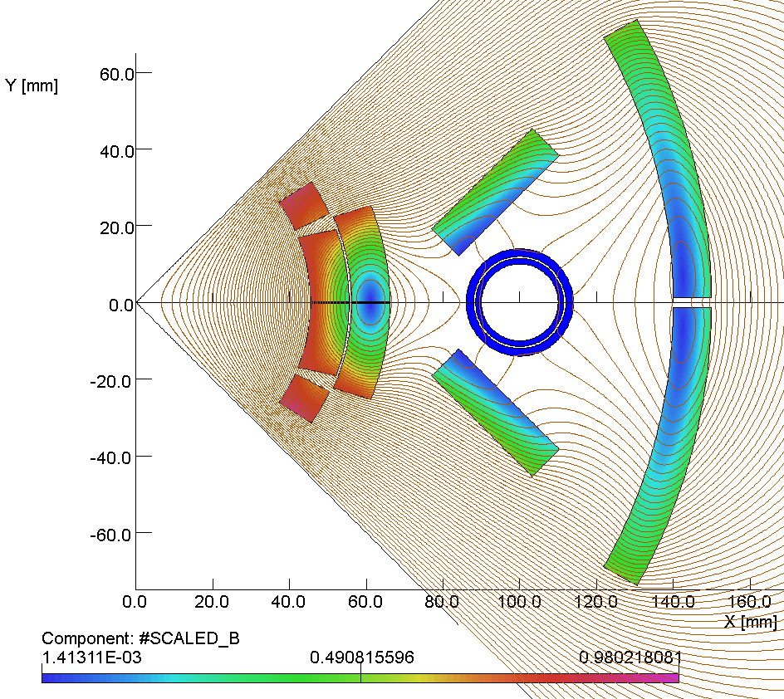
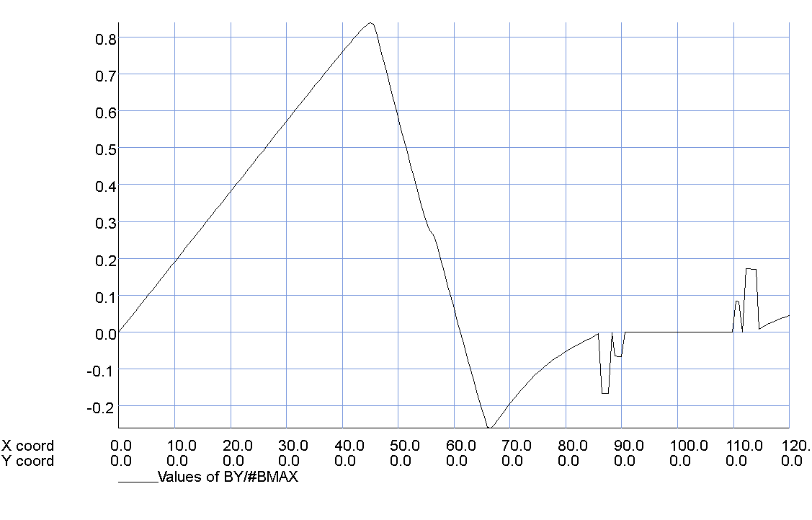
Generic Septum Quadrupole Sweet Spot Example
¼ Symmetry Final Sweet Spot Coil
Adding racetrack coils above and below the desired sweet spot region further enhances magnetic field efficiency and decreases the coil peak field.
But having conductor above/below the region of interest can dramatically reduce local field non-linearities and expand the size of the low-field sweet spot region.
Racetrack Coil
Racetrack Coil
Scaled Vertical Field at Coil Midplane
G = 230 T/m
By/B_{MAX}
Zero field inside the passive iron shield
This coil configuration has good field quality with little influence from the passive iron shield. Unlike active shielding, the sweet spot coils have the same polarity for greater efficiency. Optimizing the coil ends is the major remaining challenge.
X, Y (mm)

Slide 9
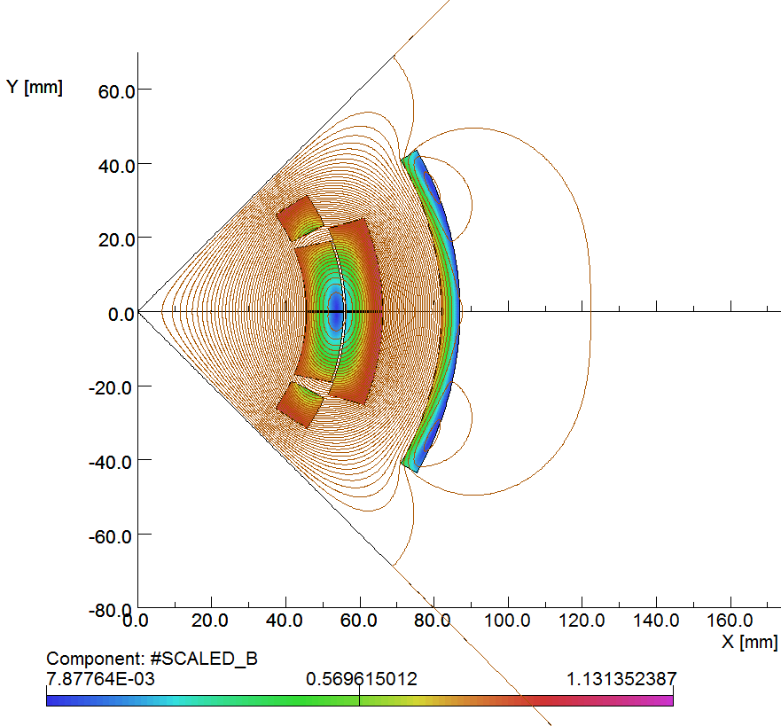
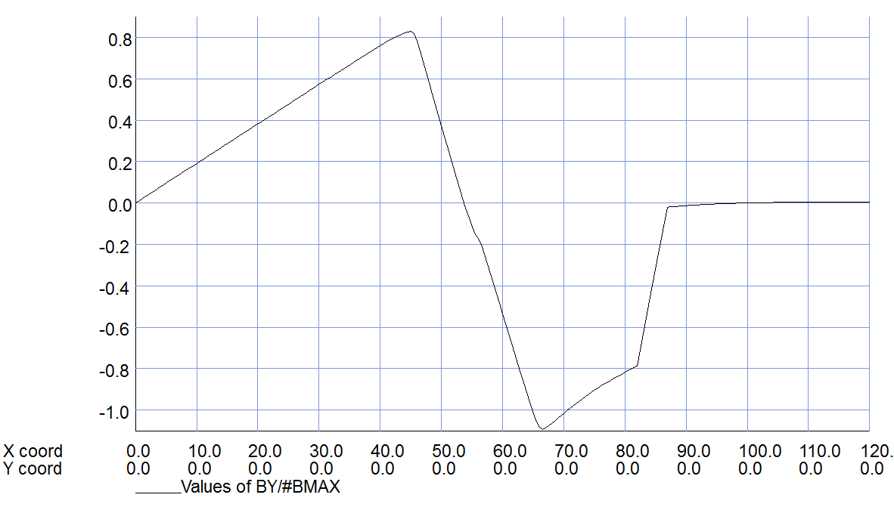
Generic Quadrupole Active Shielding Counter Example
¼ Symmetry Actively Shielded Coil
Reduced efficiency because coils “fight” each other. Efficiency goes as 1 – (R₁/R₂)⁴.
There is a net 57% increase in operating current and 14% peak field increase with respect to the previous sweet spot coil.
The good new is that there is now a large external region with very low field.
Having no magnetic material this method works while embedded in detector field.
Reverse polarity coil
2% increase here
R₁
R₂
R = 100 mm
Scaled Vertical Field at Coil Midplane
Flux returns between coils
Small field outside the active shield
G = 230 T/m
By/B_{MAX}
This coil configuration dramatically reduces the external field at the cost of returning all the flux between the inner and outer coils. Works best with more space between inner and outer coils (original ILC IR). We still need to very carefully optimize the coil ends to avoid large local field overshoot/undershoot.
New spot for the peak field
X, Y (mm)

Slide 10
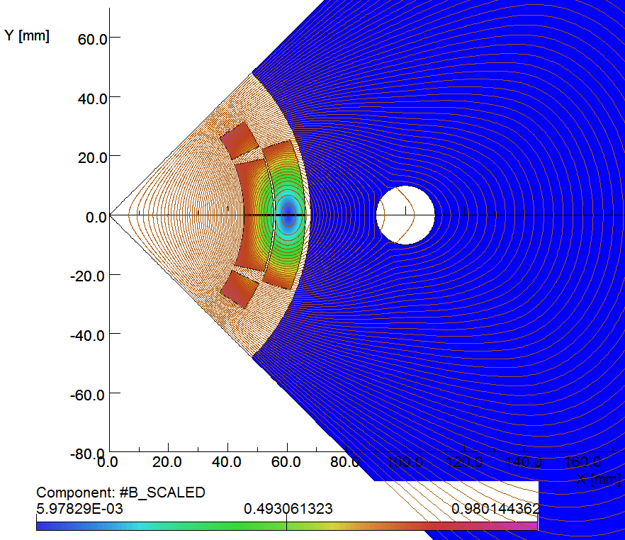
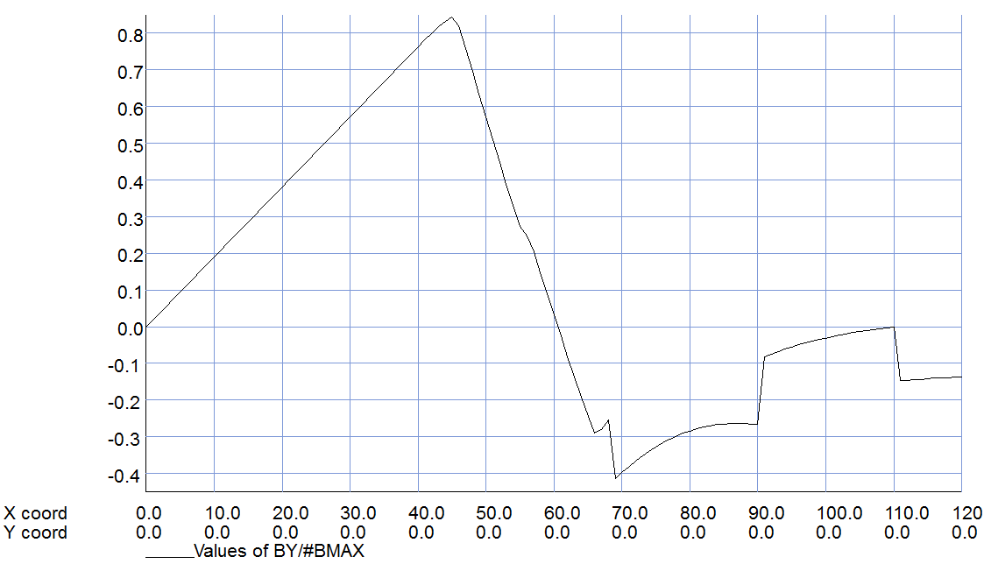
Generic Quadrupole Yoke Shielding Counter Example
Similar peak field to that of sweet spot coil but operating current is now 5% higher.
For 230 T/m, B > 1 T in the cutout region.
Moving cutout region closer to coil will only make things worse!
Could consider making the cutout larger and inserting an active compensation coil? (going this road is full of complications)
¼ Symmetry Coil with Close In Yoke
Saturated Yoke
R = 100 mm
Scaled Vertical Field at Coil Midplane
G = 230 T/m
#B_{MAX} = 12 T
Linear on the
inside
By/B_{MAX}
-9% of #BMAX inside cutout
For a low field magnet, sending beam through a small cutout is the easiest solution. But this highly saturated yoke is ineffective at shielding field from penetrating into the cutout region. There are also significant transition fields (3d end effects) where the yoke terminates.
Reversed in the coil
Yoke
Yoke
X, Y (mm)

Slide 11
eRHIC IR Q1 with Sweet Spot Barely Outside Main Coil
Q1, Version 2.5 Optics, Full Model
Q1 Version 2.5 Parameters
Magnetic Length = 1.975 m
Main Gradient = 136.9 T/m
Field @ e-Beam < Few Gauss
Note that the Q1 sweet spot region comes much closer to the main coil than the previous generic solution.
The Q1 outer coils contribute ≈36% of the total gradient and the peak field reaches 6.2 T on the inner main coil
Field quality is close to 1 x 10⁻⁴ at R_{ref} = 20 mm (i.e. about 1 Unit).
Field inside elongated shielded region is less than 1 gauss in the main body.
These Q1 parameters would be very hard to achieve by any other means.
Coil ends do not preserve the body cross section, so we must carefully optimize end turns. Combining magnetic and superconducting materials, “magnetic cloaking,” may be helpful. https://wiki.bnl.gov/eic/index.php/Magnetic_Cloak

Slide 12
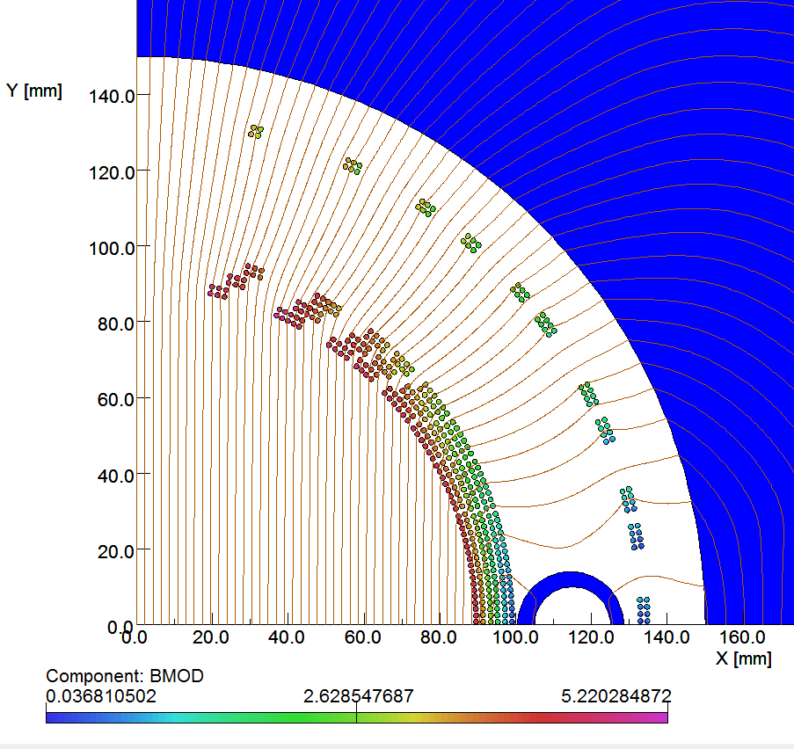
eRHIC IR B1 with Sweet Spot Barely Outside Main Coil
B1, Version 2.5 Optics, ¼ Symmetry Model
B1 Version 2.5 Parameters
Magnetic Length = 2.9 m
Dipole Field = 4.6 T
Field @ e-Beam < Few Gauss
For those already familiar with the RHIC DX magnet, this is in effect a septum version of that magnet.
Since the external field for a dipole falls off more slowly than from quad, (R_{coil}/R)², and the B1 coil radius is so large, we expected that it would be hard to make the sweet spot this close.
But the slower fall-off led to smaller residual field non-linearity over the sweet spot region and there is no need for any Q1-style racetrack coils.
We are constructing a 1 m long Direct Wind version of the inner coil now in FY’15 using BNL LDRD funding.
Passive, sweet spot shield is located just outside the main coil
Field Magnitude, |B|, Mapping at the coil in Tesla
With a full 3d model we find that because the B1 end-fields change much less rapidly than for Q1, it is much easier to preserve the sweet spot throughout the magnet ends.

Slide 13
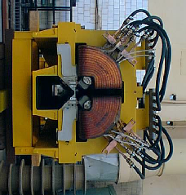
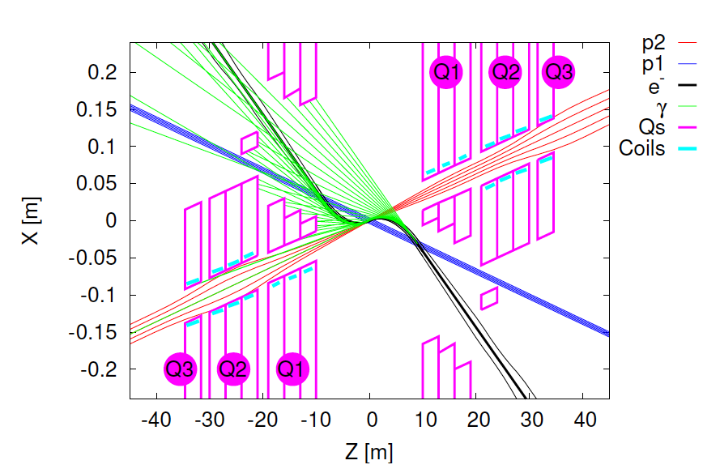
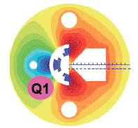
Septum Magnet Experience from HERA-II
HERA-II Septum Quadrupole
Beam is off-axis; so if Q1 set is strong enough to focus p-beam, then there should be some deflection seen here.
Parker et.al.
Off-axis Beam Spot
A sweet spot quad has double the gradient with the same aperture or for same gradient twice as much aperture.
LHeC Septum Quadrupole
LHeC (CDR) 60 GeV *7 TeV Interaction Region
Magnetic Septum Quadrupoles (MSQ), whether HERA-II (warm) or the LHeC (cold) version, focused beam passes off-axis and is deflected. MSQ aperture is surprisingly limited. Maybe IR sweet spot coil configurations could be useful? And also for pp injection?

Slide 14
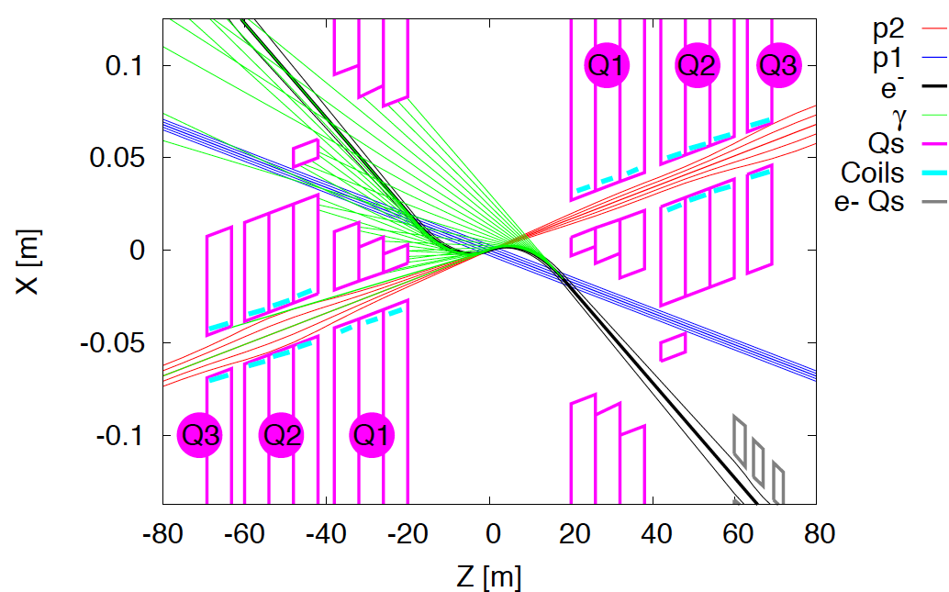

Experimental Background Experience from HERA-II
FCC-he (ERL) 60 GeV * 50 TeV Interaction Region
Synrad Albedo
Even given a perfectly functioning machine, the early HERA-II luminosity was limited by the tolerable levels of experimental background in the ZEUS and H1 detectors.
The albedo backscatter radiation from sufficiently high critical energy synchrotron radiation is profuse, nearly isotropic and very difficult to collimate close to the detector.
The experiment probably wants some amount of dipole field in the forward/backward directions but maybe we can still keep the e-beam bending as small as possible?
Again using sweet spot coil septum magnet configurations may be helpful for this.

