Slide 1
FCC-hh
Injection and Extraction
Wolfgang Bartmann, CERN
with many inputs from
M. Atanasov, M.J. Barnes, J. Borburgh, T. Fowler, B. Goddard, W. Herr, T. Kramer, A. Lechner, M. Meddahi, R. Ostojic, R. Schmidt, D. Schulte
FCC week, 23th-27th March 2015

Slide 2
Outline
FCC injection
  Machine protection consideration
  Kicker rise time specification
  Septum strength
  Optics and overall insertion length
FCC dump system
  Extraction locations and link with collimation
  Insertion overview and alternative concepts
  Dump block limitations
Summary
  Challenges
  Study directions and R&D programs
  Timeline

Slide 3
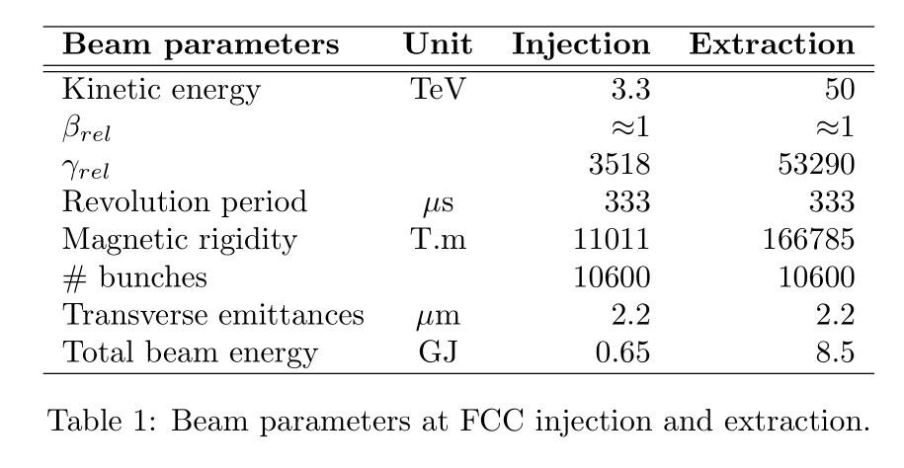
FCC-hh parameters

Slide 4
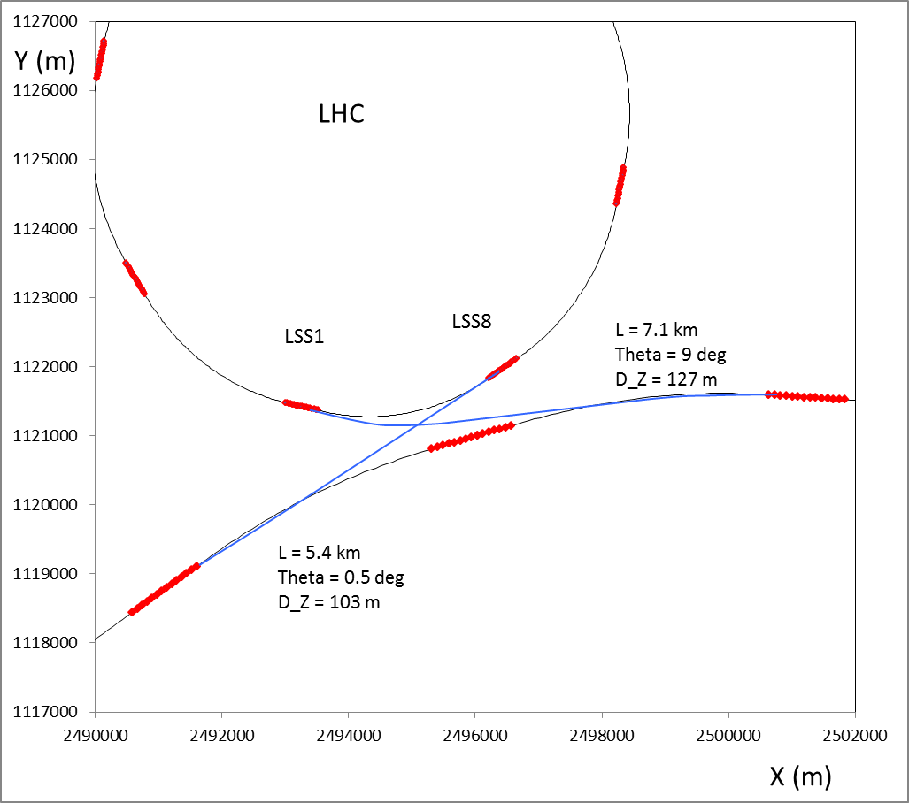
Injection concept
Fast bunch-to-bucket transfer
A total of 650 MJ beam energy to transfer
For HL-LHC with an injected beam energy of ~5 MJ reach limit of injection protection devices
Transfer beam from HEB to FCC in stages
50 – 70 bunches per transfer
  Gives a total of ~200 injections to fill FCC
  ~60 injections to transfer a full LHC bunch train
Time required for the injection process
  Have to wait for re-synchronisation between machines
  (~10 ms for LHC-FCC case)
  Total time required to inject one LHC bunch train ~0.5 s
  Would need 3 - 4 LHC trains to fill FCC
FCC

Slide 5
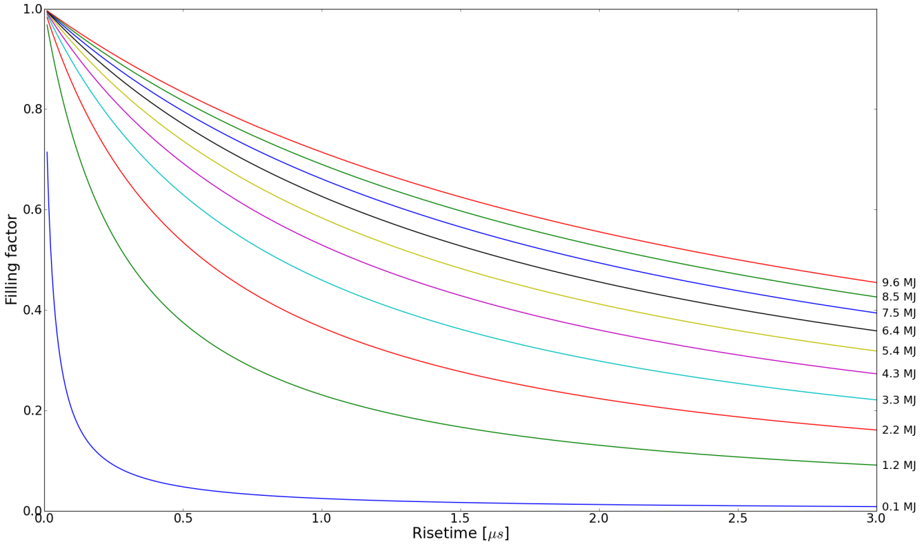
Constraints for FCC filling scheme
Beam transfer from HEB to FCC is machine protection limited
Aim to fill 80% of FCC
Assume about 3 us for abort gap
280 ns rise time for injection kicker rise time

Slide 6
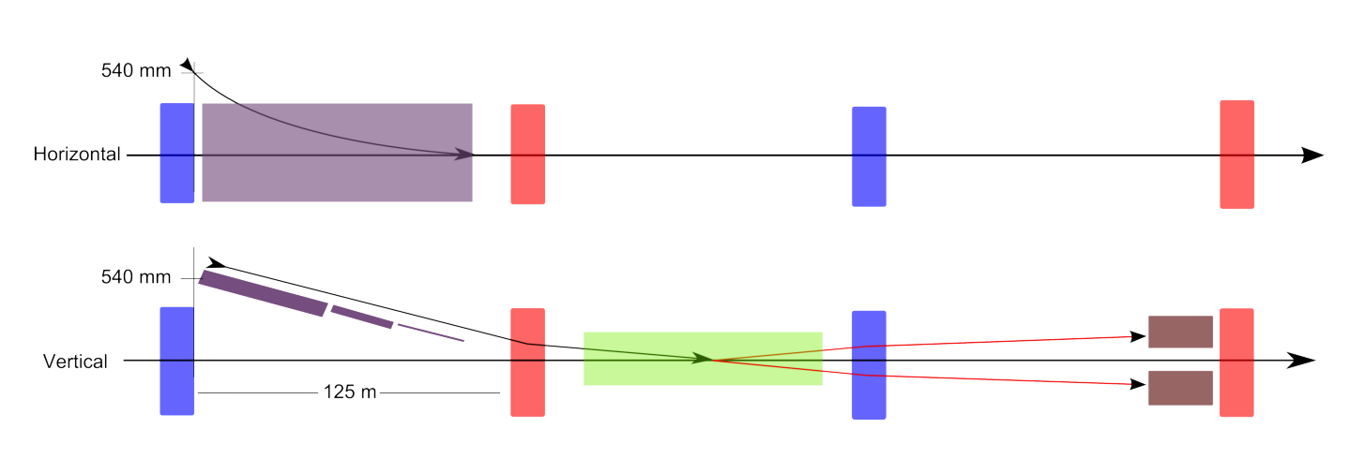
FCC Injection Schematic
Lambertson septum
QF
Injection kicker
QD
Internal dump
150 m
Massless septum as active injection protection?

Slide 7
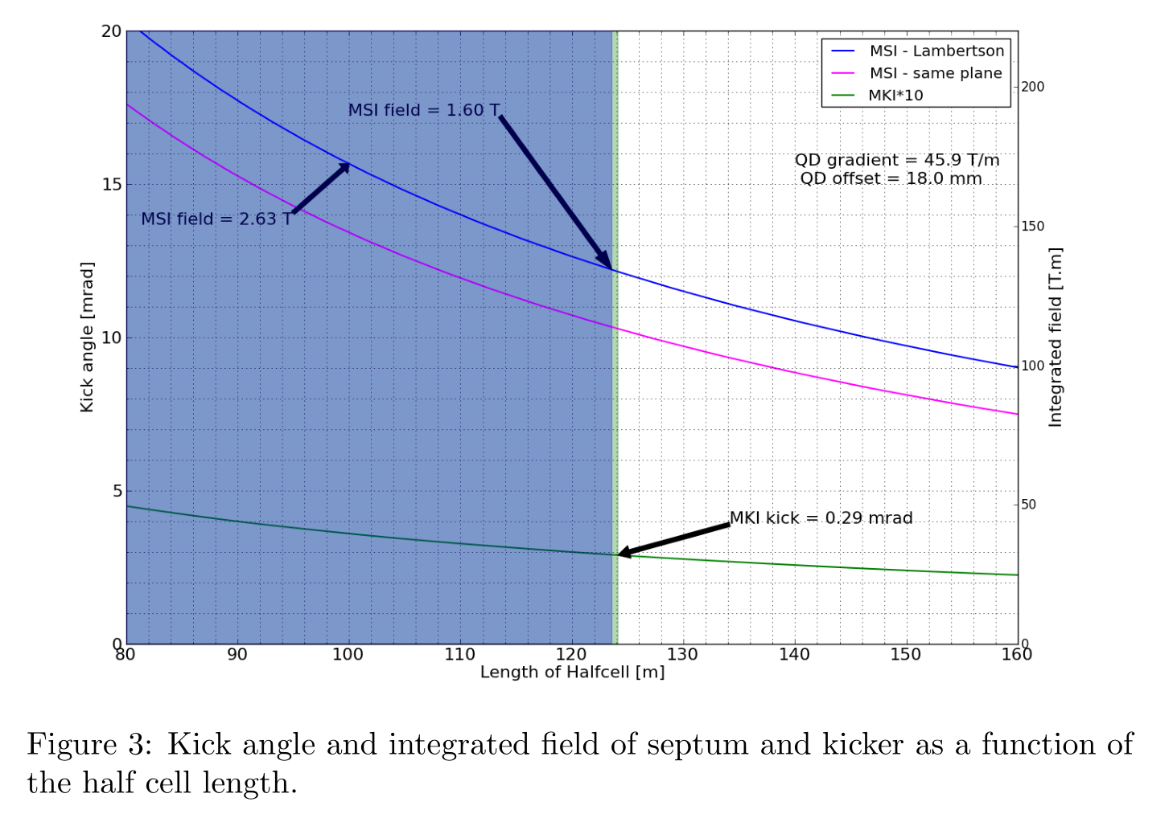
Injection septum strength

Slide 8
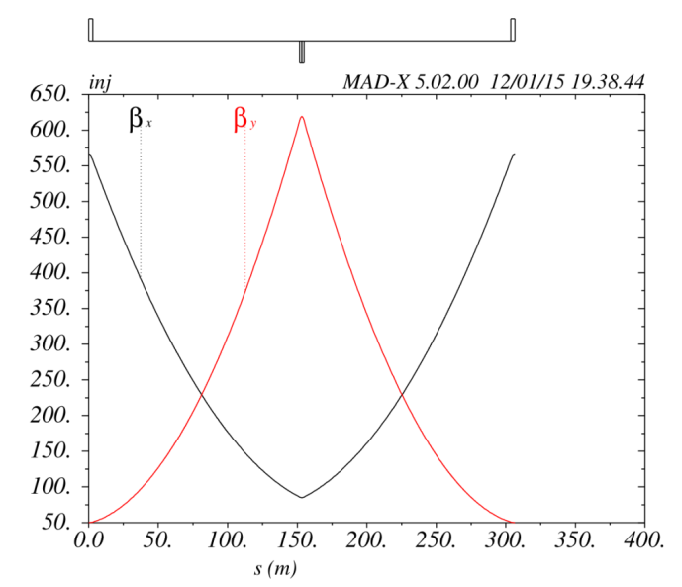
Injection straight optics
Increase regular half cell length from 100 m to 150 m in injection insertion
  Relax magnet strengts, make space for instrumentation and protection devices
Maximum betas of 620 m – why not go higher?
Total injection insertion requires about 500 m for septum, kicker and internal dump
Further protection downstream is required

Slide 9
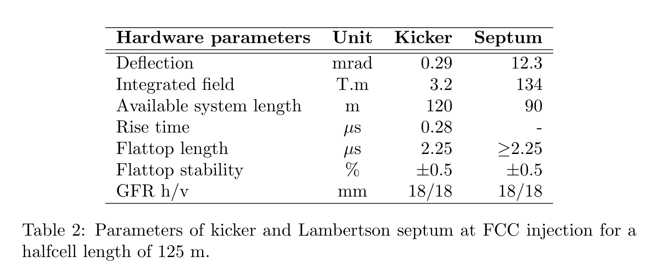
Injection HW

Slide 10
FCC Extraction

Slide 11
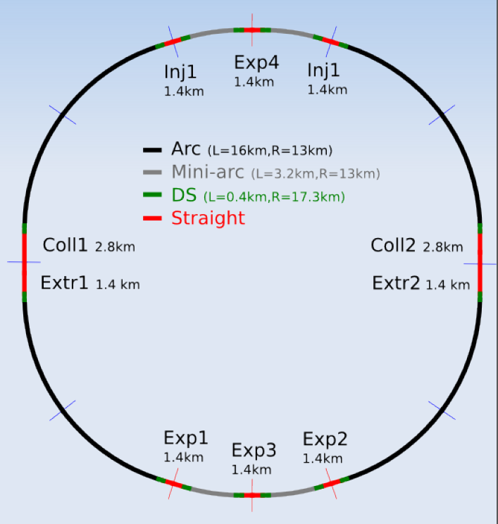
FCC Extraction
Two separated extraction insertions
Sequence of collimation and extraction systems
  If betatron cleaning is separated would be ideal to have collimation downstream extraction
  Protection of downstream machine and experiments in case of asynchronous dump

Slide 12
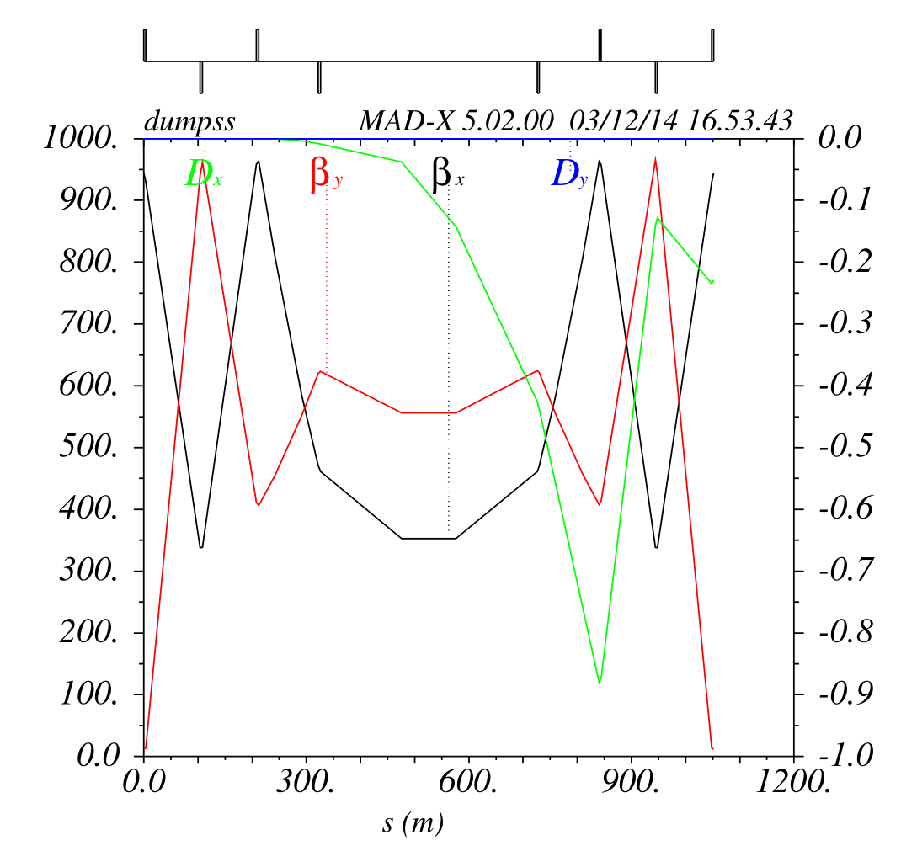
Dump insertion – LHC scaled
110 m
400 m
Rms beam size ~ 1 mm
Extraction kicker:
0.13 mrad, 22 T.m
110 m drift
Enlarged quadrupole:
9 mm offset
Bump (not in LHC):
9 mm
0.3 mrad, 50 T.m
Extraction septum:
17 mm septum width
150 m drift to clear blade
50 m for protection devices
+2 bumpers
200 m available length
1.7 mrad, 284 T.m, 1.42 T

Slide 13
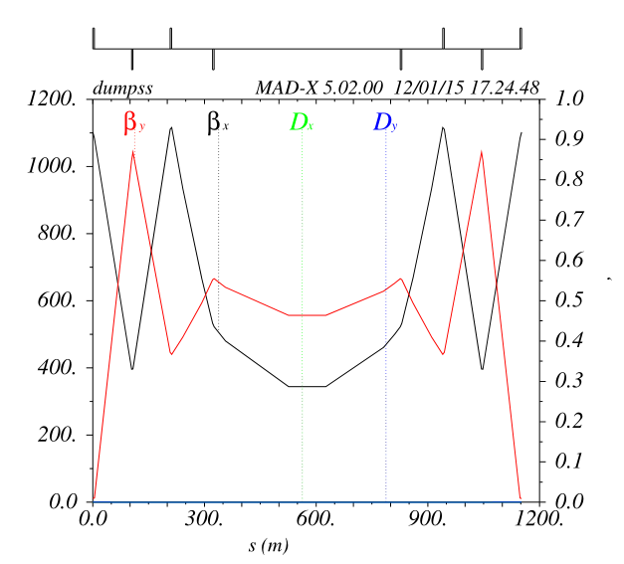
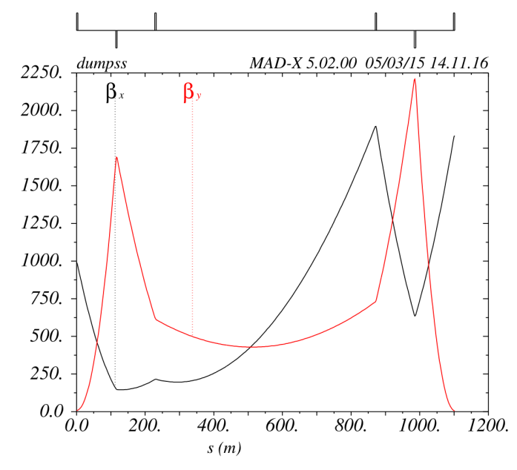
Dump insertion alternatives
SSC like
  Septum is part of extraction bump
  Use field free channel of septum to extract
  Need strong, good field quality septum
Asymmetric insertion optics
  Avoid asynchronous dumps by accepting single kicker erratic
  High segmentation of kicker system (200-300 modules)
  Asymmetric optics
    to reduce oscillation from single kicker failure
    (small hor beta)
    to reduce kicker strength and dilute beam at absorbers (high betas at septum)

Slide 14
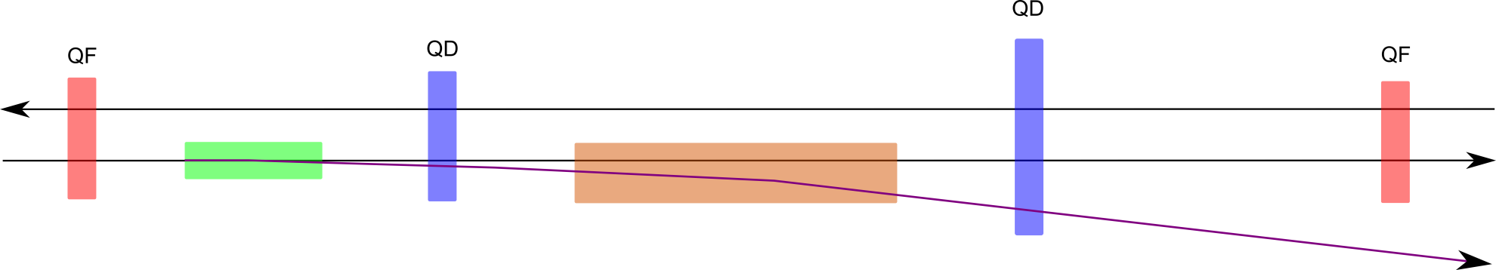
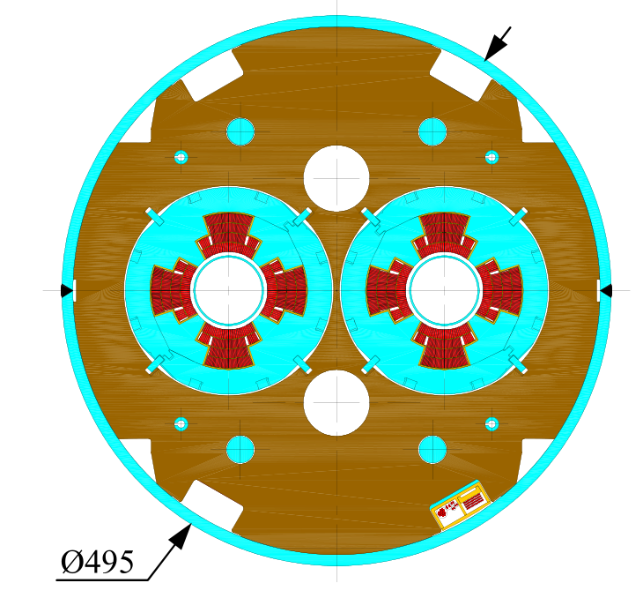
Requirements for special quadrupoles
Enlarged quadrupole
Triple chamber quadrupole?
Beam offset:
Injection up to 18 mm
Extraction up to 9 mm

Slide 15

Dump block limitations
Assume 1.5 km dump line without active dilution
  400 µm rms beam size at dump
Assuming graphite (1.2-1.77 g/cm³)
  Limit in energy density such that peak temperature of ~1500°C not exceeded
  Minimum of ~1.8 mm separation between bunches → requires min of 20 m linear sweep length!
Actively dilute beam in dump line (beta function of 100 km)
  2.0 mm rms beam size
  Still need ~1.5 mm separation between bunches - not much gain from active dilution
See talk by A. Lechner: Energy deposition challenges
 | Unit | 25 ns | 5 ns
Bunch population |  | 1e11 | 0.2e11
# bunches |  | 10600 | 53000
Transv. emittance normalised | um | 2.2 | 0.44
Spotsize at dump (rms) for 1.5 km dump line | mm | 0.4 - 1.6 | 0.2 – 0.7
Total beam energy | GJ | 8.5 | 8.5
Average power (5 h fills) | kW | 500 | 500

Slide 16
Summary
Challenges
Study direction and R&D programs
Timeline

Slide 17
Challenges
Beam energy at HEB-FCC transfer and FCC injection
Fast injection kicker field rise and recharging
Injection protection: passive, maybe also active
Asynchronous dump mitigation
  Kicker system segmentation
  Kicker generators: ultra-reliable triggering
Asynchronous dump protection devices
Dump absorber
Beam dilution
Special insertion magnets
Limited access possibilities: hot spares, remote handling
Controls and electronics: remote, compact, reliable, radiation hardness
Power consumption/recycling
Constraints on filling schemes from injection and dump

Slide 18
Study directions and R&D programs
Conceptual
  Separate extraction systems and link to other systems
  Failure mitigation (retriggering or segmented kicker system, #abort gaps)
  Beam dilution
  Minimize impact of injection and extraction on FCC filling scheme
Kicker system
  Generator: fast field rise time, short pulses and fast generator recharging; semiconductor switches
  Magnet: Beam screen and ferrite cooling
  Segmentation and built-in redundancy
Septa:
  High field Lambertson with high saturation material shims and NC or SC coils
  Massless septum to deflect mis-kicked beam into dedicated injection dump channel
  Superconducting septum
Electronics
  Radiation to electronics mitigation
  Ultra-high reliability triggering and synchronisation concepts for highly segmented systems
Dump absorber and passive protection devices:
  Study new materials and concept of sacrificial absorbers
  Beam dilution requirements

Slide 19
Timeline
2015:
  Detailed R&D program proposal for kicker generator, kicker and septum magnet, electronics
  Finalize conceptual studies for injection, extraction and failure mitigation
  Specify kicker systems, septa and special insertion magnets
2016:
  Finalize linear optics of injection and dump lines; dilution pattern
  Specify passive protection devices and massless septum for injection protection
2017:
  Finish error studies, specify power converter stability and field homogeneities
  Measurement report of individual components for kicker generators; design report prototype
  Finished design of kicker beam screen and ferrite cooling; radiation hard sensor board developed
2018:
  Finish prototype construction of kicker generator, kicker beam screen and septum
  CDR write-up
2019:
  Document prototype testing results of kicker generator, magnet, electronics and septa magnets

