Slide 1
Prospects of a 16T CCT Magnet for FCC
Shlomo Caspi
Superconducting Magnet Group
Lawrence Berkeley National Laboratory
Washington, March 23-27 2015

Slide 2
OUTLINE
The CCT magnet
A 16T 90mm single bore
A 16T 90mm double bore
Scaling to 50mm bore

Slide 3
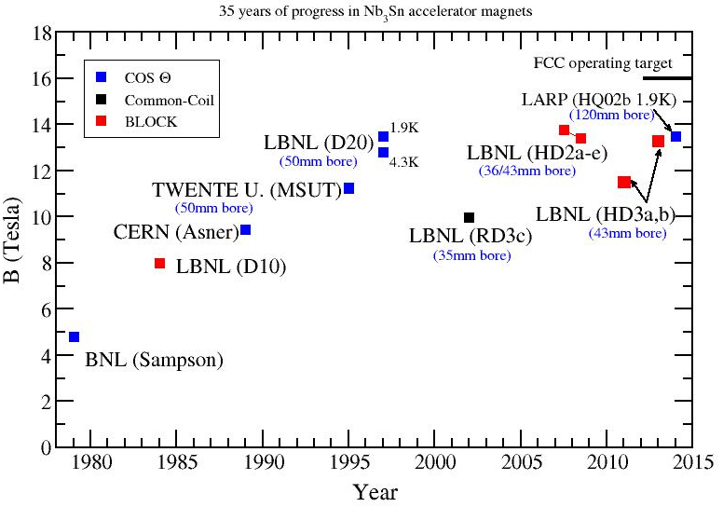
Progress in Selected Nb₃Sn magnets (with bores)
Limited selection
Not selected are flat racetracks and coils with no bores
LBNL has experience with 4 magnet types
  Cosine-theta
  Common-Coil
  Block
  Canted-Cosine-Theta

Slide 4
The FCC - a mandate for change
  The Canted-Cosine-Theta (CCT) magnet is a paradigm shift that attempts to addresses three critical performance issues: Margin, Training, Technology.
High quality field:
    Field quality of each layer over the straight section and “ends”
Low conductor stress:
    Structure intercepts Lorentz-Forces
    Limited pre-stress
    Coils and structure integrated
    Applied to any bore size
    Grading - use of a single strand size
Cost-effective:
    Fewer parts, simplified tooling and assembly
    Compatibility between NbTi, Nb₃Sn and HTS
Based on paper by D.I. Meyer and R. Flasck “A new configuration for a dipole magnet for use in high energy physics application”, Nucl. Instr. and Methods 80, pp. 339-341, 1970.)

Slide 5
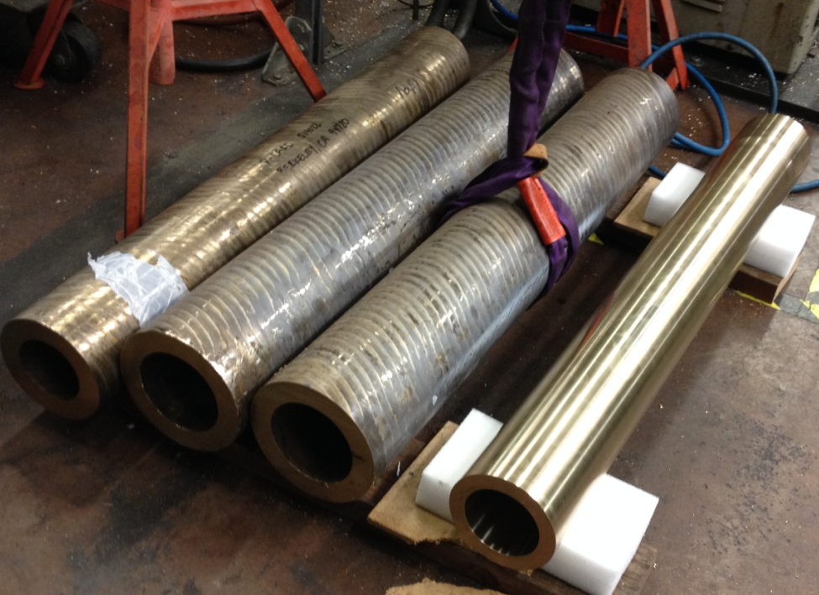
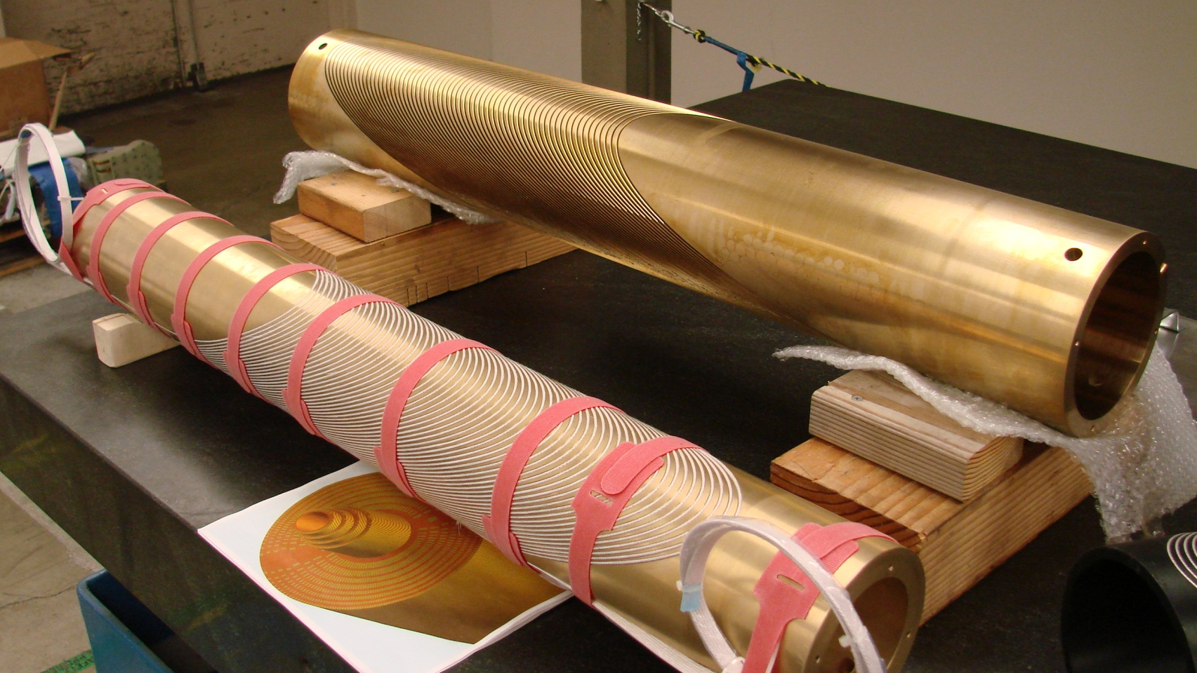
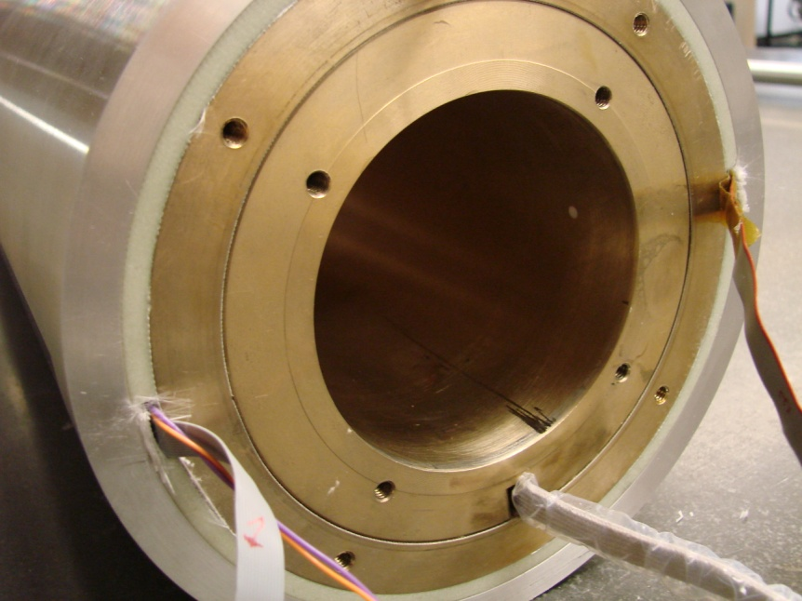
The Canted-Cosine-Theta (CCT2)
Inner coil structure
Layer 2
Bronze tubing
Layer 1
Mandrels integrate windings and structure, assemble poles and are part of the reaction and impregnation tooling.
CCT2 – a 5T NbTi 90mm clear bore

Slide 6
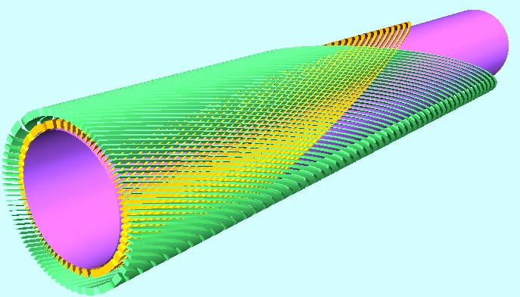
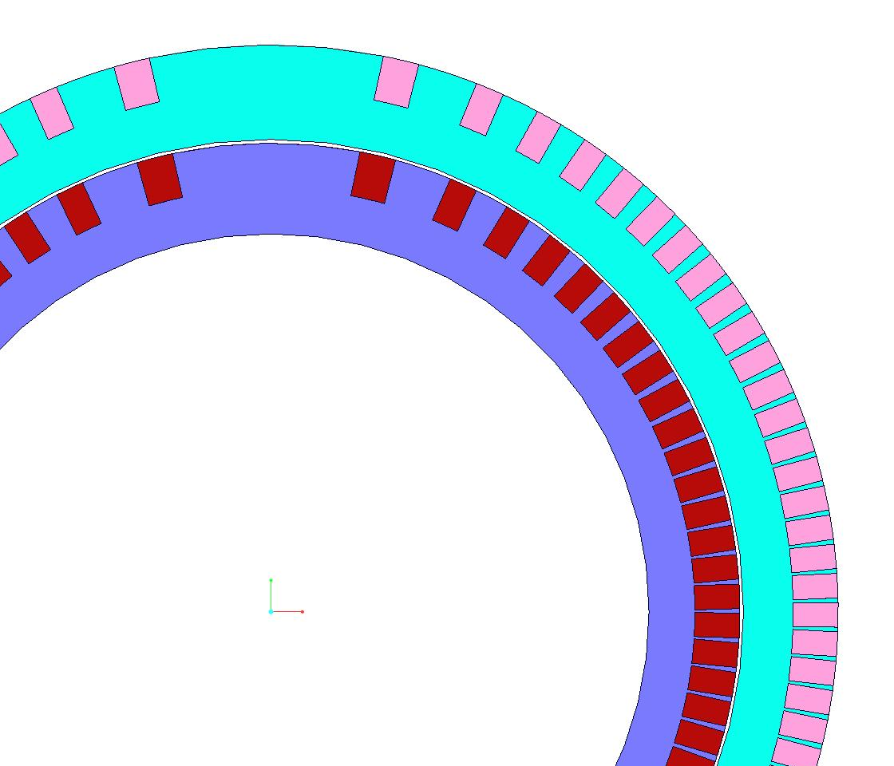
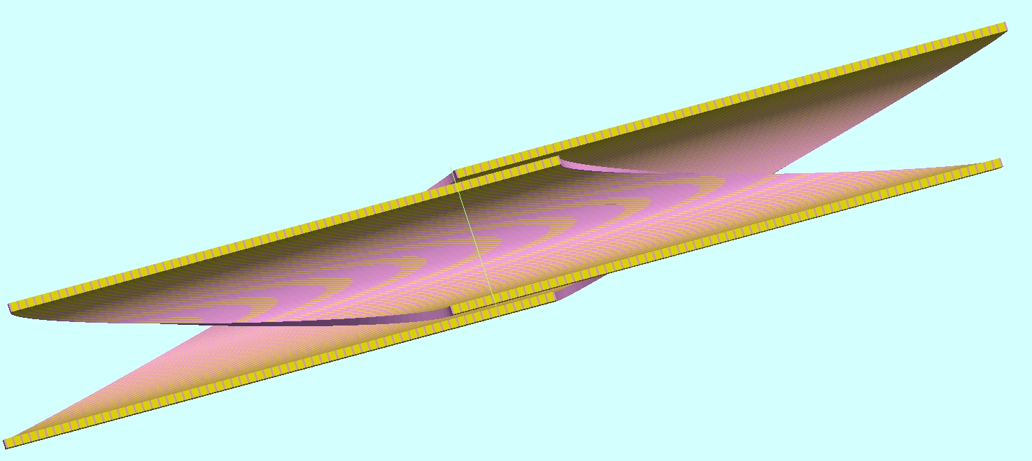
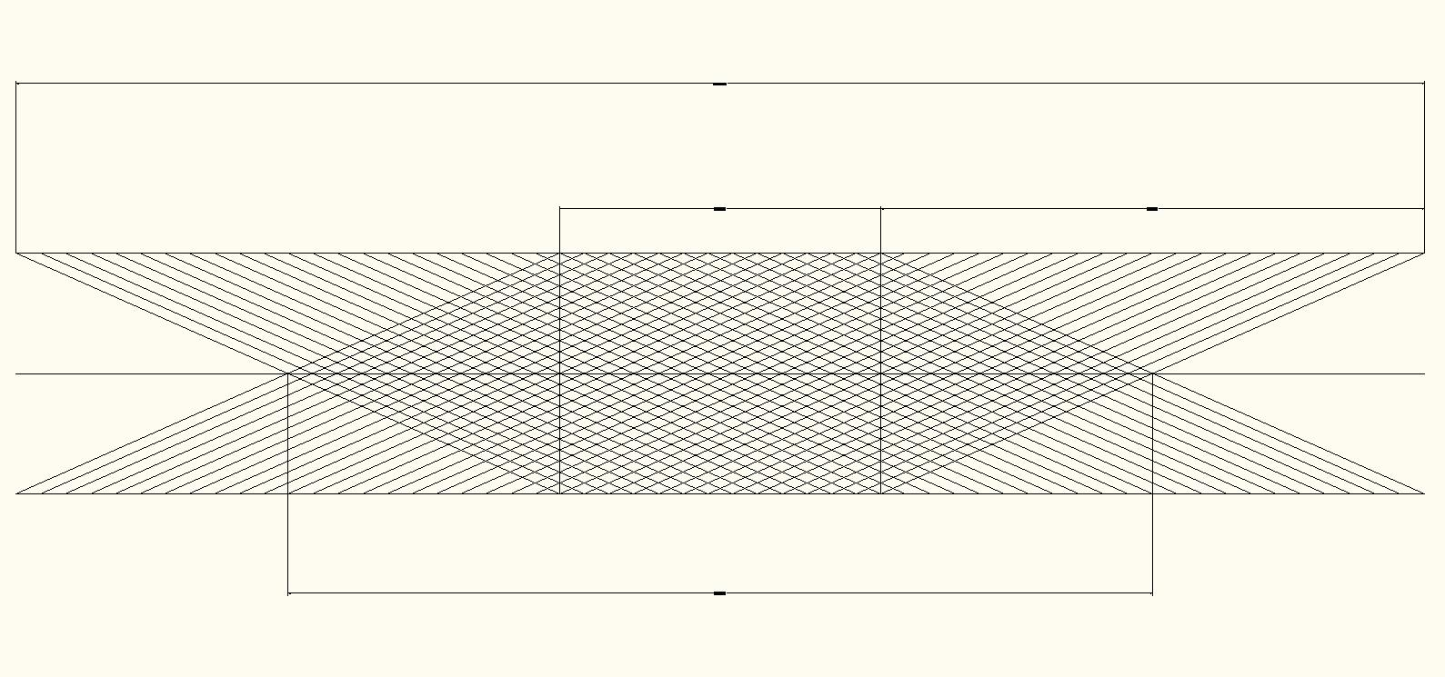
The CCT Magnet
Ribs (wedges) simulate a Cosine-Theta current density and intercept the Lorentz forces
Two superimposed coils, oppositely skewed, achieve a pure cosine-theta field and eliminate axial field.
Turns
Ribs or “wedges”
Magnet length
The Spar integrates forces
Straight-section-length
End-length
Magnetic-length
Harmonics over each “end” integrate to zero
Magnetic-length = pitch*Nturns
L. J. Laslett, S. Caspi, and M. Helm, Configuration of coil ends for multipole magnets, Particle Accelerators, 1987, Vol. 22, pp. 1-14.

Slide 7
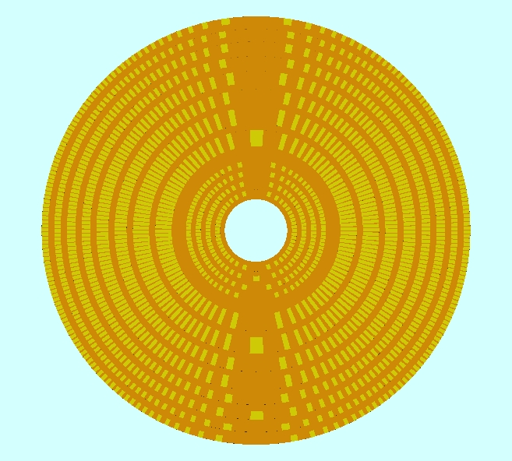
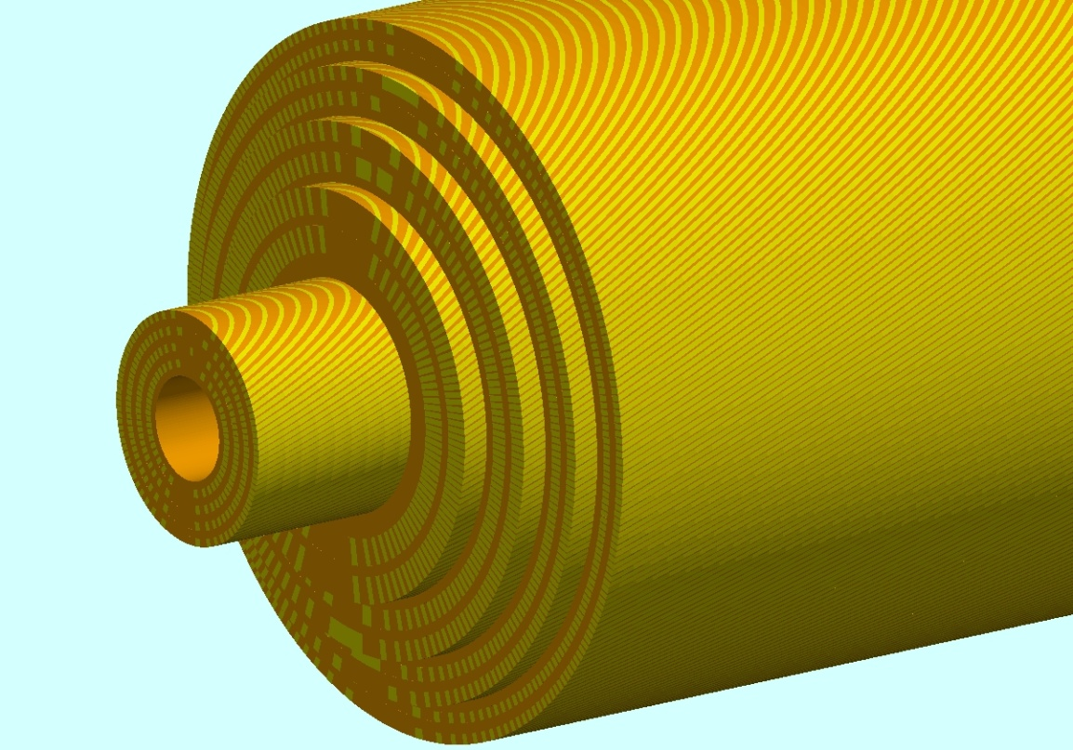
CCT7 - 18T Graded Design
8 layers Nb₃Sn, 90 mm inner bore
4 layers Bi2212 insert, 40 mm clear bore
OD=274 mm
Total length of Nb₃Sn strand (0.8mm) 20.3Km/1m-magnetic-length (graded), 36.5(Km/m) (not graded)
Total length of Bi2212 strand (0.8mm) 2.2Km/1m-magnetic-length
* S. Caspi, F. Borgnolutti, L. Brouwer, D. Cheng, D.R. Dietderich, H. Felice, A. Godeke, R. Hafalia, M. Martchevskii, S. Prestemon, E. Rochepault, C. Swenson and X. Wang “Canted-Cosine-Theta Magnet (CCT) - a Concept for High Field Accelerator Magnets”, ieee transactions on applied superconductivity, vol. 24, no. 3, p. 4001804, june 2014.

Slide 8
LBNL CCT High Field Program (no iron, 4.25K)
Adding 2 new layers to each test
1-in-1 version
Name | layers | Clear Bore (mm) | Material | I (A) | |B-cond| (T) | B-bore (T) | Inner Layer J_{strand} (A/mm²) | Energy (MJ/m) | Inductance (mH/m)
CCT1 | 2 | 50 | NbTi | 4050 |  | 2.5 |  | 0.016 | 0.194
CCT2 | 2 | 90 | NbTi | 10600 | 5.9 | 5.3 | 917 | 0.272 | 4.84
CCT3 | 1-2 | 90 | Nb₃Sn | 20700 | 11.6 | 10.3 | 1790 | 1.04 | 4.84
CCT4 | 1-2-3-4 | 90 | Nb₃Sn | 13550 | 13.8 | 13.1 | 1172 | 2.31 | 25
CCT5 | 1-2-3-4-5-6 | 90 | Nb₃Sn | 10100 | 15.2 | 14.7 | 874 | 3.63 | 71
CCT6 | 1-2-3-4-5-6-7-8 | 90 | Nb₃Sn | 8100 | 16.2 | 15.8 | 700 | 5.03 | 153
CCT7 | 8+4 | 40 | Nb₃Sn+ Bi-2212 | 7580+2620 | 18.1/16.3 | 17.7 | 651/655
CCT-Bi | 4 | 40 | Bi-2212 | 3950 | 4.9 | 4.4 | 982
Bore diameter | (mm) | 90 | 50
0.8mm strand/1m magnetic length (CCT6) | (Km/m) | 20 | 16
Conductor volume | ( m³/m) | 0.010 | 0.0081
Conductor Nb₃Sn /assume 70Km dipoles (CCT6) | (ton) | 6000x1 | 4750x1
Structural Bronze/assume 70Km dipoles (CCT6) | (ton) | 21420x1 | 16730x1
Stress at short-sample | Layer | Max/Min σ_{t} | Max/Min σ_{r} | Max/Min σ_{b}
CCT7 | Inner Nb3Sn | 41/-28 | 27/-29 | 36/-48
CCT7 | Inner Bi2212 | 74/-35 | 43/-48 | 60/-59

Slide 9
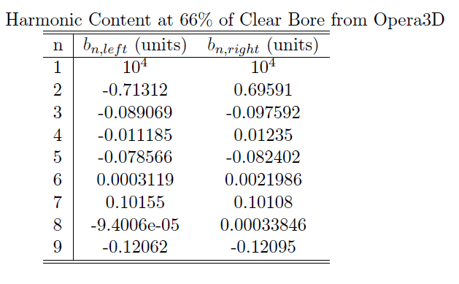
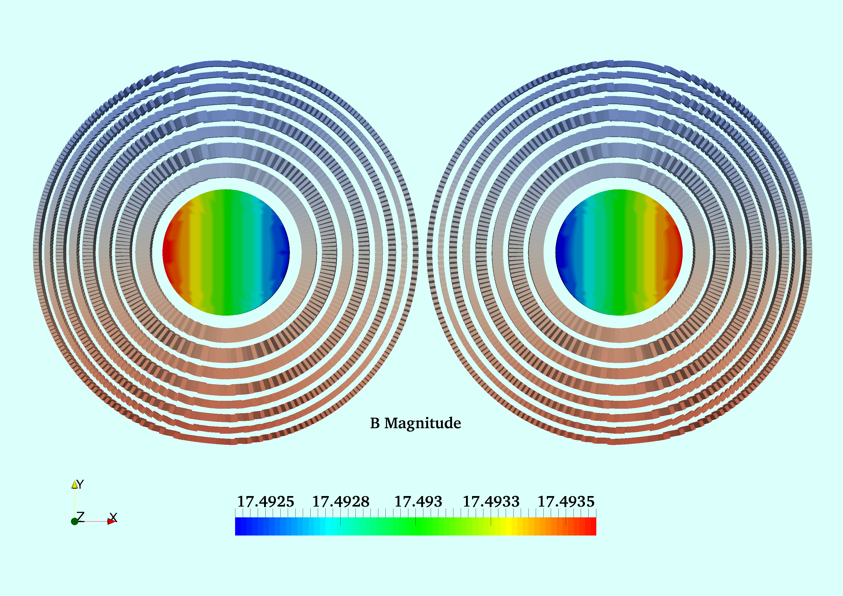
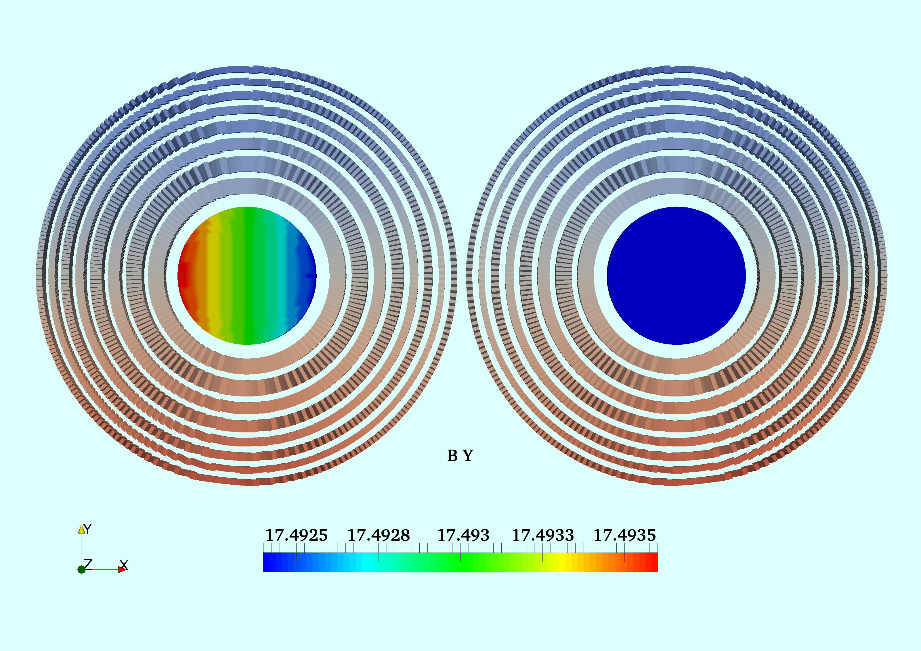
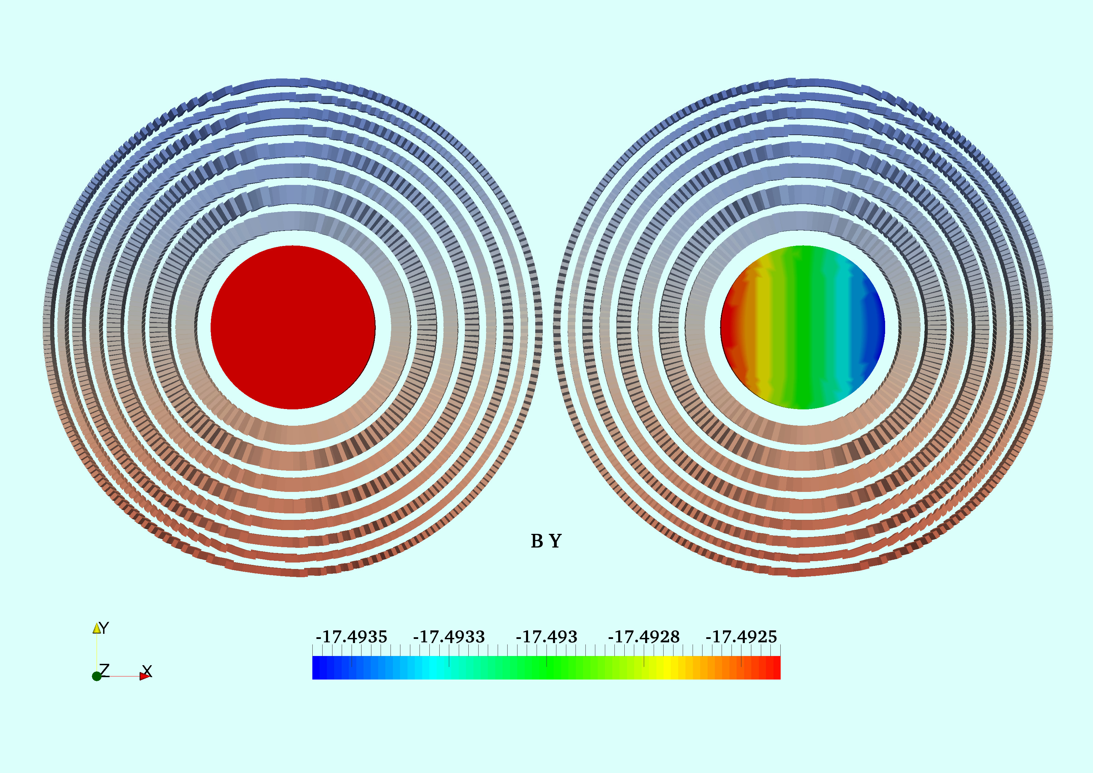
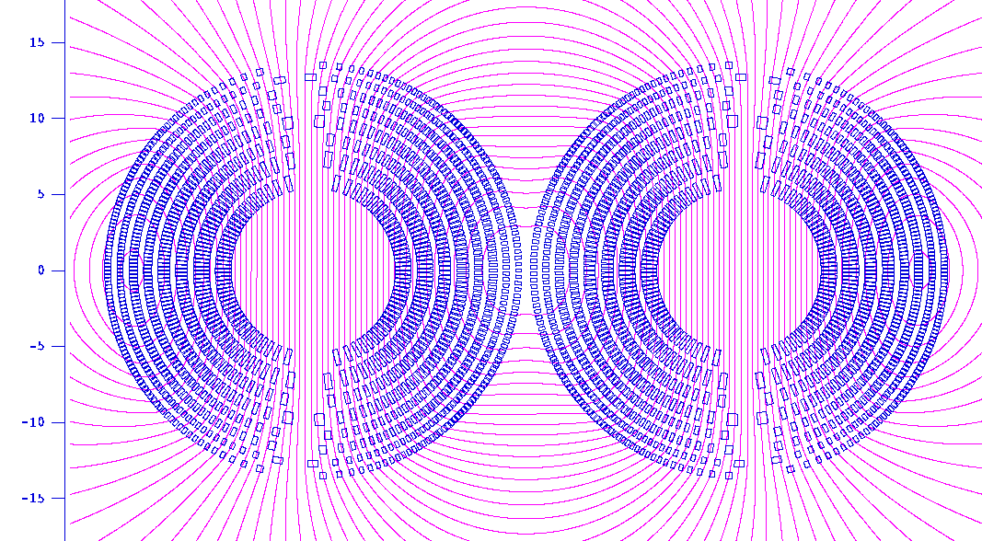
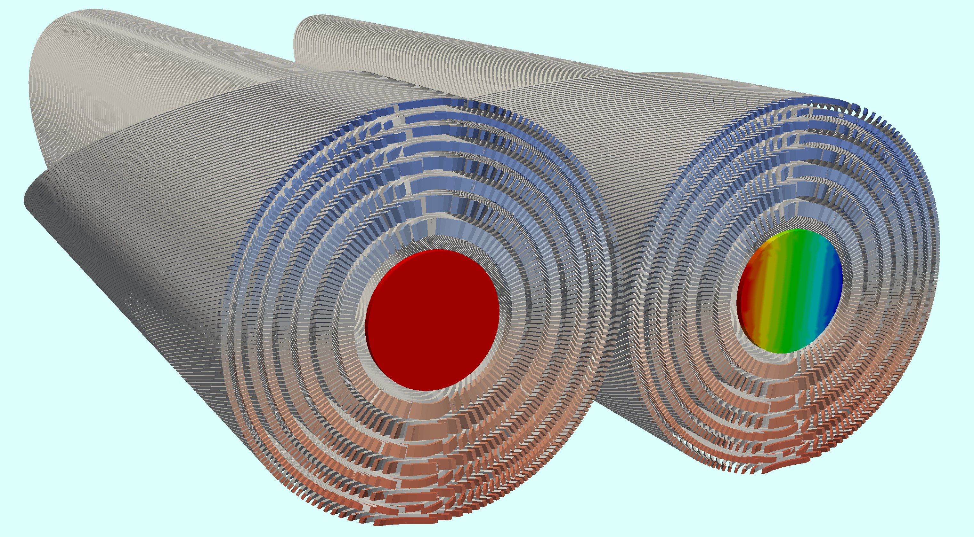
2-in-1 Dipole - Combined Function CCT
dB/B=0.57x10-4
90 mm bore
I -
I+
I+
Reduces harmonics cross-talk and distance between bores
280 mm

Slide 10
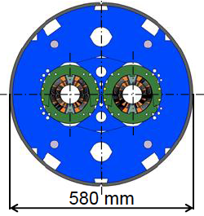
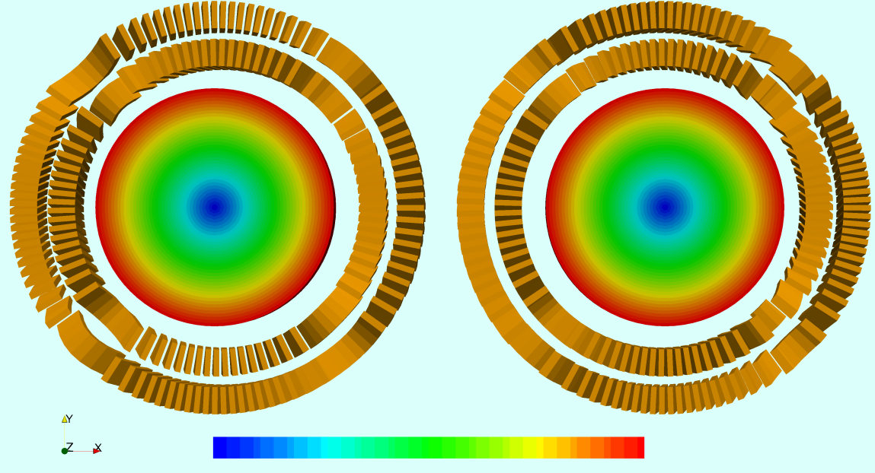
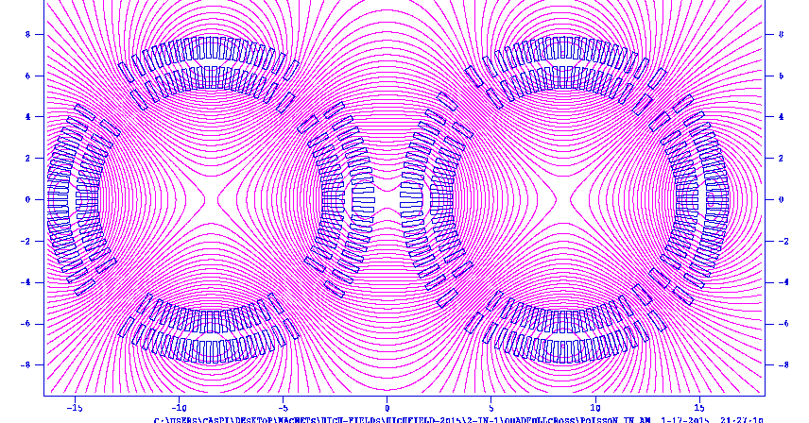
2-in-1 magnets
LHC - 56mm bore, ~10T 1.9K
Example – 2-in-1 quads
0
1
FCC (CCT) - 90 mm bore, ~18T 1.9K
I+
I+
Iron placed outside the cryostat, not part of the structure
~600 mm

Slide 11
Short-Sample for 1-in-1 and 2-in-1 Dipole
Type | Non-Cu (%) | T (K) | Bbore (T) | Bconductor (T) | Jstrand (A/mm²) | Icable (A)
1-in-1 | 47 | 4.25 | 15.6 | 16.1 | 700 | 8100
1-in-1 | 60 | 4.25 | 16.3 | 16.9 | 732 | 8500
2-in-1 | 60 | 4.25 | 16.7 | 17.2 | 680 | 7820
1-in-1 | 60 | 1.9 | 17.9 | 18.5 | 803 | 9230
2-in-1 | 60 | 1.9 | 18.2 | 18.8 | 740 | 8510
Strand 0.8mm dia.
8 layers Nb₃Sn (no insert)
23 strands inner layer
90 mm clear bore
No-iron
Jstrand HD3-Coil-2 with Jsc=3525 A/mm² at 12 T, 4.2K
*Nb₃Sn only (no HTS)

Slide 12
2-in-1 CCT Dipole with 90mm and 50mm clear bore
Number of apertures | (-) | 2 | 2
Aperture (clear) | (mm) | 90 | 50
Inter-aperture spacing | (mm) | 280 | 240
Operating current | (A) | 7480 | 7480
Operating temperature | (K) | 1.9 | 1.9
Operating field | (T) | 16 | 16
Peak field | (T) | 16.53 | 16.53
Margin along the loadline | (%) | 12 | 12
Stored magnetic energy | (MJ/m) | 5x2 | 3.2x2
Inductance (single bore) | (mH/m) | 153 | 94
2-in-1- OD (no iron) | (mm) | 300x2 | 260x2
Weight (coil+bronze) | (kg/m) | (85+306)x2 | (67+239)x2
Strand current density | (A/mm²) | 650 | 650
Peak/mid-plane/pole stress | (MPa) | 28/72 | 28/72
Short-Sample conductor field | (T) | 18.8 | 18.8
Short-Sample bore field | (T) | 18.2 | 18.2
0.8mm strand/1m magnetic length | (Km/m) | 20x2 | 16x2
Total amount of Nb3Sn /70Km ring | (ton) | 6000x2 | 4750x2
Total amount of structural Bronze/70Km ring | (ton) | 21420x2 | 16730x2

Slide 13
CCT - Summary
The CCT is a paradigm shift in SC magnet design
3D field quality in each layer (no optimization; not a result of cancellation between layers)
Coils and structures are integrated – Lorentz forces are intercepted
No/reduced pre-stress - Simplified assembly and tooling
Structure dominated and no iron - Linear analysis , reduced components
Generic design – NbTi, Nb3Sn, HTS
Combined function fields (2-in-1 and curved geometry)
Future R&D:
    Improve ground insulation and remove conductor insulation
    Address quench protection and quench-back

