Slide 1
Communicating the Future:
Future Circular Colliders
Rick Borchelt, Office of Science, DOE – March 2015

Slide 2
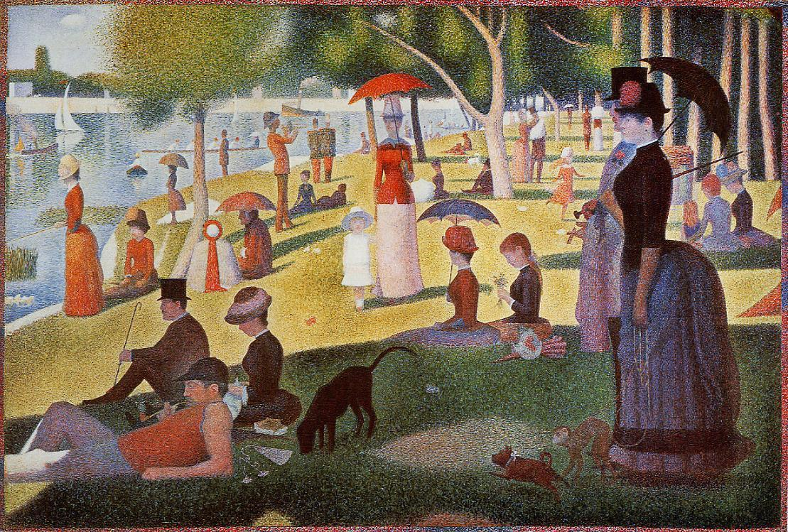
What a reporter asks
What a scientist hears

Slide 3
Lifecycle Communications Planning --1
Three Stages
  Awareness
  Understanding
  Support
  But in a decades-long project, these cycles overlap, bleed into each other, and need to be repeated with each new cohort

Slide 4
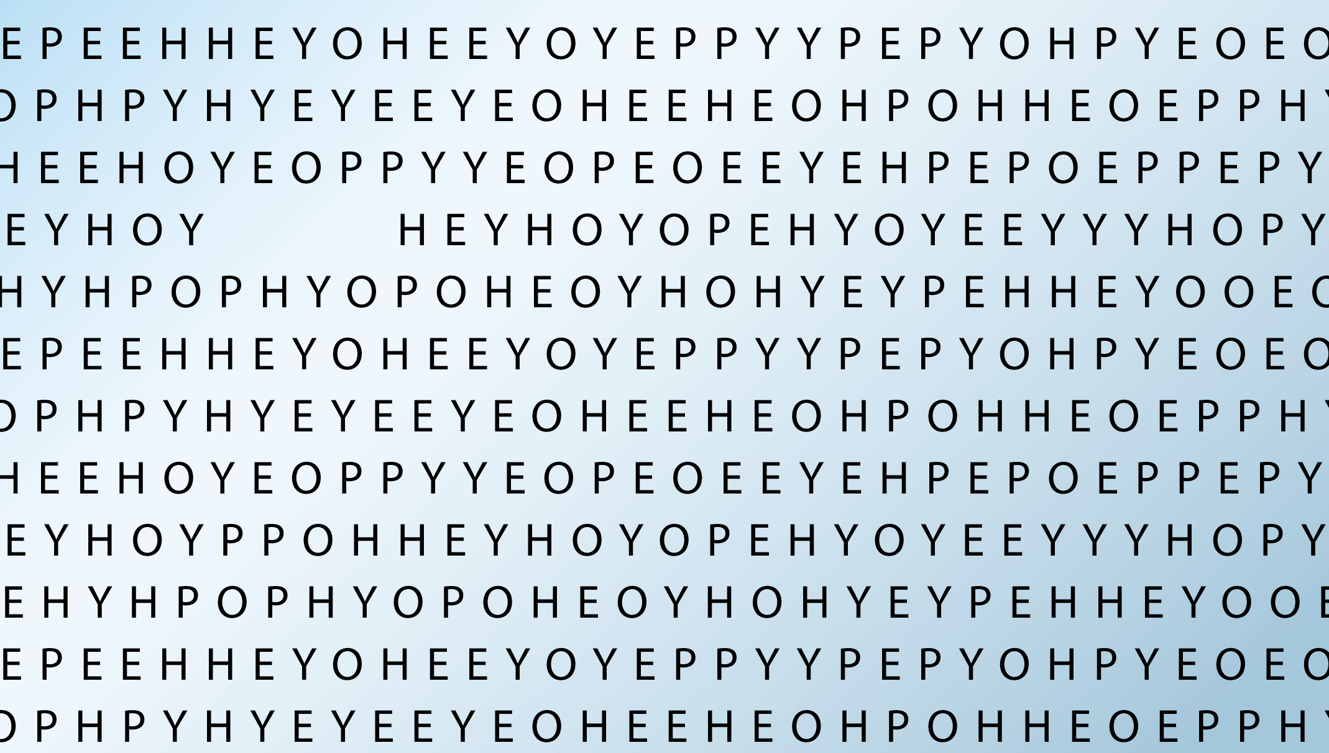



Slide 5
Lifecycle Communications Planning --2
These repeating cycles can also be thought of as:
  Recruitment
    Build visibility, generate buzz
  Maintenance
    Build connections, generate dialogue
  Retention
    Build consensus, generate support

Slide 6


Slide 7
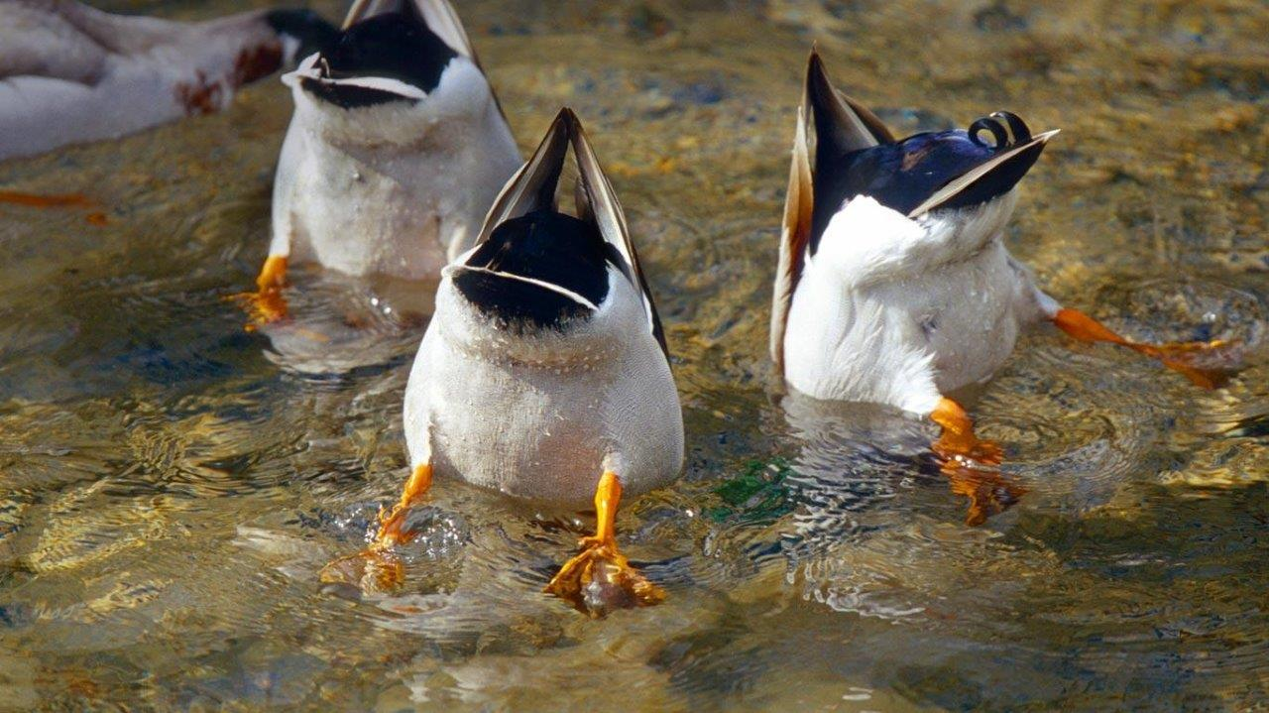

Slide 8
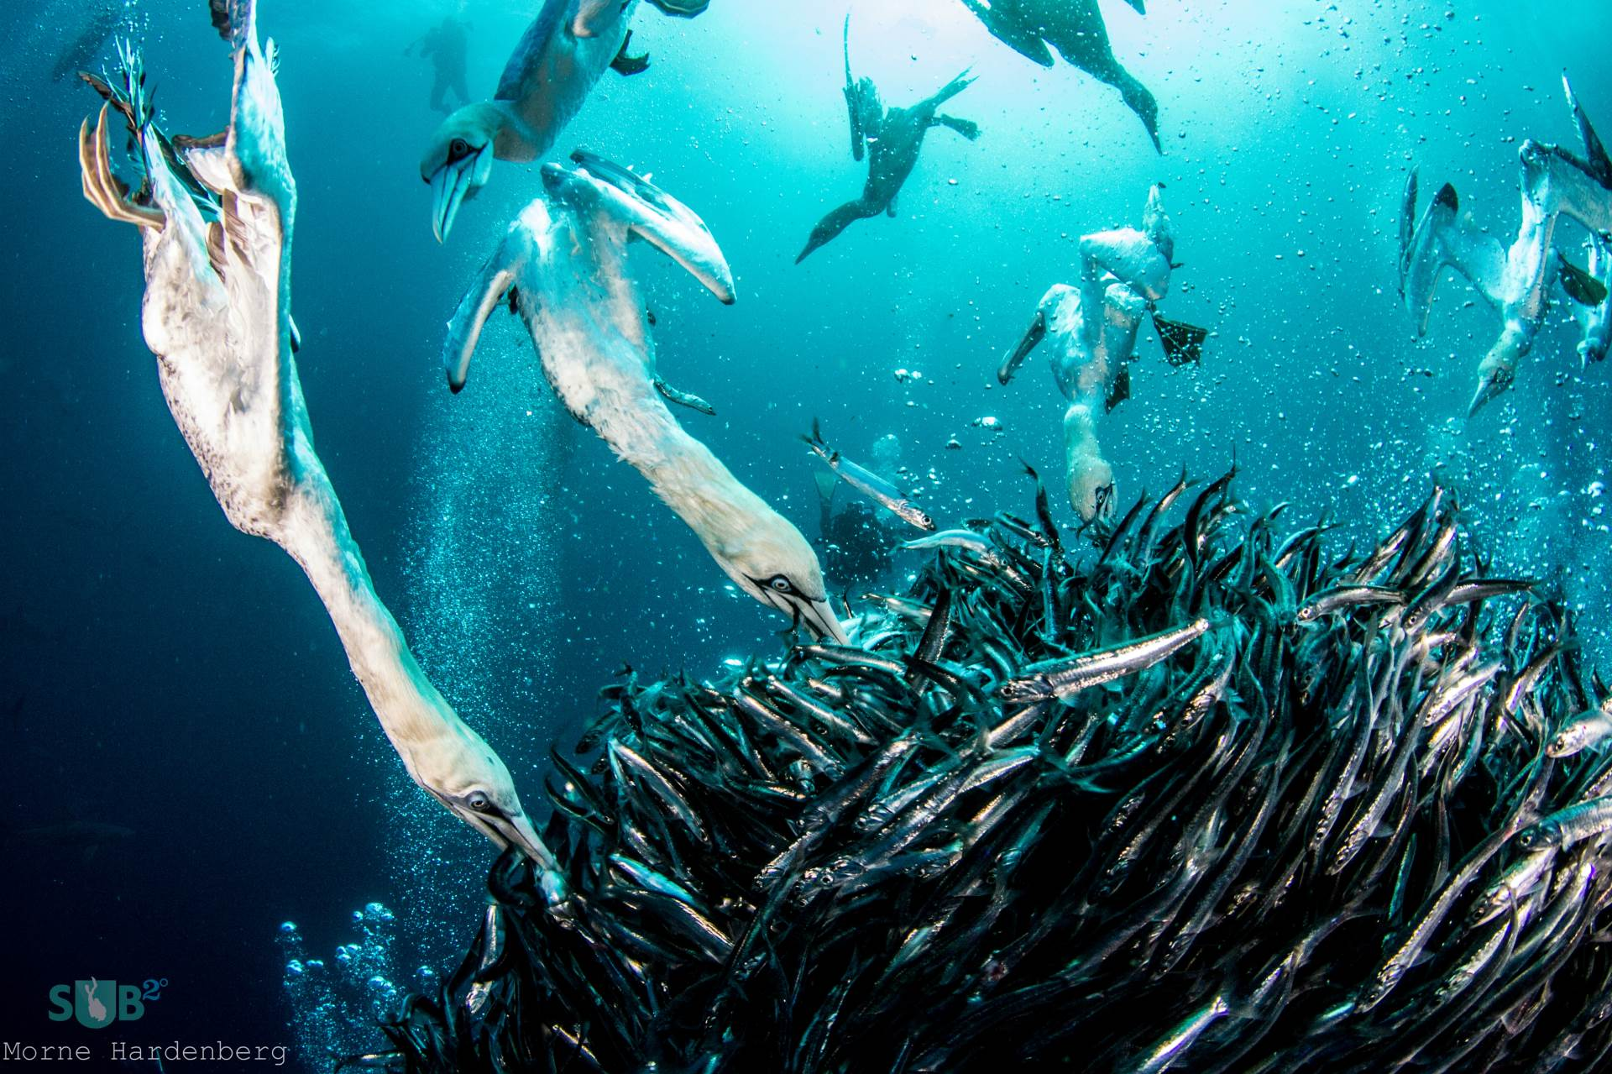

Slide 9
Spectrum of Sophistication
Policymakers and
decision leaders
“Science-attentive” public
Scientific peers

Slide 10
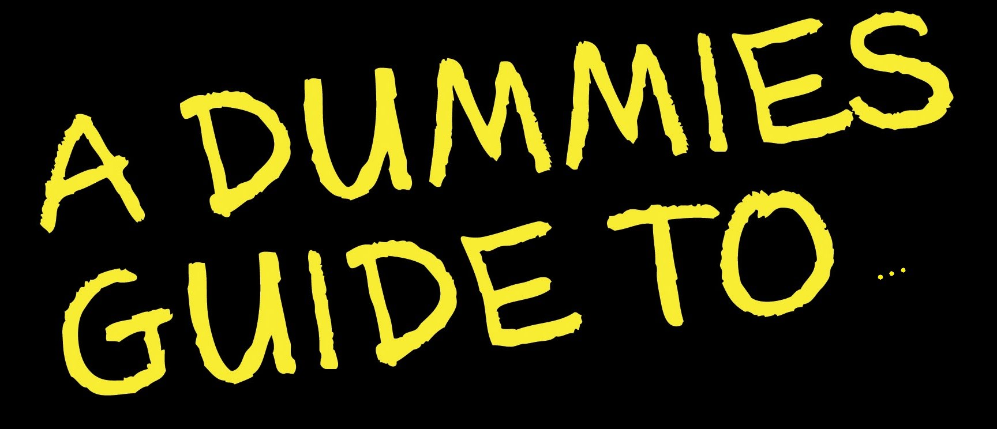
Science of Science Communication
30 years of communications research

Slide 11
High Salience
Low CR
Highly motivated activist public
High Salience
High CR
Latent Public
Salience
Low Salience
Low CR
Latent Public
Low Salience
High CR
Apathetic Unengaged Public
Constraint Recognition
Notes:
But here’s all you really need to understand about the literature at a 30,000-foot level

Slide 12
Long-term projects provide excellent opportunities for evaluation
MMAPing Outcomes of Communications
Measurable
Meaningful
Actionable
Predictive

Slide 13
A Different Kind of Target -- Audiences
REPEAT AFTER ME:
There is no such thing as the general public.
There is no such thing as the general public.
There is no such thing as the general public.
There is no such thing as the general public.
There is no such thing as the general public.
There is no such thing as the general public.
There is no such thing as the general public.
There is no such thing as the general public.
There is no such thing as the general public.
There is no such thing as the general public.

Slide 14
Contact: Rick Borchelt
rick.borchelt@science.doe.gov @rickborchelt

