Slide 1
FCC-hh Detector Overview
FCC week Washington
23-27 March 2015
W. Riegler for the FCC-hh detector working group
A. Ball, D. Fournier, F. Gianotti, A. Henriques, H. ten Kate, M. Manelli, L. Ponetecorvo, W. Riegler & Colleagues

Slide 2
Physics at a 100 TeV Hadron Collider
Exploration + Higgs as a tool for discovery
Numerous physics opportunities with a large number of possible measurements.
How to specify detectors for such a machine ?
ATLAS and CMS are general purpose detectors that were benchmarked with the ‘hypothetical’ Higgs in different mass regions with tracking up to η=2.5.
The Higgs is also key benchmark for the FCC detectors, with highly forward boosted features (100TeV, 125GeV Higgs)
FCC detectors must be ‘general general’ purpose detectors with very large η acceptance and extreme granularity.

Slide 3
Recent Workshops
Higgs and BSM at 100TeV, March 11-13, 2015
https://indico.cern.ch/event/352868/
Workshop on requirements for future detector technologies in view of FCC-hh, March 3-4, 2015
https://indico.cern.ch/event/358198/

Slide 4
Driving Requirements
for an
FCC-hh Detector

Slide 5
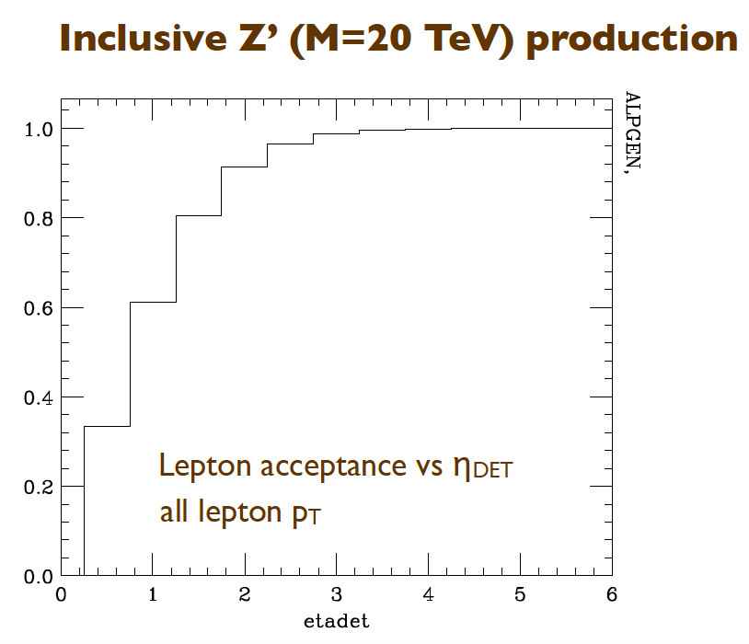
(1) Physics at the Lσ Limit
“Drell-Yan” limit m(Z’) ≈ 30TeV
Z’→: muon spectrometer spec.
Z’→ee: Emcal spec.
„QCD“ limit m(q*) ~ 50 TeV
q*→jets: Emcal+Hcal spec.
10 λ_{int} (LHC) → 12 λ_{int} (FCC)
SUSY
complex signatures E_{Tmiss}, jets, leptons, taus,…

Slide 6
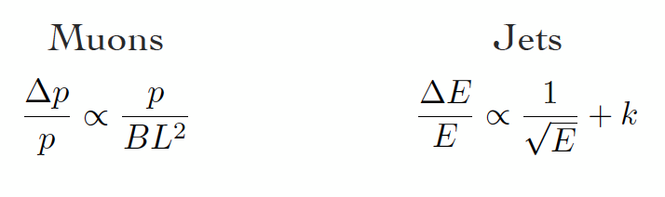
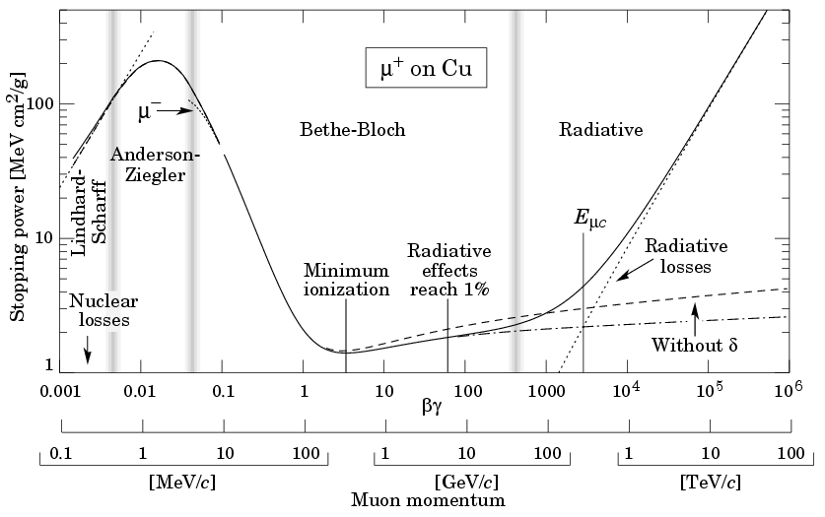
Do we need to measure High Energy Muons well ?
Muons Jets → Ecal, Hcal → k
‘expensive’, 10% at 15TeV difficult ‘ cheap’, 1% at 20TeV achievable ?, 2-3% needed
Careful !!
Calibration of jet energy scale at 20TeV is far from evident
Muon systems are intrinsically linear ! Calibrate at low p_{t} – confidence at hight p_{t}
Determination of charge for FB asymmetry essential
For the enormous scale of the FCC-hh machine, detectors should not compromise !
Also to be careful here: Critical Energy
E_{c}: Electrons 550MeV/Z, Muons ≈20TeV/Z
Muons in Iron ≈ 800GeV !
Energy loss due to radiative processes dominates !
How are muons doing behind 12 λ_{int} of Calo ?

Slide 7
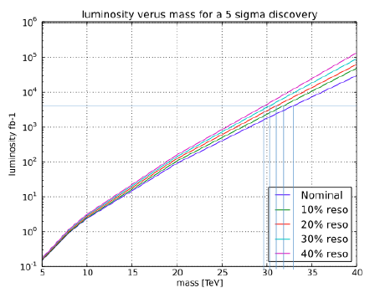
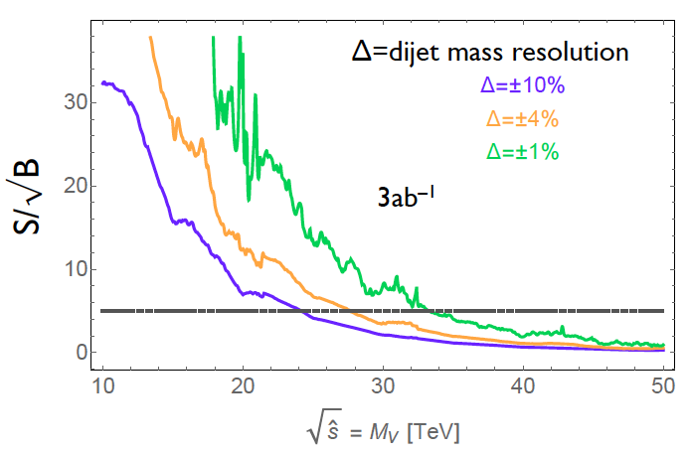
Muons vs. Jets
C. Helsens, M. Mangano
3ab⁻¹
Muon resolution 15% at 10TeV ok ?
→ Constant term dominates, 1-2% goal
full shower containment is mandatory !
A tail catcher behind 1.7m of coil will also not be very useful
Do not compromise on 12 lambda !

Slide 8
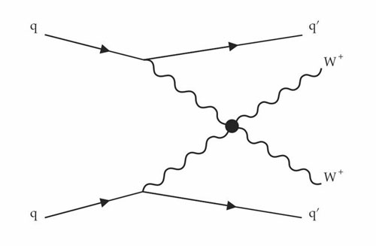
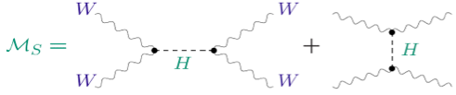
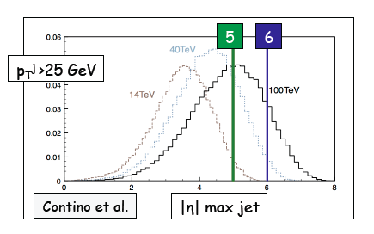
(2) WW scattering by VBF Mechanism
Is H playing it’s role ? Unitarity at 1TeV ?
Are there high mass resonances WW, ZZ, HH, …
VBF jets between η~2 and η~6
need to be well measured and separated from pile-up
Muons (and electrons) around ~1 TeV p_{T}
need to be triggered, identified, precisely measured

Slide 9
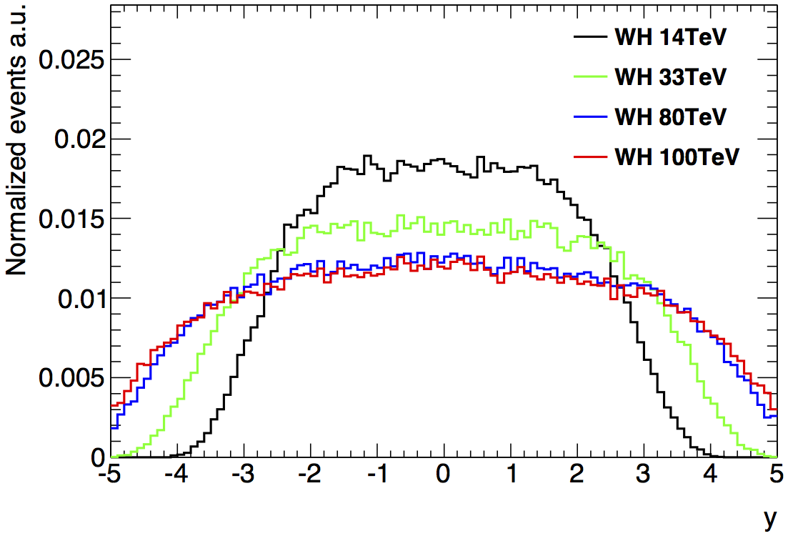
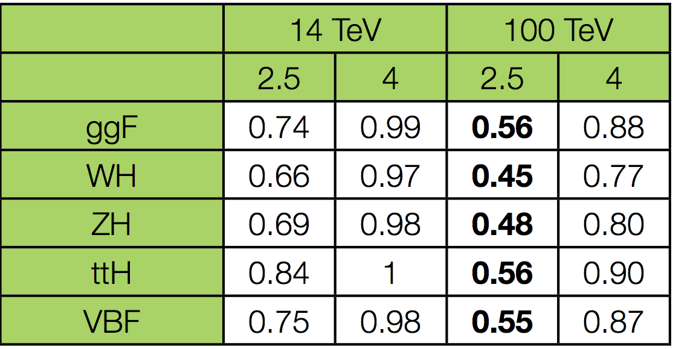
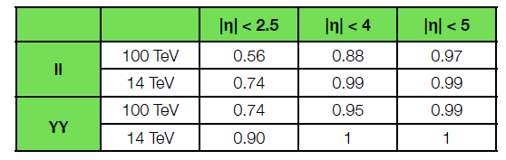
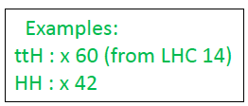
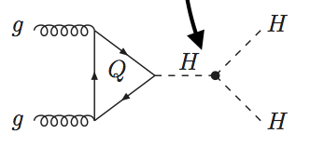
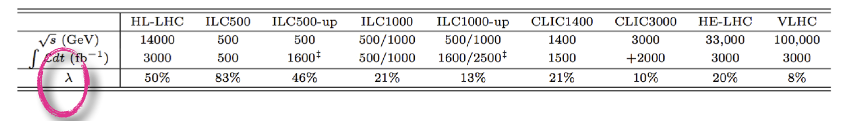
(3) Higgs Measurements
H→ 4l acceptance vs η coverage (l p_{T} cuts applied)
H. Gray, C. Helsens
→ 30-50% acceptance loss for H→ 4l at 100 TeV wrt 14 TeV if tracking and precision EM
calorimetry limited to |η|<2.5 (as ATLAS and CMS)
→ can be recovered by extending to |η|~ 4
“Heavy” final states require high √s, e.g.:
HH production (including measurements of self-couplings λ)
ttH (note: ttH→ ttμμ, ttZZ “rare” and particularly clean)
g_{HHH}~ λv

Slide 10
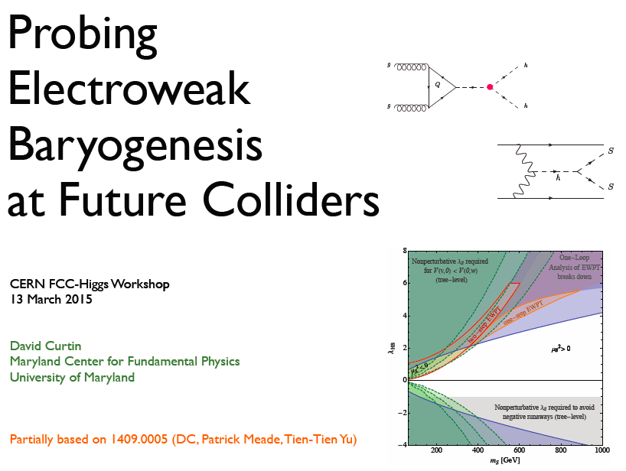
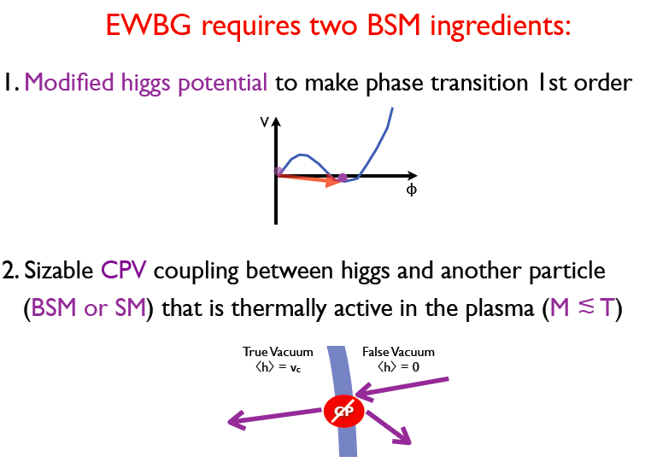
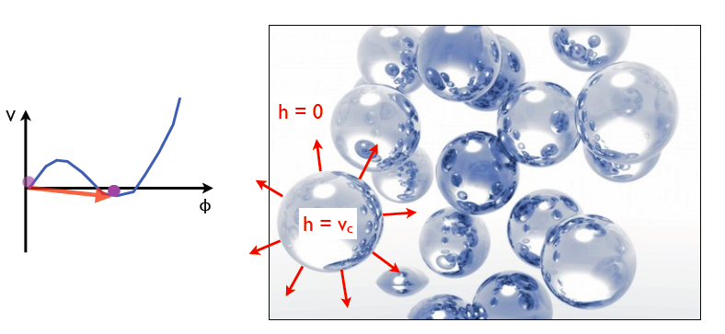
Electroweak Baryogenesis ?

Slide 11
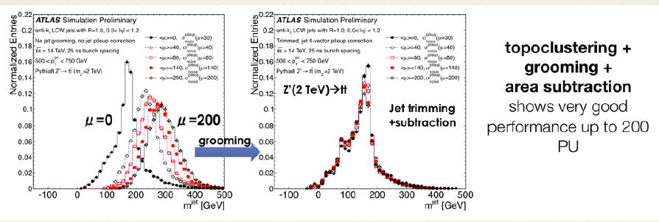
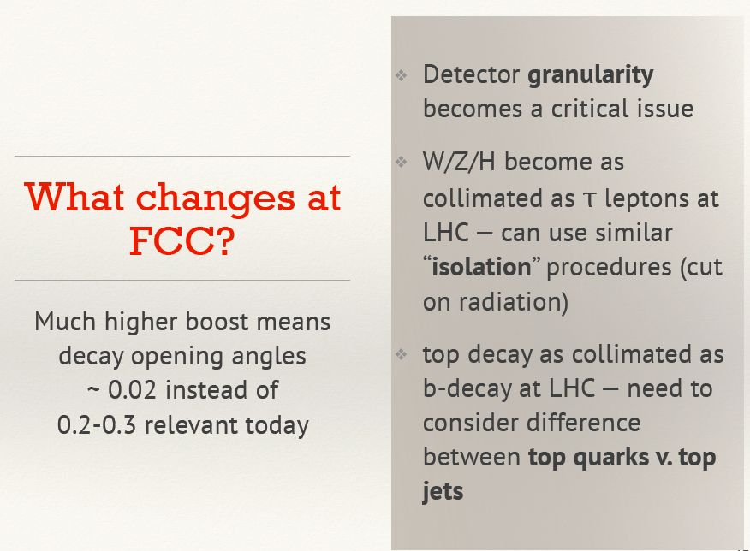
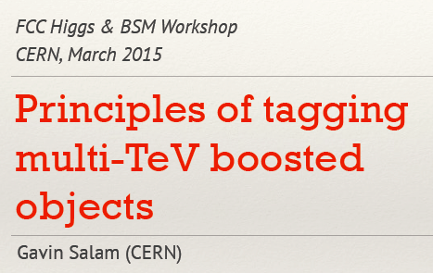
(4) Pileup, Boosted Objects

Slide 12
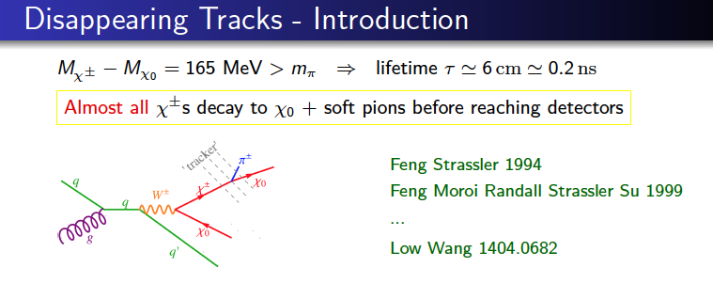
(5) More Exotic

Slide 13
Approximate Overall Needs
Tracking: Momentum resolution ≈15% at p_{t}=10TeV
Precision tracking (momentum spectroscopy) and Ecal up to η=4
Tracking and Calo for jets up to η=6.
98% containing calorimetry of 12 λ_{in}, 1-2% constant term.
Calorimeter granularity to mitigate pileup and measure jet substructure and boosted objects.
B-tagging, timing for pileup rejection etc. …

Slide 14
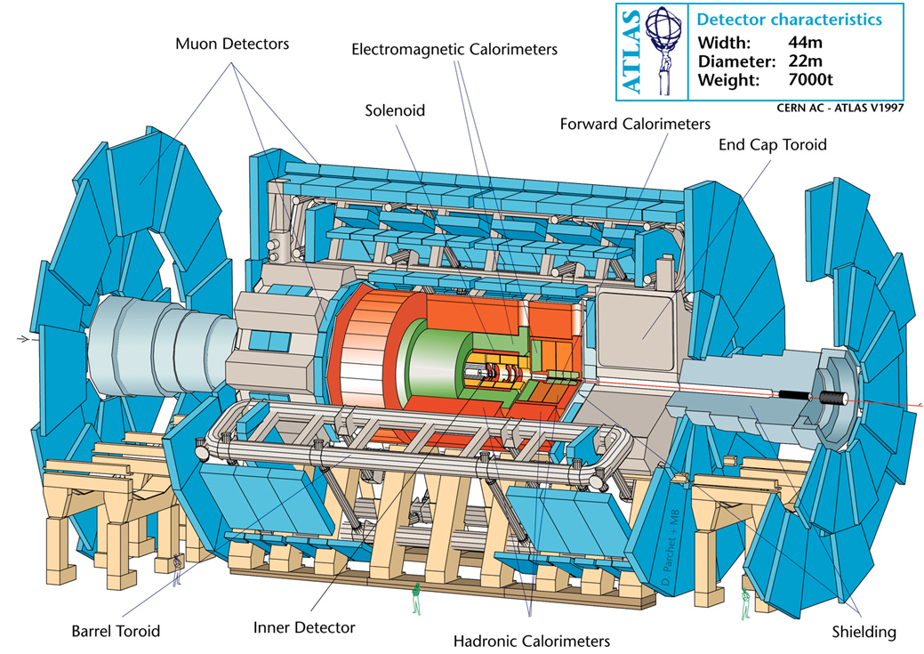
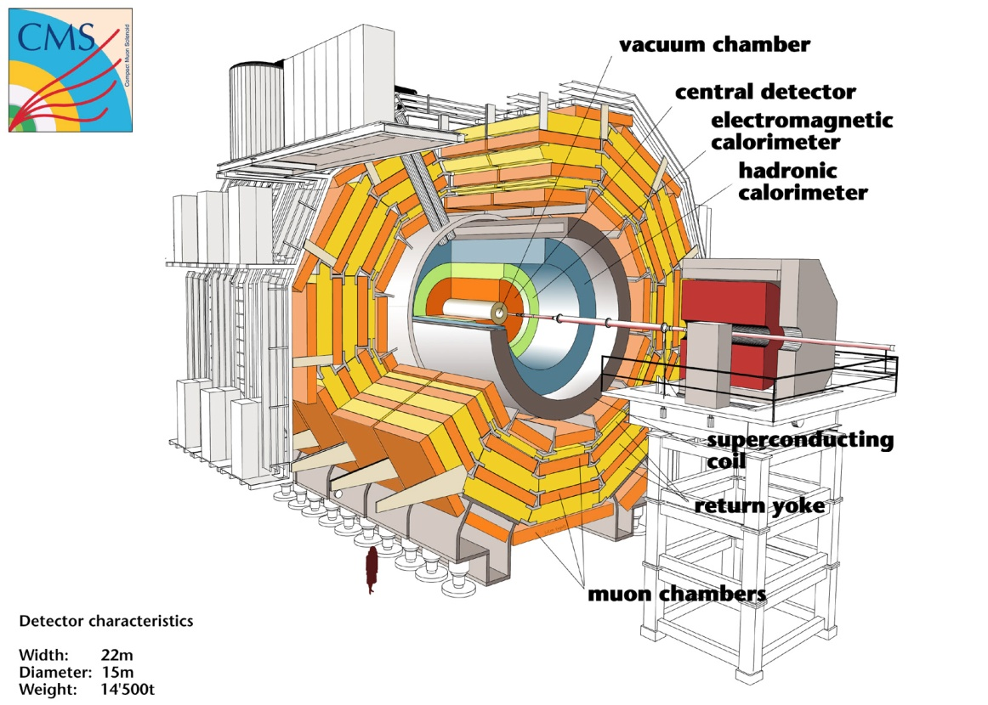
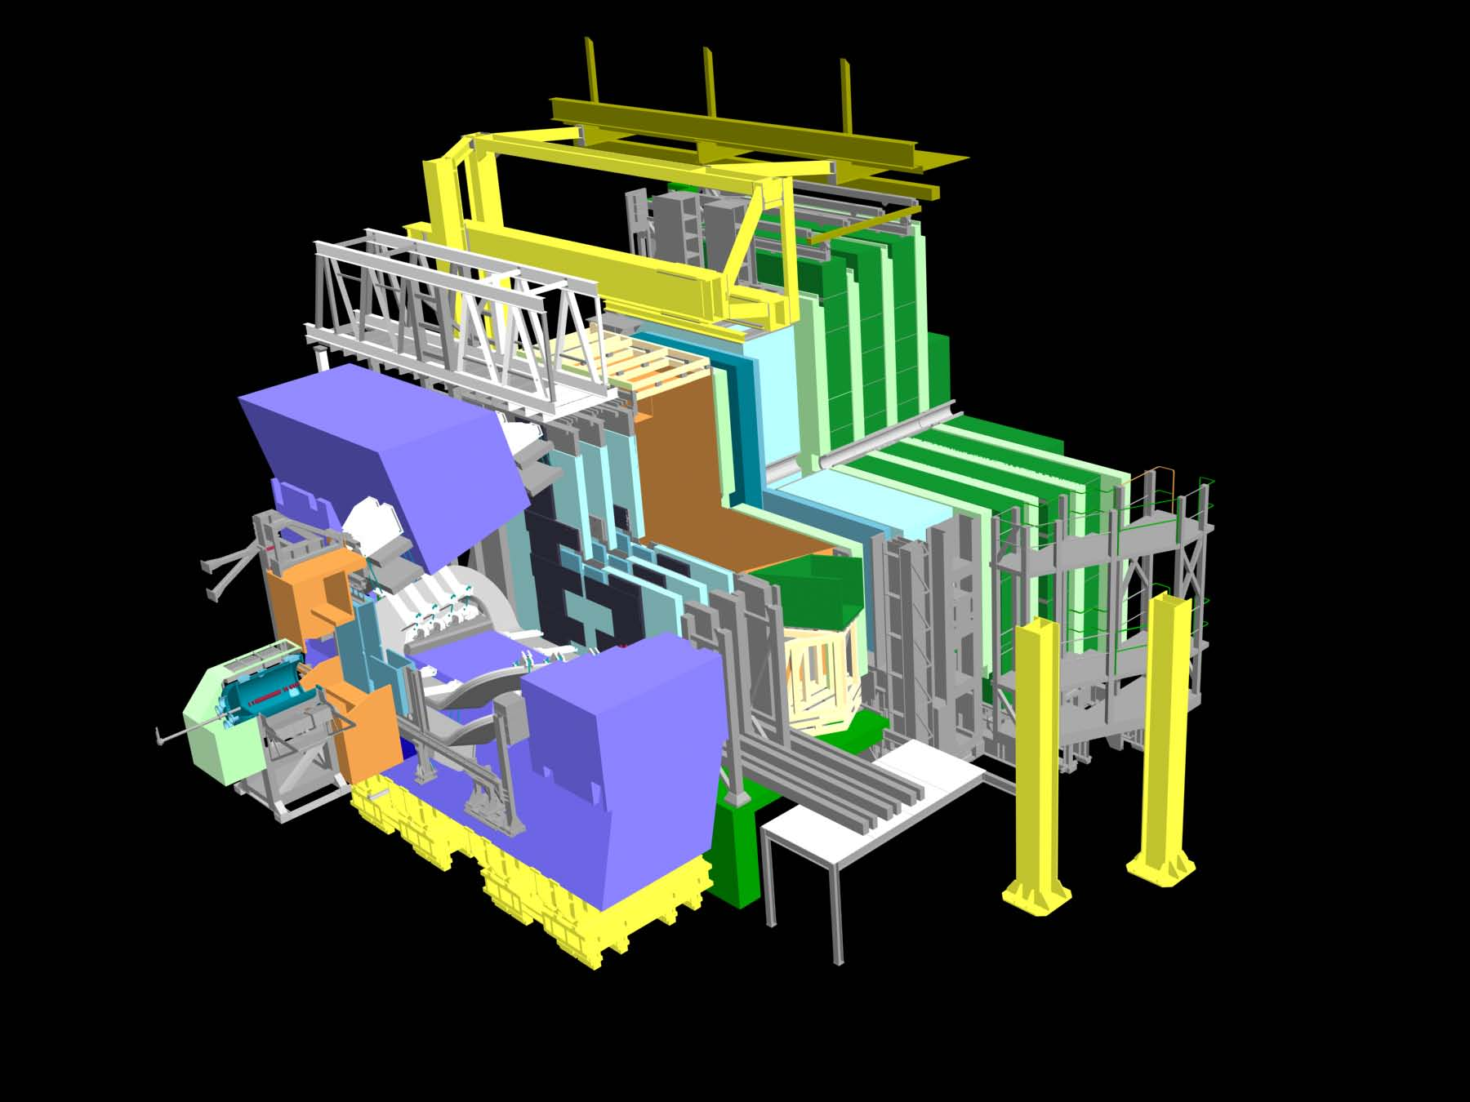
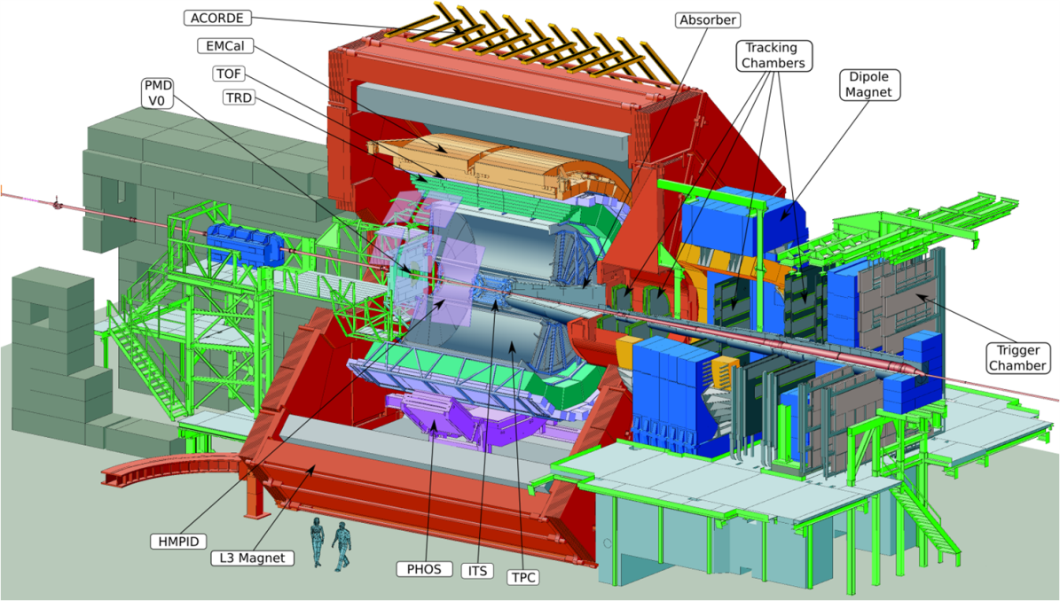
ATLAS, CMS, ALICE, LHCb

Slide 15
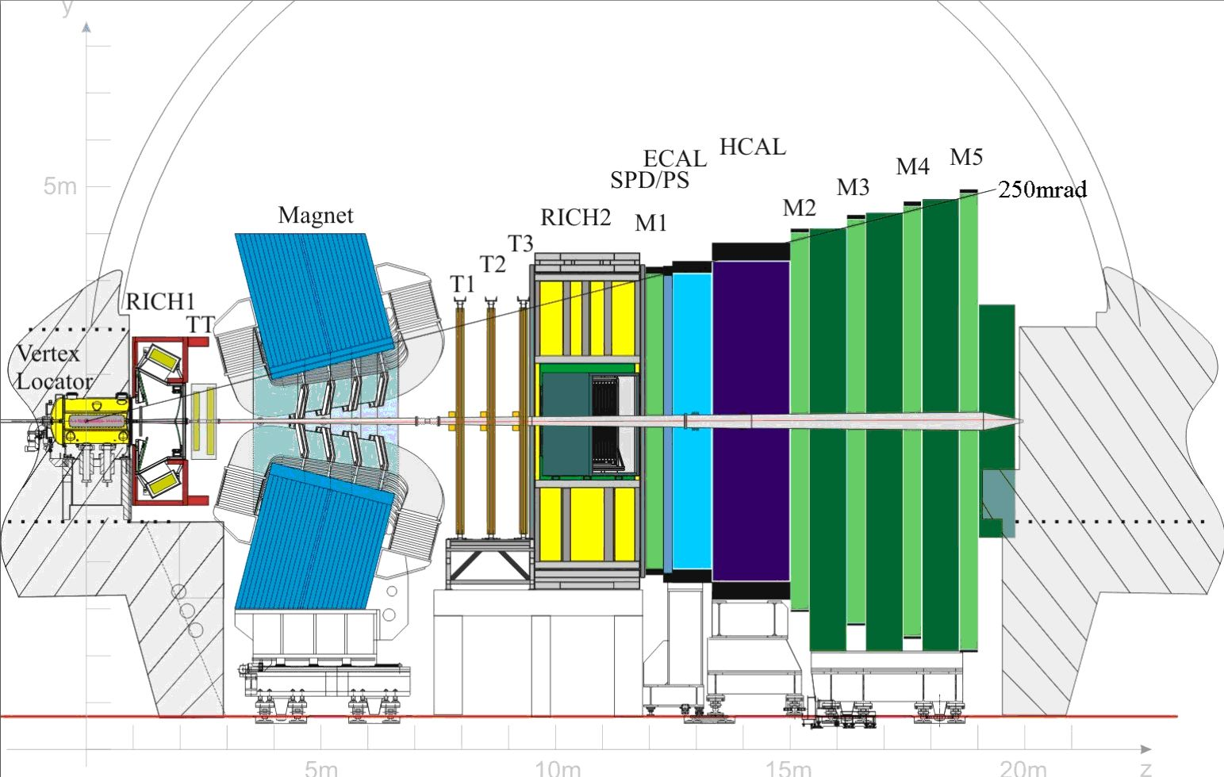
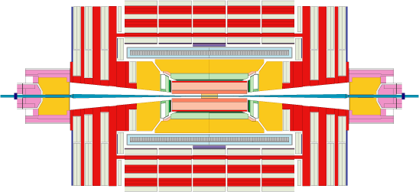
Tracking LHCb η = 2 - 5
… all with impressive performance …
Tracking CMS tracking η -2.5,2.5
η=1.0
η=1.5
η=3

Slide 16
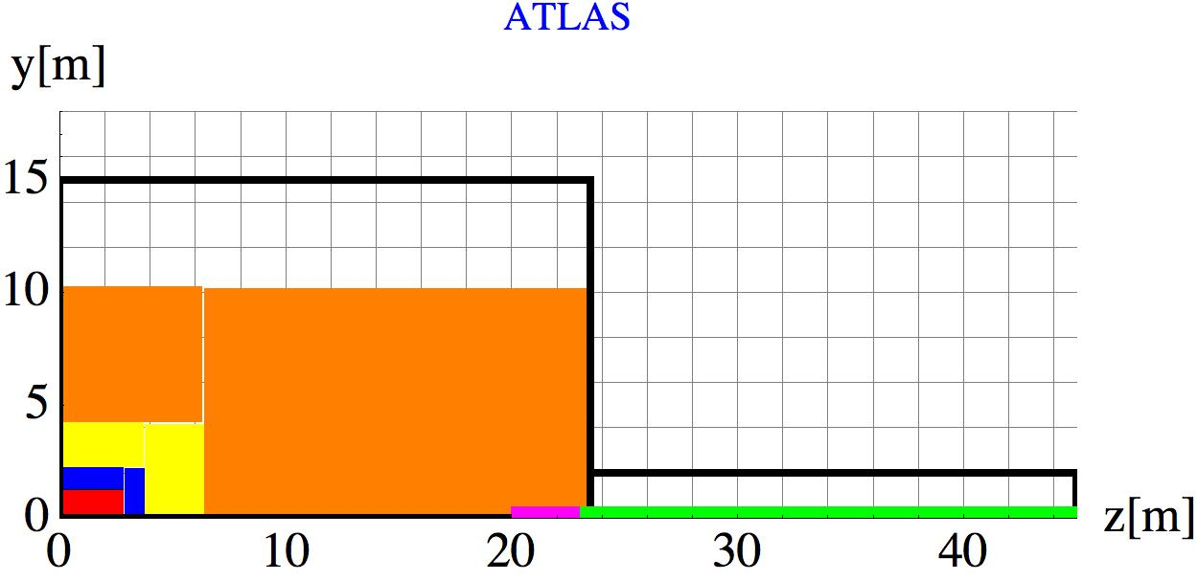
ATLAS
LHC L*=23m, TAS inside the air core muon system, heavy shielding
Tracker r=1m, B=2T thin coil in front of the calorimeters
LArg ECAL, HCAL and 7.4 λ_{int} that returns the flux
Large air core toroid, B=0.5T ‘standalone muon system’
Tracker
Emcal
Hcal
Muon
Coil
TAS
Triplet

Slide 17
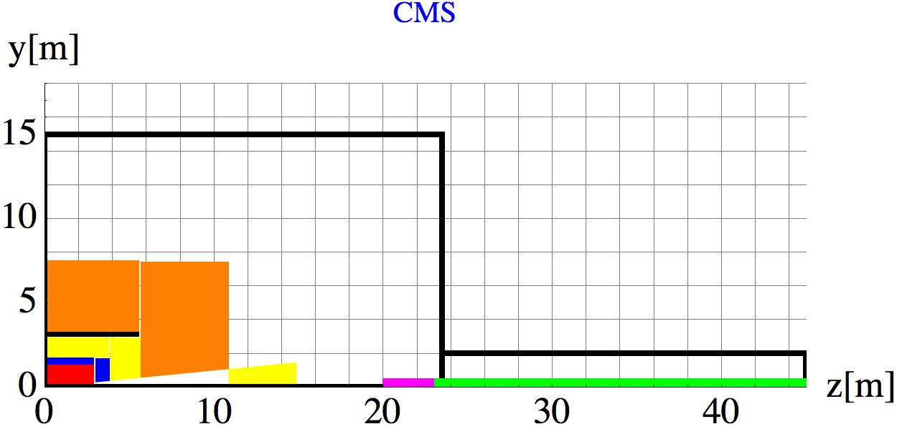
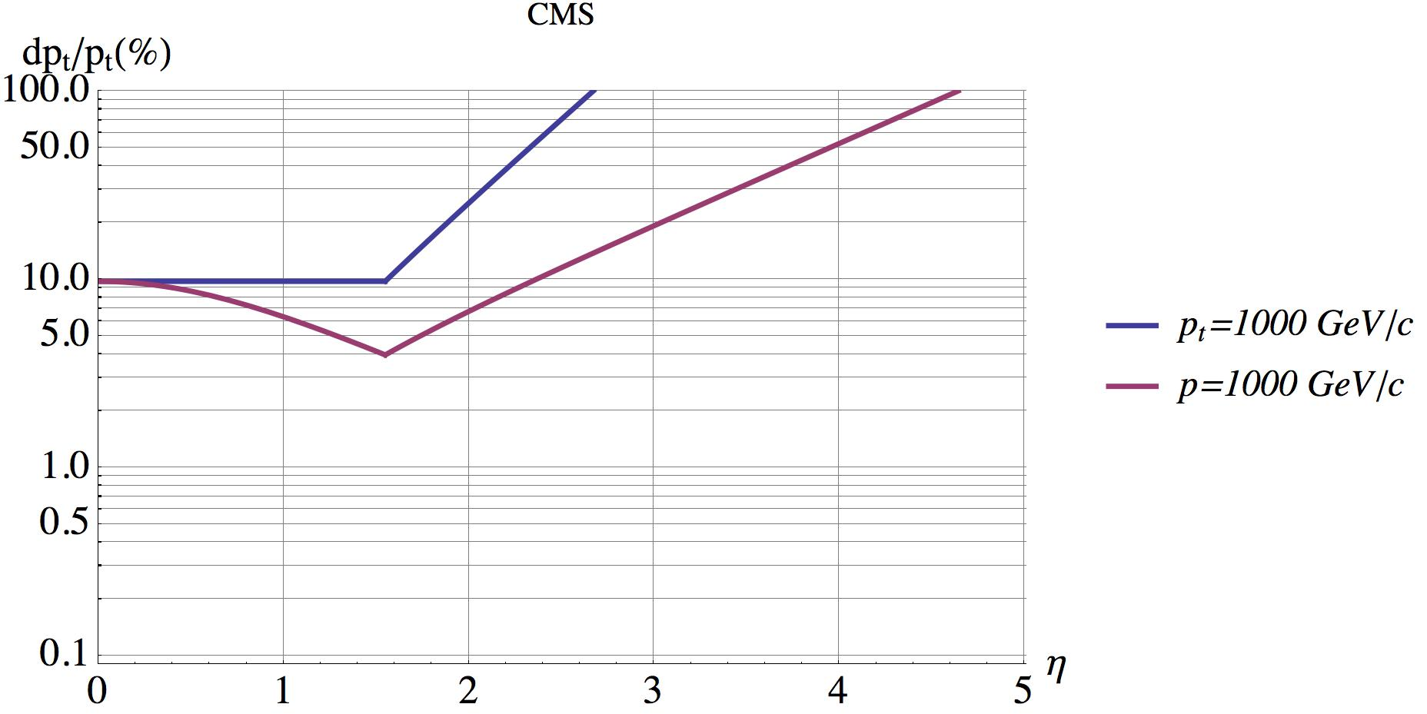
CMS
LHC L*=23m, TAS shielding inside the cavern
Tracker r=1.2m in B=3.8T
Compact Crystal ECAL, ‘short’ HCAL of and 5.82 λ_{int}, cut at η = 3 to move FCAL away.
Iron Yoke to return Flux, instrumented with muon chambers.
CMS muons are relying on a properly working tracker.
Tracker
Emcal
Hcal
Muon
Coil
TAS
Triplet
Muon
Hcal
Emcal
Tracker
Coil

Slide 18
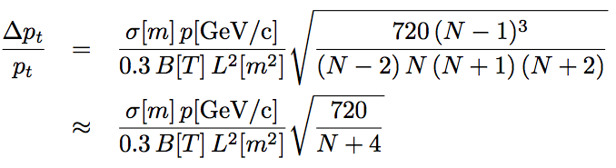
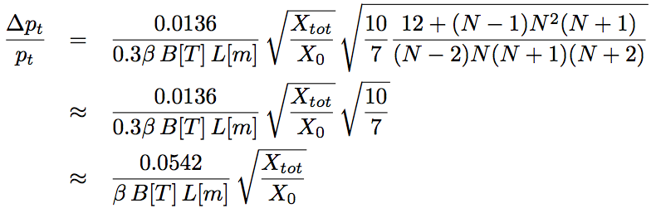
Point Resolution and Multiple Scattering
1 2 3 … N
B
σ … point resolution/plane
X_{tot}/X₀ … total material budget
…..
L
Position Resolution
Multiple Scattering

Slide 19
CMS
LHC L*=23m, TAS shielding inside the cavern
Tracker r=1.2m in B=3.8T
Compact Crystal ECAL, ‘short’ HCAL of and 5.82 λ_{int}, cut at eta = 3 to move FCAL away.
Iron Yoke to return Flux, instrumented with muon chambers.
CMS muons are relying on a properly working tracker.
Tracker
Emcal
Hcal
Muon
Coil
TAS
Triplet
Muon
Hcal
Emcal
Tracker
Coil

Slide 20
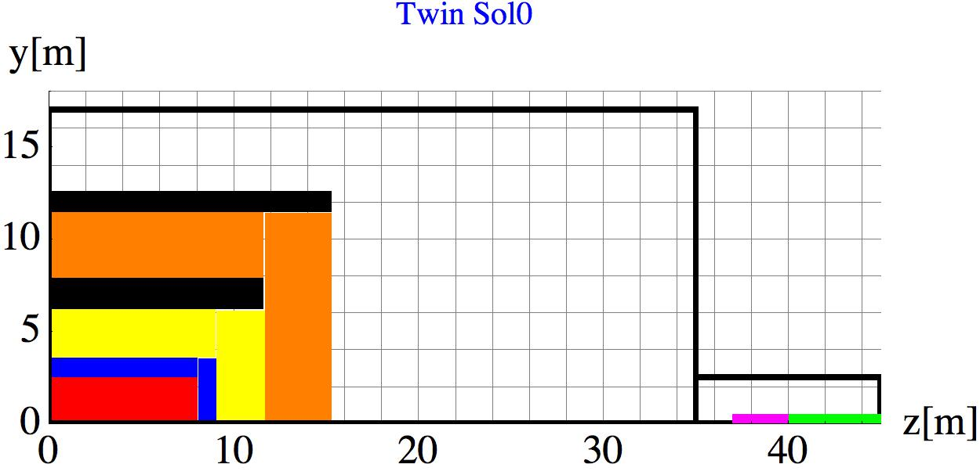
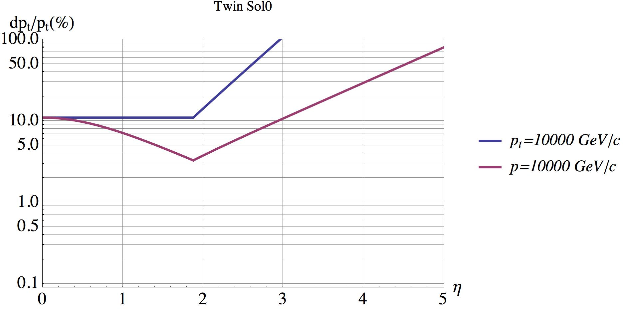
Twin Solenoid 7xBL² scaling
FCC L*=40m, hide inside tunnel
Solenoid and shielding solenoid with B=6T in Tracker and B=3T in Muon System
Tracker r=2.5m, L=16m, tracker resolution same as CMS detector
ECAL+HCAL = 2.4m = 12 λ_{int}
Momentum resolution gets marginal at η>3.
Tracker
Emcal
Hcal
Muon
Coil
TAS
Triplet

Slide 21
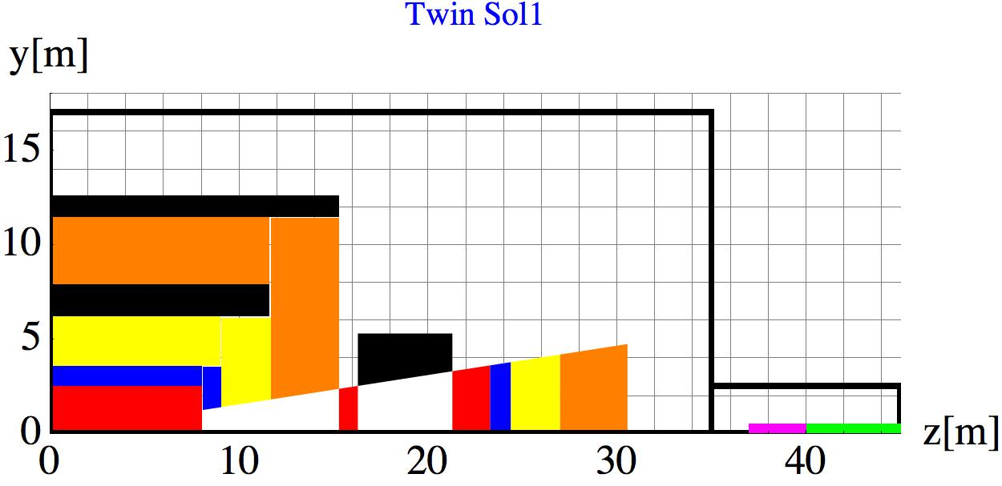
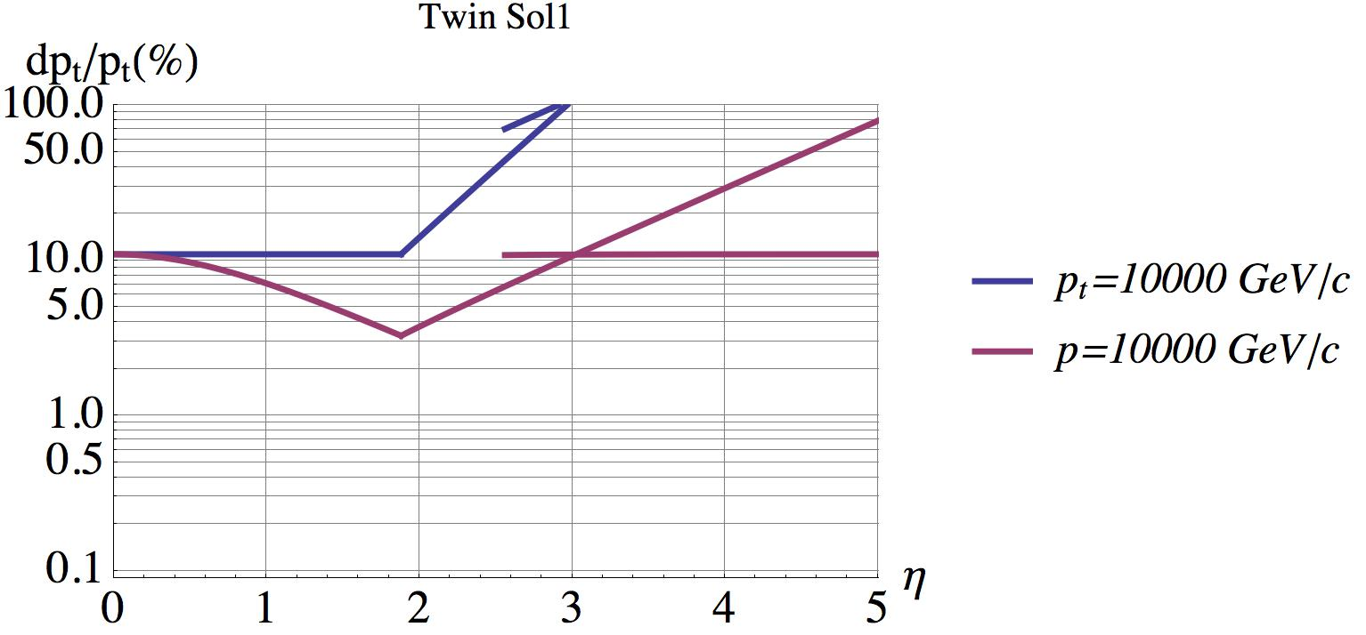
Twin Solenoid 7xBL² scaling+Forward Dipole
Opening at η = 2.5
Adding a Dipole forward for momentum spectroscopy.
Moving forward calorimeters to larger distance decreasing the particle densities and overlaps.
Allows separate instrumentation and upgrade of forward detectors
Integration and maintenance is a challenge
Tracker
Emcal
Hcal
Muon
Coil
TAS
Triplet

Slide 22
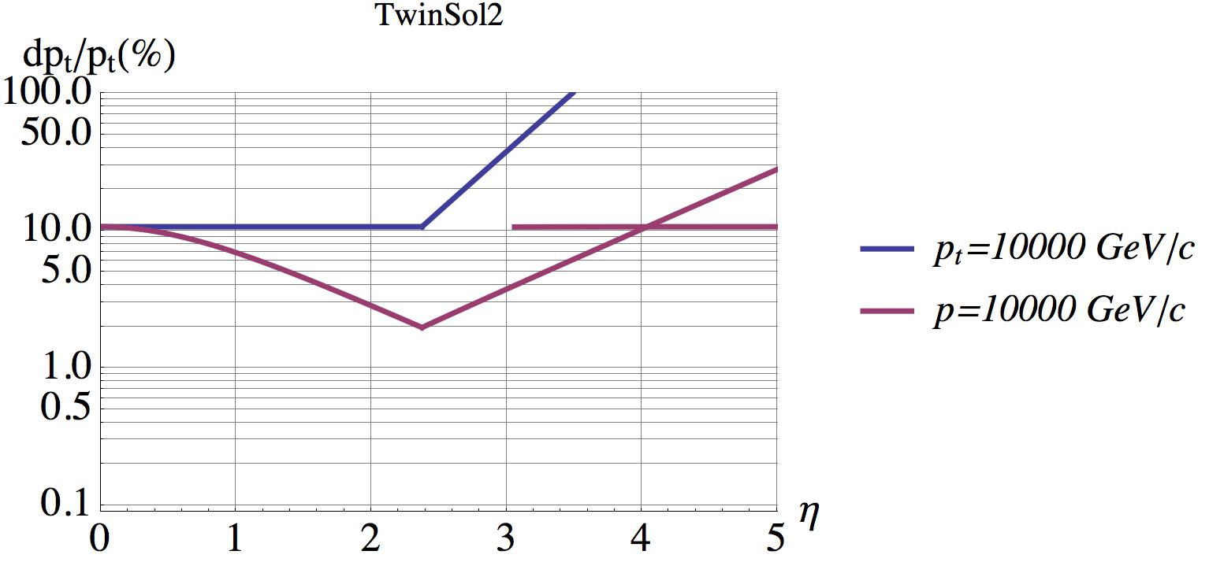
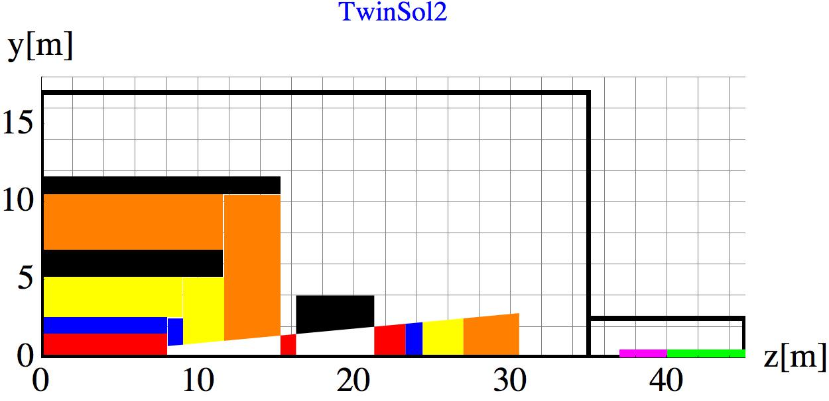
Twin Solenoid r=1.5m Tracker scaling+Forward Dipole
Smaller tracker radius r=1.5m and improvement of resolution by factor 3 (7um, 15 layers) to keep same resolution
Overall scale of solenoid stays the same if sower containment of 12 λ_{int} is required.
Larger η acceptance for spectroscopy in central region
Opening at eta η = 3.1 → smaller dipole needed
→ Push on tracker technology
Tracker
Emcal
Hcal
Muon
Coil
TAS
Triplet

Slide 23
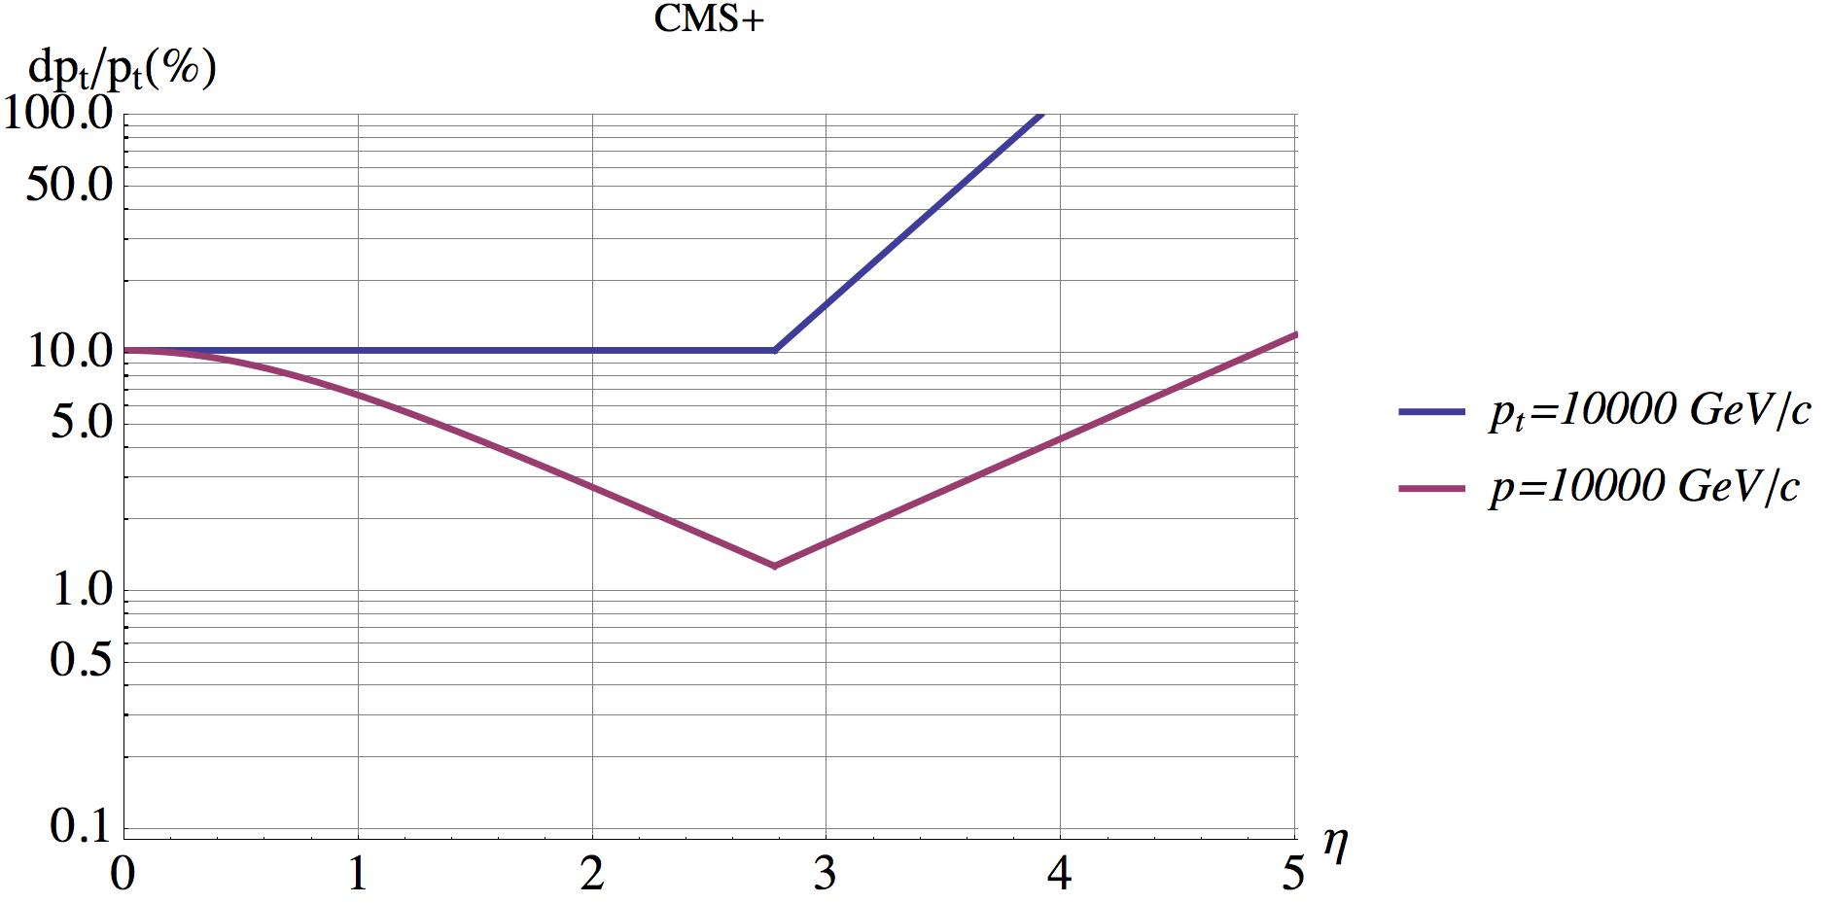
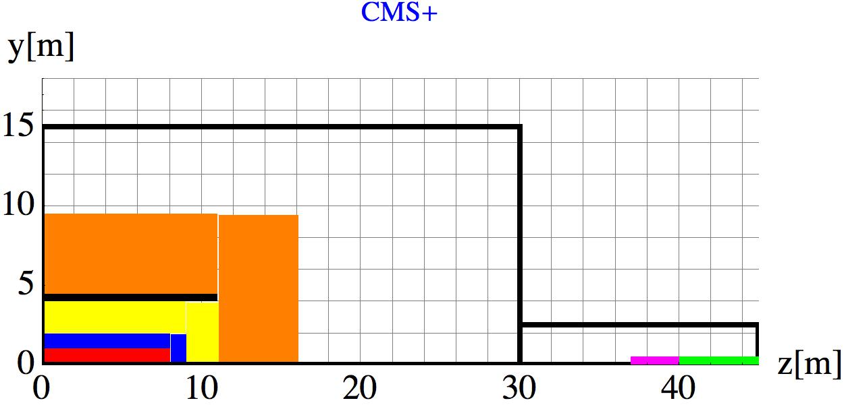
CMS scaled detector with very long extreme resolution tracker
Maximum coil producing 6T with affordable iron yoke (r=4m)
Tracker radius 1m, resolution has to be improved factor 6 (15 layers, 3um resolution)
8m long tracker gives large η acceptance.
2.8m available for EMCAL+HCAL e.g. very compact W/Si particle flow calorimeters
Very high granularity forward calorimeters needed
Muon system a’la CMS
→ ‘extreme’ technology challenge.

Slide 24

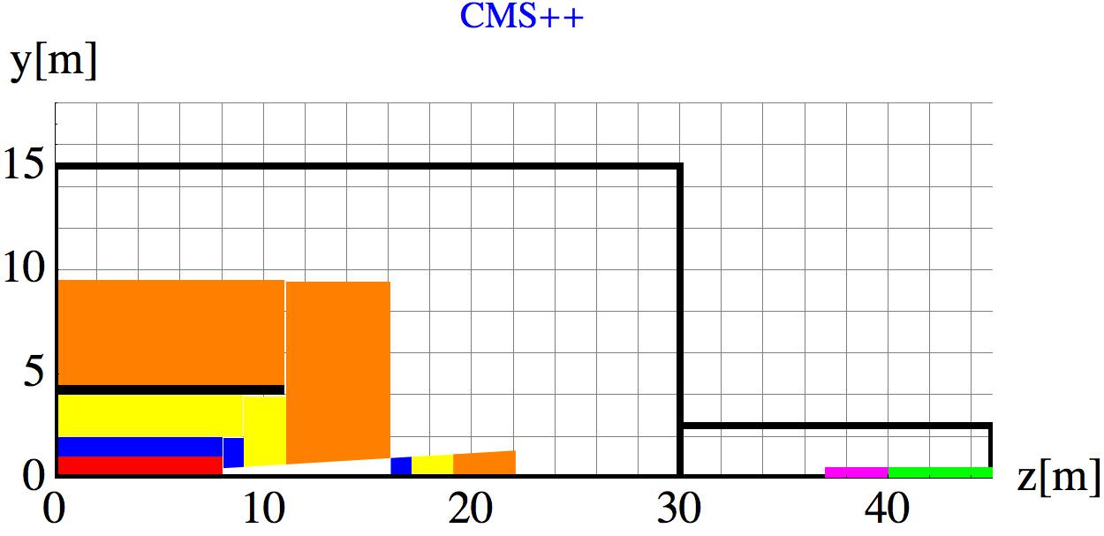
CMS scaled detector, calorimetry moved to
Forward calorimetry moved to large distance from η = 3.5 for reduced occupancy and radiation load

Slide 25
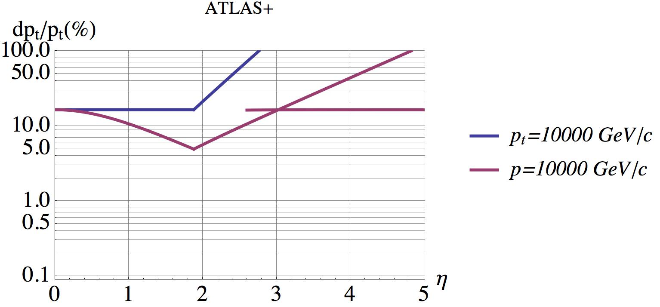
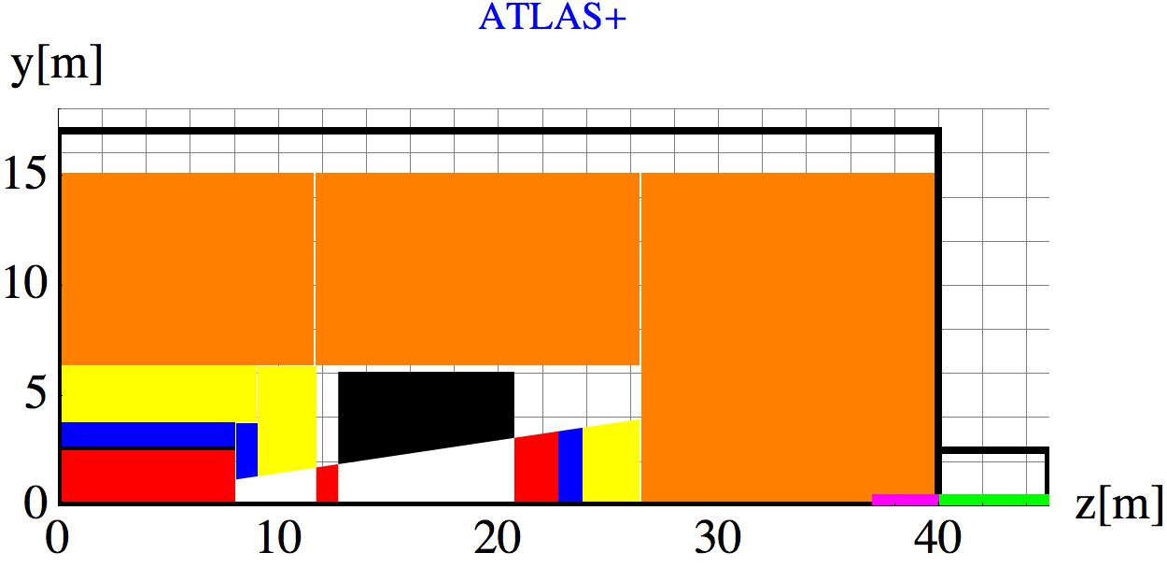
Scaled ATLAS Detector 7xBL² with Integrated Dipole
4T thin solenoid r=2.5m in front of ECAL
Tracker r=2.5m, 16m long.
Return flux through HCAL.
Large Toroid for “standalon muon momentum spectroscopy” (needed ?)
Maintenance is challenging

Slide 26
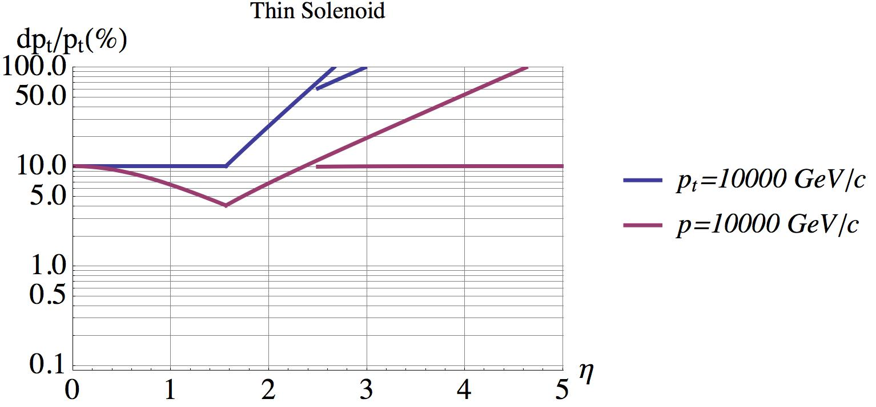
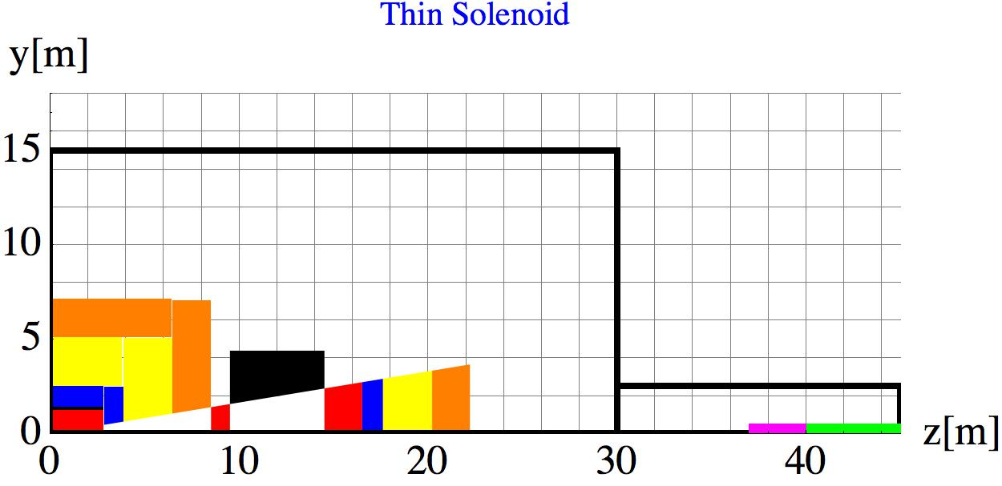
ATLAS type detector with muon tagging only
Thin Coil B=4T of r=1.3m in front of ECAL
Point resolution 3um in 15 layers
Muon momentum measured on tracker, muon system only as Muon Indentifier

Slide 27
CMS & ATLAS
Twin Solenoid
+ Dipole
Popular at Present
CMS+
ATLAS+
+ Dipole

Slide 28
Key Point and Strategy
If the FCC hadron machine with 16T magnets, 5MW synchrotron radiation and a 100km tunnel can be realized, there is no doubt that a detector, that makes full use of the physics potential, can be built.
Much of detector technology is driven by silicon technology and computing power i.e. we can count on significant improvements.
Since the maximum energy an delivered luminosity are the key goals for the FCC-hh machine, the detector efforts should put minimal constraints at the machine efforts.

Slide 29
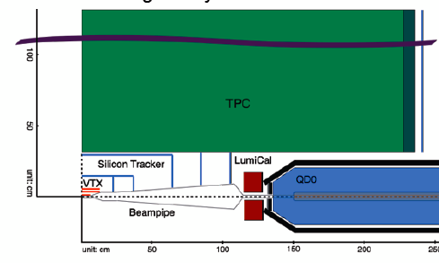
Conclusion on MDI Parameters
L* [25, 40]m or larger
Presently 60m is popular, we however stick to these numbers for now.
L_{peak} [5x10³⁴ , 30x10³⁴] cm⁻²s⁻¹
→ N_{pileup} [170, 1020] at 25ns
→ N_{pileup} [34, 204] at 5ns
L_{int} [3, 30] ab⁻¹
Thes upper limits of L_{peak} and L_{int} should be read as Phase II assumptions for the MDI effort, and not as numbers specified for or promised by the machine !
FCC-ee, L* O(1.5m)
We don’t envy them

Slide 30
14TeV → 100TeV:
Inelastic crossection 14 →100TeV changes from 80 → 108mb.
Multiplicity 14 →100TeV changes from 5.4 → 8 charged particles per rapidity unit.
Average p_{T} of charged particles 14 → 100 TeV 0.6 →0.8 GeV/c, i.e. bending radius in 4T magnetic field is 50 → 67cm.
Transverse energy increase by about a factor of 2.
→ The Min. Bias events at FCC are quite similar to the Min. Bias events at LHC.

Slide 31
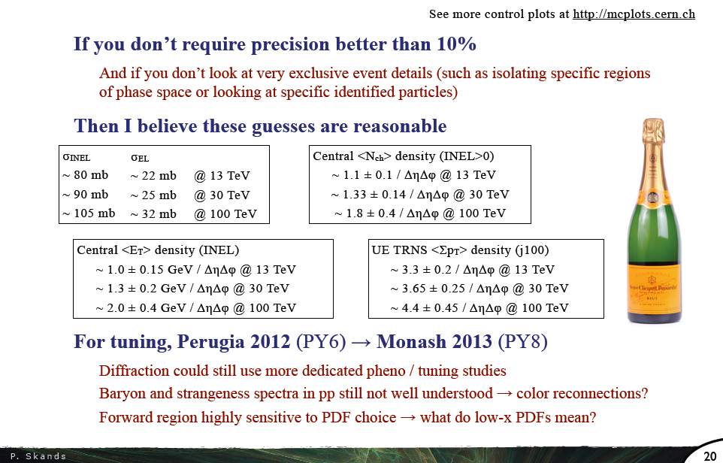
Peter Skands:

Slide 32
Integrated Luminosity
Estimate for radiation load of first Pixel Layer at r=3.7cm:
HL-LHC 3ab⁻¹
1MeVneq Fluence = 1.5x10¹⁶ cm⁻²
Dose = 5MGy
FCC 3ab⁻¹
1MeVneq Fluence = 3x10¹⁶ cm⁻²
Dose = 10MGy
FCC 30ab⁻¹
1MeVneq Fluence = 3x10¹⁷ cm⁻²
Dose = 100MGy

Slide 33
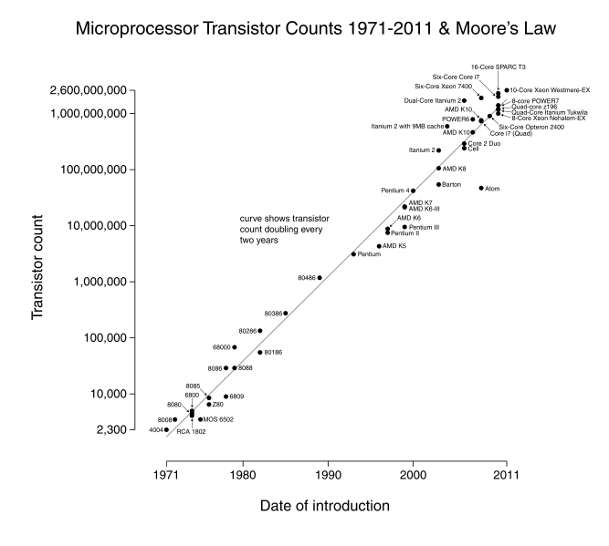
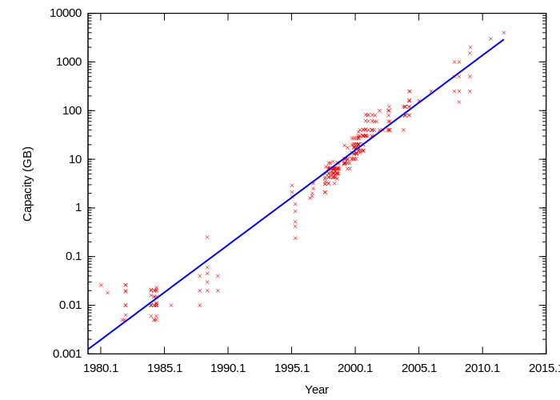
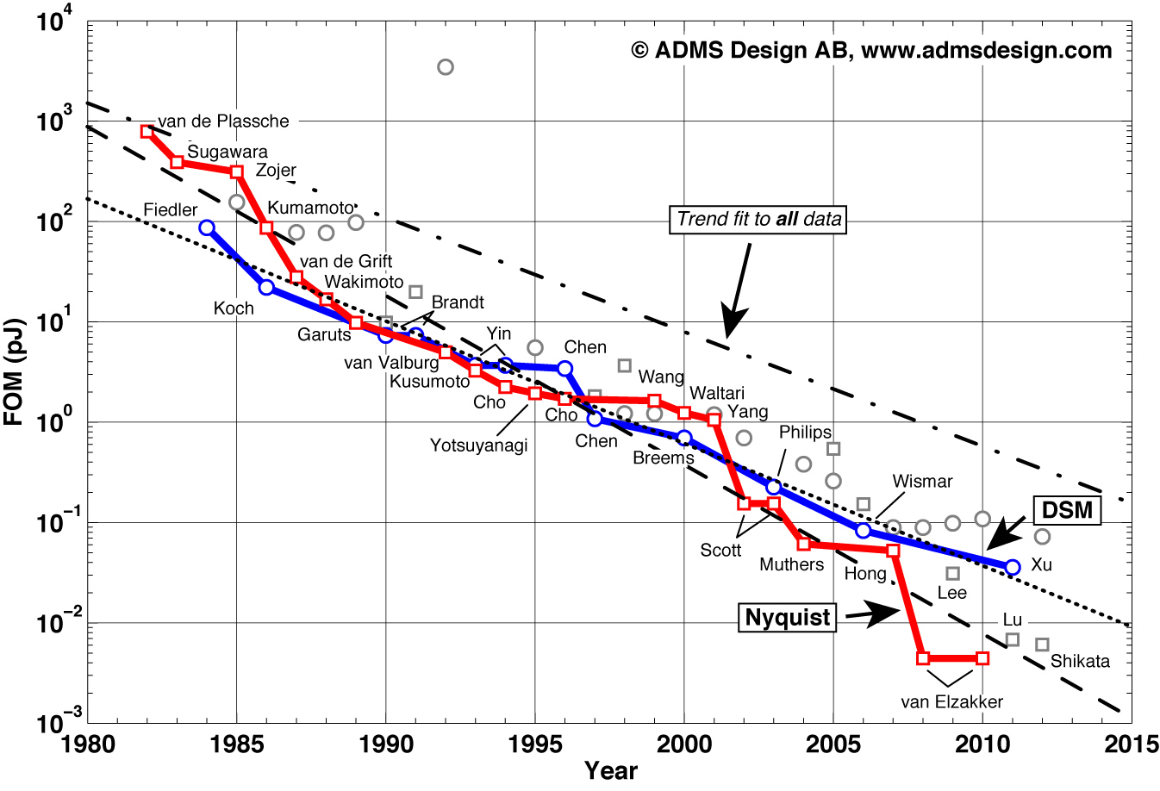

Prospects for ‚Microelectronics‘
Data Storage
Transistors/mm²
Bandwidth
ADC pJ/conversion
All these figures showed doubling times of < 2 years up to now ! Some scalings will stop, but different tricks might come in.
May dream about a factor 2¹⁰ = 1024 from 2014 – 2034 (of course optimistic)
This will allow major detector improvements !

Slide 34
Moore‘s Law
http://www.livescience.com/23074-future-computers.html
“If the doubling of computing power every two years continues to hold, then by 2030 whatever technology we're using will be sufficiently small that we can fit all the computing power that's in a human brain into a physical volume the size of a brain”,
explained Peter Denning, distinguished professor of computer science at the Naval Postgraduate School and an expert on innovation in computing.
"Futurists believe that's what you need for artificial intelligence. At that point, the computer starts thinking for itself.“
Computers will anyway by themselves figure out what to do with the data by 2035.
Magnet systems and shielding will be rather conventional and can be worked out to some detail now.
For detector technology and computing power we are allowed to dream a bit.

Slide 35

LHCb & ALICE in 2018
40 MHz
4 TByte/s into PC farm for HLT selection.
1 TByte/s into PC farm for data compression. All events to disc.
40 MHz
50 kHz
Reconstruction
+
Compression
5-40 MHz
20 kHz (0.1 MB/event)
50 kHz (1.5 MB/event)
Storage
2 GB/s
⬅ PEAK OUTPUT ➔
75 GB/s

Slide 36


ATLAS & CMS @ Run 4
40 MHz
Level 1
Level 1
5 TByte/s into PC farm for HLT selection.
Would be 200TByte/s without Level1
0.5-1 MHz
HLT
HLT
5-10 kHz (2MB/event)
10 kHz (4MB/event)
Storage
Storage
10-20 GB/s
⬅ PEAK OUTPUT ➔
40 GB/s

Slide 37
Trigger ?
CMS HL-LHC results in 200TByte/s into the online system for a triggerless readout.
For 2022 this is considered too difficult.
Assuming that the total track rate for 100TeV pp collisions (Phase I) is only a factor 2 larger, there is very little doubt that by 2035 and FCC-hh detector can be read out in a triggerless fashion.
In 2035 maybe no hardware trigger necessary ! All data to the online system, synchronous or asynchronous, where a sophisticated selection and compression can be done.
N.b. the techniques to get the data out of the detector with a small amount of material is a key question to be solved.

Slide 38


Detector Technologies
Luis Alvarez-Gaume
The graveyard of invented detectors that never made it to a successful large scale application is also significant !

Slide 39


Slide 40

ALICE 2018 upgrade, 20x20um monolithic pixels
CERN-LHCC-2013-024

Slide 41



Slide 42






Pixel Revolution Hybrid → Monolythic
Dramatic decrease in cost.
Very low power consumption, possibly <100mW/cm² i.e. simple water cooling
Ultra low material budget <0.3% for inner layers, <1% for outer layers.
Question of speed and radiation hardness:
At present,
integration time of 4μs (noise, electron diffusion)
radiation resistance up to few 10¹³ neq.
Development (next 20 years) towards larger (full) depletion will improve speed and radiation hardness significantly.
Also – in case one has a full pixel tracker one can use 1 or 2 layers with ‚fast‘ pixels to do the BCID (25ns or even 5ns) and then match the other hits.
With a full pixel tracker of 20x20um pixels one can pile up a fair amount of events before occupancy gets to large !!!
→ Technical design report for the upgrade of the ALICE inner tracking system CERN-LHCC-2013-024

Slide 43

200mm wafer =
0.03m²
10⁶ wafers=
30 000 m²
An FCC detector with 3000m² = 3 days

Slide 44
Simulation setup for FCC
One framework for simulation/reconstruction
  Gaudi framework chosen
One single detector description source
  for simulation, digitisation, fast simulation & reconstruction
  xml-based DD4Hep chosen
Main idea
  single simulation framework that allows layout prototyping in fast simulation
  layouts can then be evolved towards full simulation in the same setup

Slide 45
Several different MC exist in HEP
A. Salzburger, B. Hegner, J. Hrdinka, Anna Zaborowska
Different speed with different accuracy
CPU time
Geant4/V, FLUKA
full
G4Flash,
Frozen Showers
G4Flash
needs reconstruction
Fatras,
CMSFastSim
Fast MC
Parametric
ATLFAST1,
Delphes
accuracy

Slide 46

A. Salzburger, B. Hegner, J. Hrdinka, Anna Zaborowska
Common event
processing framework:
Gaudi/GaudiHive
Common I/O
handling via
Gaudi/FCC
event
loop
generator input
Single simulation kernel:
Geant4 RunManager
embedded as Gaudi algorithm
Detector
description
input:
DD4Hep
central particle stack,
forking into fast/full simulation engines
C
xml input file
Fast MC
G4Flash
Geant4/V
Parametric
hits
hits
C
Digitisation/Reconstruction
reconstructed
event data
job configuration,
initialisation,
event loop
common service with
translators into specific
geometry/event data
input file
output file
C

Slide 47




J. Hrdinka
Detector
description
input:
DD4Hep
xml input file
C
Geant4GeoConverterTool
RecoGeoConverterTool
Geant4
Fast MC
detector geometry
hits (straight tracks)

Slide 48
Conclusion
Next:
Define granularities and basic parametrization.
Simulation of benchmark channels with parametrized detector response.
Explore magnets, technologies.
Medium term:
Delevop strategy how do we push R&D in an effective way once the HL-LHC R&D is concluded.

