Slide 2

Lessons learnt and new concepts for conventional Safety in FCC
André Henriques, Saverio La Mendola
FCC Week 2015
26th March 2015
For a general overview:
R. Trant, “Health, safety and environment, FCC Kick-off”
http://cds.cern.ch/record/1694672

Slide 3
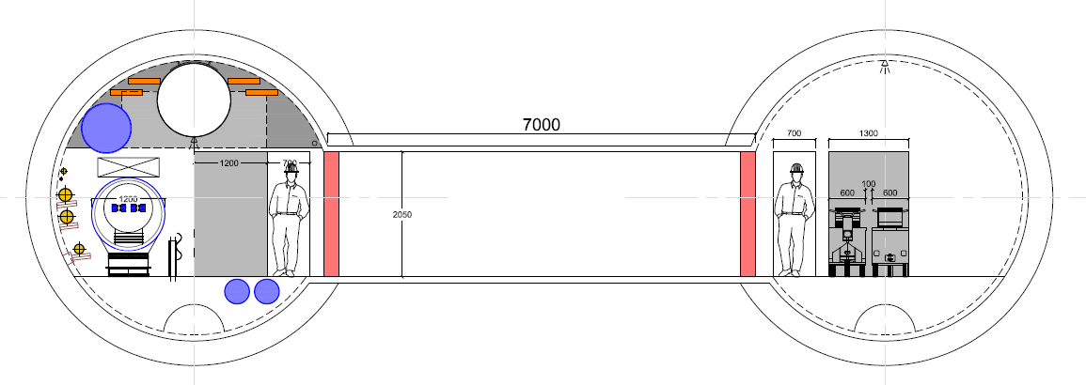
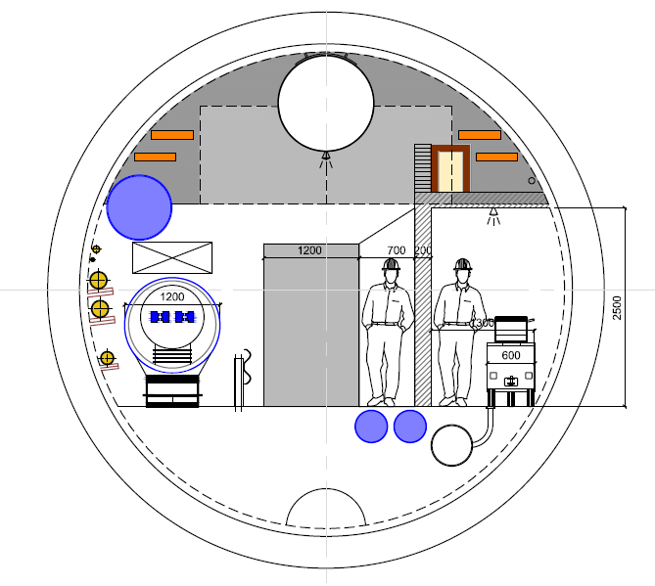

Overview
Focus on studies for conventional Safety aspects:
  Air management^{[1]} 2. Cryogenic Safety 3. Evacuation
Studies focused on two main tunnel cross-sections FCC-hh:
  4.5 m Ø double tunnel
Outcome is in line with RP constraints
  6 m Ø single tunnel
^{[1]} Air Management for RP
See M. Widorski presentation

Slide 4
Air management functions
Provide fresh air during access
Cope with different accidental scenarios (e.g. fire, Oxygen Deficiency Hazard, gas leak)
Provide dynamic confinement between “machine zone” and “safe zone” for protection of occupants in accidental scenarios
Provide dynamic confinement between “controlled” areas and areas accessible during run for protection of occupants
Provide sufficient air flow for heat removal during operation

Slide 5
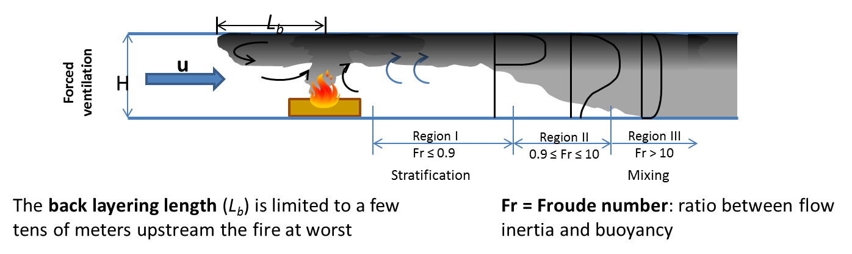
Air management concepts
Longitudinal ventilation (LV):
Main Advantages, w.r.to conventional Safety | Main Disadvantages, w.r.to conventional Safety
Provides fresh air for occupants during access Regulate air speed in the tunnel | Propagation and contamination of smoke to others volumes of the tunnel Even if the ventilation is stopped , the smoke still propagates
Smoke propagation in LV:
See also the presentation «A simplified model for tunnel fire dynamics predictions» by S. La Mendola EDMS 1278776
Courtesy of S. La Mendola

Slide 6
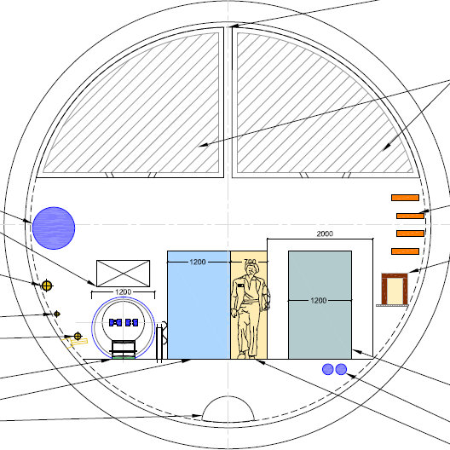
Air management concepts
Transverse ventilation (TV):
Main Advantages, w.r.to conventional Safety | Main Disadvantages, w.r.to feasibility of the system
Limit the propagation and contamination of smoke to others volumes of the tunnel Provide dynamic confinement localized near the fire | Large ducts are needed → occupy ~50 % of the tunnel volume Larger tunnel needed
Smoke propagation in TV:
D = 7.5 m → A_{total} = 44 m² → A_{useful} = 34 m²
A_{ducts} = 14 m² →
41 % of the useful area
Fresh air supply duct
Vitiated air exhaust duct
Fresh air supply duct
Vitiated air exhaust duct
Ø 7.5 m
Normal operation
Fire conditions
Notes:
In case of fire, a transverse ventilation system limits the propagation and contamination of smoke to other volumes of the tunnel. Additionally, it provides dynamic confinement localized near the fire.
However, it needs large ducts that occupy about 50 % of the tunnel volume. This also results in increased tunneling costs.

Slide 7
Air management concepts
“Optimised” solution:
Longitudinal Ventilation for normal operations
  Provide the requirements for occupational health (Fresh air)
  Dedicated smoke extraction system
  Limit propagation and contamination of smoke to others volumes of the tunnel
  Provide the dynamic confinement
  Reduced cross section of the smoke extraction duct

Slide 8
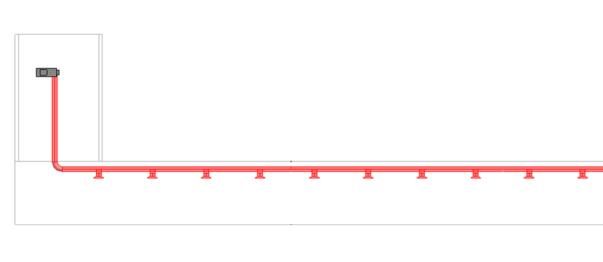
Smoke extraction system
Example of a section of the FCC tunnel:
  Nominal conditions
Shaft
Dedicated smoke extractor
Dedicated smoke extraction duct
Smoke control dampers
LV for Fresh air
…
Tunnel

Slide 9
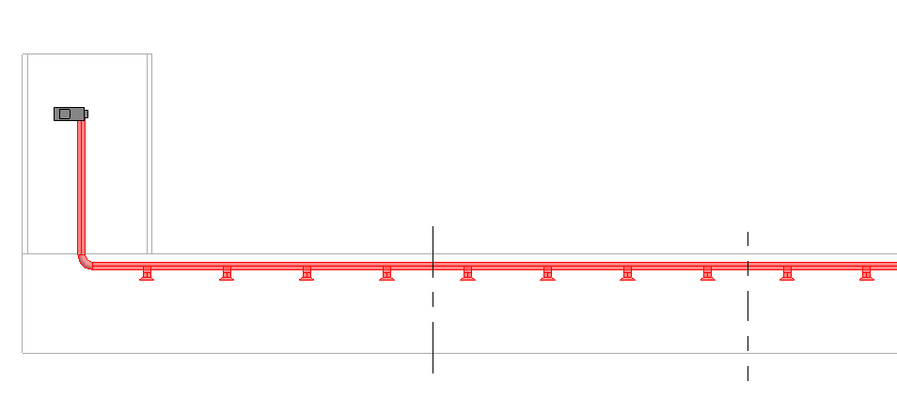
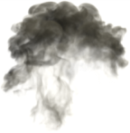

Smoke extraction system
Example of a section of the FCC tunnel:
  Accidental scenario – e.g. Fire
  Longitudinal ventilation is stopped
  Smoke extraction is ON
Dynamic Confinement
…
Length of Smoke Compartment

Slide 10
Smoke extraction system
Fire Detection system:
  Shall be able to identify the fire location within a certain length, to ensure that the dampers open in the correct location
…
Length of Smoke Compartment

Slide 11

Smoke extraction system
Fire Detection system:
  Shall be able to identify the fire location within a certain length, to ensure that the dampers open in the correct location
…
Length of Smoke Compartment

Slide 12

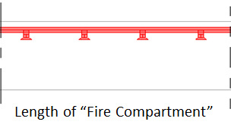
Smoke extraction system
Fire Detection system:
  Shall be able to identify the fire location within a certain length, to ensure that the dampers open in the correct location
…
Length of Smoke Compartment

Slide 13

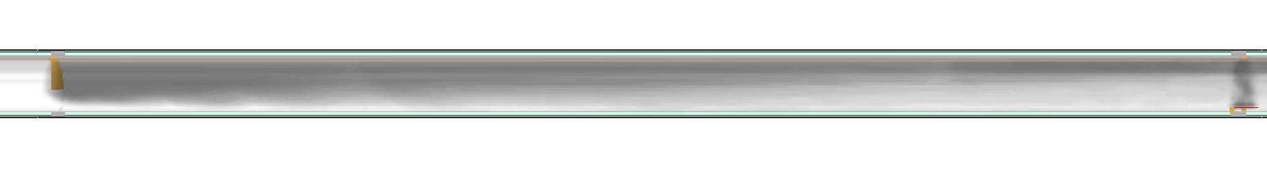


Smoke extraction system - Simulations
Smoke compartment = 200m
Extraction flowrate = 12 m³/s
Smoke curtain (in addition)
H - h = 3 m
Smoke curtain
H = 5 m
h = 2 m
Full confinement within the 200 m compartment for a 1 MW fire and 12 m³/s
Full confinement within the 200 m compartment for a 2 MW fire and 12 m³/s
This system provides a good smoke confinement also in off-nominal conditions
Courtesy of S. La Mendola
Notes:
12 m3/s → 43000 m3/h
With 36 m3/s we wont need curtains

Slide 14
Pressure drop – Curtains
Fixed curtain
Roller curtain
Ø 6 m tunnel
Curtain: Fixed part
Length = 10 km
Air flow = 140 000 m³/h (1 ACH)
Dh = 4.2 m
 | # | ΔP_{fixed} [Pa] | ΔP_{complete} [Pa]
Curtains | 1 | 13.5 | 109
 | 50 (1 per 200m) | 675 | 5450
 | 20 (1 per 500m) | 270 | 2180
Feasible from pressure drop point of view
Tunnel → ΔP = 136 Pa
Notes:
Full curtain 5400 Pa

Slide 15
Smoke extraction system
Considering:
Extraction flow rate of 12 m³/s;
Velocity in duct of 10 m/s;
Requires an extraction duct of 1.2 m
Fixed curtain
Extraction duct Ø 1.2 m
Roller curtain
Can this system be used for other purposes?

Slide 16
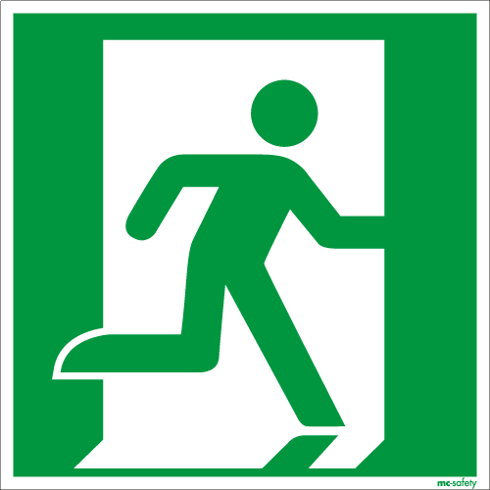
Cryogenic Safety – ODH
Can the smoke extraction system also cope with a potential He release?
Based on LHC, we have 2 scenarios:
Access (no powering): few hundred g/s
→ Compatible with smoke extraction proposal (12 m³/s)
No access (beam mode / magnets powered): couple tenths kg/s
→ By far not compatible with smoke extraction proposal (12 m³/s)
✓
Smoke extraction system → Emergency Extraction system (EES)
Notes:
Linked to a Maximum Credible Incident

Slide 17
Evacuation
6 m Ø Single Tunnel
Evacuate through a door leading to a “Safe Zone”:
Fire resistant
Air tight in case of cryogen release
Overpressure, w.r.to machine zone
Personnel transportation for evacuation
Safe zone with limited amount of combustible material
Notes:
Evacuate through a door leading to a “Safe Area” within or part of the same tunnel, but separated in view of

Slide 18
Evacuation
4.5 m Ø Double Tunnel
Evacuate through a passage way connecting to a “Safe Zone” in the parallel tunnel:
Overpressure, w.r.to machine zone
More space for transportation and for emergency intervention teams
Fire resistant
Air tight in case of cryogen release
If access to // tunnel during powering → “Pressure resistant” doors
ΔP major release

Slide 19
Evacuation
✓
Dimensions for Safe Area in front of the lifts
Assumptions (rough scaling from LHC):
Maximum occupants x3
Accidental scenario
Uniform distribution in arc
…
Data:
Lifts in machine shaft: 1 lift capacity of 30 people; velocity of 5 m/s; stroke 300m
Arc length 8 km
Evacuation speed: 2.5 m/s (9 km/h)
Similar areas as for the LHC today
Courtesy of S. La Mendola
Notes:
Clearly state the assumptions (x3)
30 people/min (fcc)
20 people/min (lhc)
Other assumptions:
- Occ.s don’t interact between each other
Walking speed is constant var. Gaus distribution
Pre-movement time = 0s (occ start moving at t=0s)
Every occ moves with the same transportation mean (“RTL”)

Slide 20
Conclusions
Air Management:
Smoke curtains:
Cryogenic Safety:
Evacuation:
Cross-section:
Longitudinal ventilation → nominal operation
Emergency Extraction system (EES) → accidental scenarios
Optimized → Fixed + Roller part
Feasible solution w.r.to pressure drop
Release in access mode → can be handled by EES
During powering → “pressure resistance” towards Safe Area
Separate hazards from Safe zone
Dimensions of Safe area near lifts → further studies but comparable to LHC
Double tunnel has advantages for Safety and accessibility
Notes:
emergency intervention teams (Fire Brigade)

Slide 21
Further Studies
Additional simulations for the EES → optimisation
Pressure build-up in case of major helium release (no access)
Impact on the mechanical properties of the ventilation system (ducts, supports, etc.), due to the low temperatures
  Optimise sizing of cryogenic relief devices – Kryolize Project
  Optimisation of the transportation mean and layout for evacuation
Evacuation scenarios for surface area in front of lifts
Prepare environmental impact study
Support all FCC WGs on Safety issues

Slide 22
Thank you very much
for your attention
Acknowledgements:
C. Cook, S. La Mendola, P. Lebrun, M. Nonis, J. Osborne, I. Ruehl, L. Tavian, R. Trant, M. Widorski

Slide 24
Spare Slides

Slide 25
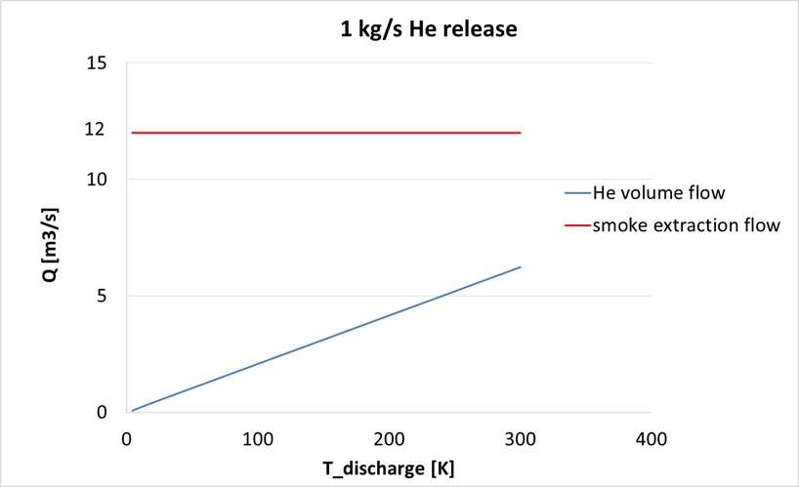
Cryogenic Safety – ODH
Access Mode:
Release scenario of ~1 kg/s
Aid evacuation
✓
margin
Smoke extraction proposal OK to extract 1 kg/s He release, w.r.to flow rate capacity → min margin by factor 2
Study the impact on the mechanical properties of the ventilation system (ducts, supports, etc.), due to the low temperatures

Slide 26
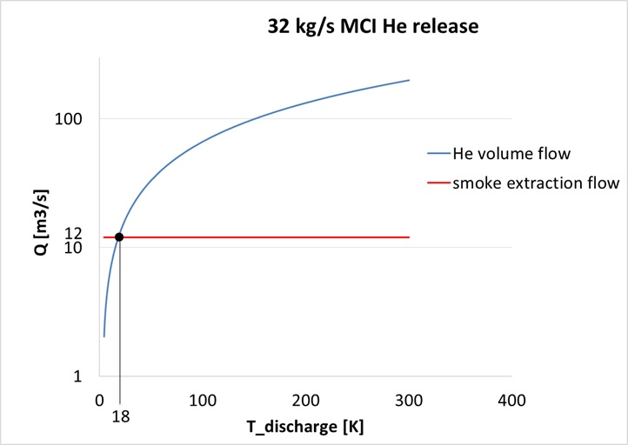
Cryogenic Safety – ODH
No Access “Beam Mode”:
Release scenario of ~ 30 kg/s (assumption from LHC)
After 18 K, Q due to He leak > Q smoke extraction
Smoke extraction proposal will, by far, not be possible to cope with MCI, but:
No access
Protect installation

Slide 27
Cryogenic Safety – ODH
No Access “Beam Mode”:
Release scenario is 32 kg/s (assumption from LHC)
~ Sectorise the QRL each 2 cells ~ 2*100m
6 L LHe / m → 5200 L LHe @ 300 K → 3640 m³ GHe
FCC SACR: 3.2 km (most conservative)
4.5 m Ø : 11 m2
6 m Ø : 14 m2
4.5 m Ø → 43100 m3 of air + 3640 m³ GHe → 154 mbar pressure increase
6 m Ø → 33700 m3 of air + 3640 m³ GHe → 120 mbar pressure increase

Slide 28
Cryogenic Safety – ODH
ΔP = 154 mbar
ΔP = 120 mbar
4.5 m Ø
In LHC (MCI): from 30 to 200 mbar
6 m Ø
Ref: Report of the Safety task force, 2009

Slide 29
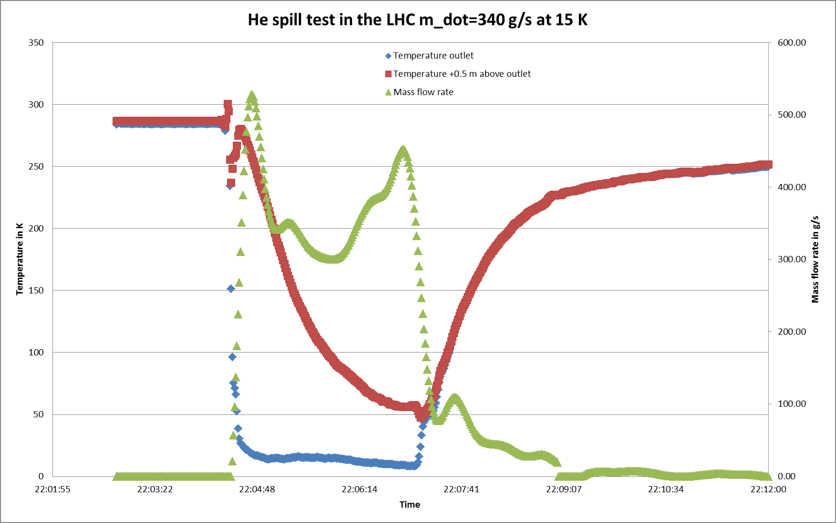
Cryogenic Safety – ODH
He Spill Test in LHC: Temperature for 340 g/s GHe release
Temperature +0.5m
above the outlet
Stable at 250 K
after 5min
Discharge
Courtesy of T. Koettig TE/CRG, CERN

Slide 30
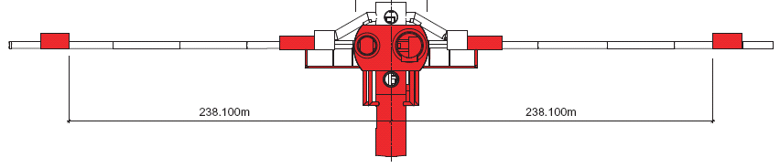
Evacuation
✓
Dimensions for Safe Area (in front of the lifts)
Data:
Lifts in machine shaft: 1 lift capacity of 30 people; velocity of 5 m/s; stroke 300m
t = 0 s (evacuation alarm)
Arc length 8 km
Evacuation speed: 2.5 m/s (9 km/h)
Assumptions (rough scaling from LHC):
Maximum occupants, accidental scenario
Evacuation from experiments:
60s < t < 600s
Uniform distribution in arc: ~4 occ. / 100m
Safe Area in PM shaft
150 people (LSS+UL+PM)
300 people (arc)
300 people (Exp. Cavern)
Courtesy of S. La Mendola
Notes:
Clearly state the assumptions (x3)
Other assumptions:
- Occ.s don’t interact between each other
Walking speed is constant var. Gaus distribution
Pre-movement time = 0s (occ start moving at t=0s)
Every occ moves with the same transportation mean (“RTL”)

Slide 31
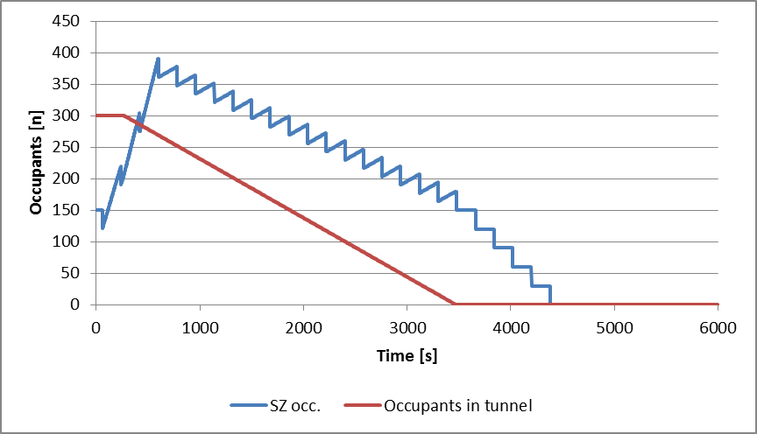
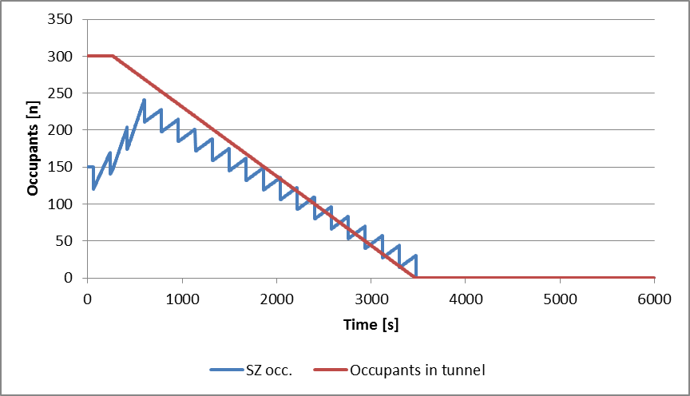
Evacuation
Nominal value 3 persons/m²
4 persons/m²
3 ≤ d ≤ 4
^{Tolerated only}
^{for very short periods}
d < 3
^{Acceptable}
d > 4
^{Not acceptable}
Dimensions for Safe Area
Scenario 1: alarm during maintenance of the experimental (PX) lift
130 m²
Safe Area
Scenario 2: alarm during maintenance in the PX lift
Limit the occ. In the exp. Cavern by ½
80 m²
Safe Area
Areas same order of magnitude as for the LHC today.
Courtesy of S. La Mendola

Slide 32
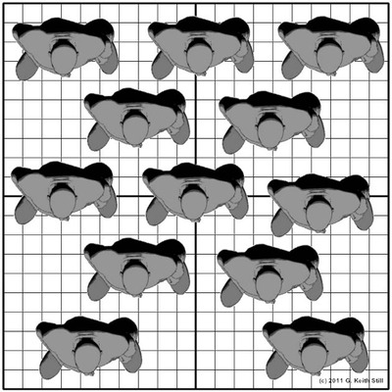
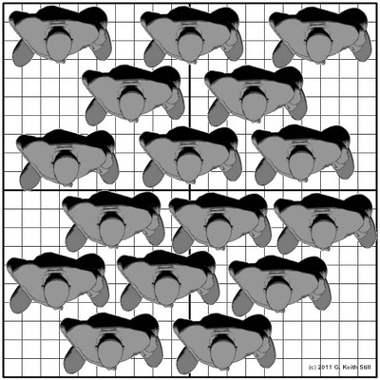
Maximum admissible crowding in safe zones
Nominal value 3 persons/m²
4 persons/m²
3 ≤ d ≤ 4
^{Tolerated only}
^{for very short periods}
d < 3
^{Acceptable}
d > 4
^{Not acceptable}
Art. L 3 of the ERP regulation fixes a maximum crowding of 3 persons/m² for people attending an event in a room without chairs or benches.
3 persons/m²
4 persons/m²
At 3.8 persons/m² movement ceases
These figures have been tested for a number of fire scenarios.

