Slide 1




FCC-ee: Lattice optimization and emittance tuning
Bastian Haerer (CERN, Geneva; KIT, Karlsruhe) for the FCC-ee lattice design team

Slide 2
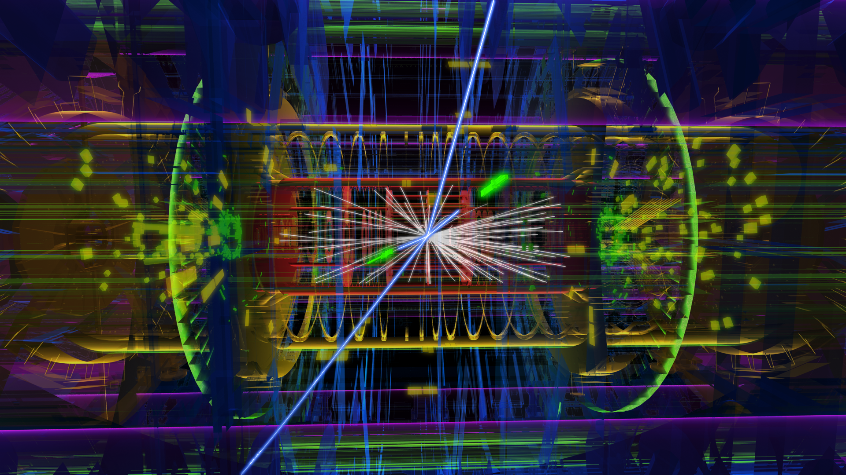
Physics goals of FCC-ee
ATLAS event display: H → e⁺ + e⁻ + μ⁺ + μ⁻
Main physics programs / energies (+ scan around central values):
  Z (45.5 GeV): Z pole, high precision of M_{Z} and Γ_{Z,}
  W (80 GeV): W pair production threshold,
  H (120 GeV): H production,
  t (175 GeV): tt threshold.
All energies quoted
refer to BEAM energies

Slide 3
Challenges: the parameter list
Design & optimise a lattice for 4 different energies
Horizontal emittance is increasing with reduced energy
Extremely small vert. beta* (β_{y}* = 1 mm)
High chromaticity
Challenging dynamic aperture
High synchrotron radiation losses include sophisticated absorber design in the lattice
 | Z | W | H | tt
Beam energy [GeV] | 45.5 | 80 | 120 | 175
Beam current [mA] | 1450 | 152 | 30 | 6.6
Bunches / beam | 16700 | 4490 | 1330 | 160
Bunch population [10¹¹] | 1.8 | 0.7 | 0.46 | 0.83
Transverse emittance ε Horizontal [nm] Vertical [nm] | 29.2 0.06 | 3.3 0.007 | 0.94 0.0019 | 2 0.002
Momentum comp. [10⁻⁵] | 18 | 2 | 0.5 | 0.5
Betatron function at IP β* Horizontal [mm] Vertical [mm] | 500 1 | 500 1 | 500 1 | 1000 1
Energy loss / turn [GeV] | 0.03 | 0.33 | 1.67 | 7.55
Total RF voltage [GV] | 2.5 | 4 | 5.5 | 11

Slide 4
175 GeV: Arc FODO cell
Completely symmetric!
Layout already considers space for absorbers, flanges etc.
S
Q
S
Q
S
B
B
B
B
S
Q
0.5 m
10.0 m
1.5 m
0.775 m
0.65 m
0.15 m
50 m
B = bending magnet, Q = quadrupole, S = sextupole
N_{dipoles} = 6152 (192 half bend)
(ρ ≈ 9.79 km, θ = 1.02 mrad, B = 60 mT)

Slide 5
Arc FODO cell: Optics
L = 50 m
Ψ = 90°/60°
β_{x,max} = 77.0 m
β_{y,max} = 96.5 m
D_{x,max} = 13.0 cm
LEP: D_{x,max} = 2.2 m*
* LEP Design Report Vol. II

Slide 6
FCC Layout
Exp.
RF(?)
RF(?)
RF(?)
RF(?)
Exp.
P. Lebrun & J. Osborne

Slide 7
Horizontal Dispersion

Slide 8
β functions

Slide 9
β functions II

Slide 10
Emittance tuning for lower beam energies

Slide 11
Motivation
Beam energy (in GeV) | Horizontal emittance (50 m cell lattice) (in nm rad) | Horizontal emittance (baseline) (in nm rad)
175.0 | 1.00 | 2.00
120.0 | 0.49 | 0.94
80.0 | 0.22 | 3.30
45.5 | 0.07 | 29.20
(γ = Lorentz factor)

Slide 12
Idealized Lattice
RF
RF
RF
RF
RF
Symmetric layout:
Circumference: 100 km
Arc length: 2 x 3.4 km
Straight section length: 1.5 km
50m FODO cell
RF
RF
RF
RF
RF
RF
RF
BPM
Corrector
Q
Q
S
B
B
Q
S
B
B
B = bending magnet, Q = quadrupole, S = sextupole

Slide 13
Changing the horizontal emittance for lower energies
There are two different possibilities:
Change the phase advance Ψ of the FODO cell
→ Larger emittance: smaller phase advance
Change the cell length
Larger emittance: increase cell length
Court. B. Holzer

Slide 14
Changing the cell length
L_{cell} = 50m
L_{cell} = 100m
L_{cell} = 150m

Slide 15
Feasible Lattice Changes
80 GeV beam energy:
Cell length L | Phase advance Ψ_{x} | Emittance ε_{x}
Baseline parameter: |  | 1.65 nm × 2
50 m | 45° | 1.50 nm (analyt.)
100 m | 90° | 1.74 nm (analyt.)
45.5 GeV beam energy:
Cell length L | Phase advance Ψ_{x} | Emittance ε_{x}
Baseline parameter: |  | 14.60 nm × 2
200 m | 60° | 13.56 nm (analyt.)
250 m | 72° | 15.91 nm (analyt.)
300 m | 90° | 15.24 nm (analyt.)

Slide 16
Examples: Different cell lengths
175 GeV and 120 GeV: L_{cell} = 50 m, Ψ = 90°/60°
Half-bend dispersion suppressor
80 GeV: L_{cell} = 100 m, Ψ = 90°/60°
Dispersion suppressor based on quadrupoles
45.5 GeV: L_{cell} = 300 m, Ψ = 90°/60°
300 m
250 m
200 m
200 m
Arc cells
Straight matching section (with RF)
Dispersion Suppressor
Straight cells (with RF)

Slide 17
80 GeV: L_{cell}=50 m, Ψ_{x,y}=45°

Slide 18
80 GeV: L_{cell}=100 m, Ψ_{x}=90°

Slide 19
45.5 GeV: L_{cell}=300 m, Ψ_{x}=90°

Slide 20
Emittance tuning: Results
80 GeV beam energy
Cell length in arc (m) | 50 | 100 | Baseline
Phase advance in arc cell | 45°/45° | 90°/60° | parameter
Horizontal emittance (nm) | 1.47 | 1.70 | 2 x 1.65
45.5 GeV beam energy
Cell length in arc (m) | 200 | 250 | 300 | Baseline
Phase advance in arc cell | 60°/60° | 72°/72° | 90°/60° | parameter
Horizontal emittance (nm) | 12.5 | 14.5 | 14.2 | 2 x 14.6

Slide 21
Status
Several lattices with different cell length and phase advance were proposed
Final choice requires further investigation
Misalignment studies, coupling
How much does horizontal emittance increase?
Calculation of the distorted orbit and vertical emittance
Fine tuning wigglers required:
→ Damping, excitation, Robinson?
Work in progress!

Slide 22
Chromaticity correction in the arcs – first approach

Slide 23
Idealized Lattice
RF
RF
RF
IR
RF
RF
Circumference: 100 km
Arc length: 2 x 3.4 km
Straight section length: 1.5 km
4 mini-beta insertions (IR)!
50m FODO cell
RF
IR
IR
RF
RF
IR
RF
RF
RF
RF
BPM
Corrector
Q
Q
S
B
B
Q
S
B
B
B = bending magnet, Q = quadrupole, S = sextupole

Slide 24
Mini-beta insertions
L* = 2 m
β*_{x} = 1 m
β*_{y} = 0.001 m

Slide 25
Chromaticity
Change of the tune with energy deviation
Textbook:
In our case not precise enough:

Slide 26
FCC-ee: Natural Chromaticity
 | no IRs | 4 IRs | ΔQ (δ=1.5 %)
Q_{x} | 498.85 | 502.16
Q_{x}’ | -554.93 | -603.80 | -9.06
Q_{x}’’ | 1587.57 | -8258.29 | -0.93
Q_{x}’’’ | -8071.77 | -1.4e+08 | -79.31
Q_{x}’’’’ | -3.27e+09 | -2.1e+12 | -4.43e+03
Q_{y} | 331.24 | 334.28
Q_{y}’ | -458.98 | -2044.43 | -30.67
Q_{y}’’ | 1086.30 | -8.4e+06 | -944.12
Q_{y}’’’ | -4547.47 | -2.0e+11 | -1.10e+05
Q_{y}’’’’ | -3.62e+09 | -6.5e+15 | -1.37e+07
Q(δ) = Q₀ + Q’ δ + Q’’ δ²/2 + …

Slide 27
Montague functions
Chromatic variables
W-vector
Final Focus Quad:
ΔA ≅ -β₀ k₀ l_{q}
A
Sextupole:
ΔA ≅ -β₀ k’₀ D_{x}l_{s}
B
Rotates with twice the phase advance!

Slide 28
FCC-ee sextupole scheme
SF1
SD1
SF2
SD2
SF1
SD3
μ_{x} = 90° = π/2
μ_{y} = 60° = π/3
μ_{x} = 180° = π (→ -I transformation)
Even number of sextupoles per family!

Slide 29
-I transformation
Sextupoles of each
family are in phase
→ W-vector
rotates by 2π
A
SD1[1]
FF Quad
SD1[2]
SD1[3]
B

Slide 30
W functions for 1 quarter
W_{x}, W_{y}
x
y
IP
IP
IP
IP
s (km)
IP
IP
Arc 1
Arc 2
Arc 3

Slide 31
Momentum acceptance
[-0.14 %; +0.05 %]
Work in progress!

Slide 32
“Corrected” Chromaticity
 | Nat. Chrom. | Corr. Chrom. | ΔQ (δ=0.05 %)
Q_{x} | 502.16 | 502.16
Q_{x}’ | -603.80 | 5.7e-05 | 2.83e-08
Q_{x}’’ | -8.3e+03 | 3.5e+03 | 4.41e-04
Q_{x}’’’ | -1.4e+08 | -5.5e+05 | -1.14e-05
Q_{x}’’’’ | -2.1e+12 | -8.5e+09 | -2.20e-05
Q_{y} | 334.28 | 334.28
Q_{y}’ | -2044.43 | 2.8e-01 | 1.39e-04
Q_{y}’’ | -8.4e+06 | -1.2e+04 | -1.53e-03
Q_{y}’’’ | -2.0e+11 | -3.4e+09 | -7.00e-02
Q_{y}’’’’ | -6.5e+15 | 3.6e+10 | 9.25e-05

Slide 33
3rd order chromaticity
~W²
Anton Bogomyagkov

Slide 34
Advantage of local CCS
*
3 orders of magn. smaller!!!
Anton Bogomyagkov
* Using one quarter of the ring

Slide 35
Next steps
Optimization of the Chromaticity Correction Scheme
Improve 3rd order chromaticity correction
Find best combination of local chromaticity correction and arc sextupoles
Optimization of the tune, phase advance
Chromaticity Correction Scheme for Low Energy Lattices
Same chromaticity, less sextupoles in the arc available

Slide 36
Other ongoing studies
Interaction Region Design
→ Anton Bogomyagkov (BINP),
Roman Martin, Rogelio Tomas (CERN)
Alignment tolerances, coupling, vertical emittance calculations
→ Sandra Aumon, Andreas Doblhammer (CERN)
Dynamic aperture studies
→ Pavel Piminov (BINP), Luis Medina, Rogelio Tomas (CERN)
Solenoid compensation scheme
→ Sergey Sinyatkin (BINP)
Very much progress in the first year!

Slide 37

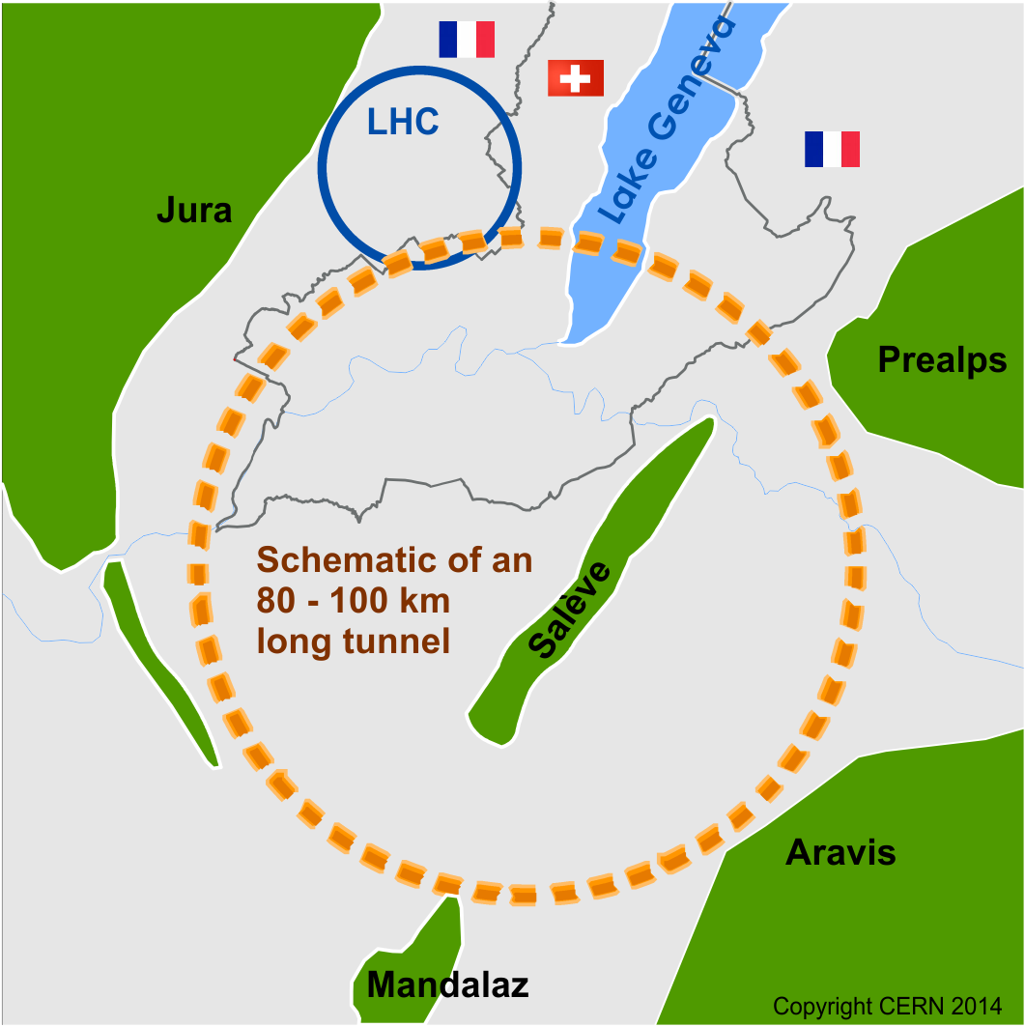
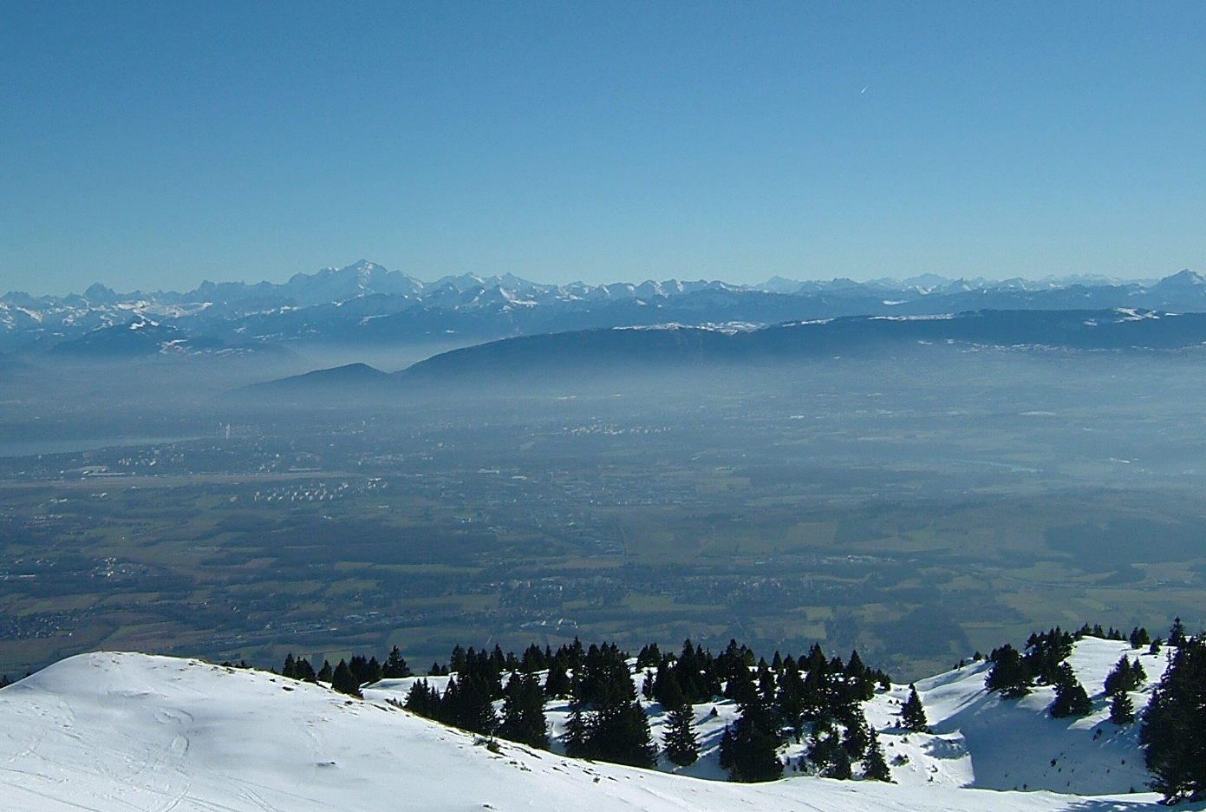
Thank you for your attention!
Courtesy to Jörg Wenninger

Slide 38
Lattice modules
… used for FCC-ee:
Abbreviation | Generic name | Number | Length (km)
LSS | Long straight section | 6 | 1.4
ESS | Extended straight section | 2 | 4.2
TSS | Technical straight section | 4 | ?
SARC | Short arc (incl. DS) | 4 | 4.0
LARC | Long arc (incl. DS) | 8 | depends on circumference (Version 16: 7.7)
P. Lebrun & J. Osborne

Slide 39
Energy sawtooth
(Ideal lattice)
12 RF sections
4 RF sections
Energy loss per turn: U₀ = 7.72 GeV

Slide 40
W functions comparison
With IRs
Without IRs

Slide 41
Vertical W-function in Arc 1
SD1
SD1
SD1
DS

Slide 42
W-functions in Arc 2
DS

