Slide 1
Conceptual Design Study on 12 T Beam Separation Dipole (D1) for FCC
Michinaka SUGANO, Tatsushi NAKAMOTO, Toru OGITSU
KEK

Slide 2
Requirement of D1 for FCC
Single Aperture
Given by Luca Bottura

Slide 3
Design Parameters of D1 for FCC
Nominal Field: 12 T
Coil Bore: 60 mm
L_{mech}: 12 m
Yoke Outer Dia.: 700 mm
Field Quality: ~10⁻⁴ @R_{ref} =20 mm, 2/3 of coil bore
Stray Field: < 0.1 T
T_{op}: 1.9 K
Margin: ~20 %
Good reference: “11 T Dipole”?

Slide 4
HL-LHC 11 T Dipole for DS Collimation
Developed at CERN
Main mechanical parameters | 1-1
Aperture [mm] | 60
Nominal Field [T] | 11.20
Coil peak field [T] | 11.72
Nominal Current [kA] | 11.85
Yoke outer diameter [mm] | 510
Magnetic length [mm] | 1690
Shell thickness [mm] | 12
Horizontal EM-force F_{x} per side at I_{nom} [kN/m] | 6.22
Vertical EM-force F_{y} per coil at I_{nom} [kN/m] | 3.18
Longitudinal EM-force F_{z} per coil at I_{nom} [kN] | 472
Stored energy at I_{nom} [kJ/m] | 445
Nominal current I_{nom} [kA] | 11.85
CERN “1 in 1” short model magnet
Mechanical Design up to 12 T
Cable geometric parameters
Nb₃Sn (RRP from OST & PIT from Bruker-EAS )

Slide 5
Conceptual Design of D1 for FCC
2D electromagnetic field design by ROXIE
  Target load line ratio: 80 %
  No mechanical FEA
Hypothesis of mechanical support
  Following the design of “11 T Dipole” with “Collared coil concept” up to 12 T
    Collar thickness of 30 mm for D1
Conductors for case study
  Nb₃Sn RRP
  Nb₃Sn Bronze for ITER
  RHQ-Nb₃Al
Cable geometry
  Cable for “11 T Dipole” or narrower one
  Insulation thickness of 0.1 mm
Assumption of the present performance
(Jc – B, filament diameter)

Slide 6
Strand and Cable
Strand data
 | RRP-Nb₃Sn | Bronze-route Nb₃Sn | RHQ-Nb₃Al
Strand diameter (mm) | Fixed to 0.7
Filament diameter (μm) | 55 | 20 (geometry 2.3) | 36
Cu/SC ratio | 1.106 | 1 | 1
Strand diameter was fixed and the reported values were adopted only for filament diameter and Cu/SC ratio.
Cable data
 | Baseline (11T dipole cable) | Narrower cable for RRP 4 layer coil
Height (mm) | 14.847 | 12.83
Width (mm) | 1.202, 1.411 | 1.162, 1.386
Number of strands | 40 | 34
Degradation ratio (%) | 10 | 20
Insulation thickness (mm) | 0.1 mm for both radial & azimuthal dir.

Slide 7
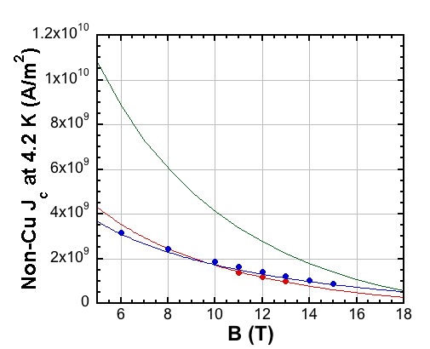
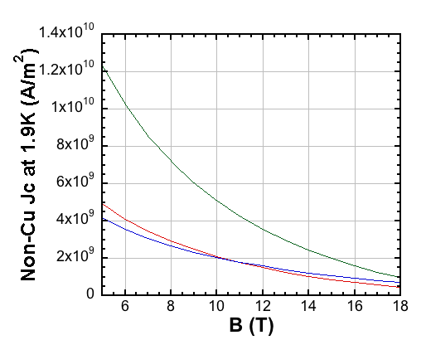
Jc – B Curves
4.2 K
1.9 K
RRP for 11T dipole
Bronze-Nb₃Sn
RRP for 11T dipole
Bronze-Nb₃Sn
RHQ-Nb₃Al
RHQ-Nb₃Al
RRP for 11T dipole by OST
Bronze-route Nb₃Sn: ITER-CS strand produced by JASTEC
RHQ-Nb₃Al: K3-strand developed by NIMS
Reported Jc-B data were fitted by the Summers I equation to estimate parameter “C”
 | RRP- Nb₃Sn | Bronze- Nb₃Sn | RHQ-Nb₃Al
B_{c20} (T) | 27.012 | 28 | 36.2
T_{c0} (K) | 18 | 18 | 17.8
C (A/m²) | 4.30e10 | 1.69e10 | 1.29e10

Slide 8
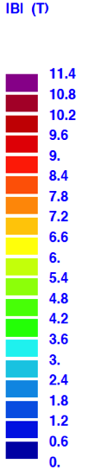
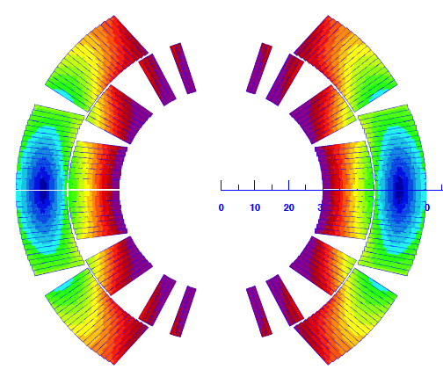
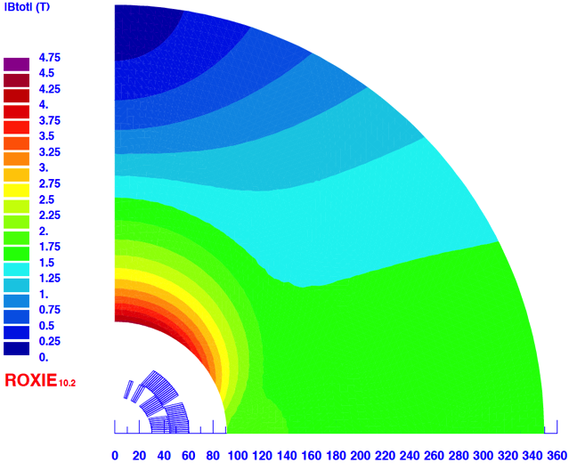
Case Study A: RRP (based on 11 T dipole coil)
Parameter
Cable design | Baseline (cable for 11 T dipole)
Filament diameter (μm) | 55
# of layers | 2
# of blocks | 6
# of total turns | 56
# of turns in each coil block | 9, 8, 3, 2/ 16, 18
Cable length (m) | 2688
Yoke R_{inner} (mm) | 91.5
Yoke R_{outer} (mm) | 350
Nominal current (A) | 12600
Nominal Field (T) | 12.114
Load line ratio (%) | 86.3 (4th block)
Peak field w/o self-field (T) | 12.51 (4th block)
Stored energy (kJ/m) | 519.9
ΣFx for quad. (MN/m) | 3.69
ΣFy for quad. (MN/m) | -1.81
Stray field at MP (T) | 0.0034
Load line ratio is higher than 80 %.
Higher order multipole components was optimized at I_{nom} by coil geometry. (See in later slide)

Slide 9
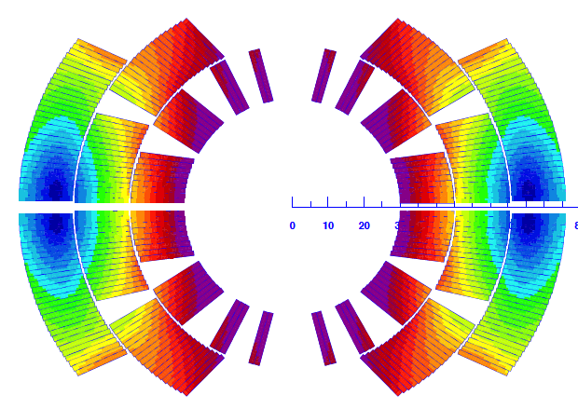
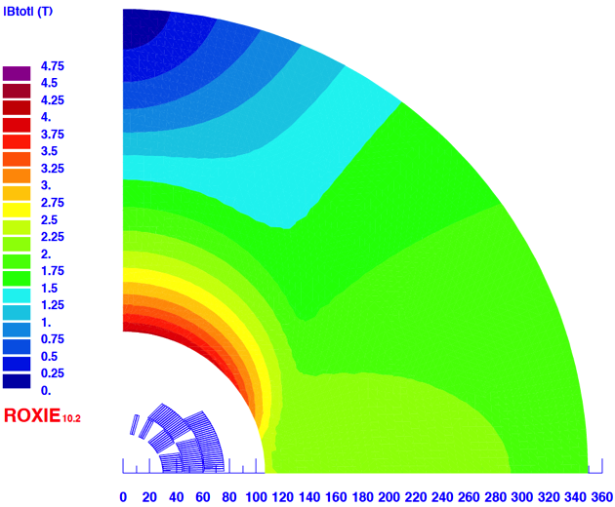
Case Study B: RRP w/ 3 layer coil
Parameter
Cable design | Baseline (cable for 11 T dipole)
Filament diameter (μm) | 55
# of layers | 3
# of blocks | 7
# of total turns | 86
# of turns in each coil block | 9, 8, 3, 2/ 16, 18/ 30
Cable length (m) | 4128
Yoke R_{inner} (mm) | 107
Yoke R_{outer} (mm) | 350
Nominal current (A) | 9200
Nominal Field (T) | 12.133
Load line ratio (%) | 79.5 (2nd block)
Peak field w/o self-field (T) | 12.38 (2nd block)
Stored energy (kJ/m) | 668.7
ΣFx for quad. (MN/m) | 4.07
ΣFy for quad. (MN/m) | -1.97
Stray field at MP (T) | 0.024
This looks OK.
Maybe, some difficulty of “3 layer” coil in fabrication (lead splice support?)
Wider cable for 2 layer coil would be better but if it can fit to given bore of 60 mm.

Slide 10
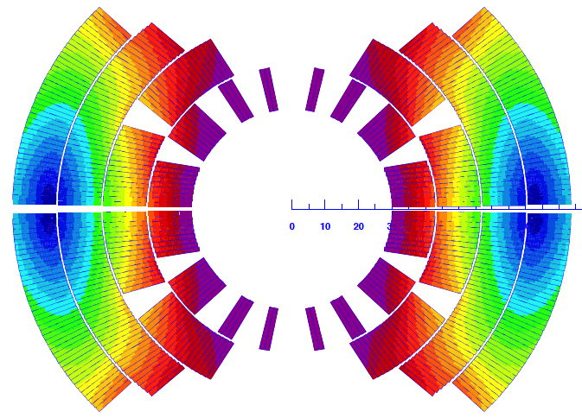
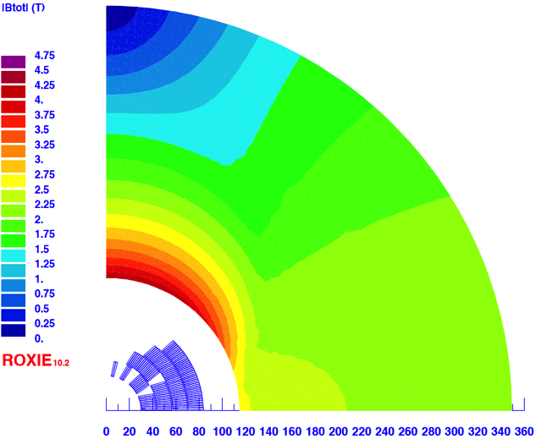
Case Study C: RRP w/ 4 layer coil
Parameter
Cable design | Narrower cable
Filament diameter (μm) | 55
# of layers | 4
# of blocks | 8
# of total turns | 138
# of turns in each coil block | 9, 8, 3, 2/ 16, 18/ 40 / 42
Cable length (m) | 6624 (*34 strands)
Yoke R_{inner} (mm) | 115
Yoke R_{outer} (mm) | 350
Nominal current (A) | 6300
Nominal Field (T) | 12.196
Load line ratio (%) | 78.2 (2nd block)
Peak field w/o self-field (T) | 12.48 (2nd block)
Stored energy (kJ/m) | 768.4
ΣFx for quad. (MN/m) | 4.27
ΣFy for quad. (MN/m) | -1.21
Stray field at MP (T) | 0.082
x1.4 conductors needed in comparison with Case B.
14 % higher stored energy.
Detailed FEA study comparing Case B & C is interesting to see.

Slide 11
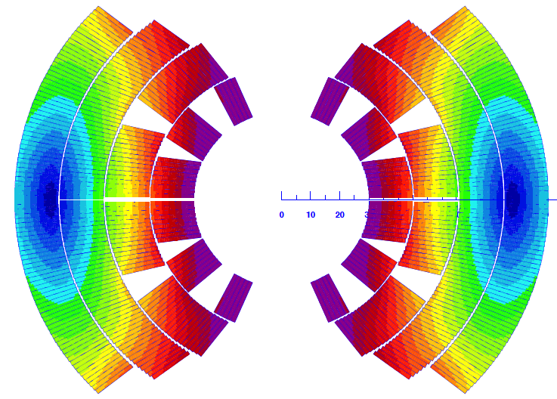
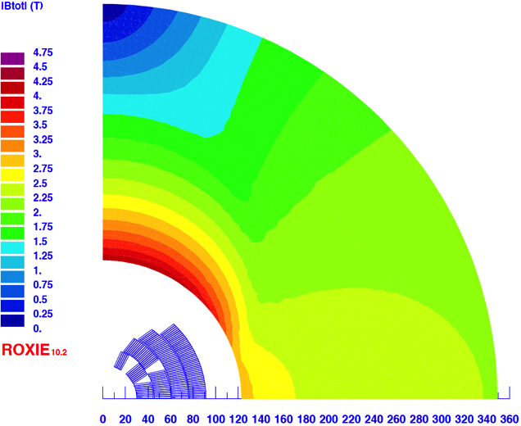
Case Study D: Bronze Nb₃Sn w/ 4 layer coil
*3 layer coil w/ Bronze wire cannot generate 12 T…
Parameter
Cable design | Same geometry as 11 dipole cable
Filament diameter (μm) | 20 (D_{geo}=2.3)
# of layers | 4
# of blocks | 7
# of total turns | 145
# of turns in each coil block | 9, 8, 5/ 16, 18/ 44/ 46
Cable length (m) | 6960
Yoke R_{inner} (mm) | 123
Yoke R_{outer} (mm) | 350
Nominal current (A) | 6400
Nominal Field (T) | 12.235
Load line ratio (%) | 89.7 (3rd block)
Peak field w/o self-field (T) | 12.62 (3rd block)
Stored energy (kJ/m) | 892.1
ΣFx for quad. (MN/m) | 4.66
ΣFy for quad. (MN/m) | -2.23
Stray field at MP (T) | 0.16
Drawback: load line ratio of ~90 %, higher stored energy.
+70 % conductors needed in comparison with Case B.
Stray field becomes an issue.
Smaller D_{eff.} of 20 μm will improve magnetization effect.

Slide 12
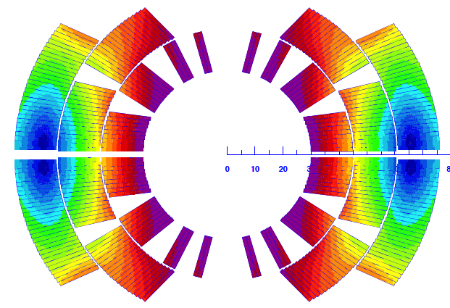
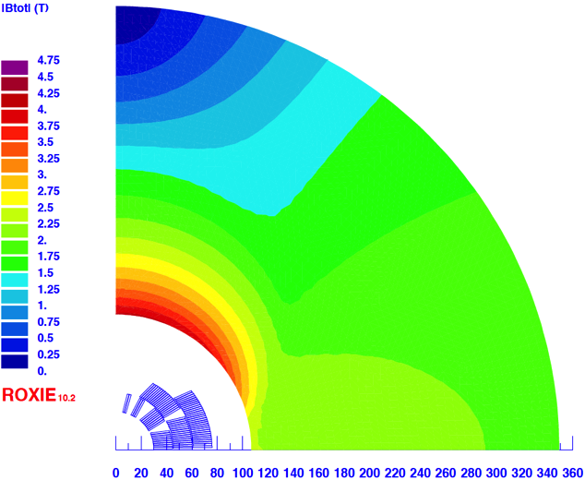
Case Study E: RHQ-Nb₃Al w/ 3 layer coil
*2 layer coil w/ Nb₃Al wire cannot generate 12 T…
Parameter
Cable design | Same geometry as 11 dipole cable
Filament diameter (μm) | 36
# of layers | 3
# of blocks | 7
# of total turns | 86
# of turns in each coil block | 9, 8, 3, 2/ 16, 18/ 30
Cable length (m) | 4128
Yoke R_{inner} (mm) | 107
Yoke R_{outer} (mm) | 350
Nominal current (A) | 9200
Nominal Field (T) | 12.133
Load line ratio (%) | 95.28 (2nd block)
Peak field w/o self-field (T) | 12.38 (2nd block)
Stored energy (kJ/m) | 667.0
ΣFx for quad. (MN/m) | 4.07
ΣFy for quad. (MN/m) | -1.97
Stray field at MP (T) | 0.024
Very small margin < 5 % on the load line.
Perhaps this is not realistic.

Slide 13
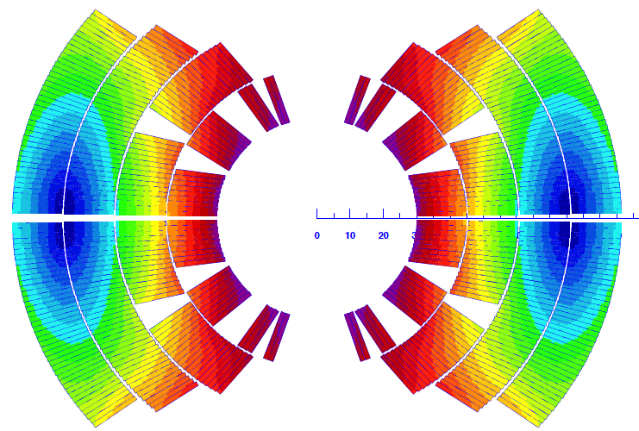
Case Study F: RHQ-Nb₃Al w/ 4 layer coil
Parameter
Cable design | Same geometry as 11 dipole cable
Filament diameter (μm) | 36
# of layers | 4
# of blocks | 8
# of total turns | 138
# of turns in each coil block | 9, 8, 3, 2/ 16, 18/ 40/ 42
Cable length (m) | 6624
Yoke R_{inner} (mm) | 123
Yoke R_{outer} (mm) | 350
Nominal current (A) | 6600
Nominal Field (T) | 12.16
Load line ratio (%) | 85.0 (4th block)
Peak field w/o self-field (T) | 12.48 (4th block)
Stored energy (kJ/m) | 869.5
ΣFx for quad. (MN/m) | 4.50
ΣFy for quad. (MN/m) | -2.20
Stray field at MP (T) | 0.14
Load line ratio is lower than Bronze case, but still 85%.
  Robust Nb3Al w/o degradation could be OK??
Higher stored energy.
+60 % conductors needed in comparison with Case B.
Stray field exceeds the limit.

Slide 14
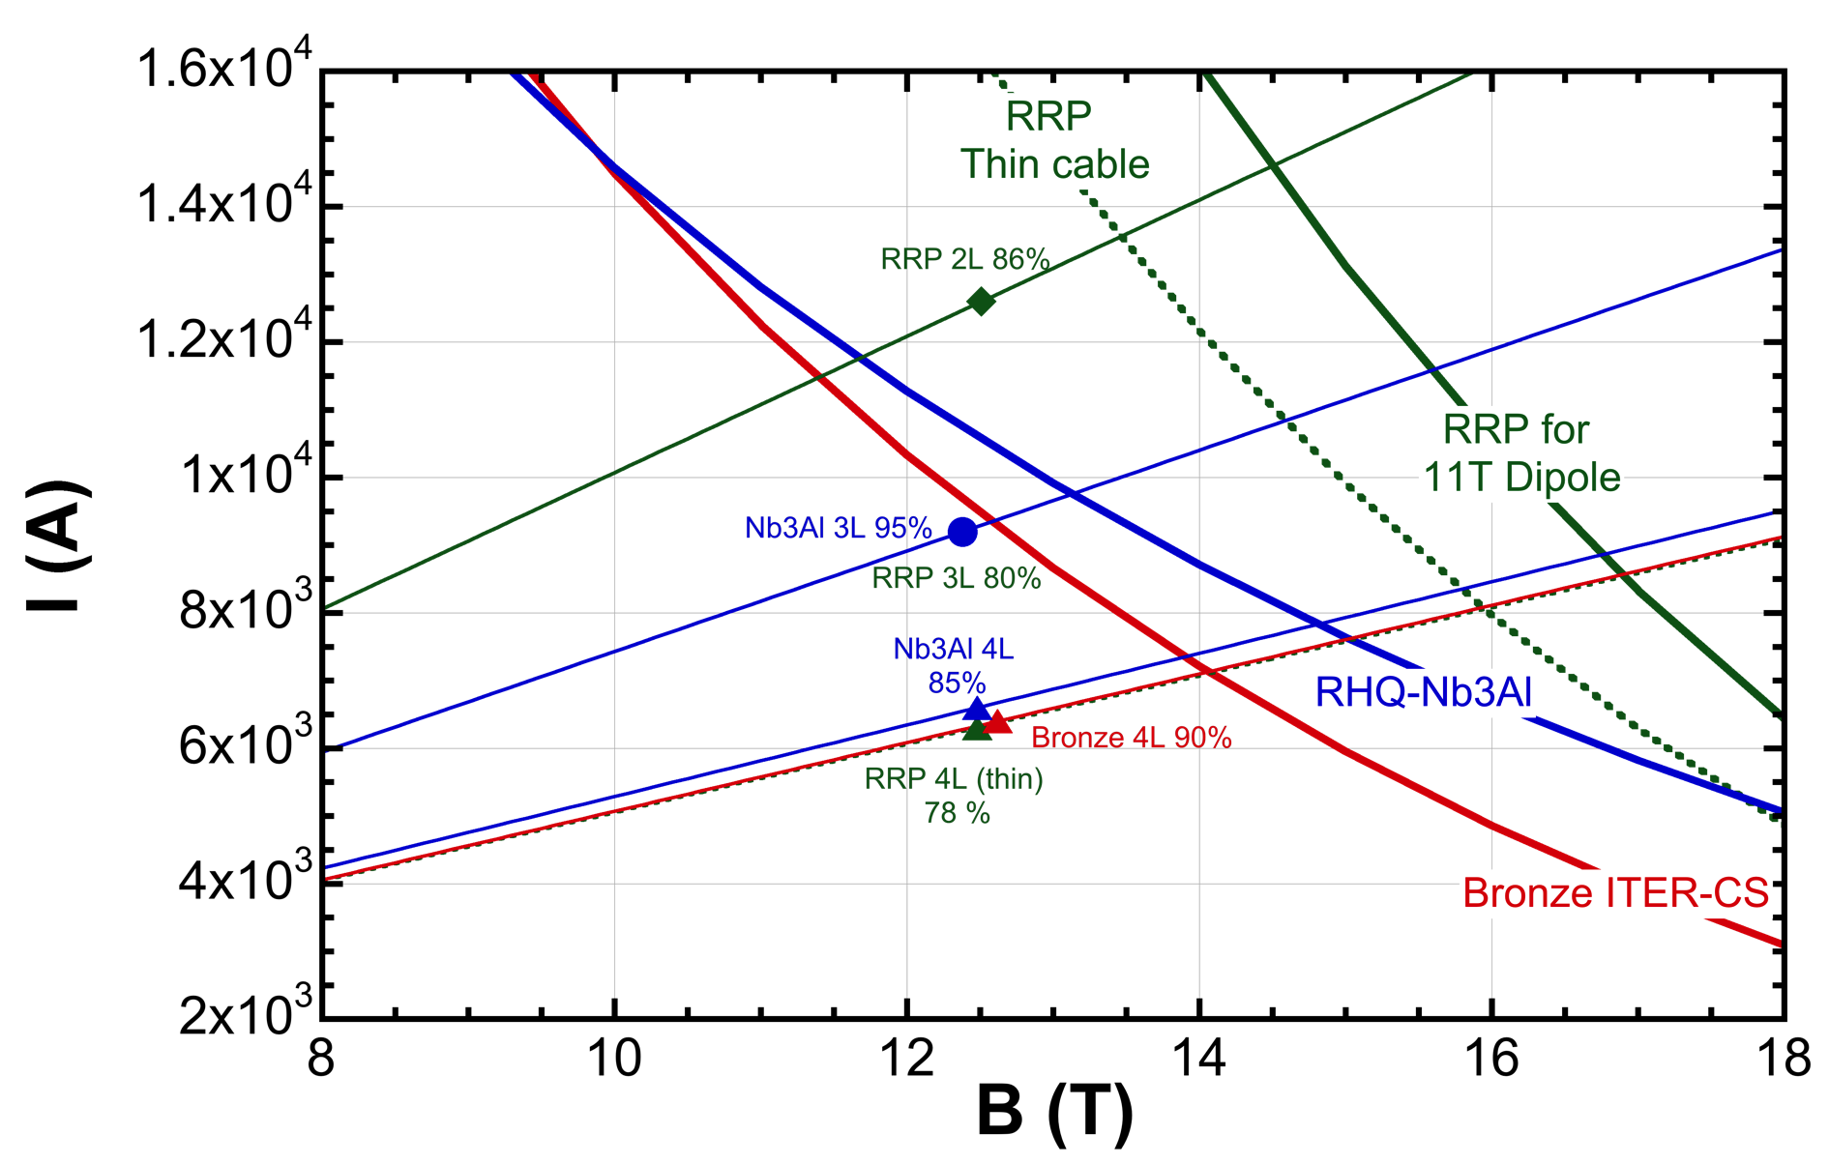
Summary of Load Line Curves
D1: 12 T, 60 mm bore

Slide 15
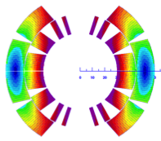
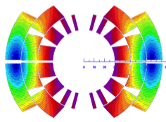
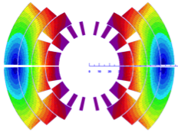
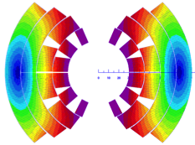
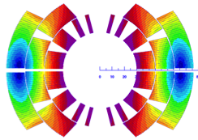
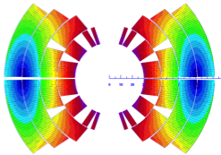
Field Quality at Nominal Field
 | Case A RRP 2L | Case B RRP 3L | Case C RRP 4L | Case D Bronze 4L | Case E RHQ-Nb₃Al 3L | Case F RHQ-Nb₃Al 4L
b3 | 0.16 | -1.43 | 1.70 | 0.07 | 0.00 | -0.01
b5 | 0.02 | 0.00 | 0.98 | 0.05 | 0.00 | 0.06
b7 | 0.00 | 0.01 | 1.66 | 0.21 | 0.00 | 8.54
b9 | 3.52 | 3.73 | 4.42 | -0.74 | 3.70 | 0.40
b11 | 2.12 | -0.46 | -0.09 | 2.04 | -0.46 | 0.98
b13 | -0.91 | -0.99 | -0.68 | -0.72 | -0.99 | -0.84
b15 | -0.32 | -0.25 | -0.30 | -0.22 | -0.25 | -0.19
b17 | 0.00 | 0.06 | 0.09 | 0.08 | 0.06 | 0.07
b19 | 0.05 | 0.01 | 0.00 | -0.01 | 0.01 | 0.00
Some coefficients is still higher than 1 unit but they could be reduced in further optimization.
(Unit)

Slide 16
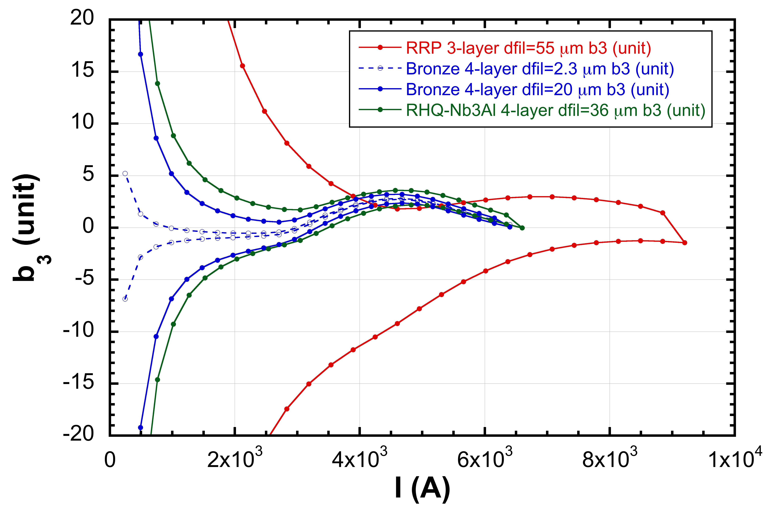
Field Quality: Magnetization, Saturation
Multipole components are minimized at I_{nom} by coil geometry.
No saturation correction with yoke geometry, but amplitude below 5 unit.
Small magnetization effect in Bronze wire (D_{eff} 20 μm).

Slide 17
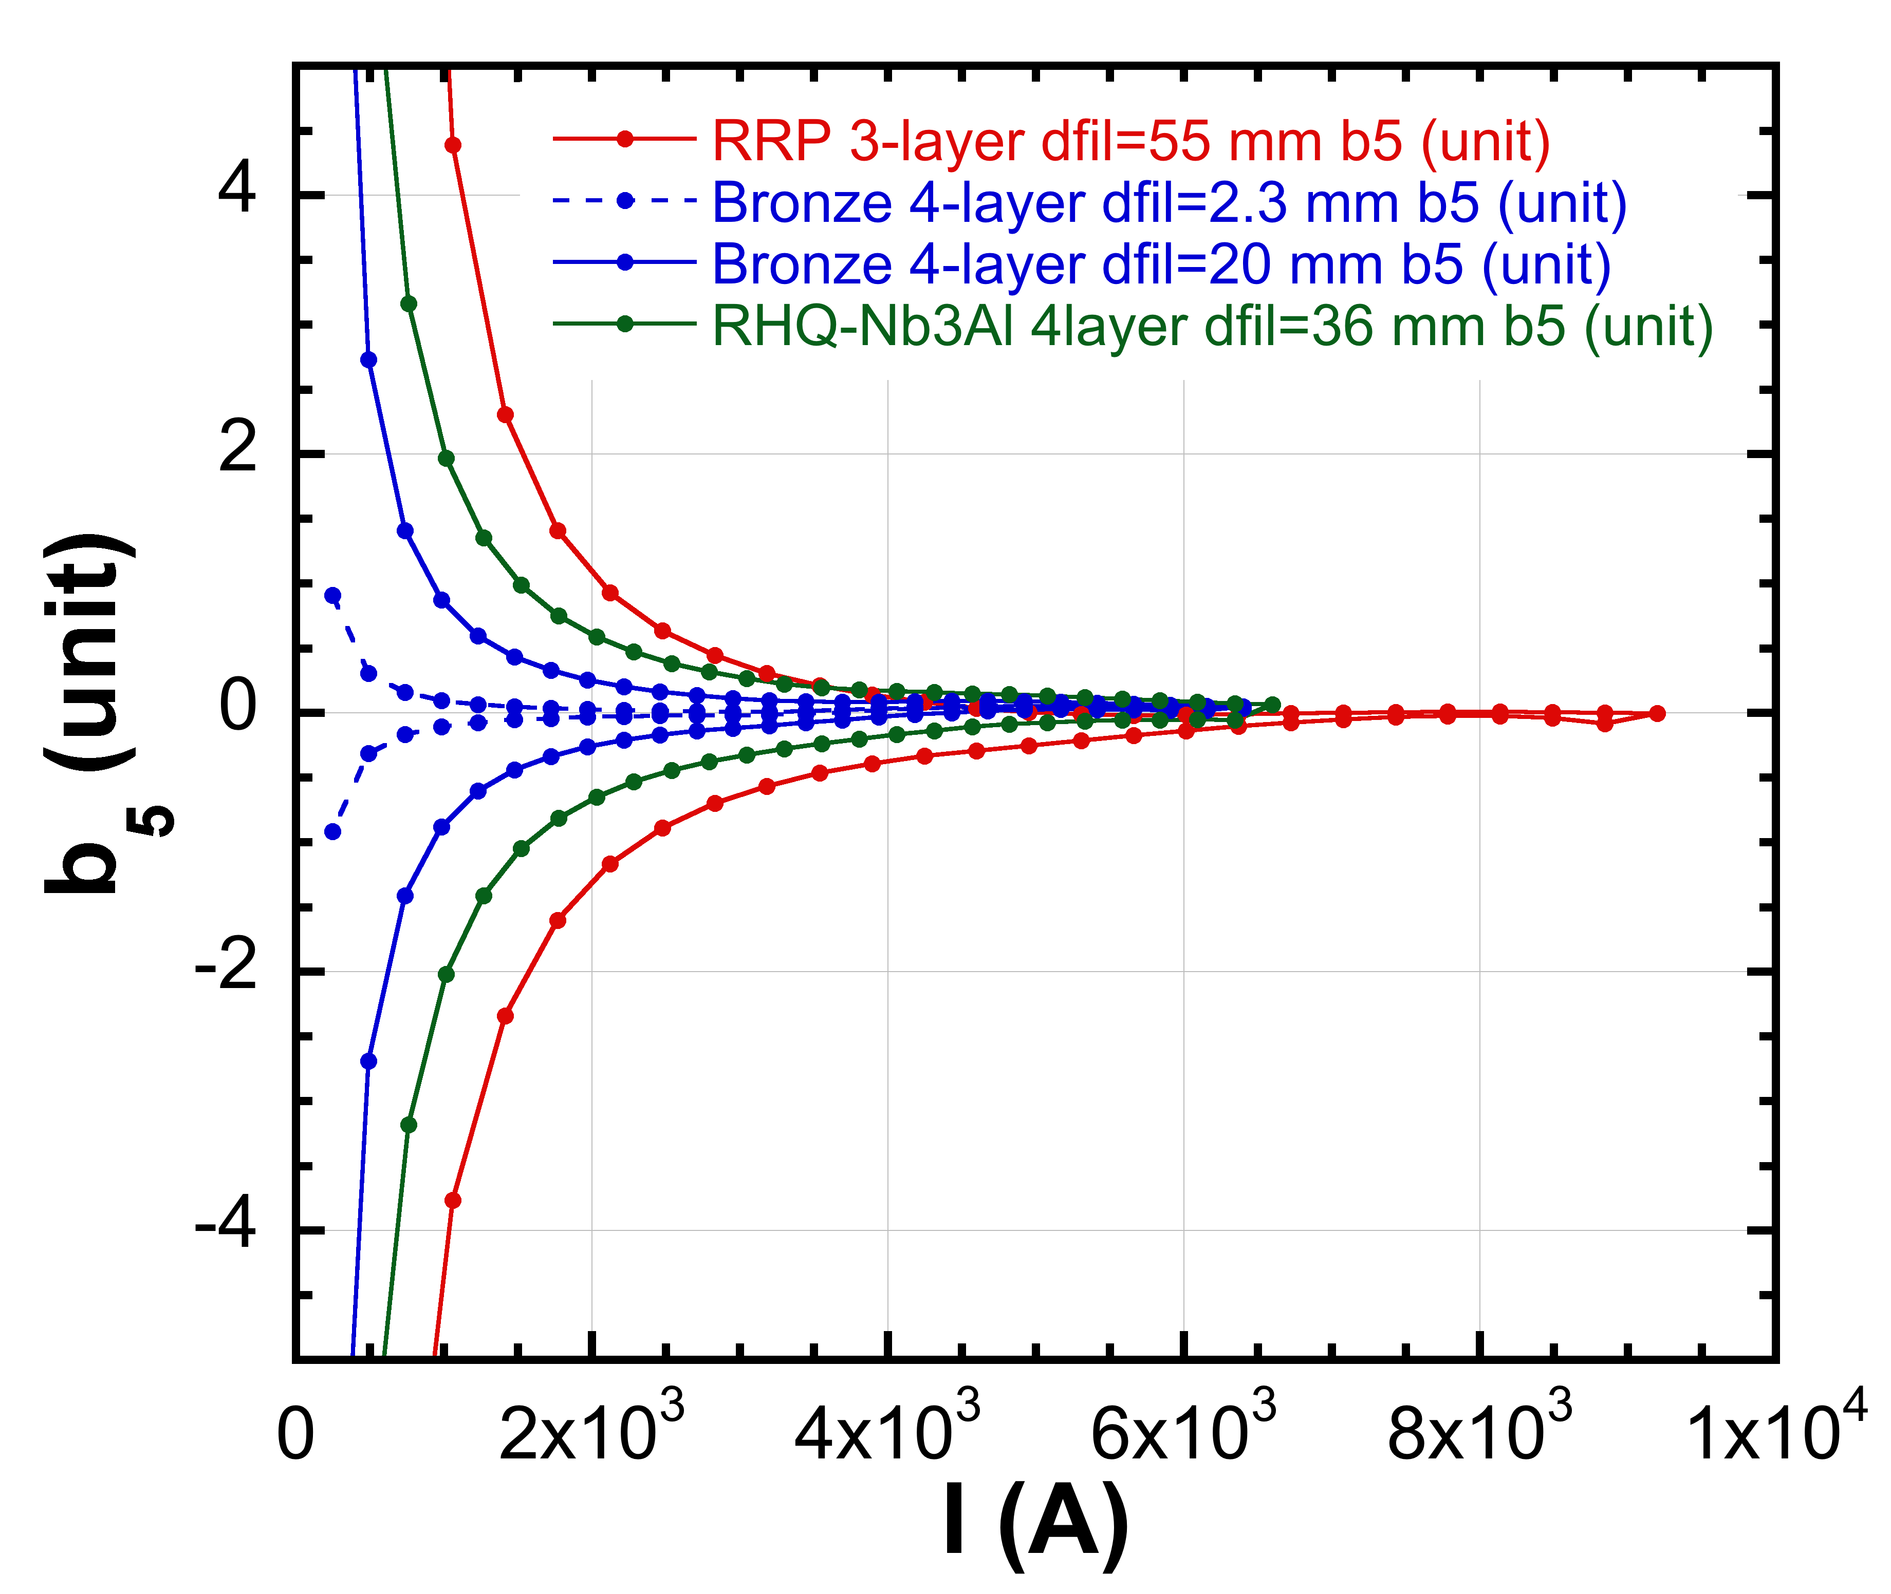
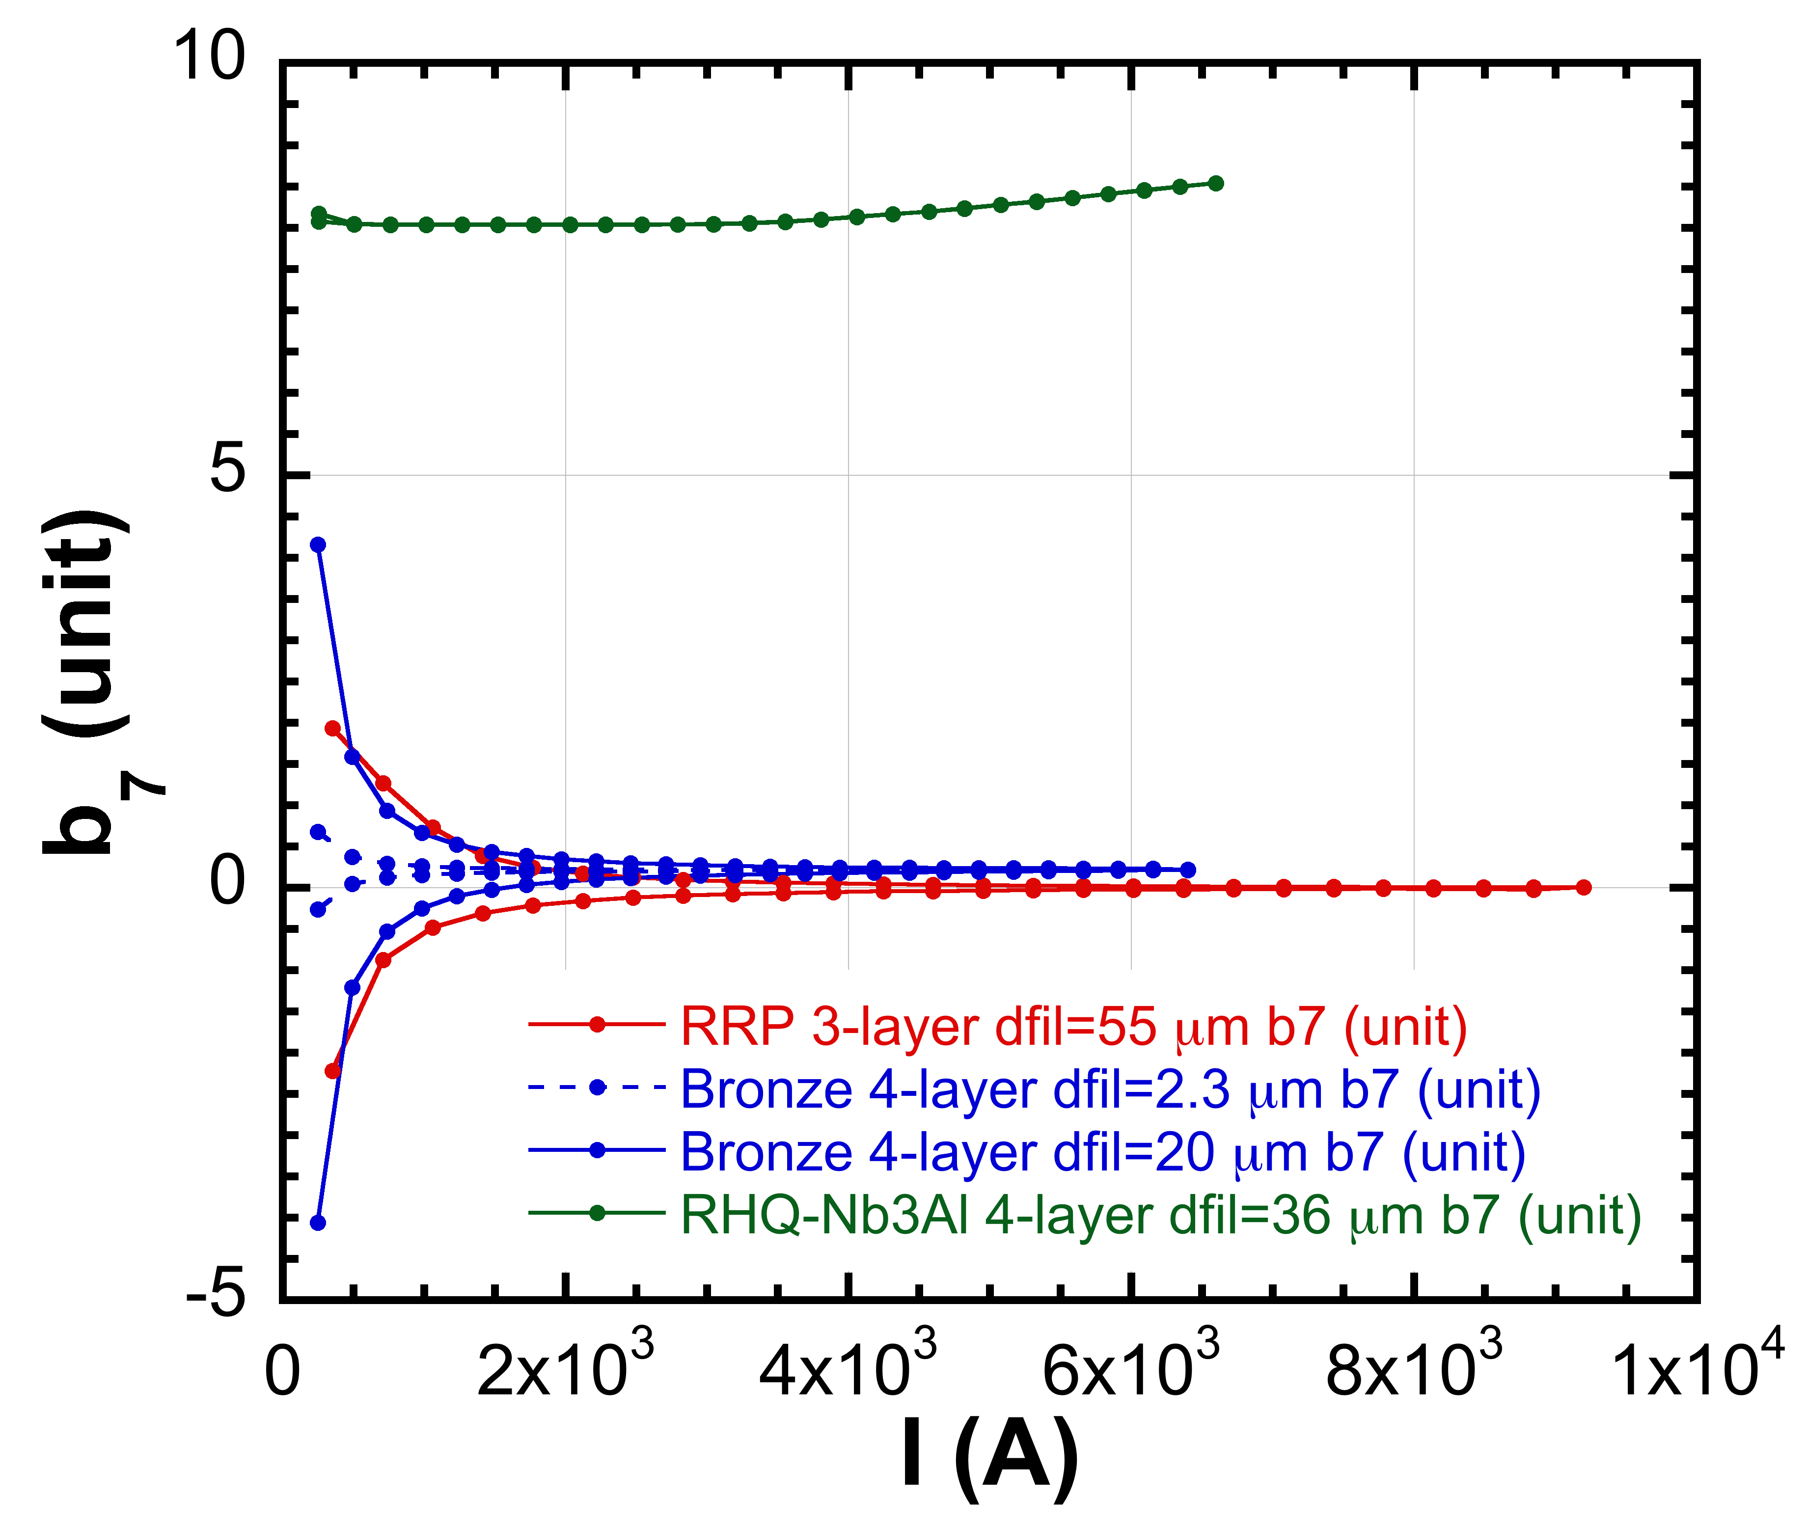
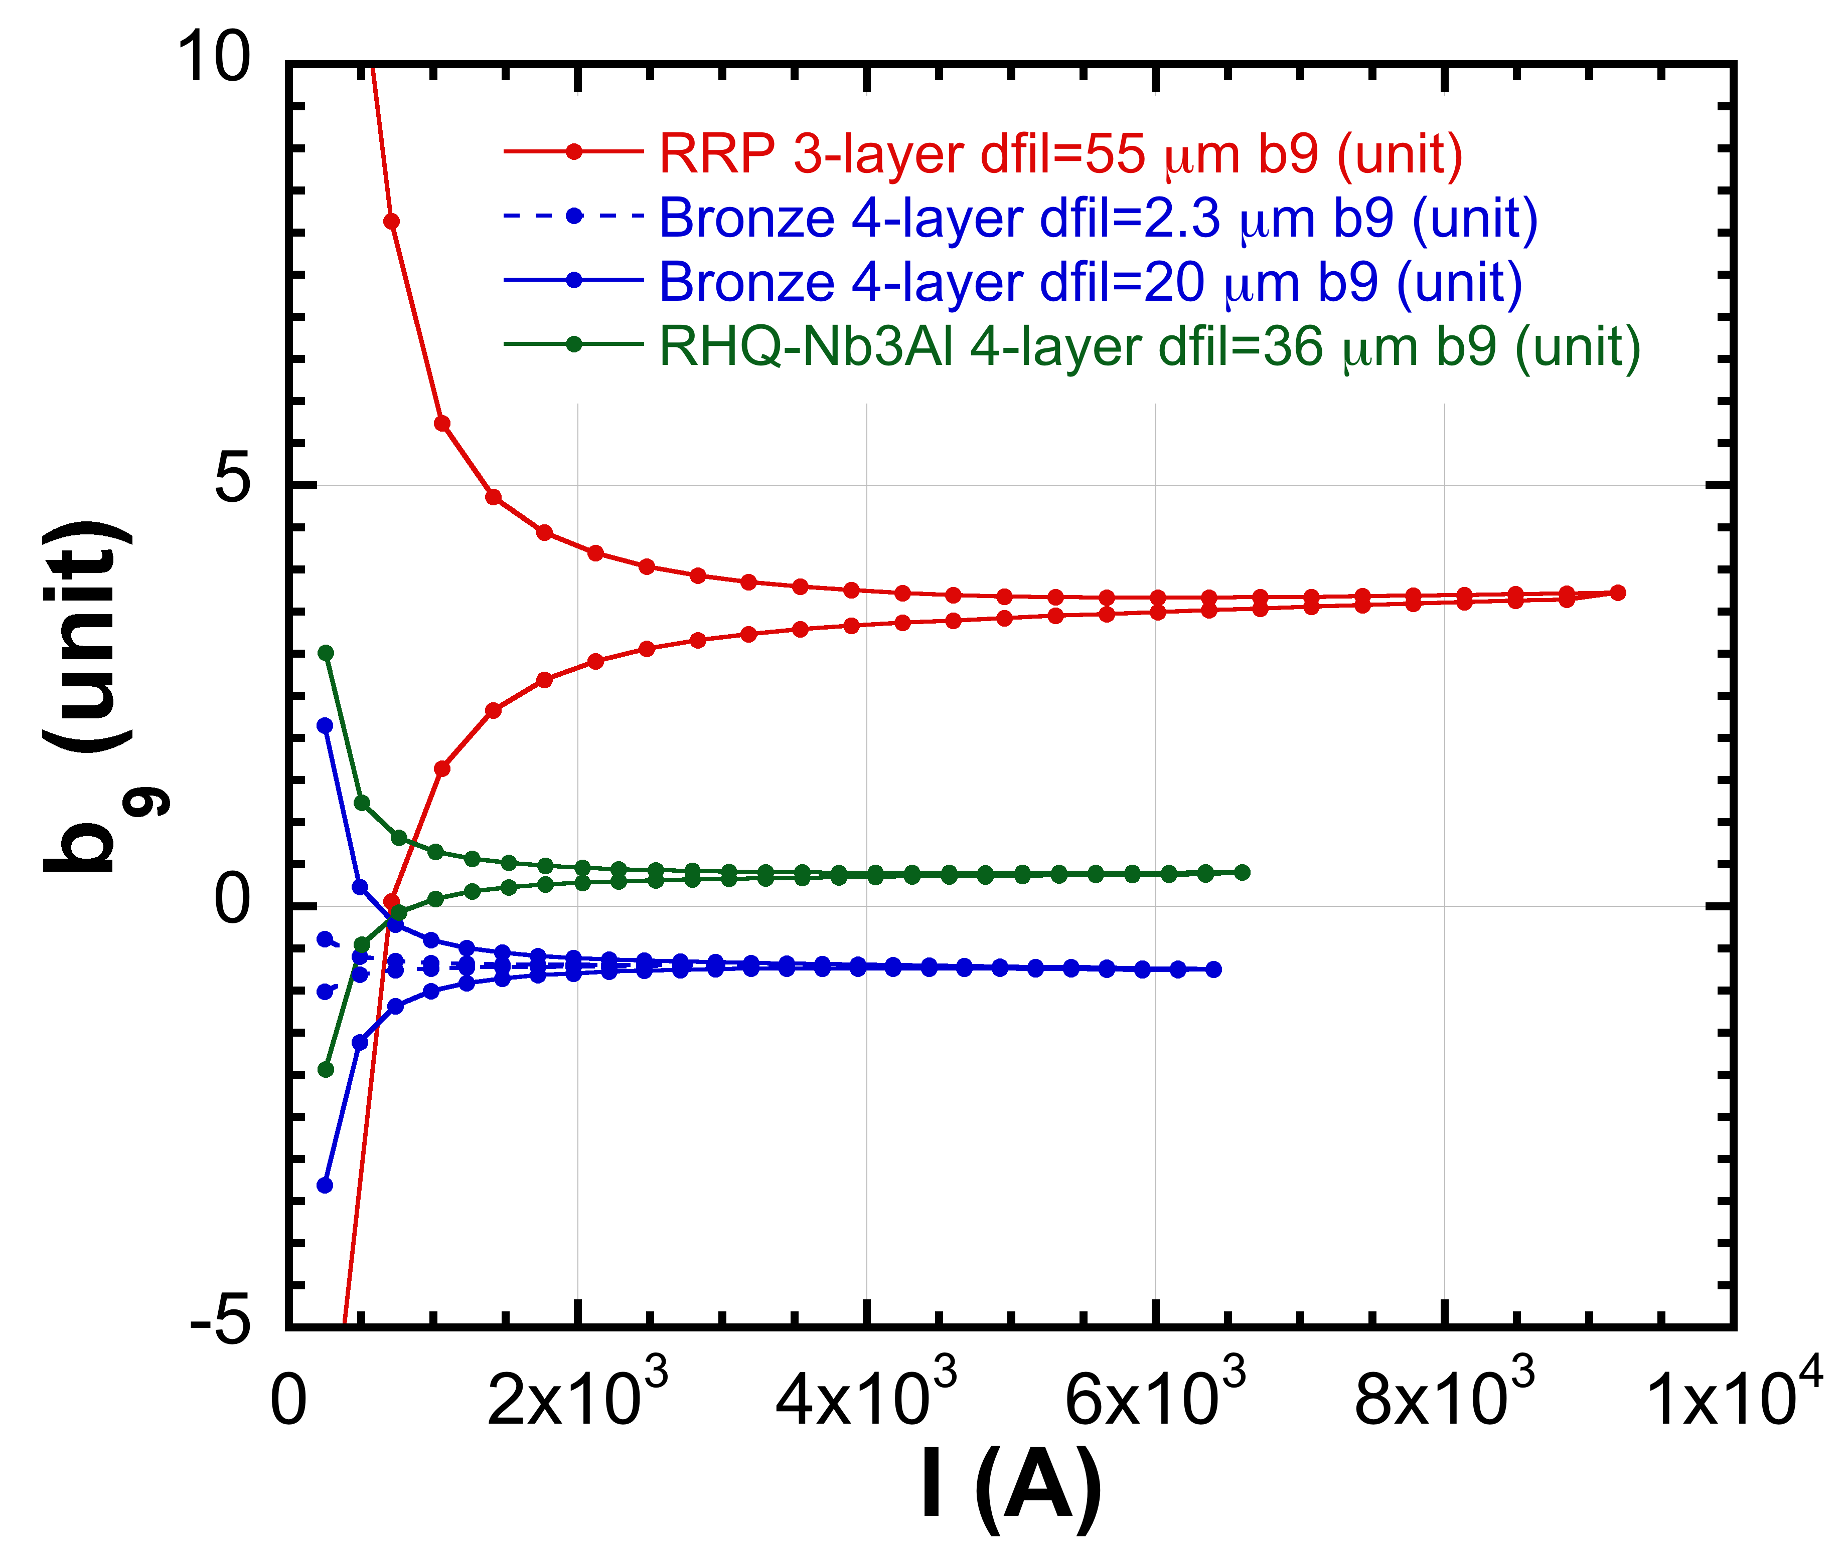
Field Quality: Magnetization, Saturation
b₇
b₅
b₉

Slide 18
Summary
Conceptual design study of 12 T beam separation dipole (D1) for FCC has been carried out.
  Several case studies using different type of A15 conductors.
Among them, 3-layer coil with RRP-Nb₃Sn (w/ present Jc performance) would be a good candidate.
  Either present bronze-Nb₃Sn or RHQ-Nb₃Al will not be applicable.
Mechanical analysis will be needed.
“Stand-alone” D1 could be energized with dump resister. But dump resister allowing terminal voltage of 1 kV cannot protect the magnet in case of quench with conductor MIITs ~14 (RRP).
  QPH must be needed for all cases.

