Slide 1
Advancing Measurement for Breakthrough Science
A Company Overview

Slide 2

Lake Shore is committed to
our customers’ pursuit of the
science that benefits mankind

Slide 3



Advancing Research
Advancing Testing
Advancing Aerospace
Measure with Confidence
Explore New Frontiers
Reliable Results
Reliable Measurements
for Breakthrough Science
Reliable Testing for
Dependable Quality Control
Reliable Performance
Under Extreme Conditions
Notes:
Proven in mission critical applications
Precise temperature measurement
in ground and flight systems

Slide 4
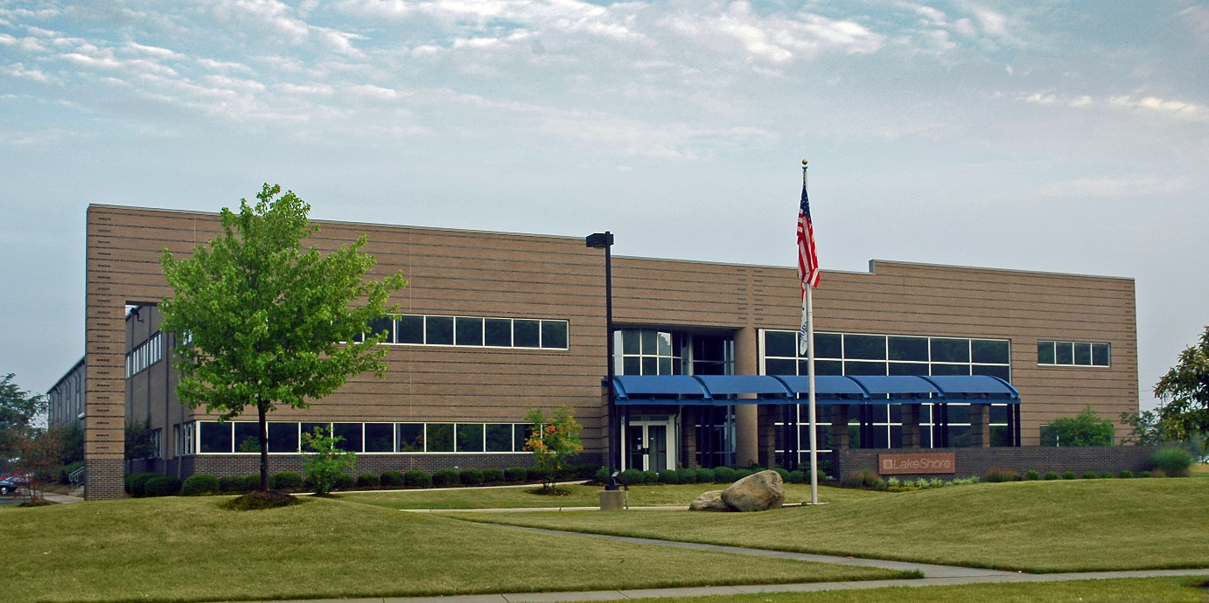
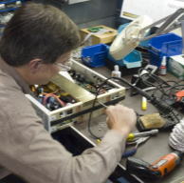
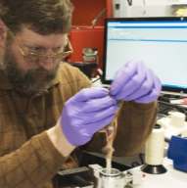
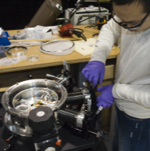
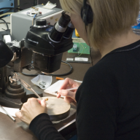
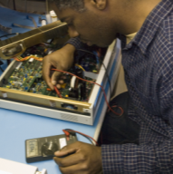
Company Profile
Established and dependable
Over 45 years in operation
  HQ near Columbus, OH, USA
ISO 9001 quality system
Readily available technical expertise to support your work
  Over half of our employees have degrees in physics, engineering, or materials science

Slide 5
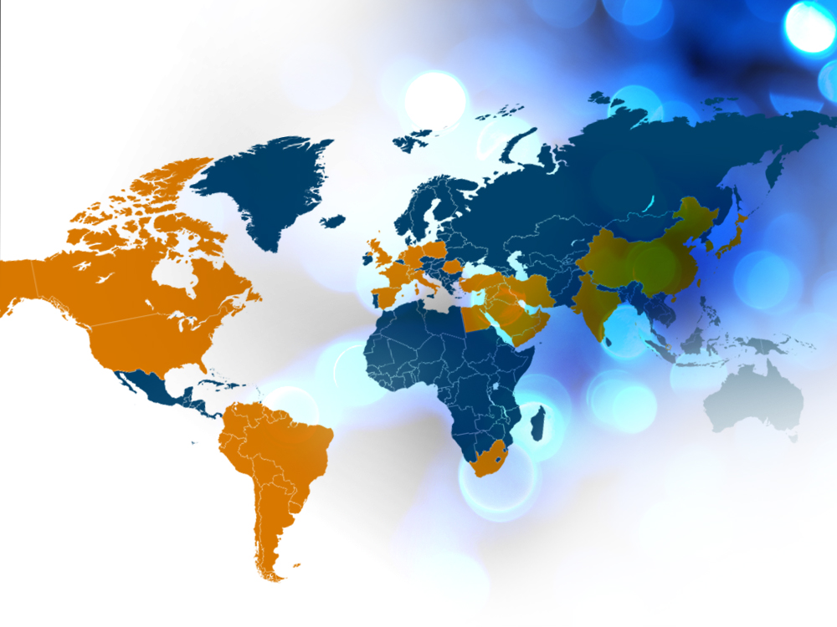
Advancing Science Globally
Over 60%
of sales are
Exports
Local technical
experts globally
= LS coverage
= Rep/dealer
|
Confidential Lake Shore Cryotronics, Inc.
Notes:
Japan
China
Korea
Taiwan
Singapore
India
Middle East
South Africa
Canada
South America
Germany
UK
France
Switzerland
Italy
Spain
Holland
Poland
Romania

Slide 6

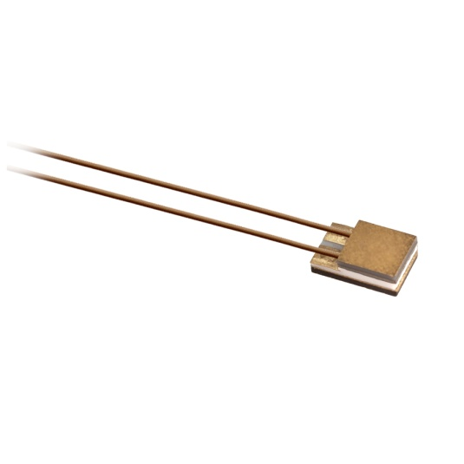
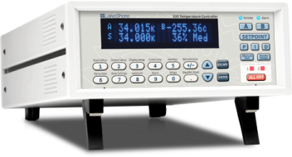
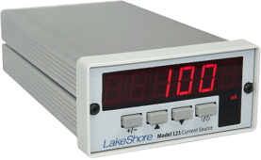
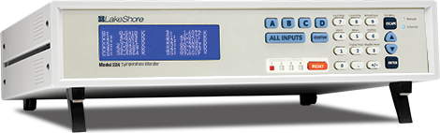

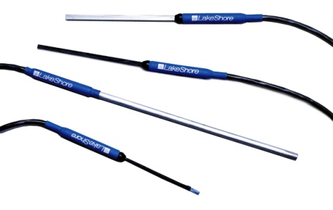
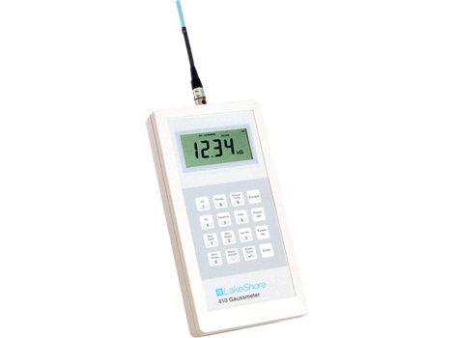


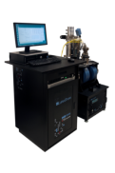
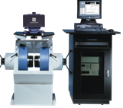
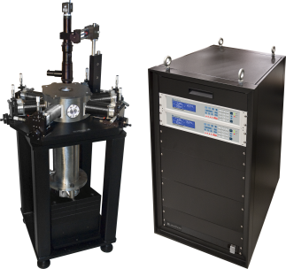
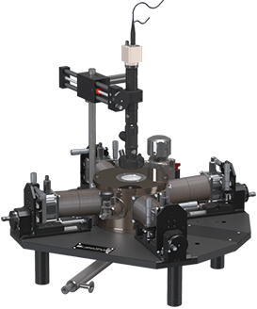
Core Competencies
Precision sensors, instruments, and
measurement systems for science & research
Temperature
Measurement
Magnetic Field
Measurement
Material
Characterization
Systems
Notes:
Temperature products: World-respected accuracy, stability, and performance
Magnetic products: Precision monitoring and control, with intuitive operation
System products: Integrated solutions for material characterization
Our products have been used in some of the most well-recognized research underway today…

Slide 7

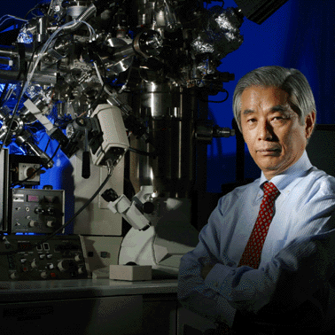
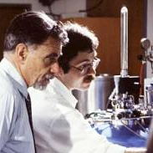
Supporting Significant
Scientific Accomplishments
Dr. Sumio Iijima
Inventor of the carbon nanotube
CERN LHC
Particle Accelerator
National Ignition Facility
NASA James Webb
Space Telescope
Alex Mueller & Georg Bednorz
Nobel Prize in Physics in 1987 for work
in high temperature superconductivity

Slide 8

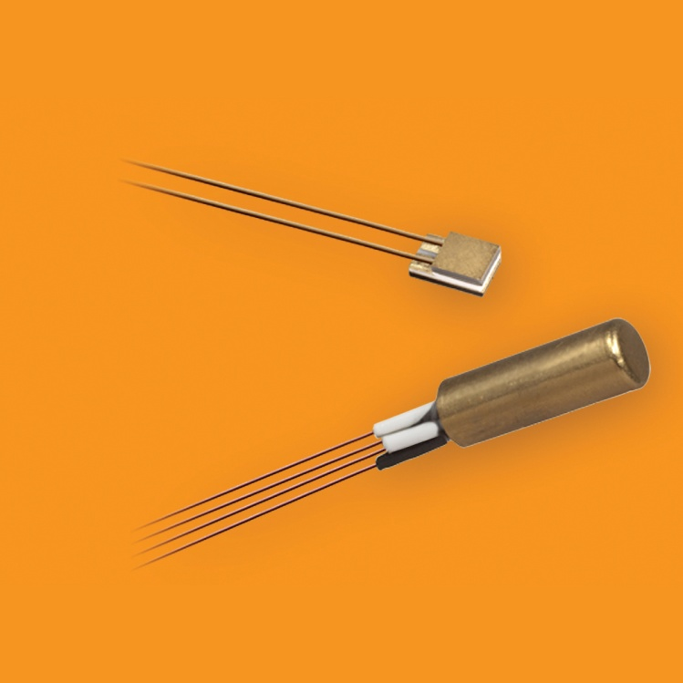
CERN LHC
Particle Accelerator
About 5,400 Cernox™ sensors used to
monitor superconducting magnets
SWITZERLAND
8
|
Confidential Lake Shore Cryotronics, Inc.

Slide 9

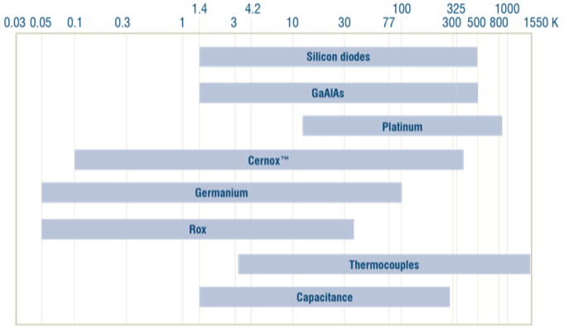






Cryogenic Temperature Sensors
Silicon diodes
GaAlAs
GaAlAs Diodes
Silicon Diodes
Platinum
Cernox™
Germanium
Platinum
Rox™
Thermocouples
Germanium
Capacitance
Cernox
Capacitance
Ruthenium Oxide

Slide 10
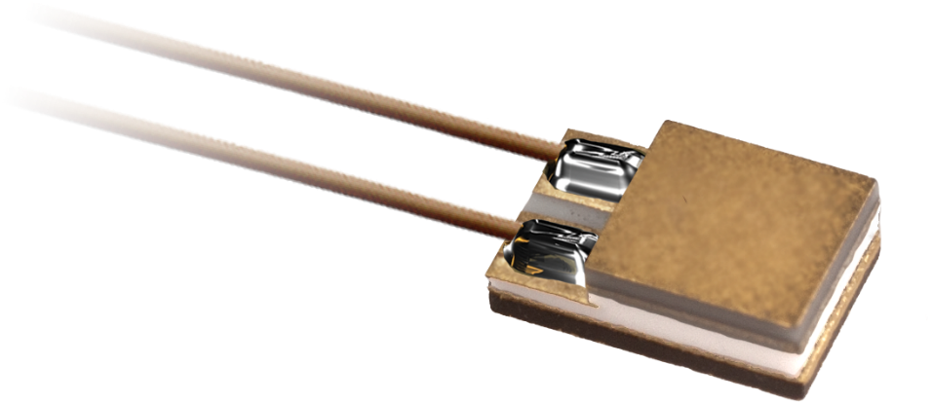
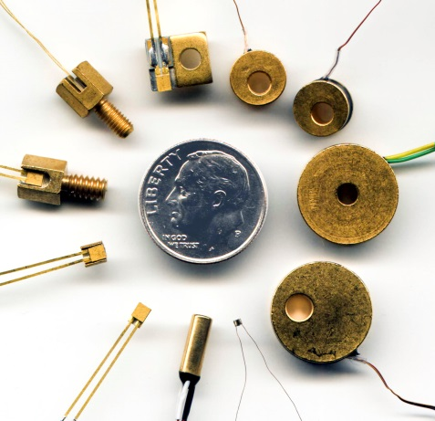
Cernox™
Thin film cryogenic RTDs
Small size
Fast thermal response
Low magnetic ﬁeld induced errors
Excellent resistance to ionizing radiation
High sensitivity at low temperatures
Excellent stability
Variety of packaging options
Proven and trusted globally

Slide 11
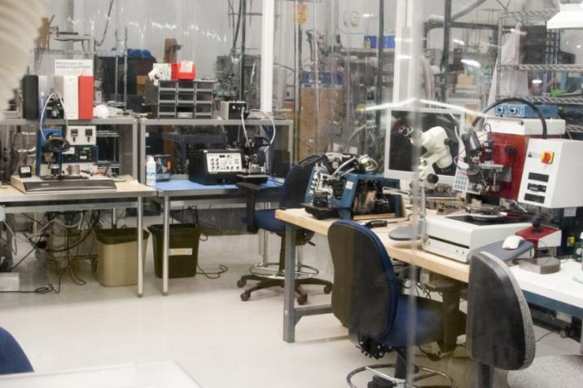
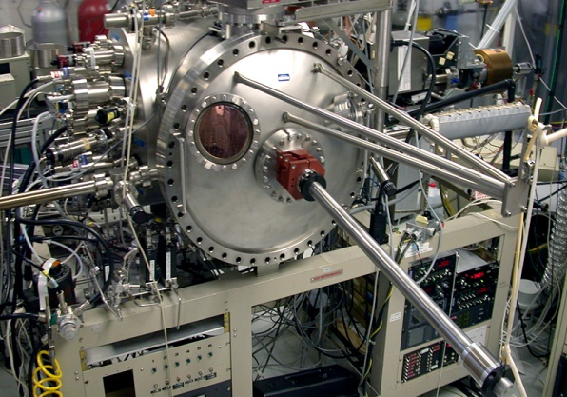
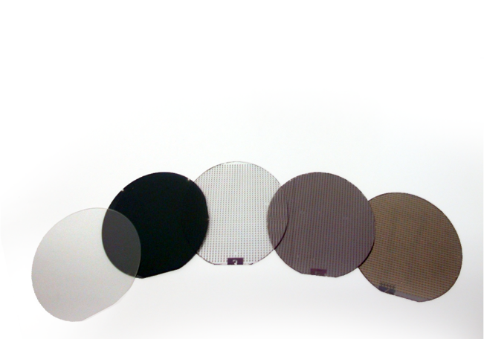
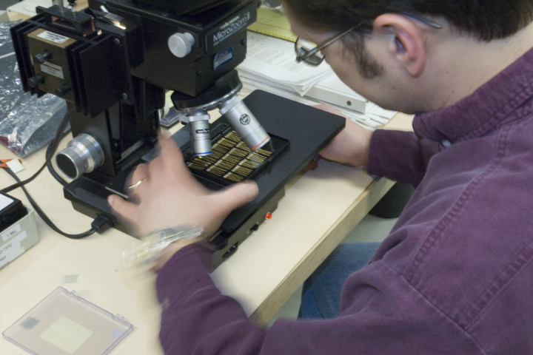

Sensor Manufacturing
Extensive in-house thin-film sensor development and production capability
Packaging
Device Fabrication
Thin film deposition
Wafer characterization
Lithography
Dicing, wire bonding
Packaging, hermetic sealing
Lead attachment
QC and calibration
High reliability screening
Customization
Deposition
QC
Lithography
Lead attach

Slide 12
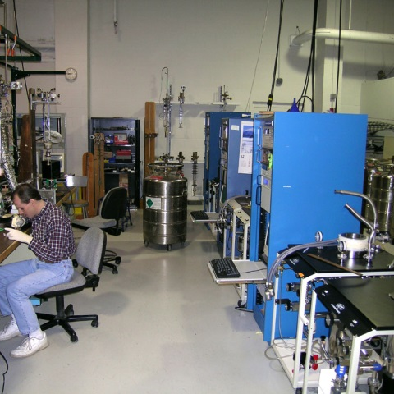
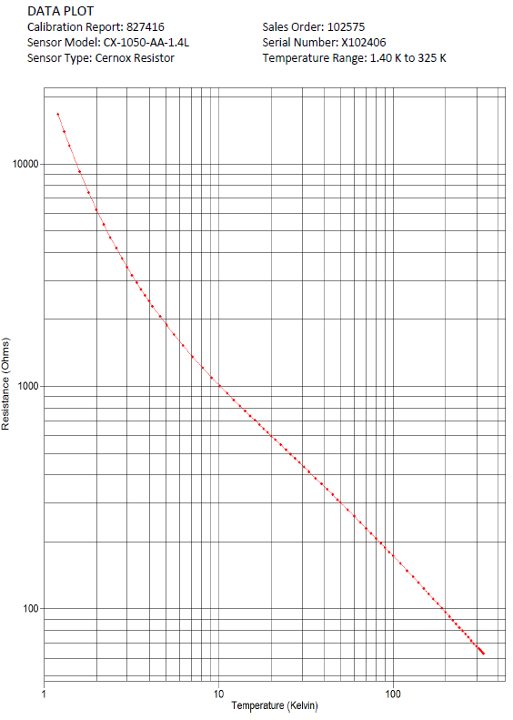
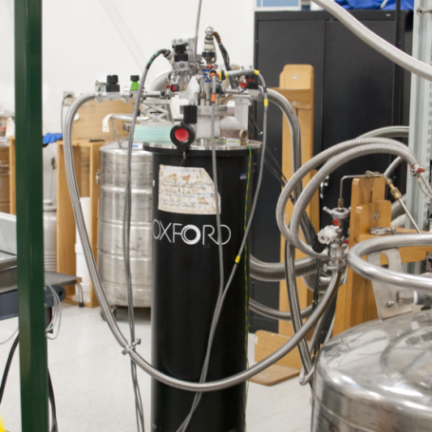
Calibration Services
Lake Shore operates one of the most advanced temperature sensor calibration facilities in the world
Cryogenic Capability
  Dilution refrigerators for sub 20 mK calibration
  Referenced to NIST, NPL, & PTB standards
High Temperature Capability
  Up to 900 K
Sensor Calibration Facility
Dilution Refrigerators
ITS-90 and PLTS-2000 standards maintained on standard platinum (PRT), rhodium-iron (RIRT), and germanium (GRT) resistance thermometers
Standards calibrated directly by an internationally recognized national metrology institute (NIST, NPL, PTB) for T < 330 K or an ISO 17025 accredited metrology laboratory for 330 K < T < 800 K.
A nuclear orientation thermometer is also used for temperatures less than 50 mK.

Slide 13
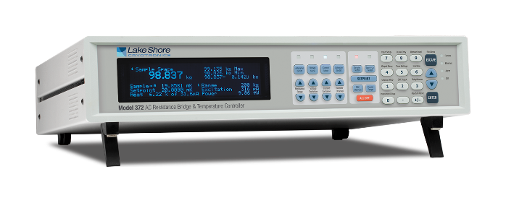
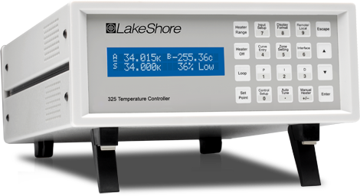
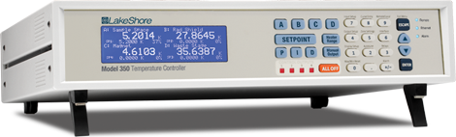
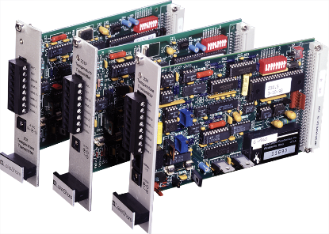
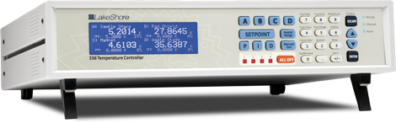
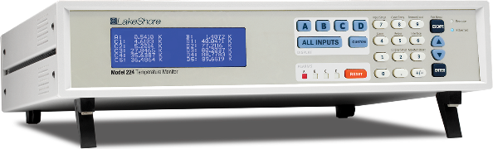
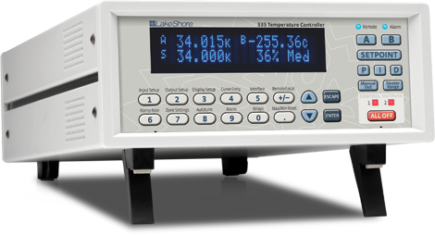
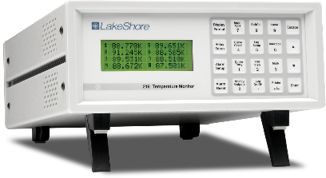
Cryogenic Temperature Controllers & Monitors
Model 325
Low Cryogenic
Temperature Controller
Model 350
Ultra-Low Cryogenic
Temperature Controller
Model 372
AC Resistance Bridge and
Temperature Controller
Model 335 & Model 336
Advanced Low Cryogenic
Temperature Controllers
Model 224
12-Channel Cryogenic
Temperature Monitor
Model 218 and transmitters
8-Channel Cryogenic Temperature Monitor and Transmitter Cards

Slide 14
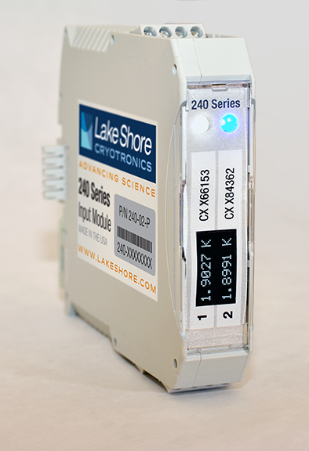
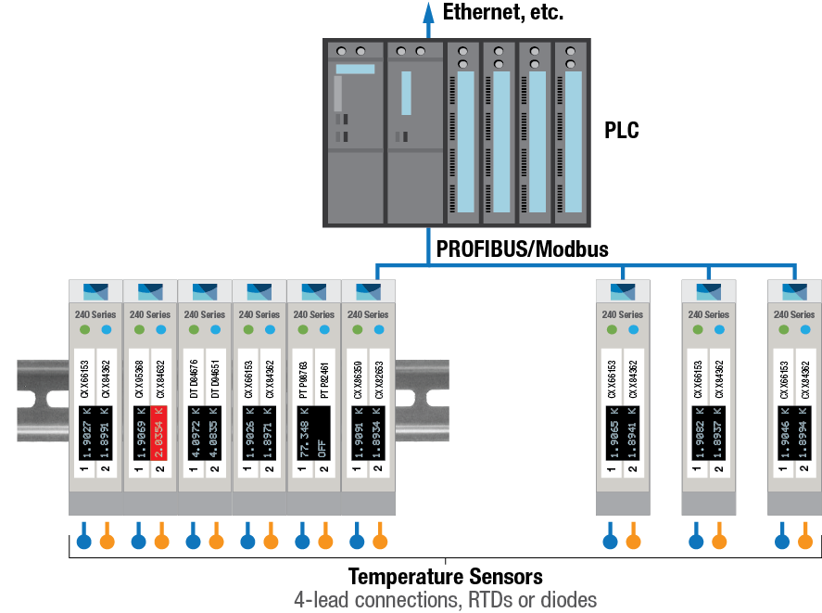
NEW—Cryogenic Sensor Input Modules
Distributed temperature measurement for large applications
DIN rail mountable modules
2 sensor inputs/module
  Cernox™ RTDs
  Diodes
  Platinum RTDs
4-wire measurement
On-module conversion to
temperature units
Fieldbus network interfaces
  PROFIBUS-DP
  Modbus
Lake Shore 240 Series
Cryogenic Sensor Input Module

Slide 15
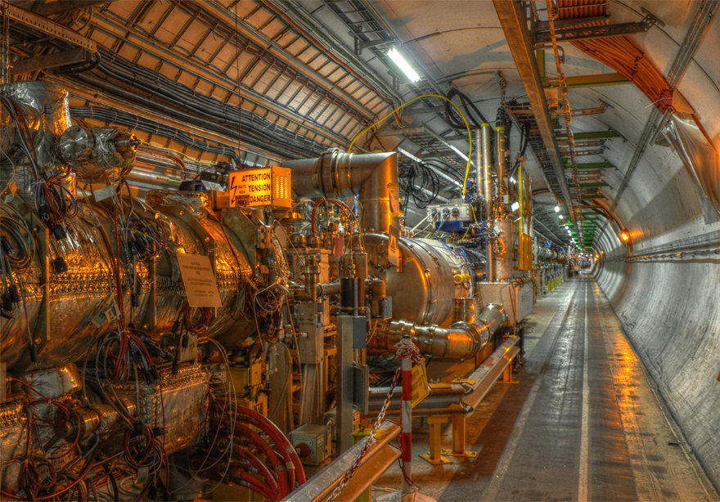
Reference “Big Physics” Projects
Projects
Accelerators
  LHC at CERN – Switzerland (about 5,400 Cernox™)
  SNS at Oakridge National Lab – U.S.
  SLAC at Stanford – U.S.
  LCLS and others at Fermilab – U.S.
  Advanced Photon Source at Argonne National Lab – U.S.
  (Cernox)
  FAIR – Germany
  SRF LINAc at IFMIF (about 60 Cernox)
  STF at KEK – Japan (about 80 Cernox)
  FEL at DESY – Germany (Cernox)
  CEBAF Linac at Thomas Jefferson Nat’l Lab – U.S. (Cernox, diodes)
  Superconducting Ring Cyclotron at Riken – Japan (Cernox)
Fusion Reactors
  ITER – France
  NIF at Lawrence Livermore National Lab – U.S.
  KSTAR – Korea (about 400 Cernox)
  W7x at Max Plank – Germany (Cernox)
Other
  ALMA radio telescope – Chile
  Dozens of unmanned research satellites (NASA, etc.)

Slide 16
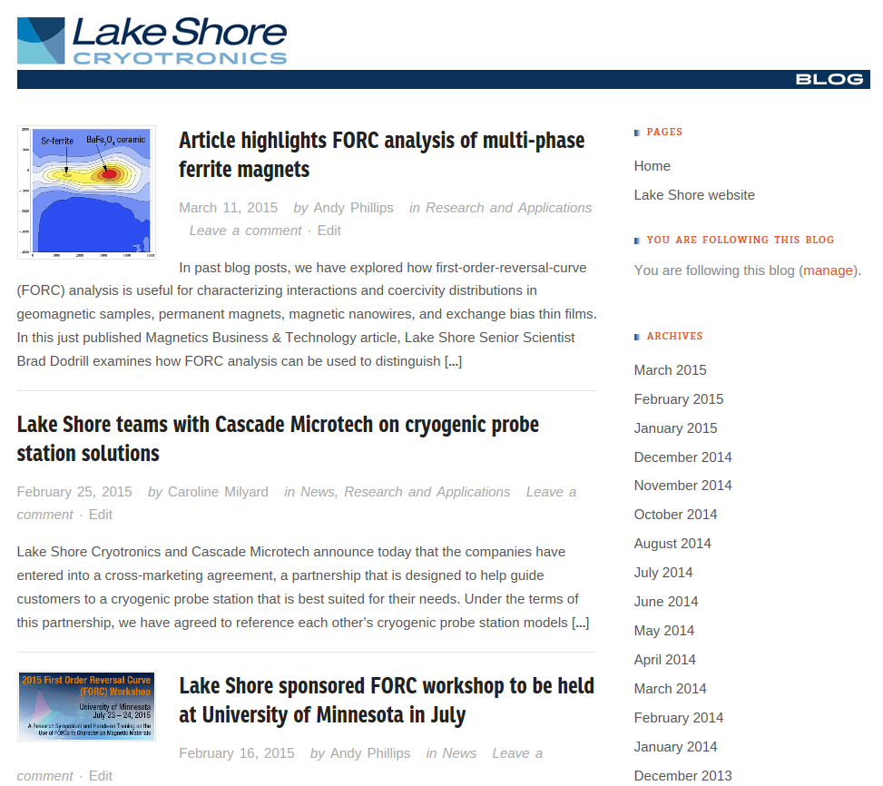
Contact Us
Contacts
www.lakeshore.com
  Detailed product and application information
  Local contacts
sales@lakeshore.com
  Tell us what you need
Lake Shore Blog
  Recent happenings, new products, customer papers
2015 Conferences
  All of the major cryogenics, magnetics, and physics conferences—
  check our website for upcoming events

