Slide 2
Rad-hard warm magnets
P. Fessia, N. Mariani, A. Sanz Ull, D. Tommasini and the whole TE-MSC-MNC section
Presented by P. Fessia
Contributions on the LHC from
Fluka analysis: Francesco Cerutti, Anton Lechner, Eleftherios Skordis
Collimation input: Rodrick Bruce, Stefano Redaelli, Belen Maria Salvachua Ferrando, Elena Quaranta
MNC team: Paolo Fessia, N. Mariani, Pierre Alexandre Thonet, D. Tommasini
Power Converter: Hugues Thiesen
Optics: Massimo Giovannozzi
MME design office: L. Favre, T. Sahner
VSC: E. Page, N. Zelko
Magnetic Measurement team: M. Buzio

Slide 3
LHC→HL-LHC→FCC
LHC
30-50 MGy
HL-LHC
250-300 MGy
FCC
Where ?

Slide 4
LHC or re-acting

Slide 5
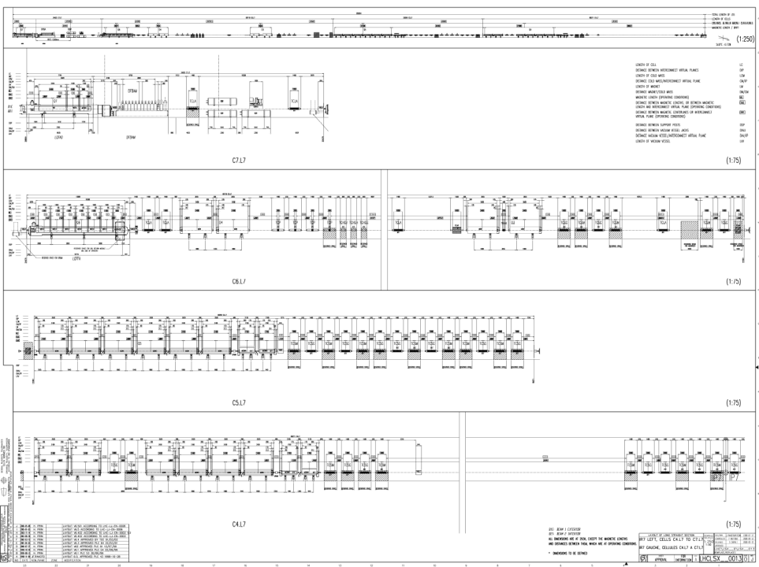
MQW: Magnet Quadrupole Warm
MBW: Magnet Bending Warm
Point 7

Slide 6
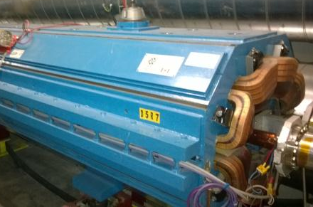
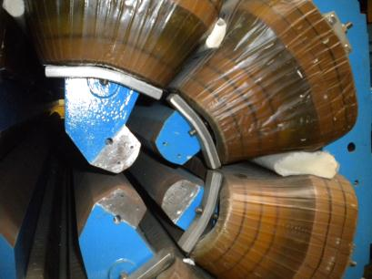
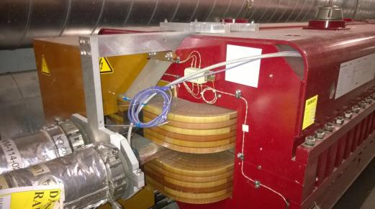
Identified Failure modes
Degradation of the insulation system due to radiation leading to inter turn short or shorts to ground
Remark magnet build with no coil on the mid plane and therefore out from the expected zone of highest losses
Degradation of the insulation system due to radiation leading to inter turn short or shorts to ground
Degradation of the mechanical shimming performed with ambient temperature cured resins

Slide 7
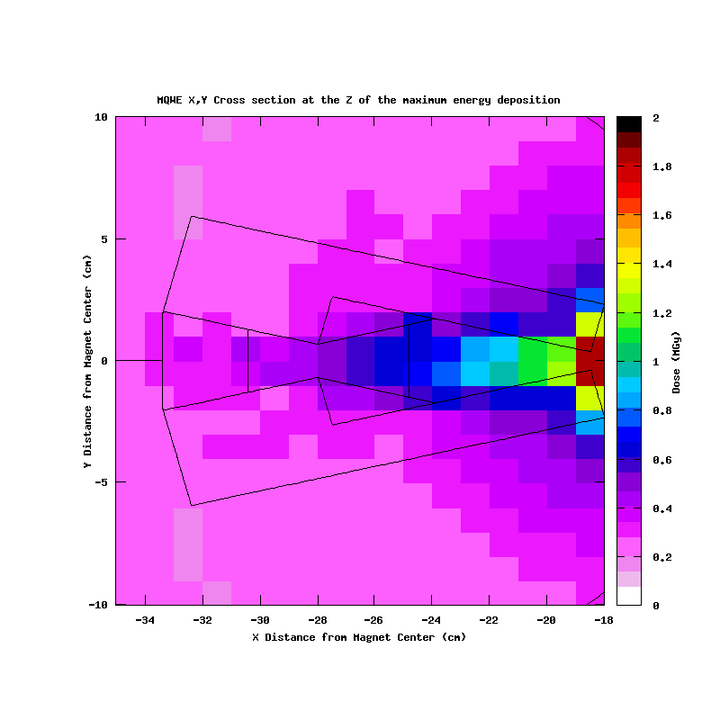
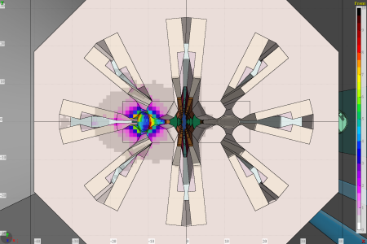
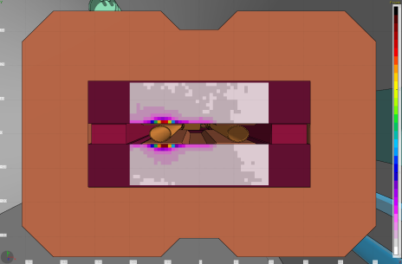
Type of deposition map
Dose (MGy)
Dose (MGy)
Normalization: 1.15 10¹⁶ p (30-50 fb⁻¹ ).
Computations with E 6.5 TeV relaxed collimator settings

Slide 8
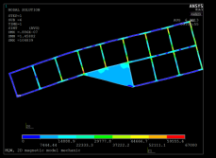
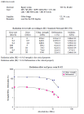
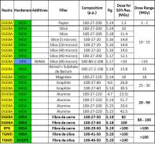
Radiation resistance dose estimation
Degradation of mechanical properties appears and it can be measured before degradation of electrical properties
Actions of the fillers on the radiation resistance
Results mechanical test of the irradiated used resin or similar one
Value of mechanical load in the insulation
Estimation of the level of resistance of the insulation system to radiation
But …
What is the effect of the insulation thickness on the degradation ?
We know that exposure to air during irradiation should make the larger the damage.
How much ?
Worth re-evalauting the correlation between electrical and mechanical properties degradation

Slide 9
Point 3 and 7 coil magnet damage estimation
IP 3
IP 7
MQW | MBW
From 10 to 20 MGy | From 40 to 60 MGy
From 20 to 50 MGy | From 60 to 80 Mgy
Larger than 50 MGy | Larger than 80 MGy

Slide 10
Preparing HL-LHC or acting

Slide 11
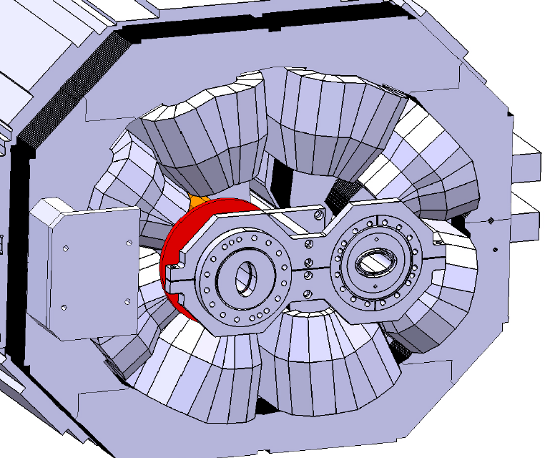
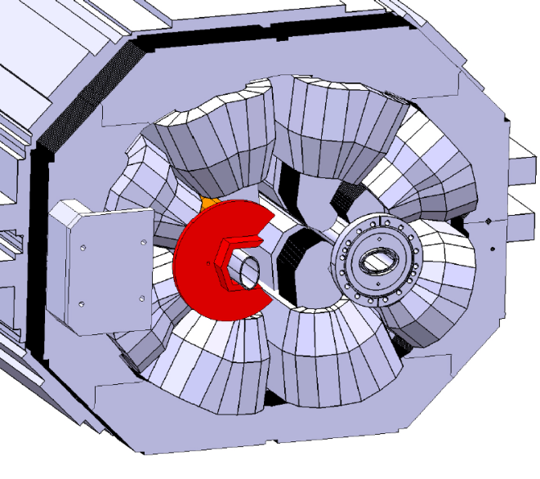
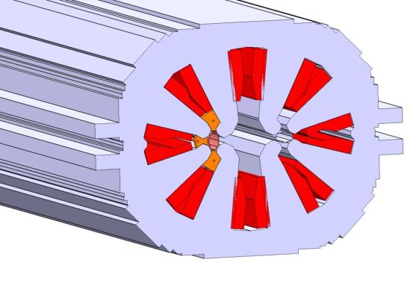
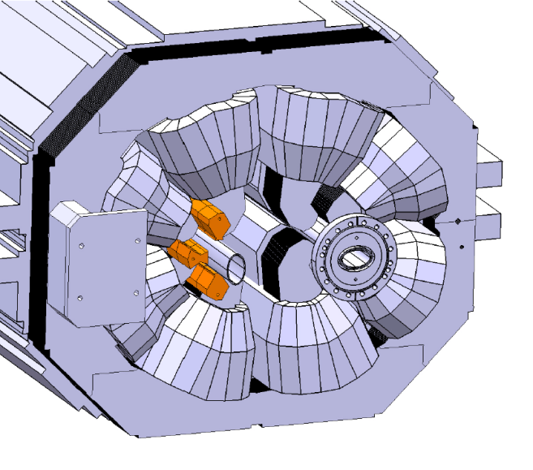
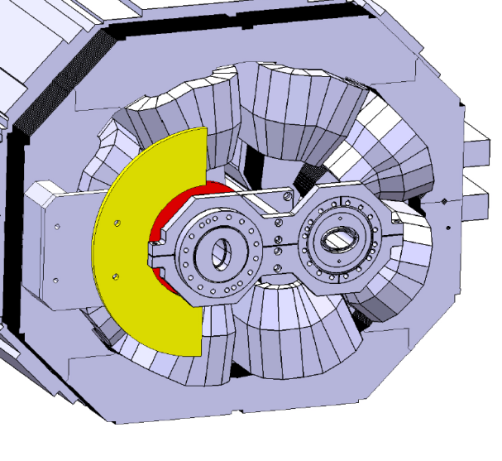
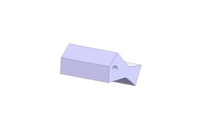
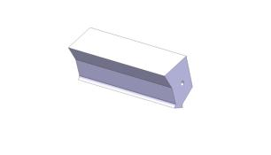
MQW shielding

Slide 12
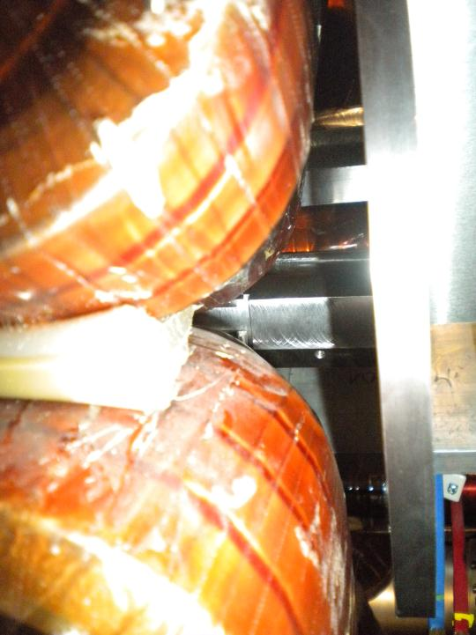
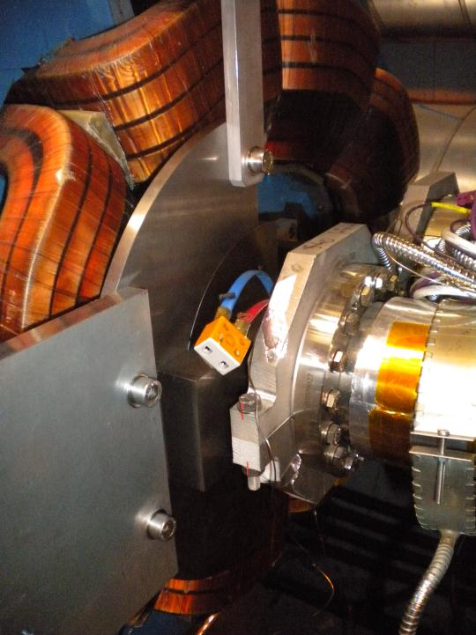
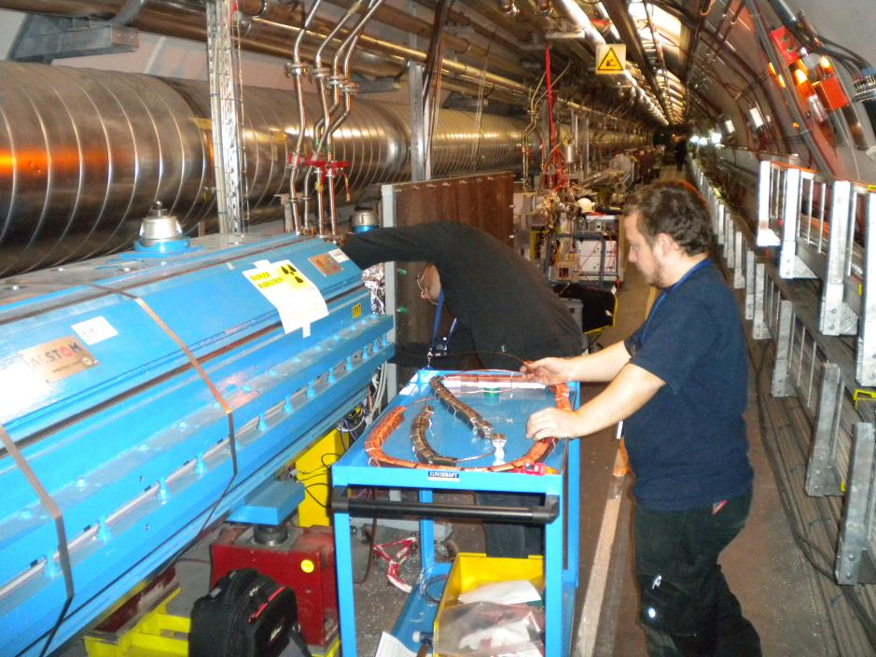
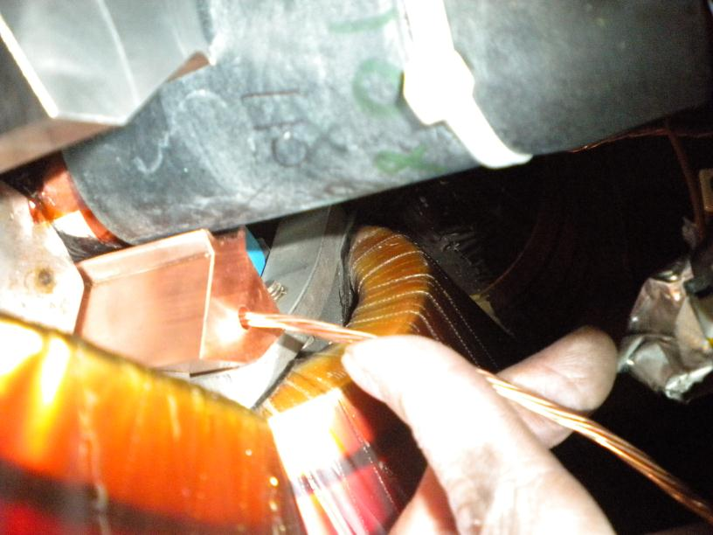
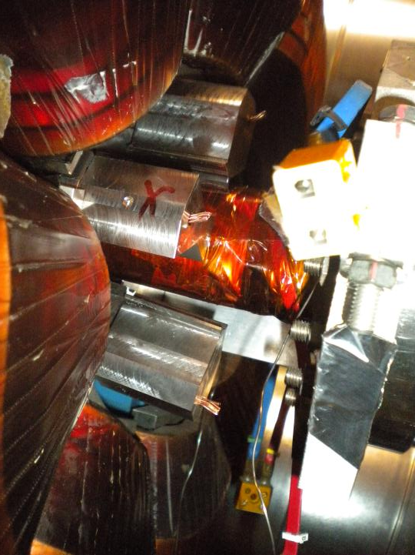

Slide 13
MQW shielding effect on the coil
Normalization: 1.15 10¹⁶ p (50 fb⁻¹ )
Beam 2
Beam 2
Reduction Factor 3 on most exposed magnet with the hardest spectra. It shadows 20 % the radiation on the following magnet
Reduction Factor 4 on less exposed magnet with the softer spectra.

Slide 14
Point 3 and 7 coil magnet damage estimation with shielding green arrow installed LS1 yellow arrow foreseen for LS2
IP 3
MQW | MBW
From 10 to 20 MGy | From 40 to 60 MGy
From 20 to 50 MGy | From 60 to 80 Mgy
Larger than 50 MGy | Larger than 80 MGy
IP 7
R

Slide 15
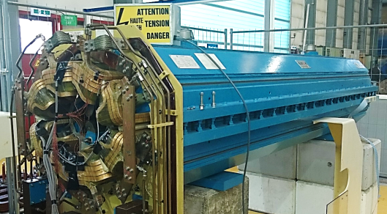
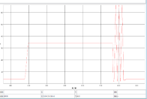
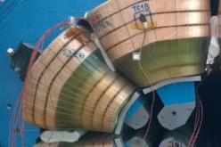
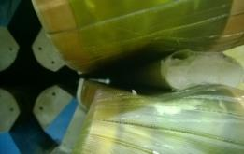
MQW Life Test to the HL-LHC era
Estimation of mechanical induced damage on LHC Warm Quadrupoles
Reproduction of electromagnetic induced stresses on coils, spacers and magnet’s frame to assess life expectation of installed magnets with respect to cyclic loads during LHC operations.
Imposed load: 4 power cycles every LHC physics run, ~47’000 cycles expected up to HL-LHC era end.
Experimental activities:
Measure of coil-coil displacement to identify eventual mechanical degradation (12 positions)
Measure of Temperature evolution (20 positions)
Measure of coils longitudinal and transversal deformation (8 positions)
Electrical verification of the magnet at regular intervals with two complete certifications (at 50% and 100% of foreseen life cycle)
Temperature probes and strain gauges
Coil-coil relative displacement
Work performed in collaboration with: CERN Mechanical Laboratory, CERN Polymer Laboratory and CERN Design Office.

Slide 16
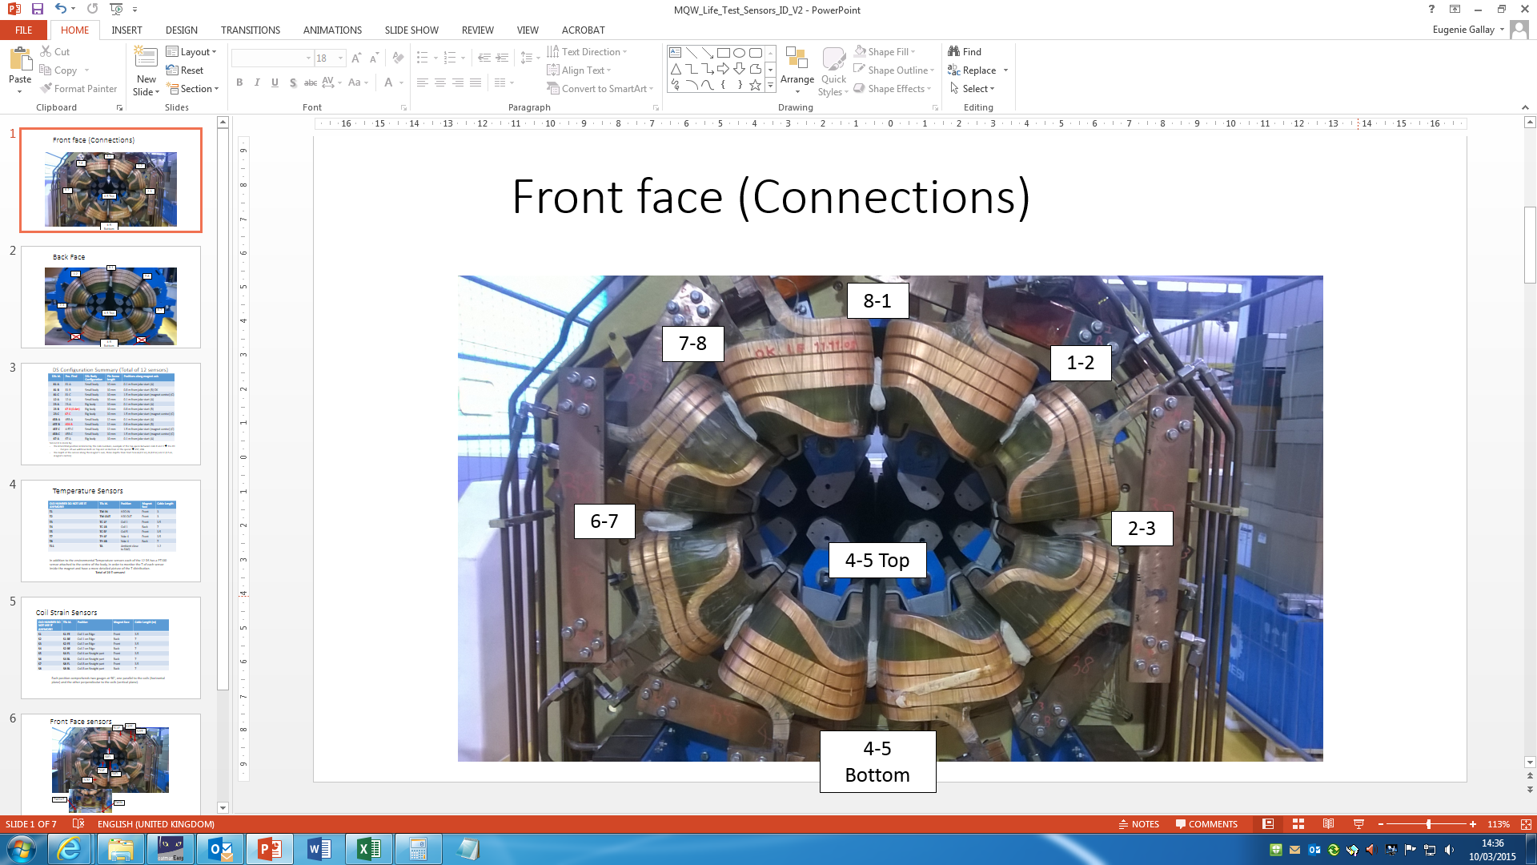
MQW Life Test: first results
Preliminary results up to 25’000 cycles (half of foreseen magnet’s life)
Very stable signal with few oscillations mostly due to T effect.
No influence of em fields or hysteresis effects.
Displacements constant since beginning of test.
Coils Strains giving regular and strong signal.
MQW 038 is well behaving through the endurance test, which is now prosecuting the road to 50’000 cycles (end of HL-LHC era)!

Slide 17
MQW/MBW Coils Insulation Resins Characterization
Additional activities to predict the long term behaviour of the materials used for MQW (and MBW) magnets, including:
Mechanical tests,
Electrical tests,
Microstructural analysis…
All evaluated as a function of received dose (irradiation campaign under preparation)!
Fracture Surface of MQW coils insulation resin sample showing fibres detachment.
Metallographic sample of type E glass fibres embedded in MQW epoxy resin.
Flexural Tests plots courtesy of O. Sacristan De Frutos (CERN Mechanical Laboratory).

Slide 18
FCC and HL-LHC development or pro-acting

Slide 19
Know better
for HL-LHC and FCC
Known margin
Know before

Slide 20
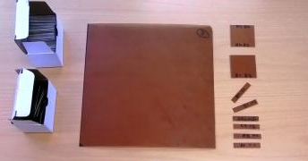
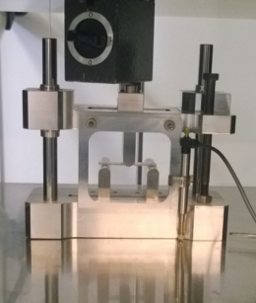
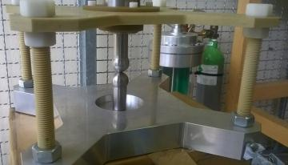
Know better: resin testing from present to future
Presently used insulations systems and new insulation systems

Slide 21
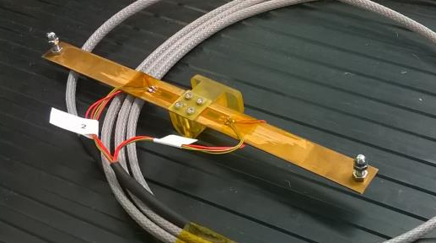
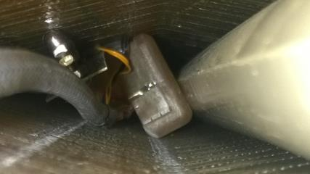
Monitoring the health of the magnet:
DS R&D
High demanding requirements:
High precision and reproducibility over a long number of cycles;
No influence from Temperature and EM fields;
Capable to slide in the small interstitial between MQW coils, adapting to irregular surfaces and locations…
Displacement measured through “Home made CuBe beam based displacement sensors”, in the following DS.
DS are made of a CuBe plate, instrumented with strain gauges and mounted on a support structure in 3D printed polymer.
The DS is then calibrated and inserted inside the magnet along the interstitials between coils up to 1.5 m depth.
Final accuracy achieved ~0.5 microns for excursions of ~4 mm.
➔ The technology can be implemented in different situations by ad hoc designs of the main body and of the CuBe plate geometry…
Strain gauges
3D printed body
30 mm
Measuring pins
CuBe plate
Final sensor inserted between coils 6-7

Slide 22
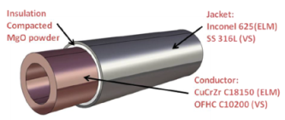
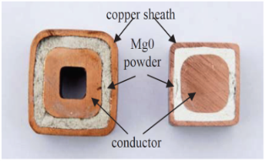
Know margin: rad hard insulation schemes
Organic insulations
Possible schemes
Non organic insulations
Cyanate Esther compounds
High radiation hard epoxy with mica
ITER cables: round shape, tailored design for different machine areas.^{[2]}
S glass fibre
E glass fibre
Hitachi cables used in KEK & PSI: square shape, Cu cladding, different dimensions available. ^{[1]}
22

Slide 23
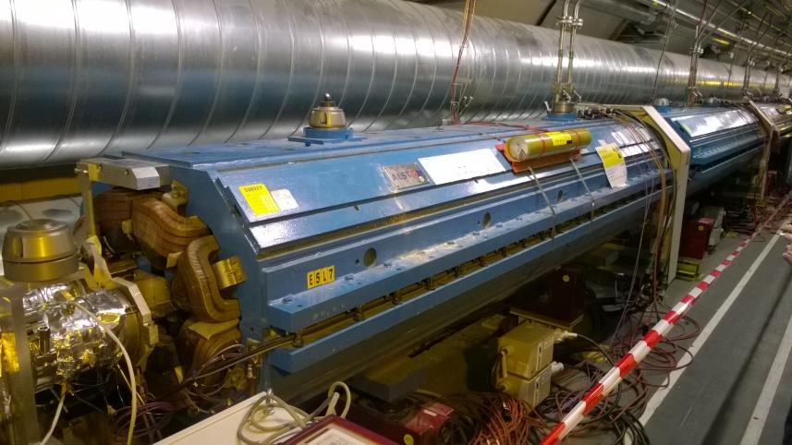
Known margin: the whole magnet
mechanical systems to allow fast or remote handling, alignment, connection and disconnection.
reliable, radiation hard, fast hydraulic fittings, compatible with remote handling
for reliable, radiation hard, fast electrical fittings, compatible with remote handling

Slide 24
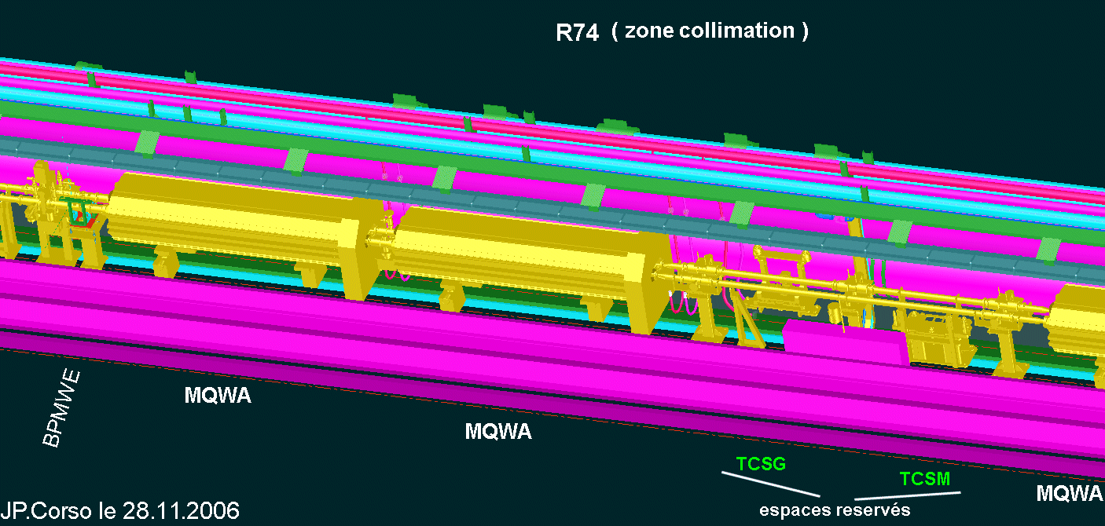
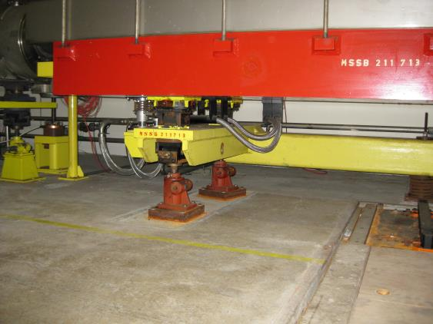
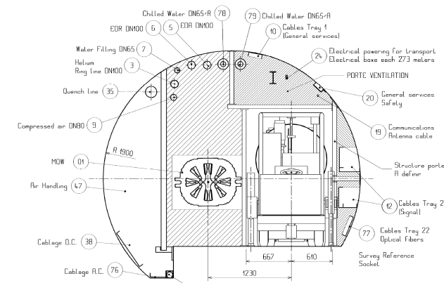
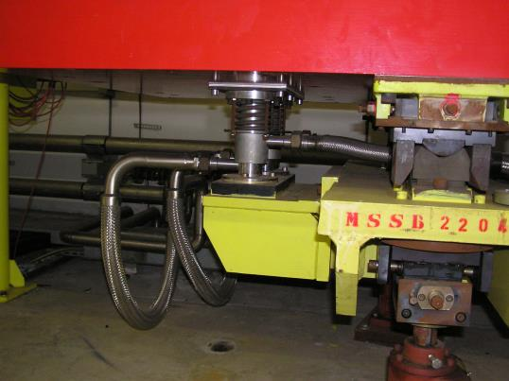
Plug in magnet for tunnel installation

Slide 25
Conclusion
The development of rad-hard magnets for FCC is a continuum of the LHC Consolidation program and of the HL-LHC development program. The Three projects are synergic and build one on the other
A rad hard coils does not mean a rad hard magnet: electrical connection, hydraulic connections and manipulation have to be intimately integrated to provide an homogenous product. CERN needs partners in order to develop the adequate answers in the different fields

