Slide 1
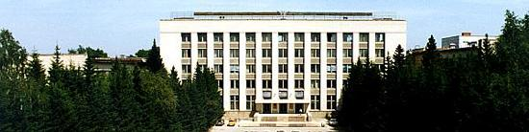
BINP
Cold test stands
for cryogenic beam vacuum Qualification
Alexander Krasnov
Budker Institute of Nuclear Physics (BINP), Novosibirsk, Russia
E-mail address: a.a.krasnov@inp.nsk.su
FCC week, Washington 25.03.2015

Slide 2
BINP
- Motivations
- Historical tour: measurements made at BINP for SSC and LHS cold beam vacuum
- What we have to know else
- Parameters of perspective SR beam lines at BINP for vacuum cold stands
- SEY measurements in presence of strong magnetic field
FCC week, Washington 25.03.2015
a.a.krasnov@inp.nsk.su

Slide 3
BINP
1E14 eV
FCC hh
FCC energy scale
1E4 eV
Synchrotron radiation,
Electrons in e-clouds
1 eV
Binding energy of atoms in molecules
1E-2 eV
Condensation energy of hydrogen
2E-4 eV
T=2K, High field superconducting magnets
a.a.krasnov@inp.nsk.su
FCC week, Washington 25.03.2015

Slide 4
Initial surface condition
after pumping at RT down to 1e-4 ÷ 1e-5 Torr :
30 ÷ 100 ML of
Chemically bound: MxOy, Mx(OH)y, Mx(HOC3)y, carbon clusters
Physically adsorbed: H2O, organics
SR provoke dissociation of the molecules.
Note 1: Evaporating 0.1% of 1ML cause gas density increase on 100 time more of acceptable level!
Note 2: Life time of Physically adsorbed molecules on a surface can by evaluated from Frenkel equation:
BINP
a.a.krasnov@inp.nsk.su
FCC week, Washington 25.03.2015

Slide 5
First SR beam lines at BINP for cold vacuum tests
BINP
Ec = 20 ÷ 500 eV (SSC – 300 eV, LHC – 46 eV,
FCC week, Washington 25.03.2015
a.a.krasnov@inp.nsk.su

Slide 6
Stand for testing of prototype chambers for SSC cold beam vacuum
BINP
a.a.krasnov@inp.nsk.su
FCC week, Washington 25.03.2015

Slide 7
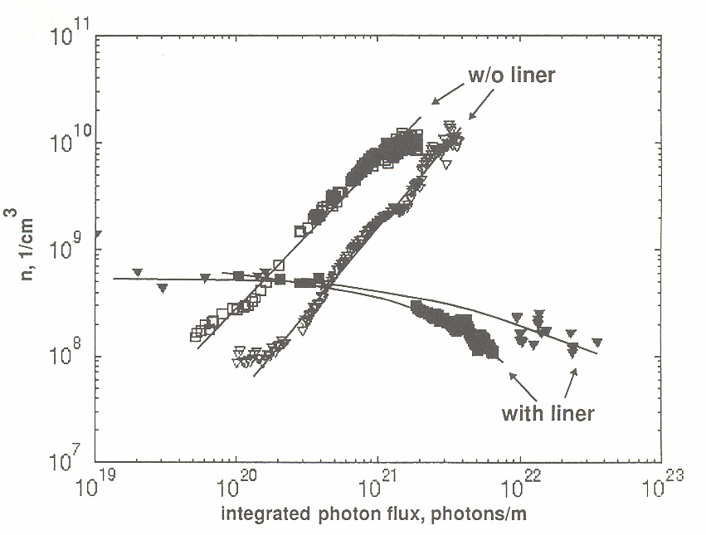
H2 dynamic pressure vs photon dose
BINP
100 h
He
T=1.9K
ID=50mm
39mm
slots
Beam screen
T=5
÷
20K
OD=49mm
Cooling tubes
He
Long term prognosis for CO, CO2, O2 ?
FCC week, Washington 25.03.2015
a.a.krasnov@inp.nsk.su

Slide 8
One of prototype chamber with beam screen for LHC cold beam vacuum
BINP
Long term prognosis for CO, CO2, O2 ?
a.a.krasnov@inp.nsk.su
FCC week, Washington 25.03.2015

Slide 9
One of first prototype chamber with beam screen for LHC cold beam vacuum
BINP
Long term prognosis for CO, CO2, O2 ?
a.a.krasnov@inp.nsk.su
FCC week, Washington 25.03.2015

Slide 10

a.a.krasnov@inp.nsk.su
Dynamic pressure of H2 vs temperature inside simple tube with TiZrV getter film.
BINP
1
E
-
1
0
]
Торр
[
2
P
1
E
-
1
1
1
E
-
1
2
5
0
1
0
0
1
5
0
·
2
0
0
2
5
0
3
0
0
T
e
m
p
e
r
a
t
u
r
e
[
K
]
SR photon flux 4E10 ph/s, Ec=4.5 keV
FCC week, Washington 25.03.2015

Slide 11
Installation for investigation photo-desorption of condensed gases
BINP
a.a.krasnov@inp.nsk.su
FCC week, Washington 25.03.2015

Slide 12
Photo-desorption of condensed gases
BINP
a.a.krasnov@inp.nsk.su
FCC week, Washington 25.03.2015

Slide 13
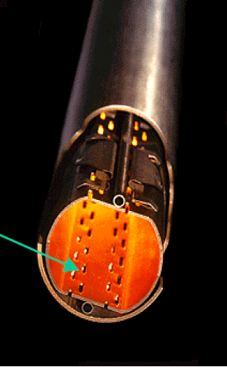
Electron cloud consideration
(started too late)
a.a.krasnov@inp.nsk.su
BINP
SR
0.02÷0.03
0.5
Slots
Indirect photon fluxes hitting of internal surface was decreased by a factor of 4 at least
Two benefits:
Decreasing of photoelectrons contribution in e-clouds from roughly 20% to 5%
Mitigation of recycling of condensed molecules: helps for surface conditioning
FCC week, Washington 25.03.2015

Slide 14

Electron cloud consideration
BINP
Screen for e-cloud
e⁻
T=1.9K
γ
ID=50mm
Saw tooth
p⁺
γ_{d}
e⁻
e⁻_{ph}
T=5
÷
20K
OD=49mm
Cooling tubes
Slots
A thermo-cycling might be needed
a.a.krasnov@inp.nsk.su
FCC week, Washington 25.03.2015

Slide 15
What we have to investigate by testing of FCC cold beam chamber prototypes:
First stage
Dynamic pressure in presence of SR (Ec up to 4.5 keV) in temperature range 40 ÷ 80K. Transparency of BS.
Possible pressure raise during thermo-cycling after accumulating a photon dose. Definition suitable temperature range
Azimuthal distribution of photoelectrons
Specular SR reflecting, distribution of diffusely scattered photons
SEY of cold surface in presence of strong magnetic field (up to 13T)
Add at second stage
SEY in situ
XPS (Auger) in situ (surface element analysis)
Ion desorption under SR
BINP
a.a.krasnov@inp.nsk.su
FCC week, Washington 25.03.2015

Slide 16
Parameters of available and potentially available SR beam lines for vacuum investigations at BINP
BINP
Parameter | BEP |  | VEPP-3 |  | NISSI
 |  |  |  |  | Normal dipole |  |  | Super-bend
 | min | max | min | max | min |  | max | min | max
E [GeV] | 0,2 | 0,9 | 0,3 | 2 | 0,4 |  | 2 | 0,4 | 2
SR critical energy [keV] | 0,014 | 1,3 | 0,016 | 5 | 0,028 | 3,5 |  | 0,13 | 16
SR incident angle [mrad] | 10 (5) |  | 10 |  | 10 |  |  | 10
SR flax on testing chamber [ph/m/s] | 3E16 (1,5E15) | 4E17 (2E17) | 1,6E15 | 3E16 | 3E16 | 3E17 |  | 2,7E16 | 2E17
SR max power on testing chamber [W/m] | 30 (15) |  | 7,7 |  | 58 |  |  | 160
Sample chamber possible length [m] | 1 (in 2015) 2 (in 2016) |  | 1,5 |  | 3 |  |  | 3
Available [year] | from 2015 |  | 2015 ÷ 2017 |  | from 2020 |  |  | from 2020
a.a.krasnov@inp.nsk.su
FCC week, Washington 25.03.2015

Slide 17
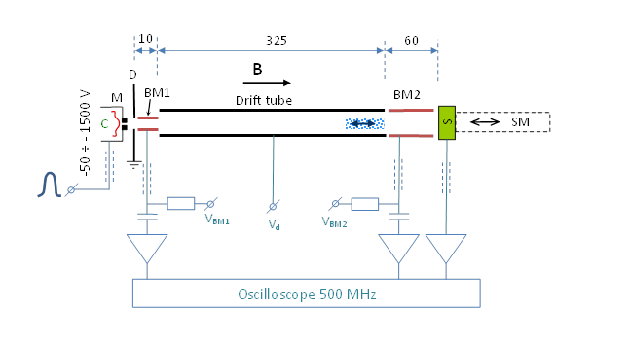
SEY at magnetic field
Set-up for RT experiments
BINP
“C” – thermo-cathode
“M” – modulator
“D” – diaphragm
“BM1, BM2” – beam monitors
“S” – sample
“SM” – sample manipulator
Parameters
-Energy of primarily electrons: 50 ÷ 1500 eV
-Primarily beam pulse current: up to 200 µA
-Primarily electron beam pulse duration: 1 ÷ 10 ns.
-Beam diameter: ~ 1.5 mm
-Maximum magnetic field: 0.05 T
-BM1, Drift tube, BM2 bias: -600 ÷ +600 V
Element (from left to right) | ID [mm] | Length [mm] | Gap with right element [mm]
C | - | - | 0.25
M | 0.5 | 2 | 3
D | 4.5 | 1 | 1
BM1 | 4 | 10 | 0
Drift tube | 7 | 325 | 1
BM2 | 7 | 59 | 2 ÷ 3 (to sample)
FCC week, Washington 25.03.2015
a.a.krasnov@inp.nsk.su

Slide 18
First experimental results
BINP
BM2
S
BM1
Primary
Secondary
Secondary - Primary
FCC week, Washington 25.03.2015
a.a.krasnov@inp.nsk.su

Slide 19
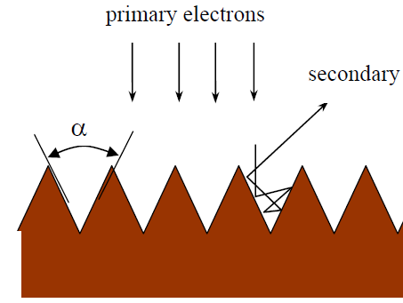
First experimental results. SEY
BINP
10
325
60
D
B
M
BM1
Drift tube
BM2
C
S
FCC week, Washington 25.03.2015
a.a.krasnov@inp.nsk.su

Slide 20
10
325
60
D
B
BINP
M
BM1
Drift tube
BM2
C
S
Flat
FCC week, Washington 25.03.2015
a.a.krasnov@inp.nsk.su

Slide 21
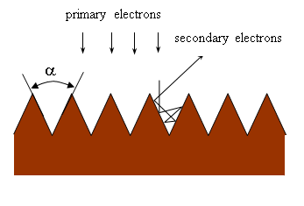
SEY vs extracting bias Ubm2
BINP
10
325
60
D
B
M
BM1
Drift tube
BM2
C
S
FCC week, Washington 25.03.2015
a.a.krasnov@inp.nsk.su

Slide 22

Energy distribution
BINP
10
325
60
D
B
M
BM1
Drift tube
BM2
C
S
z
0
where E_{z}=E_{sz}+U_{bm2} and delay t’ is defined as:
$$If I\left(t=0, z=0\right)=Q∙δ\left(0\right)$$
Ubm1=Udrift=Ubm2=5V
FCC week, Washington 25.03.2015
a.a.krasnov@inp.nsk.su

Slide 23
Energy distribution
BINP
10
325
60
D
B
M
BM1
Drift tube
BM2
C
S
FCC week, Washington 25.03.2015
a.a.krasnov@inp.nsk.su

Slide 24
BINP
Conclusion
The installation provides adequate measurements of SEY in the present of magnetic field
Effective reflectivity of secondary electrons cannot be measured ( electron density has to be decreased by a factor of 100 )
Mitigation of effective SEY by a grooved surface more stronger than it was predicted. If its space charge effect, the application of grooves should significantly decrease saturation density of e-cloud
FCC week, Washington 25.03.2015
a.a.krasnov@inp.nsk.su

Slide 25
BINP
Conclusion/ proposals for future
SEY
Installation into superconducting solenoid to provide experiments at magnetic field up to 10 Tesla
Installation of photo-cathode to avoid electromagnetic excitation and increase beam diameter up to 4 – 6 mm to decease electron density by a factor of 100 at least
systematic measurements samples with special coatings and surface treatments
FCC week, Washington 25.03.2015
a.a.krasnov@inp.nsk.su

Slide 26
BINP
Thanks a lot to
Vadim Anashin, Vincent Baglin, Bernard Henrist, Jose Miguel Jimenez, Oleg Malyshev, Paolo Chiggiato, Roberto Cimino for collaboration work and helpfull discussions
Thank for your attention!
FCC week, Washington 25.03.2015
a.a.krasnov@inp.nsk.su

