Slide 1
Transport and Handling Considerations for the FCC
Ingo Rühl / CERN - EN-HE
First Annual Meeting of the Future Circular Collider Study
Washington D.C., 23-27 March 2015

Slide 2
Topics
General issues
FCC geographical data
Vertical handling aspects
  Lifts
  Cranes
Tunnel transport aspects
  Automatic guided vehicles (AGVs)
Conclusion

Slide 3
General Issues
Need to consider all transport and handling phases
Delivery of components
Assembly
Test
Storage (just on time?)
Transfer to shaft (road transport)
Surface Underground transfer (crane or lift)
Loading underground
Transport along tunnel
Unloading / Transfer onto supports
Removal for repair
Integrate transport and handling design requirements into equipment and infrastructure design as early as possible.

Slide 4

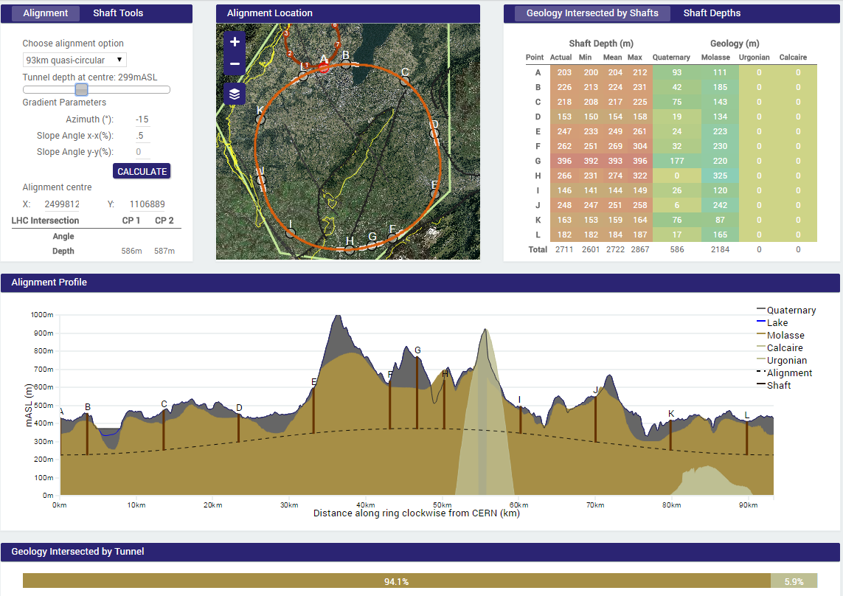
FCC Geographical Data - Option 1a (93km)

Slide 5
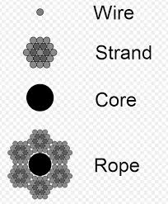
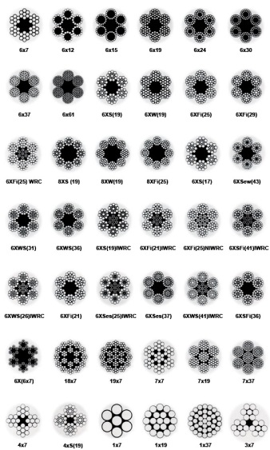
Wire Ropes – Safety Factor
Safety Factor: Ratio strength of rope / working load
wire rope strength 10,000 pounds / working load 2,000 pounds → safety factor 5
Safety Factor depends not only on the loads applied, but also on:
speed of operation;
the acceleration and deceleration;
the length of rope;
number, size and location of sheaves and drums (bending radius / forces);
the type of fittings used for securing the rope ends;
the factors causing abrasion and corrosion…
Safety Factors (only a guide)
Miscellaneous Hoisting Equipment 5 to 6
LIFTS 12 (US + Japan 10)
Mine Shafts 8.0 for depths to 500ft.
        7.0 for depths 500-1000ft.
        6.0 for depths 1000-2000ft.
        5.0 for depths 2000-3000ft.
        4.0 for depths 3000ft. and more
http://www.seile.com/

Slide 6
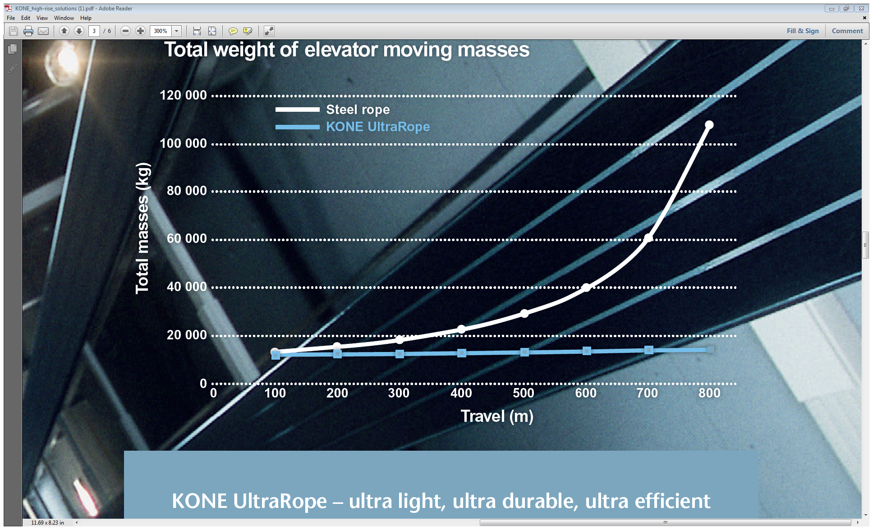


Wire Ropes for Lifts
Lift travel of ~500m considered as maximum feasible due to SF of 12
  Latest development by KONE lifts – carbon fibre ropes (Bending ᴓ > 1m)
  1st time commercialized in 2014; Lift travel of 1000 m and more
  Lower mass = Lower wear + Energy savings + Higher speed (16m/s)

Slide 7
FCC Shaft Lifts
Lifts with standard steel wire ropes should still do for shaft depths of 400m but
    Will require fix landing systems for 3t lift due to rope extension/flexibility when loading/unloading lift cabin
    Lift redundancy a must (i.e. one 3t/35people and one 350kg/4people lift operating next to each other in the same shaft)
    Higher lift speed (min. 5 m/s for 3t lift and 10 m/s for 350kg lift) requires more pit depth and top clearance
    n° of people in tunnel depends on evacuation means → lift capacity and speed
    Will not be possible to simply take over the shaft, pit & machine room dimensions from LHC!
By the time of the FCC construction carbon fibre cables in lifts could have become a standard …

Slide 8
FCC Shaft Cranes
Crane lifting heights of ~3000m currently feasible and in operation - offshore and mining industry
Lifting heights of 400m is in itself is not a problem but problematic with standard EOT crane layout
    Twin rope drum system → major impact on bldg. height and width
    Or multiple layers of ropes … normally not applied on EOT cranes
    Push and pull system combined with strand jack lifting systems as applied for CMS also remains an option for handling heavy detector components

Slide 9
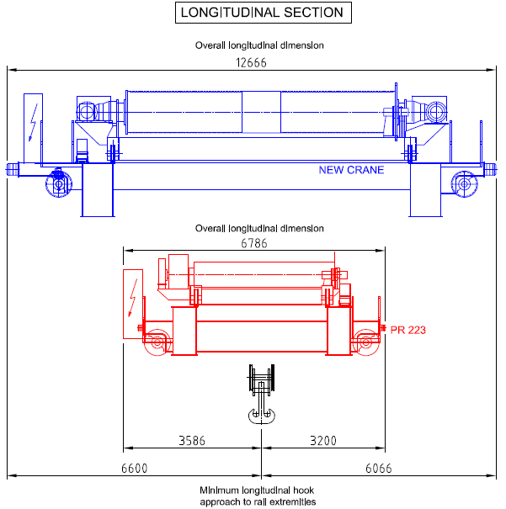
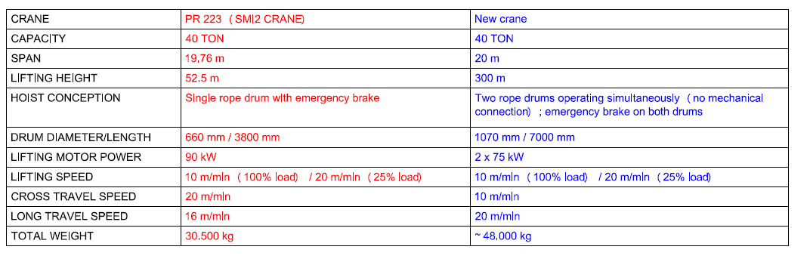
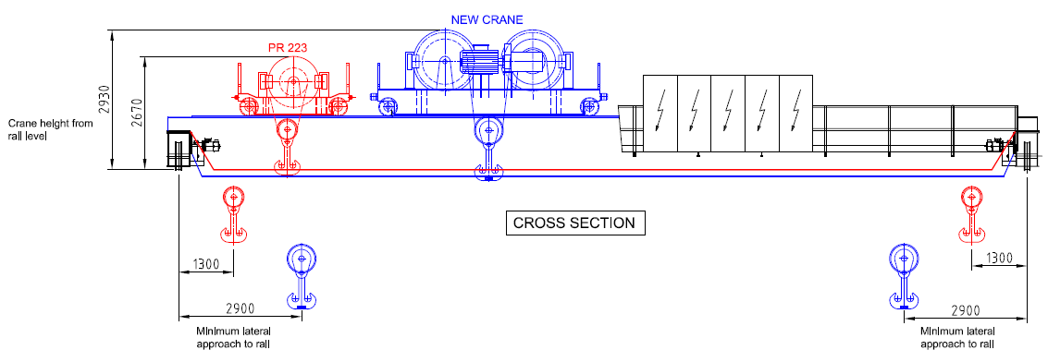
40t EOT Crane Comparison LHC vs. FCC

Slide 10
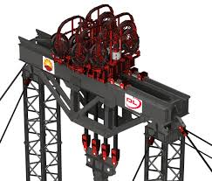
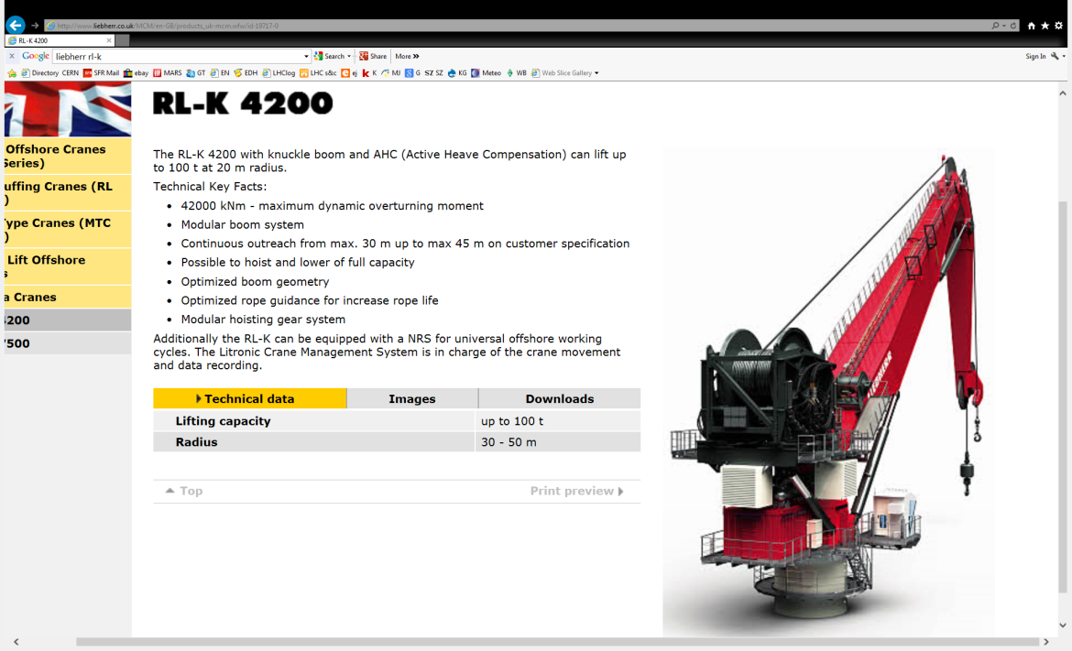
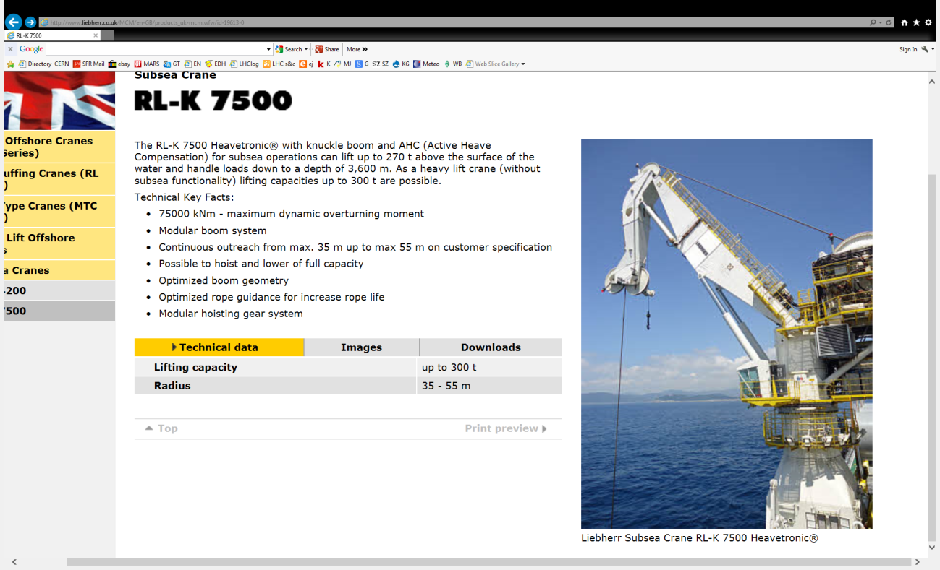
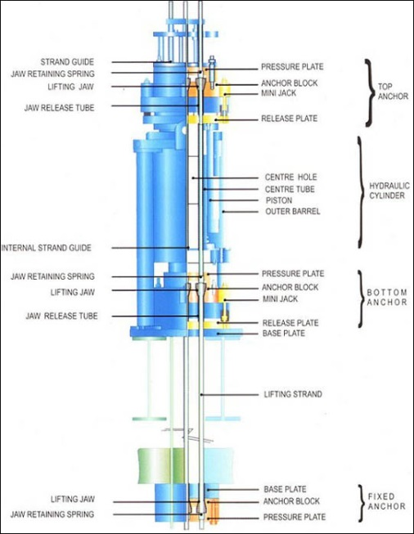

Alternative Crane Solutions

Slide 11

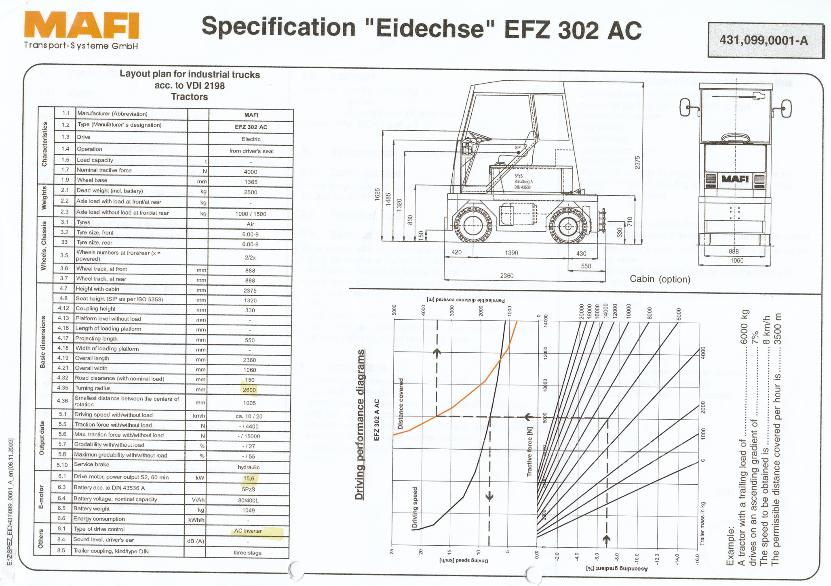
NOTES ON SLOPES
Encyclopedie de la Manutention (~1980)
“rampe ≥ 7% = problème délicate”
  needs for example continuous forced ventilation for brakes and motors
with increased slope the load capacity or the use factor reduces
Effect of 2% slope is to double traction force needed compared with flat surface
  stronger / bigger equipment
Example:
Towing tractor nominal capacity 20t at 10km/h
At a 7% slope
towing capacity 6 t at 3.5 km/h

Slide 12


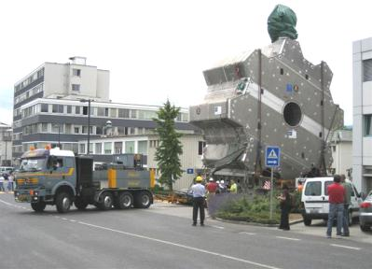
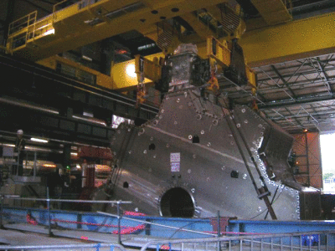
Detector cavern access
Vertical Shaft vs. Inclined tunnel?
Tunnel ᴓ = Biggest component
+ Transport equipment
+ Safety clearance(s)
+ Tunnel infrastructure (ventilation ducts etc.)
395m
Inclined tunnel
2800m
3º
6%
~3000m

Slide 13
Detector cavern access
Vertical Shaft vs. Inclined tunnel?
Need of flat ‘parking’ station(s) (escape lane(s)!) somewhere along the inclined tunnel!
395m
Inclined tunnel
2800m
3º
6%
>3000m

Slide 14
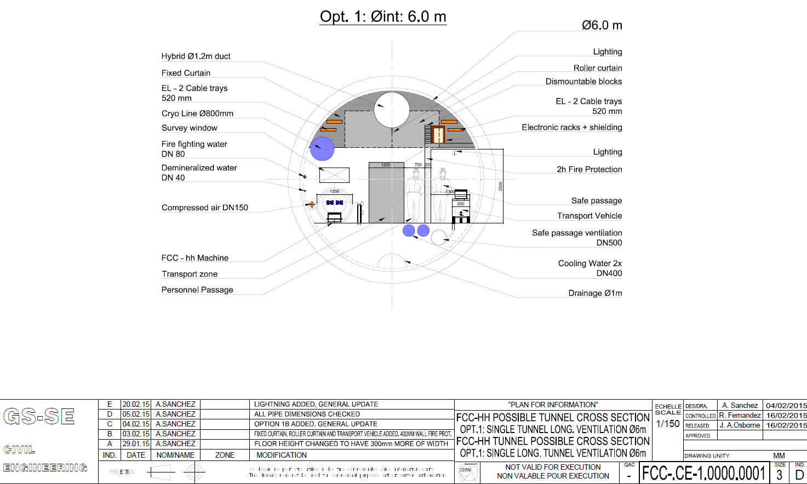
FCC-hh Single Tunnel Option

Slide 15
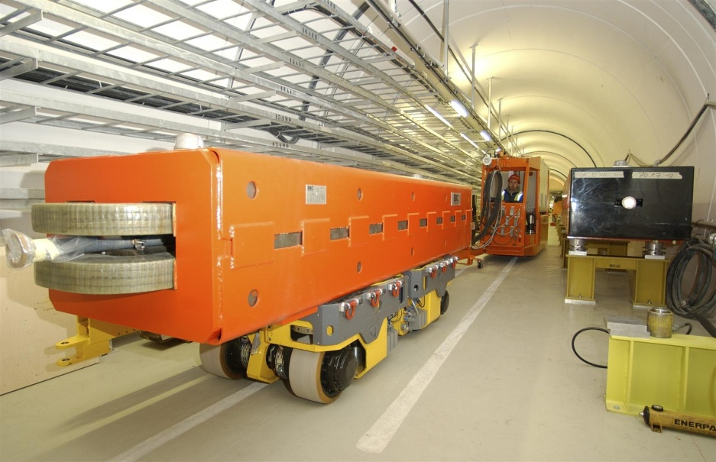
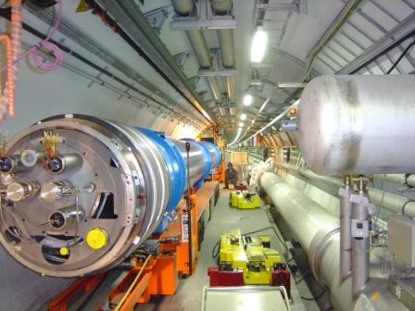
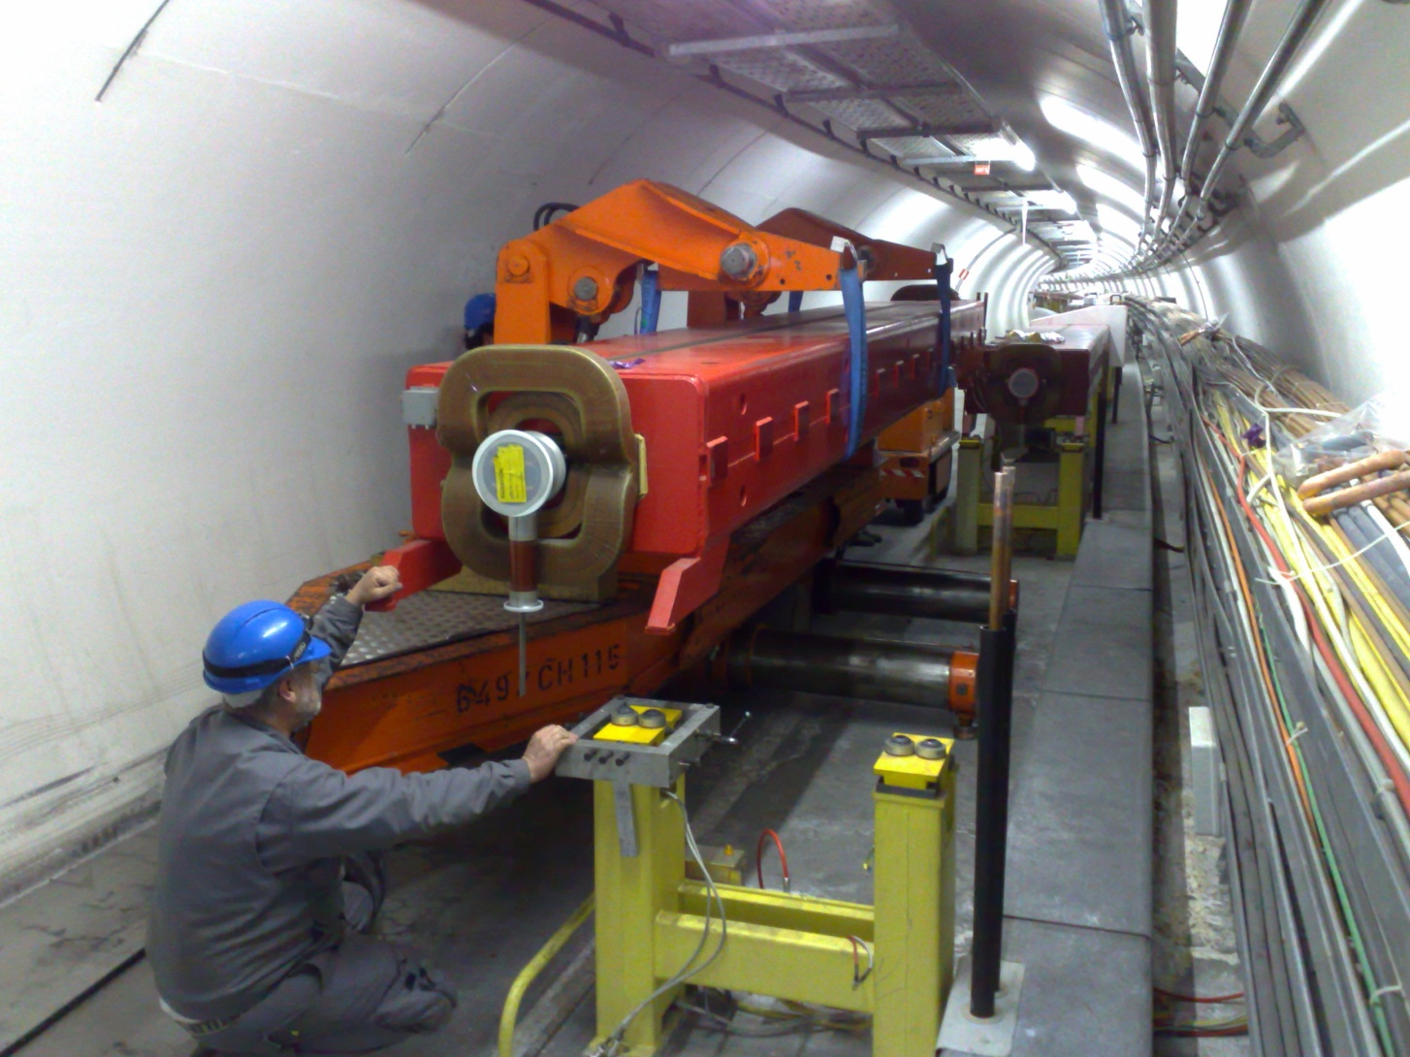
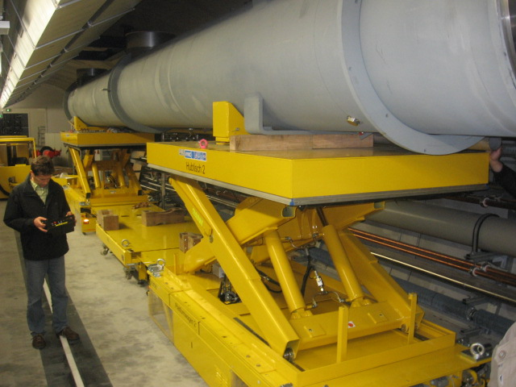
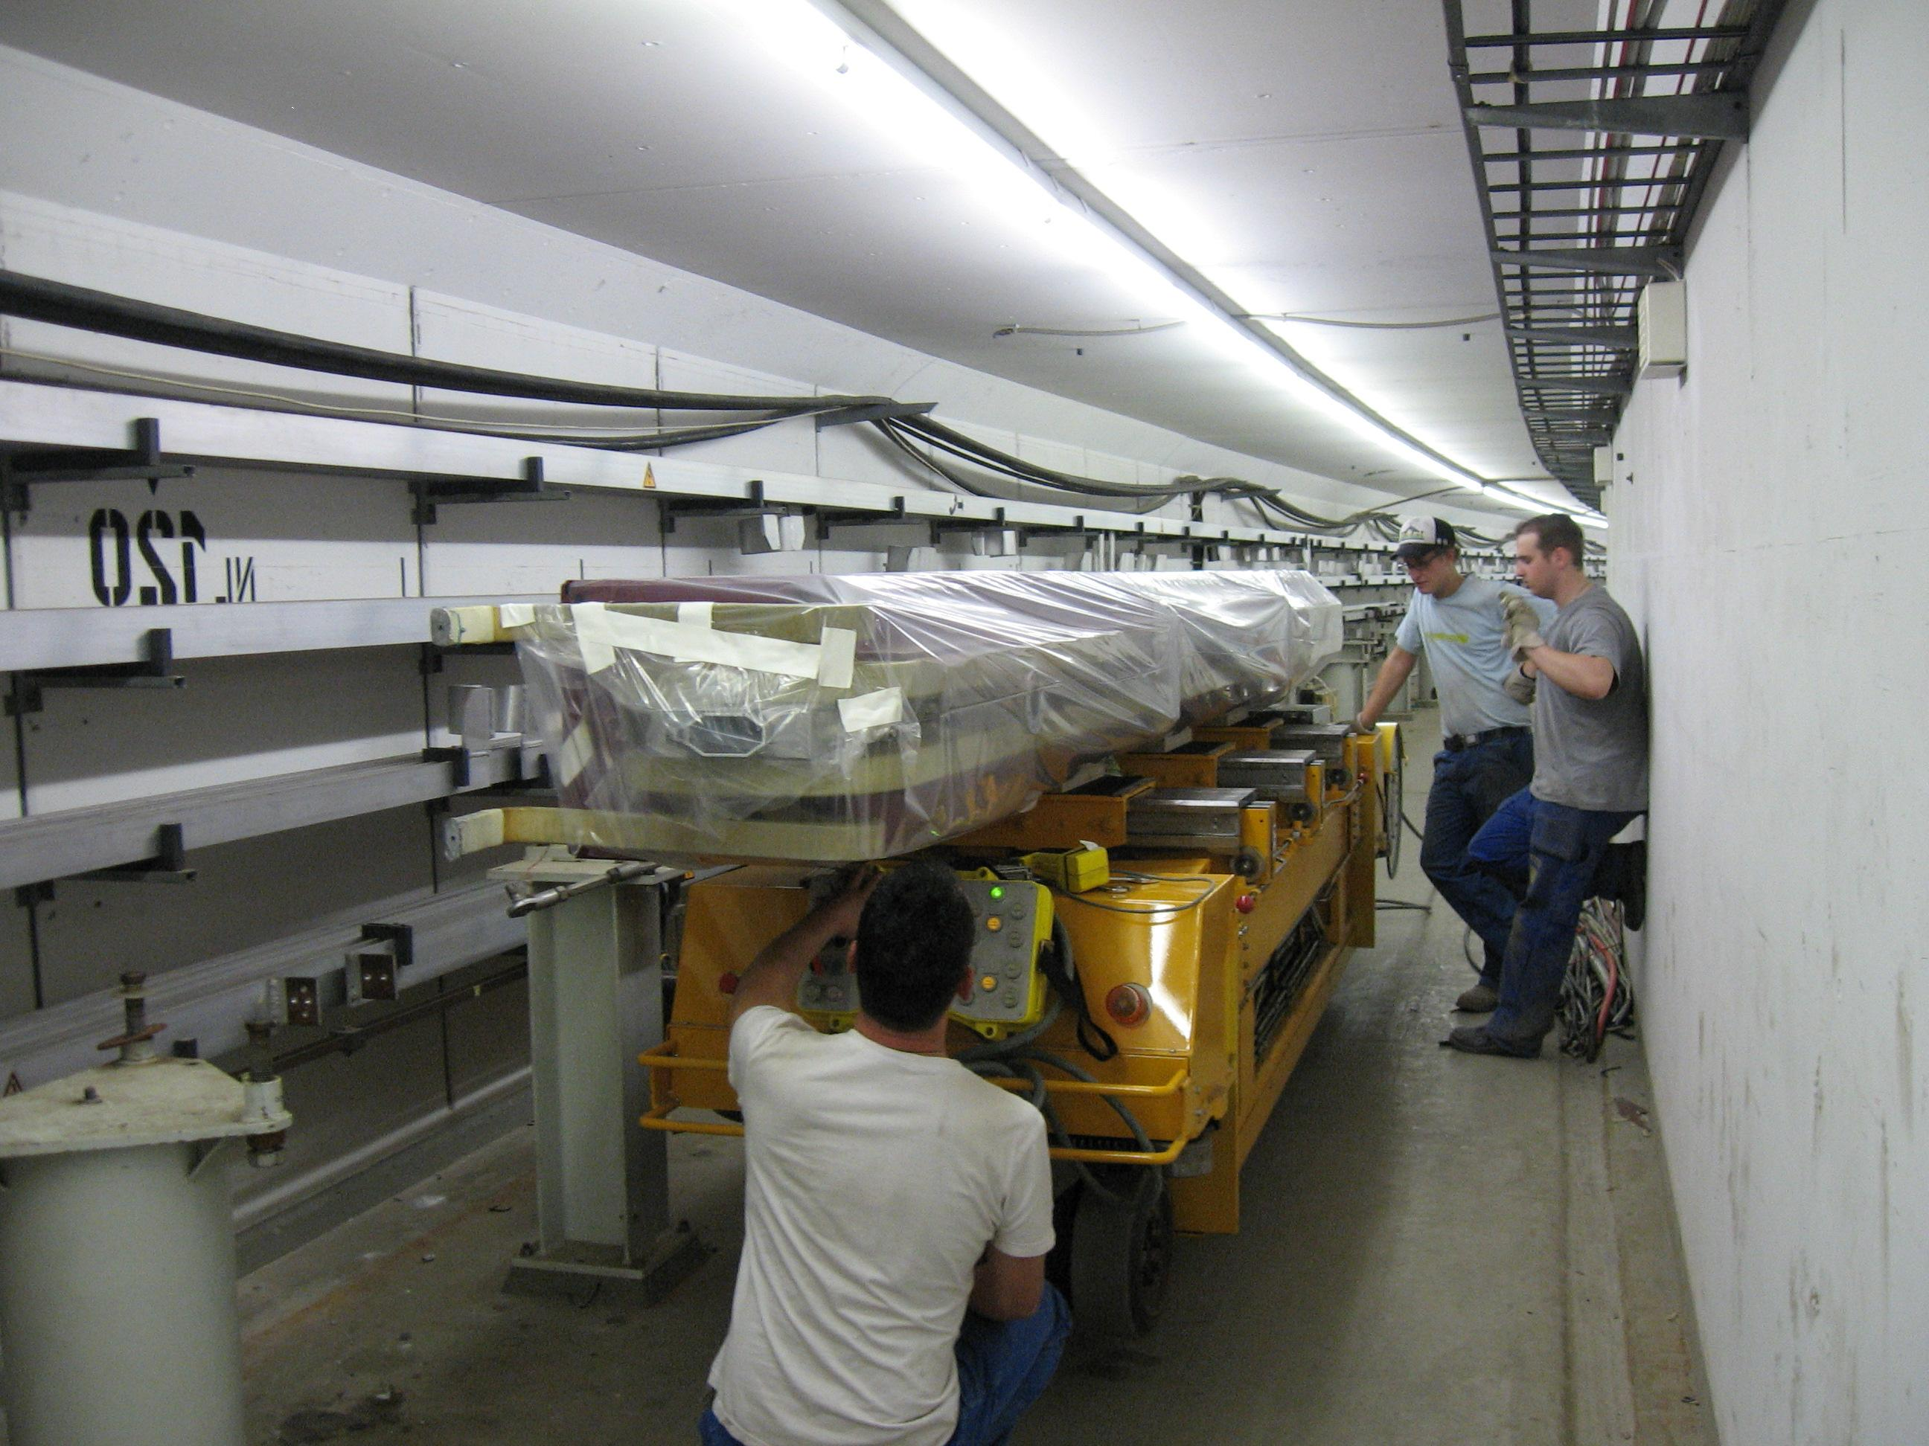
Tunnel Transport & Handling Equipment
These 4 solutions incorporate the longitudinal transport and lateral transfer!
Boundary condition:
Sufficient clearance under the accelerator components!!!
CERN LHC conventional-magnet installation
Capacity: 9 t per buggy
Eq. height: 560 mm
CERN LHC cryo-magnet installation
Capacity: 35t/20t
Eq. height: 500mm (TES 300mm)
CERN LEP conventional-magnet installation
Capacity: 5 t per wagon
Eq. height: n.a.
CERN SPS conventional-magnet installation
Capacity: 20 t
Eq. height: 800 mm
DESY XFEL installation
Capacity: 6.t per lifting platform
Lifting height: 2.4m
DESY conventional-magnet installation
Capacity: ???
Eq. height: ???

Slide 16
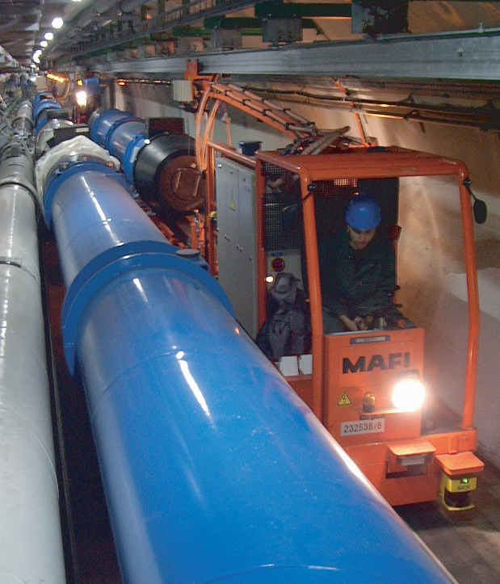
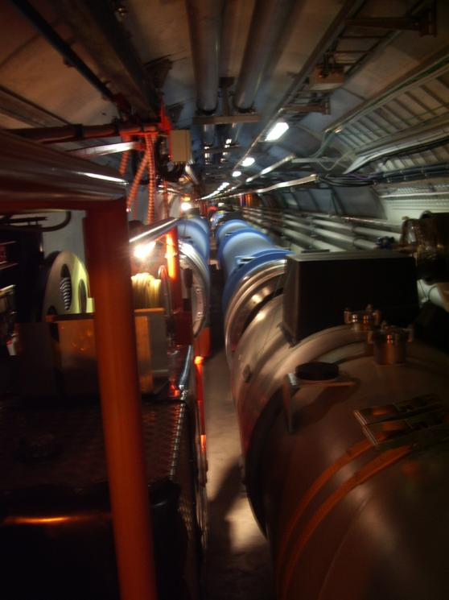
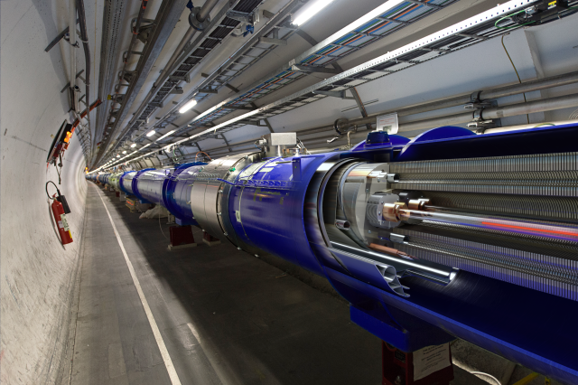
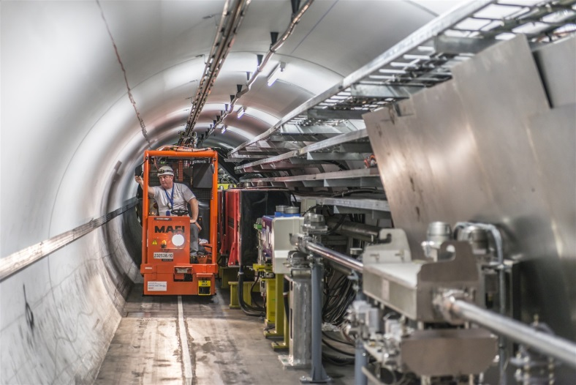
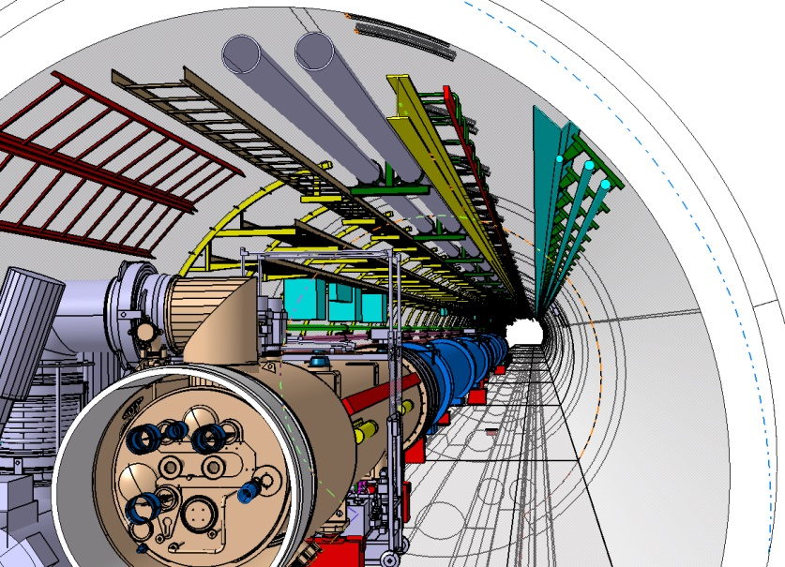
LHC power feed rail

Slide 17

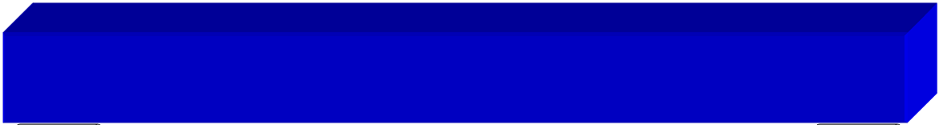
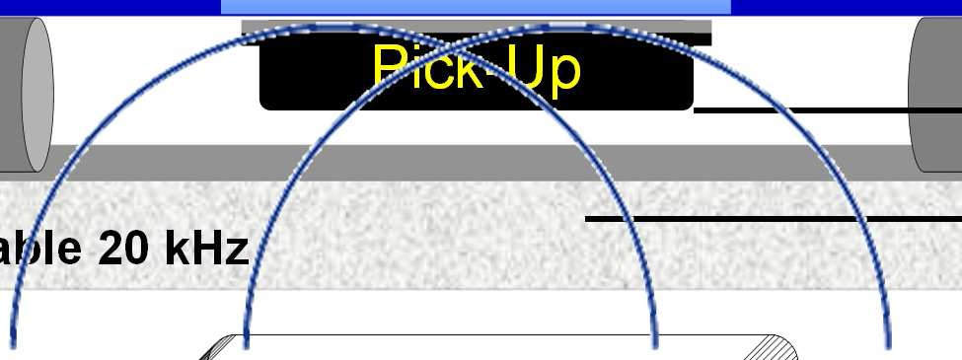
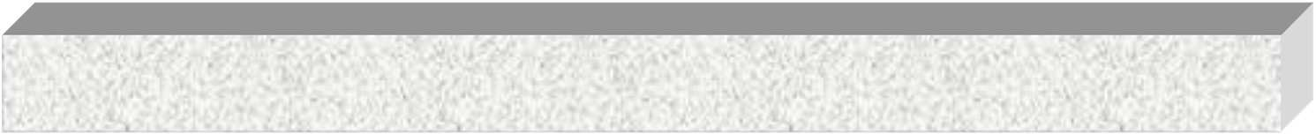




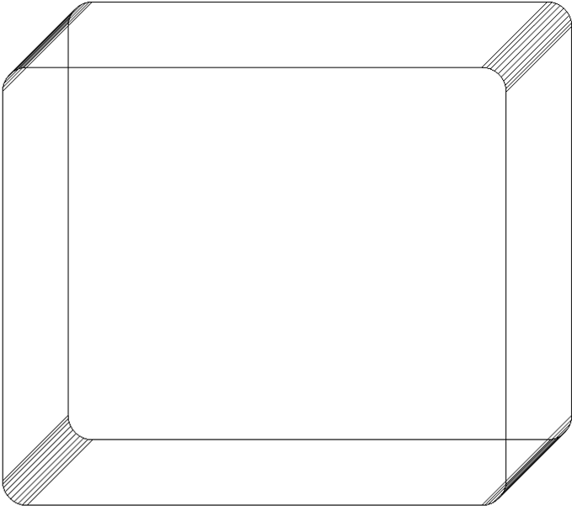




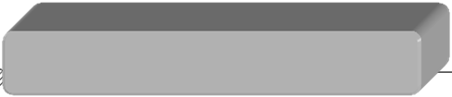
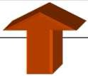

Principle of function
AGV application
24-48-560 VDC
voltage regulation
max. distance: 20 mm
Pick-Up
able 20 kHz
Primary C
compensation transformer inverter rectifier
filter
380 V / 50 Hz

Slide 18
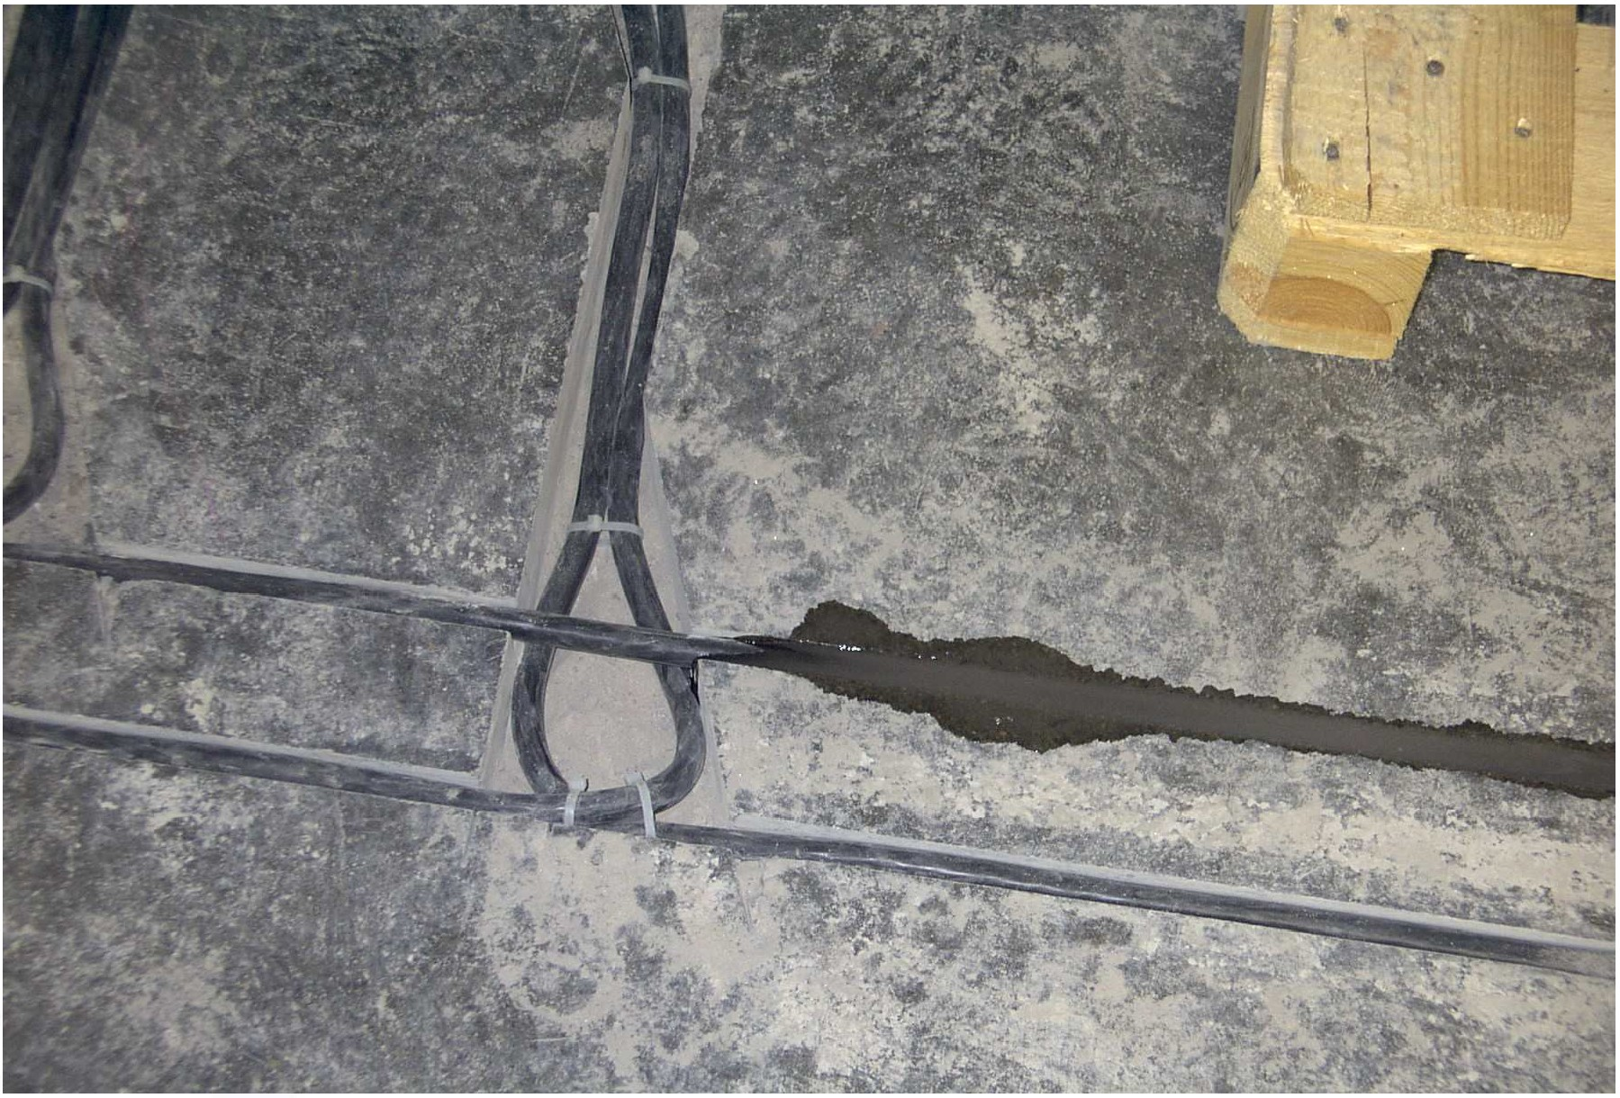
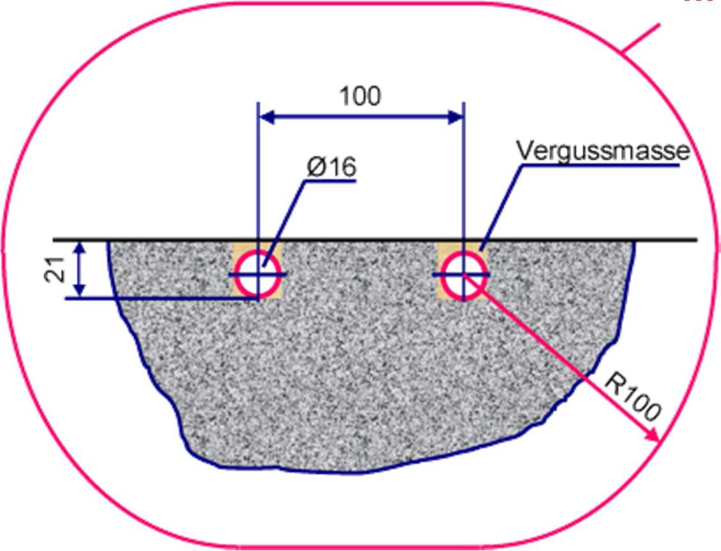
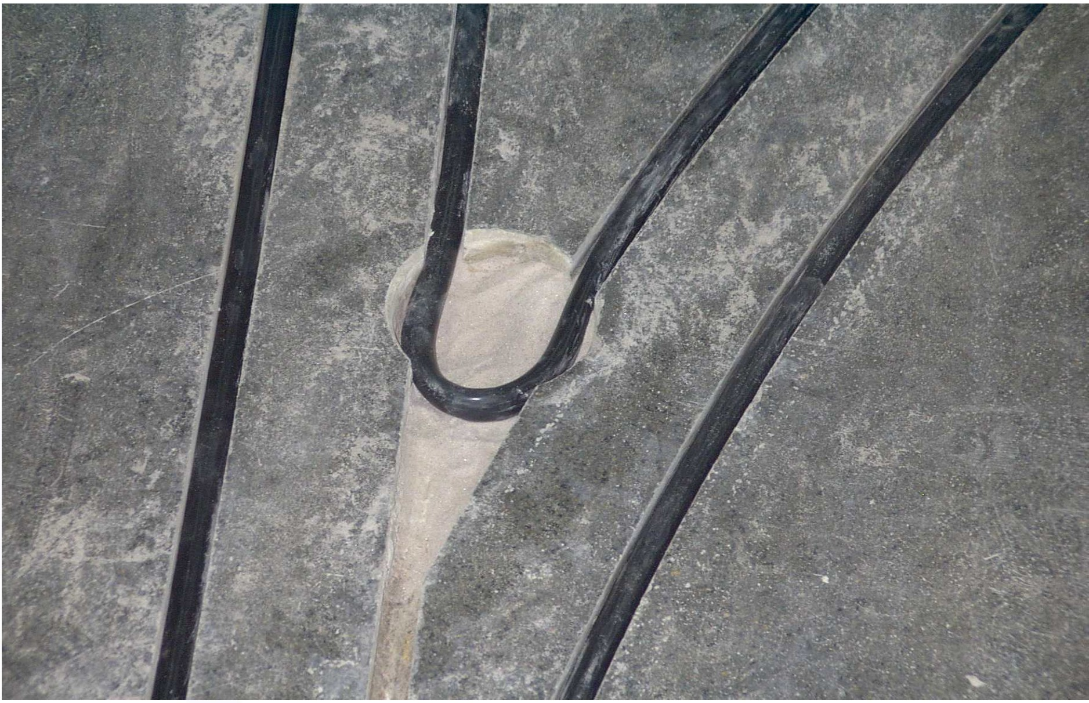
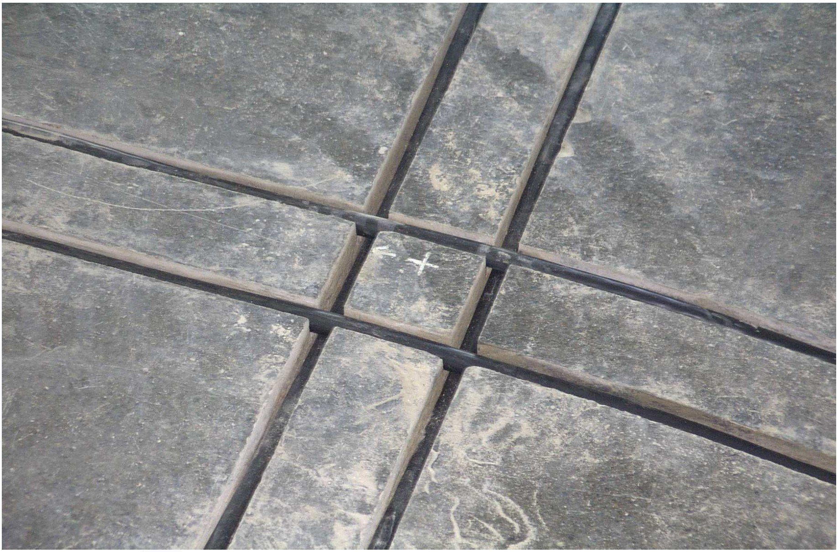
Under floor primary cable installation
metal free area
Min. clearance of 100mm to surrounding steel

Slide 19
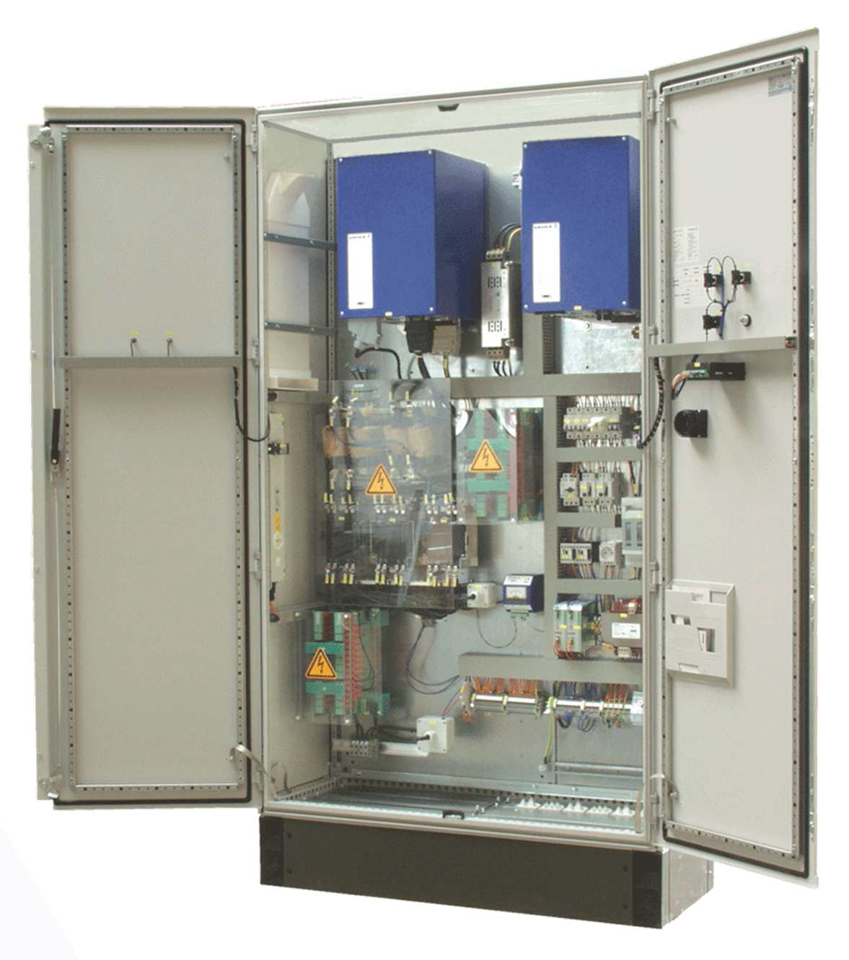
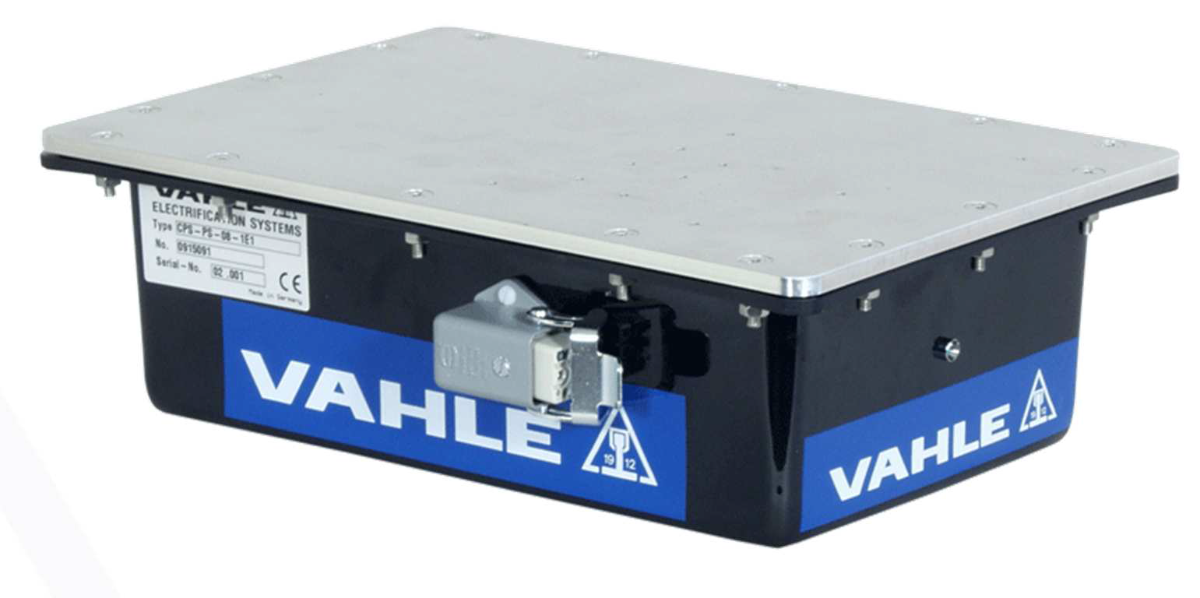
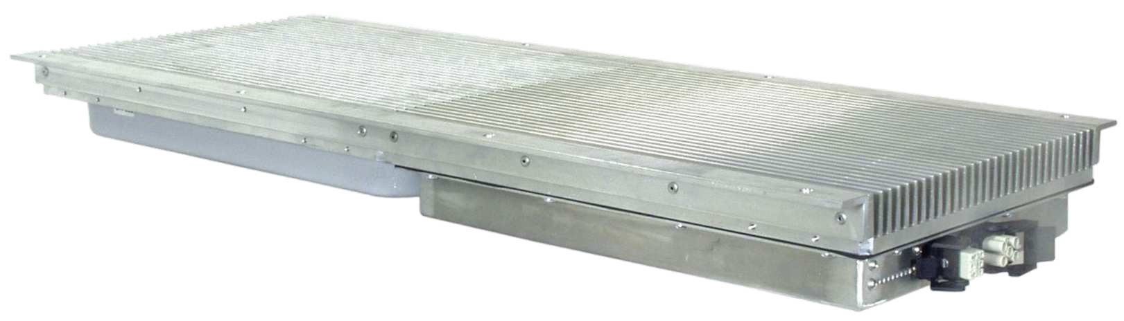
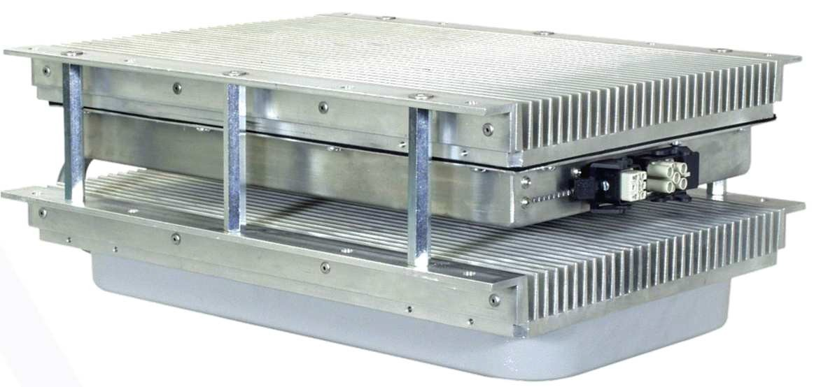
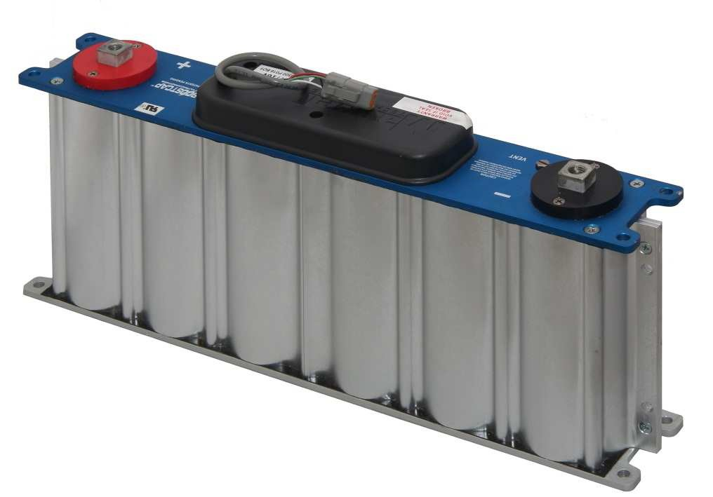
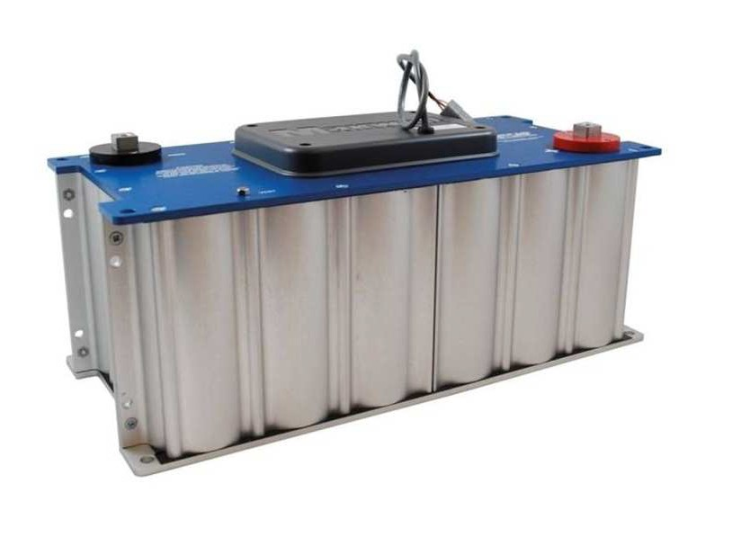
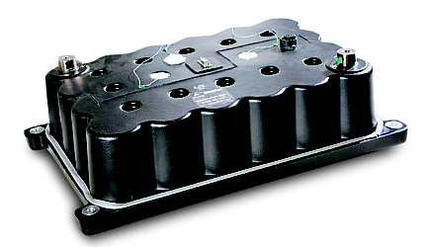
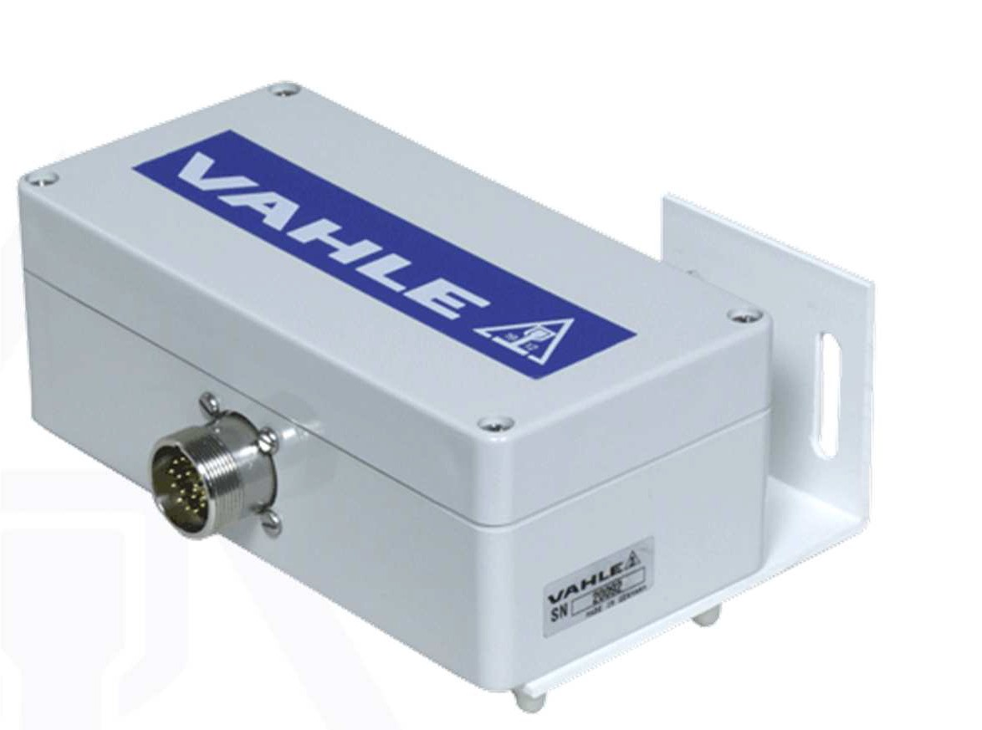
Flat-style Pick-Up
flat version
PS19
compact version
PS 08
Output:
24 VDC 500W or
24-27 VDC with battery charging system
Output:
560-680 VDC 3000W, & 24VDC auxiliary power supply
Primary Inverter cabinet
available power: 11, 45, 90 KW
UCAP‘s
Track Guiding Sensor for detecting the electro-magnetic field of the Primary cable
analog output signal,
0-5V, 0-10V and 0-20mA for vehicle steering control
digital output signal Profibus, RS485
suitable for curves and track switches

Slide 20
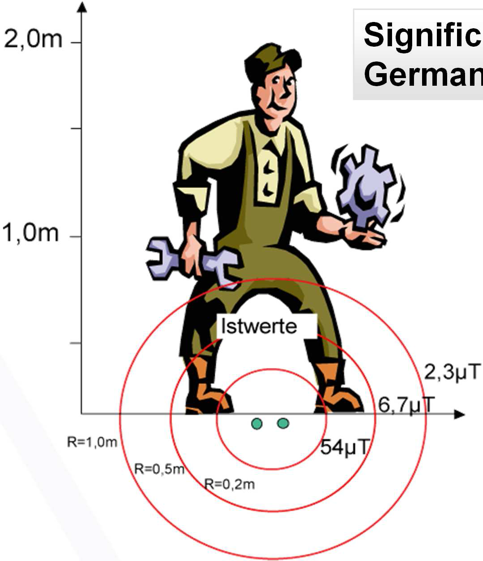
Magnetic flux density (EMF)
Signific Germa
antly below the
n Regulation BGV11:
67 µT - limit value for trunk
169 µT - limit value for extremities
CPS® values

Slide 21
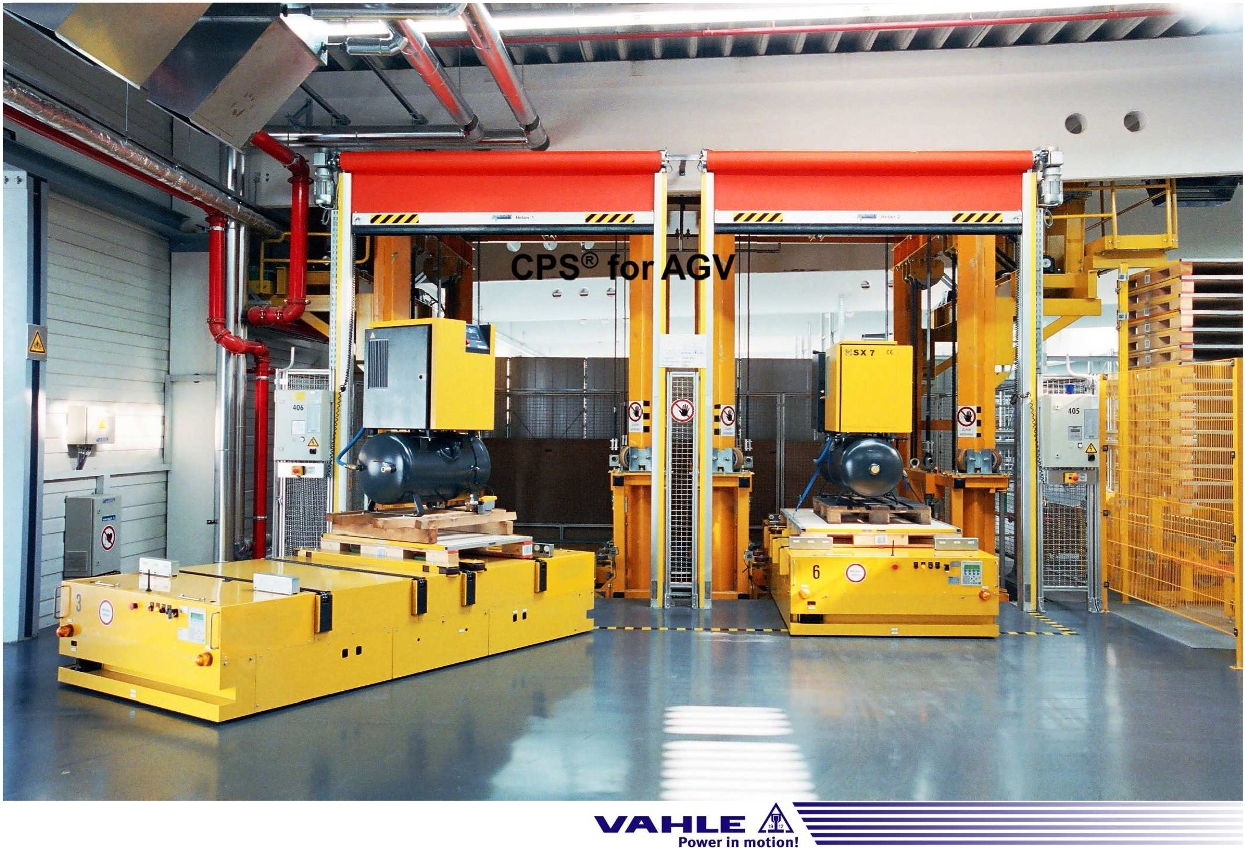
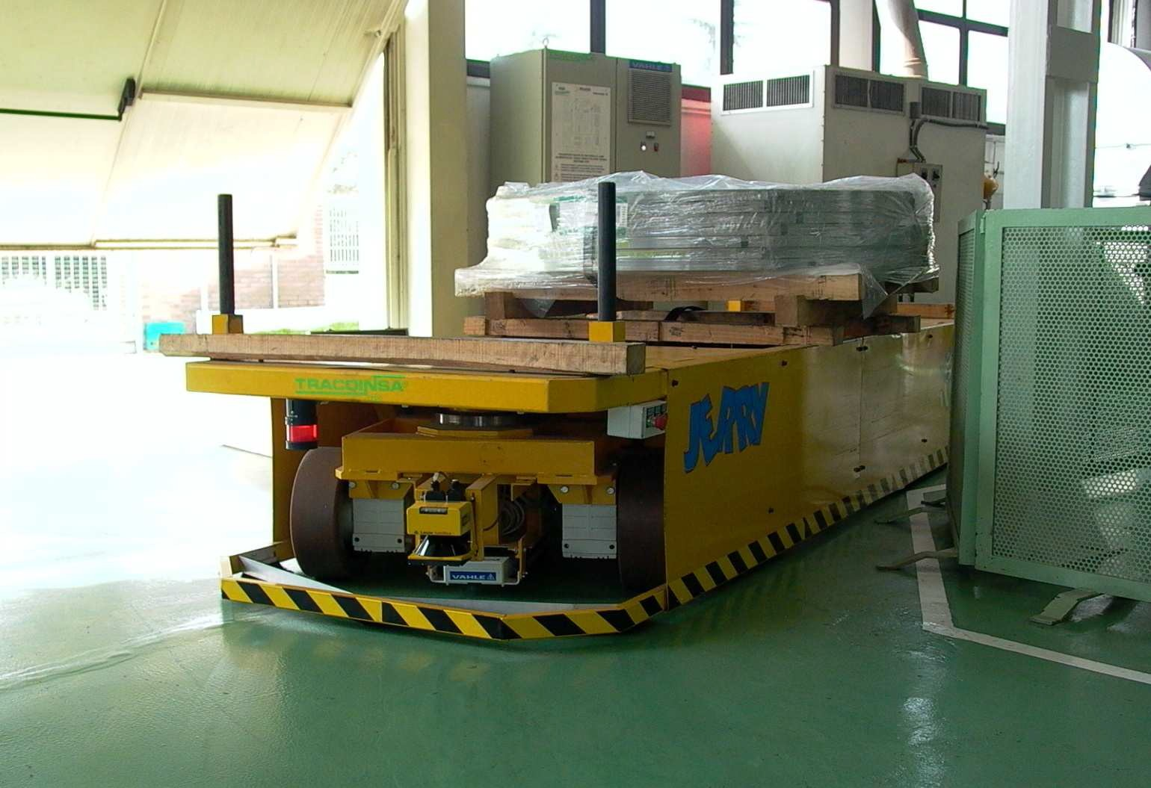
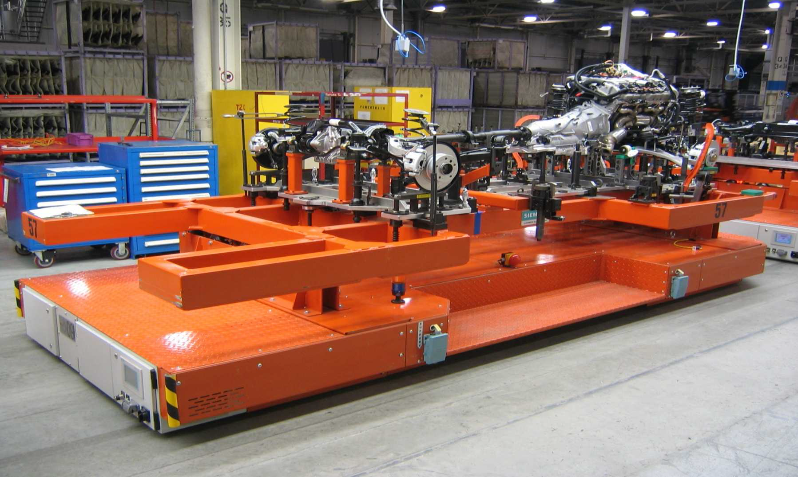
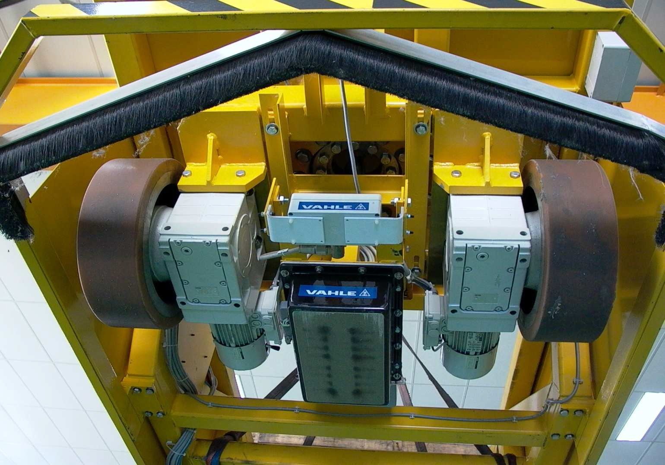
CPS®forAGV
Page 25cPS presentation (Feb ₂₀₁₄l

Slide 22
Comparison LHC vs AGV systems
 | LHC system | AGV system | Remarks
Installation powering & guiding system
time | - | +++ | AGV power supply cabinets at a distance of ~1km - less frequent than for LHC but bigger in size. Component compatibility when machine on?
costs | - | +
integration | - | ++
Maintenance | - | +++ | Practically no mechanical wear
Operation
safety | + | +(?) | EMF limits to be confirmed
manpower | - | ++ | Very limited operation manpower required for AGVs
acceleration / speed | o | + | Not really an issue for heavy accel. component transports. Higher speeds possible with AGVs (up to 20 km/h) for smaller/lighter components and passenger transport
Powering
Conductor | + | - | Direct power supply or via Battery or Hybrid possible for both solutions
Inductive | - | +
Battery | + | +
Guidance
Optical | + | - | Very cumbersome & maintenance intensive
Inductive | - | + | Low maintenance; variable tracks
Manual | + | + | Always necessary for a few manœuvres
Machine Interference
installation phase | + | + | Not an issue
Techn. stops / operation phase | + | ? | AGV/EMF interference when machine in stand-by?
Remote Monitoring & Control System | - | +++ | Small team of operators and maintenance staff can operate several AGV convoys at a time
  If not compatible, then
  inductive guiding system
  plus
  defined charging stations,
  which requires important battery capacities
  for the AGVs.

Slide 23
Conclusion
Lifts for shaft depth of up to 400m should be feasible with standard solutions but will require some additional technical features
Cranes for shaft depths of up to 400m still feasible with standard EOT cranes but will require more studies regarding existing industrial equipment / applications
For both cases the standard LHC layout for buildings and shafts cannot be applied!
Keep tunnel slope as low as possible (<2%)
Allow for sufficient clearance under accelerator components to allow transport and handling vehicles with incorporated lateral transfer systems
Compatibility between an inductive guiding and powering system and accelerator components when in stand-by mode to be further assessed

Slide 24
Summary
There are plenty of technical challenges regarding transport and handling aspects for the FCC that need some in-depth studies but no show stoppers so far (based on the present tunnel and shaft configurations)!!!
Thanks

Slide 25
Acknowledgements
KONE Corporation Finland
KONE Oyj
Keilasatama 3
P.O. Box 7
Espoo, FIN-02150
Liebherr-Werk Ehingen GmbH
D-89584 Ehingen/Donau
Paul Vahle GmbH & Co. KG
Westicker Str. 52
D-59174 Kamen
Titre : | Encyclopédie de la manutention / Syndicat des industries de matériels de manutention
Auteur(s) : | Syndicat des industries de matériels de manutention (France). Fonction à préciser
Date(s) : | c1980-1983
Editeur(s) : | Paris : AFNOR : SOMIA, c1980-1983
JM. Chevalley, B. Feral, K. Kershaw, J. Osborne, … / CERN

