Slide 1




Future Circular Collider Week 2015
Closing Remarks
Michael Benedikt
March 23-27, 2015, Washington DC, USA

Slide 2
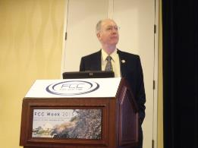
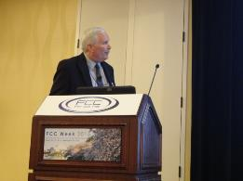
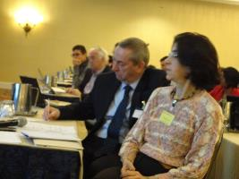
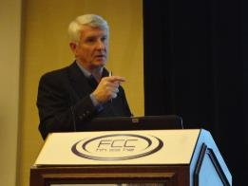
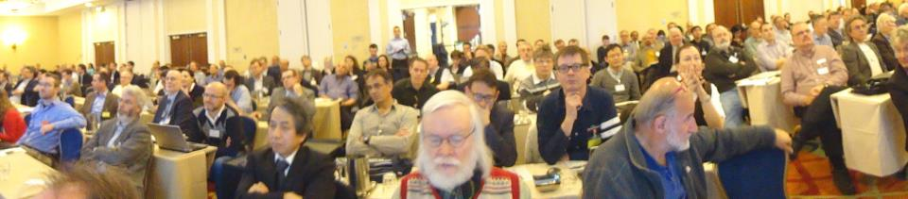
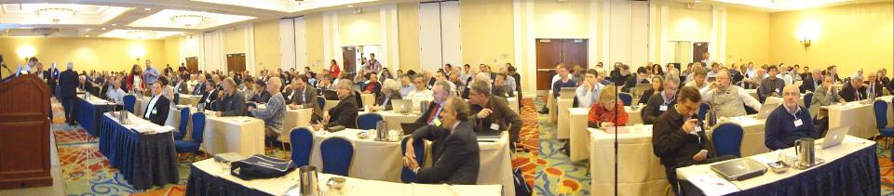

Slide 3
FCC Kick-off goals
Following ESU in May 2013, creation of a small preparation group in autumn 2013 to prepare on a short time scale:
preliminary draft baseline parameter sets for all options
a possible work breakdown structure and study organisation
an international kick-off meeting (now!)
From Kick-off Meeting
Geneva, February 2014
Kick-off event should start process of internat. collaboration
presenting preparatory work as basis for discussion → draft parameter sets & WBS documents available
inviting feedback and suggestions
working towards formation of a
global design study collaboration integrating all aspects of machines, physics and detectors
Reflected in kick-off meeting programme.

Slide 4


STATISTICS
340
Registrants
128
Institutes
21 Countries

Slide 5
GENDER
Female
12%
Male
88%

Slide 6
PROFESSION
Admin
2%
Student
2%
Management
26%
Research
55%
Engineering
15%

Slide 7
AGE
< 45 y
38%
>= 45 y
62%

Slide 8
Next steps (ii)
Keep momentum of the meeting and continue discussions and work started in break-out sessions
Start common work on informal basis for:
  Further identification of design drivers and work topics
  Refinement of work topics according to interest and resources of all partners
  Development of a work plan for exploratory phase 1
From Kick-off Meeting
Geneva, February 2014

Slide 9
Progress
After an intense week with a lot of information:
→ We have strongly increased our momentum!
Thanks to all speakers for the excellent presentations and the enormous work that already went into the study!
Thanks to the Scientific Programme Comittee for putting together a really interesting program
Thanks to the session conveners for keeping order during this dense days.
All participants for having joined us for this
first FCC Week in Washington DC.

Slide 10
Many Thanks to:
Fantastic Support Throughout the Week
Evelyne Delucinge, Cristina Martin Perez,
Connie Potter, Barbara Rohman,
Winnie Yu, Wil Stem, Michael Cooke
The Organising Team in Washington
Suzanne Strauss, Bruce Strauss, Abid Patwa
IEEE Council for Superconductivity
DOE Office of Science
Many other colleagues that have contributed to making this first FCC Week a success
Special thanks to
Johannes Gutleber and Frank Zimmermann!

Slide 11
Outlook 2015
Freeze baselines parameters and concepts
  Colliders, injectors and infrastructures
Put Nb₃Sn/16 T magnet program on solid feet
Define and launch selected
technology R&D programmes
Reinforce physics and detector simulations
Pursue MDI and experiment studies
Further enlarge our global FCC collaboration

Slide 12
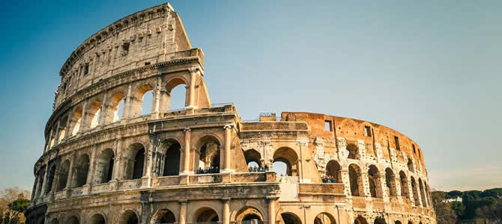
FCC Week 2016
Rome, 11 – 15 April 2016
See you in Rome next year!

