Slide 1
Next plans for FCC-ee
-- e+e- physics: ‘every event is signal’
-- qualité of FCC-ee experiments are intimately related to accelerator performance
-- available energy points
-- Luminosities
-- beam polarization and energy calibration
-- knowledge of beam other parameters (e.g. energy spread)
-- we can (mostly out of LEP experience) project fairly well the experimental precisions
sometimes they are vertiginously small
ex: Δ sin²θ_{W}^{eff} = 5 10⁻⁶ , Δm_{Z}= 0.1 MeV Δm_{W} = 0.5 MeV Δσ_{ZH} /σ_{ZH} ~10⁻³ etc...
➔ please use these ! as Roberto emphasized, common uncertainties such as Δα
can be eliminated by combination of several observables.
-- it remains that full use of precision measurements requires a considerable improvement
in the theory calculations
-- for the measurements themselves (e.g. Full two loops exponentiated for the QED ISR)
-- for the interpretation; full three loop calculations for EWRCs
and on inputs (Δα_QED(m_{Z})
need to work hand-in-hand

Slide 2
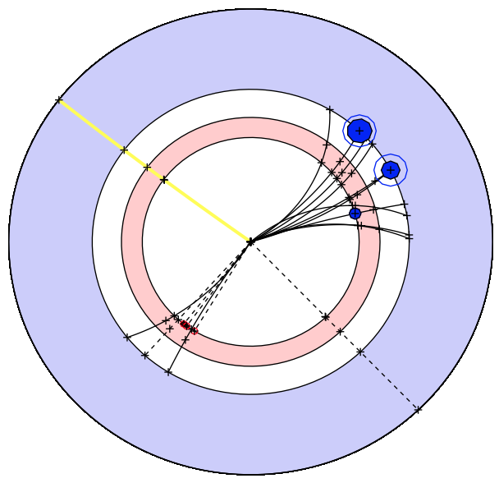
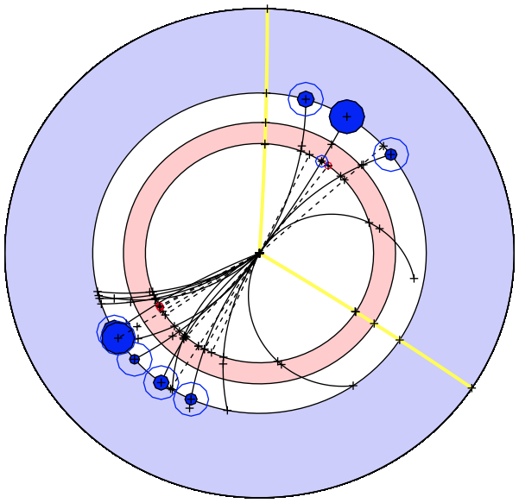
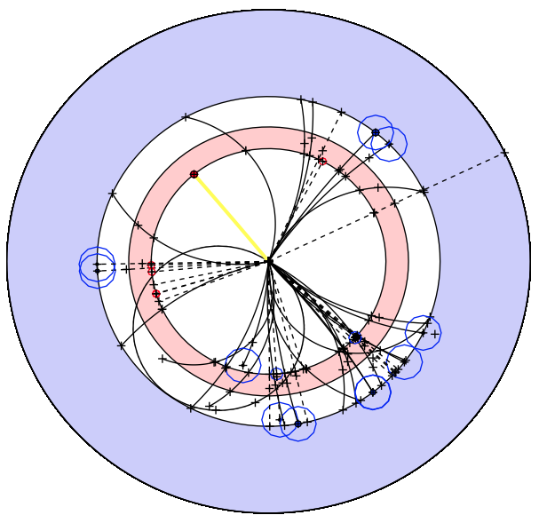
Activities common to FCC-ee, -hh, -eh (2)
Offline software developments
  Conveners: Colin Bernet & Benedikt Hegner
  Weekly meetings and monthly tutorials towards enabling physics analyses
    Subscribe to fcc-experiments-sw-dev@cern.ch
√s = 160 GeV
√s = 240 GeV
√s = 350 GeV
At least for FCC-ee we are at the point of being able to look at events!
e⁺e⁻→ W⁺W⁻
-
e⁺e⁻→ HZ
e⁺e⁻→ tt
Overall twiki page : https://twiki.cern.ch/twiki/bin/viewauth/FCC/FccSoftware

Slide 3
FCC-ee : Working groups (2)
Phenomenology studies – Coordinators J. Ellis, C. Grojean
  Match theory predictions to FCC-ee experimental precisions
  How to discover new physics in precision measurements, in rare decays (Z, W, t, H, b, c, τ, …), and in rare or invisible processes
  Set up the framework for global fits and understand the complementarity with other colliders (LHC, FCC-hh, in particular)
QCD and γγ Physics
(Joint exp/th)
P. Skands
Precision EW calculations
S. Heinemeyer
Flavour Physics
(Joint exp/th)
Jernej Kamenik
Model Building and New Physics
Andreas Weiler
Synergy with
FCC-hh physics
Linear collider physics,
LEP physics
HF physics
:
Global Analysis, Combination, Complementarity
John Ellis

Slide 4
FCC-ee : Working groups (1)
Experimental studies – Coordinators A. Blondel, P. Janot
  Precision measurements of the Z, W, H, t properties - Rare decays – BSM physics
  Develop the necessary tools Understand the experimental conditions
  Set constraints on the possible detector designs to match statistical precision
EW Physics (Z pole)
R. Tenchini
F. Piccinini
Diboson physics,m_{W}
R. Tenchini
F. Piccinini
H(126) Properties
M. Klute
K. Peters
Top Quark Physics
P. Azzi
QCD and γγ Physics
D. d’Enterria
P. Skands
Flavour Physics
S. Monteil
J. Kamenik
New Physics
M. Pierini
C. Rogan
Physics Software
C. Bernet
B. Hegner
Online & Trigger
E. Perez
C. Leonidopoulos
Exp’tal Environment
N. Bacchetta
Common across FCC
Synergies with LCs
Synergy with FCC-hh
and Linear Colliders
Detector Designs
A. Cattai
G. Rolandi
Synergy with linear collider detectors:
Collaboration with CLIC detector (CERN group)
Several detectors possible
lots of space for new ideas!

Slide 5
On our horizon:
-- we have regular VIDYO conferences on Monday 15:00 -- 17:00 (both acc. and phys.)
-- regular meetings of heavy flavour (leptons or quarks) group
-- workshop on precision calculations for Future Colliders
13-14 July, CERN
-- workshop on interpretation of precision SM tests
in the fall : -- to what new physics are these sensitive
-- extracting info from a series of different measurements
-- Workshop on detectors technologies for future e+e- colliders
(should get input from accelerator designs and from phenomenological ‘interest’)
investigate requirement from precision flavour and searches
Go to FCC-ee web site http://cern.ch/fcc-ee
and register to be informed

Slide 6
Fill the complemntarity matrix
Physics coordination: FCC-ee, -hh, -eh coordinators + project managers
  Ensure that all physics studies progress as one single endeavour
    Propose physics topics to be used in the study of complementarity and synergies
Subject |  | ee | hh | eh
Higgs Physics | Precision studies Higher dimension operators Composite Higgs Rare and exotic decays Multiple Higgs production Extra Higgs bosons
Interface with Cosmology | Dark matter Baryogenesis Right-handed/(almost) sterile neutrinos
EW Symmetry Breaking | WW scattering Supersymmetry Extra dimensions Composite models
Flavour Changing | Rare H,Z,W,top decays Lepton flavor violation
Extensions of the SM | Extra vector-like fermions SU(2)_{R} models Leptoquarks
QCD | Perturbation theory, structure functions Modelling final states
EW/SM precision issues | Precision measts (m_{Z},m_{W},m_{t},α,α_{s}(m_{Z}),sin²θ_{W}.R_{b}... Higher-order EW corrections W,Z triple and quadruple couplings Top (anomalous) couplings Charm/bottom flavor studies
Suggest that we form (a) small working group(s) to establish the matrices

