Slide 1
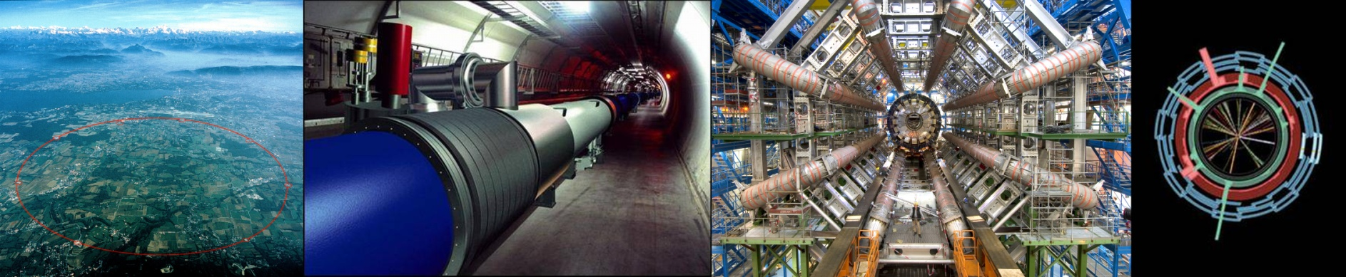
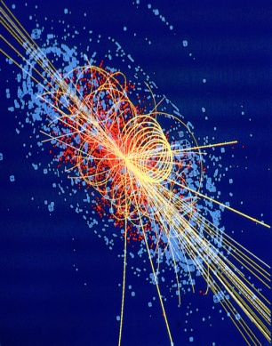
Introduction to LHC
Beam Instrumentation
Beam Position and Beam Intensity
CERN Academic Lectures 2014
10th – 14th November, 2014
Dr. Rhodri Jones
Head of the CERN Beam Instrumentation Group

Slide 2
Introduction
What do we mean by beam instrumentation?
  The “eyes” of the machine operators
    i.e. the instruments that observe beam behaviour
    An accelerator can never be better than the instruments measuring its performance!
What does work in beam instrumentation entail?
  Design, construction & operation of instruments to observe particle beams
  R&D to find new or improve existing techniques to fulfill new requirements
  A combination of the following disciplines
    Applied & Accelerator Physics; Mechanical, Electronic & Software Engineering
  A fascinating field of work!
What beam parameters do we measure?
  Beam Position
    Horizontal and vertical throughout the accelerator
  Beam Intensity (& lifetime measurement for a storage ring/collider)
    Bunch-by-bunch charge and total circulating current
  Beam Loss
    Especially important for superconducting machines
  Beam profiles
    Transverse and longitudinal distribution
  Collision rate / Luminosity (for colliders)
    Measure of how well the beams are overlapped at the collision point

Slide 3
More Measurements
Machine Tune
QF
QD
Characteristic Frequency
of the Magnetic Lattice
Given by the strength of the
Quadrupole magnets
QF
QD
QF
SD
SF
SD
SF
SF
Machine Chromaticity
Spread in the Machine Tune due to Particle Energy Spread
Controlled by Sextupole magnets
Optics Analogy:
Lens
[Quadrupole]
Focal length is
energy dependent
Achromatic incident light
[Spread in particle energy]

Slide 4
The Typical LHC Instruments
Beam Position
  electrostatic or electromagnetic pick-ups and related electronics
Beam Intensity
  beam current transformers
Beam Profile
  screens
  wire scanners
  synchrotron light monitors
  ionisation monitors
Beam Loss
  ionisation chambers and solid-state detectors
Machine Tune and Chromaticity
  base band tune measurement system
Other Monitors
  Luminosity, schottky, abort gap, instability
Today
Tomorrow
Friday

Slide 5
Position Measurement
Main functionalities
  Orbit measurements and single turn trajectories
  Feedback to align and stabilize beams
  Position interlock to dump the beam if deviating
Secondary functionalities
  Measurements of lattice parameters:
    Turn-by-turn on a single monitor:
      Betatron oscillation, beam response, transfer function
    Turn-by-turn on the whole monitors:
      Phase advance, phase change, optics checks, local chromaticity
    Averaged read out:
      Energy calibration, Machine impedance

Slide 6


Electromagnetic Fields & Relativity
Static Point
Charge
Moving Point
Charge
Relativistic
Point Charge
+
+
+
1/(βγ)
LHC Case – relativistic protons
  Electric & magnetic fields transverse to the direction of motion
  Can be considered as a TEM wave

Slide 7
Measuring Beam Position – The Principle
-
+
-
+
-
-
+
-
+
-
+
-
-
+
-
+
-
+
-
-
+
-
+
-
+
-
-
+
-
+
-
+
-
-
+
-
+
-
+
-
+
-
+
+
+
-
-
+
+
-
+
-
+
+
+
-
-
+
+
-
+
-
+
+
+
-
-
+
-
+
-
-
+
-
+
-
+
-
-
+
-
+
-
+
-
-
+
-
+
+
+
+
+
+
+
+
+
+
+
+
+
+
+
+
+
+
+
+
+
+
+
+
+
+
+
+
+
+
+
+
+
+
+
+
+
+
+
+
+
+
+
+
+
+
+
+
+
+
+
+
+
+
+
+
+
+
+
+
+
+
+
+
+
+
+
+
+
+
+
+
+
+
+
+
+
+

Slide 8
Electrostatic Monitor – The Principle
V
-
+
-
+
-
-
+
-
+
-
+
-
-
+
-
+
-
+
-
+
-
-
+
-
+
-
+
-
+
-
+
-
+
-
-
-
+
+
-
-
+
+
-
-
-
-
+
-
+
-
+
-
-
+
-
+
-
+
-
-
+
-
-
-
-
-
+
-
+
+
-
+
-
-
+
-
+
-
+
-
+
-
+
+
+
+
-
+
-
-
+
-
+
+
+
+
+
+
+
+
+
+
+
+
+
+
+
+
+
+
+
+
+
+
+
+
+
+
+
+
+
+
+
+
+
+
+
+
+
+
+
+
+
+
+
+
+
+
+
+
+
+
+
+
+
+
+
+
+
+
+
+
+
+
+
+
+
+
+
+
+
+
+
+
+
+
+
+
+
+

Slide 9
Electrostatic Monitor – Beam Response
C
Response (V)
V_{B}
0
0
Frequency (Hz)
R
V
+
+
+
+
+
+
+
+
+
+
+
+
+
+
+
+
+
+
+
+
+
+
+
+
+
+
+
+
+
+
+
+
+
+
+
+
+
+
+
+
+
+
+
+
+
+
+
+
+
+
+
+
+
+
+
+
+
+
+
+
+
+
+
+
+
+
+
+
+
+
+
+
+
+
+
+
+

Slide 10
Electrostatic Monitor – The Principle
V
-
+
-
+
-
-
+
-
+
-
+
-
-
+
-
+
-
+
-
+
-
-
+
-
+
-
+
-
+
-
+
-
-
+
-
+
+
-
-
-
-
+
-
+
-
-
-
-
+
+
-
+
-
-
+
-
+
-
-
-
-
-
-
-
-
-
+
-
+
+
-
+
+
-
+
-
-
+
-
+
-
+
-
+
-
+
+
+
+
-
+
-
-
+
-
+
+
+
+
+
+
+
+
+
+
+
+
+
+
+
+
+
+
+
+
+
+
+
+
+
+
+
+
+
+
+
+
+
+
+
+
+
+
+
+
+
+
+
+
+
+
+
+
+
+
+
+
+
+
+
+
+
+
+
+
+
+
+
+
+
+
+
+
+
+
+
+
+
+
+
+
+
+
+
+
-
+
+
-
+
+
-
-
-
-
+
-
-
+
-
-
+
+
+
-
-
+
-
+
+
-
-
-
+
-
+
-
-
-
-
-
-
+
-
+
+
+
+
-
+
-
-
+

Slide 11
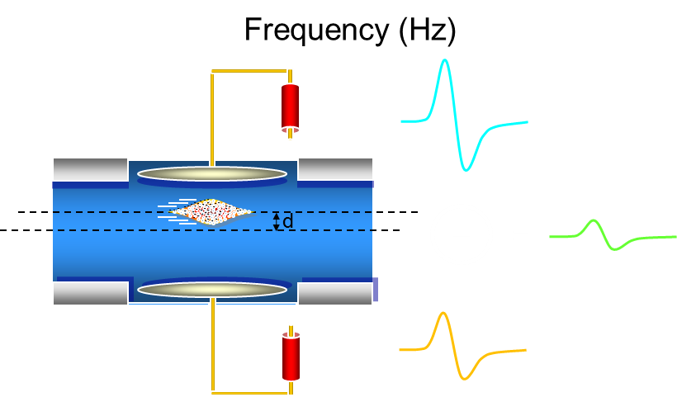
Electrostatic Monitor – The Principle

Slide 12
Electrostatic Pick-up – Button
Area A
Low cost ⇒ most popular
Non-linear
  requires correction algorithm
  when beam is off-centre
r
For Button with Capacitance C_{e} & Characteristic Impedance R₀
Transfer Impedance:
Lower Corner Frequency:

Slide 13
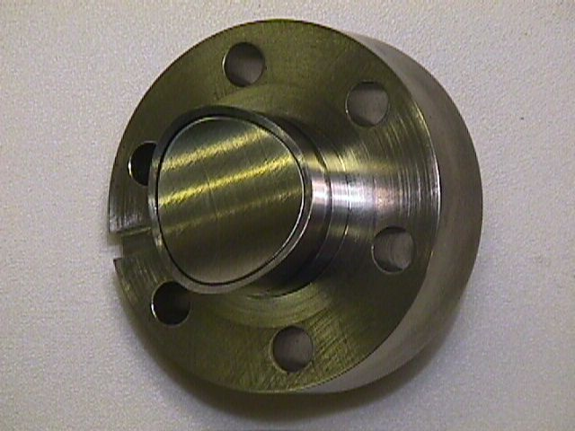
A Real Example – The LHC Button
Response (V)
0
Frequency (Hz)
0

Slide 14
Normalising the Position Reading
To make it independent of intensity
3 main methods:
  (E₁ – E₂) / (E₁ + E₂) = Δ / Σ
  Arctan(E₁ / E₂)
  Log(E₁) – Log(E₂)
LHC uses equivalent of 2nd method as we’ll see in a moment
E₁
E₂

Slide 15
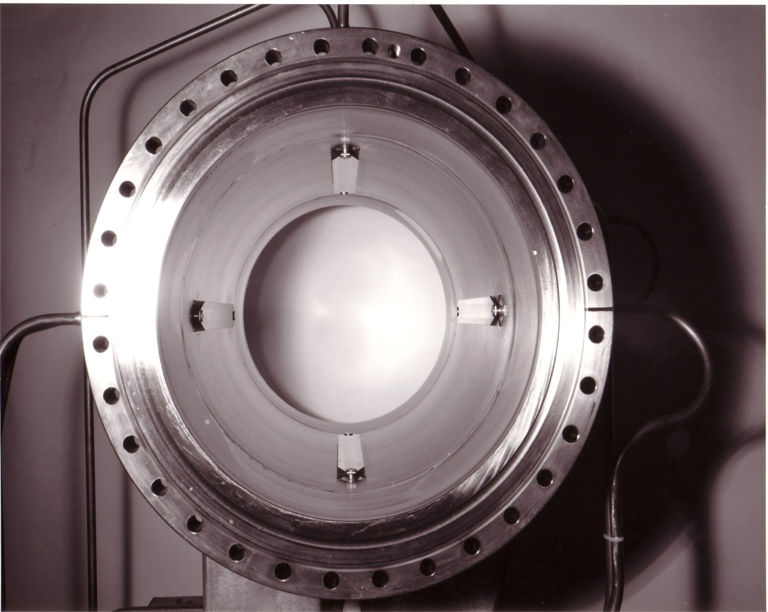
Electromagnetic (Directional) coupler
A transmission line (stripline) which couples to the transverse electromagnetic (TEM) beam field
  Z_{t ∞}= 60 ln[(r+h)/r]
  ≡ Z₀*[a/2π(r+h)]
    Z₀ is the characteristic
    impedance
    a, r, h, l are the
    mechanical dimensions
    t = l/c is the propagation
    time in the coupler
a
r
h

Slide 16
EM Stripline Coupler – right travelling beam
+
+
+
+
+
Left Output Port
Right Output Port
Left
Right

Slide 17
EM Stripline Coupler – left travelling beam
+
+
+
+
+
Left Output Port
Right Output Port
Left
Right

Slide 18
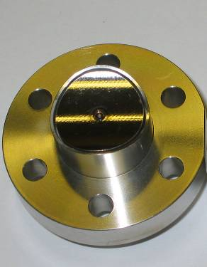
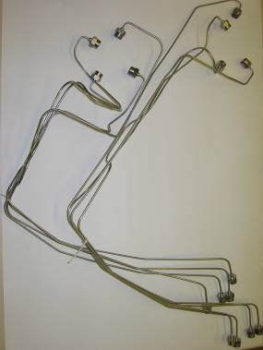
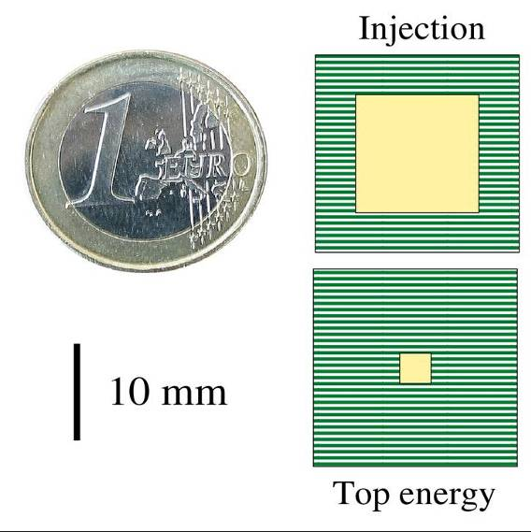
Beam Position System Challenges
Pick-up requirements
  Mechanics that can operate at ~4K
  Maximise aperture & signal strength
  Minimise transverse impedance
Dynamic Range
  From 1 bunch of 1×10⁹ charges to 2808 bunches of 1.7×10¹¹ charges
Linearity
  Better than 1% of half radius, ~130μm for arc BPMs
    Over whole intensity range
    Over large fraction of the aperture
Resolution
  In the micron range for accurate global orbit control
    Driven by collimation requirements
    Over 120 collimator jaws in the LHC

Slide 19
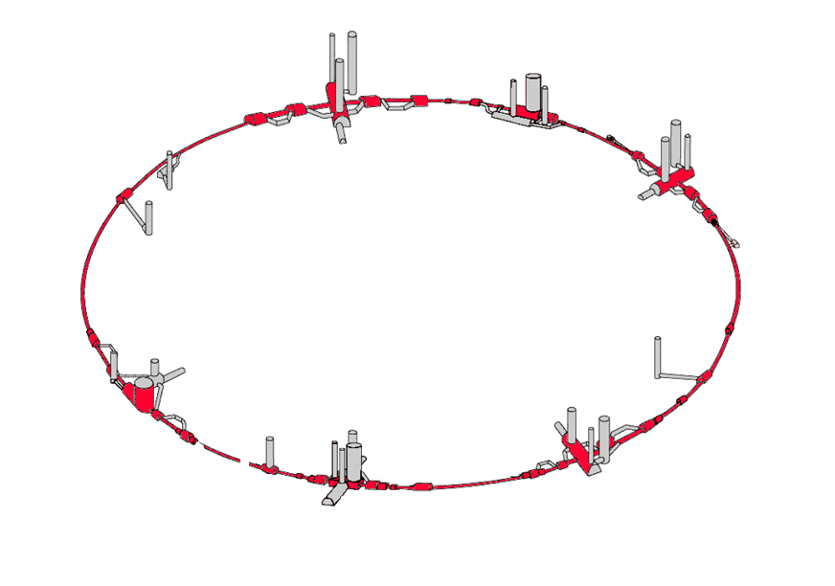
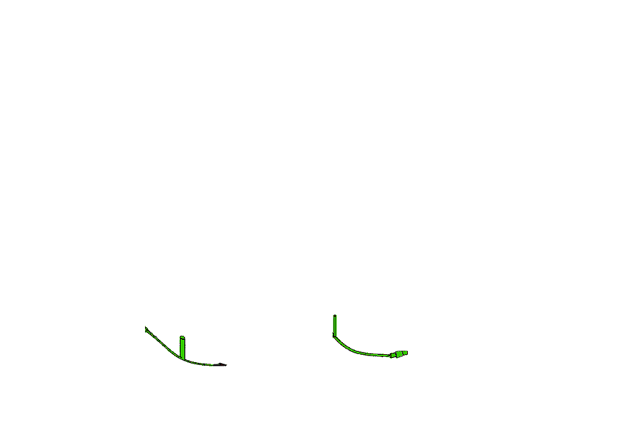
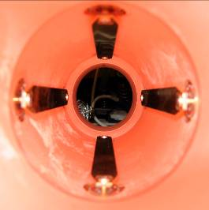
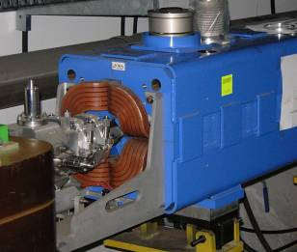
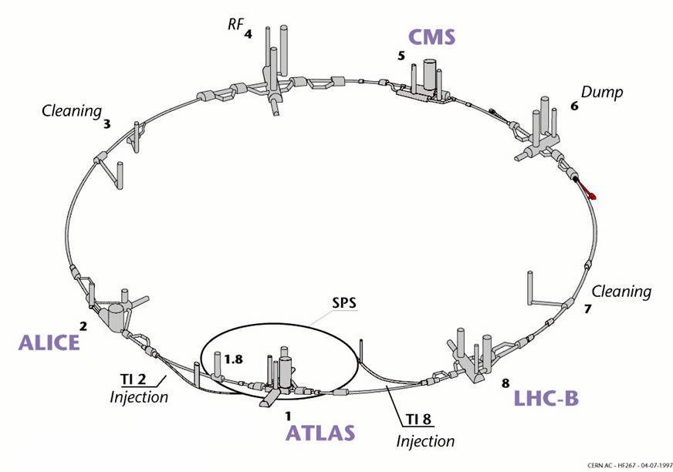
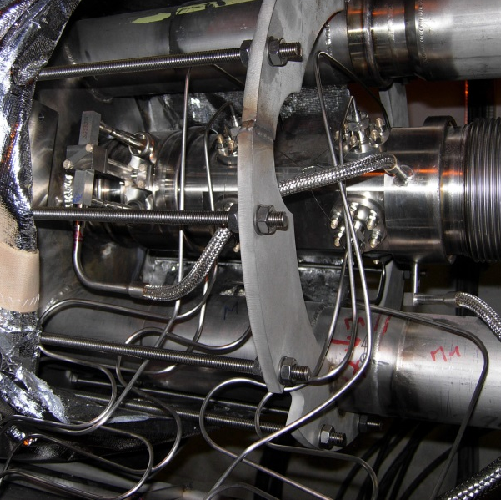
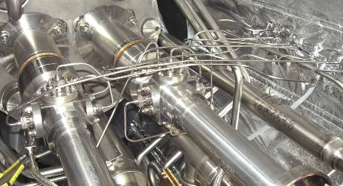
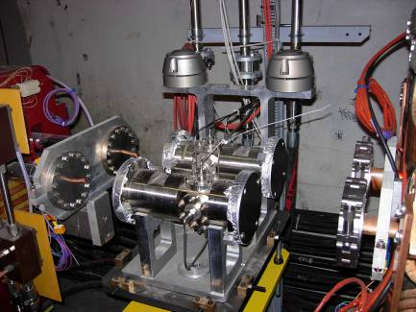
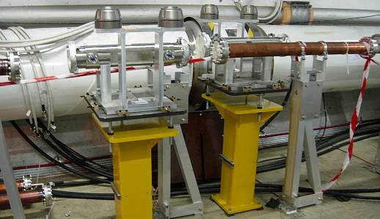
LHC BPM System - General Layout
Total of 1182 BPMs for the LHC
and its Transfer Lines
24 Directional Couplers
52 Enlarged Button
& 8 Trigger BPMs
Interaction Regions
54 Special BPMs for Tune & Chromaticity,
Transverse Damper & RF, Beam Dump
912 Button Electrode BPMs (24mm)
for the
Main Arcs & Dispersion Suppressors
Injection Lines: 100 Warm, Button BPMs
(Buttons Recuperated from LEP)
36 Warm
BPMs -
34mm Button
Electrodes

Slide 20
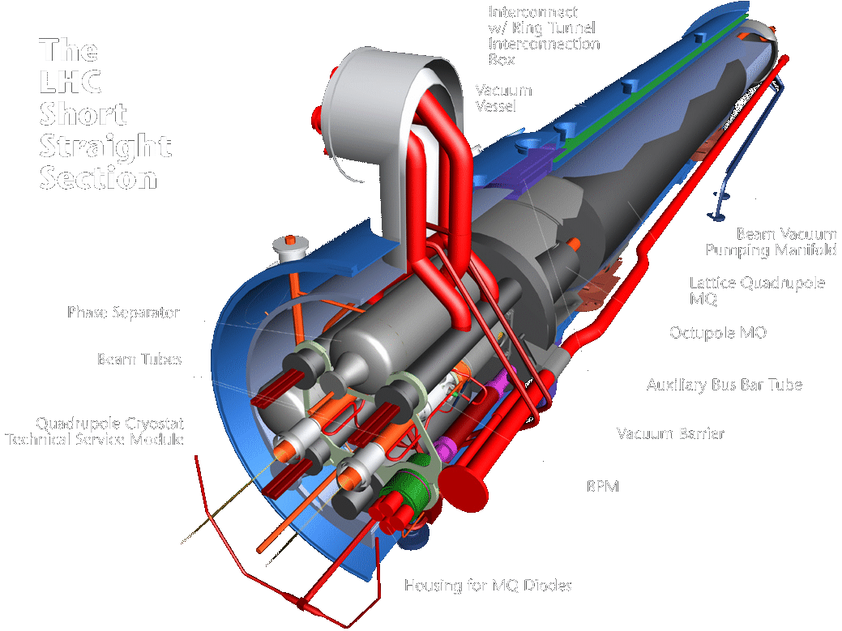
The Arc BPM - SSS Layout

Slide 21
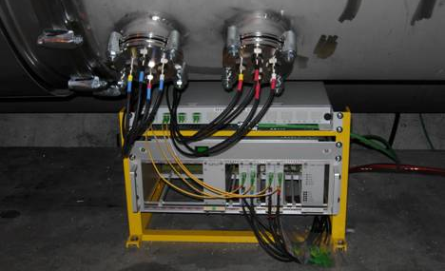
BPM electronics
Distributed System
  Front-ends located under each arc quadrupole
    Minimises cable length
    Radiation tolerant (12Gy/year expected dose)
  Amplitude to time normalisation in tunnel
    Position converted into time difference
  Fibre-optic transmission to surface

Slide 22
Amplitude to Time Normalisation
A
B
B + 1.5ns
1.5ns
A
Beam
Splitter
Delay lines
Combiner
B
Pick-up

Slide 23
Amplitude to Time Normalisation
A + (B + 1.5ns)
A
B
Δt depends on position
B + (A + 1.5ns)
A
B

Slide 24
The Wide Band Time Normaliser
A
B
A+(B+1.5ns)
B+(A+1.5ns)+10ns
Interval = 10 ± 1.5ns
System output

Slide 25
LHC BPM Acquisition Electronics
Advantages
Fast normalisation (< 25ns)
  bunch to bunch measurement
Signal dynamic independent of the number of bunches
  Input dynamic range ~45 dB
  No need for gain selection
Reduced number of channels
  normalisation at the front-end
~10 dB compression of the position dynamic due to the recombination of signals
Independent of external timing
Time encoding allows fibre optic transmission to be used
Limitations
Reserved for beams with empty RF buckets between bunches e.g.
  LHC 400MHz RF but 25ns spacing
  1 bunch every 10 buckets filled
Tight time adjustment required
No Intensity information
Needs two sensitivity threshold settings to avoid spurious triggers
Propagation delay stability and switching time uncertainty are the limiting performance factors

Slide 26
LHC Beam Position System Layout

Slide 27
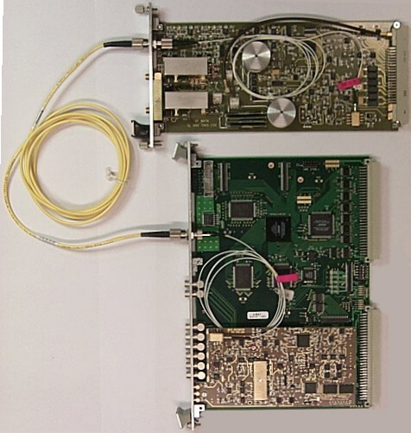
The LHC BPM Acquisition System
Very Front-End WBTN Card
70MHz Low Pass Filters
Supplied by TRIUMF (Canada)
1310nm Diode Laser Transmitter
Tunnel
Single-Mode Fibre-Optic Link
Surface
VME based
Digital Acquisition Board
TRIUMF (Canada)
(2 x 12bit 40MHz Acq)
WBTN Mezzanine Card
(10bit digitisation at 40MHz)

Slide 28
WBTN - Linearity v Intensity
For LHC Arc BPMs 1% ~ 130μm

Slide 29
WBTN - Linearity v Position
For LHC Arc BPMs 1% ~ 130μm
For LHC Arc BPMs 1% ~ 130μm

Slide 30
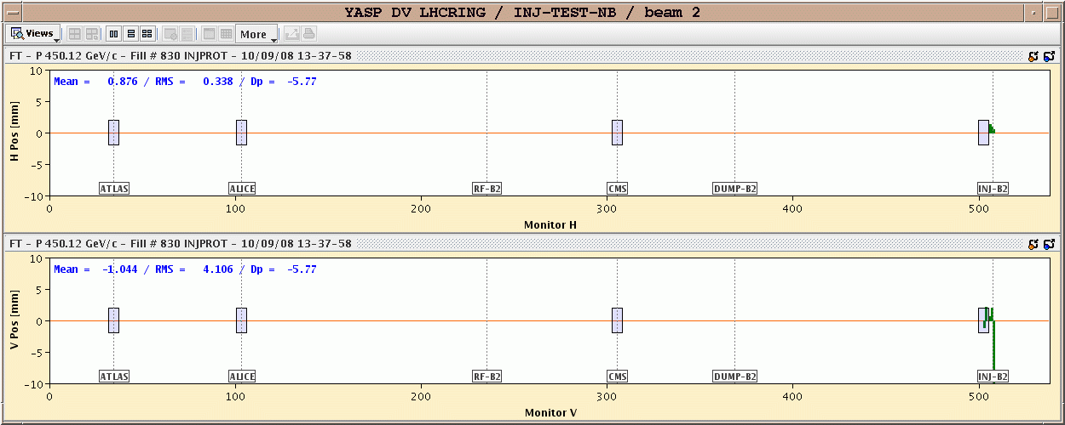
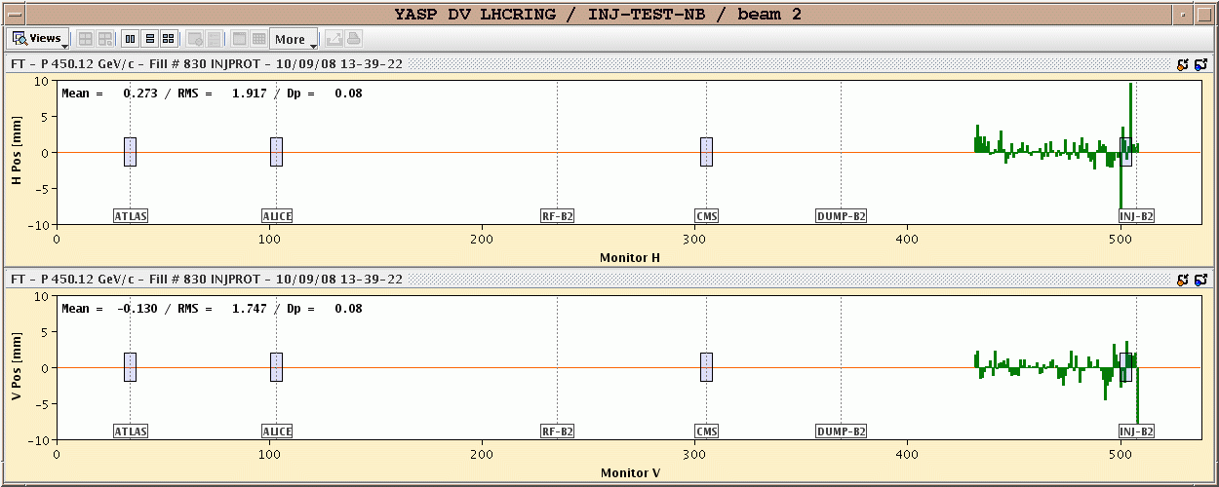
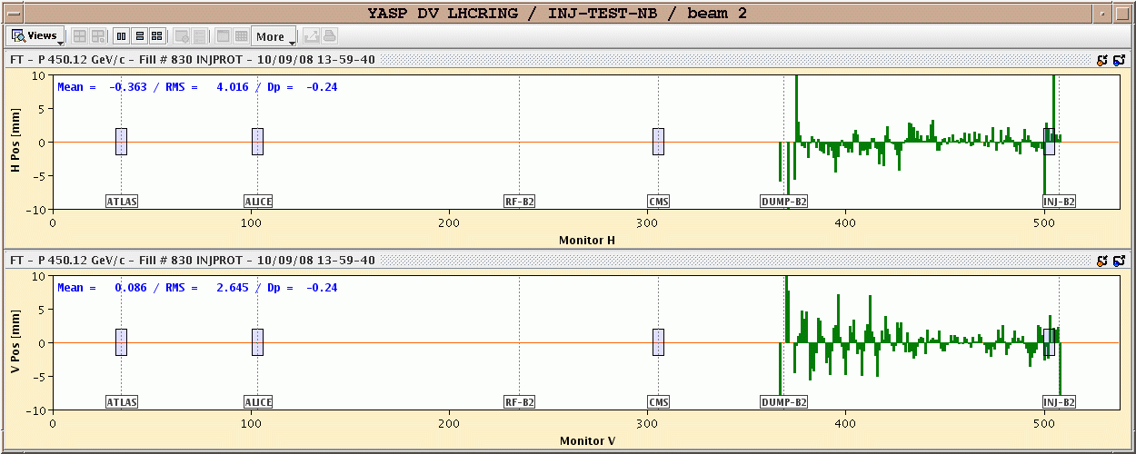
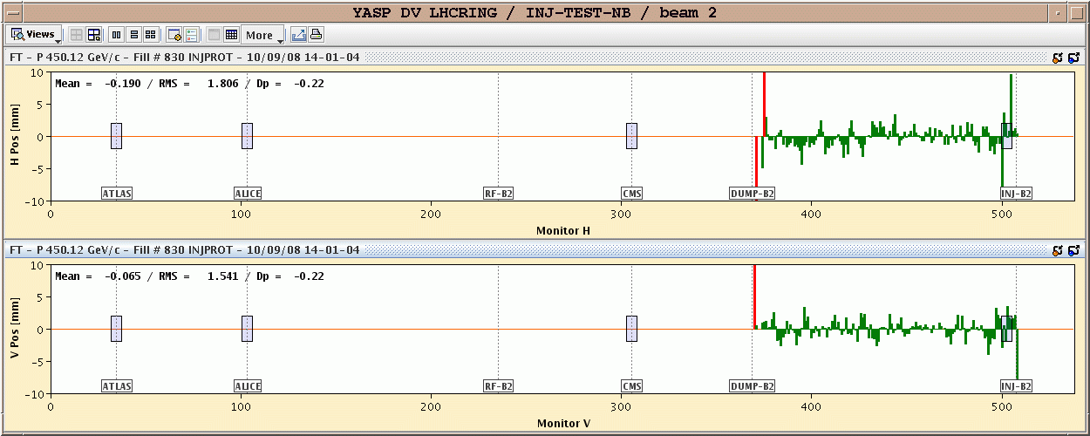
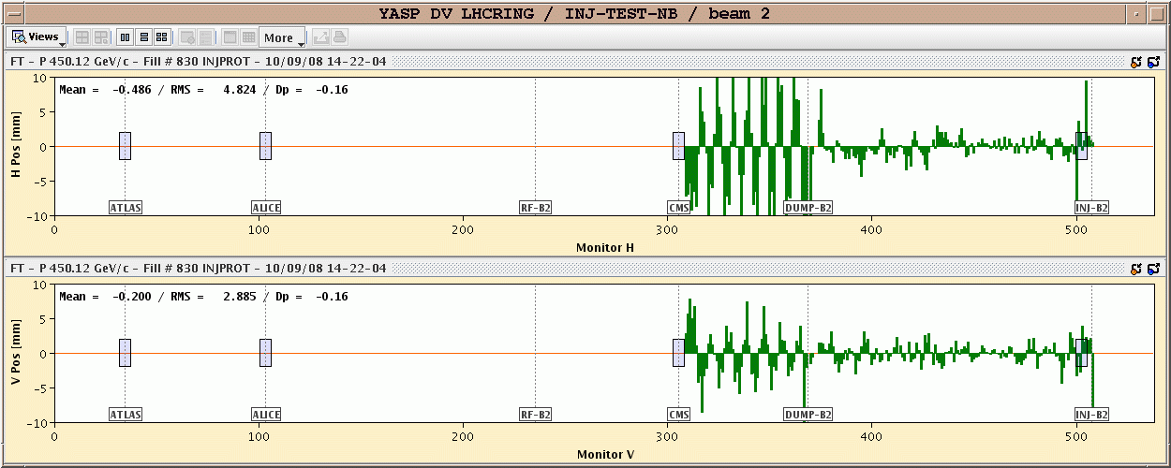
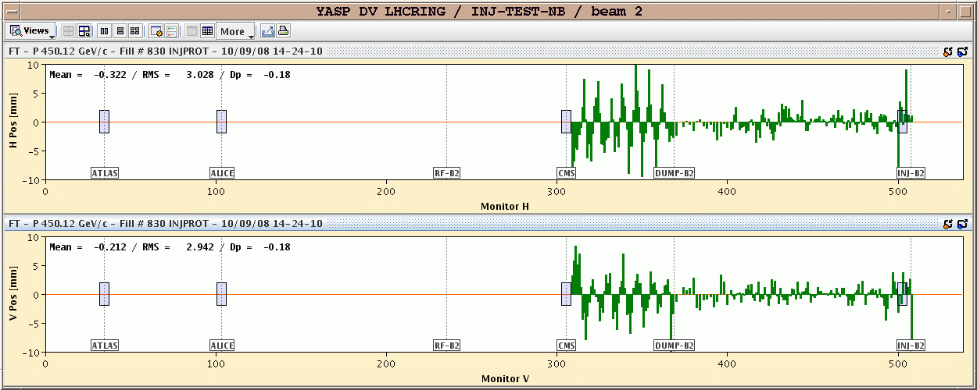
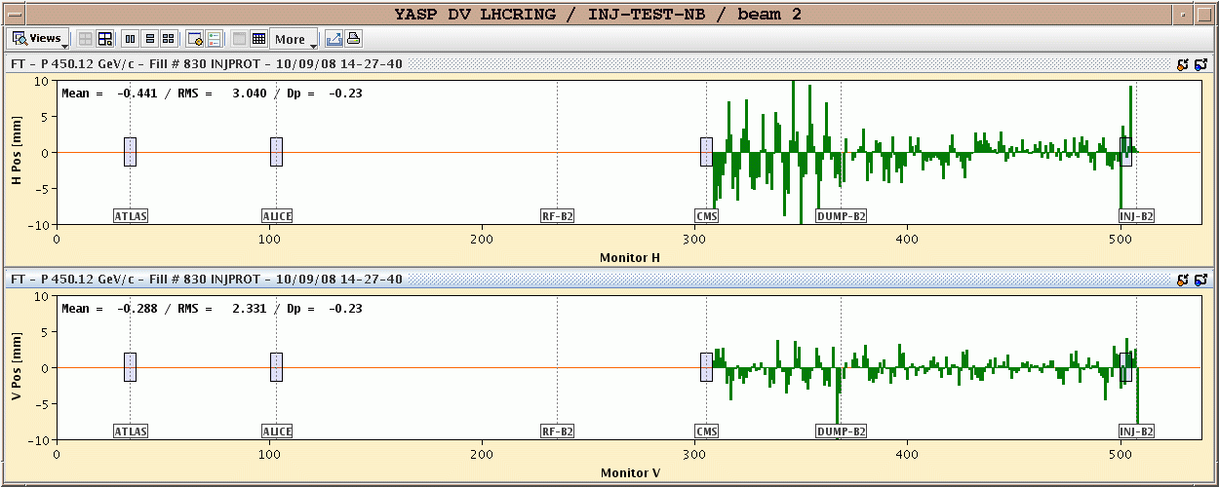
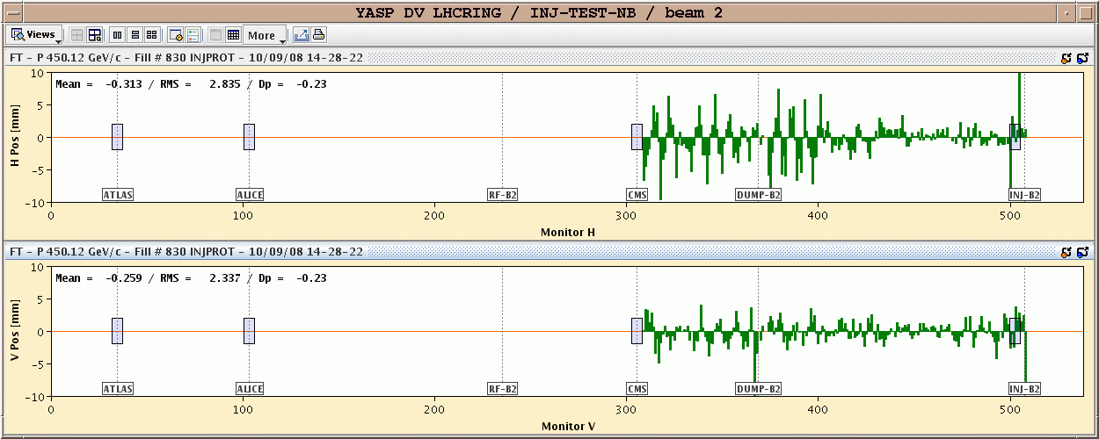
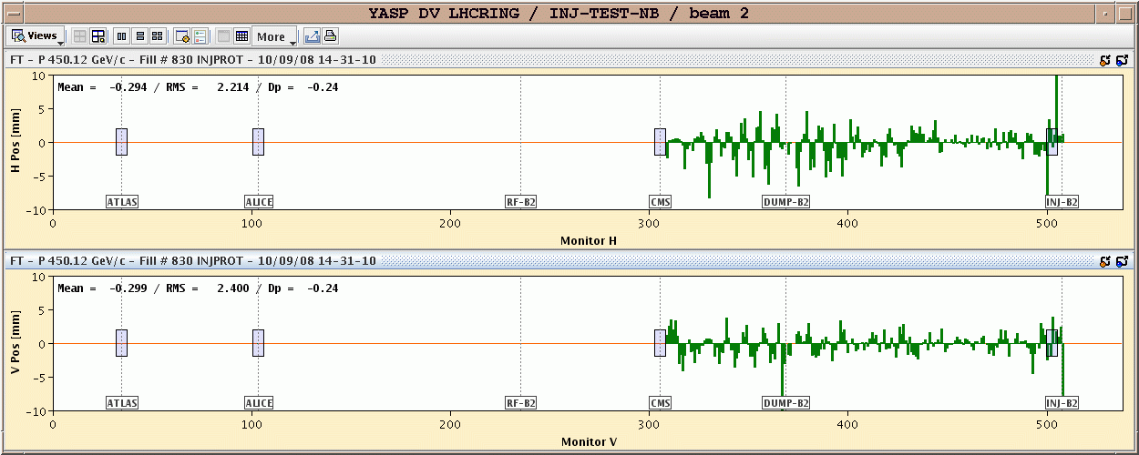
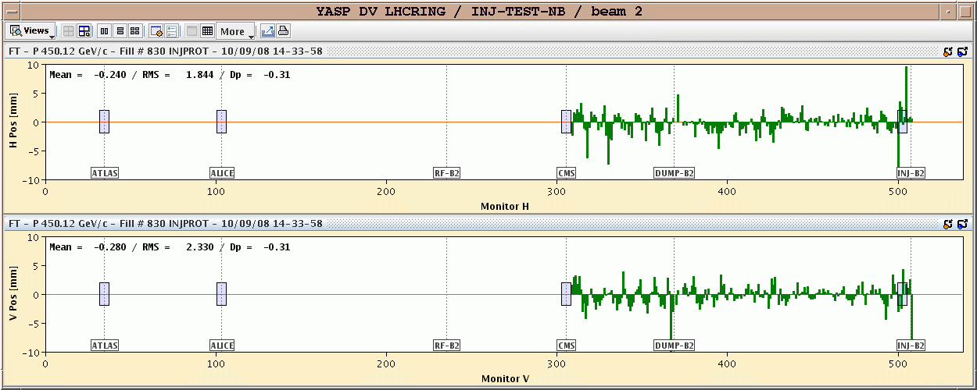
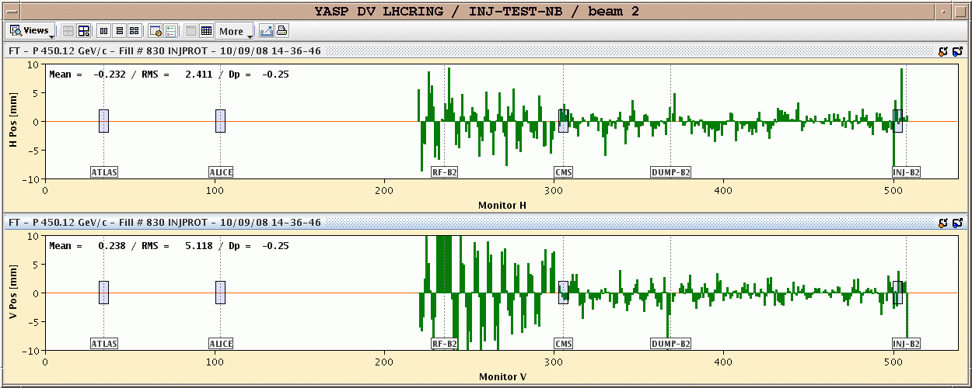
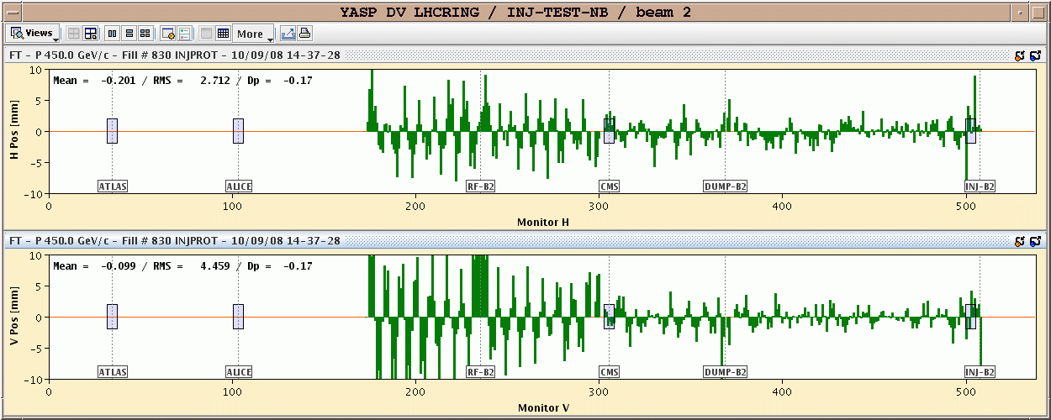
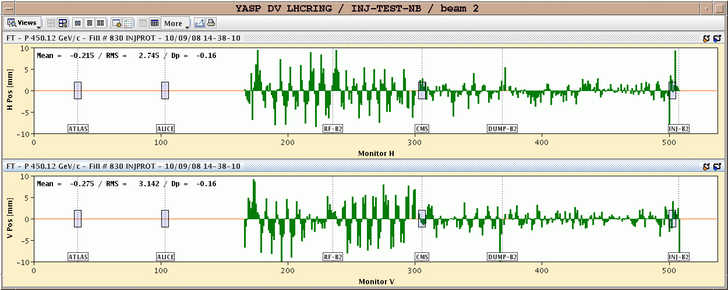
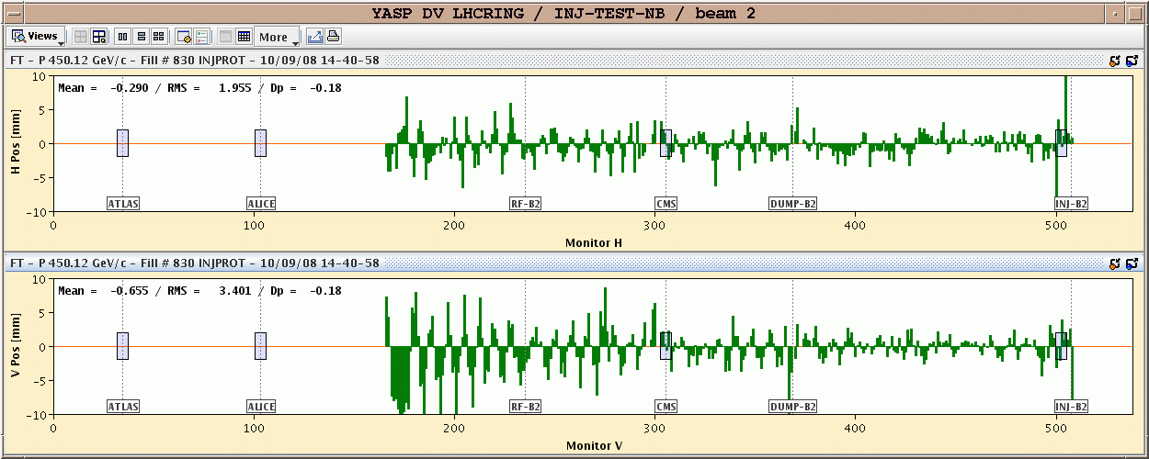
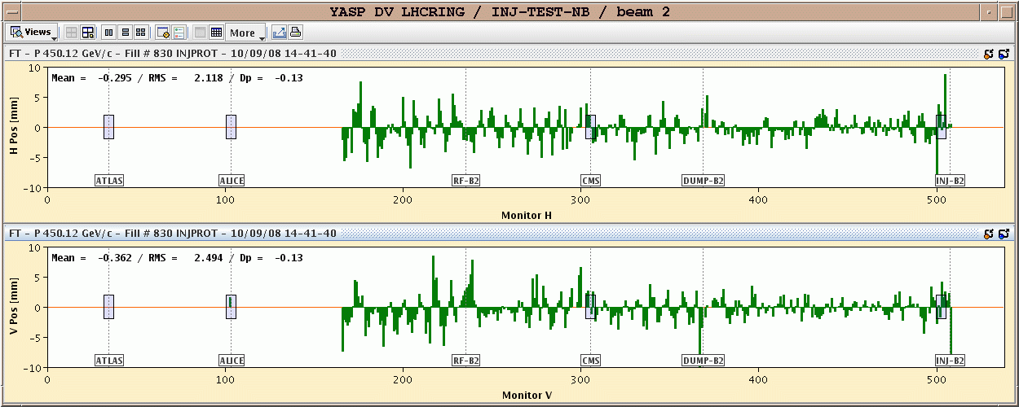
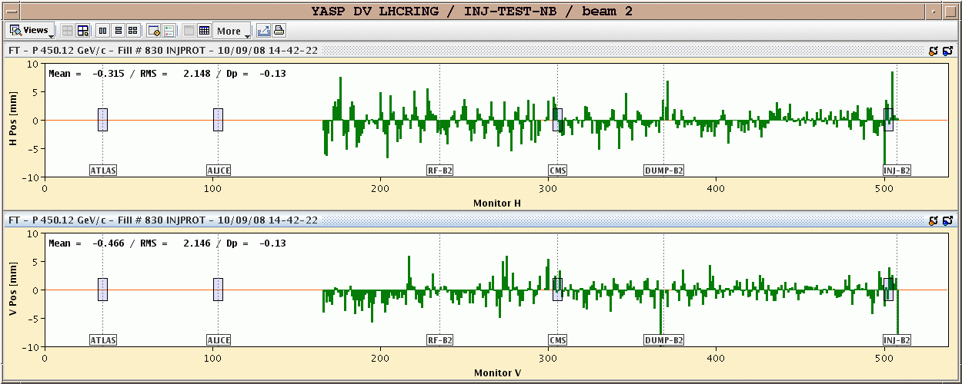
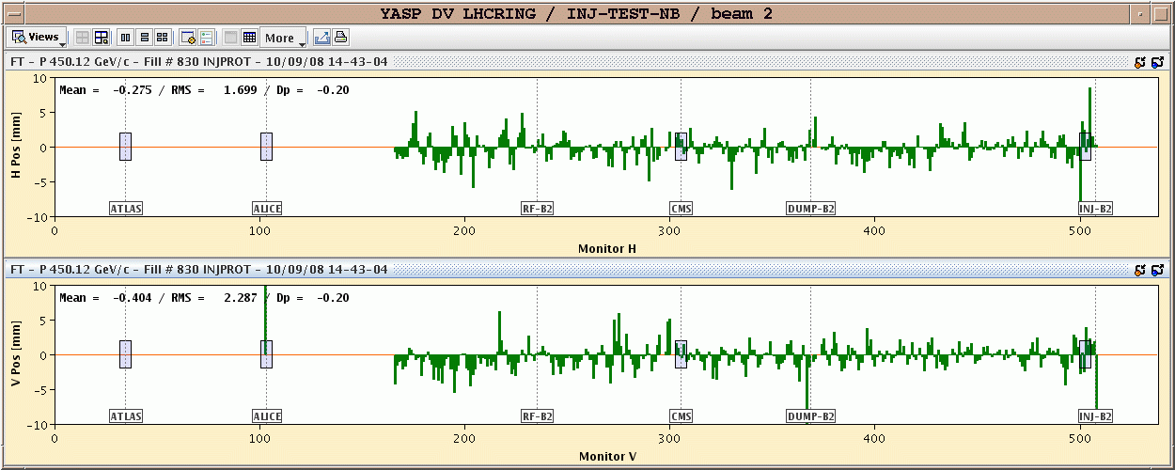
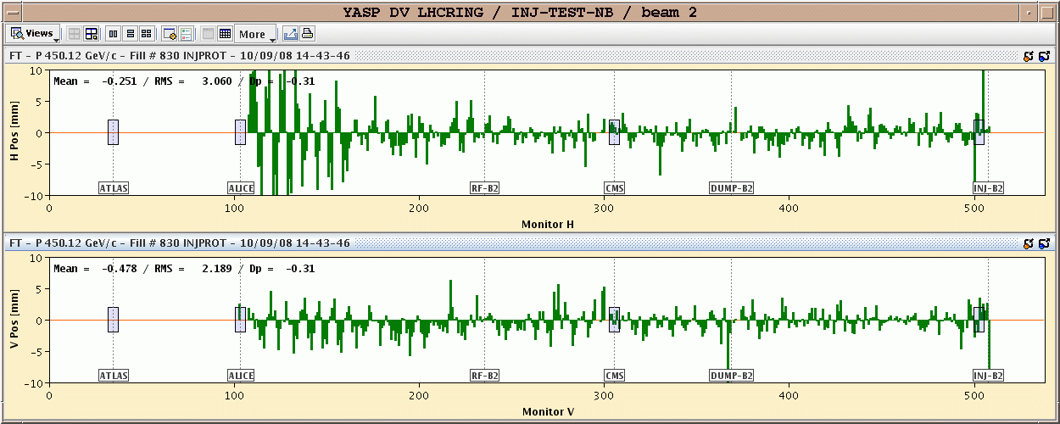
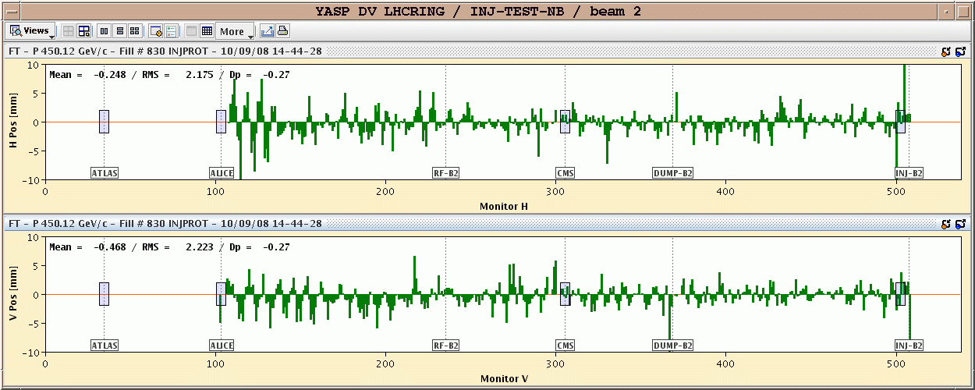
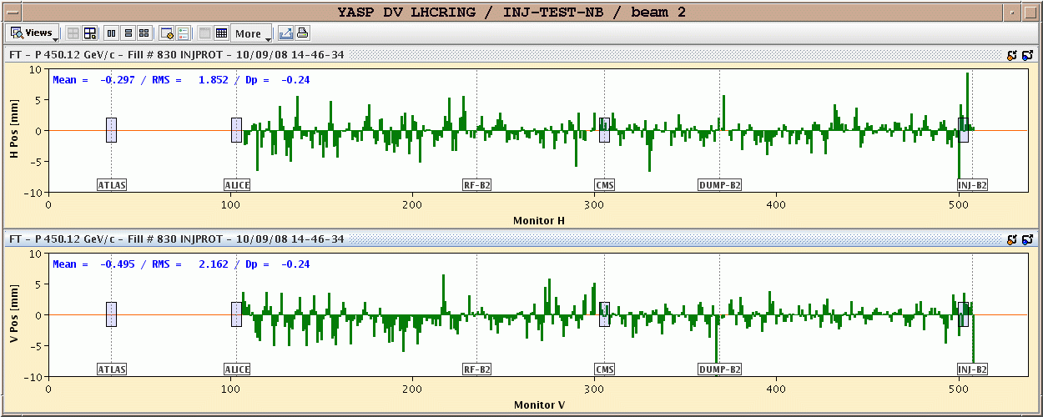
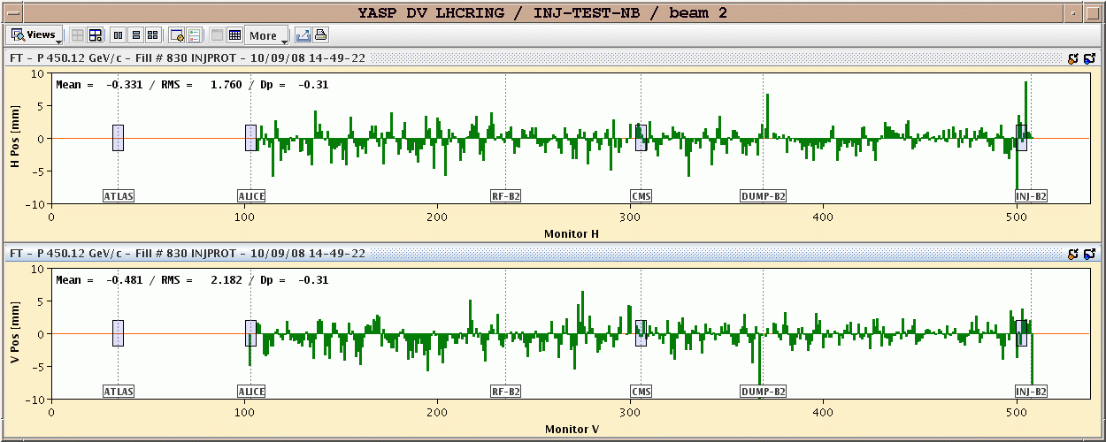
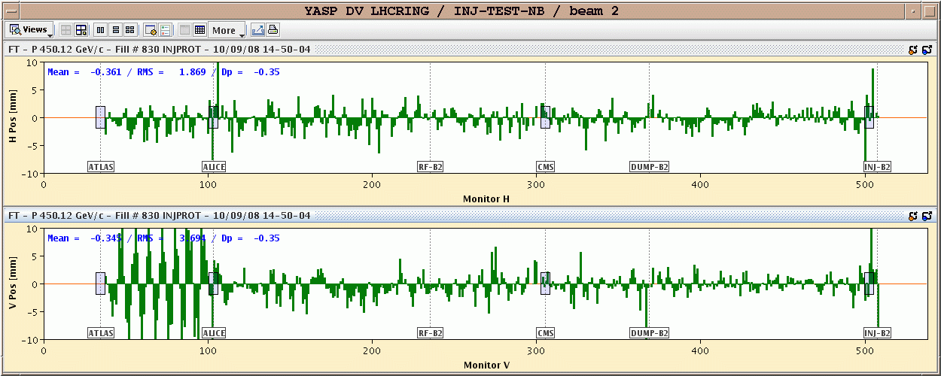
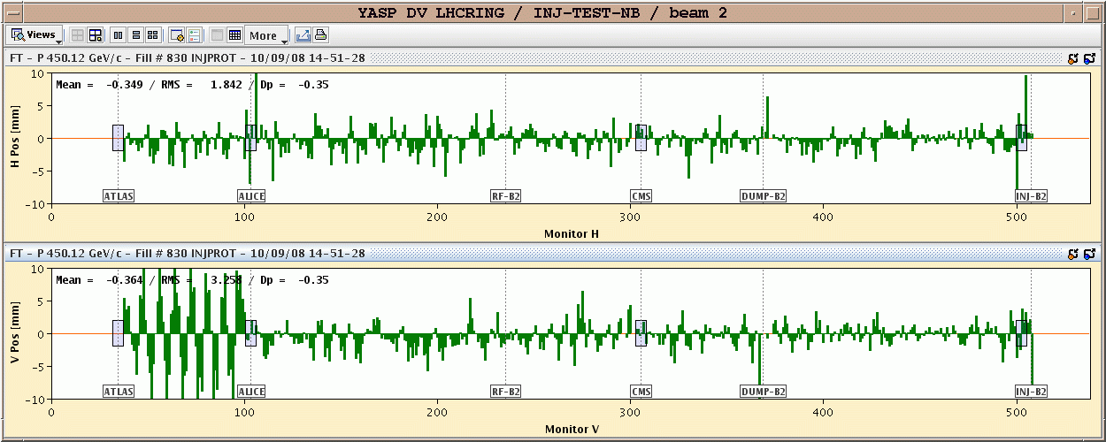
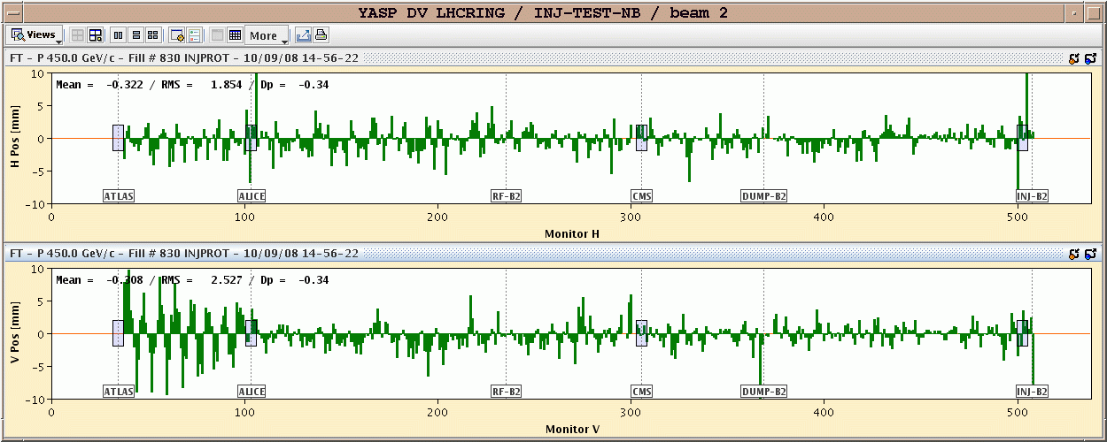
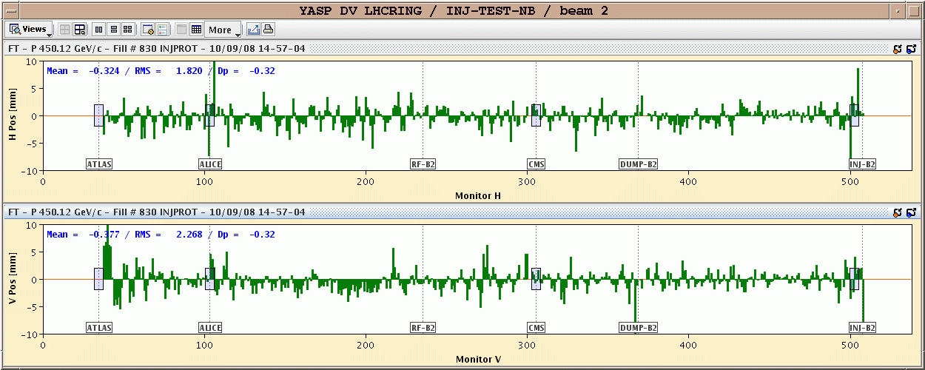
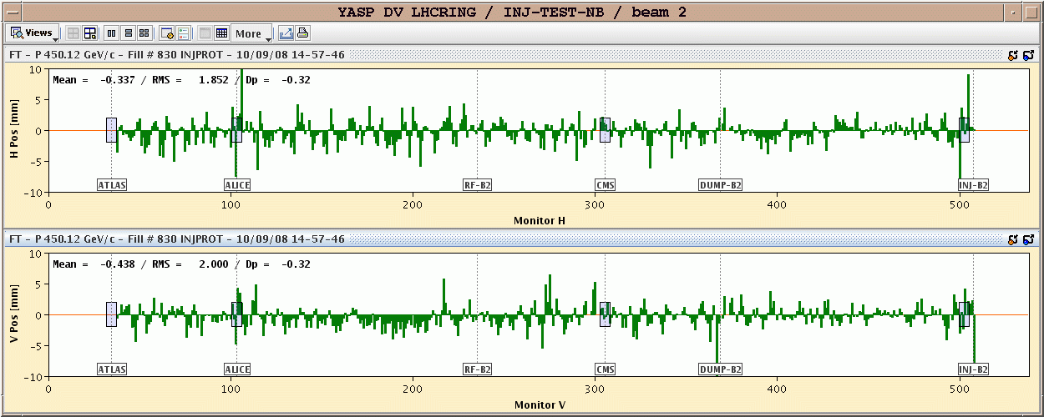
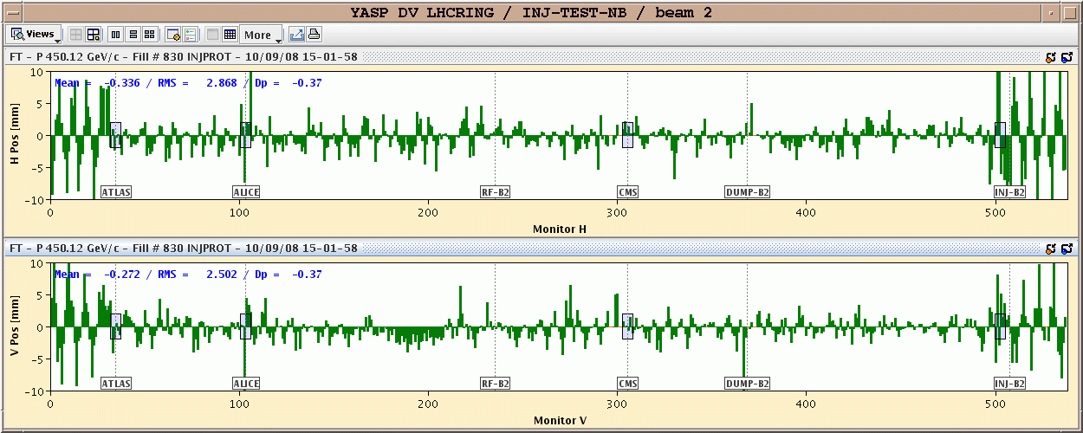
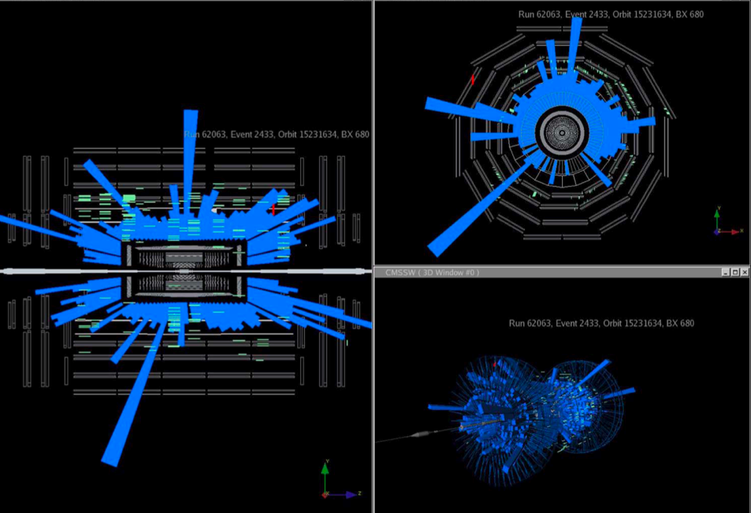
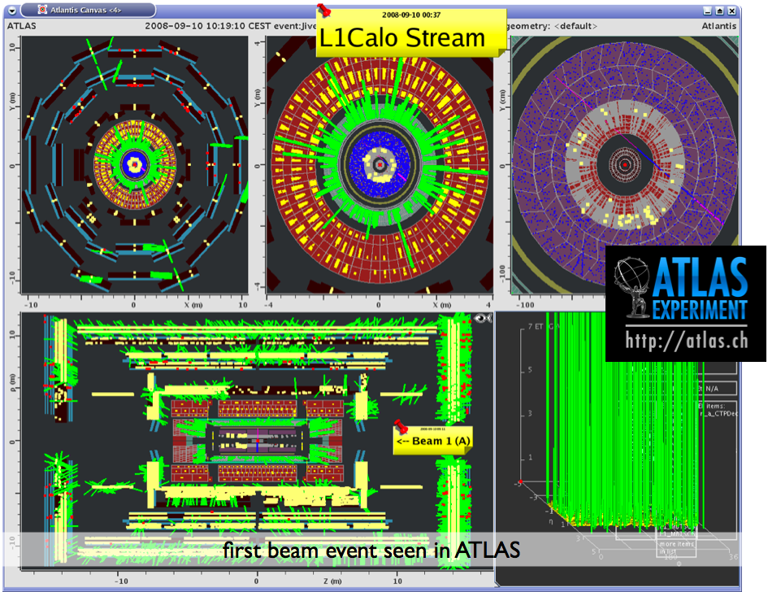
LHC BPM System Performance
Threading the first pilot bunch round the LHC
  Trajectory
    using BPMs one beam at a time, one hour per beam
    each bar represents one BPM horizontal or vertical channel
    dipole corrector magnets used to optimise trajectory
Courtesy of CMS
Courtesy of ATLAS

Slide 31
LHC BPM System Performance
On line analysis of BPM Data
  Powerful on-line tools
  Polarity errors easily identified with 45° BPM sampling
  Quick indication of phase advance errors
  Used to verify optics functions & matching from transfer lines into ring
Optics phase error
BPM polarity error

Slide 32
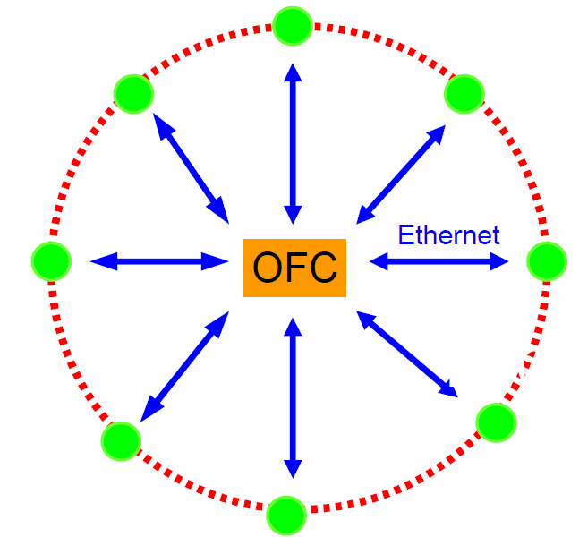
Machine Optimisation - Feedbacks
Opted for central global feedback system regrouping:
  Orbit, energy, tune (operational)
  Chromaticity, coupling (tested)
Initial requirements:
  Chromaticity expected to be most critical parameter for real-time control
  BUT
    Large losses during early ramps changed focus to tune followed by orbit feedback
Orbit Feedback Controller
Orbit-Feedback is largest & most complex LHC feedback:
  1088 BPMs → 2176+ readings @ 25 Hz from 68 front-ends
  530 correction dipole magnets/plane, distributed over ~50 front-ends
  Closed Loop Bandwidth of 1Hz
Total >3500 devices involved
  more than half the LHC is controlled by beam based feedbacks!

Slide 33

Orbit Stability
Earth Tides dominate during Physics

Slide 34


Orbit Stability
Important for collimation and collision process
LHC does not work without orbit feedback
Main limitations
  Temperature dependence of electronics
  Linearity and directivity of stripline couplers near the interaction points
Orbit correction at IP to bring beams head-on
Slow drift over year not corrected by feedforward
2012 data
80 μm
7 μm rms
Fill to fill difference is very small

Slide 35
Orbit Stability Limitations
Systematic BPM reading dependence on temperature
  Initially caused drifts up to 300μm on long-term orbit
  Suppressed to the order of 100μm by
    Calibration before each fill
    Temperature compensation of each individual BPM channel
  During LS1 - placed electronics in temperature controlled racks

Slide 36



Improving the LHC BPM System
Collimators with Embedded BPMs
  18 tertiary collimators now equipped with BPM buttons
  Readout via high resolution Diode Orbit electronics
    Compensated diode peak detectors
    Resolution <100nm for centred beams
  Allows fast, parallel alignment
    < 20 s without touching beam
    2 orders of magnitude faster than BLM method

Slide 37
The Typical LHC Instruments
Beam Position
  electrostatic or electromagnetic pick-ups and related electronics
Beam Intensity
  beam current transformers
Beam Profile
  screens
  wire scanners
  synchrotron light monitors
  ionisation monitors
Beam Loss
  ionisation chambers and solid-state detectors
Machine Tune and Chromaticity
  base band tune measurement system
Other Monitors
  Luminosity, schottky, abort gap, instability

Slide 38




AC (Fast) Current Transformers
Image
Core of high
relative permeability
Ceramic Gap
Image
Beam
CoFe based amorphous alloy Vitrovac: μ_{r}= 10⁵

Slide 39


AC (Fast) Current Transformers
i_{BCT}
Beam
V_{BCT}
B_{B}

Slide 40
Fast Beam Current Transformer
Image
Current
1:40 Passive
Transformer
Ceramic Gap
BEAM
80nm Ti Coating
20Ω to improve
impedance
Calibration winding
500MHz Bandwidth
Low droop (< 0.2%/μs)

Slide 41


FBCT Acquisition Electronics
Integrator Output
25ns
FBCT Signal after 200m of Cable
Data taken on LHC type beams at the CERN-SPS

Slide 42

Bunch by bunch intensity measurement
Extensively used to understand loss mechanisms
  Example for intensity loss due to electron cloud instabilities
    Effect of scrubbing in reducing the effect clearly visible

Slide 43
The DC transformer
AC transformers can be extended to very low frequency but not to DC ( no dI/dt ! )
DC measurement is required in storage rings
To do this:
  Take advantage of non-linear magnetisation curve
  Use 2 identical cores modulated with opposite polarities
B
I

Slide 44
DCCT Principle – Case 1: no beam
Hysteresis loop
of modulator cores
B
I
Modulation Current - Core 1
Modulation Current - Core 2
I_{M}
t

Slide 45
DCCT Principle – Case 1: no beam
B
I
dB/dt - Core 1 (V1)
dB/dt - Core 2 (V2)
Output voltage = V₁ – V₂
V
t

Slide 46
DCCT Principle – Case 2: with beam
B
Beam Current I_{B}
Output signal is at TWICE
the modulation frequency
I
dB/dt - Core 1 (V1)
dB/dt - Core 2 (V2)
Output voltage = V₁ – V₂
I_{B}
V
t

Slide 47
Zero Flux DCCT Schematic
V_{a} - V_{b}
Synchronous
detector
V_{a}
V_{b}
Modulator
Power supply
Beam
R
V = R × I_{beam}
Compensation current I_{feedback} = - I_{beam}

Slide 48

The LHC DCCT
AC core added to extend bandwidth
  Up to 1.5kHz
Modulation frequency of 212Hz
  Chosen to avoid beating with harmonics of mains
Intensity range
  From ~3μA to ~900mA
  Now covered by single 24bit ADC

Slide 49


The LHC BCTs
Visual diagnostics for intensity & lifetime

Slide 50

BCT Error Sources & their Mitigation
Bunch pattern dependence & saturation of the DCCT
  Modified DCCT feedback loop, wall-current bypass & front-end amplifiers
  Uncertainty in the absolute DCCT calibration now at the 0.1% level
Satellite bunches and unbunched beam
  Produces uncertainty in cross-calibration of FBCT with DCCT
  LDM & data from experiments used to ensure this is well below 1%
Main Peak
at 10⁵

Slide 51


BCT Error Sources & their Mitigation
Bunch length dependence of the fast BCT
  Mitigated with 70MHz LP filters - still allows bunch-by-bunch measurement
Bunch position dependence of the fast BCTs
  At 1% per mm this effect was not at all expected
    Found to come from commercial toroid used - new monitor under development
  Fortunately orbit is kept sufficiently stable & limits effect to well below 1%

Slide 52

BCT Error Sources & their Mitigation
Essential for Absolute Luminosity Determination
  Important progress made in understanding many error sources
  Bunch population uncertainties now in line with other experimental sources for absolute luminosity determination
1%

Slide 53
Summary
This was an overview of the LHC Beam Position and Beam Intensity Measurement systems
Both systems have undergone upgrades during LS1
  BPM system
    Temperature controlled racks for electronics in all surface buildings
    Addition of BPMs embedded in collimators with their own dedicated, high resolution acquisition system
  Fast BCT system
    2 new types of toroid installed for testing to try and overcome bunch length and position dependency
Tomorrow you will see how we measure the beam profile in the LHC
  Essential to calculate the beam size & determine beam emittance

Slide 54
Acknowledgements
My thanks for today’s slides, data & general input go to:
  David Belohrad
  Christian Boccard
  Daniel Cocq
  Eva Calvo Giraldo
  Marek Gasior
  Jean-Jacques Gras
  Heinz Jakob
  Michal Krupa
  Thibaut Lefevre
  Patrick Odier
  Jean-Pierre Papis
  Hermann Schmickler
  Ralph Steinhagen
  Jorg Wenninger
  Guiseppe Vismara
I would also like to thank the whole of the CERN Beam Instrumentation Group and our external collaborators for their hard work over many years to make these systems operational

