Slide 1
Lecture 4 - Transverse Optics II
ACCELERATOR PHYSICS
MT 2014
E. J. N. Wilson

Slide 2
Contents of previous lecture - Transverse Optics I
Transverse coordinates
Vertical Focusing
Cosmotron
Weak focusing in a synchrotron
The “n-value”
Gutter
Transverse ellipse
Cosmotron people
Alternating gradients
Equation of motion in transverse co-ordinates

Slide 3
Lecture 4 - Transverse Optics II Contents
Equation of motion in transverse co-ordinates
Check Solution of Hill
Twiss Matrix
Solving for a ring
The lattice
Beam sections
Physical meaning of Q and beta
Smooth approximation

Slide 4
Equation of motion in transverse co-ordinates
Hill’s equation (linear-periodic coefficients)
  where at quadrupoles
  like restoring constant in harmonic motion
Solution (e.g. Horizontal plane)
Condition
Property of machine
Property of the particle (beam) ε
Physical meaning (H or V planes)
  Envelope
  Maximum excursions

Slide 5
Check Solution of Hill
Differentiate
  substituting
Necessary condition for solution to be true
  so
Differentiate again
  add both sides

Slide 6
Continue checking
The condition that these three coefficients
  sum to zero is a differential equation for
  the envelope
alternatively

Slide 7
Twiss Matrix
All such linear motion from points 1 to 2 can be described by a matrix like:
To find elements first use notation
We know
Differentiate and remember
Trace two rays one starts “cosine”
The other starts with “sine”
We just plug in the “c” and “s” expression for displacement an divergence at point 1 and the general solutions at point 2 on LHS
Matrix then yields four simultaneous equations with unknowns : a b c d which can be solved

Slide 8
Twiss Matrix (continued)
Writing
The matrix elements are
Above is the general case but to simplify we consider points which are separated by only one PERIOD and for which
The “period” matrix is then
If you have difficulty with the concept of a period just think of a single turn.

Slide 9
Twiss concluded
Can be simplified if we define the “Twiss” parameters:
Giving the matrix for a ring (or period)

Slide 10
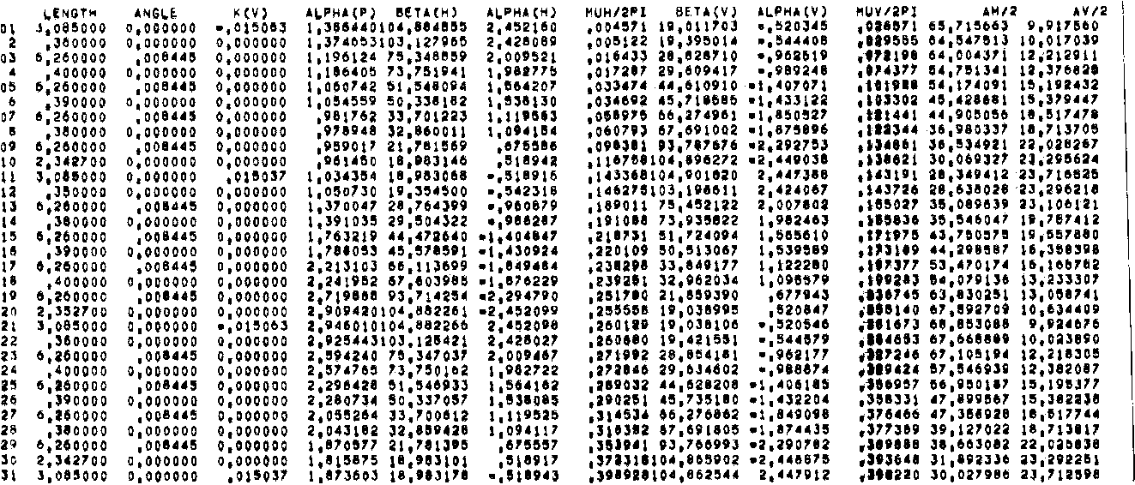
The lattice

Slide 11
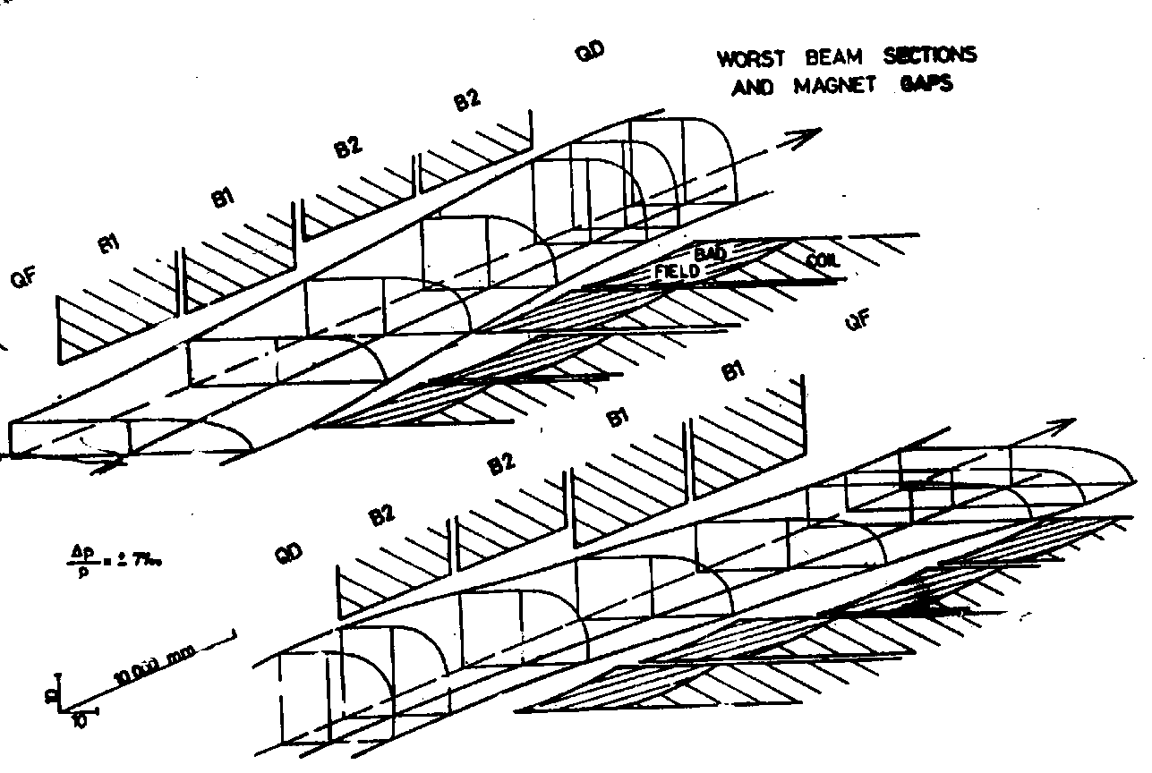
Beam sections
after,pct

Slide 12
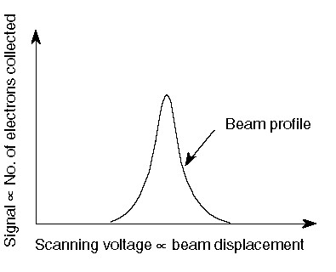
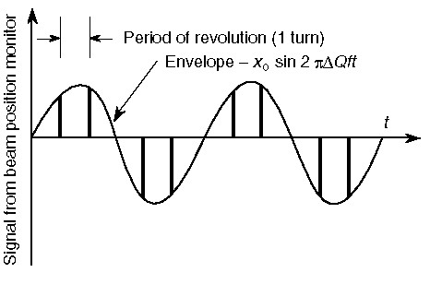
Physical meaning of Q and βετα

Slide 13
Smooth approximation

Slide 14
Principal trajectories

Slide 15
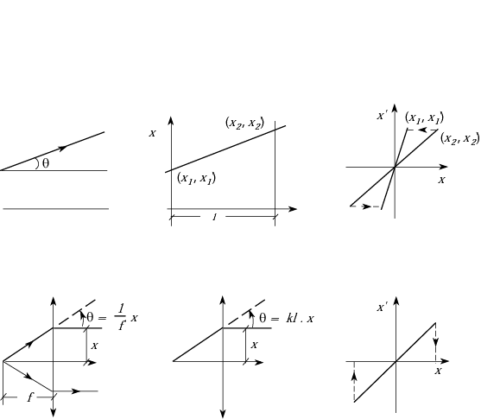
Effect of a drift length and a quadrupole
Drift length
Quadrupole

Slide 16
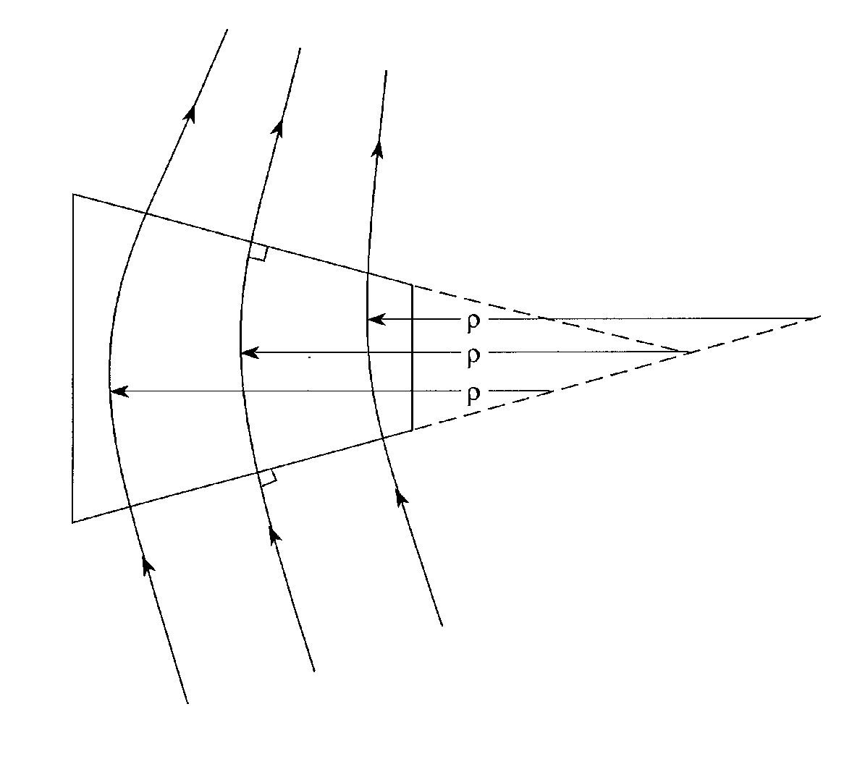
Focusing in a sector magnet

Slide 17
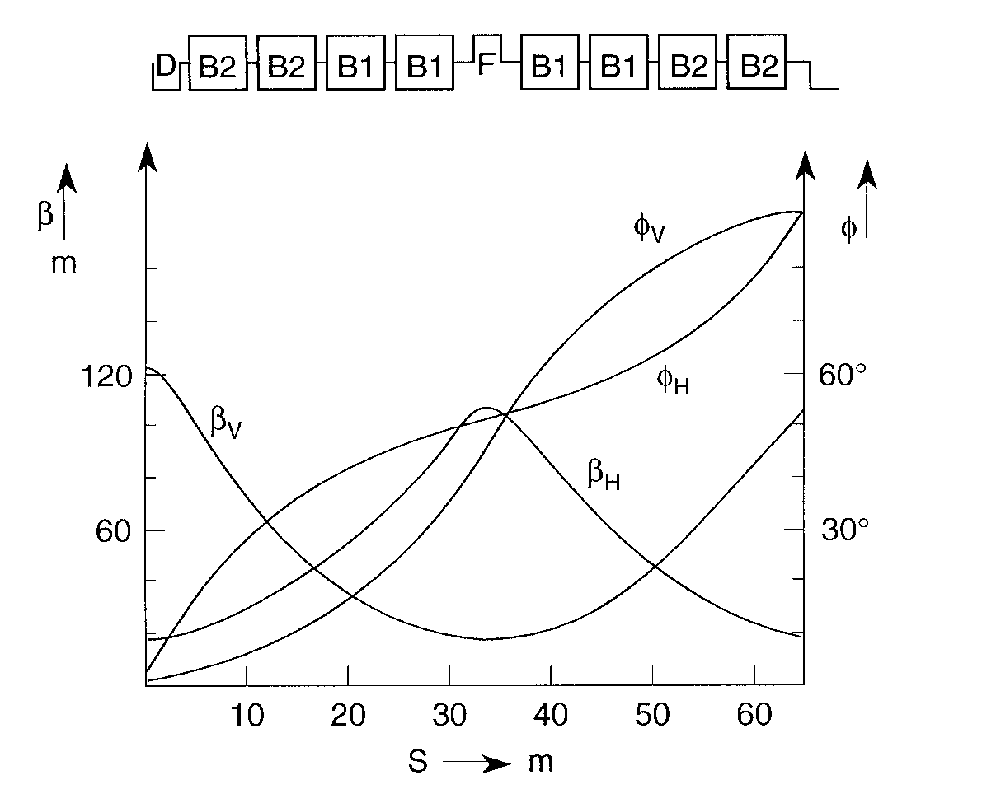
The lattice (1% of SPS)

Slide 18
Calculating the Twiss parameters
THEORY
COMPUTATION
(multiply elements)
Real hard numbers
Solve to get Twiss parameters:

Slide 19
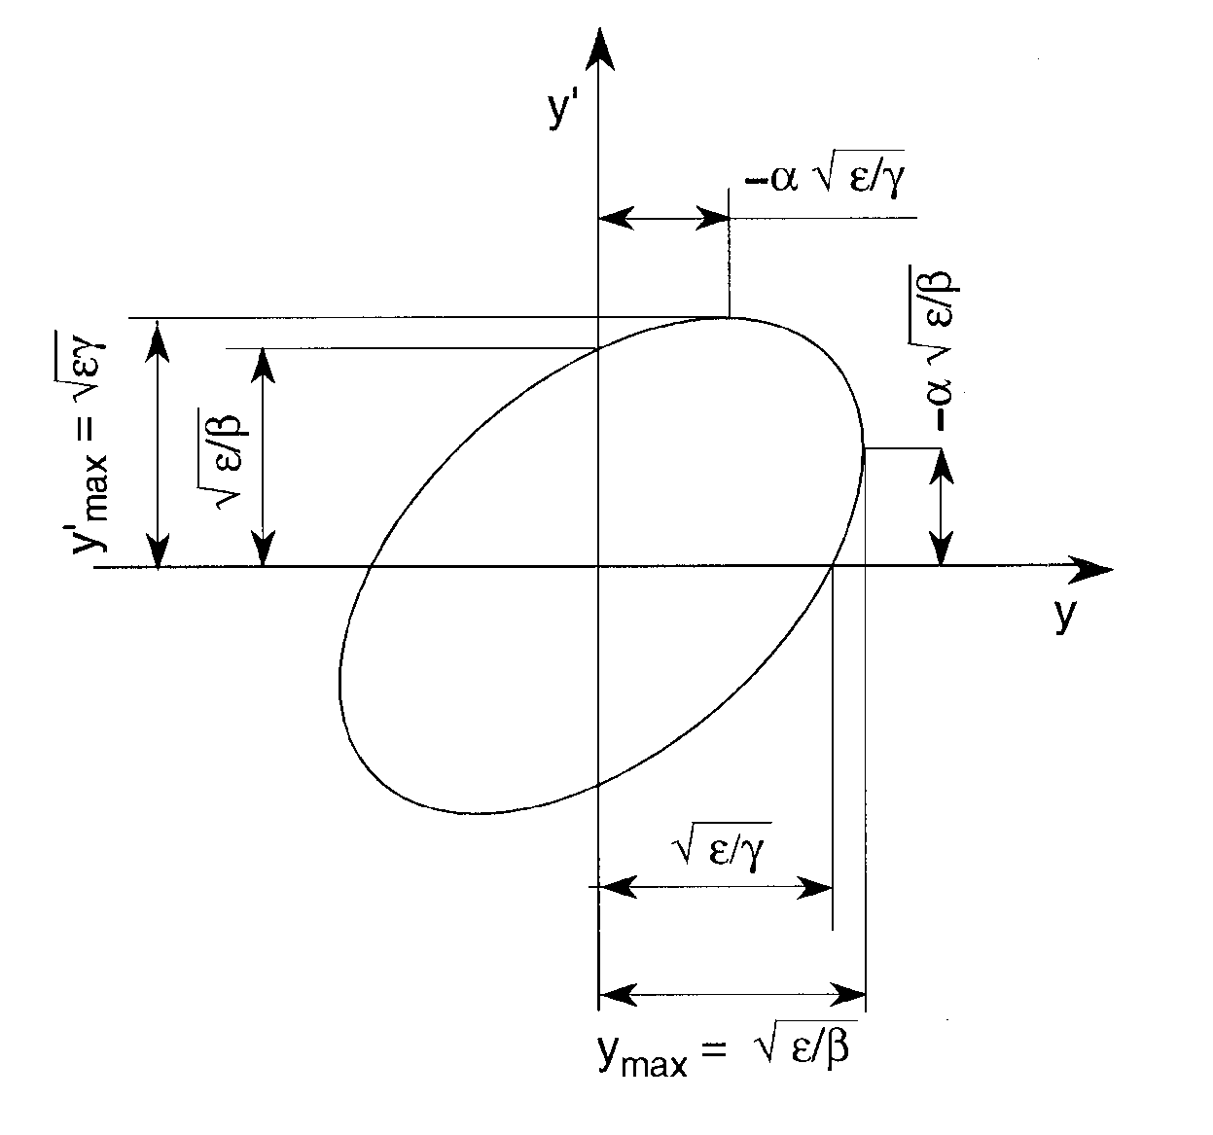
Meaning of Twiss parameters
ε is either :
    Emittance of a beam anywhere in the ring
    Courant and Snyder invariant fro one particle anywhere in the ring

Slide 20
Example of Beam Size Calculation
Emittance at 10 GeV/c

Slide 21
Summary
Equation of motion in transverse co-ordinates
Check Solution of Hill
Twiss Matrix
Solving for a ring
The lattice
Beam sections
Physical meaning of Q and beta
Smooth approximation

Slide 22
Further reading
The slides that follow may interest students who would like to see a formal derivation of Hill’s Equation from Hamiltonian Mechanics

Slide 23
Relativistic H of a charged particle in an electromagnetic field
Remember from special relativity:
  i.e. the energy of a free particle
Add in the electromagnetic field
    electrostatic energy
    magnetic vector potential has same dimensions as momentum

Slide 24
Hamiltonian for a particle in an accelerator
Note this is not independent of q because
Montague (pp 39 – 48) does a lot of rigorous, clever but confusing things but in the end he just turns H inside out
is the new Hamiltonian with s as the independent variable instead of t (see M 48)
Wilson obtains
    assumes curvature is small
    assumes
    assumes magnet has no ends
    assumes small angles
    ignores y plane
Dividing by
Finally (W Equ 8)

Slide 25
Multipoles in the Hamiltonian
We said contains x (and y) dependance
We find out how by comparing the two expressions:
We find a series of multipoles:
For a quadrupole n=2 and:

Slide 26
Hill’s equation in one ( or two) lines
Hamilton’s equations give an equation of motion (remember independent coordinate is now s not t )
  and:

Slide 27
Other interesting forms
In x plane
Small divergences:
But:
Substitute a Taylor series:
Multipoles each have a term:
Quadrupoles:

