Slide 1
MSS Beam Dump
Sylvain Ravat PH/DT-DI

Slide 2
MSS - Upgrade to MSS2
Magnet Safety System (MSS) is used for all LHC experiments
MSS re-designed to MSS2: NI cRIO FPGA platform to replace obsolete fuse programmable based FPGA
  MSS2 tested on COMPASS Magnet in April-May 2014
Upgrade to MSS2 during LS1 only for :
  Alice Solenoid and Dipole
  LHCb Dipole
  Atlas Central Solenoid (MSSa)
Keep current MSS for :
  CMS Solenoid (MSSa and MSSb)
  Atlas Toroids (MSSa and MSSb)
  Atlas Central Solenoid (MSSb)

Slide 3
MSS rack structure
MSS Rack is composed of 4 types of crates:
  API : concentrates MSS Digital and Analog signals and distribute it to ACS and LCS crates.
  ACS : receives, treats analog signals and sends results as digital signals to LCS crates,
  LCS : receives digital signals from API and ACS, an FGPA will combine these signals and take actions to protect the magnets,
  APC : sends FPGA orders to dependent system such as magnet power supply, cryogenic plant, quench heaters, beam dump…
CMS MSSA rack

Slide 4
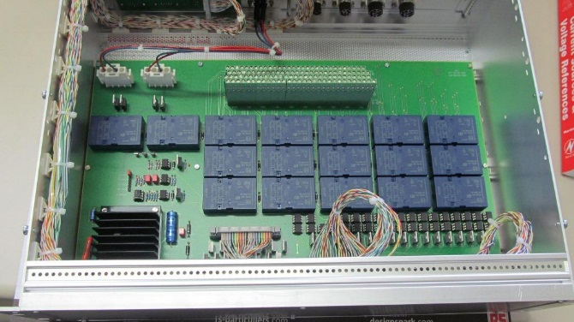
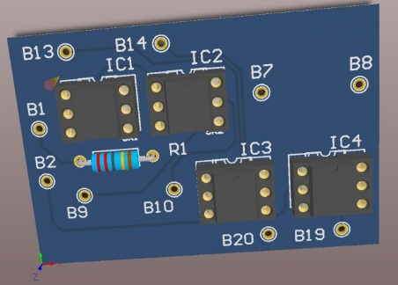
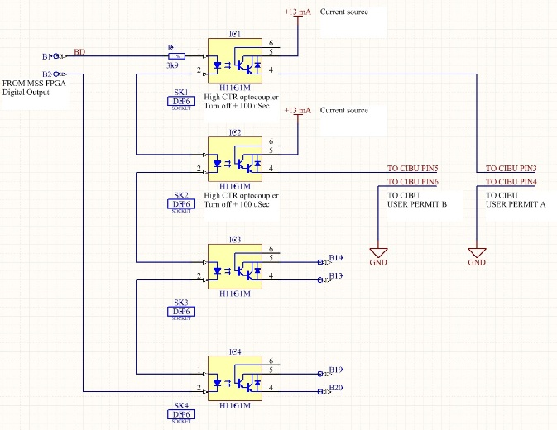
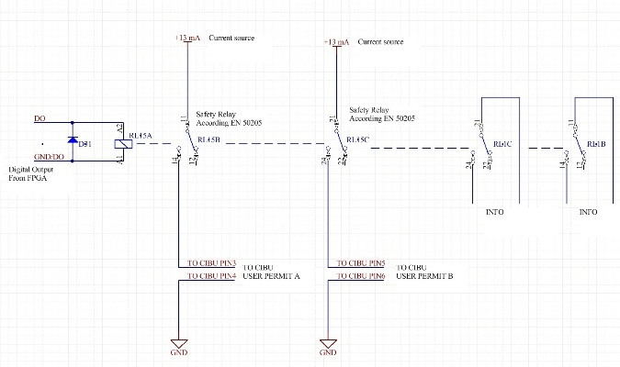
MSS behaviour - APC Modification
Optocoupler patch to replace relays
Power Converter Fault
13 ms
API
Inputs based on optocouplers
APC crate
1 ms
LCS
FPGA Processing
1 ms
APC
Outputs based on safety relays
CIBU
Transition time = 15ms
Transition time = 1ms

Slide 5
MSS2 rack structure
Similar Structure as MSS
VAC module: Versatile Analogue Chassis, Analogue 3U chassis containing 8 analogue modules (2 or 4 channels)
MAC module: Main Chassis, Principal 6U chassis of the MSS2 system; contains CRIO controller, interfaces and redundant power supplies, Integration of MSS APC functionalities.

Slide 6
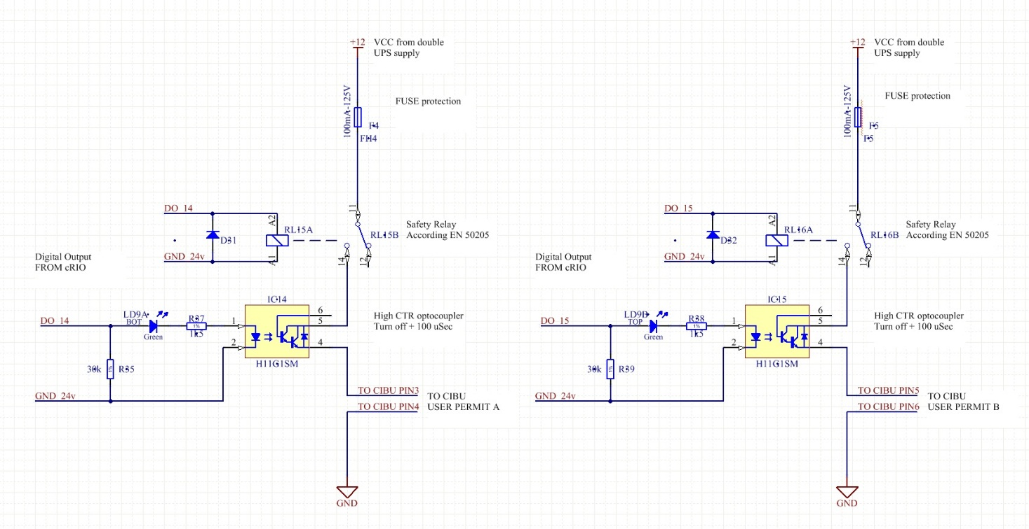
MSS2 APC
Power Converter Fault
13 ms
Inputs based on optocouplers
1 ms
MAC
cRIO FPGA Processing
1 ms
Two dedicated outputs based on optocoupler and safety relays
1 ms
CIBU

Slide 7
Conclusion
Transition time to trigger a beam dump reduced to ~3ms
Both solution will be tested and validated with a CIBU in our lab in collaboration with Christophe Martin (TE-MPE-EP)
Beam Dump will be implemented for :
  Alice Dipole and Solenoid
  Lhcb Dipole
  Atlas Central Solenoid (MSSa and MSSb)
  CMS Solenoid (MSSa and MSSb)

