Slide 1
Status of the BSRA
BE-BI-PM

Slide 2
BSRA
The Abort Gap (AG) monitor (BSRA) monitors the AG population by measuring the Synchrotron Light (SL) emitted by a SC undulator (E < 1.5 TeV) and a D3 dipole (E > 1.5 TeV).
MCP-PMT Broadband measurement: 200-800 nm
After LS1, BSRA will eventually be connected to the interlock system.
Improvement of reliability: optical line and software

Slide 3
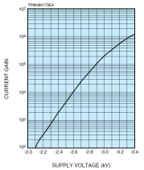
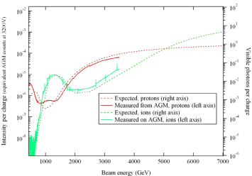

Software: automatic calibration
Introduction of automatic calibrations:
  Before injection: voltage-gain calibration with external source (no beam):
  Injection, with pilot beam @ 450 GeV: measured SL originated from a single particle (needs normalisation of FBCT signal)
  Periodic system check (every hour TBC): measure a bunch of known intensity, compare with FBCT signal
$$G(V)= G_{0}{10}^{aV^{2}+bV}$$
A. Jeff, 2012

Slide 4
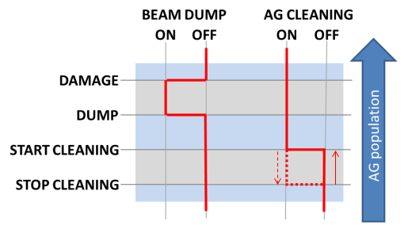
Software: thresholds and flags
The BSRA publishes two flags: “AG cleaning” and “beam dump”
The flags logic determined by threshold levels:

Slide 5
AG cleaning
When 5 reading out of the last 10 are above the AG cleaning threshold and beam mode is not RAMP and no errors or alarms are present.
When AG population is decreasing, stop cleaning threshold some 10% (TBC) lower.

Slide 6
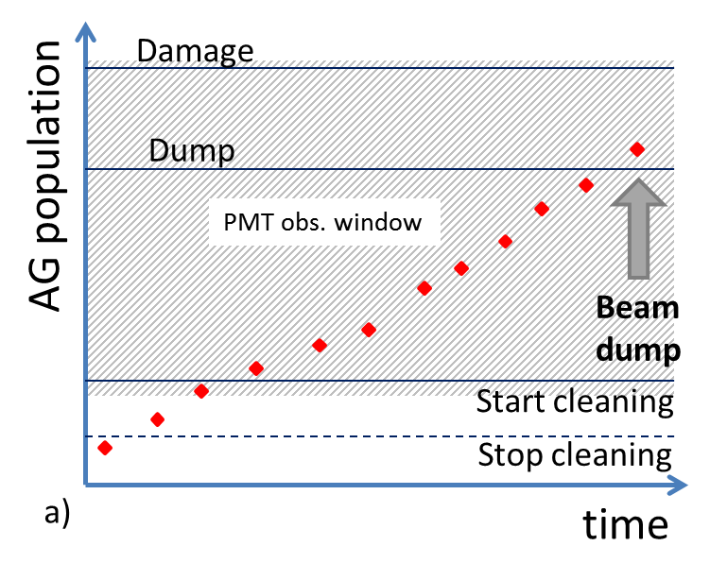
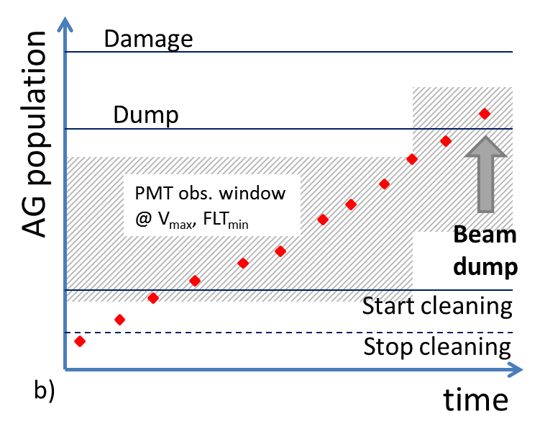
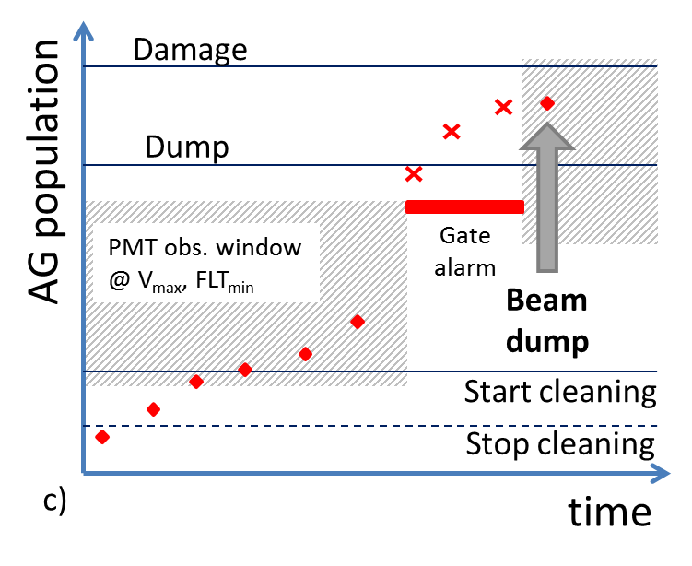
Beam dump
PMT gate protection determines BSRA behaviour.
When signal can be followed by the HV/filters feedback:

Slide 7
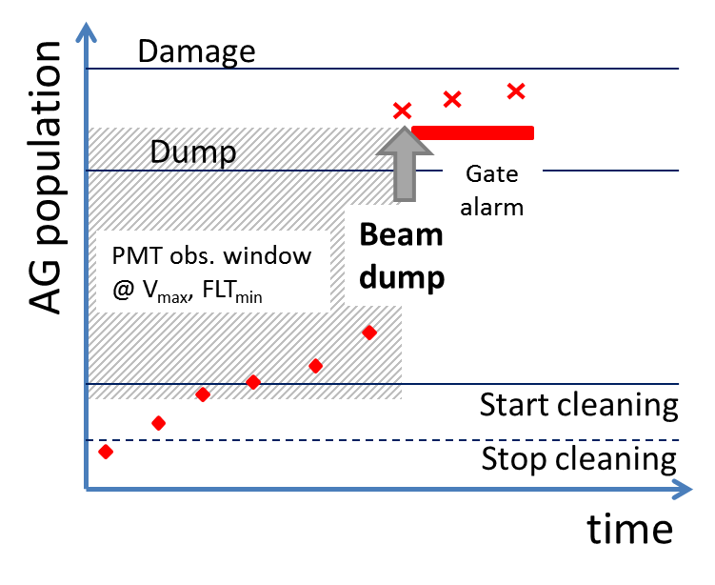
Beam dump
When signal increases abruptly and gate alarm above the dump threshold: beam dumped even in presence of gate alarm.

Slide 8
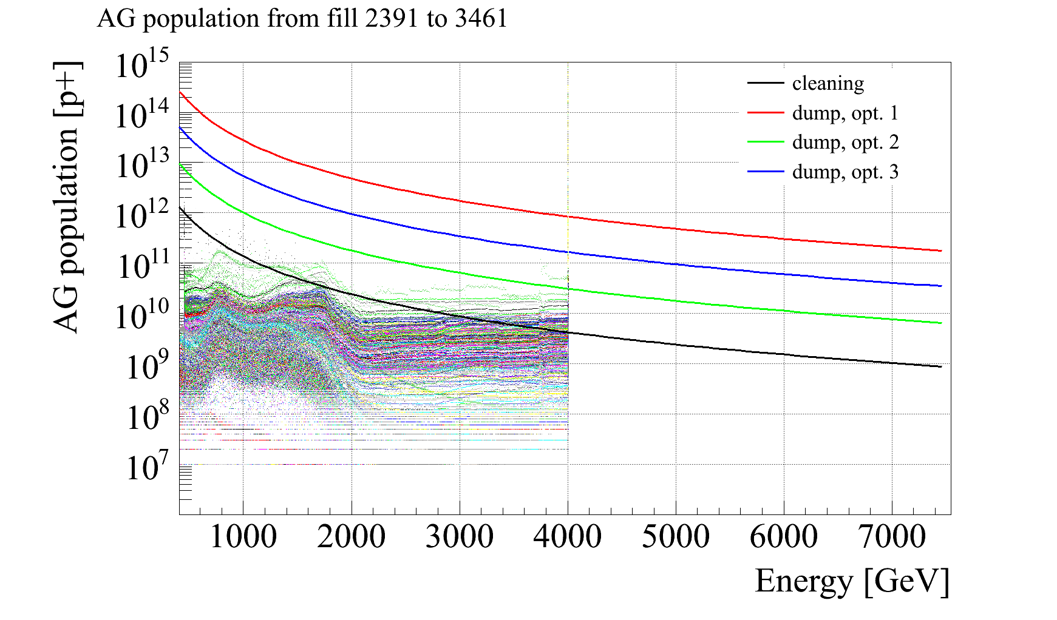
Thresholds
Values of thresholds still to be defined precisely:
  start cleaning approx. 10% of min Q4-Q5 quench level (around1e+09 @ 6.5 TeV).
  Dump: around40x quench level (4e+10)
  Damage: 400x (?)

Slide 9
Final remarks
EDMS document 1337184 “Calibration procedures and automated actions for the Abort Gap Monitors of LHC” to be finalised.
Software development started (S. Bart).
Parasitic MD to calibrate new optical line.

Slide 10
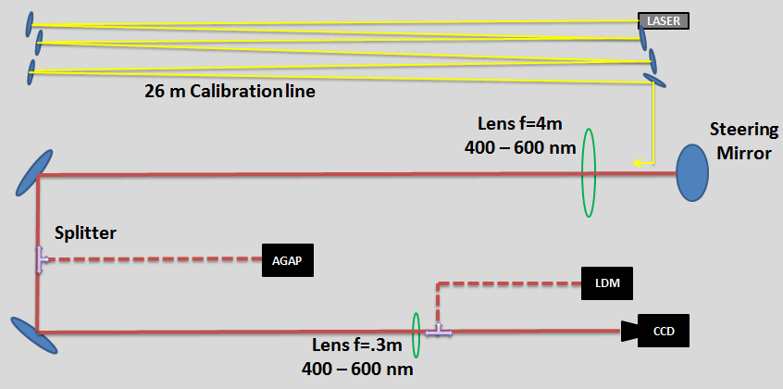
Extra
BSRT Optical Table Layout end of 2012
G. Trad, Evian 2014

Slide 11
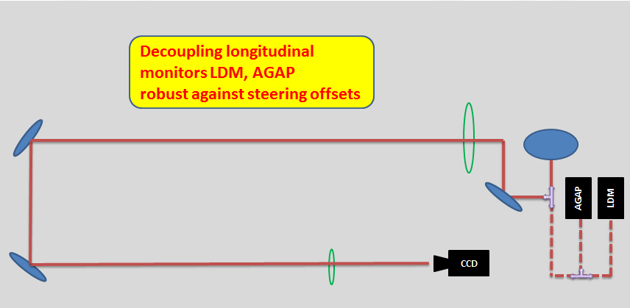
Extra
New BSRT Optical Table Layout
G. Trad, Evian 2014

Slide 12
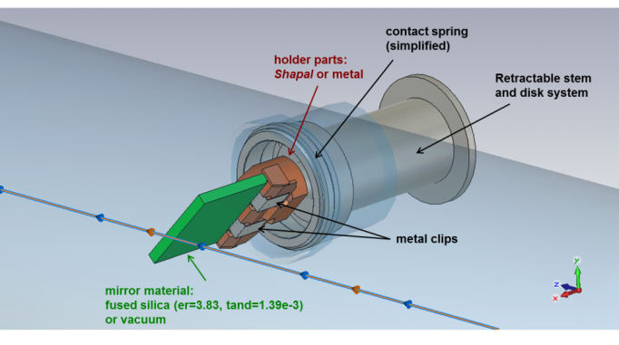
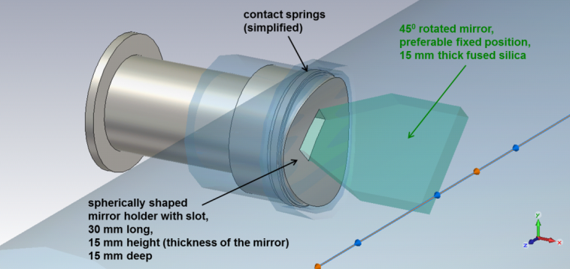
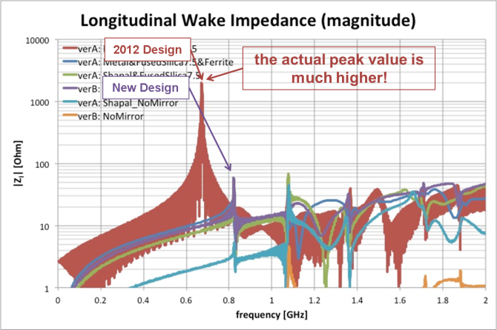
Extra
OLD Extraction Mirror
NEW Extraction Mirror
G. Trad, Evian 2014

