Slide 1



Non-invasive Profile Measurement for the CLIC Drive Beam
Adam Jeff
CERN & University of Liverpool

Slide 2
Contents
Curtain Gas Jet
  Lab tests at the Cockcroft Institute
Pencil Gas Jet
  Focusing element in production, tests at C.I. soon
Electron-Beam Scanner
  Simulations ongoing (O. Antoniou)
Off-axis Synchrotron Radiation
  Simulations completed
adam.jeff@cern.ch

Slide 3
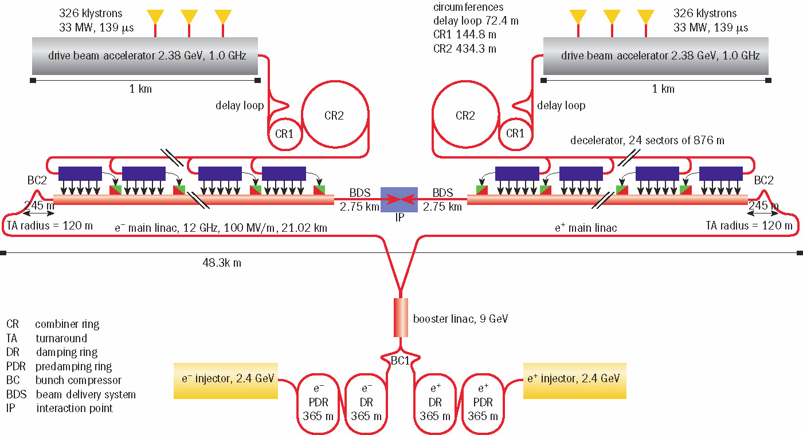
Beam Energy | to 2.4 GeV
Beam Current | 4.2 A
Pulse Length | 140 μs
adam.jeff@cern.ch The CLIC Drive Beam 1 / 24

Slide 4
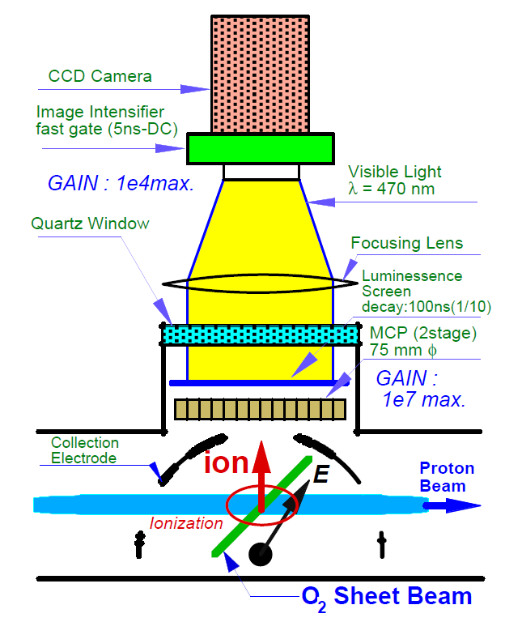
Generate thin atom gas curtain,
Ionize atoms with primary particle beam,
Extract ions via electric field,
Monitor on MCP, P screen.
adam.jeff@cern.ch Principle of the gas jet monitor 2 / 24
Y. Hashimoto et al., Proc. Part. Acc. Conf., Chicago (2001)

Slide 5
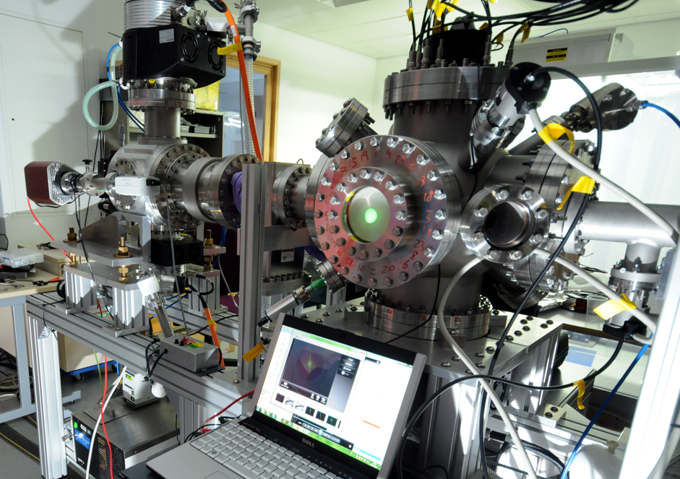
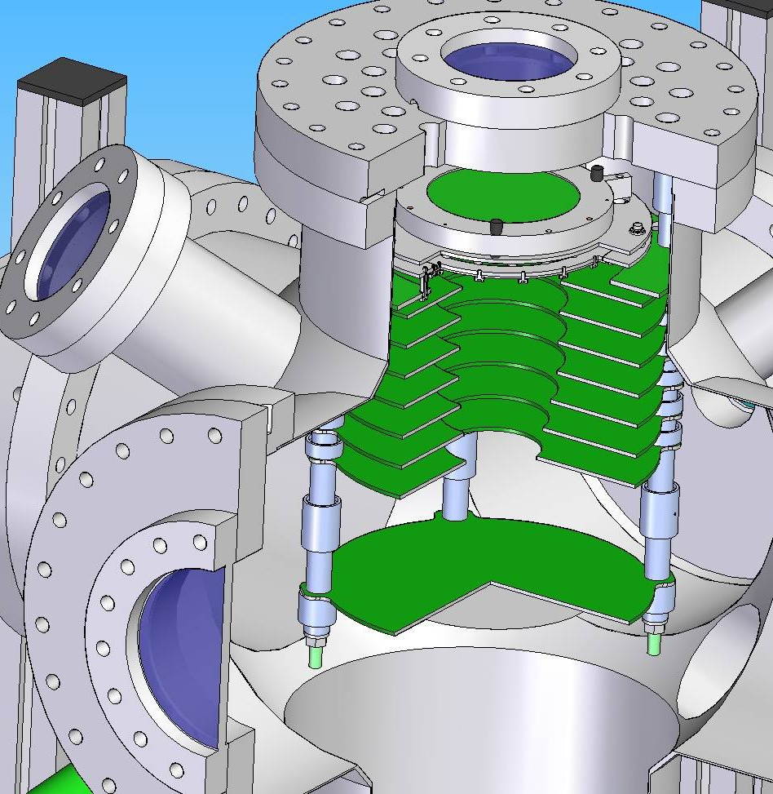
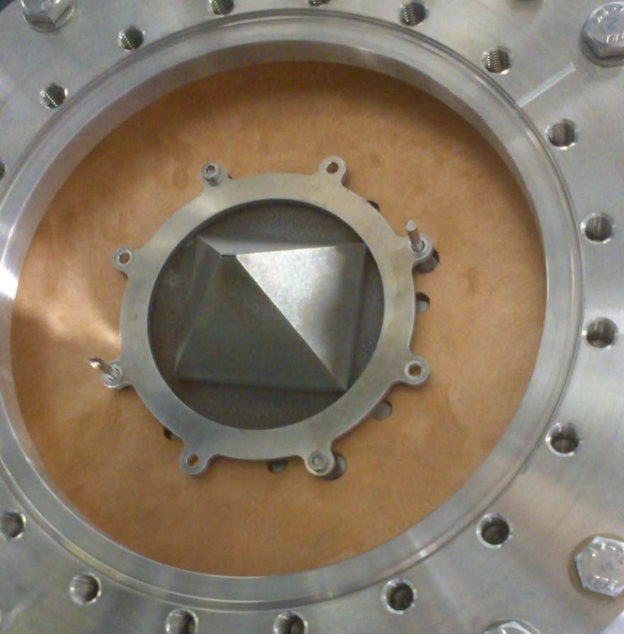
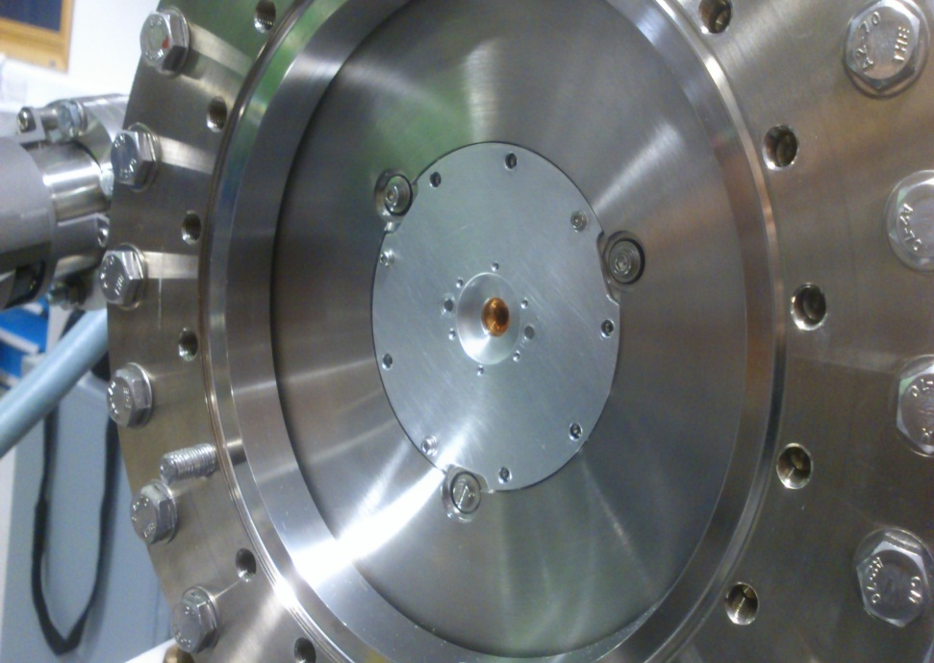
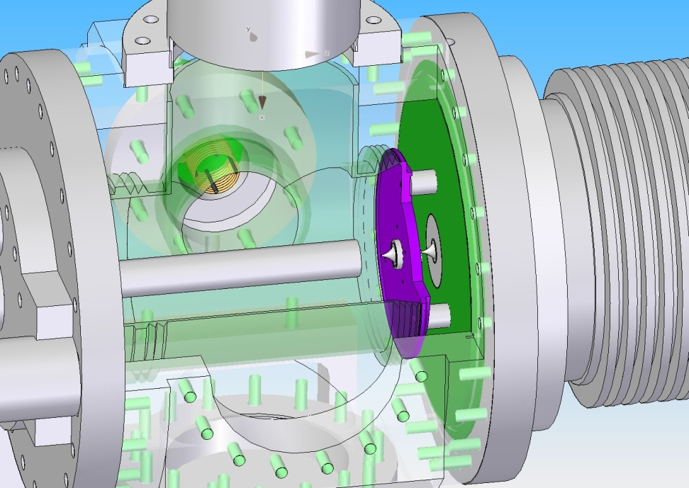
adam.jeff@cern.ch Test Setup @ Cockcroft Institute 3 / 24
Thanks to M. Putignano

Slide 6
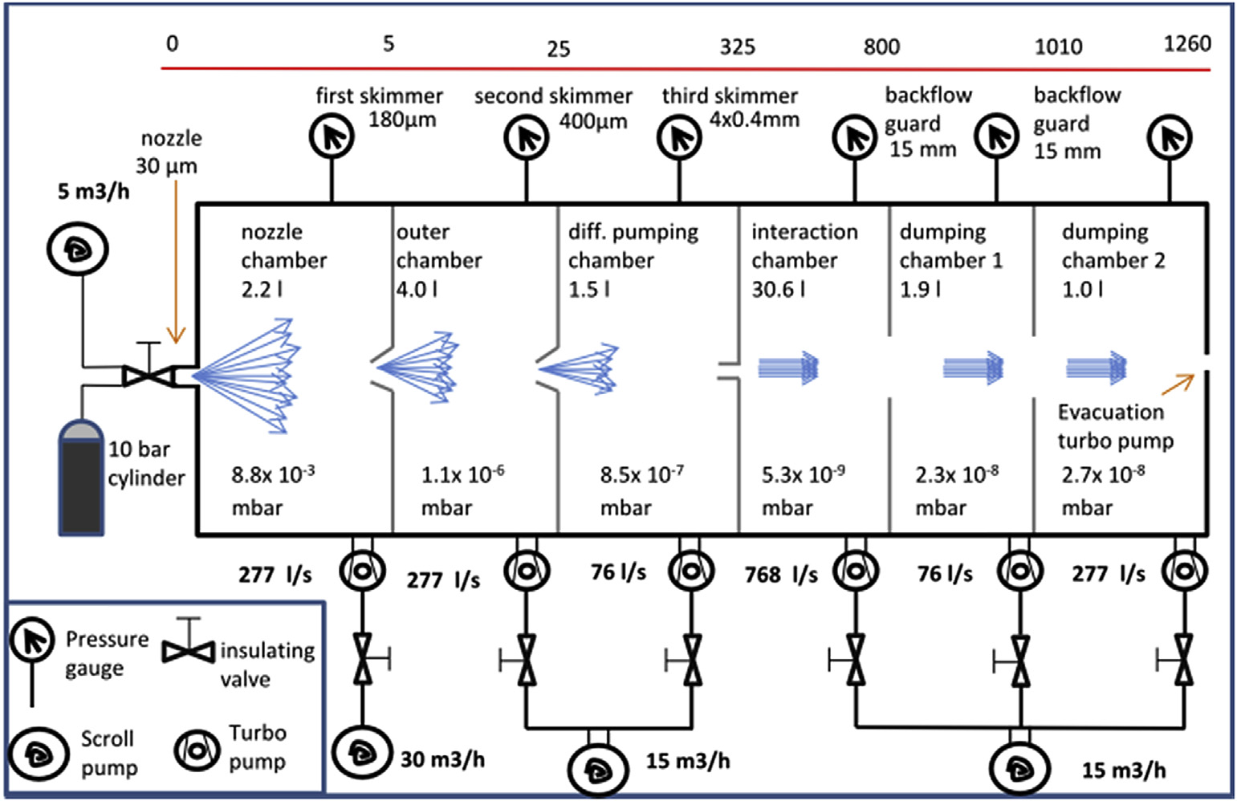
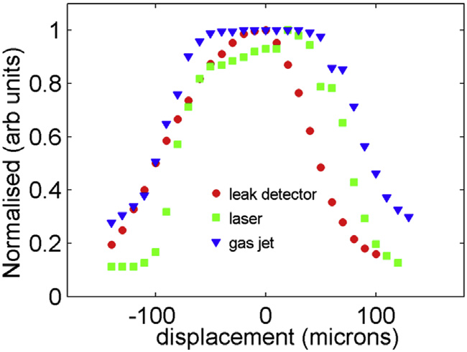
adam.jeff@cern.ch Test Setup @ Cockcroft Institute 4 / 24

Slide 7
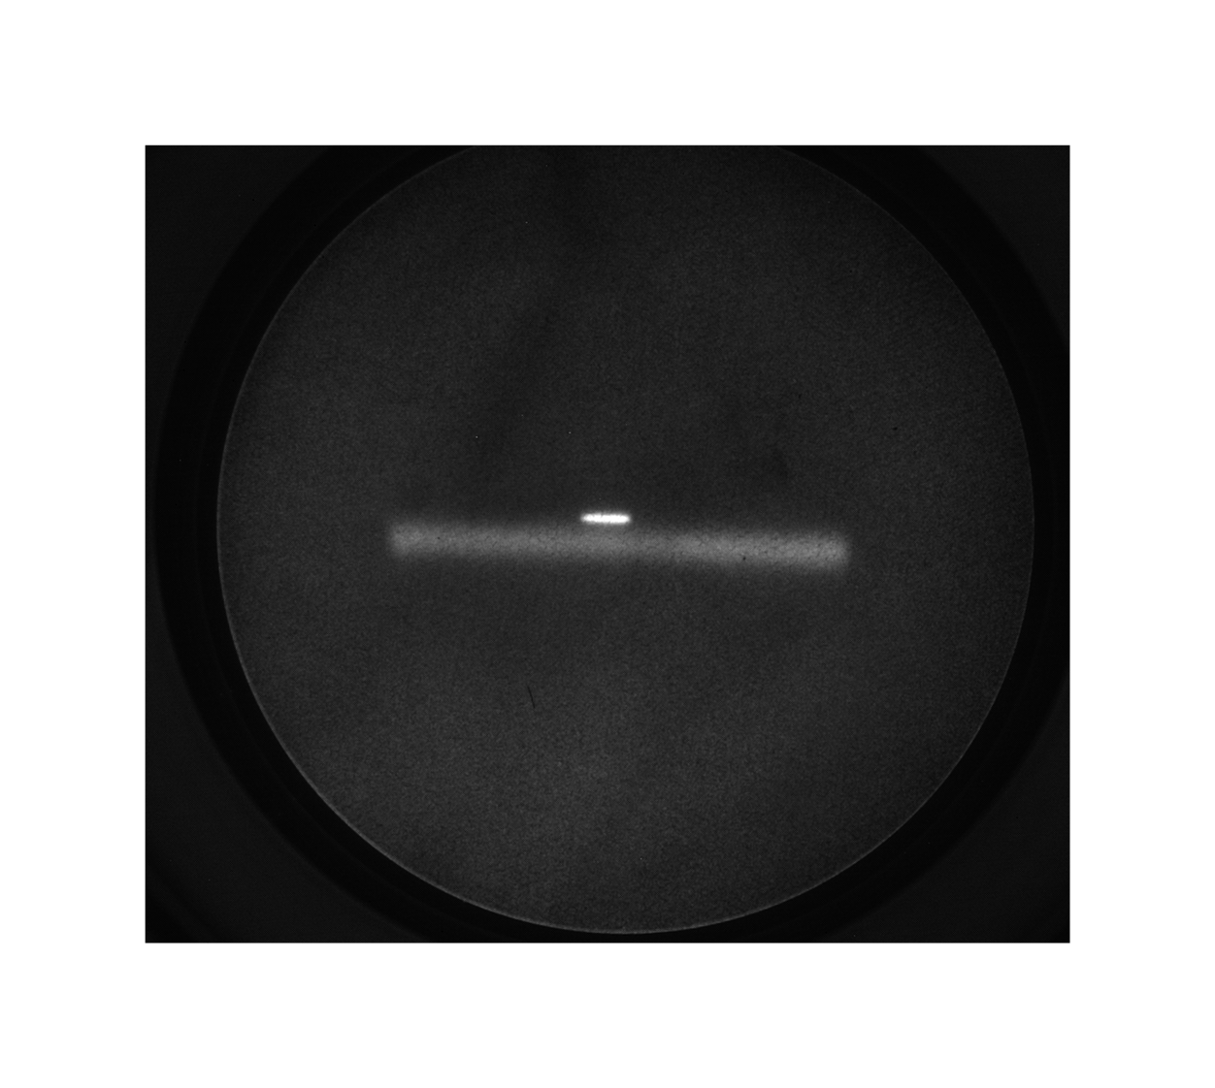
e⁻ beam
Gas Jet
adam.jeff@cern.ch Test Setup @ Cockcroft Institute 5 / 24

Slide 8
Gas Jet Ions
Residual Gas Ions
E
Gas Jet
adam.jeff@cern.ch Test Setup @ Cockcroft Institute 6 / 24
e⁻

Slide 9
adam.jeff@cern.ch Test Setup @ Cockcroft Institute 5 / 24

Slide 10
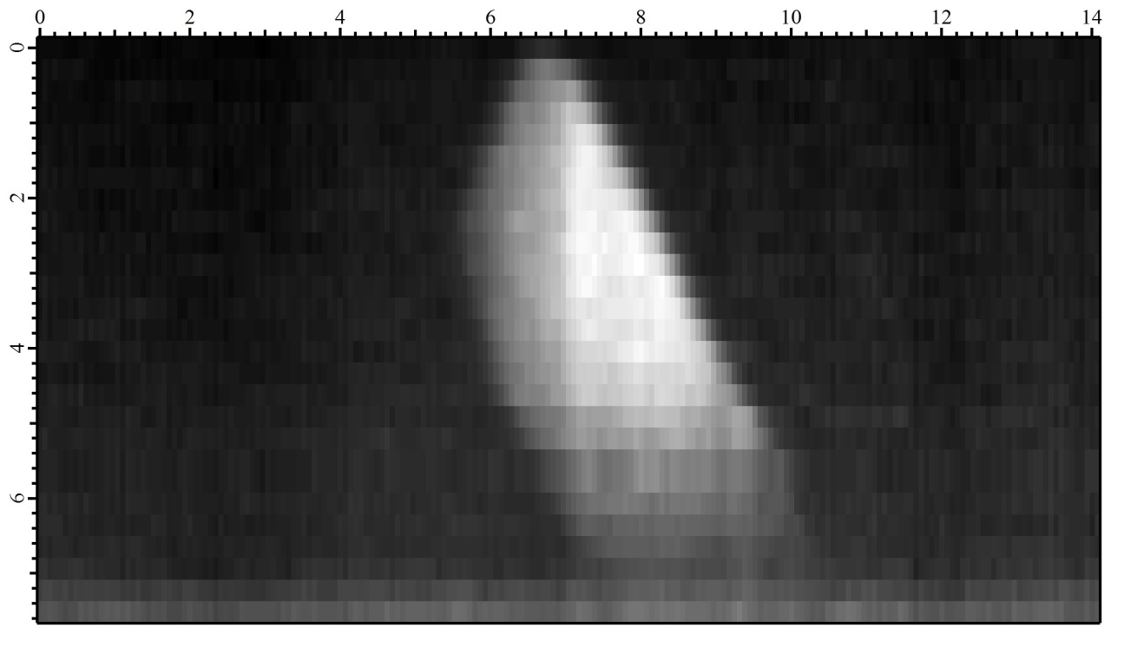
Horizontal position (mm)
adam.jeff@cern.ch Test Setup @ Cockcroft Institute 7 / 24
e⁻
Vertical position (mm)
Gas density in jet cross-section

Slide 11
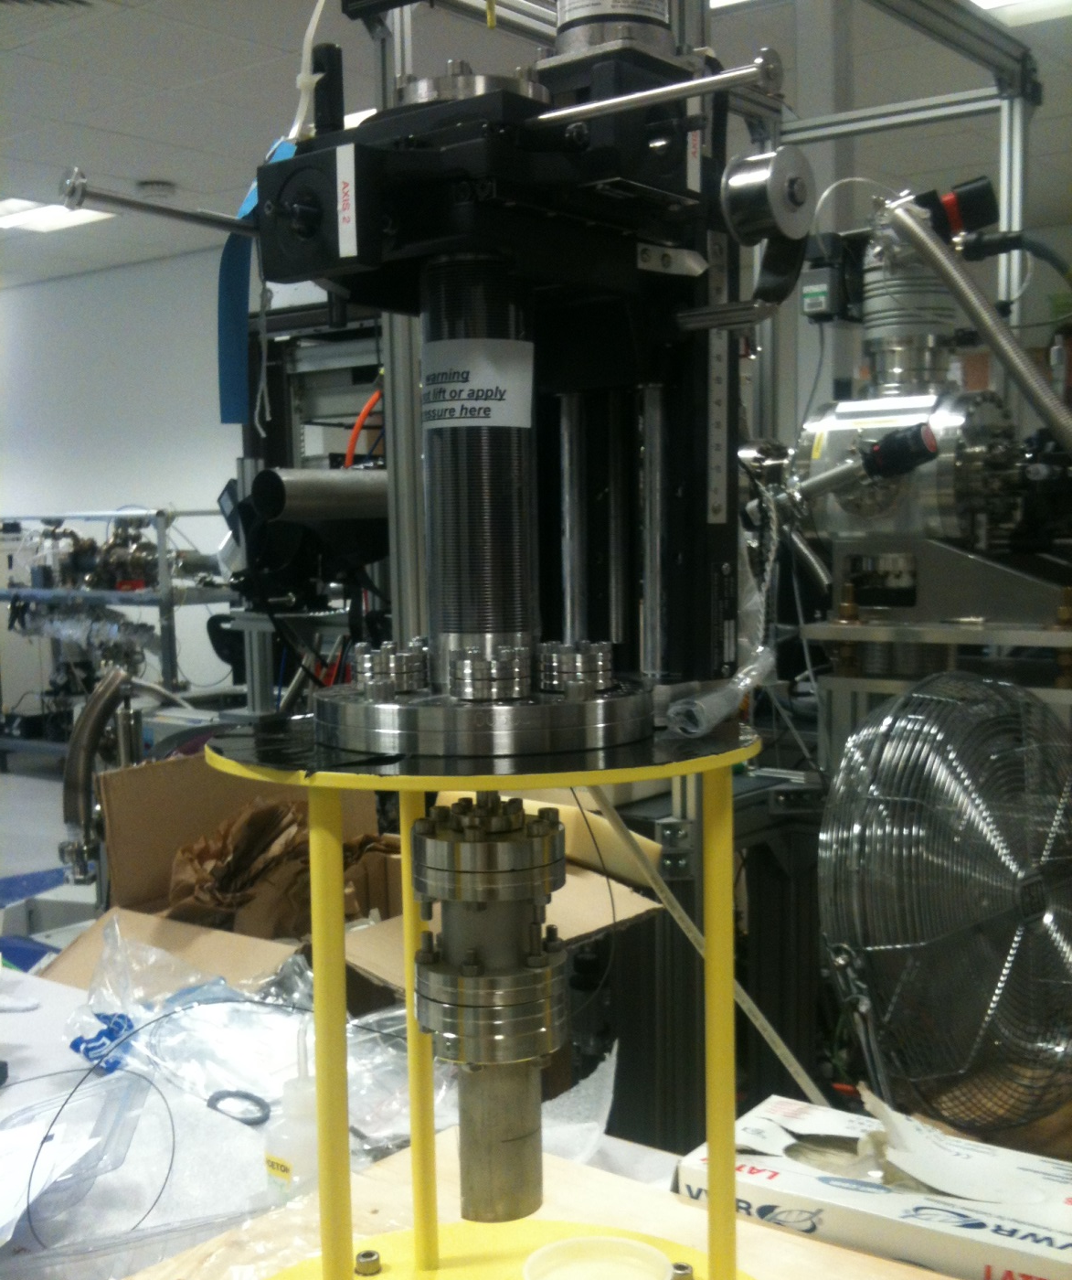
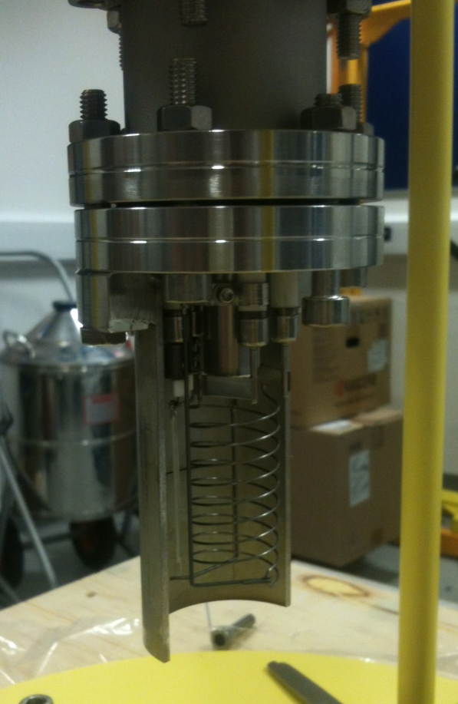
adam.jeff@cern.ch Test Setup @ Cockcroft Institute 8 / 24

Slide 12
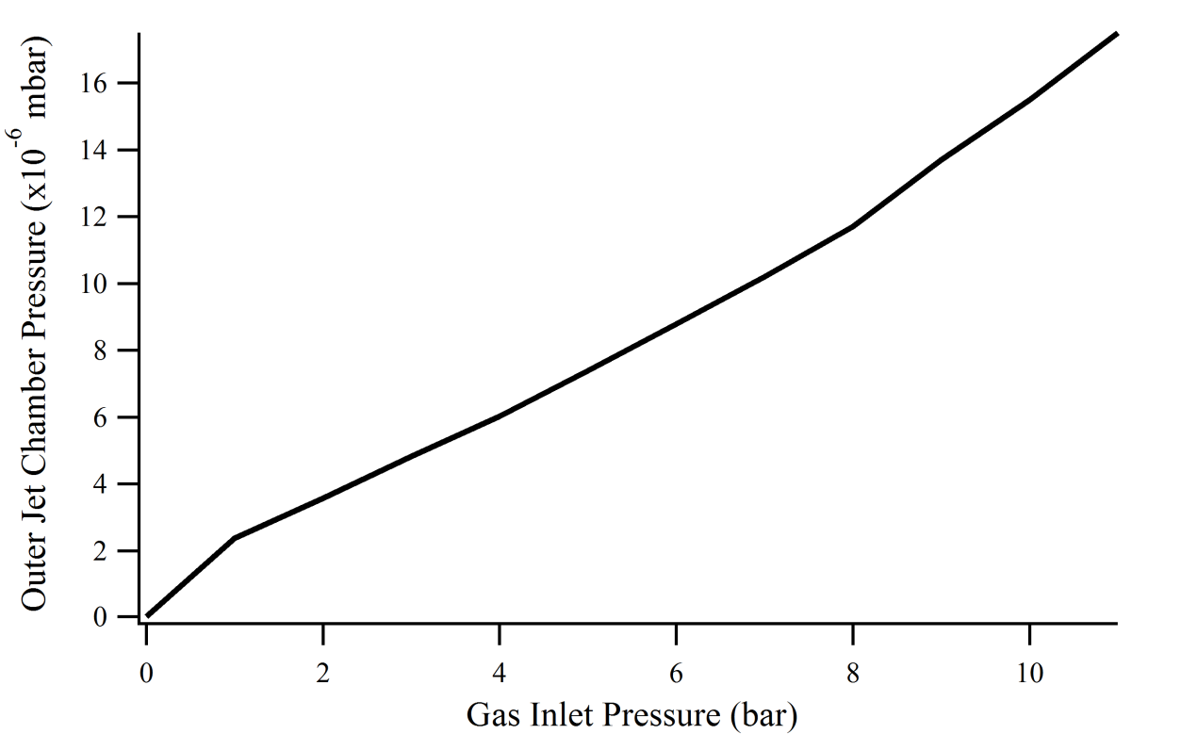
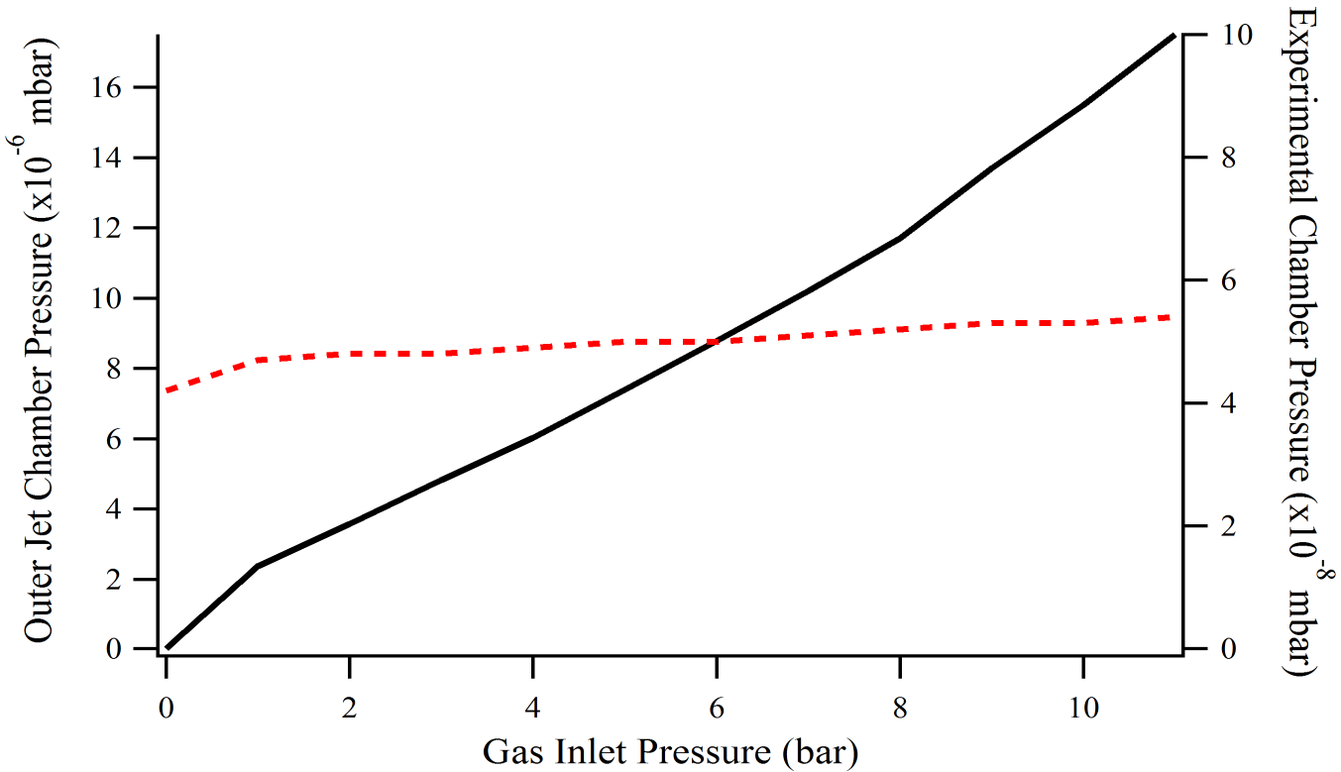
adam.jeff@cern.ch Vacuum Effects 9 / 24
V. Tzoganis, A. Jeff, C. Welsch , “Gas dynamics considerations in a non-invasive profile monitor for charged particle beams”,
Vacuum (2014), dx.doi.org/10.1016/j.vacuum.2014.07.009

Slide 13
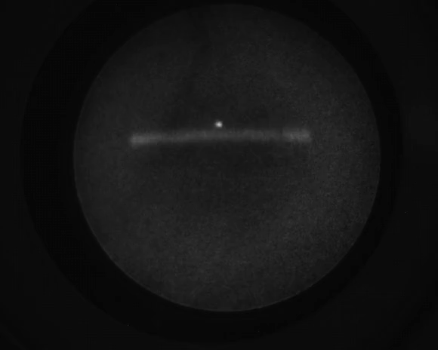
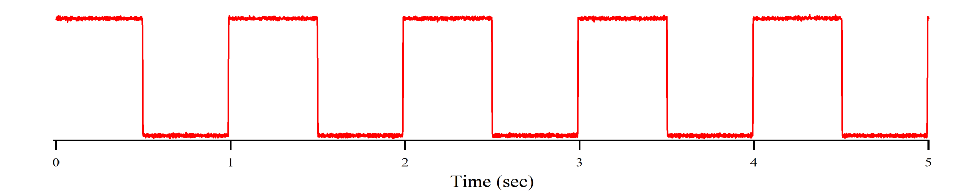
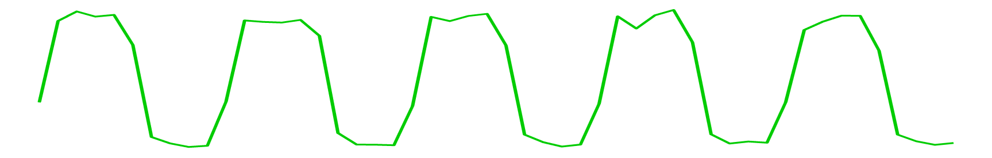
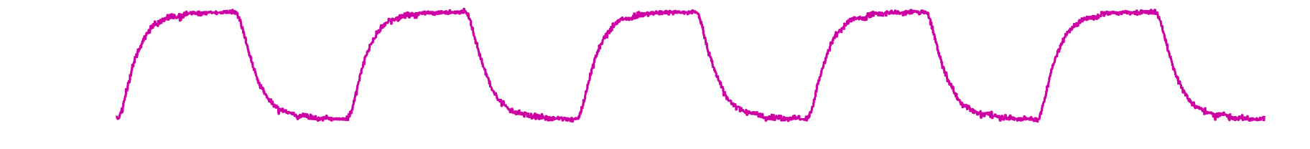
Valve Control
adam.jeff@cern.ch Pulsed Jet 10 / 24
Jet Brightness
Chamber Pressure

Slide 14
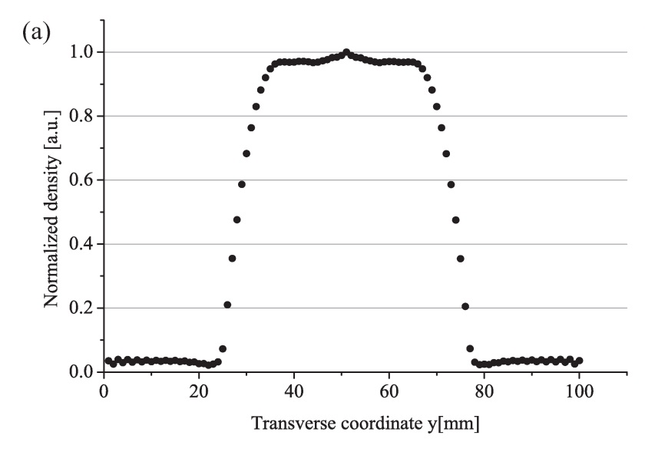
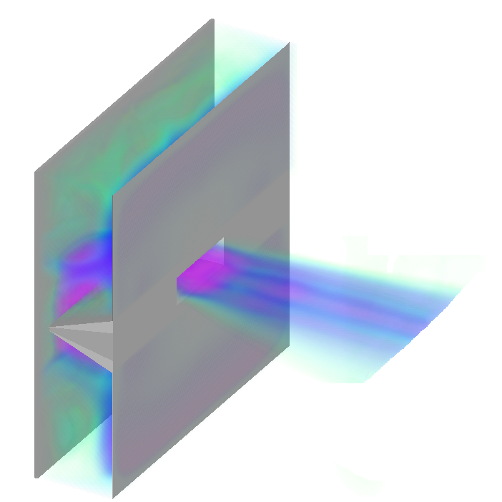

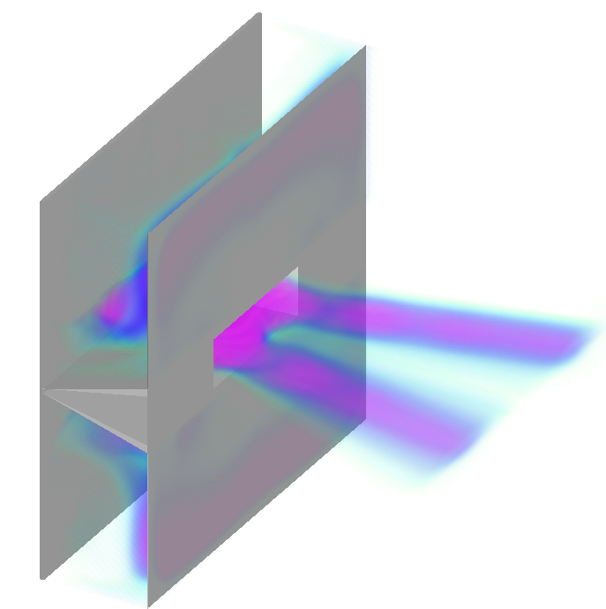
Shaping of gas curtain possible through sole manipulation of Pressure and Temperature of Gas Reservoir.
1 order of magnitude density difference between core and side strands
adam.jeff@cern.ch Gas Jet Halo Monitor 11 / 24
M. Putignano, C.P. Welsch, “Numerical study on the generation of a planar supersonic gas-jet”, NIM A 667 (2012)

Slide 15
Planar jet suitable for large beams only
  Difficult to make the jet thin enough for CLIC Drive Beam
  Space Charge also a problem
Solution: Gas Jet Scanner
  Generate a thin pencil jet and scan it through the beam
  Like a wire scanner but non-interceptive
  Still collect ions but position not important: not affected by space charge
  Need a way to generate a thin jet…
adam.jeff@cern.ch Gas Jet Scanner 12 / 24

Slide 16
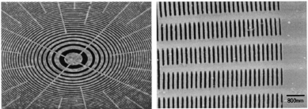
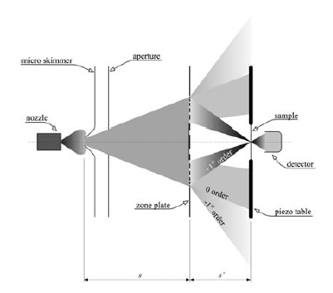
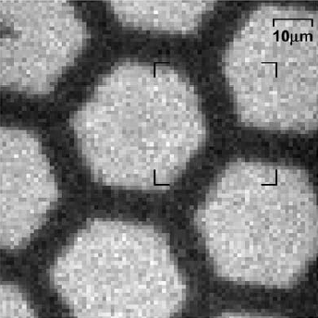
Matter-Wave Focusing for a Thin Neutral Jet
Smallest zone 100 nm
FWHM at focus 2μm !
adam.jeff@cern.ch Matter-Wave Focusing 13 / 24
T. Reisinger, S. Eder, M.M. Greve, H.I. Smith, B. Holst, “Free-standing silicon nitride zoneplates for neutral-helium microscopy”, Microelectronic Engineering 87 (2010)

Slide 17
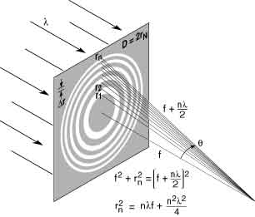

The path difference between each successive light ring is equal to 1 wavelength (at the focal point) constructive interference.
Each zone is equal in area
Focal spot size is roughly the width of the narrowest (outer) zone
Compared to traditional lens: no spherical aberration, large chromatic aberration
adam.jeff@cern.ch Fresnel Zone Plates 14 / 24
DeBroglie wavelength ≈ 0.05 nm
for room temperature Helium
Focal length of zone plate
Resolution ≈ width of smallest zone (ignoring chromatic effects)
radius of outer zone
width of outer zone
$$f= \frac{2r_{N}∆r_{N}}{λ}$$

Slide 18
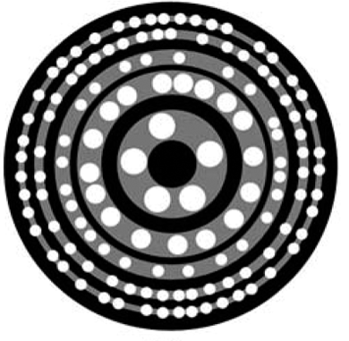
Photon Sieve replaces clear zones of an FZP with a series of holes
+ Sharper focusing
- Lower transmission
+ Easier to manufacture
adam.jeff@cern.ch Photon Sieves 15 / 24
Apodised Photon Sieve reduces higher order diffraction, increases central maximum
L. Kipp et al, “Sharper images by focusing soft X-rays with photon sieves”, Nature 414 (2001)
Notes:
In reality many more rings

Slide 19
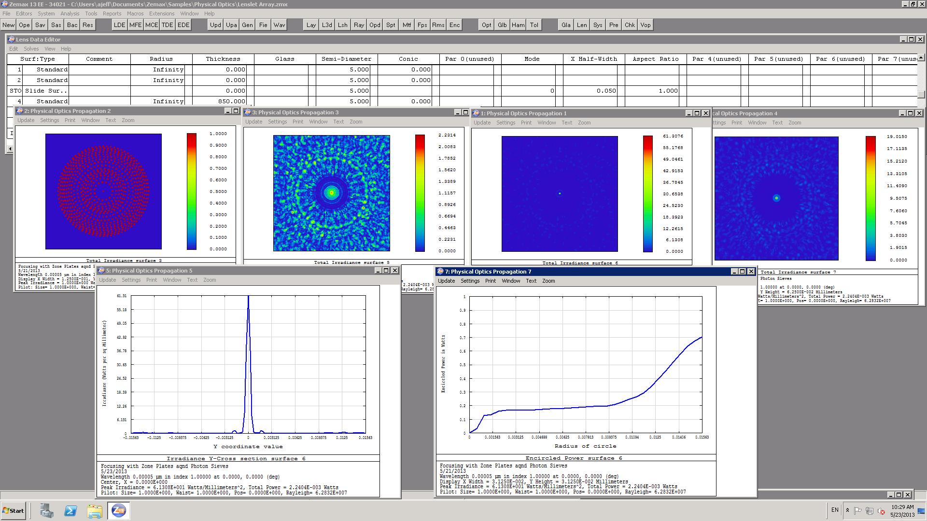
adam.jeff@cern.ch ZEMAX Simulations 16 / 24

Slide 20
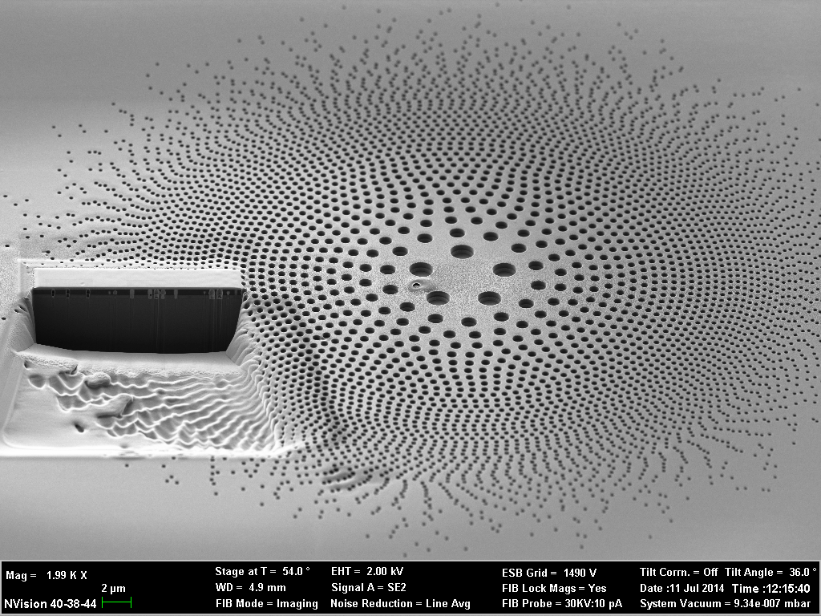
The Atomic Sieve
adam.jeff@cern.ch The Atomic Sieve 17 / 24
Notes:
Largest holes diameter 1.5 micron
Smallest 80 nm

Slide 21
Gas Jet - Conclusions
The test setup at the Cockcroft Institute has demonstrated reliable gas jet operation, and can be used for profile measurement in both continuous and pulsed mode.
Thanks to efficient dumping of the jet and differential pumping in the jet generator, the effect on the beam vacuum system is small.
For measurement of smaller beams with intense space charge, a new gas jet scanner is proposed.
A focusing method based on the deBroglie wavelength of the neutral gas atoms will be tested.
The ‘atomic sieve’ is under production and will be tested later this year.
adam.jeff@cern.ch Conclusions 18 / 24

Slide 22
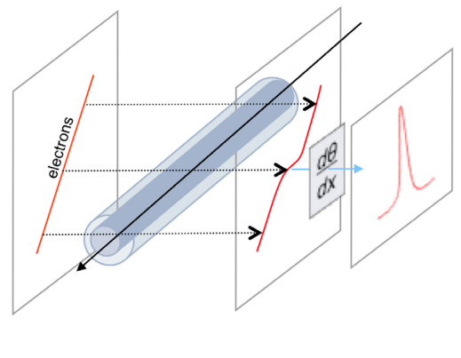
Electron Beam Scanner
Electrons are shot perpendicularly to the main beam
The deflection of the secondary beam is caught by a monitor
Take the derivative of the maxima to compute the beam Y-profile
adam.jeff@cern.ch Electron Beam Scanner 19 / 24
Already used at SNS, but could be difficult for short bunches
Technical student Orfeas Antoniou is investigating

Slide 23
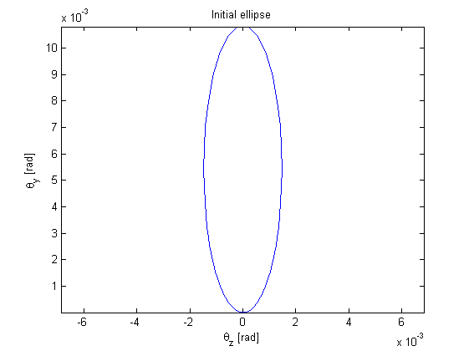
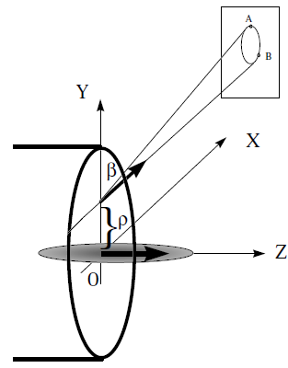
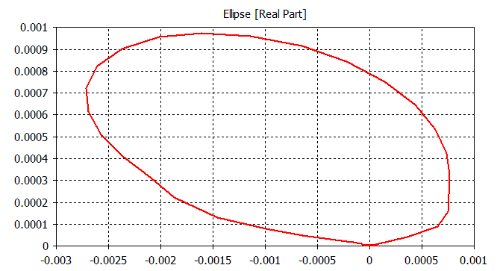
Electron Beam Scanner
Probe beam draws an ellipse if the main beam bunch length is small
adam.jeff@cern.ch Electron Beam Scanner 20 / 24
Theoretical ellipse
Plots from O. Antoniou
CST simulation

Slide 24
Electron Beam Scanner
So far:
  Used a mathematical model to see expected results
  Modeled the scanner in CST
    Investigated how parameter changes affect the results
    Investigated if bunches affect each other
Next steps:
  Better simulation time
  More accurate results
adam.jeff@cern.ch Electron Beam Scanner 21 / 24

Slide 25
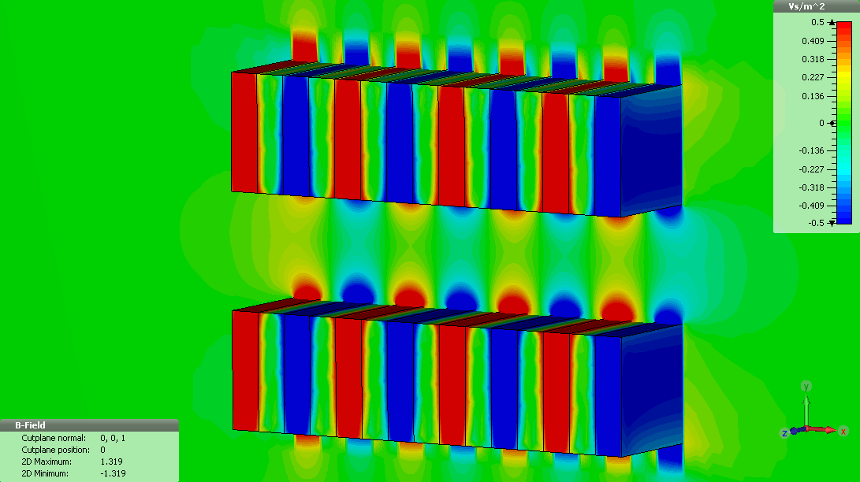
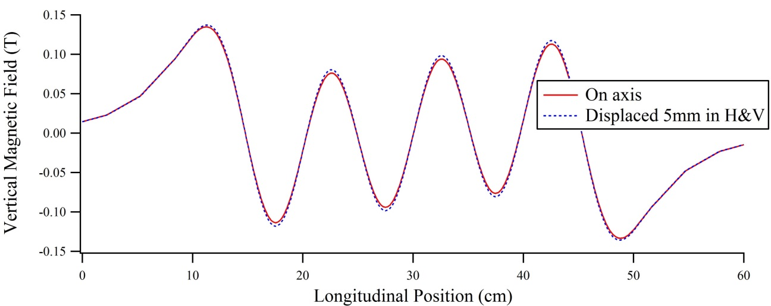
Off-Axis Undulator Radiation
Synchrotron Radiation is always a nice option for non-invasive diagnostics
Comes ‘for free’ in the combiner rings, turn-arounds
Not so easy in the linac
adam.jeff@cern.ch Undulator Radiation 21 / 24

Slide 26
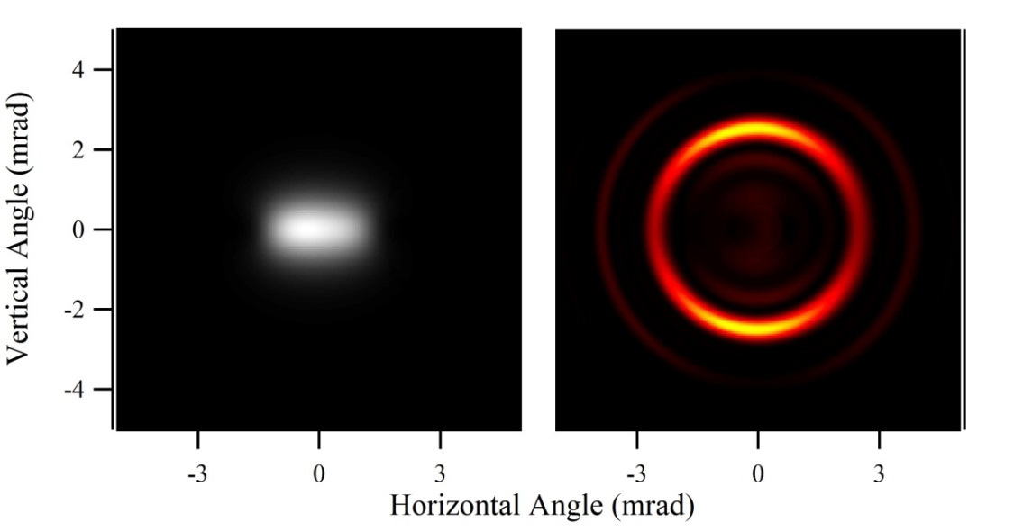
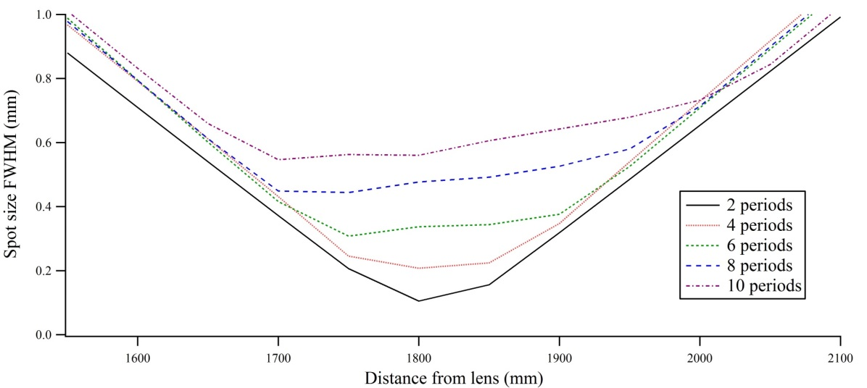
Off-Axis Undulator Radiation
All wavelengths
500nm only
Simulations with Synchrotron Radiation Workshop (SRW)
adam.jeff@cern.ch Undulator Radiation 23 / 24
Optical propagation with ZEMAX

Slide 27
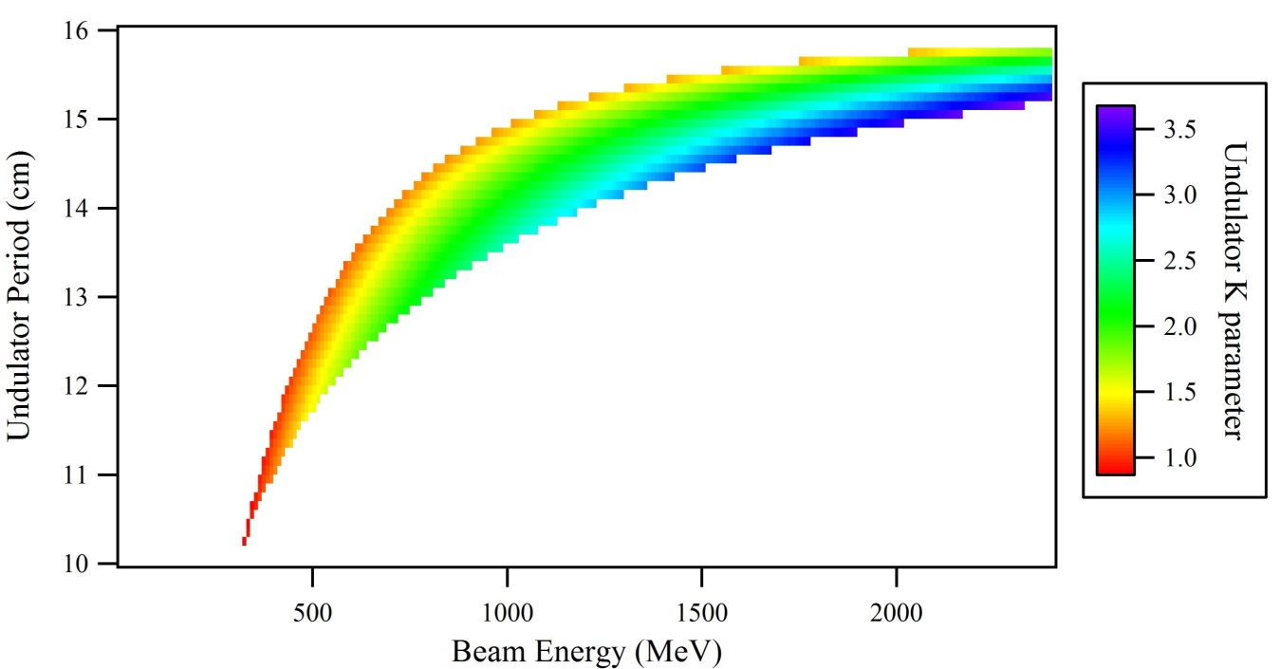
Off-Axis Undulator Radiation
Undulator period and strength have to be tuned depending on electron energy
A realistic solution can be found for any energy > 300 MeV
Undulator period and K parameter to produce visible SR at 2.5 mrad opening angle
adam.jeff@cern.ch Undulator Radiation 24 / 24
Beam Energy | Undulator Period (cm) | K | Light yield (photons / e⁻)
300 MeV | 10 | 0.7 | 2 x 10⁻³
500 MeV | 12 | 1.3 | 4.4 x 10⁻³
1 GeV | 14.5 | 1.6 | 2.8 x 10⁻³
2.4 GeV | 15.7 | 1.7 | 7 x 10⁻⁴

Slide 28
Thank you for your Attention

Slide 29
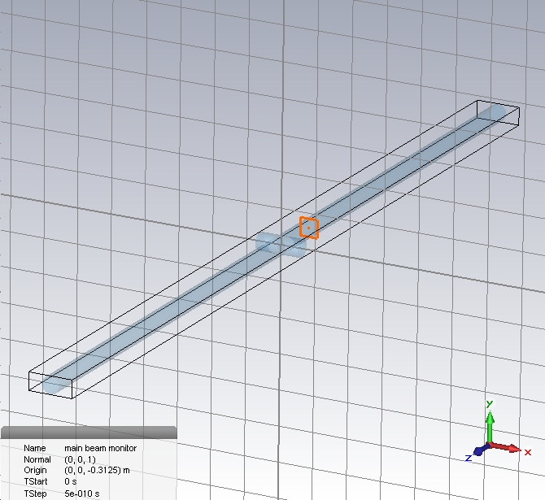
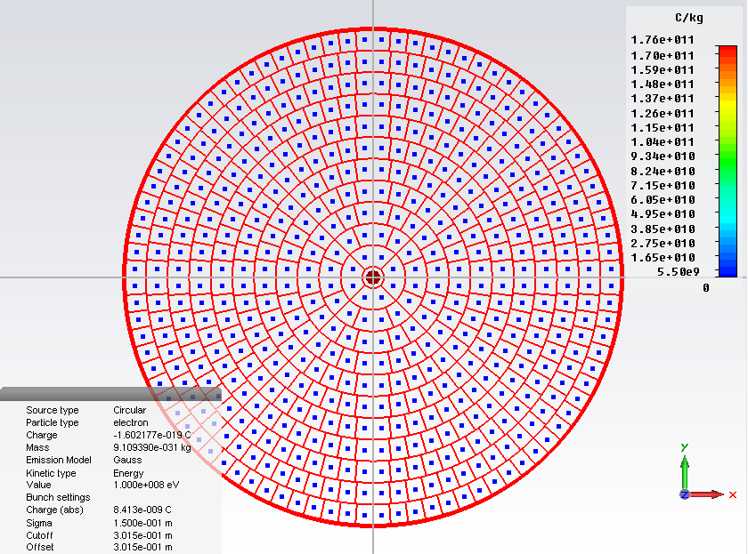

Slide 30
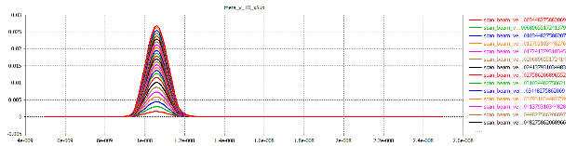
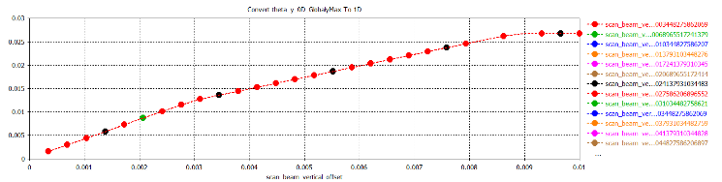
Evaluating the beam profile
Monitor the deflection of the scanning beam
Plot the maxima and compute the derivative

