Slide 1

Saturation and geometrical scaling –
– from small x DIS to high energy HI collisions
Michał Praszałowicz
M. Smoluchowski Inst. of Physics
Jagiellonian University, Kraków, Poland
Dallas SMU 28.4.2015.

Slide 2

message to take away:
There exits an intermediate energy scale, called saturation scale,
that, by dimensional arguments, deterimines inclusive and semi-
-inclusive observables in kinematical regions where no other
energy (momentum) scales exist.

Slide 3
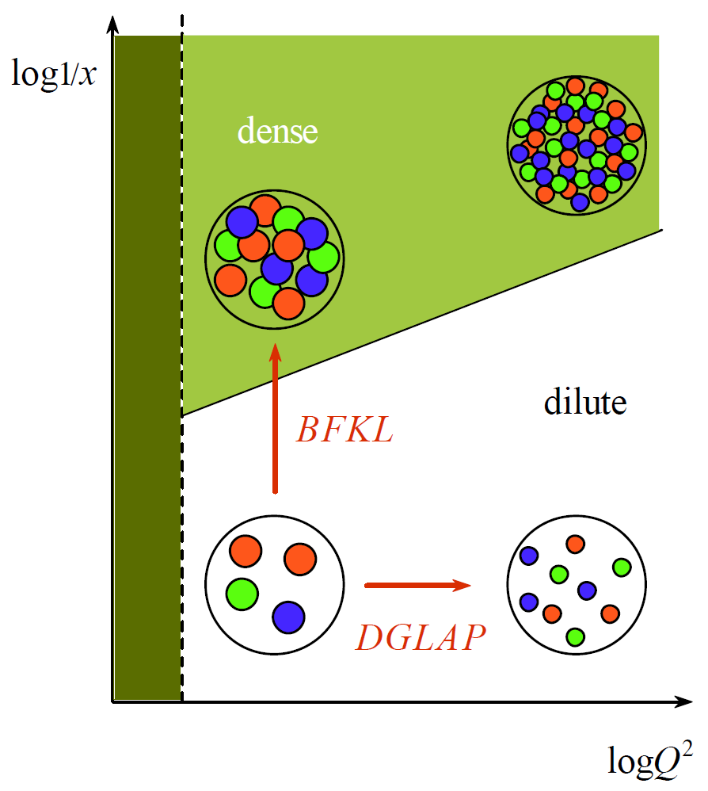

DGLAP vs BFKL Evolution
small x
large W
Balitsky, Fadin,
Kuraev, Lipatov
Dokshitzer, Gribov, Lipatov,
Altarelli, Parisi
large x
small W

Slide 4



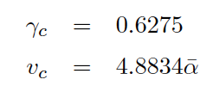


Travelling waves in QCD
Mellin transform:
minimal velocity:
travelling wave condition:
scaling
variable
saturation scale:

Slide 5
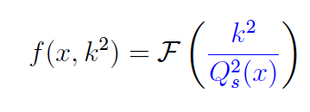
Geometrical Scaling

Slide 6
Deep Inealstic Scattering

Slide 7

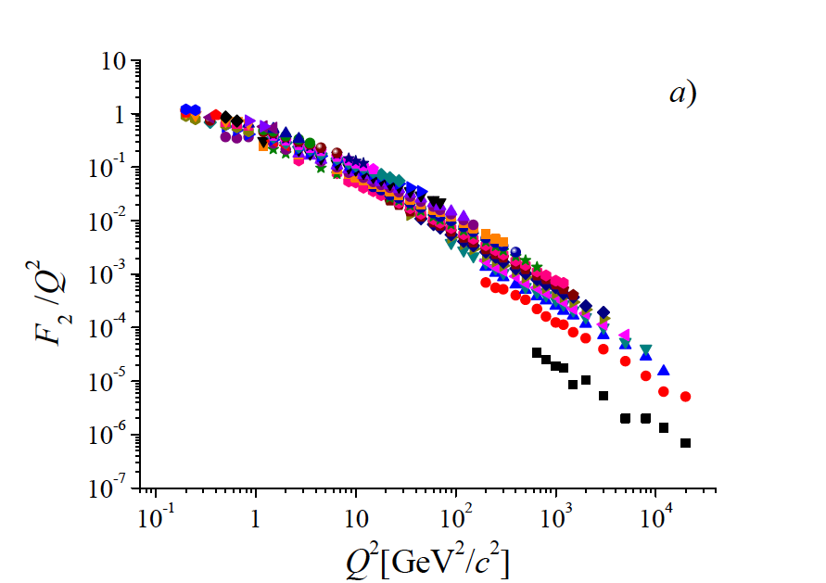
Saturation scale: energy and x dependence
A.M. Stasto, K. J. Golec-Biernat,
J. Kwiecinski
PRL 86 (2001) 596-599
M.Praszalowicz and T.Stebel
JHEP 1303, 090 (2013)
arXiv:1211.5305 [hep-ph]
and
JHEP 1304, 169 (2013)
arXiv:1302.4227 [hep-ph]

Slide 8

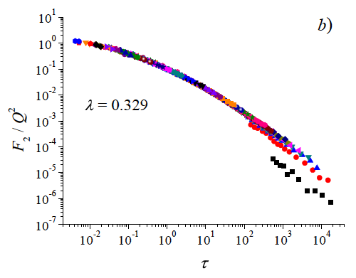
Saturation scale: energy and x dependence
λ = 0.329 ± 0.005
up to x = 0.08 (!)
large x
more ”sophisticated” scaling
variables do not work well

Slide 9
proton-proton @ LHC

Slide 10

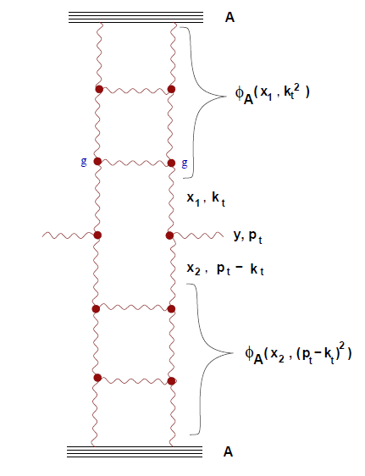

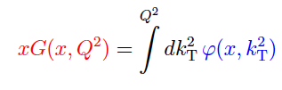
Basics of geometrical scaling
Gribov, Levin Ryskin, High p_{T} Hadrons In The Pionization Region In QCD. Phys.Lett.B100:173-176,1981.
gluon distribution
unintegrated glue
Kharzeev, Levin
Phys.Lett.B523:79-87,2001.
Notes:
Parton-hadron duality

Slide 11


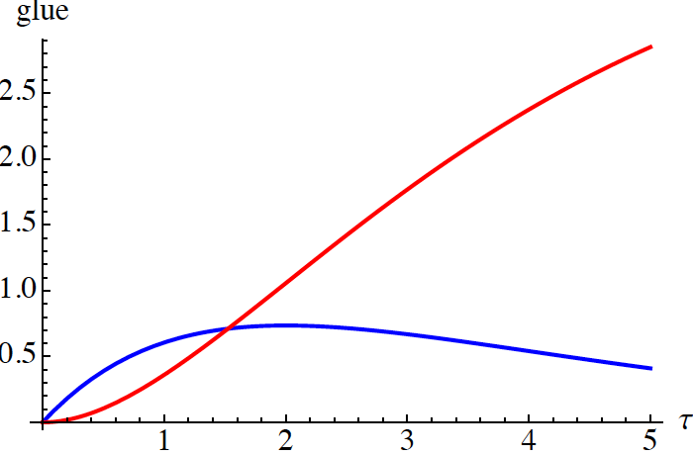
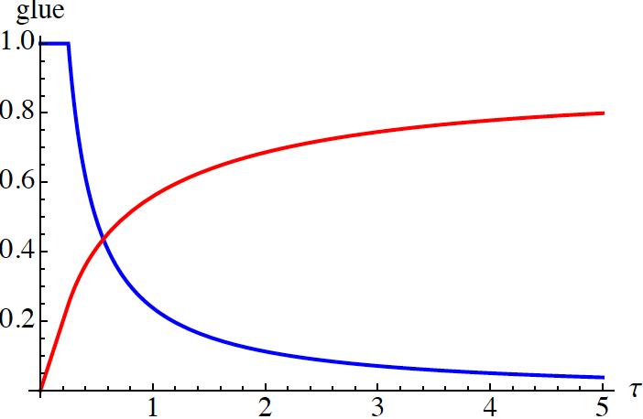

Basics of geometrical scaling
gluon distribution
unintegrated glue
Golec-Biernat – Wuesthoff (DIS) Kharzeev – Levin (AA)
scaling variable

Slide 12

Basics of geometrical scaling
for y ~ 0 (central rapidity) i.e. for x₁ ~ x₂ = x and for symmetric systems

Slide 13



Basics of geometrical scaling
for y ~ 0 (central rapidity) i.e. for x₁ ~ x₂ = x and for symmetric systems

Slide 14


Basics of geometrical scaling
for y ~ 0 (central rapidity) i.e. for x₁ ~ x₂ = x and for symmetric systems

Slide 15

Basics of geometrical scaling
for y ~ 0 (central rapidity) i.e. for x₁ ~ x₂ = x and for symmetric systems

Slide 16

Basics of geometrical scaling
for y ~ 0 (central rapidity) i.e. for x₁ ~ x₂ = x and for symmetric systems

Slide 17
Basics of geometrical scaling
for y ~ 0 (central rapidity) i.e. for x₁ ~ x₂ = x and for symmetric systems
saturation scale = gluon density
per transverse area

Slide 18
Basics of geometrical scaling
for y ~ 0 (central rapidity) i.e. for x₁ ~ x₂ = x and for symmetric systems
parton – hadron duality:
power-like growth of
particle multiplicity
saturation scale = gluon density
per transverse area

Slide 19
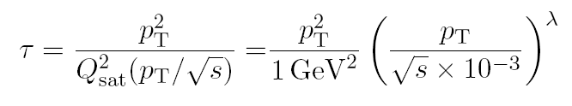
Geometrical scaling of p_{T} distributions
L. McLerran, M. P. Acta Phys.Polon.B41:1917,2010, B42:99,2011
M. P. Phys.Rev.Lett.106:142002,2011, Acta Phys.Pol. B42 (2011) 1557-1566 Phys.Rev. D87 (2013) 071502(R)

Slide 20

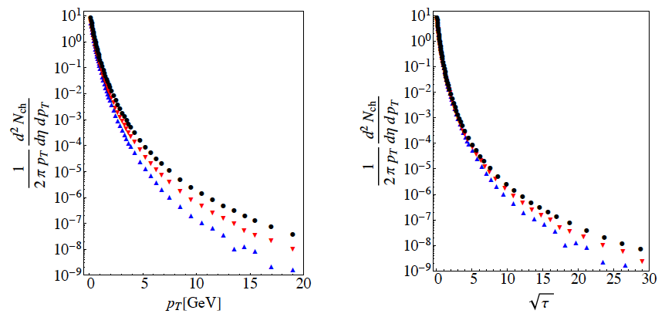
Determination of lambda
ALICE 1307.1093 [nucl-ex], Eur.Phys.J C73 (2013) 2662
inelastic

Slide 21
Determination of lambda

Slide 22
Determination of lambda

Slide 23
Determination of lambda

Slide 24
Determination of lambda

Slide 25
Determination of lambda

Slide 26
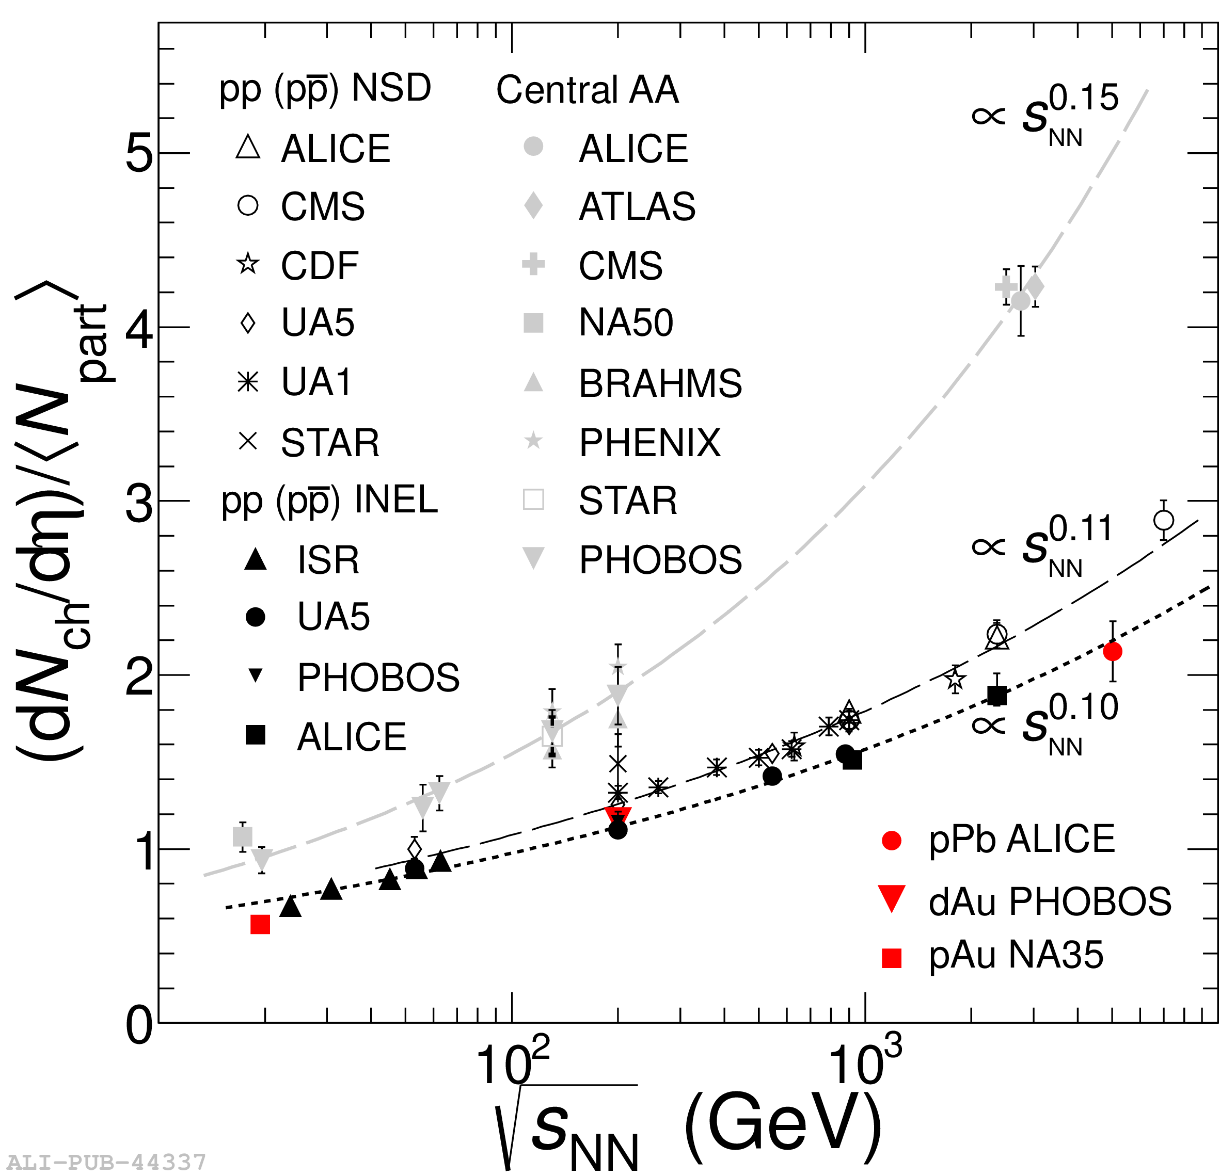
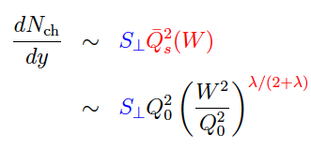
Power-like growth of multiplicity
http://th-www.if.uj.edu.pl/school/2014/talks/braun-munzinger_1.pdf
plot: P. Braun-Munzinger,
54 Cracow School of
Theoretical Physics
(from ALICE-PUB-44337)
transverse area is
energy indpendent
Notes:
Different powers depending on the process (inelastic, NSD, HI)

Slide 27
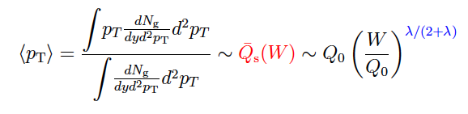
Average transverse momentum

Slide 28
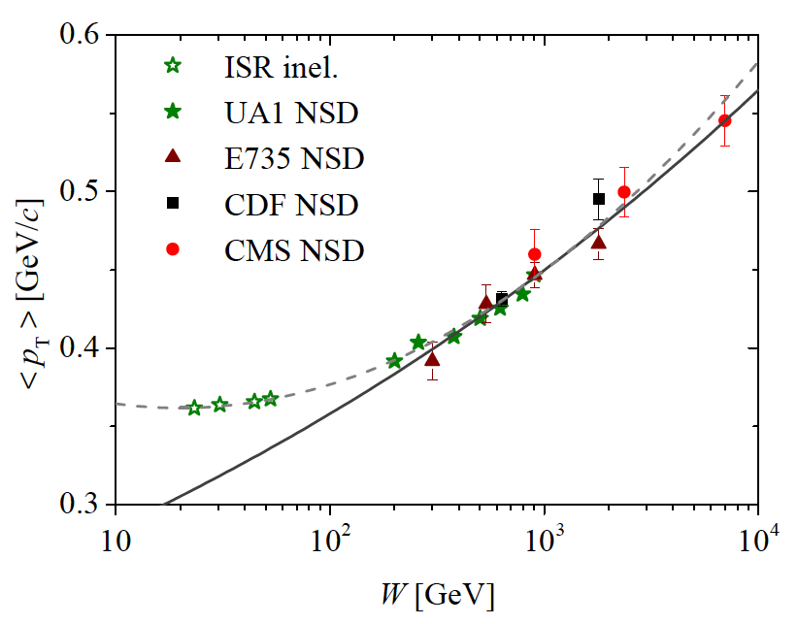
Average transverse momentum

Slide 29
Violation
of Geometrical Scaling

Slide 30
Violation of GS for y ≠ 0
M. P. Phys.Rev. D87 (2013) 071502(R)
x₁ can be large, so that gluons in 1 are dilute
x₂ is then small in the dense region

Slide 31


Kinematical range of GS in pp

Slide 32

Kinematical range of GS in pp
transverse momentum schould be larger
than some nonperturbative scale Λ

Slide 33
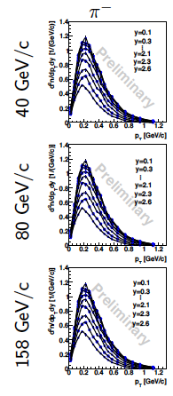
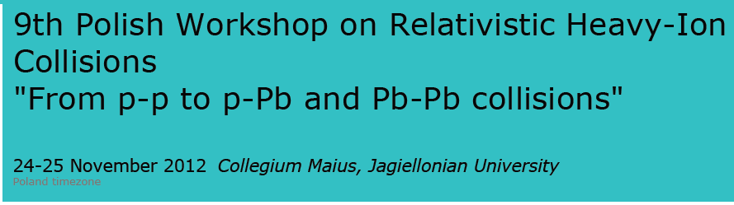
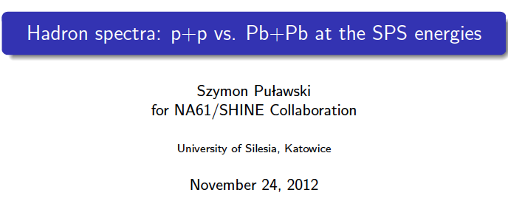
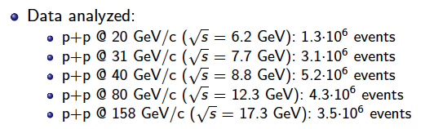
NA61 Shine data

Slide 34
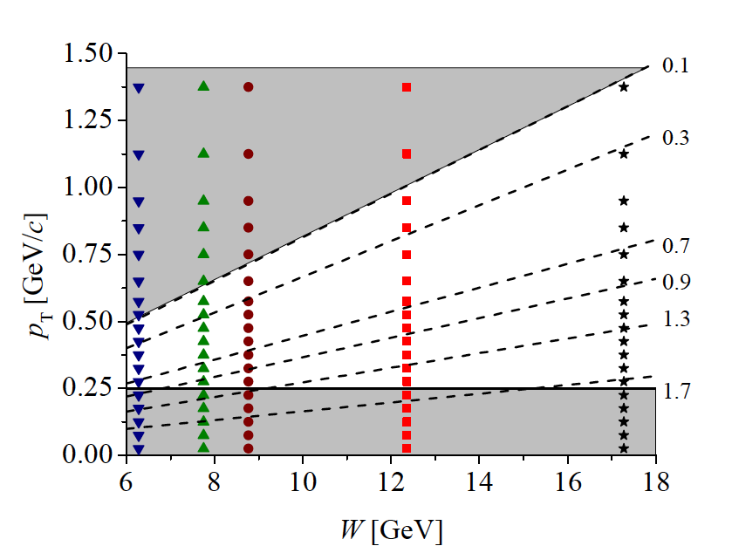
NA61 kinematical range

Slide 35
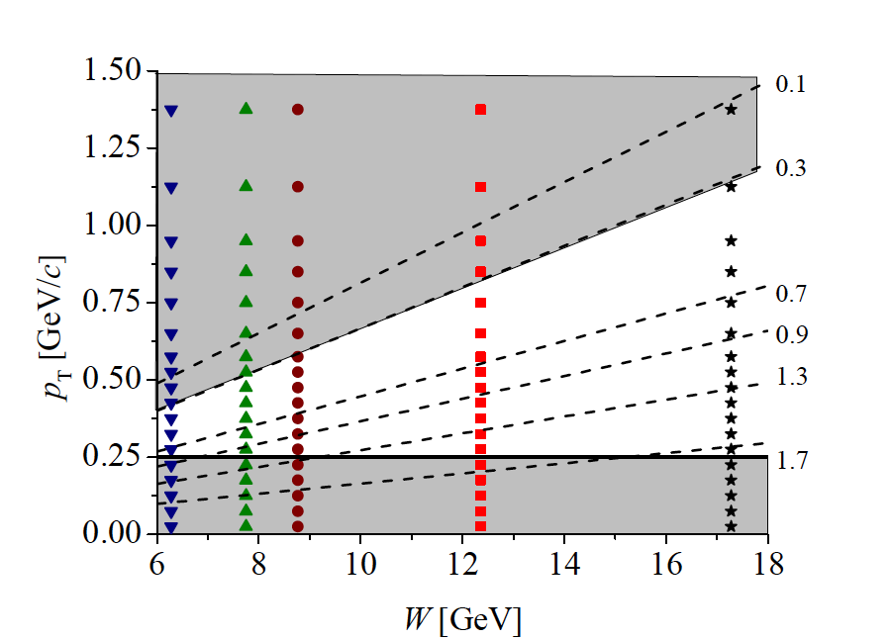
NA61 kinematical range

Slide 36
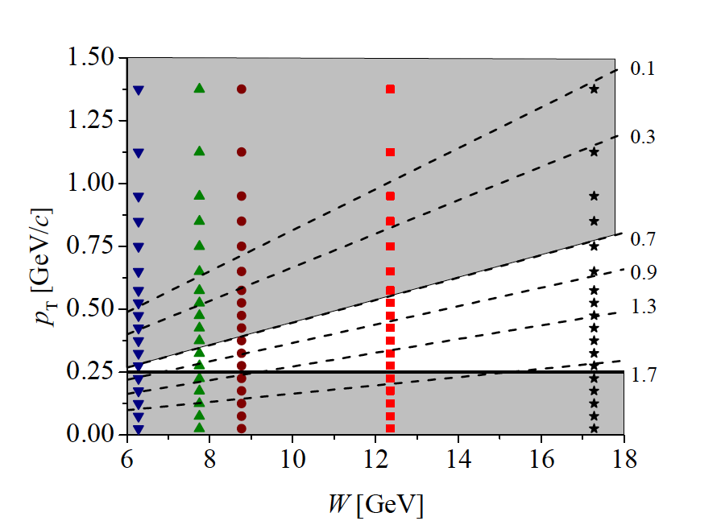
NA61 kinematical range

Slide 37
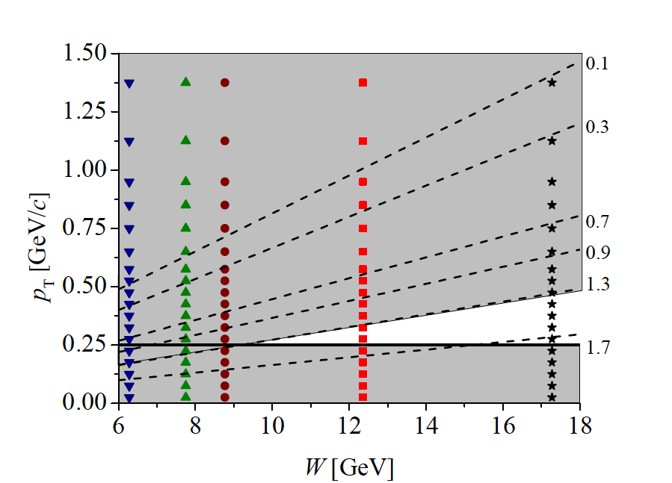
NA61 kinematical range

Slide 38
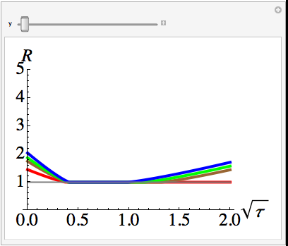
6.28
7.75
8.77
12.36

Slide 39
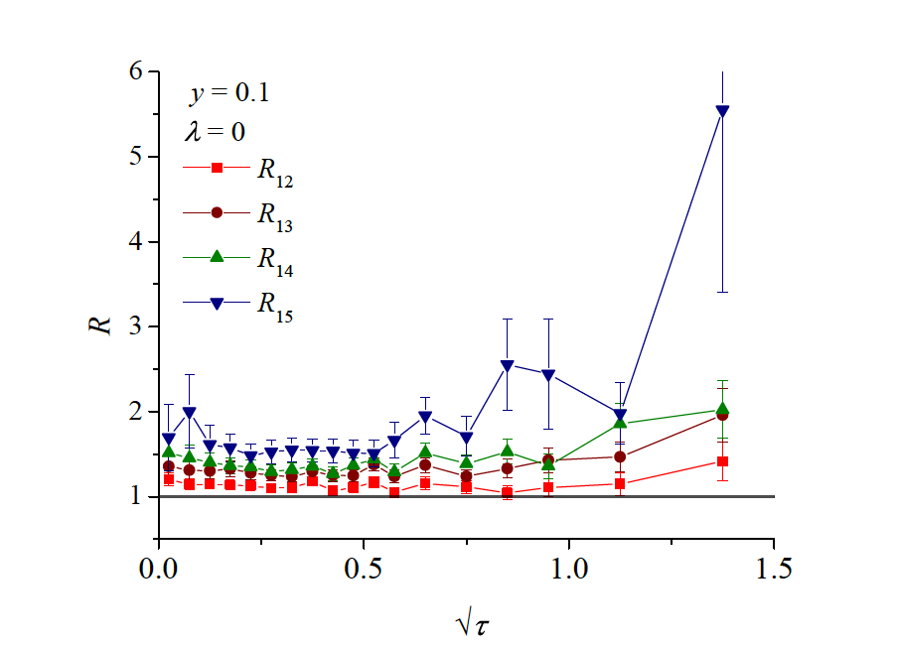
p_{T}

Slide 40
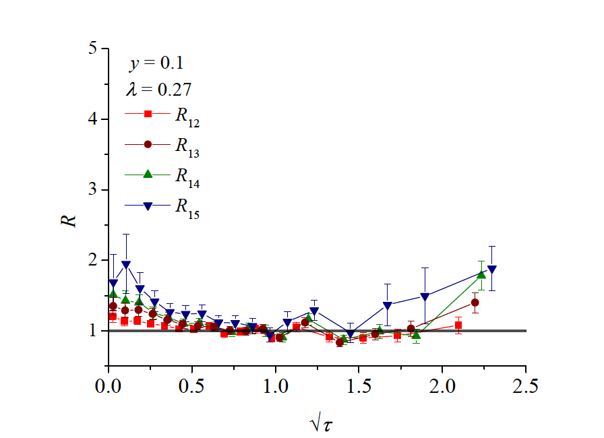

Slide 41
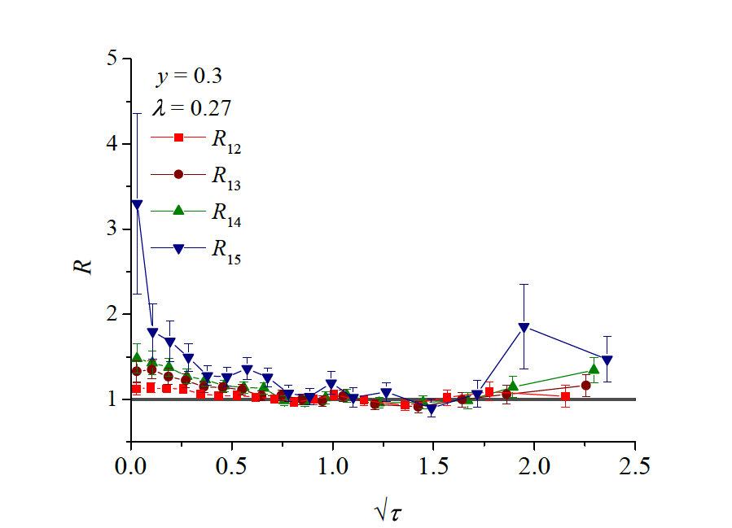

Slide 42
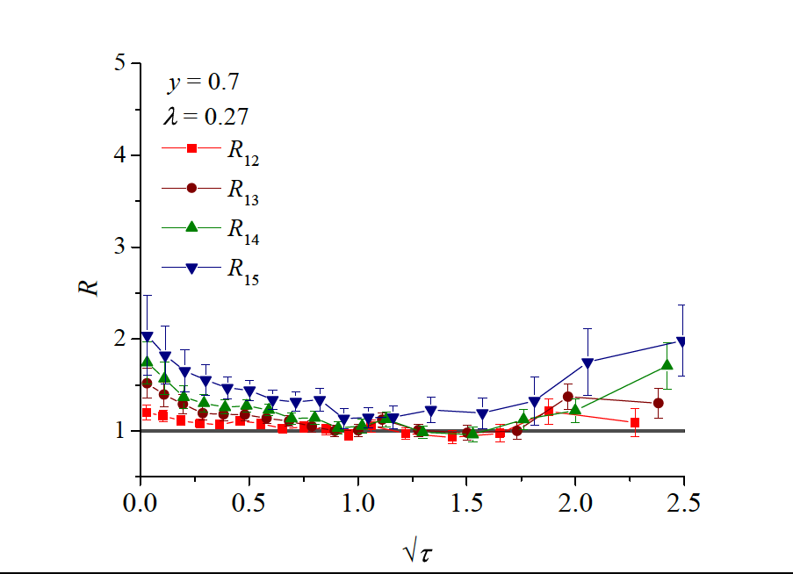

Slide 43
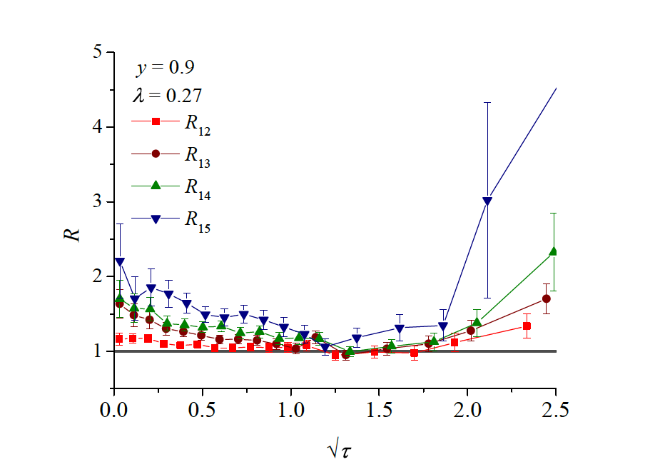

Slide 44
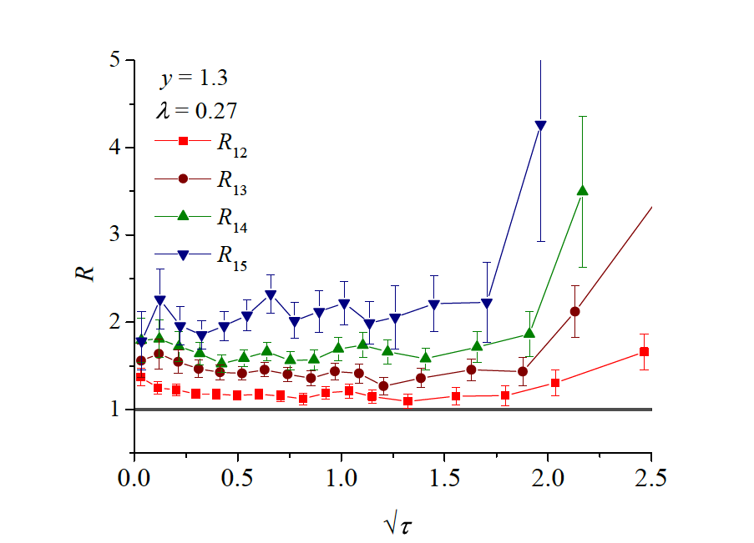

Slide 45
Geometrical Scaling
in Heavy Ion Collisions
Notes:
Why should it survive hydro?

Slide 46
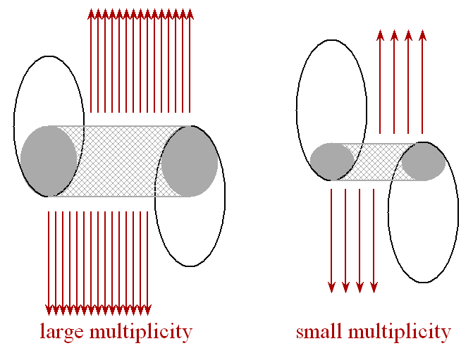
GS in HI: centrality
number of participants
N_{part} ~ V
small centrality large centrality

Slide 47
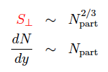

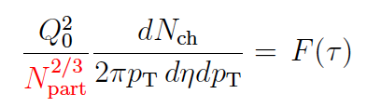
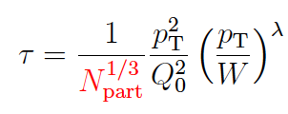
GS in HI: centrality dependence
Geometrical Scaling of Direct-Photon Production
in Hadron Collisions from RHIC to the LHC
Christian Klein-Bösing, Larry McLerran arXiv:1403.1174
Scaling of the saturation scale:

Slide 48
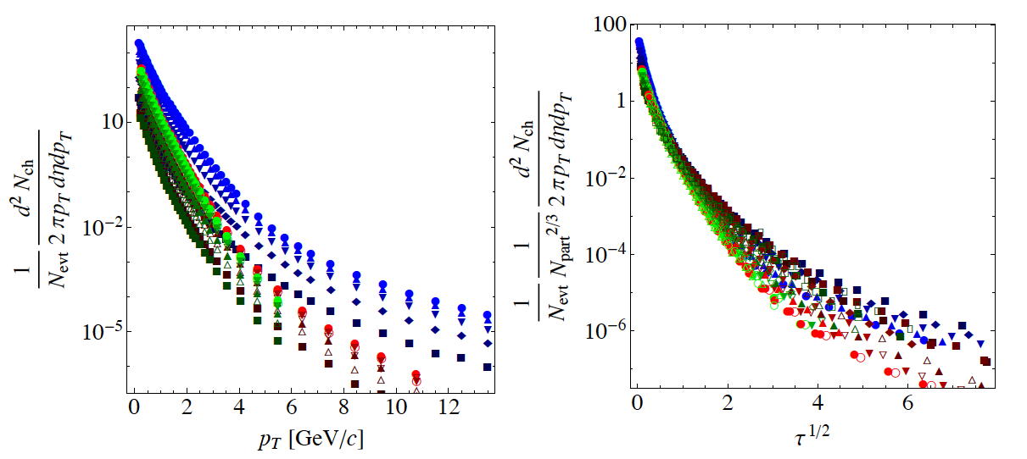
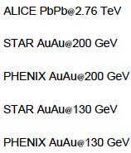
GS in HI

Slide 49
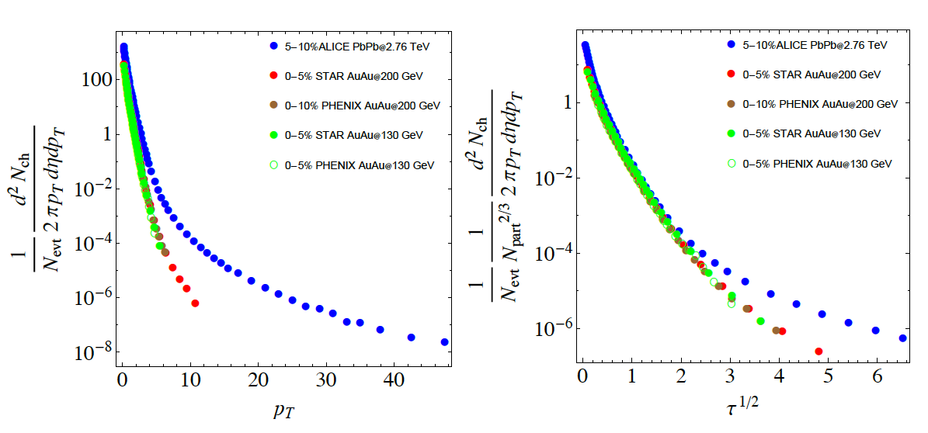
Energy Scaling in HI
energy scaling works quite well, why?

Slide 50
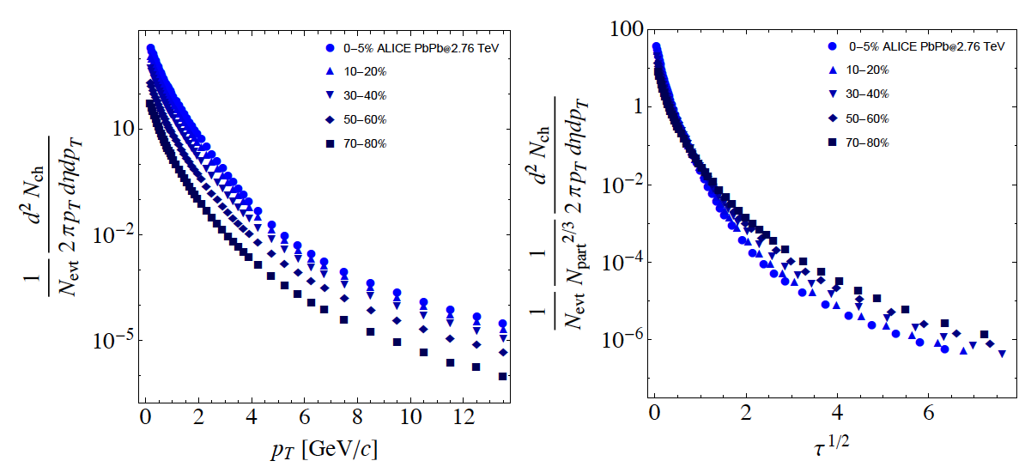
Centrality Scaling in HI

Slide 51
Summary
QCD evolution equations lead to overabundance of gluons
Nonlinear evolution introduces new scale: saturation momentum
GS should emerge if no other scales are present
GS in DIS works for rather high Bjorken x
GS works also for charged particles in pp
GS for mean p_{T} and for <p_{T}>(N_{ch})
GSV is found for y ≠ 0 in agreement with expectations
Energy and centrality dependence of GS in HI

Slide 52
Summary
QCD evolution equations lead to overabundance of gluons
Nonlinear evolution introduces new scale: saturation momentum
GS should emerge if no other scales are present
GS in DIS works for rather high Bjorken x
GS works also for charged particles in pp
GS for mean p_{T} and for <p_{T}>(N_{ch})
GSV is found for y ≠ 0 in agreement with expectations
Energy and centrality dependence of GS in HI
Is GS a real sign of saturation?
Why in pp GS is not washed out by FSI, resonances, etc.?
Why in HI hydro preserves (at least partially) GS?
Nonuniversality: different values of λ

