Slide 1

Medium Energy Electron Ion Collider at Jefferson Lab
He Zhang
On Behalf of the MEIC Design Group
DIS 2015, Dallas TX, 04/28/2015

Slide 2
Outline
Design goals and strategy
Accelerator design
Detector region
Machine performance
Beam polarization
Beam cooling
Summary

Slide 3

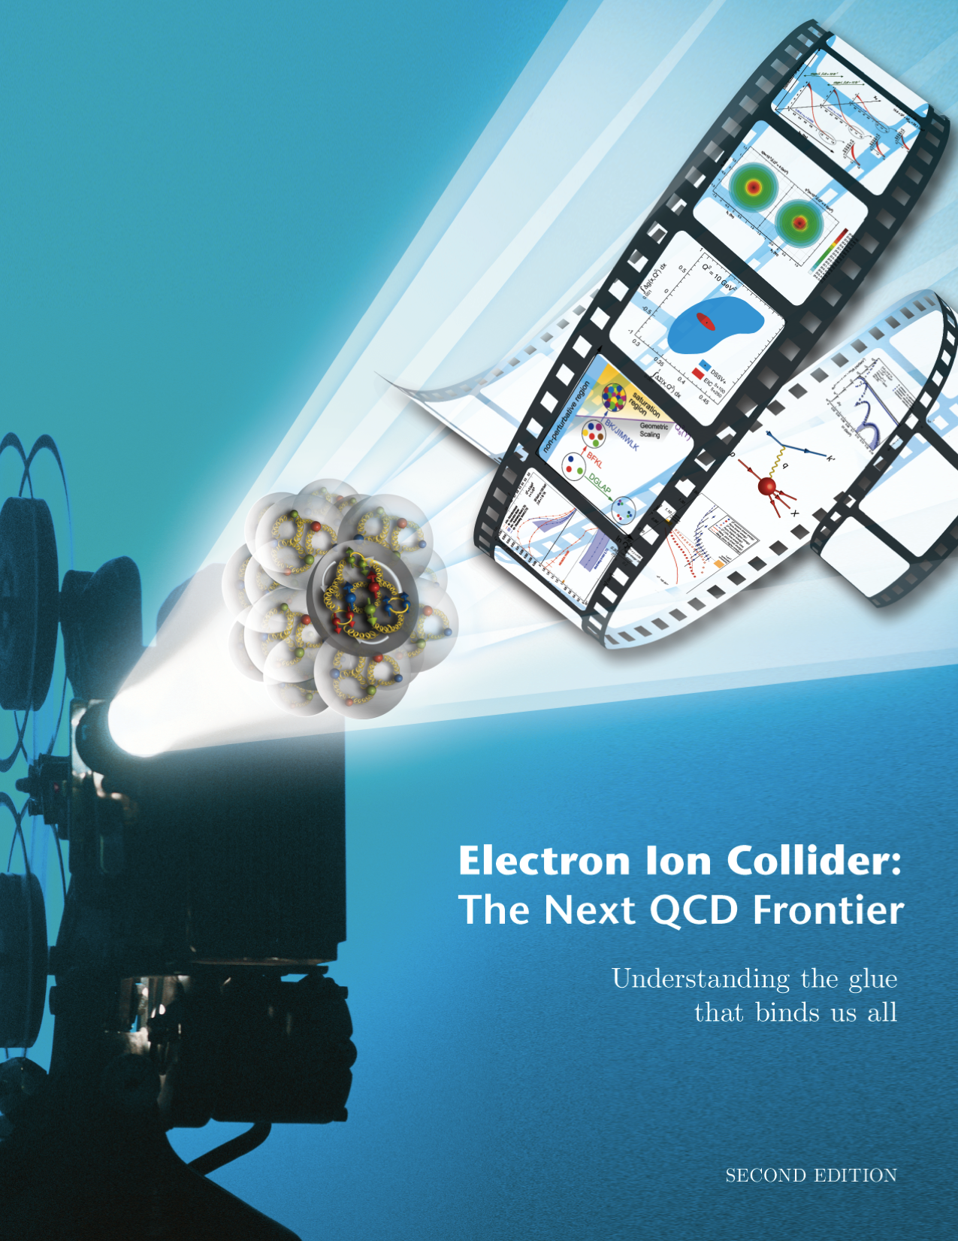
MEIC Design Goals
Energy
  Full coverage of √s from 15 to 65 GeV
  Electrons 3-10 GeV, protons 20-100 GeV, ions 12-40 GeV/u
Ion species
  Polarized light ions: p, d, ³He, and possibly Li
  Un-polarized light to heavy ions up to A above 200 (Au, Pb)
Two detectors
Primary detector – full acceptance (baseline)
Second detector – high luminosity (future)
Luminosity
  10³³ to 10³⁴cm⁻²s⁻¹ per IP in a broad CM energy range
Polarization
  At IP: longitudinal for both beams, transverse for ions only
  All polarizations >70%
Upgrade to higher energies and luminosity possible
  20 GeV electron, 250 GeV proton, and 100 GeV/u ion
  Design goals consistent with the White Paper requirements

Slide 4
High Luminosity Strategy: High Repetition Rate
The MEIC design concept for high luminosity is based on high bunch repetition rate CW colliding beams
Beam Design
High repetition rate
Low bunch charge
Short bunch length
Small emittance
“Traditional” hadrons colliders
Small number of bunches
Small collision frequency f
Large bunch charge n₁ and n₂
Long bunch length
Large beta-star
IR Design
Small β*
Crab crossing
Damping
Synchrotron radiation
Electron cooling
Linac-Ring colliders
Large beam-beam parameter for the electron beam
Need to maintain high polarized electron current
High energy/current ERL

Slide 5
High Polarization Strategy: Figure-8 Shape
All rings are figure-8 — critical advantages for both ion and electron beam
  Spin precessions in the left & right parts of the ring are exactly cancelled
  Net spin precession (spin tune) is zero, thus energy independent
  Spin is easily controlled and stabilized by small solenoids or other compact spin rotators, which do NOT affect the close orbit
  Advantage 1: Ion spin preservation during acceleration
  Ensures spin preservation
  Avoids energy-dependent spin sensitivity for all species of ions
  Allows a high polarization for all light ion beams
  Advantage 2: Ease of spin manipulation
    Delivers desired polarization at the collision points
  Advantage 3: The only practical way to accommodate polarized deuterons
  (given the ultra small g-2)
  Advantage 4: Strong reduction of quantum depolarization thanks to the energy independent spin tune.

Slide 6
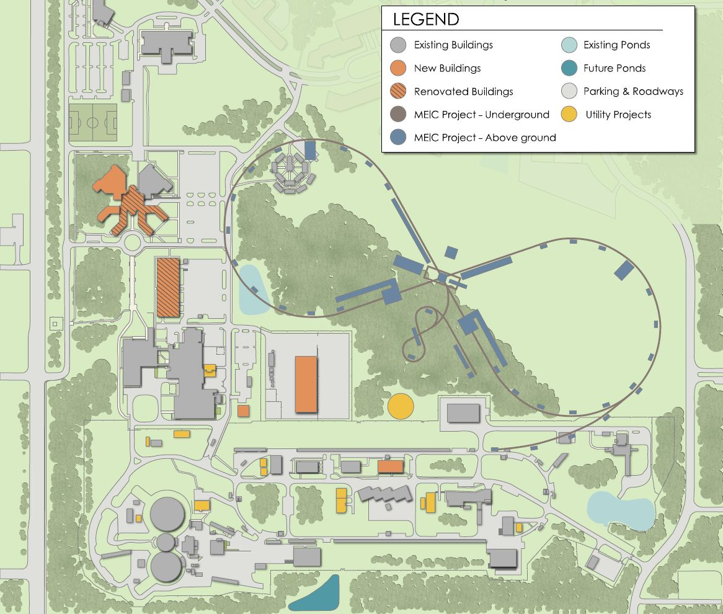
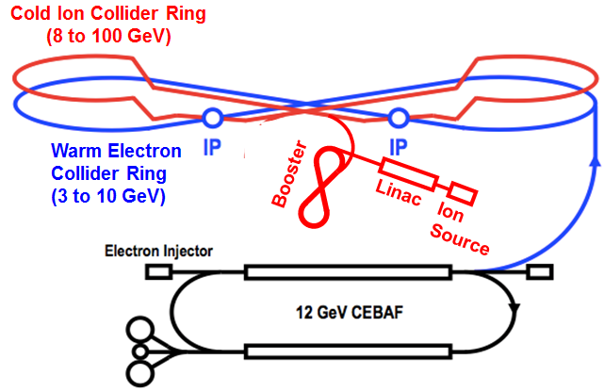
Layout

Slide 7
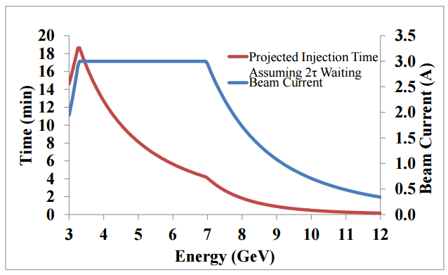
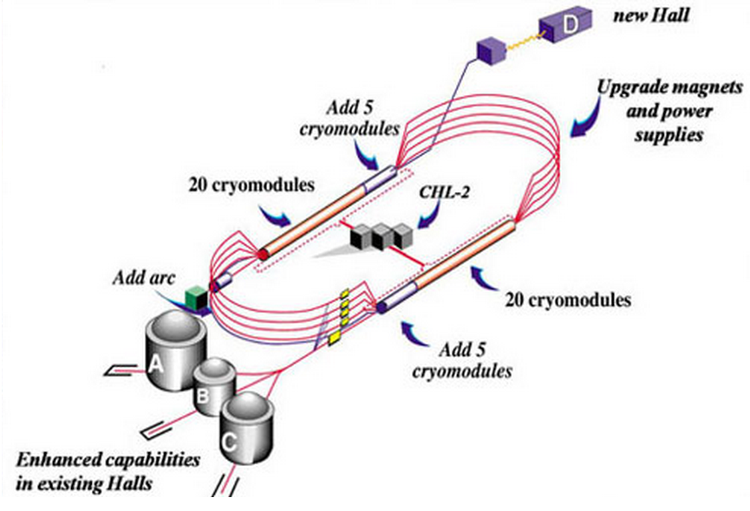
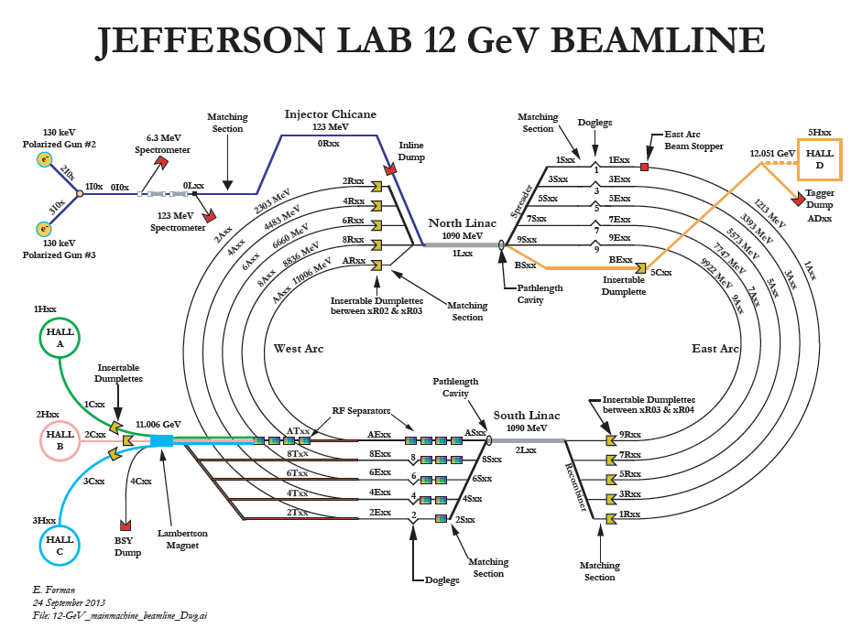
CEBAF - Full Energy Injector
5.5 pass SRF recirculating Linac
12 GeV upgrade (accelerator part finished)
Full energy injector
Frequency >1497MHz
Polarization >85%
No future upgrade needed in terms of current and polarization
new 5
cryomodules
new 5
cryomodules

Slide 8
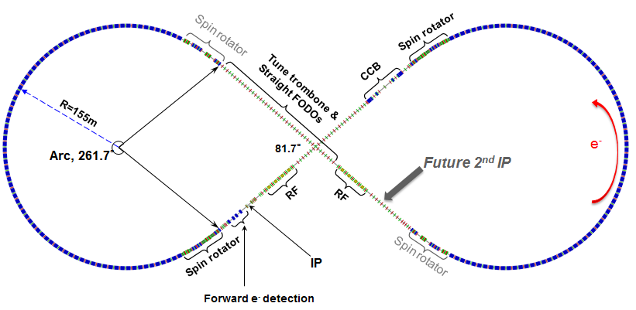
Electron Collider Ring Layout
Circumference of 2154.28 m = 2 x 754.84 m arcs + 2 x 322.3 straights
Figure-8 crossing angle 81.7°
Use PEP-II magnets, vacuum chamber, and other components.
Electron beam parameters:
  3-10 GeV energy, 3A beam current up to 6-7 GeV, ~1cm bunch length,
  small emittance, total synchrotron radiation power < 10MW, polarization >70%
Two detectors
Compensation of nonlinearity

Slide 9
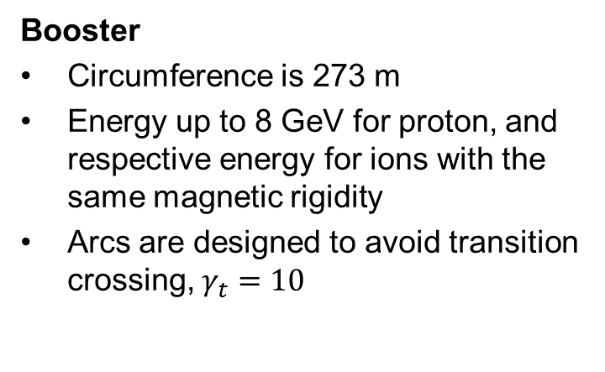
Ion Linac and Booster
Ion source and linac
ABPIS for polarized or unpolarized light ions and EBIS or ECR for un-polarized heavy ions
Linac is effective in accelerating a wide variety of ions, from H⁻ to ²⁰⁸Pb⁶⁷⁺
285 MeV for protons and 112 MeV/u for lead ions after passing through the linac
RFQ
QWR
QWR
HWR
Ion Sources
IH
4 cryostats
2
10 cryostats
4 cryos
2 cryos
10 cryos
MEBT
Optimum stripping energy: 13 MeV/u
Booster
Circumference is 273 m
Energy up to 8 GeV for proton, and respective energy for ions with the same magnetic rigidity
Arcs are designed to avoid transition crossing, $γ_{t}=10$
Crossing angle:
75 deg.
RF cavity
injection
extraction
ABPIS – Atomic Beam Polarized Ion Source, EBIS – Electron Beam Ion Source, ECR – Electron Cyclotron Resonance ion source
RFQ – Radio Frequency Quadruple, MEBT – Medium Energy Beam Transport, IH – Interdigital H-type RF structure
QWR – quarter wave resonator, HWR – half wave resonator

Slide 10
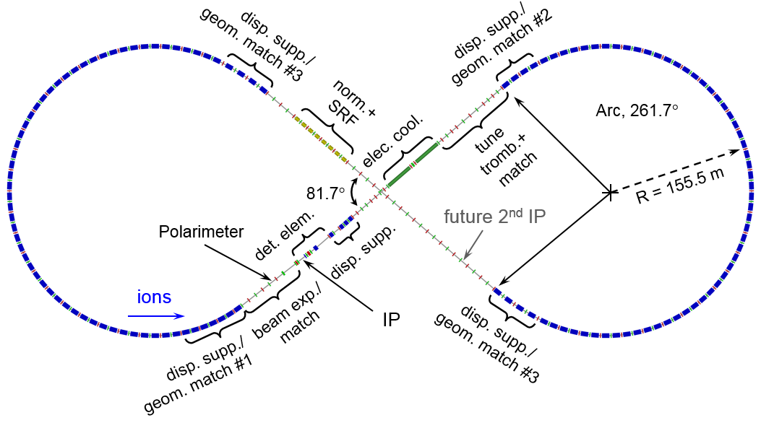
Ion Collider Ring Layout
Circumference is 2153.9 m, match the electron ring geometry
Two 261.7° arcs connected by two straights crossing at 81.7°
Beam parameters:
  8-100 GeV protons, 12-40 GeV/u ions, 0.5A beam current,
  ~1cm bunch length, small emittance, polarization >70%
Cooling section
Two detectors
Compensation of nonlinearity
Super-ferric magnets, 3T

Slide 11
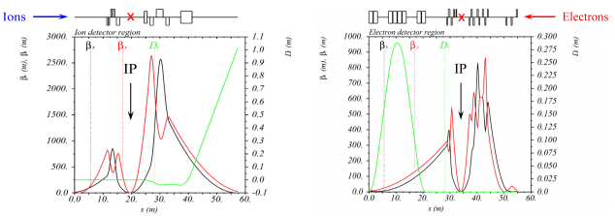
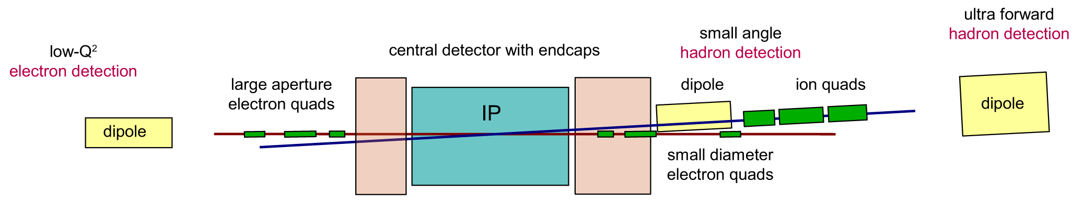

Detector Region
Full acceptance
Strong focusing, small $β^{∗}$ and small bunch size
  50 mrad beam crossing angle, quick separation of two colliding beams
  Avoid parasitic collision
  Make sufficient place for interaction region magnets
Crab-crossing to restore head on collision

Slide 12
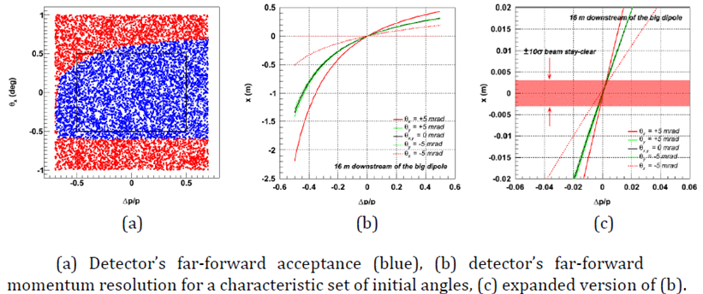
Detector Performance Optimization
Performance optimized by particle tracking (G4beamline&GEMC)
For example:
  (a) detector acceptance to small-angle forward-scattered hadrons in terms of the particles’ initial angle and momentum offset
  (b) (c) detector resolution properties at 16 m downstream of Dipole 2.
Zhiwen Zhao’s talk

Slide 13
MEIC Performance (Baseline)
For a full acceptance detector
CM energy | GeV | 21.9 (low) |  | 44.7 (medium) |  | 63.3 (high)
 |  | p | e | p | e | p | e
Beam energy | GeV | 30 | 4 | 100 | 5 | 100 | 10
Collision frequency | MHz | 476 |  | 476 |  | 159
Particles per bunch | 10¹⁰ | 0.66 | 3.9 | 0.66 | 3.9 | 2.0 | 2.8
Beam current | A | 0.5 | 3 | 0.5 | 3 | 0.5 | 0.72
Polarization | % | >70% | >70% | >70% | >70% | >70% | >70%
Bunch length, RMS | cm | 2.5 | 1.2 | 1 | 1.2 | 2.5 | 1.2
Norm. emitt., vert./horz. | μm | 0.5/0.5 | 74/74 | 1/0.5 | 144/72 | 1.2/0.6 | 1152/576
Horizontal and vertical β* | cm | 3 | 5 | 2/4 | 2.6/1.3 | 5/2.5 | 2.4/1.2
Vert. beam-beam param. |  | 0.01 | 0.02 | 0.006 | 0.014 | 0.002 | 0.013
Laslett tune-shift |  | 0.054 | small | 0.01 | small | 0.01 | small
Detector space, up/down | m | 3.6/7 | 3/3.2 | 3.6/7 | 3/3.2 | 3.6/7 | 3(3)/3.2
Hour-glass (HG) reduction |  | 0.89 |  | 0.88 |  | 0.73
Lumi./IP, w/HG, 10³³ | cm⁻²s¹ | 1.9 |  | 4.6 |  | 1.0
For a high(er) luminosity detector
Horizontal and vertical β* | cm | 1.2 | 2 | 1.6 / 0.8 | 1.6 / 0.8 | 2 /1 | 1.6 / 0.8
Vert. beam-beam param. |  | 0.01 | 0.02 | 0.004 | 0.021 | 0.001 | 0.021
Detector space, up/down | m | ±4.5 | 3 | ±4.5 | 3 | ±4.5 | 3
Hour-glass (HG) reduction |  | 0.67 |  | 0.74 |  | 0.58
Lumi./IP, w/HG, 10³³ | cm⁻²s¹ | 3.5 |  | 7.5 |  | 1.4

Slide 14
e-p Luminosity
10³⁴
10³³

Slide 15
e-A Luminosity
For a full acceptance detector
 |  | Electron | Proton | Deuteron | Helium | Carbon | Calcium | Lead
 |  | e | p | d | ³He⁺⁺ | ¹²C⁶⁺ | ⁴⁰Ca²⁰⁺ | ²⁰⁸Pb⁸²⁺
Beam energy | GeV | 5 | 100 | 50 | 66.7 | 50 | 50 | 39.4
Particles/bunch | 10¹⁰ | 3.9 | 0.66 | 0.66 | 0.33 | 0.11 | 0.033 | 0.008
Beam current | A | 3 | 0.5 | 0.5 | 0.5 | 0.5 | 0.5 | 0.5
Polarization |  | >70% | >70% | > 70% | > 70% | - | - | -
Bunch length, RMS | cm | 1.2 | 1 | 1 | 1 | 1 | 1 | 1
Norm. emit., horz./vert. | μm | 144/72 | 1/0.5 | 0.5/0.25 | 0.7/0.35 | 0.5/0.25 | 0.5/0.25 | 0.5/0.25
β*, hori. & vert. | cm | 2.6/1.3 | 4/2 | 4/2 | 4/2 | 4/2 | 4/2 | 5/2.5
Vert. beam-beam parameter |  | 0.014 | 0.006 | 0.006 | 0.006 | 0.006 | 0.006 | 0.005
Laslett tune-shift |  |  | 0.01 | 0.041 | 0.022 | 0.041 | 0.041 | 0.041
Detector space (up/down) | m | 3 / 3.2 | 3.6 / 7
Hour-glass (HG) reduction factor |  |  | 0.89 | 0.89 | 0.89 | 0.89 | 0.89 | 0.89
Lumi/IP/nuclei, w/ HG correction | 10³³ cm⁻²s⁻¹ |  | 4.6 | 4.6 | 2.2 | 0.77 | 0.23 | 0.04
Lumi/IP/nucleon, w/HG correction, | 10³³ cm⁻²s⁻¹ |  | 4.6 | 9.2 | 6.6 | 9.2 | 9.2 | 7.8
For a high(er) luminosity detector
β*, hori. & vert. | cm | 1.6/0.8 | 1.6/0.8 | 1.6/0.8 | 1.6/0.8 | 1.6/0.8 | 1.6/0.8 | 1.6/0.8
Vert. beam-beam parameter |  | 0.02 | 0.004 | 0.004 | 0.004 | 0.004 | 0.004 | 0.004
Detector space | m | 3 | 4.5
Hour-glass (HG) reduction factor |  |  | 0.74 | 0.74 | 0.74 | 0.74 | 0.74 | 0.74
Lumi/IP/nuclei, w/ HG correction | 10³³ cm⁻²s⁻¹ |  | 7.5 | 9.3 | 3.7 | 1.37 | 0.38 | 0.08
Lumi/IP/nucleon, w/HG correction, | 10³³ cm⁻²s⁻¹ |  | 7.5 | 15.1 | 11.1 | 15.1 | 15.1 | 17.3

Slide 16
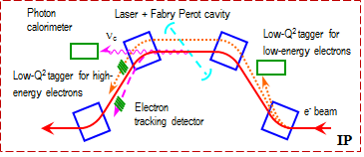
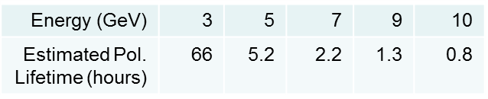
Electron Polarization Design
Requirements:
  70% (or above) longitudinal polarizations at IPs
  Polarization flipping at the required frequency
Approach:
  Figure-8 geometry – zero spin tune independent of energy
  Vertical polarization in arcs – minimize spin depolarization
  Universal spin rotator
  Two polarization states simultaneously in the ring
Long polarization lifetime
Compton polarimeter – continuous non-invasive polarization monitoring
Spin Rotator
Magnetic field
Polarization
IP
e⁻

Slide 17
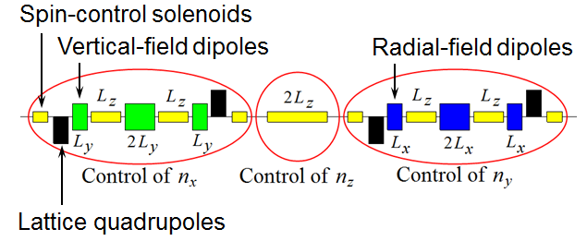
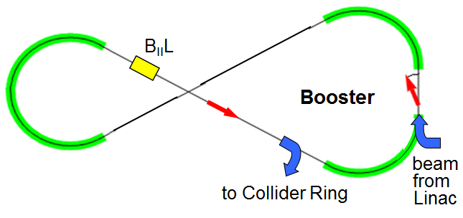
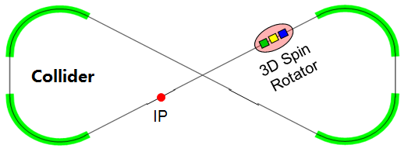
Ion Polarization
Requirements:
  70% (or above) polarizations at IPs
  Polarization flipping at the required frequency
Approach:
  Figure 8 for both rings
  Booster: a weak solenoid stabilizes the
polarization in the longitudinal direction
in the straight
  Collider ring: 3D spin rotator provides any
desired polarization at the IP

Slide 18
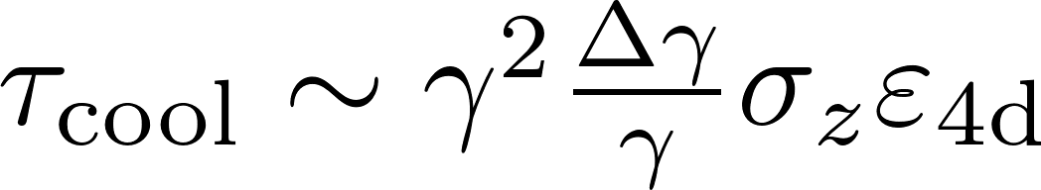
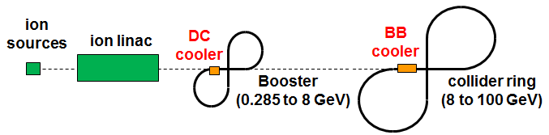
Beam Cooling
Conventional electron cooling
Multipole stage cooling scheme:
  DC electron cooling at the booster, reduce the emittance
  Bunched electron cooling at
  the collider, maintain the emittance
Bunched electron cooler
  55 MeV, 0.2 A magnetized electron beam
  Single pass energy-recovery-linac (ERL)
  Bunch to coasting/bunch cooling
Electron energy | MeV | up to 55
Current and bunch charge | A / nC | 0.2 / 0.42
Bunch repetition | MHz | 476
Cooling section length | m | 60
RMS Bunch length | cm | 3
Electron energy spread | 10⁻⁴ | 3
Cooling section solenoid field | T | 2
Beam radius in solenoid/cathode | mm | ~1 / 3
Solenoid field at cathode | KG | 2
ion bunch
Cooling section
solenoid
electron bunch
energy recovery
SRF Linac
injector
dump

Slide 19
Summary and Outlook
MEIC is a ring-ring collider project with mature design.
It can deliver luminosities of up to 10³⁴ in the √s range of 15-65 GeV.
It can provide beam polarizations of over 70%.
Technical risks are intentionally kept low.
The design is upgradable in energy and luminosity.
The MEIC baseline design fulfills the white paper requirements.
The current design is being further optimized for cost and performance.
R&D continues with increasing effort.

Slide 20
MEIC Design Group
A. Bogacz, P. Brindza, A. Camsonne, E. Daly, Ya. S. Derbenev, D. Douglas, R. Ent, D. Gaskell, R. Geng, J. Grames, J. Guo, L. Harwood, A. Hutton, K. Jordan, A. Kimber, G. Krafft, R. Li, F. Lin, T. Michalski, V.S. Morozov, P. Nadel-Turonski, F. Pilat, M. Poelker, R. Rimmer, Y. Roblin, T. Satogata, M. Spata, R. Suleiman, A. Sy, C. Tennant, H. Wang, S. Wang, H. Zhang, Y. Zhang, Z. Zhao, Thomas Jefferson National Accelerator Facility (JLab), Newport News, VA 23606 USA
D.P. Barber, Deutsches Elektronen-Synchrotron (DESY), 22607 Hamburg, Germany
A. Kondratenko, M. Kondratenko, Sci. & Tech. Laboratory Zaryad, Novosibirsk, Russia
Yu. Filatov, Moscow Institute of Physics and Technology, Dolgoprydny, and Joint Institute for Nuclear Research, Dubna, Russia
P. N. Ostroumov, Argonne National Laboratory, Argonne, IL 60439 USA
S. Abeyratne, B. Erdelyi, Northern Illinois University, DeKalb, IL 50115 USA
A. Castilla, J. Delayen, C. Hyde, K. Park, Old Dominion University, Norfolk, VA 23529 USA
Y. Cai, Y.M. Nosochkov, M. Sullivan, M-H Wang, U. Wienands, SLAC National Accelerator Laboratory, Menlo Park, CA 94305 USA
J. Gerity, T. Mann, P. McIntyre, N.J. Pogue, A. Sattarov, Texas A&M University, College Station, TX, USA

Slide 21


Slide 22
Backup

Slide 23
Ion Injector Complex Overview
Booster (8 GeV)
(accumulation)
DC e-cooling
Ion Sources
SRF Linac (285 MeV)
Ion injector complex relies on demonstrated technologies for sources and injectors
  ABPIS for polarized or unpolarized light ions, EBIS and/or ECR for
  unpolarized heavy ions
  Design for an SRF linac based on the ANL linac for FRIB
  8 GeV Booster design to avoid transition for all ion species and based on super-ferric magnet technology
  Injection/extraction lines to/from Booster are designed

Slide 24
Ion Linac – Parameters and Layout
RFQ
QWR
QWR
HWR
Ion Sources
IH
4 cryostats
2
10 cryostats
4 cryos
2 cryos
10 cryos
MEBT
Optimum(?) lead stripping energy: 13 MeV/u
Linac design based on the ANL linac for FRIB. Pulsed linac capably of accelerating multiple charge ion species (H⁻ to Pb⁶⁷⁺)
  Warm Linac sections (115 MHz)
    RFQ (3 m)
    MEBT (3 m)
    IH structure (9 m)
  Cold Linac sections
    QWR + QWR (24 + 12 m) 115 MHz
    Stripper, chicane (10 m) 115 MHz
    HWR section (60 m) 230 MHz
Ion species: p to Pb
Ion species for the reference design | ²⁰⁸Pb
Kinetic energy (p, Pb) | 285 MeV 100 MeV/u
Maximum pulse current: Light ions (A/Q<3) Heavy ions (A/Q>3) | 2 mA 0.5 mA
Pulse repetition rate | up to 10 Hz
Pulse length: Light ions (A/Q<3) Heavy ions (A/Q>3) | 0.50 ms 0.25 ms
Maximum beam pulsed power | 680 kW
Fundamental frequency | 115 MHz
Total length | 121 m

Slide 25
Forward e⁻ Detection & Polarimetry
Dipole chicane for high-resolution detection of low-Q² electrons
forward e⁻ detection
Compton polarimetry
forward ion detection
local crab cavities
local crab cavities
IP
e⁻
local
crab cavities
ions
Compton polarimetry has been integrated to the interaction region design
  non-invasive, same polarization as at the IP due to zero net bend
Compton photon
calorimeter
ν_{c}
Low-Q² tagger for low-energy electrons
Low-Q² tagger for high-energy electrons
Laser + Fabry Perot cavity
e⁻ beam to spin rotator
Compton electron
tracking detector
Luminosity monitor
e⁻ beam from IP
Compton- and low-Q² electrons are kinematically separated!
Photons from IP

Slide 26
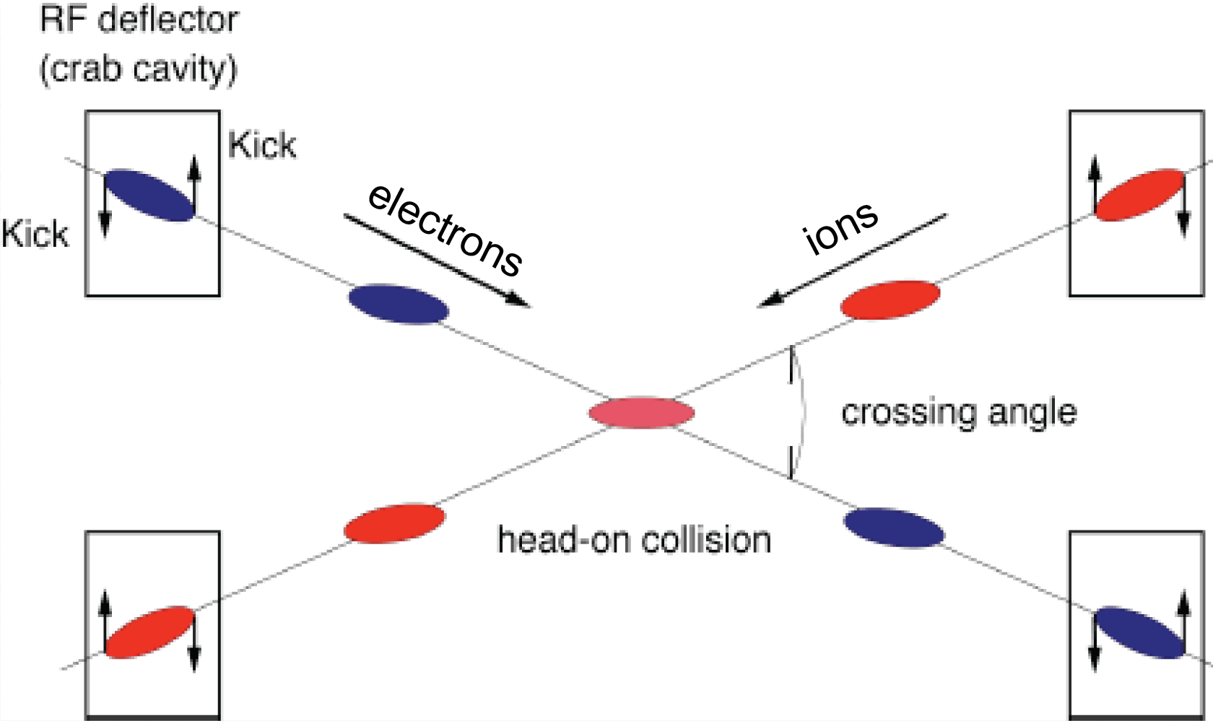
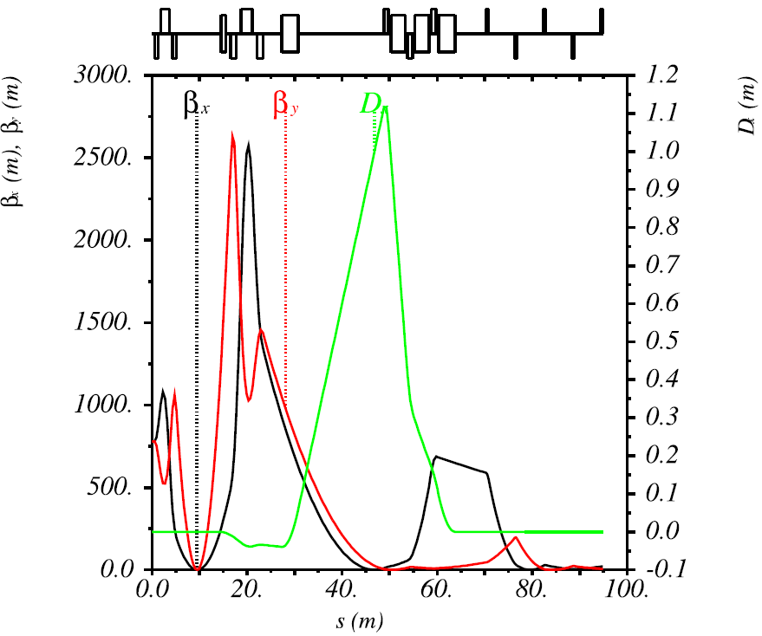
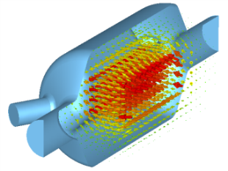
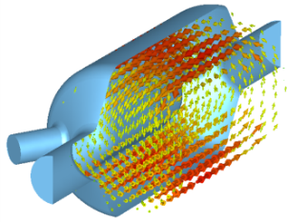
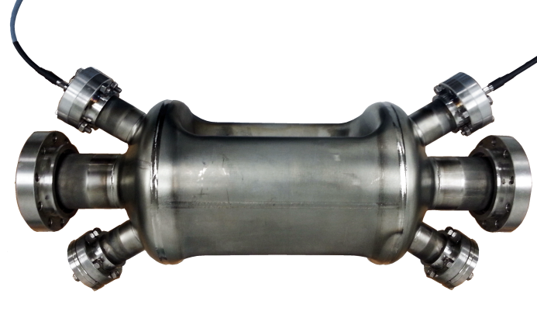
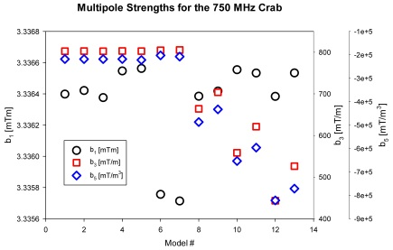
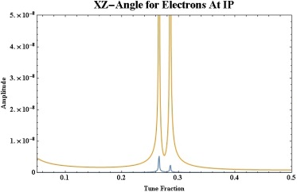
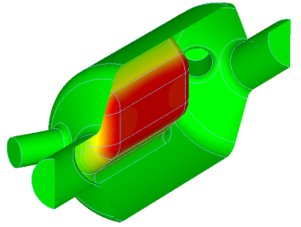
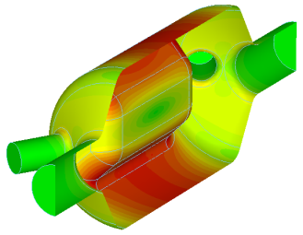
Crab Crossing
Effective head-on bunch collisions restored with 50 mrad crossing angle
Local crab scheme
Two cavities are placed at (n+1)π/2 phase advance relative to IP
Large β_{x} at location of crab cavities for minimizing the required kicking voltage
Deflective crabbing using transverse electric field of SRF cavities (as at KEK-B)
  Design and analysis completed
  Prototype fabricated and characterized
  Final testing with promising results
Location of crab cavities
π/2
3π/2
Multipole Tailoring
Beam Dynamics Studies

Slide 27
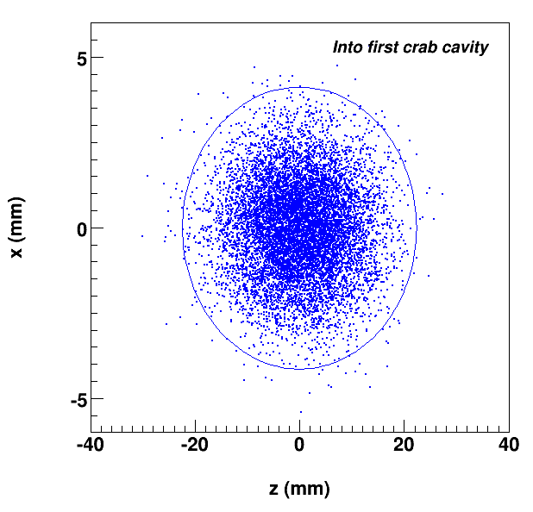
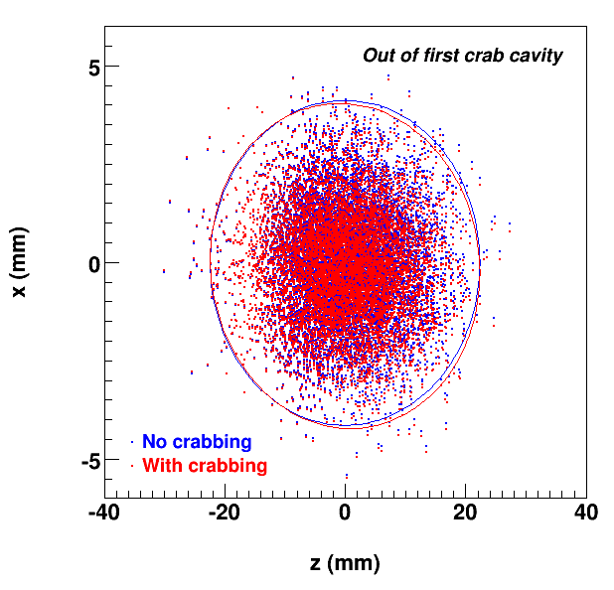
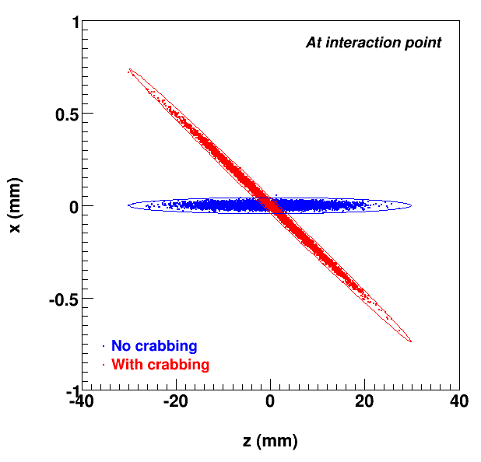
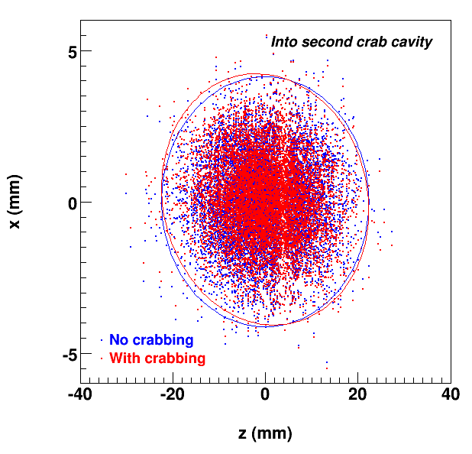
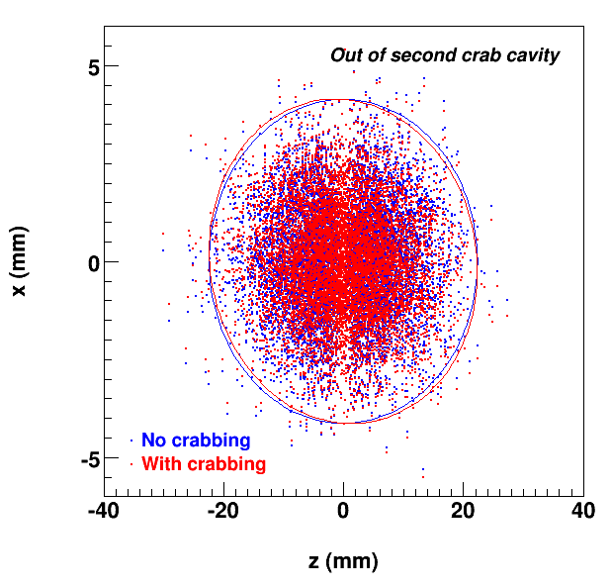
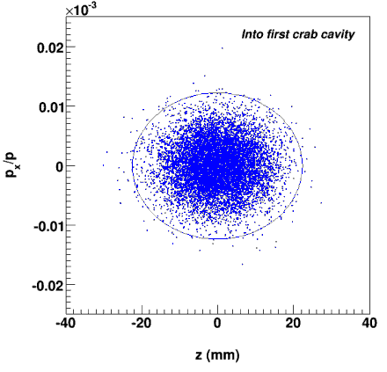
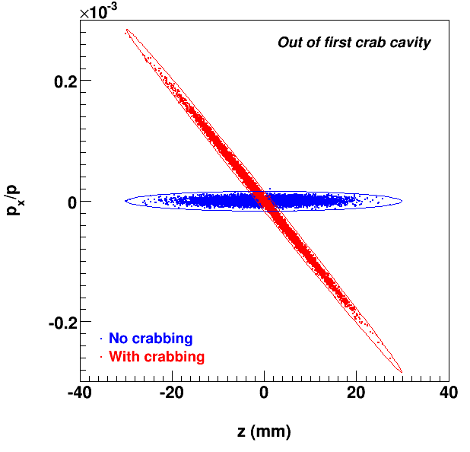
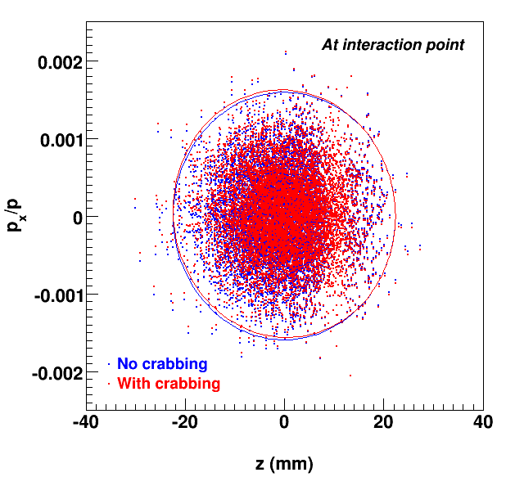
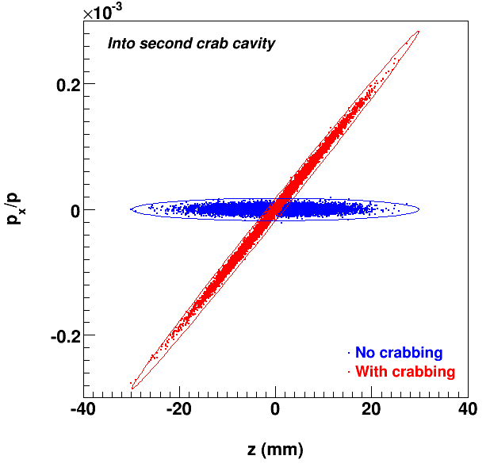
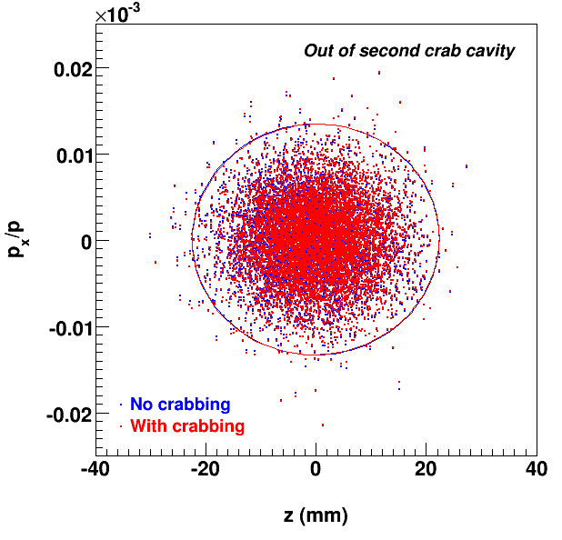
Crab Dynamics
z-x phase space without and with crabbing
incoming
after 1st crab
before 2nd crab
after 2nd crab
at IP
z-x' phase space
First crab cavity generates a (z-x') correlation
Phase advance transforms it into a (z-x) correlation at the IP
Further phase advance transforms it back into a (z-x') correlation
The second crab cavity compensates the (z-x') correlation

Slide 28
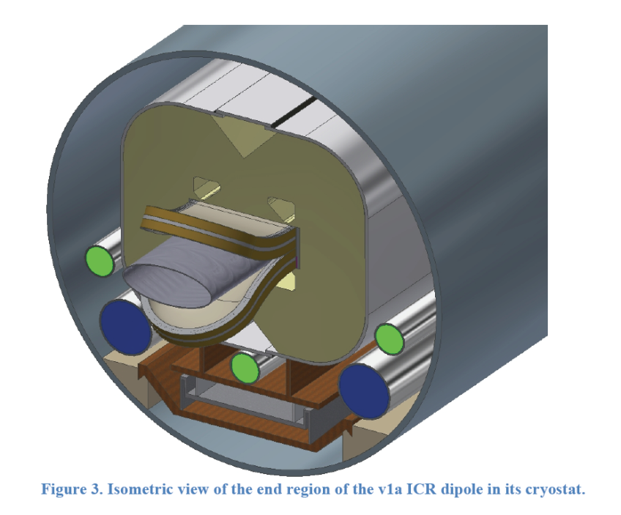
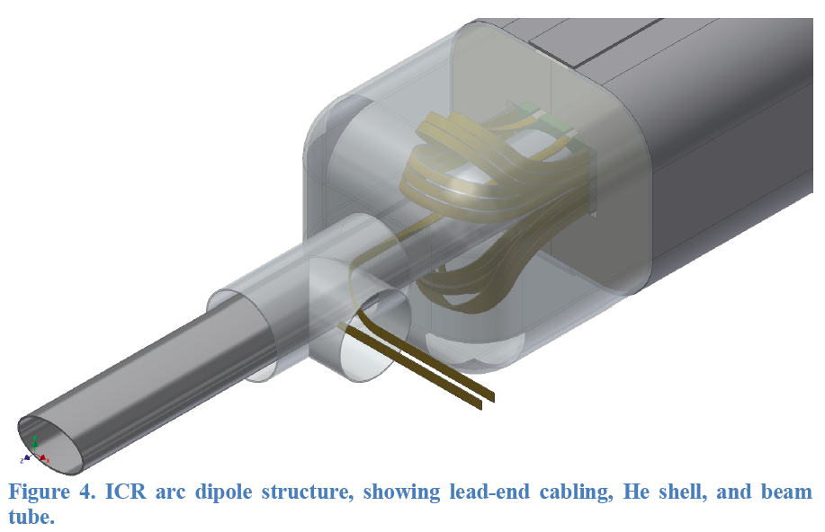
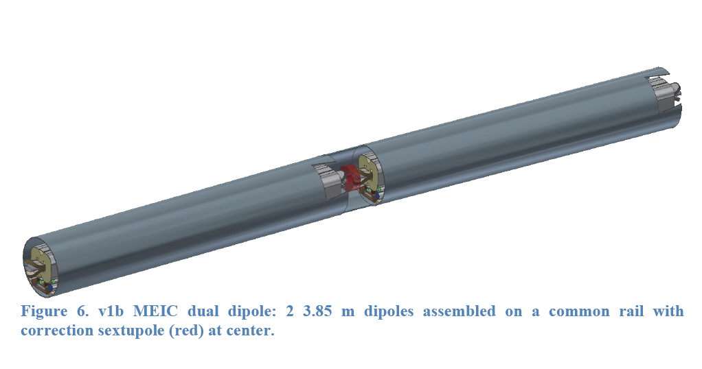
MEIC Super-Ferric Dipole
2 x 4 long dipole
NbTi cable
3 T
Correction sextupole
Common cryostat

Slide 29
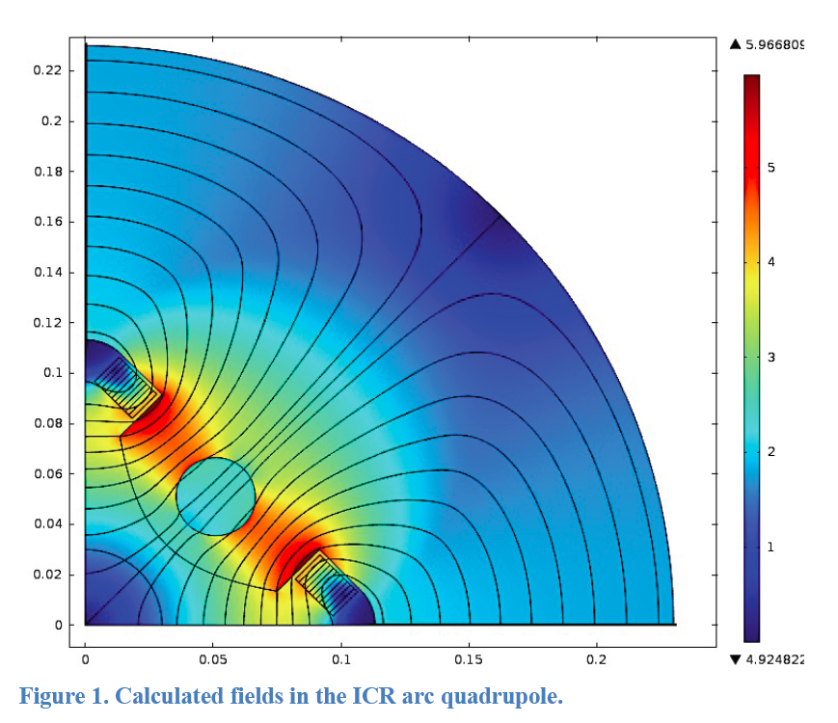
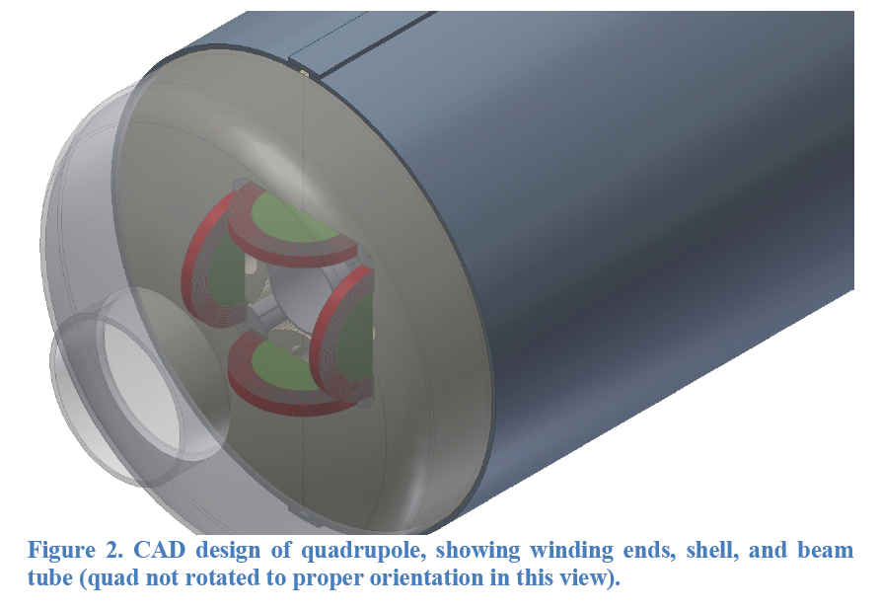
MEIC Super-Ferric Quadrupole
Arc quads ~ 50 T/m SF
Matching quads ~ 80 T/m SF
FF quads cosθ

