Slide 1
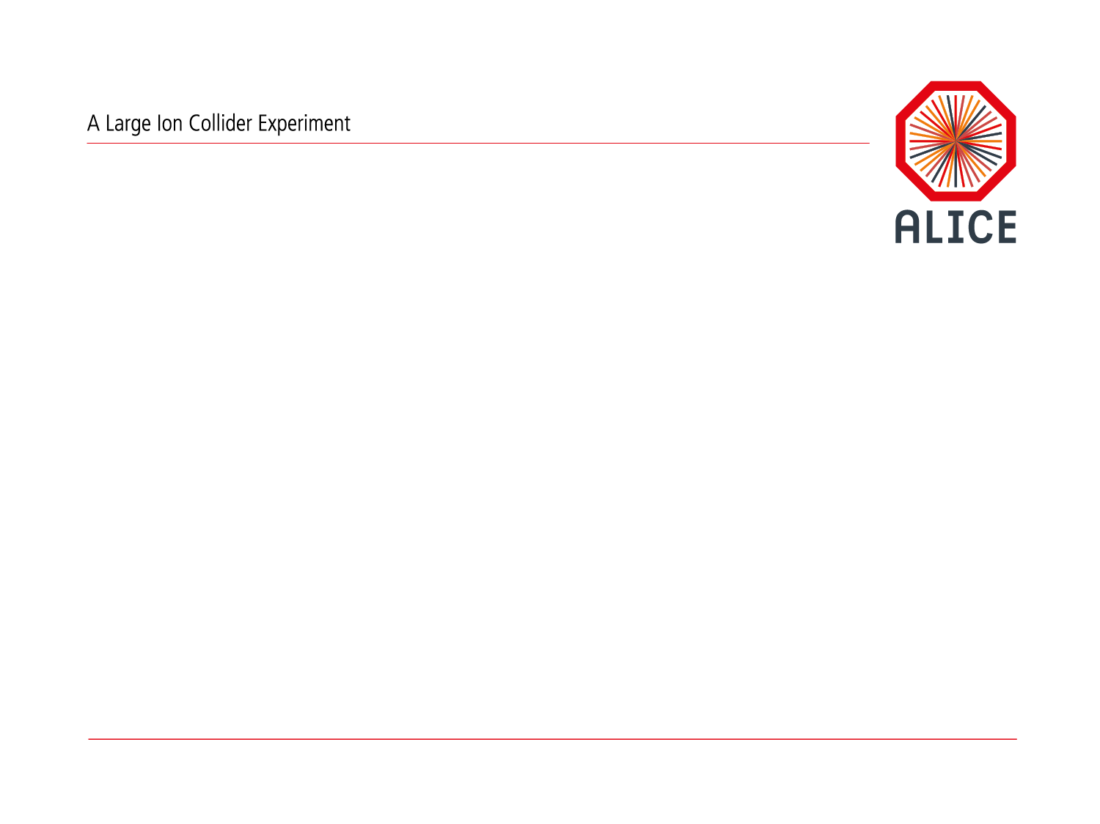
ALICE Upgrade Progress
W. Riegler, LHCC, Sept. 23rd, 2014

Slide 2

ALICE Upgrade Strategy
High precision measurements of rare probes at low p_{T,} which cannot be selected with a trigger, require a large sample of events recorded on tape
Target: Recorded Pb-Pb recorded luminosity ≥ 10 nb⁻¹  8 x 10¹⁰ events
Gain a factor 100 in statistics over the Run1+Run2 programme and significant improvement of vertexing and tracking capabilities
I. Upgrade the ALICE readout systems and online systems to
read out all Pb-Pb interactions at a maximum rate of 50kHz (i.e. L = 6x10²⁷ cm⁻¹s⁻¹), with a minimum bias trigger
Perform online data reduction based on reconstruction of clusters and tracks (tracking used only to filter out clusters not associated to reconstructed tracks)
II. Improve vertexing and tracking at low p_{T} ➔ New ITS

Slide 3
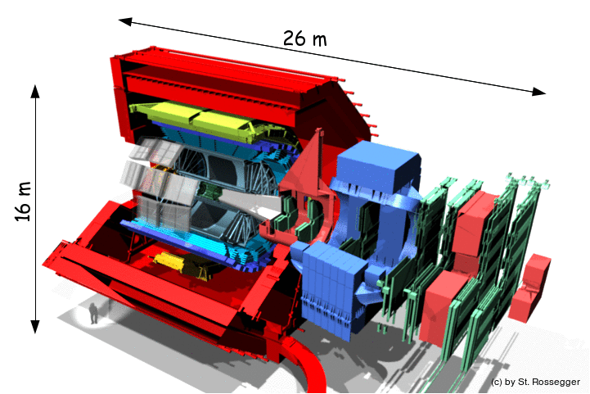
ALICE Upgrade
New Inner Tracking System (ITS)
improved pointing precision
less material -> thinnest tracker at the LHC
Muon Forward Tracker (MFT)
new Si tracker
Improved MUON pointing precision
MUON ARM
continuous readout electronics
Time Projection Chamber (TPC)
new GEM technology for readout chambers
continuous readout
faster readout electronics
Data Acquisition (DAQ)/ High Level Trigger (HLT)
new architecture
on line tracking & data compression
50kHz Pbb event rate
TOF, TRD
Faster readout
New Trigger
Detectors (FIT)

Slide 4
Long Term Schedule
PHASE I Upgrade
ALICE, LHCb major upgrade
ATLAS, CMS ‚minor‘ upgrade
Heavy Ion Luminosity from 10²⁷ to 7 x10²⁷
Run2
LS2
Run3
LS3
Run4
LS4
Run5
LS5
Run6
PHASE II Upgrade
ATLAS, CMS major upgrade
HL-LHC, pp luminosity
from 10³⁴ (peak) to 5 x10³⁴ (levelled)
ALICE will operate beyond LS3 in the HL-LHC era

Slide 5

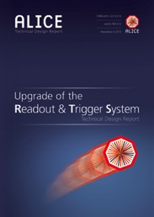


ALICE LS2 Scope
The approved LS2 upgrade is detailed in 5 Technical Design Reports
ITS
Readout and Trigger System
TPC (under review)
MFT (Nov. 2014)
Online Offline System (Jun. 2015)

Slide 6
ALICE Upgrade
New Inner Tracking System (ITS)
improved pointing precision
less material
Muon Forward Tracker (MFT)
new Si tracker
Improved MUON pointing precision
MUON ARM
continuous readout electronics
Time Projection Chamber (TPC)
new GEM technology for readout chambers
continuous readout
faster readout electronics
Data Acquisition (DAQ)/ High Level Trigger (HLT)
new architecture
on line tracking & data compression
50kHz Pbb event rate
TOF, TRD
Faster readout
New Trigger
Detectors (FIT)

Slide 7
Status of ITS CMOS Pixel Sensor
External layout
dimensions and position of IO-pads defined
Interface communication protocol defined
Internal Architecture (two options)
ALPIDE
  Specs comply with Inner Barrel and Outer Barrel
  Pixel Size: 28μm x 28μm Integration time: ~4μs
  Power density : 40 mW/cm²
MISTRAL (more conservative approach)
  Specs optimized for OB (L3-L6) but does not comply with Inner Barrel
  Pixel Size: 36μm x 62μm Integration time: ~20 μs
  Power density: ~ 100 mW/cm²
Full scale prototype of ALPIDE and MISTRAL are currently being characterized in the laboratory and test beam
Preliminary results (see following slides) very encouraging

Slide 8
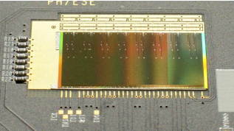
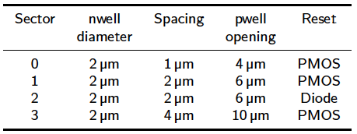
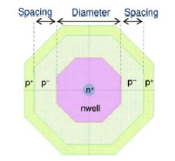
pALPIDEfs – A full-scale prototype of ALPIDE
Dimensions: 30mm x 15 mm
About 0.5 M pixels 28μm x 28μm
40 nW front-end (4.7mW / cm²)
Allows reverse substrates bias to increases depletion volume
4 sectors with different pixels
Figure: picture of pALPIDEfs
In-matrix sparsification using priority-encoder logic
No high-speed output link in this version

Slide 9
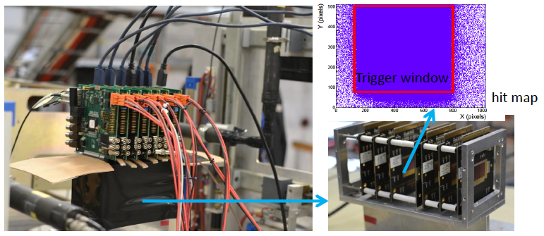
pALPIDEfs – measurements at PS test beam
Four weeks of test beam at the PS (5 – 7 GeV pions)
Telescope based on a stack-up of 6 or 7 layers of pALPIDEfs
Tested both thinned (50μm) and thick (450μm) chips
0V and 3V reverse substrate bias (measurem. at -6 V and after irradiation ongoing)
Comprehensive characterization will continue at PS and in October at SPS

Slide 10
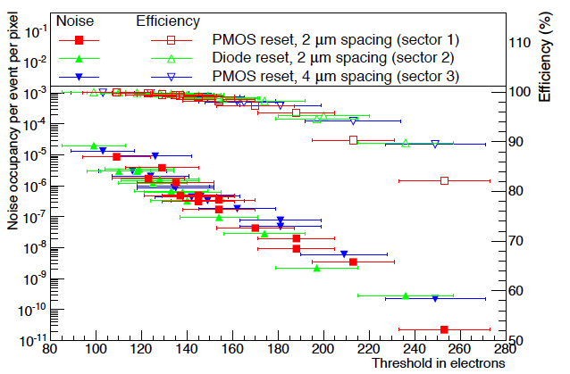
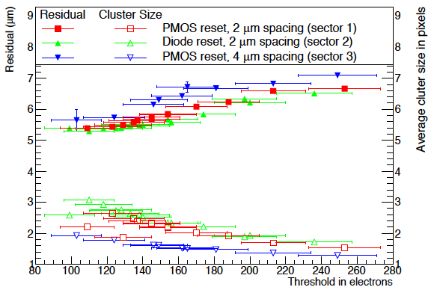
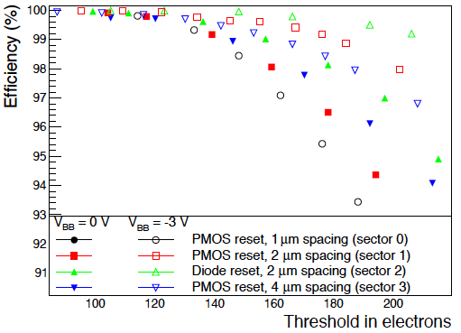
pALPIDEfs – measurements at PS test beam
99% efficiency at fake hit rate of 10⁻⁵ achievable (only 20 pixels masked) at 0V
Reverse substrate bias (V_{BB}) provides additional margin
Telescope based on a Stack-up of 6 or 7 layers of pALPIDEfs
Spatial resolution (including tracking error of ~3μm): 5.5 μm

Slide 11
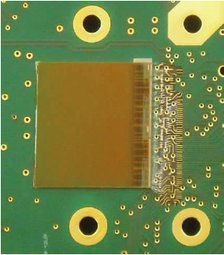
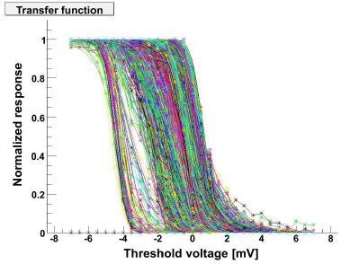
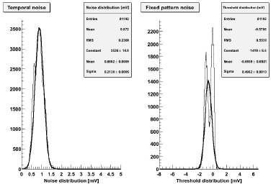
FSBB-M0 – Full Scale Building Block of MISTRAL
FSBB-M0 (Full Scale Building Block Mistral 0)
About 1/3 of a complete sensor (approx. 9mm x 17mm)
416 x 416 pixels of 22μm x 33μm (final chip 36μm x 62μm)
40μs integration time
Full chain working (front-end, discr., zero suppression)
25 sensors characterized showing similar noise perfor.
Test beam measurements at SPS in October
Figure: Two FSBB M0
TN = 0.87mV
FPN = 0.55mV
Temporal Noise
Fixed Pattern Noise

Slide 12
ALICE Upgrade
Muon Forward Tracker (MFT)
new Si tracker
Improved MUON pointing precision
New Inner Tracking System (ITS)
improved pointing precision
less material -> thinnest tracker at the LHC
MUON ARM
continuous readout electronics
Time Projection Chamber (TPC)
new GEM technology for readout chambers
continuous readout
faster readout electronics
Data Acquisition (DAQ)/ High Level Trigger (HLT)
new architecture
on line tracking & data compression
50kHz Pbb event rate
TOF, TRD
Faster readout
New Trigger
Detectors (FIT)

Slide 13
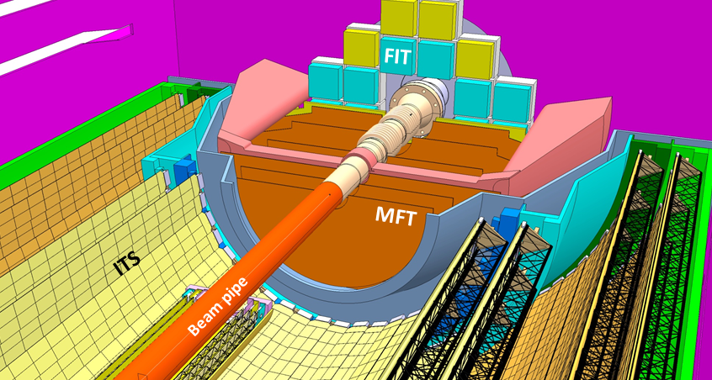
Muon Forward Tracker (MFT)
The primary goal of the Muon Forward Tracker (MFT) is to measure muon tracks in the ALICE muon spectrometer acceptance with high precision vertexing in the interaction point area.
The MFT is a silicon pixel tracker complementing the acceptance of the ALICE upgraded Internal tracking system (ITS) and covering most of the acceptance of the muon spectrometer 2.5<η<3.6.
The MFT detector is placed inside the ITS outer barrel, between the ITS inner barrel and the frontal absorber and surrounding the ALICE vacuum beam-pipe.

Slide 14
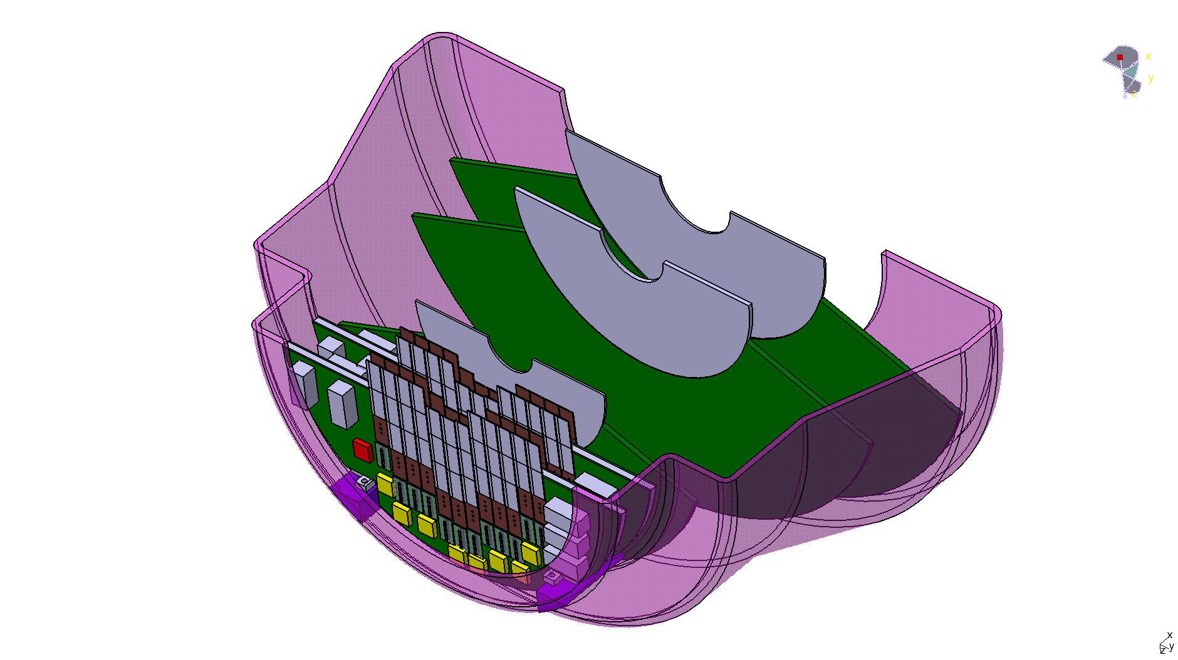
Muon Forward Tracker (MFT)
Common Silicon Sensor with ITS (15 mm x 30 mm)
Polyimide Flex Printed Circuit with Al strips.
HIC consisting in 1-5 sensors bonded to the sensor via the Laser technology developed by the ITS group.
Each disk: Two detection planes, a disk spacer, a disk support and 2 PCB.
Each detection plane consisting ladders (MFT HIC glue two a stiffener).
Two option for sensor cooling begin considered:
  Air cooling
  Water cooling with polyimide cooling water pipes embedded in the disk spacer.
For a sensor consumption of 50 (30) mW/cm² the total power dissipated by the MFT sensors is 290 (180) W.

Slide 15
ALICE Upgrade
New Inner Tracking System (ITS)
improved pointing precision
less material -> thinnest tracker at the LHC
Muon Forward Tracker (MFT)
new Si tracker
Improved MUON pointing precision
MUON ARM
continuous readout electronics
TPC
new GEM technology for readout chambers
continuous readout
faster readout electronics
Data Acquisition (DAQ)/ High Level Trigger (HLT)
new architecture
on line tracking & data compression
50kHz Pbb event rate
TOF, TRD
Faster readout
New Trigger
Detectors (FIT)

Slide 16
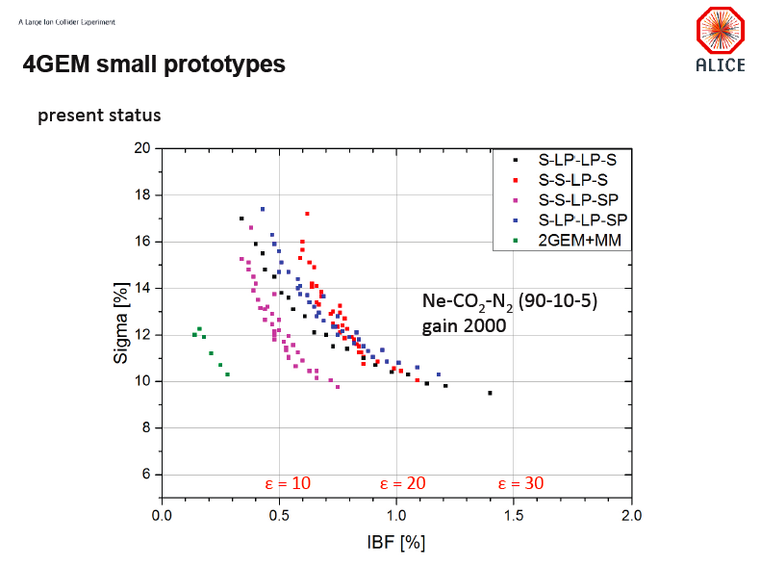
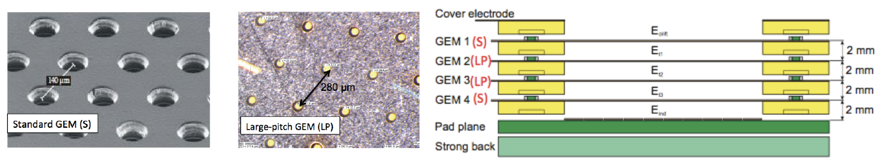
TPC Upgrade
GEM holes:
Diam: 70um
Distance:
SP: 90um
S: 140um
LP: 280um

Slide 17
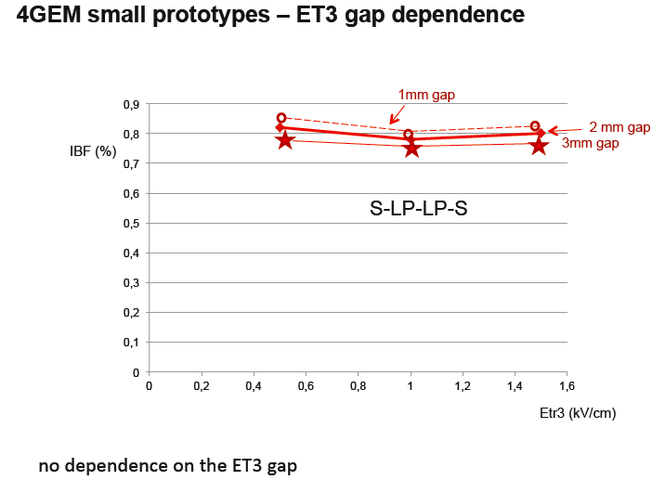
TPC Upgrade

Slide 18
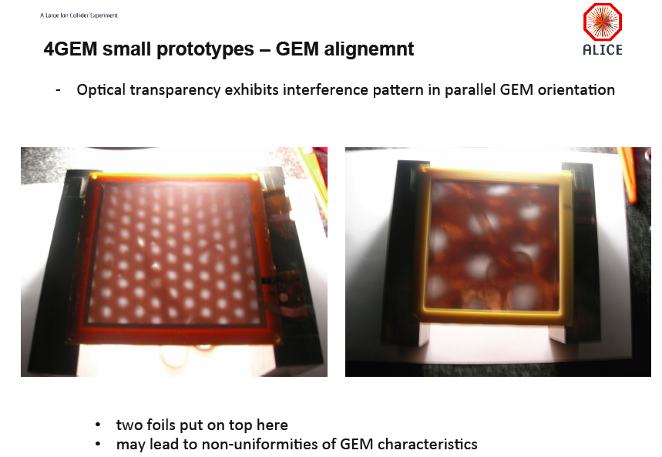
TPC Upgrade

Slide 19
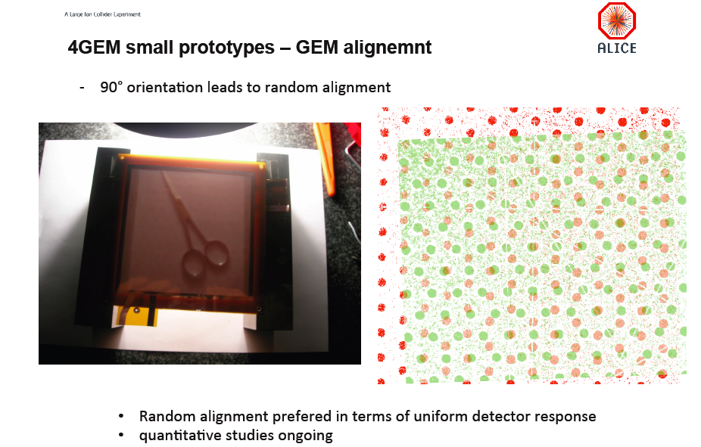

TPC Upgrade

Slide 20
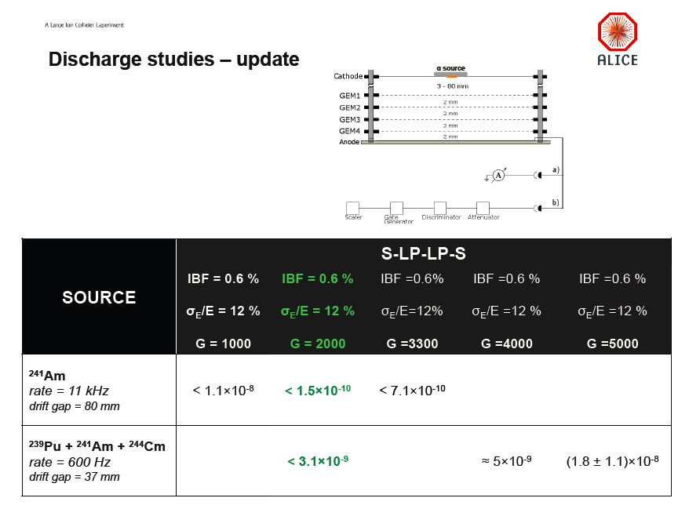
TPC Upgrade
Discharge probability is comparable
(or possibly better) than the one for ‚standard‘ GEM settings.
Tests with MIPs in Nov./Dec. testbeam

Slide 21
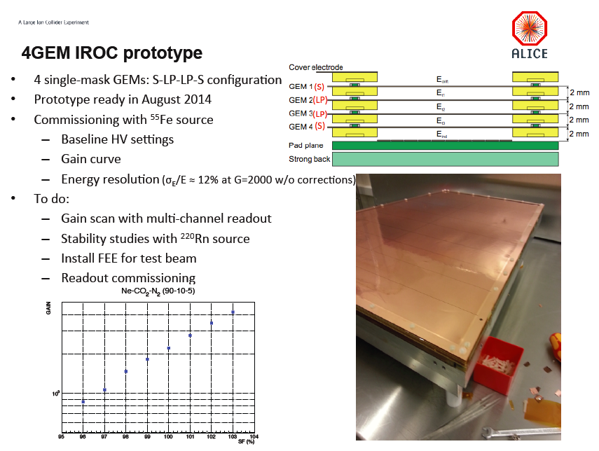
TPC Upgrade
Testbeam: PS Nov. 2014, SPS Dec. 2014

Slide 22
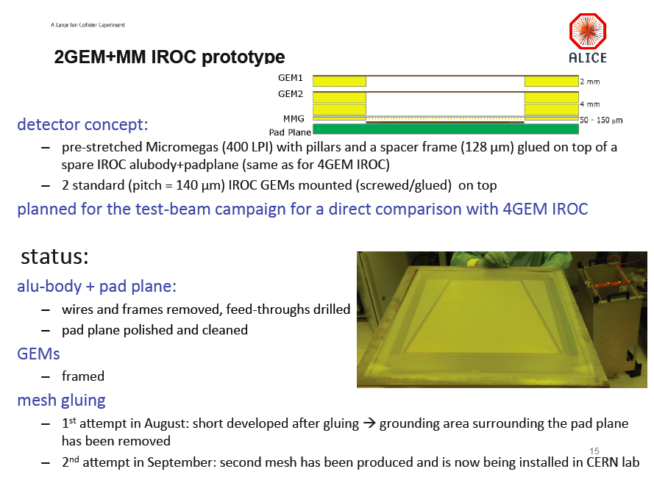
TPC Upgrade
Testbeam: PS Nov. 2014, SPS Dec. 2014

Slide 23
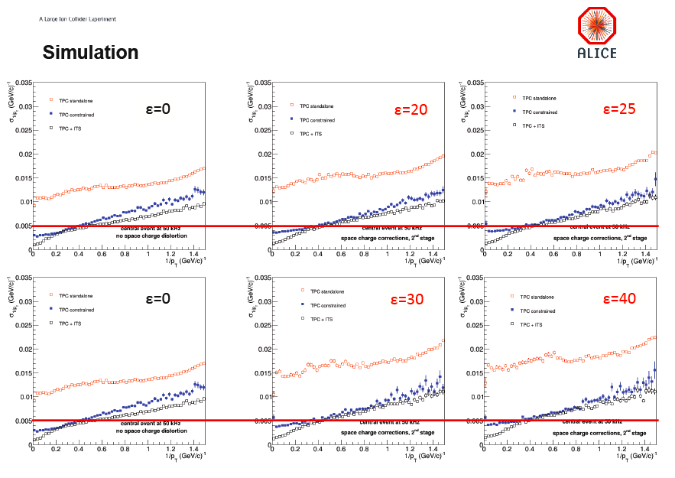
TPC Momentum Resolution

Slide 24
ALICE Upgrade
New Inner Tracking System (ITS)
improved pointing precision
less material -> thinnest tracker at the LHC
Muon Forward Tracker (MFT)
new Si tracker
Improved MUON pointing precision
MUON ARM
continuous readout electronics
Time Projection Chamber (TPC)
new GEM technology for readout chambers
continuous readout
faster readout electronics
Data Acquisition (DAQ)/ High Level Trigger (HLT)
new architecture
on line tracking & data compression
50kHz PbPb event rate
TOF, TRD
Faster readout
New Trigger
Detectors (FIT)

Slide 25
TDR Schedule
  November ’13: Table of Contents, Editorial Committee (EC) membership
  December ‘13: List of contributions from the CWGs
  Feb ‘14 List of all plots, tables and text skeleton
  Apr ’14: Draft 0 of the text for review inside CWGs
  May ’14: Draft 1 for review inside EC
  4th July ‘14: Draft 2 for review inside EC
  1st Sep ‘14: Draft 3 for review inside EC (week 22 September)
  24th -26th Sep ‘14: EC review
  Jan ‘14: Draft 4 for review inside O²
  Feb ‘14: ALICE internal review
  Mar’ 15: early: Final version for editing
  mid : Circulate TDR to the ALICE collaboration
  Apr ’15: end: Submission TDR to LHCC 29 (1 month before)
  Jun ’15 : LHCC meeting

Slide 26
Key technical milestones
Activities in progress
  Overall architecture and design
  Computing platform benchmarks
  Computing system simulation
  Software framework prototype (Alfa testbed)
    Refines dataflow functionalities
    Data distribution and load balancing studies
    Implement the first version of Run3/4 raw data format and use it for the simulated data
    Test existing HLT algorithms
    Used to compare design options and technical solutions
  TDR writing
TBD
  Decide on the options to be selected and those which will be left open in the TDR

Slide 27
ALICE Upgrade
New Inner Tracking System (ITS)
improved pointing precision
less material -> thinnest tracker at the LHC
Muon Forward Tracker (MFT)
new Si tracker
Improved MUON pointing precision
MUON ARM
continuous readout electronics
Time Projection Chamber (TPC)
new GEM technology for readout chambers
continuous readout
faster readout electronics
Data Acquisition (DAQ)/ High Level Trigger (HLT)
new architecture
on line tracking & data compression
50kHz Pbb event rate
TOF, TRD
Faster readout
New Trigger
Detectors (FIT)

Slide 28
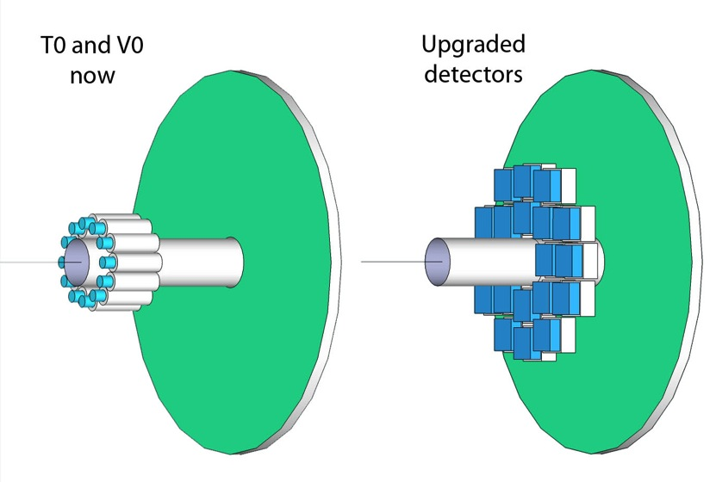
Fast Interaction Trigger (FIT)
Upgraded Quartz Cherenkov (T0+) and Plastic Scintillator (V0+)
New sensor: MCP-PMT
Larger acceptance
More channels
  T0 → 2 x 12 x 1 = 24
  T0+ → 2 x 20 x 4 = 160
Improved readout
1 pixel per T0
module
4 pixels per T0+
module

Slide 29
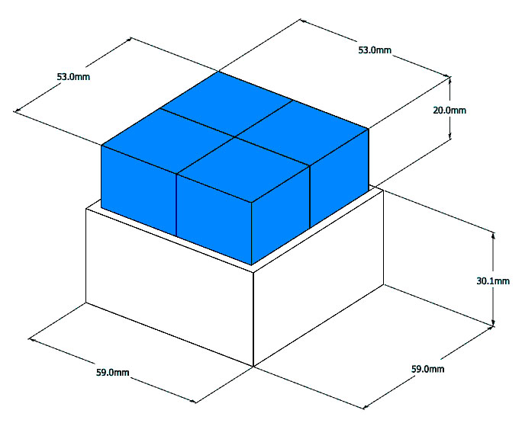
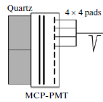
FIT: T0+
Quartz radiator
(segmented into 4)
MCP – PMT

Slide 30
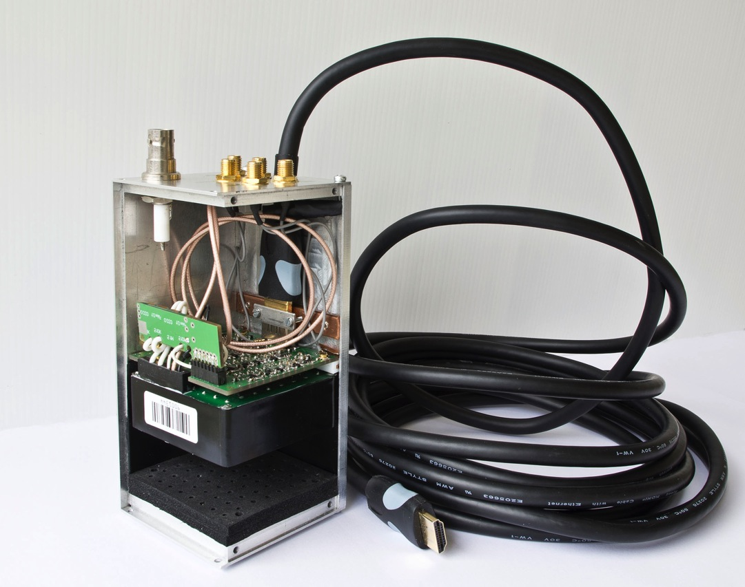
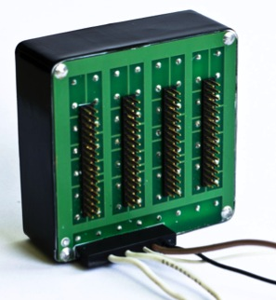
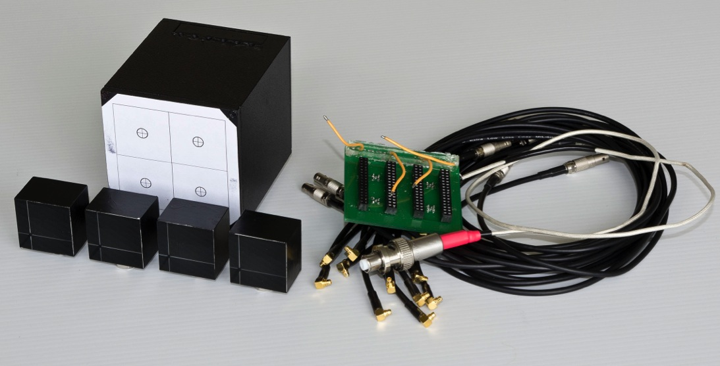
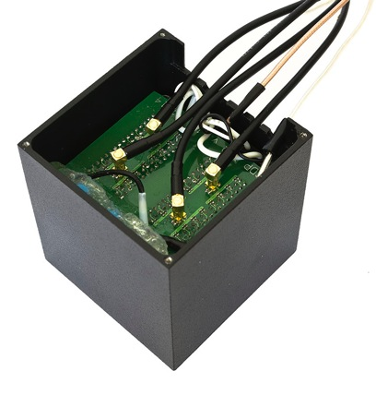
FIT: T0+ Prototypes
1st prototype with amplifier on the detector
2nd prototype with amplifier after 8m of cable.

Slide 31
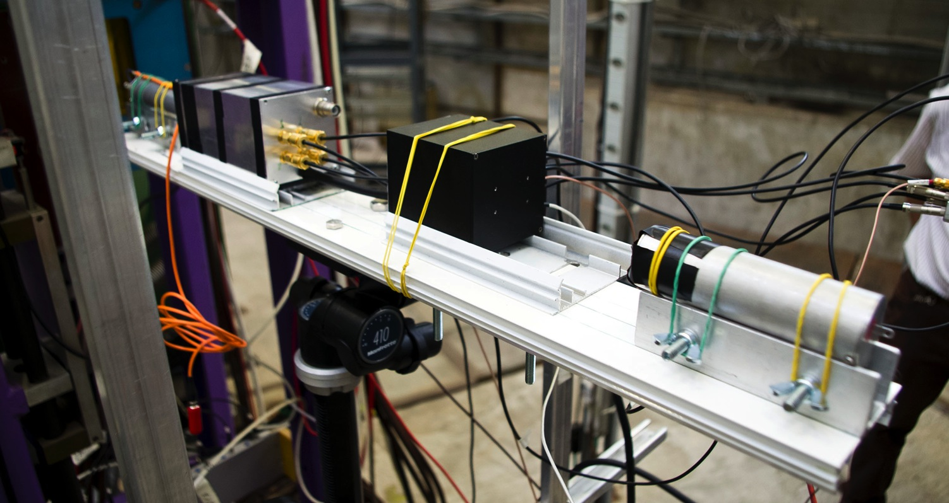
FIT: T0+ Prototypes Teastbeam

Slide 32
FIT: T0+ Time Resolution
Excellent time resolution !
For TOF Time Zero and Vertex Selection

Slide 33
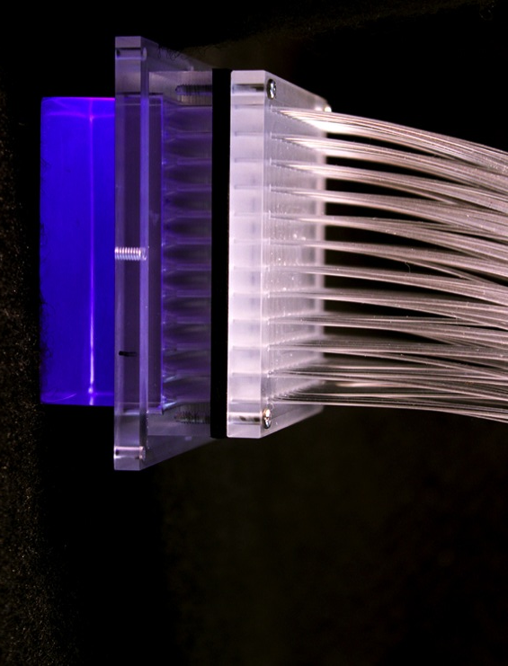
FIT: V0+ Prototype
Improved light collection scheme
Reduced fiber length between the scintillator and PMT
New sensor MCP-PMT (T0+)
New electronics & readout (fully based on T0+ solution)

Slide 34
ALICE Upgrade
New Inner Tracking System (ITS)
improved pointing precision
less material -> thinnest tracker at the LHC
Muon Forward Tracker (MFT)
new Si tracker
Improved MUON pointing precision
MUON ARM → SAMPA
continuous/triggered readout
TPC → SAMPA
Continuou(/triggered) readout
Data Acquisition (DAQ)/ High Level Trigger (HLT)
new architecture
on line tracking & data compression
50kHz Pbb event rate
TOF, TRD
Faster readout
New Trigger
Detectors (FIT)

Slide 35
SAMPA
SAMPA MPW1
  3 ASICs
    ASIC 1, 5 front-end channels
    ASIC 2, ADC and SLVS driver
    ASIC 3, 3 channels including DSP and read-out
  Submission June 2014
  Delivery Sept 2014
    Cut and packaged

Slide 36
SAMPA

Slide 37
SAMPA
Test board design
  Design Cagliari (MCH institute ) for ASIC 1/2/3
  Test board 1 & 2 design finalized (Brazil), 3 in the pipeline (Cagliari)
  FPGA based read-out board (GBT – CRU emulator)
    Bergen (TPC institute) for ASIC 3
    Hardware finalized, Firmware under development

Slide 38
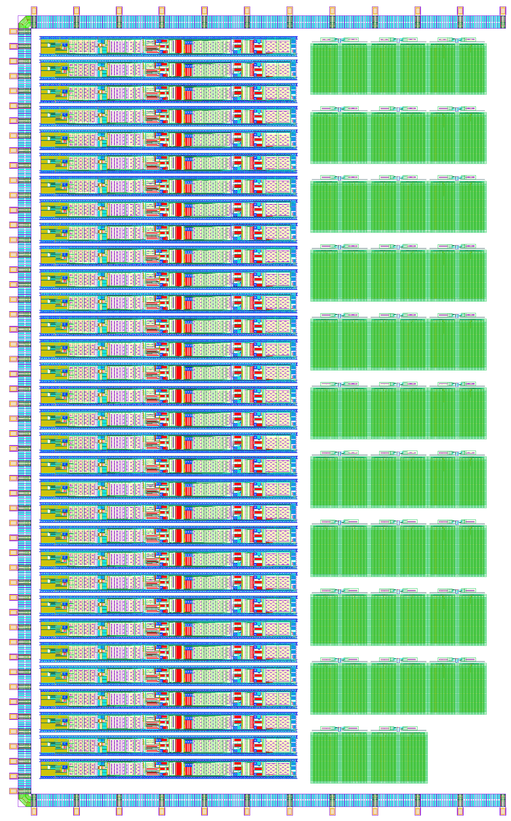
SAMPA
SAMPA MPW2
  32 – channel full scale ASIC
  full layout presently under design
    changes/adaptations after the of MPW1 possibly needed
    building blocks can be changed in the lower hierarchy without changing top level

Slide 39
Conclusions
Tests of full scale prototype for
ITS pixel chips are ongoing and very promising
TPC readout chambers in Nov. and Dec. 2014
FIT MCPs were performed with very promising results
SAMPA
MPW1 tests very soon
Full scale SAMPA chip for MPW2 in preparation
TDR
for MFT in Nov. 2014
for O2 in Jun. 2015

