Slide 1
Share Ideas
Lync: click to call and collaborate
Pawel Grzywaczewski IT/OIS
October 2014

Slide 2


Copyright: Alan Chapman, http://www.businessballs.com

Slide 3
Overview
Lync general features
  Strengthen the collaboration
Demo
Lync phone features
  New ways of calling
Demo

Slide 4
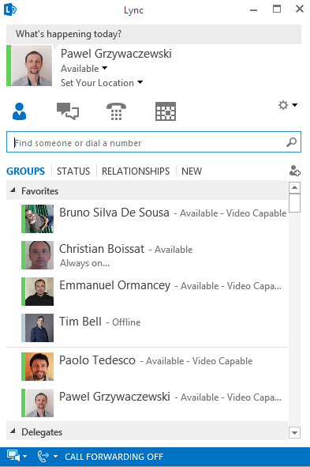
Lync

Slide 5




Collaboration - Advantages of using Lync
Softphone benefits
CERN Phone book,
Contacts in Exchange
List of contacts
Presence
Presence indicator
Clear message
Instant messaging
Phone calls from abroad (no roaming charges)
Wifi

Slide 6
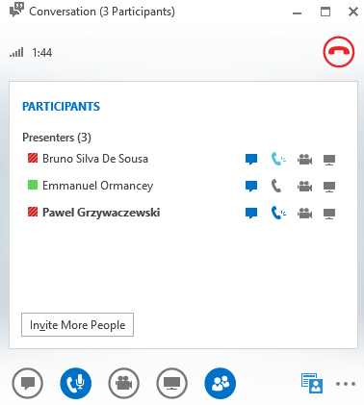
Possible use case
Start with E-mail (asynchronous communication)
Presence -> Go for instant communication
Add audio on Lync = phone/audio calls
Lync + audio + sharing = online meetings

Slide 7
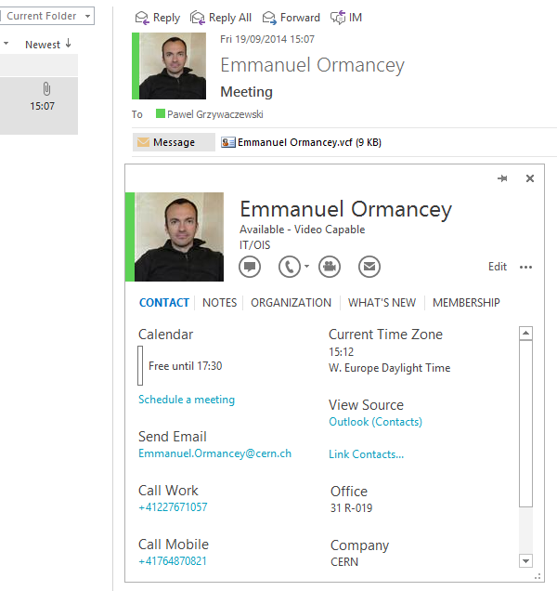
Integration: Outlook
Act from Outlook (phone, office, free/busy)
Take an action – based on status of others

Slide 8
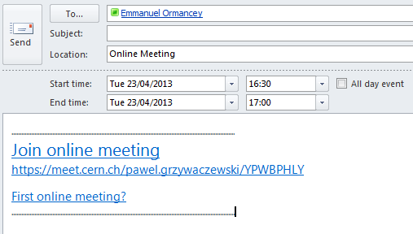
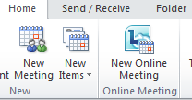
Increase productivity: Outlook
Create online meeting in Outlook
  Small meetings, 5 – 10 attendants
Participants click on link and join
  Desktop/application sharing
  Audio/Video
  Add easily new participants
“Meet Now“ – directly from Lync

Slide 9
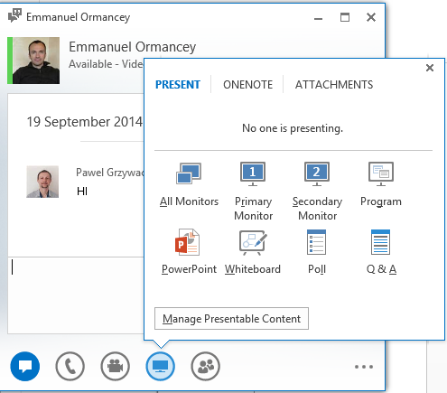
Sharing information
Click “Share” icon
Desktop.
A program (Word, Excel, Internet Explorer…)
Whiteboard
Create a poll

Slide 10
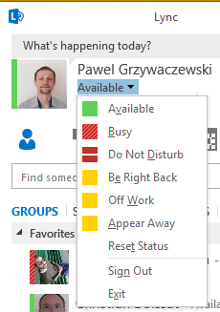
Manage presence in Lync
Available, Busy, Away, Do not disturb …
You decide who and what can see
By default people don’t see your status
  Add them to contacts to show your status
Status is synchronized with your calendar
  Out of office, events etc.
  Set your status manually
Define “Relationship” of your contacts
  “Workgroup” - will be able to bypass “Do not disturb” mode

Slide 11
One tool – several characteristics
Supports the collaboration
Efficient
Productive
  Manage your time (based on your presence)
  One tool for different actions

Slide 12
Demo

Slide 13
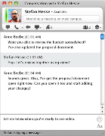
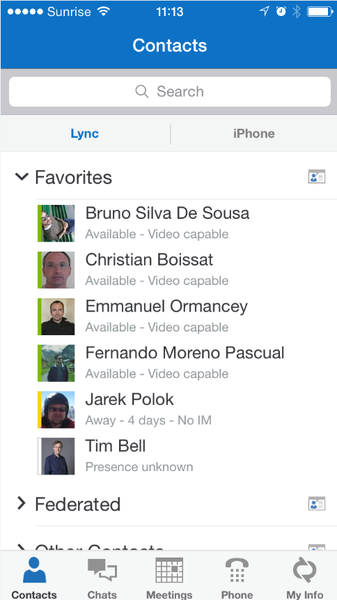
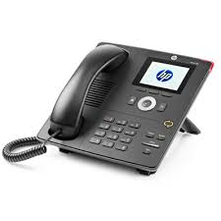
Lync clients
Lync 2010/2013 on Windows
Lync on MAC
Lync on smartphones
Lync IP Phone
Pidgin (Linux client)

Slide 14

Lync Phone system
What does it mean?
  CERN landline (fixed) number on Lync
  Somebody calls my CERN number: 77163
    It will ring an Lync clients
      Lync application (Windows/Mac, smartphones)
      Lync IP Phone
  I use my CERN phone number to place calls
      Lync application (Windows/Mac, smartphones)
      Lync IP Phones

Slide 15
Activation on Lync Phone system
Submit a “Phone request” on edh.cern.ch
Your phone number will be migrated to Lync Phone system
Use Lync clients to place phone calls
  Not compatible with Alcatel IP Phones

Slide 16
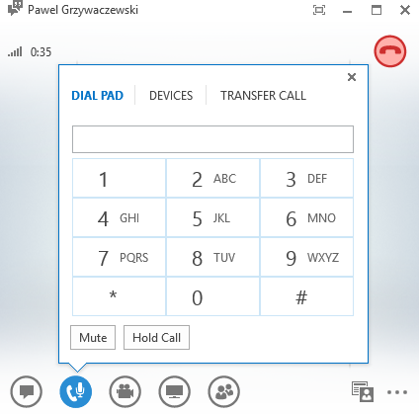
Lync application
Call your contacts with a single click
Search for CERN people (and your contacts)
If you have an external number, just paste it and press “Call”.
You can easily:
Put on hold (“pause” icon)
Forward to another number
Initiate a new call
Change the device (headset, etc.)

Slide 17
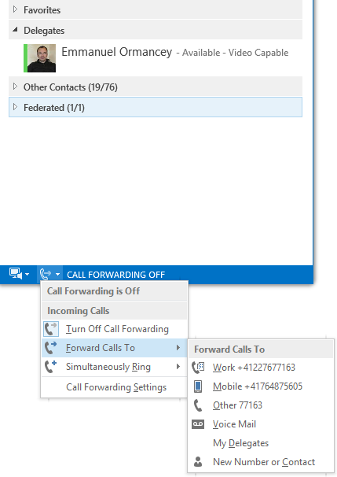
Forwarding calls
Other options are:
Forwarding to the voice mail.
To our delegates.
To any CERN number

Slide 18
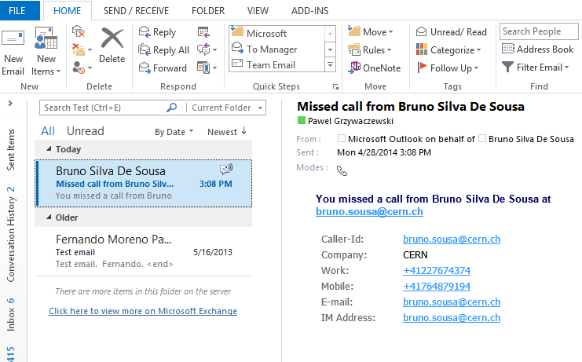
Voice mailbox & missed-calls
Lync is not running, or a person left a message on your voice mailbox:
Voice message forwarded to your inbox.
Missed incoming calls (busy, away, out of office…)
Notifications to your inbox about missed calls.
In the missed call notification we have:
All the information of the caller.
The time when the call was made.

Slide 19
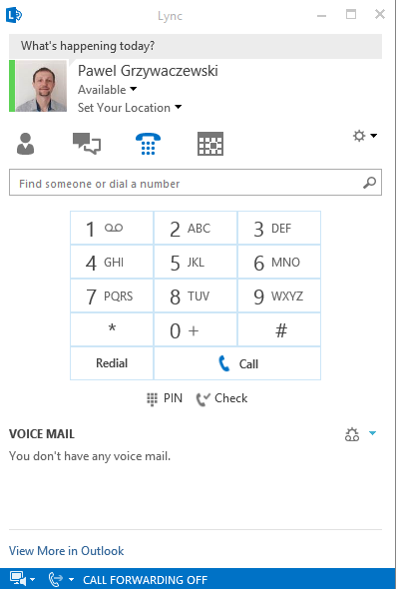
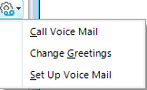
Voice mailbox
Access from Lync
Change greetings
Set up voice mail
Access/configure from a standard phone
  Call: (+412276)71111
  Use your PIN
    Received during activation
    Can be reset from Webmail
17

Slide 20
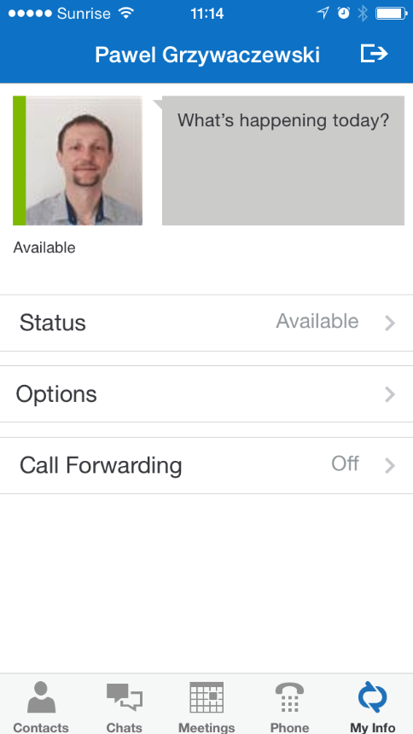
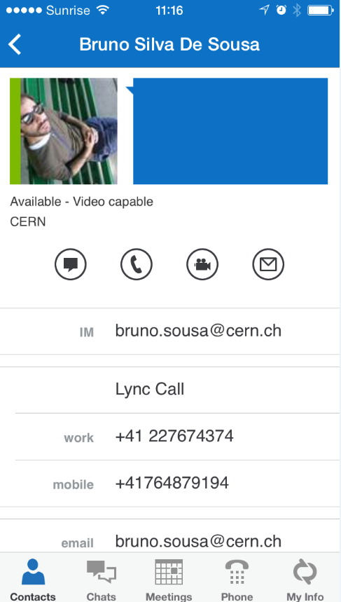
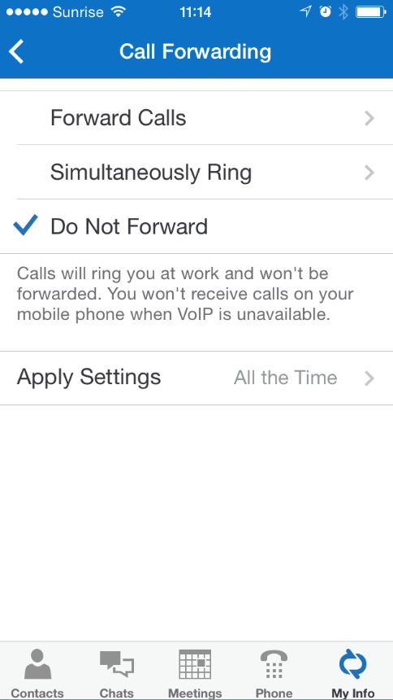
Lync on smartphones

Slide 21
Lync IP Phones
Recommended for new installation
Similar to current IP phones + advantages
  Softphone features (on Mac and Windows)
    Use your CERN phone number from anywhere (home, conference, hotel etc.)
  Easy management of phone settings and forwarding
  Voice messages received as an e-mail into Inbox
Devices available in CERN Store

Slide 22
Demo

Slide 23

Start using it …
All CERN people have Lync account
  Instant Messaging, presence etc.
Lync on Windows/Mac, and Pidgin in Linux
Add photo to Lync/mail system on http://social.cern.ch
Lync Phone
  Save costs on roaming
  Collaborate from any place around the world
Communicate with external contacts
  Other companies/institutes having Lync (federation needed)
  Gtalk
  Skype (Microsoft Live account needed)

Slide 24

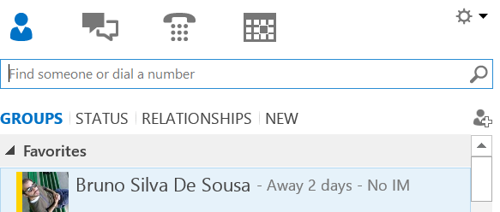
Lync to Skype
Person on Skype logs in using “Microsoft Live ID”
Person on Lync sends an invitation
  Click Add Contact
  Choose “Skype”
  Provide sip address
    login_name@domain.com
Person on Skype accepts the invitation
Contact from Lync to Skype and vice versa
  Instant messaging
  Presence
  Audio calls

Slide 25
Summary
Lync, https://cern.ch/lync
Find the best approach for your working environment
Share your thoughts on social https://cern.ch/lync-community
Lync provides you:
Different ways to collaborate
Easy way to make phone calls
Easy way to configure forwarding
  No roaming charges - Use your CERN number from anywhere (hotel, home etc.)
  Voice mail on your e-mail client
Support: contact service-desk@cern.ch

Slide 26

Thank you for your attention
Questions?

