Slide 1
Impedance of new ALICE beam pipe
Benoit Salvant, Rainer Wanzenberg and Olga Zagorodnova
Acknowledgments:
Elias Metral, Nicolas Mounet, Mark Gallilee, Arturo Tauro
TREX meeting July 31st 2014

Slide 2
Main points
The impact of the proposed change of ALICE beam pipe on effective impedances is rather small.
A single bellow impedance contribution is significant and should be avoided if possible (we understand that it is not possible here).
The heating on the smaller diameter pipe will increase and could reach 5 to 6 W/m for HL-LHC parameters. Is that acceptable?
The stainless steel (resp. Aluminium) at 20.1 mm radius should cope with 20 W/m (resp. 4 W/m) with HL-LHC beam. Is that acceptable?
If both of these points are acceptable, then there is no reason for the impedance team to reject the request.
This is not linked to the upgrade, but due to the large diameter of the cone, many modes are present and could lead to large heat load in case they are excited by the post-LS1 beam or HL-LHC beam.
→ should be monitored closely.
→ was there any temperature observation to see if something was already going on before LS1?
→ is there a way to increase the monitoring at the occasion of the upgrade?

Slide 3
Agenda
Context
Impedance computations for the updated version of the ALICE beam pipe
Conclusions

Slide 4

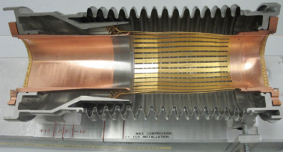
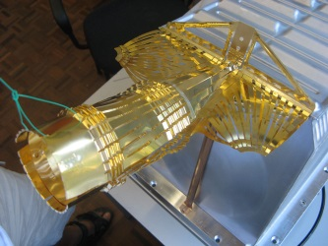
Context: minimizing the beam impedance of the LHC
LHC optimized for low impedance and high intensity beams
From the design phase, the LHC has been optimized to cope with high intensity beams and significant effort and budget were allocated to minimize the impedance of many devices and mitigate its effects
Some examples:
  Tapers (11 degrees) and RF fingers for all collimators
  Conducting strips for injection kickers MKI
  Dump kickers MKD outside of the vacuum pipe
  RF fingers to shield thousands of bellows
  Wakefield suppressor in LHCb
  Avoid sharp steps between chambers and limit tapers to 15 degrees
  ferrites and cooling in all kinds of devices (ALFA, TOTEM, TDI, BSRT, etc.)
Consequence: small LHC impedance allowed maximization of luminosity to the experiments before LS1
For comparison:
Orders of magnitude | SPS | LHC (injection) | improvement
Length | 7 km | 27 km | [/m length]
Effective longitudinal impedance | 10 Ohm | 0.1 Ohm | by a factor ~400
Effective transverse impedance | 20 MOhm/m | 2 to 4 MOhm/m | by a factor ~40

Slide 5
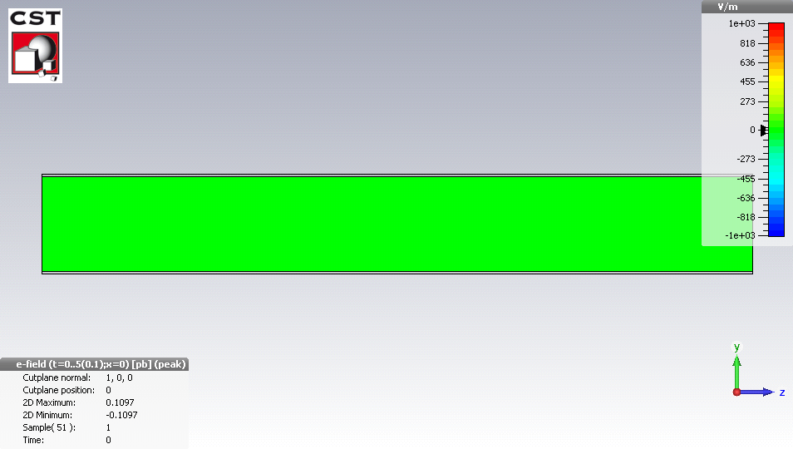
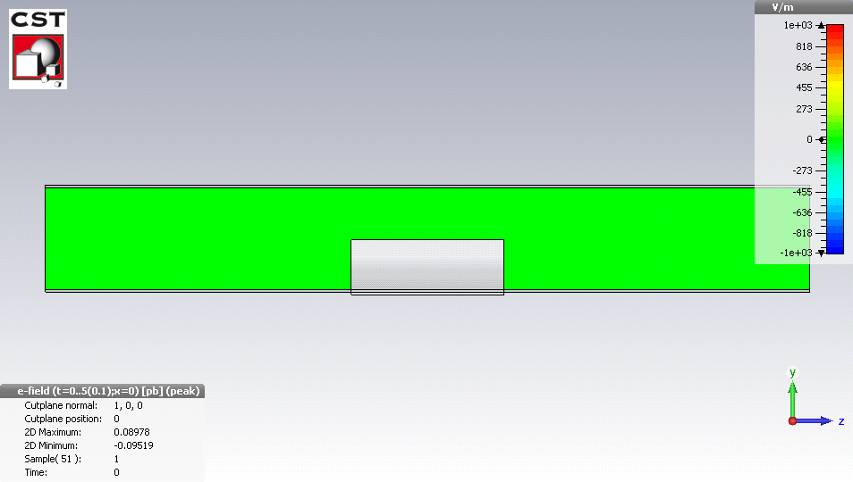
Context: impact of beam impedance on performance
When a beam of particles traverses a device which
  is not smooth
  or is not a perfect conductor,
  it will produce wakefields that will perturb the following particles
  → resistive or geometric wakefields (in time domain) and impedance (in frequency domain).
These wakefields are perturbations to the guiding EM fields to keep the beam stable and circulating.
Round beam pipe
(radius 40 mm)
Round beam pipe
with Roman pot
(at 1 mm from the beam)
Strong perturbation of the electromagnetic fields by the
Roman pots during (short range wake fields)
and after (long range wakefields) the passage of the bunch

Slide 6
Context: impact of beam impedance on performance
These perturbations are usually decomposed into longitudinal and transverse wakefields
  longitudinal wakefields lead to energy lost from the particle and dissipated in the walls of the neighbouring devices
  → heating of beam surrounding
  → temperature interlocks or degradation of machine devices
  → limits the LHC intensity and luminosity
  longitudinal wakefields lead to perturbation of the synchrotron oscillations
  → can excite longitudinal instabilities
  →degrades longitudinal emittance
  → limits the LHC intensity and luminosity
  Transverse wakefields lead to perturbation of the betatron oscillations
  → can excite transverse instabilities
  → degrades transverse emittance
  → limits the LHC intensity and luminosity
Need to study in detail the 3 components of the wakefields (real and imaginary parts)
as a function of frequency (short range and long range) to identify threats to LHC operation

Slide 7
Agenda
Context
Impedance computations for the updated version of the ALICE beam pipe
Conclusions

Slide 8
New geometry ALICE (1.2 m at 18.2 mm radius)
 | resistive wall: 1.2 m length at 18.2 mm radius | geometric | 2 bellows (20.7 to 28.5 mm, 65 mm length)
Effective longitudinal impedance Im(Z/n)^{eff} | 1.7 μΩ | 1.2 mΩ | 0.56 mΩ
Effective transverse impedance Im(Z^{eff}) | 96 Ω/m | 3 kΩ/m | 8.6kΩ/m
Power loss before LS1 | 1 W/m | ~ 400 W (for 1.25 ns) | 0
Power loss for post-LS1 | 2 W/m | ~ 1 kW (for 1.25 ns) | 0
Power loss for HL-LHC beam | 5.4 W/m | ~ 3 kW (for 1.25 ns) | 0
→ Are these values an issue?
Before LS1: 2*1374 bunches at 1.6e11 p/b (1 ns bunch length)
Post-LS1 beam: 2*2748 bunches at 1.3e11p/b (1 ns bunch length)
HL-LHC beam: 2*2748 bunches at 2.2e11p/b (1 ns bunch length)

Slide 9
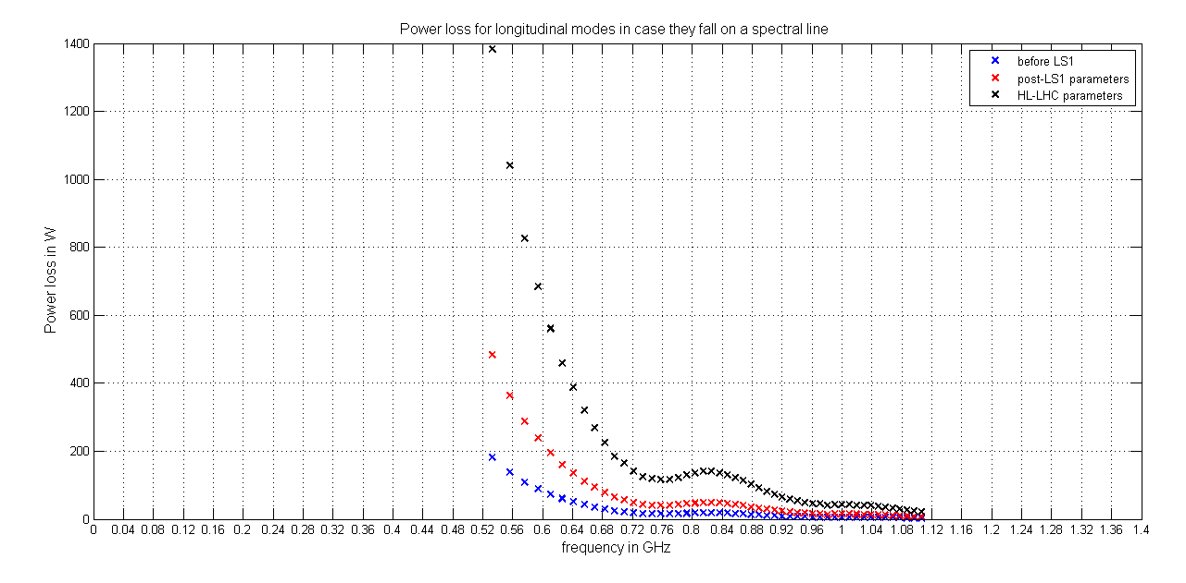
Power from resonant modes
Modes from R. Wanzenberg and O. Zagorodnova
Significant increase of power loss with HL-LHC parameters
→ even the modes at higher frequencies are significant (of the order of 20 to 50 W)

Slide 10
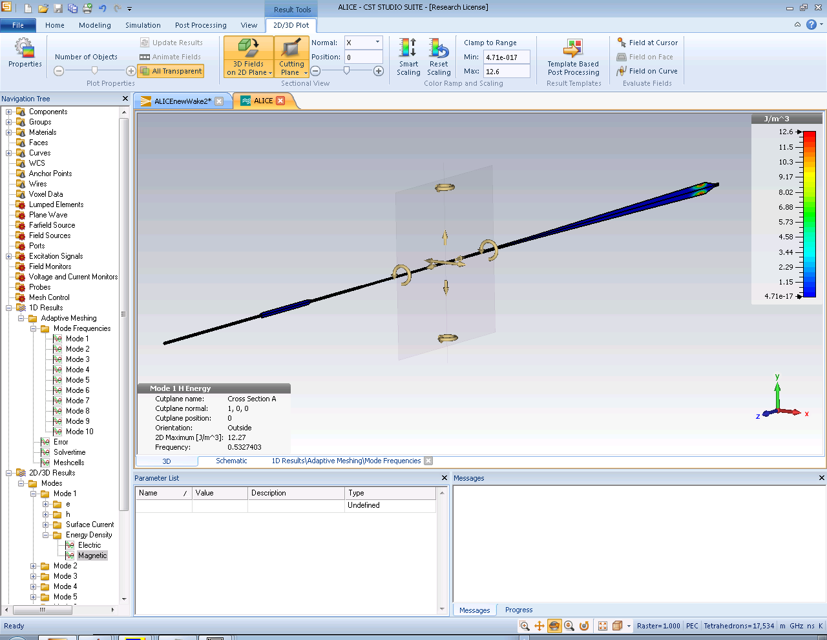
Location of modes?
Linked to the large diameter of the cone → localized there
No changes foreseen in this area, so these modes are not affected by the upgrade

Slide 11
New geometry ALICE (1.2 m at 18.2 mm radius)
 | resistive wall: 1.2 m length Be at 18.2 mm radius | geometric | 2 bellows (20.7 to 28.5 mm, 65 mm length) | Full LHC | % of full LHC | (%increase)
Effective longitudinal impedance Im(Z/n)^{eff} | 1.7 μΩ | 1.2 mΩ | 0.56 mΩ | 90 mΩ | RW << 0.1% Bellows~0.6% Geometric~1.3% | (+60%) (+34%) (+5%)
Effective transverse impedance Im(Z^{eff}) | 96 Ω/m | 3 kΩ/m | 8.6kΩ/m | 2 MΩ/m | RW << 0.1% Bellows~0.4% Geometric~0.1% | (+300%) (+45%) (+50%)
Power loss for nominal beam | 1.5 W/m | ~400 W (for 1.25 ns) | 0 | - | RW ~ 1.5 W/m Modes ~ 200 W | +60% same
Power loss for post-LS1 beam | 2 W/m | ~1 kW (for 1.25 ns) | 0 | - | RW ~ 2 W/m Modes ~ 500 W | +60% same
Power loss for HL-LHC beam | 5.4 W/m | ~3 kW (for 1.25 ns) | 0 | - | RW ~ 5.4 W/m Modes ~ 1.5 kW | +60% same
Small impact on effective impedances (i.e. on single bunch stability)
Larger heating due to smaller aperture: can the beam pipe sustain 5 to 6 W/m in HL-LHC?
No link to the change of geometry, but potentially high heat loads due to modes could be obtained with HL-LHC beams
in case the mode frequencies fall on beam spectral lines (already pointed out to LEB and HL-LHC management in 2013)

Slide 12
Agenda
Context
Impedance computations for the updated version of the ALICE beam pipe
Conclusions

Slide 13
Conclusions
The impact of the proposed change of ALICE beam pipe on effective impedances is rather small.
A single bellow impedance contribution is significant and should be avoided if possible (we understand that it is not possible here).
The heating on the smaller diameter pipe will increase and could reach 5 to 6 W/m for HL-LHC parameters. Is that acceptable?
The stainless steel (resp. Aluminium) at 20.1 mm radius should cope with 20 W/m (resp. 4 W/m) with HL-LHC beam. Is that acceptable?
If both of these points are acceptable, then there is no reason for the impedance team to reject the request.
This is not linked to the upgrade, but due to the large diameter of the cone, many modes are present and could lead to large heat load in case they are excited by the post-LS1 beam or HL-LHC beam.
→ should be monitored closely.
→ was there any temperature observation to see if something was already going on before LS1?
→ is there a way to increase the monitoring at the occasion of the upgrade?

Slide 15
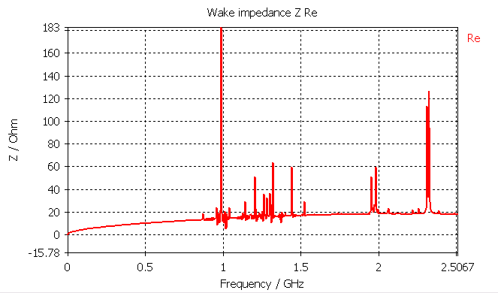
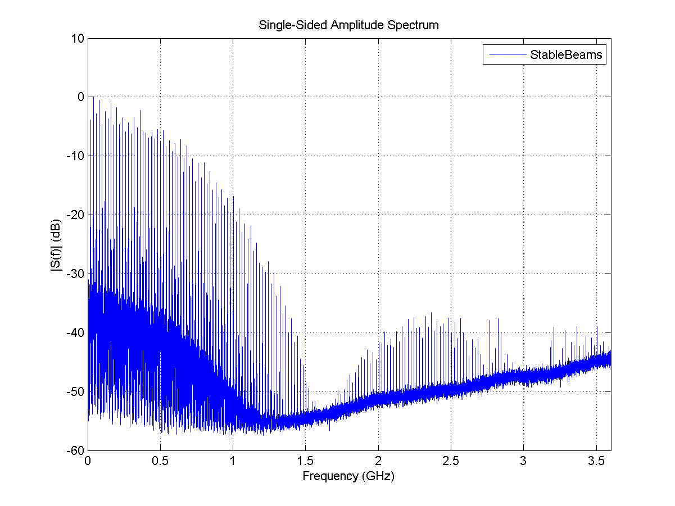
Computing power loss
Power lost by the beam in a device of impedance Z_{long} (see E. Métral at Chamonix 2012):
M=2808 bunches
N_{b}=1.15 10¹¹ p/b
Power spectrum measured on 50 ns
by P. Baudrenghien and T. Mastoridis
Impedance Re(Z_{long}) of TCP in physics
Narrow band at f_{res}
broadband

Slide 16
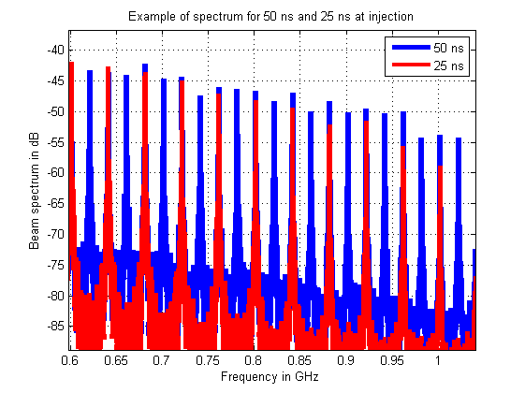
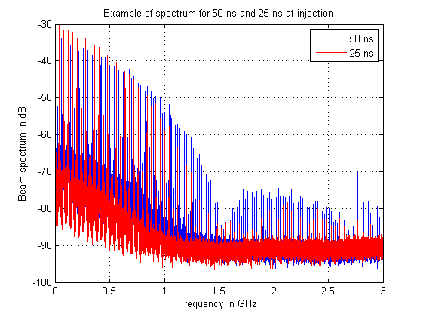
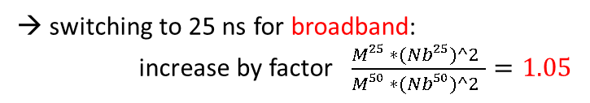
Effect of 25 ns on RF heating?
Power lost by the beam in a device of impedance Z_{long} (see E. Metral at Chamonix 2012):
Assumptions: same bunch length and same bunch distribution for 50 and 25 ns spacing
→ same beam spectrum but with half of the peaks
M=2808 bunches
N_{b}=1.15 10¹¹ p/b
Impedance Re(Z_{long})
Narrow band at f_{res}
broadband
→ switching to 25 ns for broadband:
increase by factor $\frac{M25 ∗(Nb25)^2 }{M50 ∗(Nb50)^2 }=1.05$
→ switching to 25 ns for narrow band falling on a beam harmonic line (f_{res}= k*20 MHz):
increase by factor $\frac{(M25 ∗Nb25)^2 }{(M50 ∗Nb50)^2 }=2$ (if f_{res}=2*k*20 MHz) or 0 (if f_{res}=(2*k+1)*20 MHz)

Slide 17
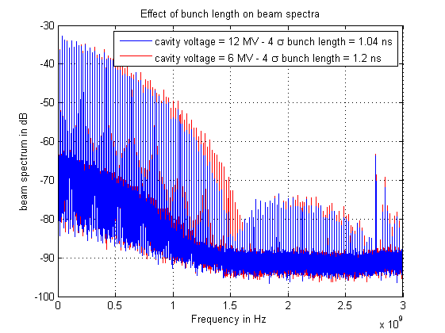
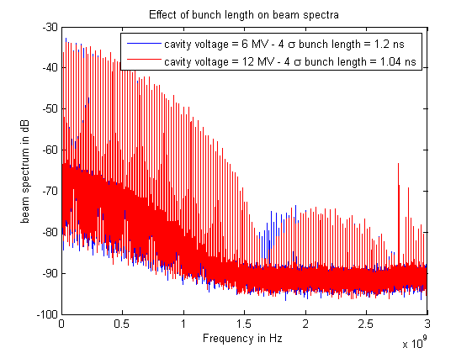
Effect of bunch length on RF heating?
Power lost by the beam in a device of impedance Z_{long} (see E. Metral at Chamonix 2012):
Assumption: same bunch distribution for 25 ns and 50 ns
→ beam spectrum is extended to higher frequencies with an “homothetic” envelope
M=2808 bunches
N_{b}=1.15 10¹¹ p/b
Impedance Re(Z_{long})
Narrow band at f_{res}
σ=1.25 ns
σ=1 ns
broadband
switching to lower bunch length for broadband:
in general regularly increases (depends on broadband resonant frequency)
→ switching to lower bunch length for narrow band:
enhances some resonances , damps others, excites higher frequency resonances
From the heating point of view, the longer the bunch the better in most cases.

Slide 18
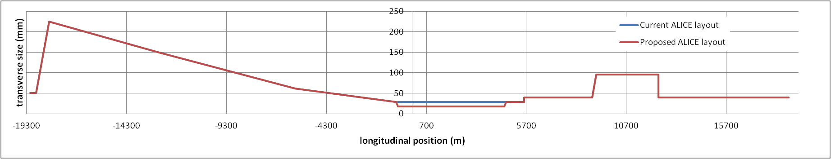
ALICE aperture change request
Nota: the new tapering angle is 7 degrees.

Slide 19
ALICE (Beryllium - length 5.317 m)
Energy | Inner radius | Bunch length (4σ_{t}) | Im(Z_{t}^{eff} ) [Ω/m] resistive part | Im(Z_{t}^{eff} ) [Ω/m] geom. part | Im(Z_{t}^{eff} ) [MΩ/m] total (LHC ring)
450 GeV | 29 mm | 1.3 ns | 120 |  | ~2.4
450 GeV | 17.5 mm | 1.3 ns | 550 | ~350
7 TeV | 29 mm | 1 ns (nominal) | 105 |  | ~25
7 TeV | 17.5 mm | 1 ns (nominal) | 480 | ~350
Transverse
Energy | Inner radius | Bunch length (4σ_{t}) | (Z||/n)^{eff} [Ω] resistive part | (Z||/n)^{eff} [Ω] total (LHC ring) | Power loss in W (2 beams)
450 GeV | 29 mm | 1.4 ns (MD) | j 0.8 10⁻⁵ | j 0.09 | 1
450 GeV | 17.5 mm | 1.4 ns (MD) | j 1.2 10⁻⁵ |  | 1.7
7 TeV | 29 mm | 1 ns (nominal) | j 0.5 10⁻⁵ | j 0.085 | 0.9
7 TeV | 17.5 mm | 1 ns (nominal) | j 0.8 10⁻⁵ |  | 1.6
Longitudinal
→ significant increase of impedance with the new geometry. However, it remains very small compared to the total LHC impedance. Is a 70% increase in power loss ok?
Also: geometric Im(Z/n)=1 10⁻⁷ Ohm

Slide 20
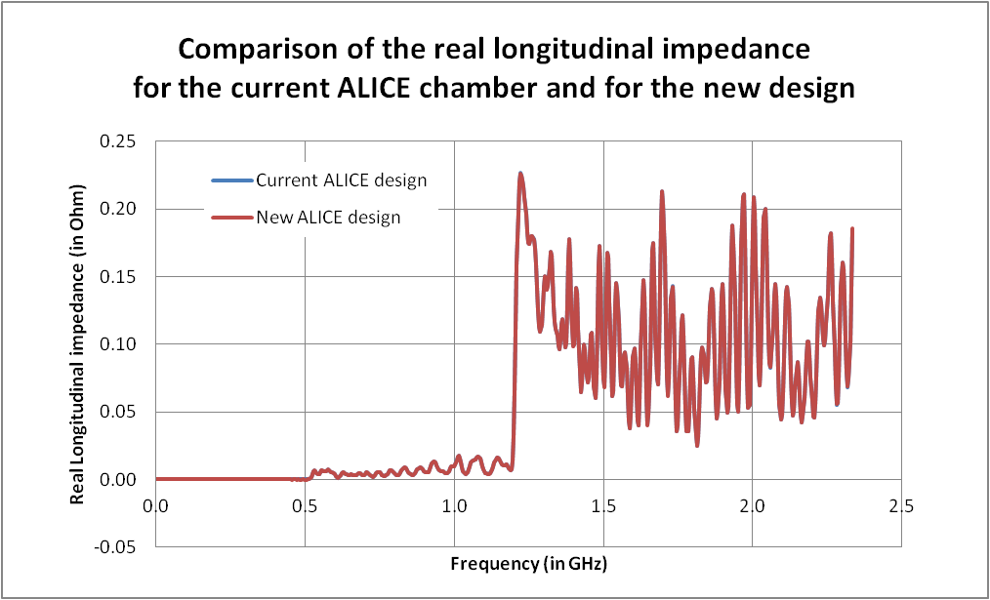
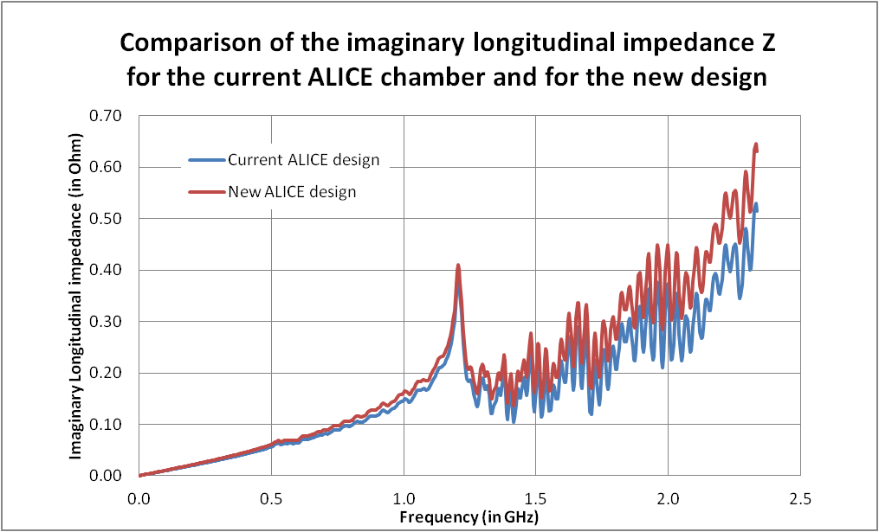
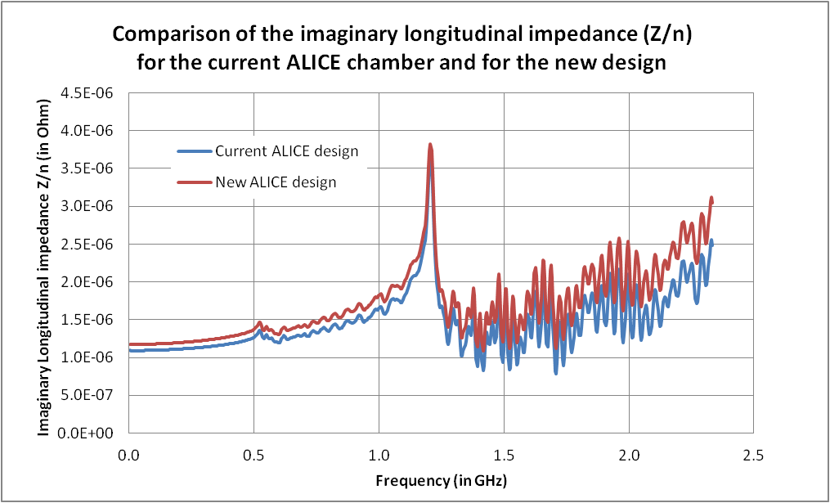
Longitudinal impedance
(broadband computed from ABCI, all materials PEC)
- No measurable difference in the real part of the impedance
- There is an increase of 7% of the imaginary part of the impedance

Slide 21
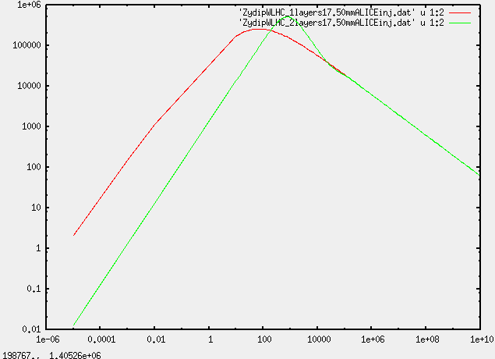
1 vs 2 layers
Difference visible below 100 kHz

