Slide 1
Calculations of Higher Order Modes of the ALICE Beam Pipes.
Rainer Wanzenberg,
Olga Zagorodnova
DESY
Hamburg, October 1, 2014

Slide 2
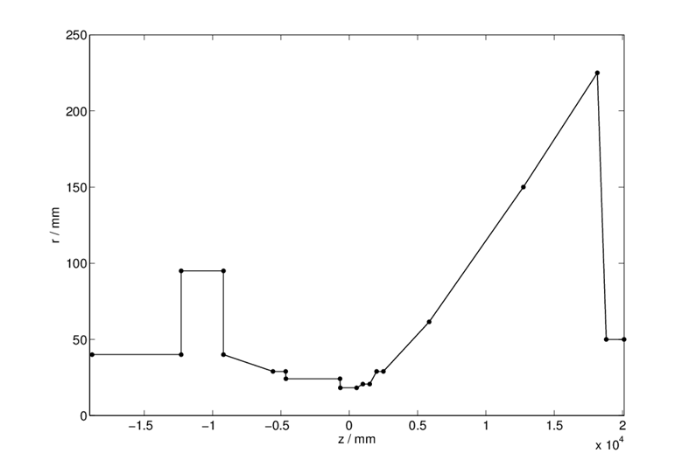
Geometrical model for HOMs calculations.
A 2-dimensional model of the ALICE beam pipe has been used for HOMs calculations.
The round pipe with a radius of 95mm has been used in the region of the ovalisation.
Length of outgoing pipe is about 30cm
ALICE “cavity” maximal radius 225 mm
Ovalization: 95mm vertical, 67.5mm horizontal.

Slide 3
The electric and magnetic fields of the HOMs are calculated with the frequency domain solver of the computer code MAFIA.
Different sets of boundary conditions were used for calculation of 100 monopole and 100 dipole modes.
The results of calculation of monopole modes were independent from boundary conditions and they are pesented for electric(E) boundary conditions on both ends of the structure.
The results of calculations of dipole modes were dependent from boundary conditions.
Most of the monopole and dipole modes are trapped in the region of ovalization (between 9m and 12m left from the IP) and in the region of taper (between 7m and 19m right from the IP).

Slide 4
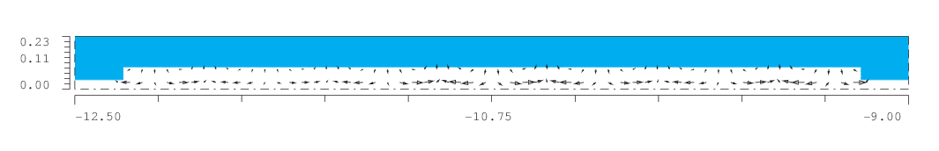
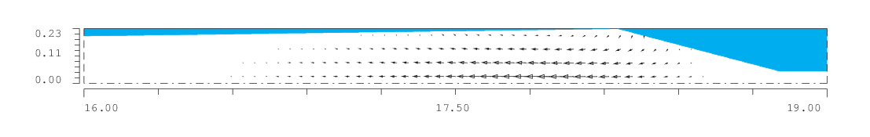
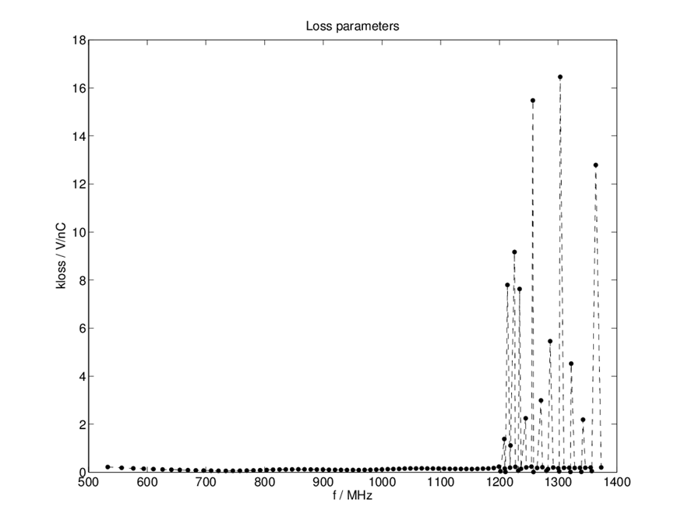


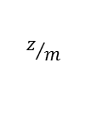

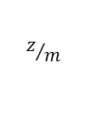
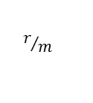
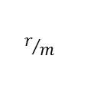
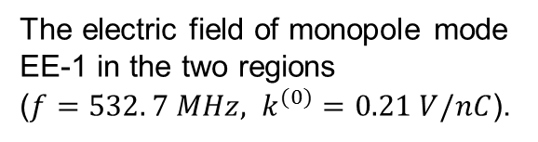
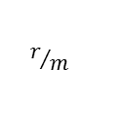
The electric field of monopole mode EE-1 in the two regions (${f=532. 7 MHz, k}^{(0)}=0.21 V/nC$).
Plot of the loss parameter of the monopole modes versus frequency.
$$r/m$$
$$z/m$$
$$r/m$$
$$z/m$$
The electric field of monopole mode EE-87 in the two regions (${f=1303.6 MHz, k}^{(0)}=16.45 V/nC$).
This mode has a largest loss parameter.
$$r/m$$
$$z/m$$
$$r/m$$
$$z/m$$

Slide 5
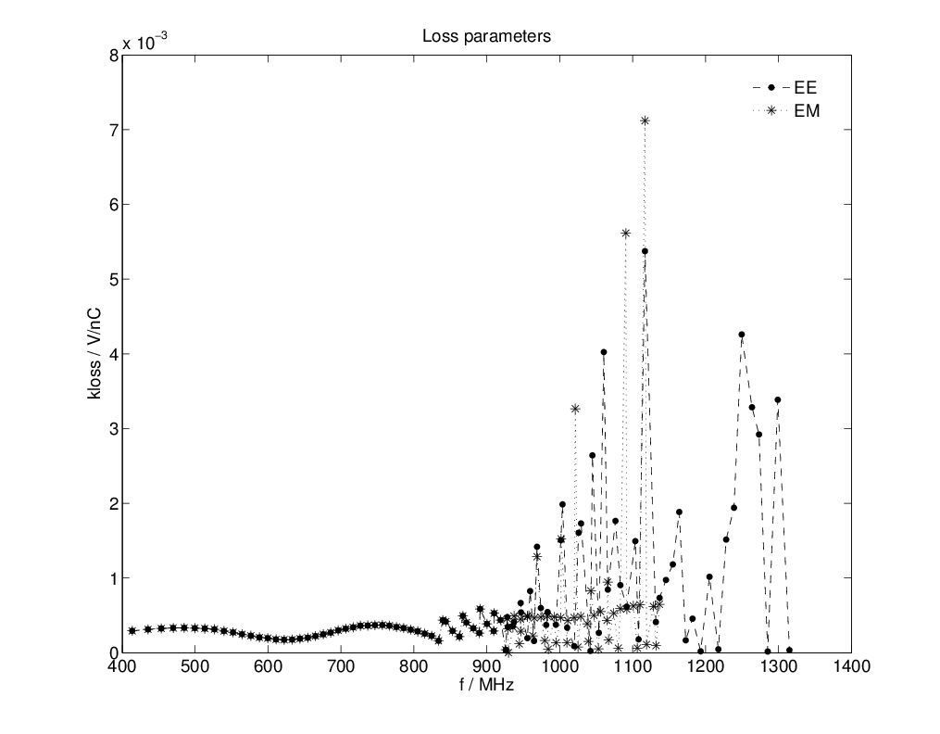
The results of calculations of dipole modes were dependent from boundary conditions.
Comparison of the loss parameter of the dipole modes at an offset of r=1cm for two sets boundary conditions (Electric-Electric, Electric-Magnetic).

Slide 6
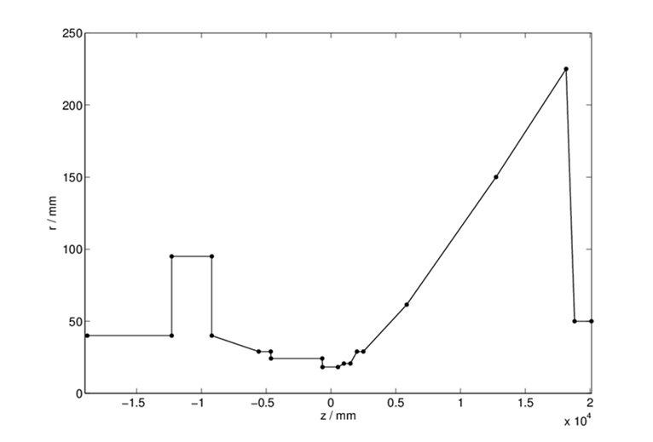
In order to obtain independent from boundary conditions results for the dipole modes the outgoing pipe with length of 1.3m was used.
Length of outgoing pipe is about 130cm (in the original geometry 30cm)

Slide 7
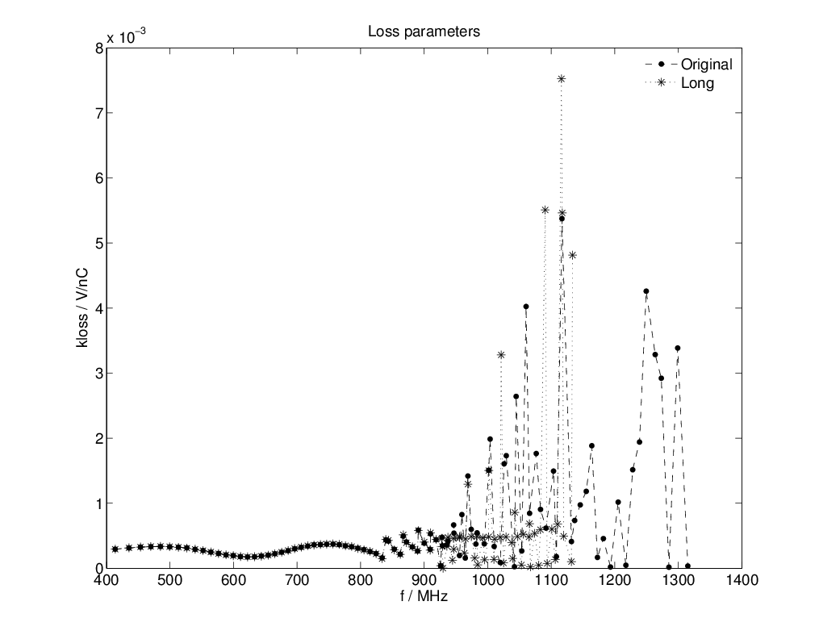
Comparison of the loss parameter of the dipole modes at an offset of r=1cm for the original geometry and for the geometry with elongated pipe. (Boundary conditions – Electric-Electric in both cases)

Slide 8
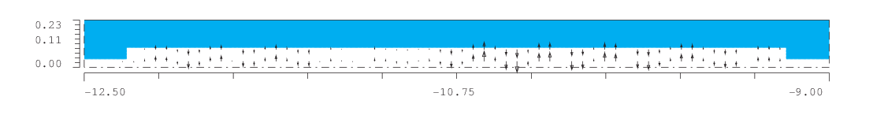

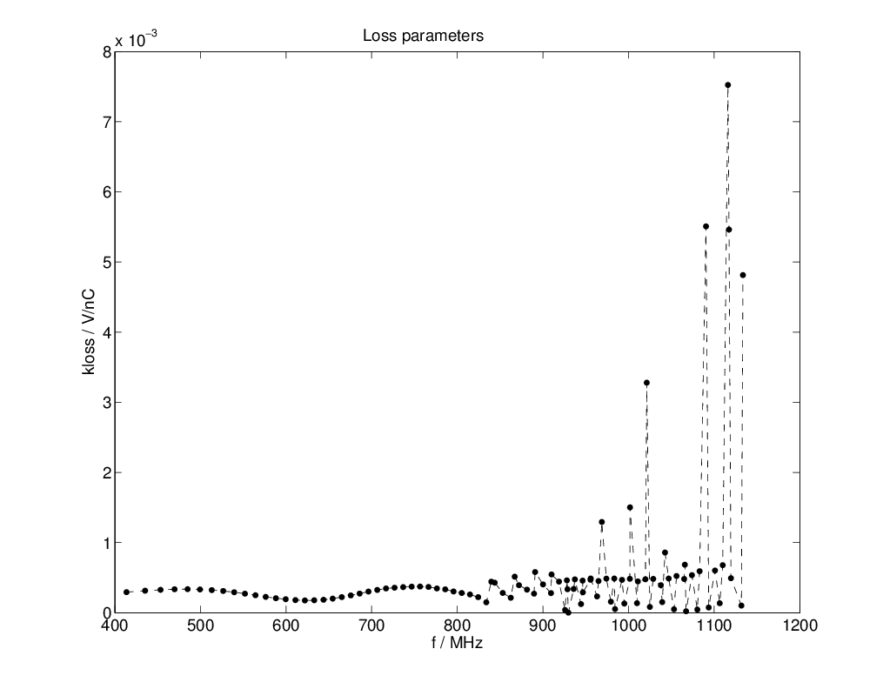


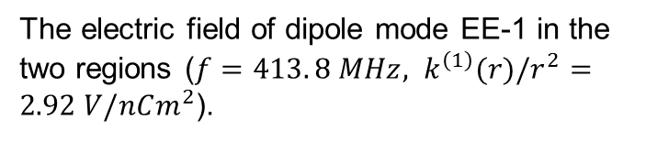
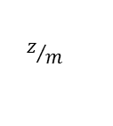
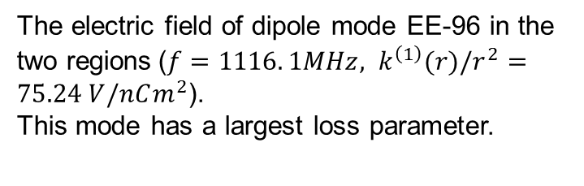
The electric field of dipole mode EE-1 in the two regions (${f=413. 8 MHz, k}^{\left(1\right)}(r)/r^{2}=2.92 V/nCm^{2}$).
Plot of the loss parameter of the dipole modes versus frequency at an offset of r=1cm.
$$r/m$$
$$r/m$$
$$z/m$$
$$z/m$$
The electric field of dipole mode EE-96 in the two regions$\text{(}{f=1116. 1MHz, k}^{\left(1\right)}(r)/r^{2}=75.24 V/nCm^{2}\text{).}$
This mode has a largest loss parameter.
$$r/m$$
$$z/m$$
$$r/m$$
$$z/m$$

