Slide 1
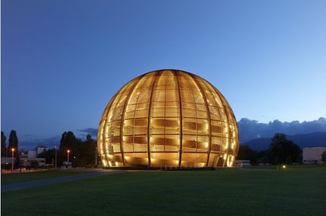
CERN-MEDICIS collaboration day
Thierry Stora
15 October 2014

Slide 2
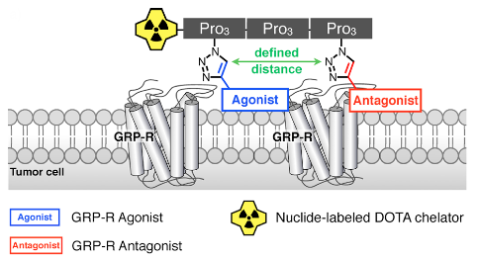
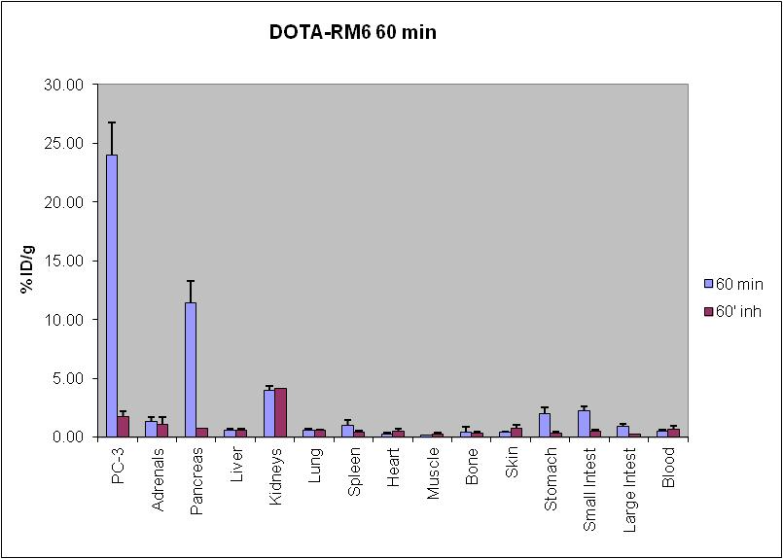
Innovative isotopes for preclinical studies
Radioligand
Biological Target
Biodistribution
SPECT/CT
¹⁷⁷Lu
F. Bucchegger et al.

Slide 3
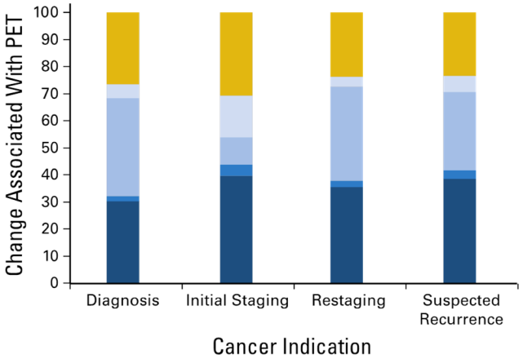
Why CERN-MEDICIS ?
No change
Minor change
Major change
Change in therapies following PET/CT functional imaging
Grey code:
Major change in management
Major change in mode of therapy
Minor change in nontreatment
Minor change in therapies
No change.
Xofigo® has been approved
when ²²³RaCl₂ replaced ²²⁴RaCl₂

Slide 4
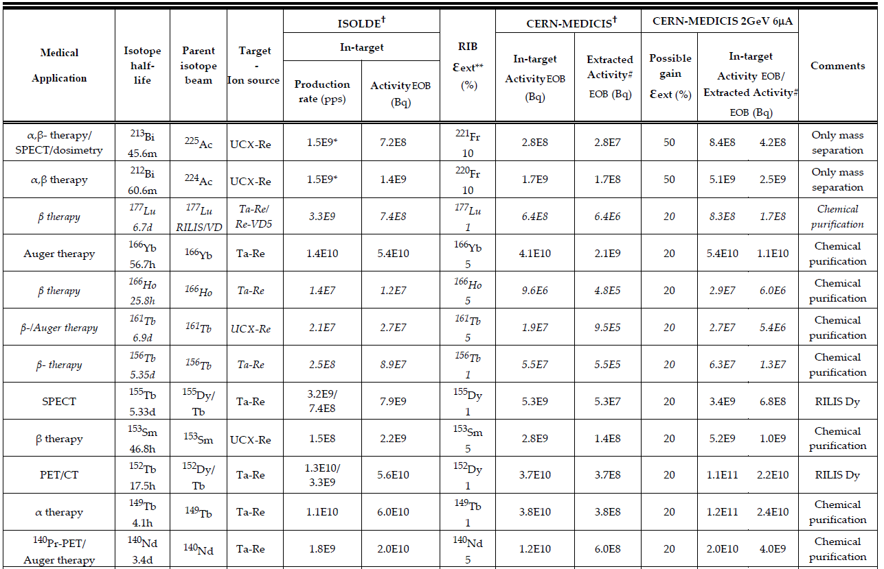
Why CERN-MEDICIS ?
Many isotopes,
High specific activity

Slide 5
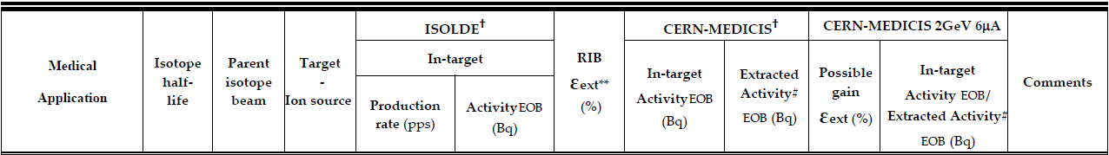
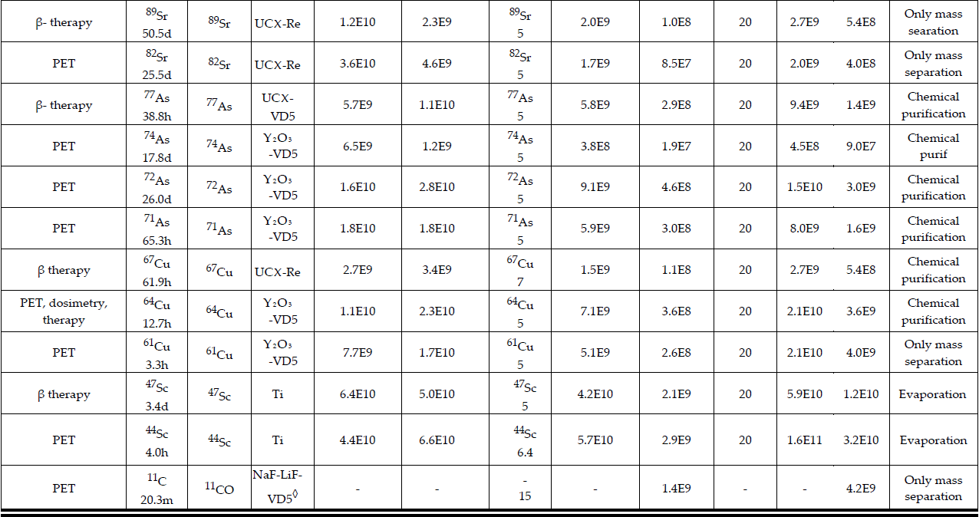
Many isotopes,
High specific activity

Slide 6
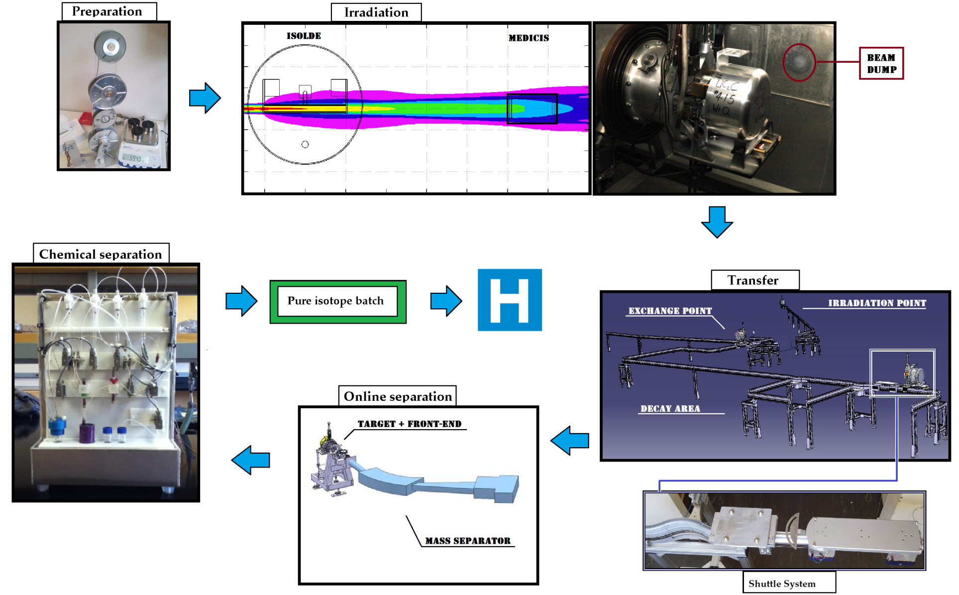
The complete MEDICIS cycle

Slide 7
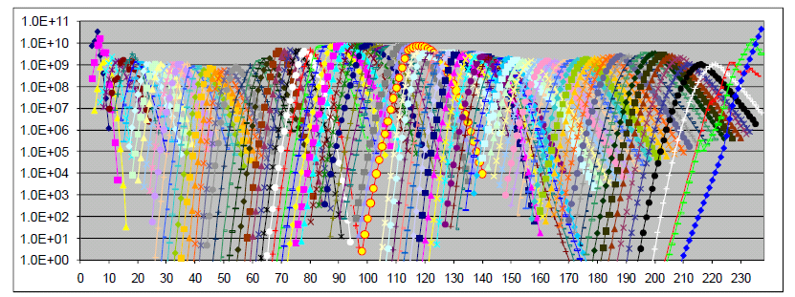
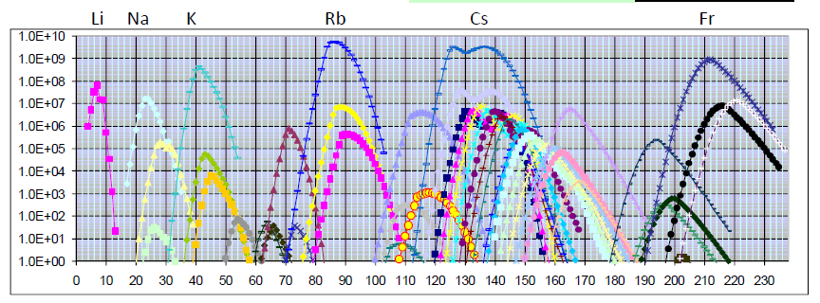
Mass separation filter
Isotopes produced
in target with protons
1 curve = 1 Chemical element
A=83
A=152
1 line = 1 mass (isotope)
Extracted+purified
isotopes

Slide 8
Planning proposal*
*subject to modification…
 | Construction | 2013-2015
PHASE I | Commissioning : No beam | end 2015
PHASE II | Commissioning with beam and light targets to gain operational experience | 2016
PHASE II B | Isotope production with light targets | mid 2016
PHASE III | Extending to heavy targets up to Tantalum | end 2016
PHASE IV | Collection of short lived alpha emitters (e.g. 149Tb) | 2017
PHASE IVB | Operation with Lasers
PHASE V | Operation with Uranium targets/possible proton beam upgrade | 2018

Slide 9
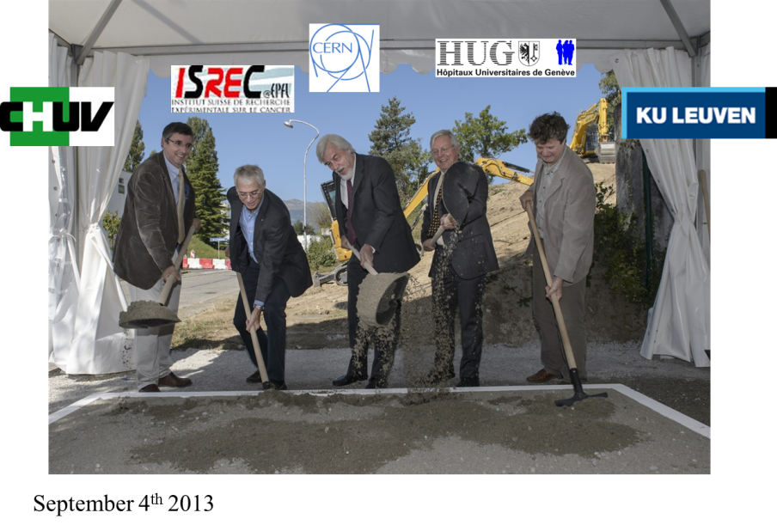
2010 → 2013 : a real start

Slide 10
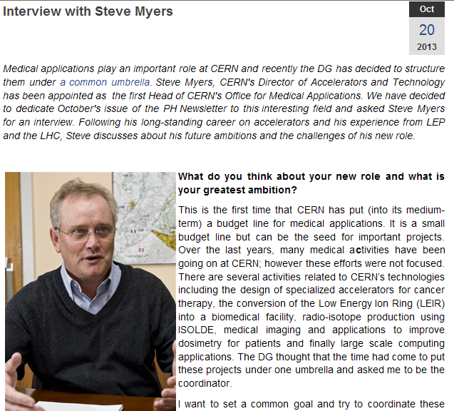
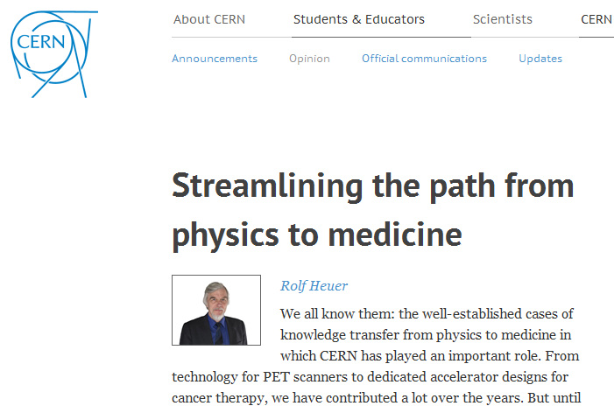
An office for biomedical applications
Brainstorming (Divonne Les Bains) 15-16 Feb 2014

Slide 11
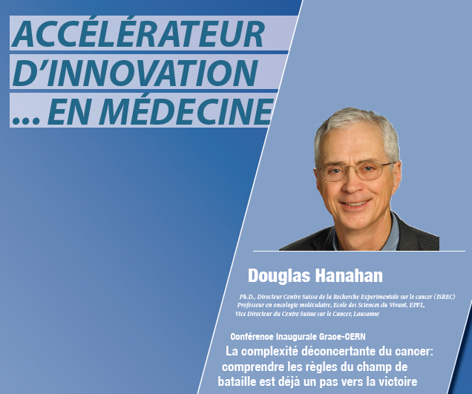
And tonight at 6:30 pm
The inaugural CERN- J. Grace lecture on cancer research

Slide 12
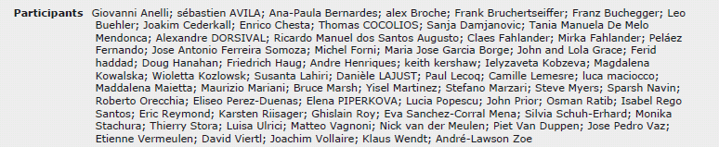
Let’s have a closer look at the program
> 60 participants
> 20 institutes represented

Slide 13
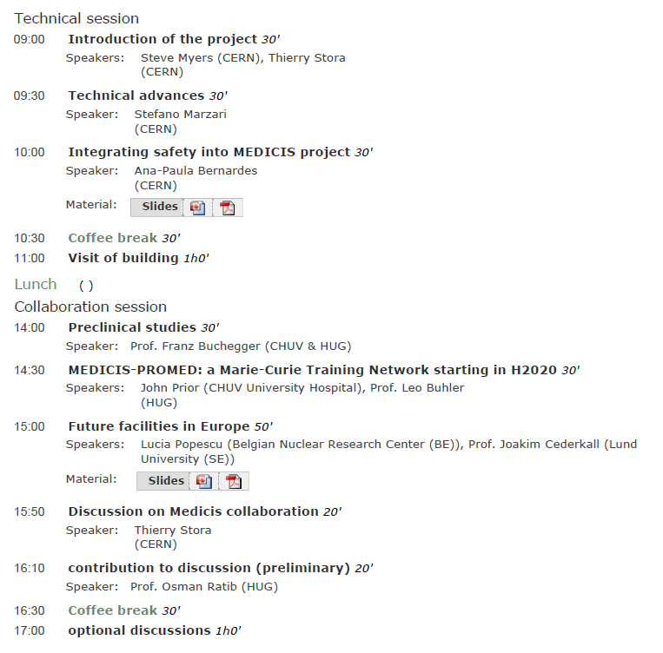
Let’s have a closer look at the program

Slide 14
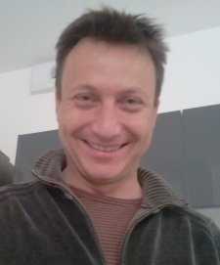
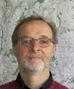

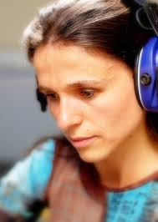
11 am : visit of the building
A shuttle will be available (can do several trips)
CERN Gate B
Globe
Shuttle to
Restaurant 2
MEDICIS !!!
Geneva (tram)
Reception
Bld 33
Walk to Restaurant 1

Slide 15
Everybody back at 2pm please
CERN Gate B
Globe
Shuttle to
Restaurant 2
MEDICIS !!!
Geneva (tram)
Reception
Bld 33
Walk to Restaurant 1

Slide 16
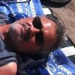

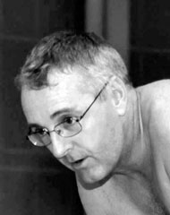
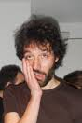

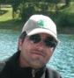
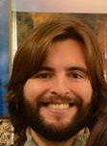

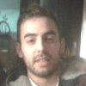
People at CERN
CE
KT
STI
EL
Rail conveyor
RP
HE
MEF
CV
Fluka

Slide 17
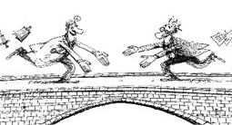
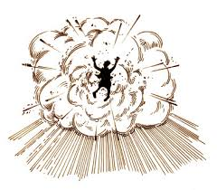
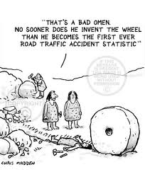
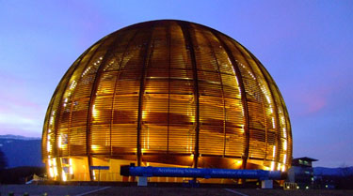
Let us see what is ahead of us !*
*New ideas
*Critical mass
*Unexpected result

Slide 18
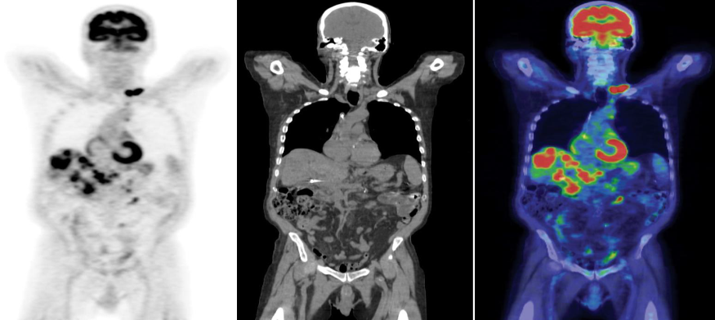
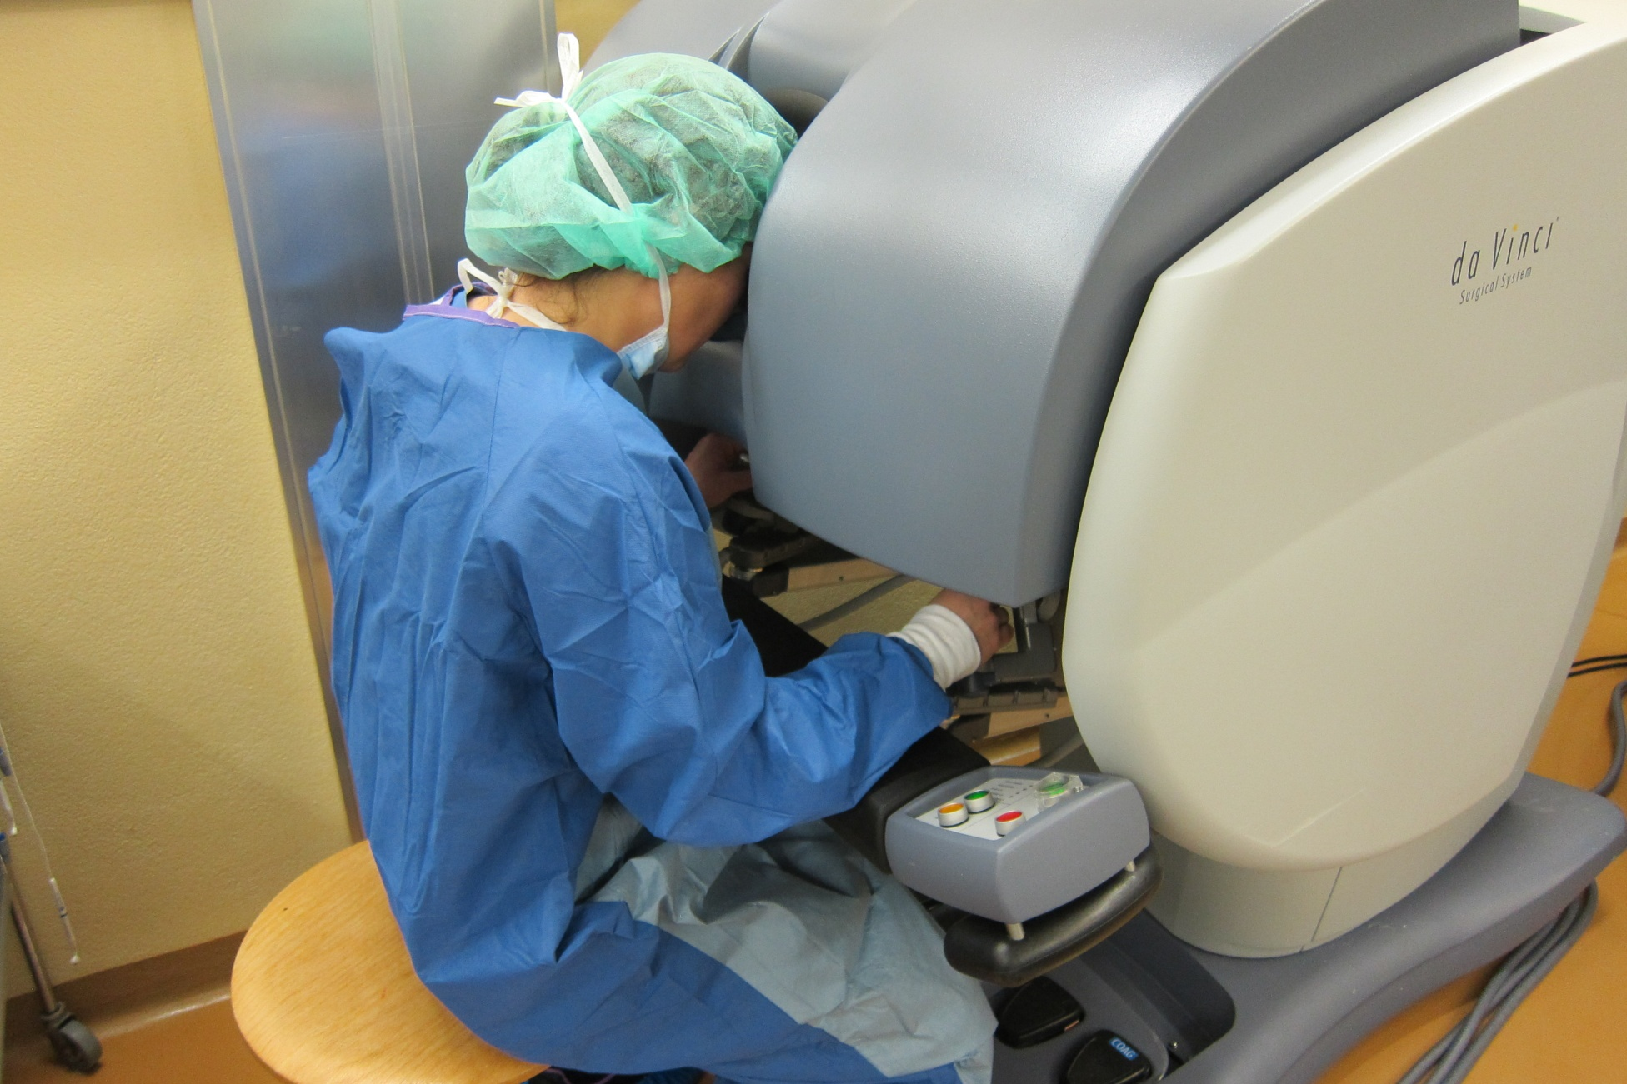
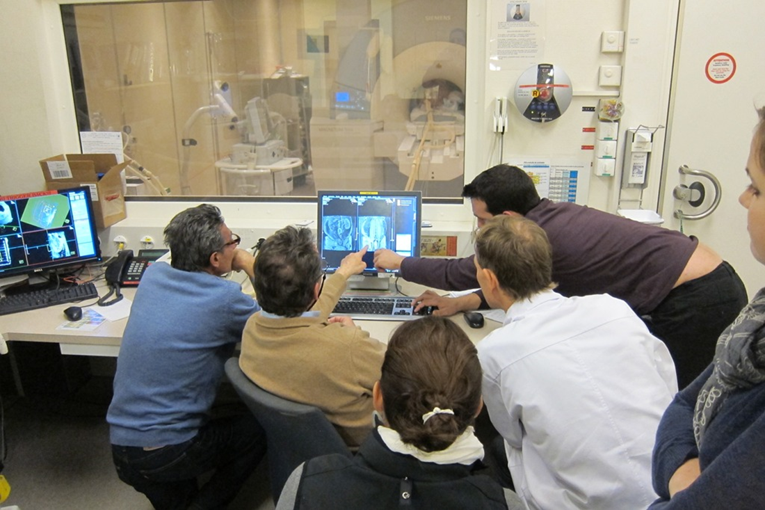
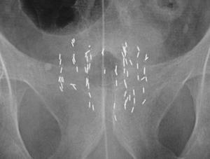

Development of surgical methods
Brachytherapy

Slide 19
Thanks
To the many contributors, colleagues and friends
To Geraldine, Daniele and Ricardo, and some others, for the organization
To the Globe of science and innovation
CMASG and Life Science groups
And if you get lost/have questions :
A mobile telephone number: 076-487 08 08 (+41 76 487 08 08)

