Slide 1
CERN Medical Applications
Steve Myers
Head of CERN Medical Applications
Former Director of Accelerators and Technology
CERN, Geneva

Slide 2
The New CERN Medical Initiatives
Medical Accelerator Design
  coordinate an international collaboration to design a new compact, cost-effective accelerator facility, using the most advanced technologies
Biomedical Facility
  creation of a facility at CERN that provides particle beams of different types and energies to external users for radiobiology and detector development
  Iterative experimental verification of simulation results
Detectors for beam control and medical imaging
Diagnostics and Dosimetry for control of radiation
Radio-Isotopes production (bio-imimaging, treatment..)
Large Scale Computing (treatment planning, data storage and analysis, and simulations)
Applications other than cancer therapy
Will be carried out in a global collaboration

Slide 3
CMA Initiatives: Where are we?
Obtained some “seed” funding from CERN, as well as donations from outside
“CERN Medical Applications Workshop” followed the ICTR-PHE (15-16 February)
Attracted ~80 top experts from all over the globe
Many collaborators have volunteered (both inside and outside CERN)
Funding, governance,… “institute or..”
Regular CERN discussion meetings (CMASG, covering all topics)
International Strategy Committee (Nov 2014), (world experts)
CERN as a medical data repository (WHO, Geneva)
Medicis; Radio-isotopes project well under way
RFQ development, design OPENMED, diagnostics and dosimetry
White paper well under way

Slide 4

DRAFT Structure (to be decided)
CERN Directorate
International Advisory Committee
International Collaboration Board
Steering Group for Medical Applications
Finance Committee
Project 1
Project 2
Project 3
Project n
WP1
WP2
WP3
WPn

Slide 5
Thank you for your attention

Slide 6
Initiative: Accelerator reminder PIMMS
“In 1996, CERN initiated the Proton Ion Medical Machine Study (PIMMS), which aimed at designing a synchrotron optimized for the treatment of moving organs with carbon ions (and protons). The project was adapted by TERA and used as a basis for the CNAO centre, which has been completed in Pavia by the CNAO Foundation and INFN. The MedAustron facility utilises the same synchrotron design, and is currently being built in Wiener Neustadt (Austria).”

Slide 7
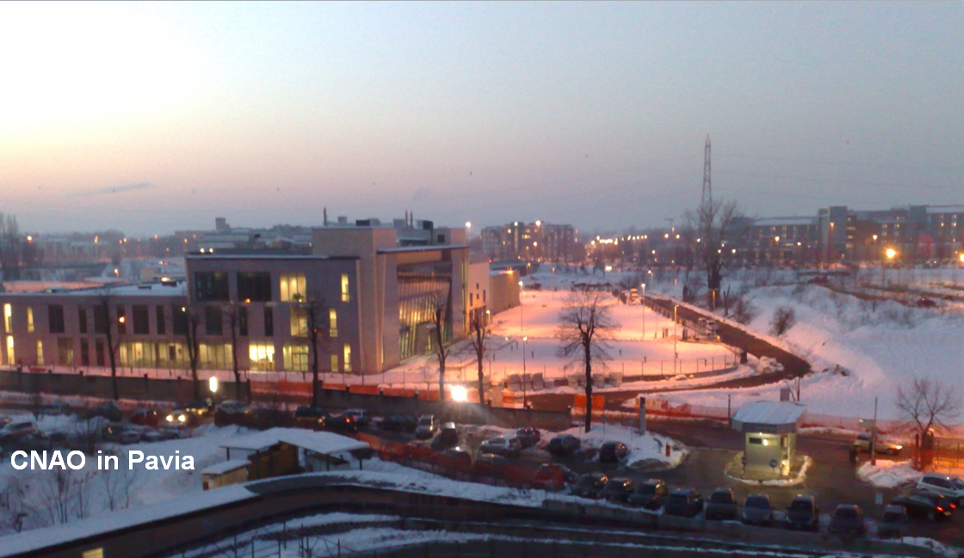

Slide 8
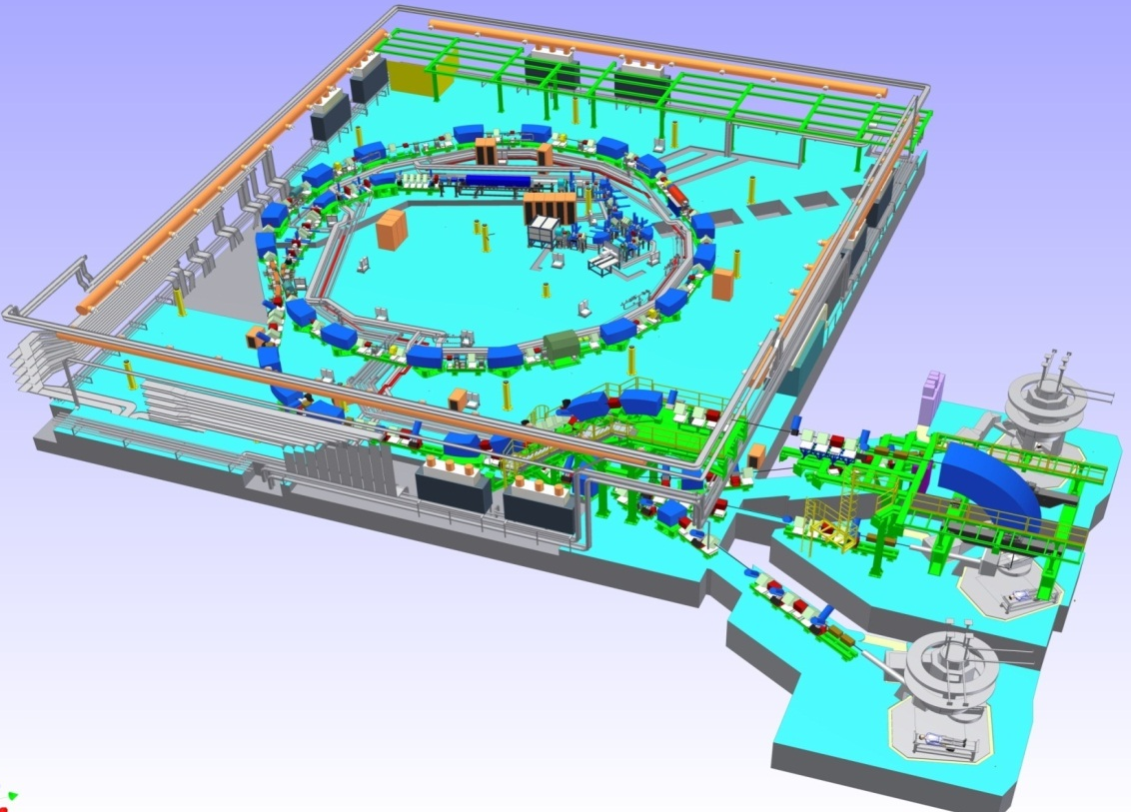
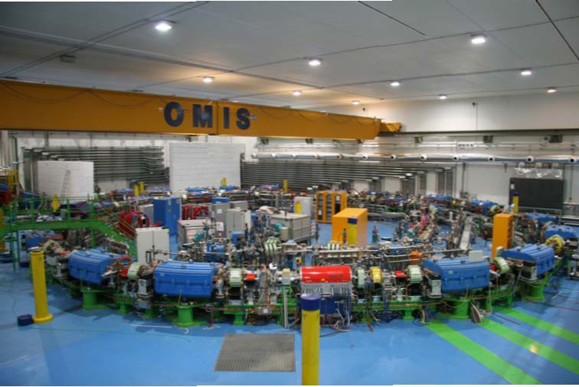
CNAO (Pavia) is treating patients
Perspective view

Slide 9
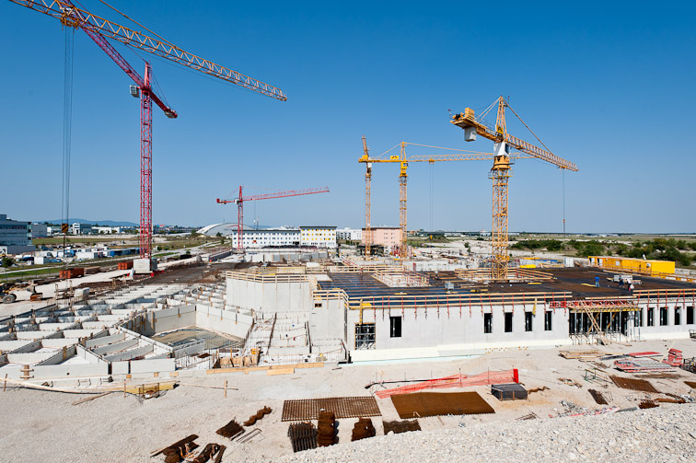
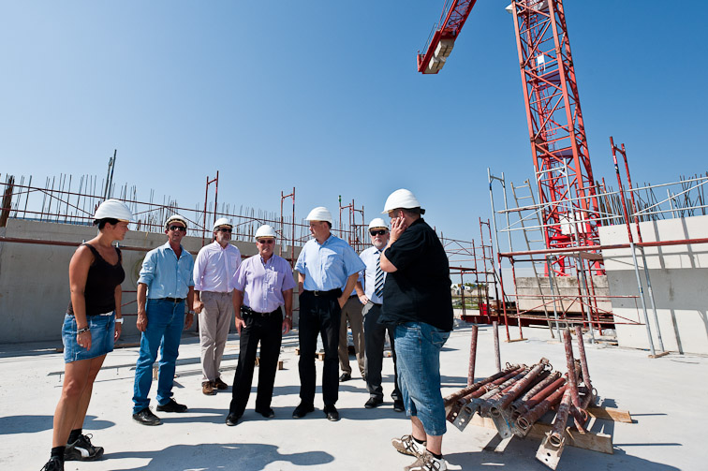
MedAustron is building a centre in Wiener Neustadt

Slide 10
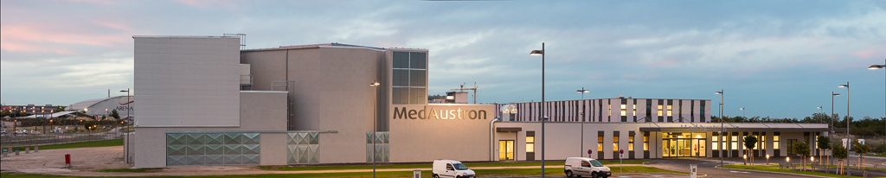
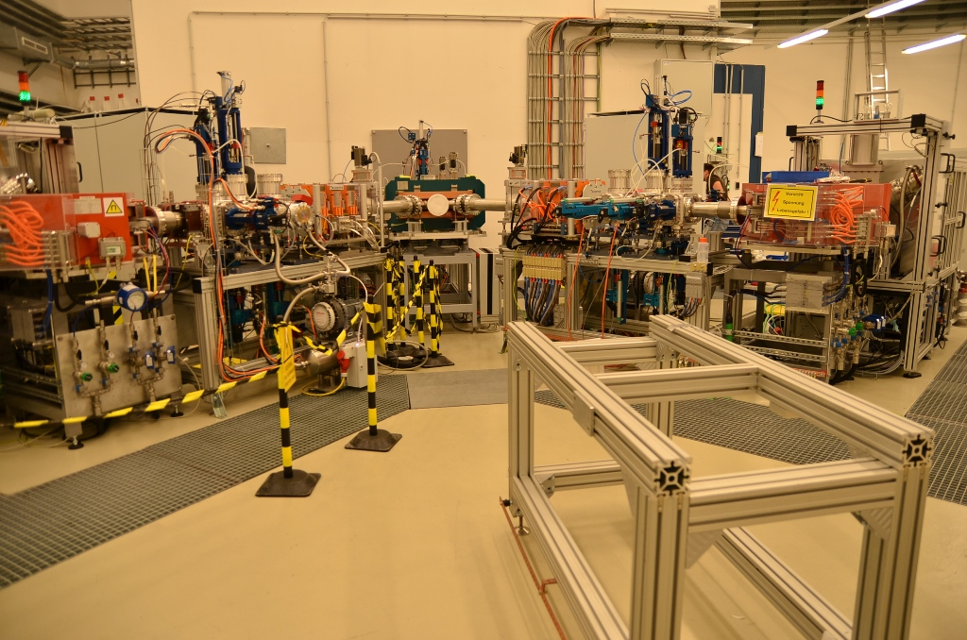
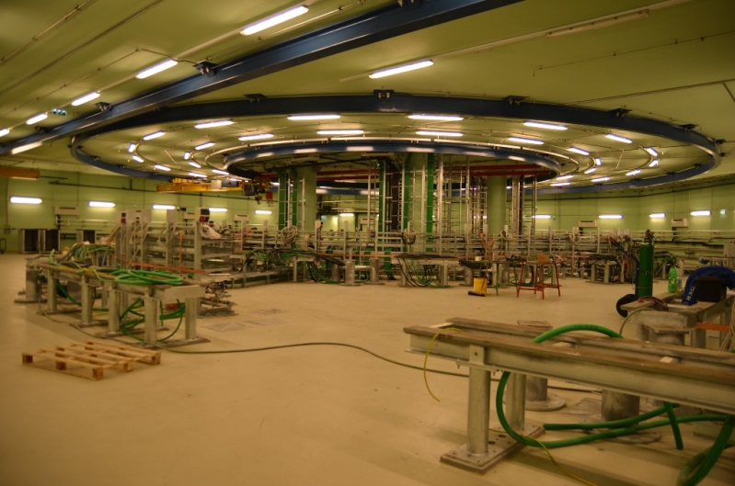
MedAustron Status – Wiener Neustadt
PIMMS1 design has been a big service to the community
2 source branches installed
Beam commissioning
Synchrotron hall installation

Slide 11
What has happened since 2000 on the technology side?
LHC accelerator technology development
    Operation of 8T magnets
    Testing of 11T magnets for Luminosity upgrade
    Development of 18-20T magnets for energy upgrade
LHC Detectors developments
    Crystal scintillators improvements
    Medipix proliferation and enhancements
    Developments of new vertex detectors for LHC luminosity upgrade
    Development of TOF resolution for Luminosity Upgrade
CLIC
    Accelerating structure frequency reduced from 30GHz to 12GHz
    Development of room temperature structures for 100MV/m gradient
    Proposals for structures of 3 and 5.7 GHz with 30 and 50 MV/m for medical applications
LHC Grid
    Demonstration of the efficiency and reliability
    Rapid adoption to new domains
Developments of medical simulations with FLUKA
How can we improve the previous design using the new technologies?

Slide 12
What should an ideal facility do?
Treat the tumour and only the tumour
    monitor and control, the ideal dose to the tumour
    ⇒ Minimal collateral radiation “outside” the tumour
    Minimal radiation to nearby critical organs
  Even if the tumour is moving
Be affordable
    Capital cost ?
    Operating costs ?
    Increased number of treated patients per year ?
Compact: Fit into a Teaching Hospital ?

Slide 13
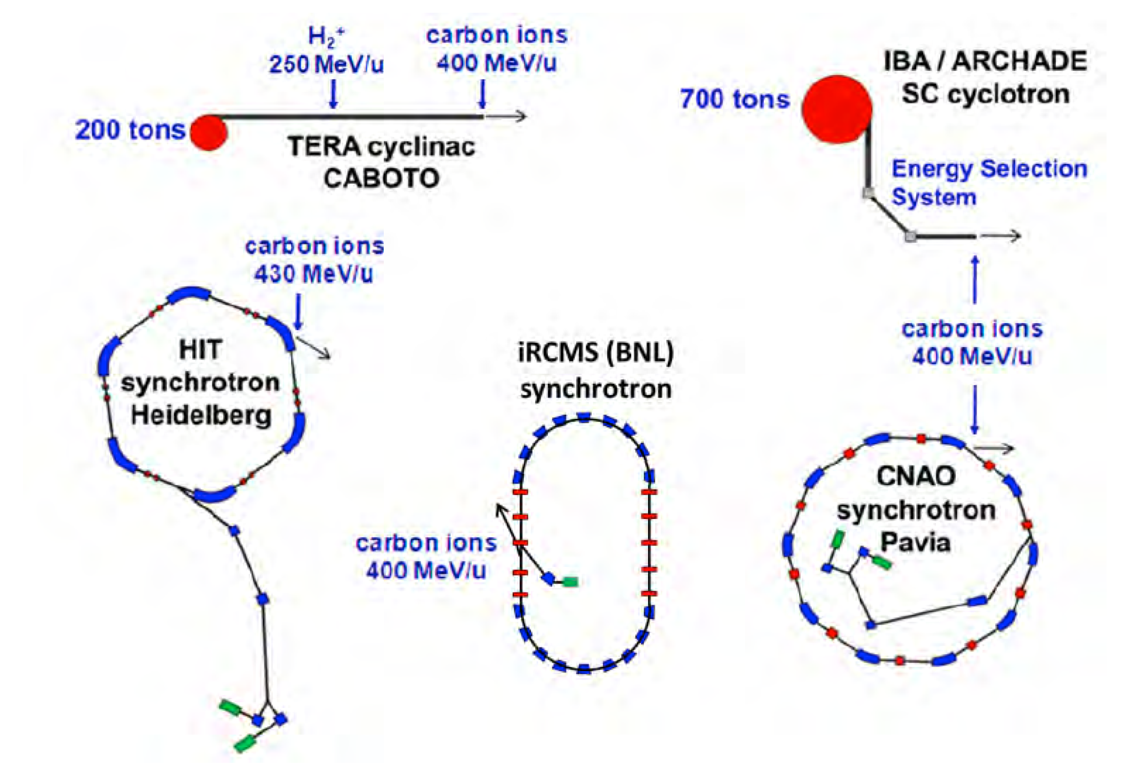

Dimensional comparison for carbon ion accelerators
Courtesy U. Amaldi/A.Degiovanni

Slide 14
Cost Questions (user Specs)
Compactness
  Specification of “maximum” dimensions…MA
  Balance of importance of compactness vs cost..MA
Cost Effectiveness .. The Over-riding Parameter
  What is a reasonable cost parameter (e.g. relative cost per patient compared with conventional therapy? Survival parameter?)..MA
  Reduction of capital cost… Acc + MA
      Number of treatment rooms + number and specs of gantries
  Reduction of running and operational costs (experts…)..Acc + MA
      Number of treatment rooms + gantries
  number of patients treated per year…MA +Acc

Slide 15
Technical/Medical Questions (user Specs)
Beam Specs (needs R&D)
  Type of Light Ion (protons to Carbon or multiple ion capability)…M
  Central beam energy and energy range (?multiple energies for different functions)….M
  Beam size (h+v) (emittance)…..M
  Energy spread of beam….M
Beam Distribution (gantry)
  Required angular coverage…..M
  Allowed rate of change of beam energy…Acc + M
  Degree of allowed movement of patient…..M
Diagnostics and Imaging (needs Test bed and simulations)
  Dose: requirements and precision deposition….M
  Beam control devices…..Acc
  Requirements for imaging (update rate, precision, resolution)… M

Slide 16
Technical/Medical Questions (user Specs)
Spot Scanning (Needs R&D)
  Comparison of specs for spot scanning (fast with low dose per shot or large dose per shot)…M
  Optimum spot scanning parameters, rate, dose, etc..M
  Control of dose per deposition….M
Type of Accelerator …Acc
  Synchrotron (normal or rapid cycling)
  Linac
  Cyclotron
  Or a combination of the above (SC, Cyclo-Linac, etc )
The agreed specs will influence decision on type of accelerators and design of gantries

Slide 17
Dealing with Organ Movement
Time gating: apply dose when the organ is in the correct position. E.g. respiration cycle
Fast rescanning: very rapid multiple painting. Statistically distribute the dose
Tumour tracking: diagnostics and imaging
All methods need high scanning speeds

Slide 18
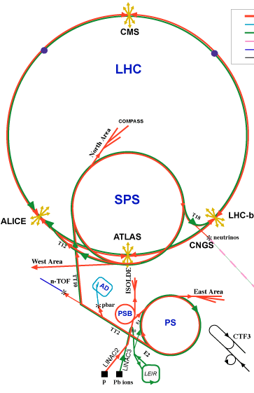
We have many accelerators at CERN
And one is perfect, LEIR
LEIR (Low Energy Ion Ring)
part of LHC injection chain
accumulator for LHC ion programme (lead ions)
  only used for several weeks / year
Plan to establish facility for
  Test-bed for medical instrumentation
  Diagnostics and dosimetry
  radiobiology
  basic physics studies such as fragmentation of ion beams
Notes:
Some background info:
• formerly: LEAR - Low Energy Antiproton Ring
• now (for LHC): LEIR - Low Energy Ion Ring
– Desired luminosity for LHC lead experiments 10^{27}cm^{-2}s^{-1} requires ~7\cdot10^{7} ions /bunch at 2.7 TeV/u within normalised emittances smaller 1.5\mu m .[Chanel2002]
– intensity/emittance ratio achievable via PS and Booster falls short of LHC specifications by factor ~30
– LEIR uses accumulation and phase space cooling to transform a series of long (~200\mu s ), low-intensity ion pulses from Linac 3 into short (\sim200 ns ), high-intensity bunches.
• Why LEIR?
– Only used during LHC ion programme (xxx weeks / year ? + commissioning)
– Would not impact on other CERN programs... no other machines required
– Energy reach of LEIR is appropriate for radiobiological experiments

Slide 19
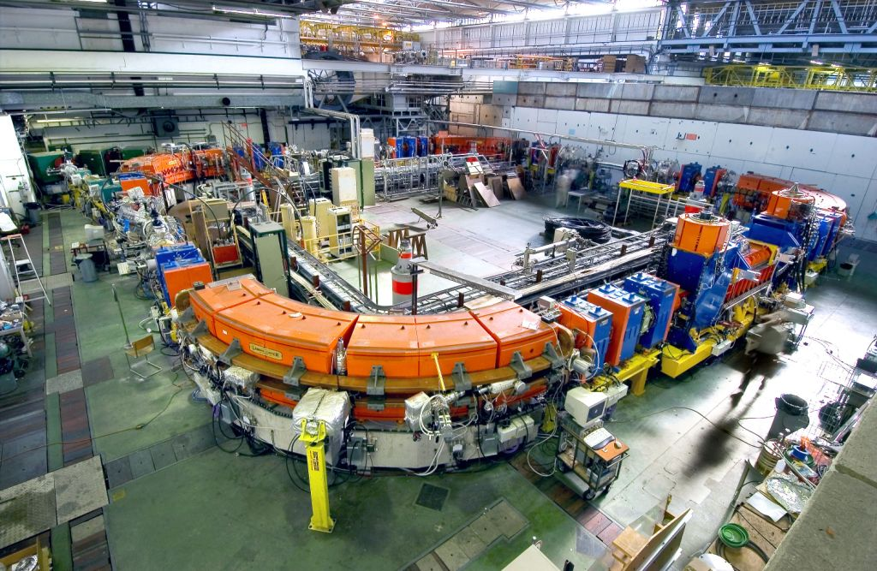
Biomedical Research Facility at LEIR

Slide 20
OPENMED Facility Summary
With a new Front End (Source)
  LEIR can provide ions of interest for biomedical studies up to <430 MeV for fully stripped ¹²C or ¹⁶O ions
  Facility can also be used to test detectors and diagnostics as well as test the results of medical simulations
  Study well under way:
    (Re-)implemention of slow ejection with longitudinal and/or transverse excitation
    New extraction channel (septa) and transfer line to experiment
Need the Funding for Implementation

