Slide 1
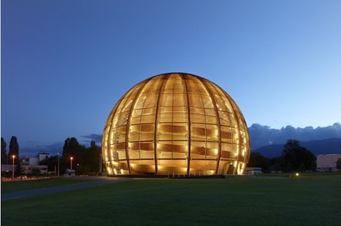
CERN-MEDICIS collaboration day
Discussion !!
Thierry Stora
15 October 2014

Slide 2
What am I going to present ?
What do we want to do ?
Supply radioisotopes for medical research
and develop the related techniques
Let’s step back a little …
It started (for the present team) back in 2010.

Slide 3



Regional node
In 2012,
We started interacting with :
This constitutes the « regional node ».
Please see next presentation .

Slide 4
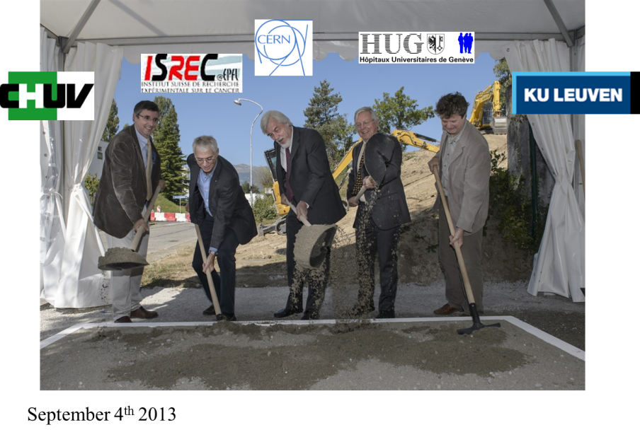

But that’s not all

Slide 5
Facility partners
There is a strong interest from the nuclear physics partners.
These could be defined as the « facility partners » which contribute
in the infrastructures : KULeuven, link to Isolde,
discussions with the « Manchester/Mainz/RILIS collaboration »
discussions with the « ESS initiative »
discussions with Myrrha

Slide 6
Expressions of interest
Prof. Lahiri - SINP-Kolkata
Prof. Dos Santos - C2TN-Lisbon
ITU-JRC Karlsruhe
PSI
Bulgarian community (Prof Piperkova, Rainovski, )
Norvegian community (Prof Siem)

Slide 7
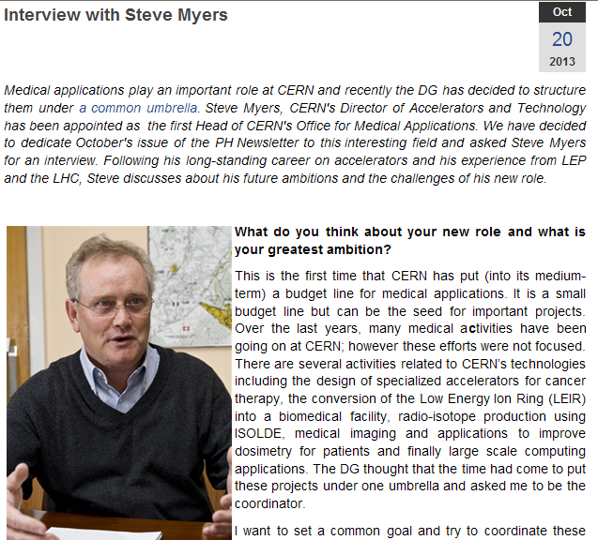
But that’s not all
Strategy paper CERN
Links to future facilities:
(SCK.CEN, « ESS initiative »)

Slide 8
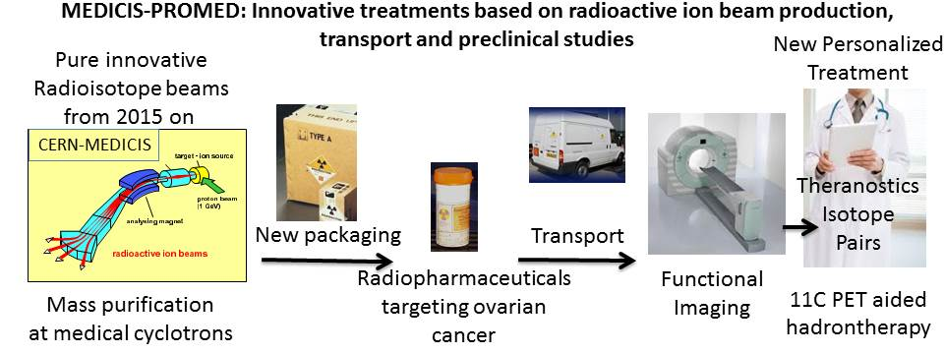
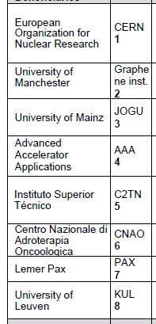
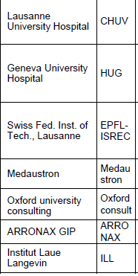
And that’s not all (yet)
Consortium
agreement

Slide 9
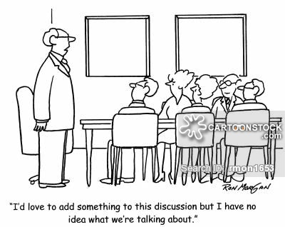
A MoU has been drafted
2 phases are defined : start-up phase 2015-2018
Operation phase 2018-2022 and beyond
The collaboration advisory board :
1 institute = 1 representative(+expert) chaired by CERN
It oversees the development of the infrastructure and its program
It decides on the incorporation of new members
The link to the Isolde facility is organized
We plan to circulate a refined drafted version soon.
HUG/CHUV/EPFL, C₂TN, KULeuven, Prof Lahiri, Isolde and CERN:
Is this the core MEDICIS board ?

Slide 10
Thanks
Questions, discussions ?

