Slide 1
Production of medical radioisotopes at MYRRHA
Lucia Popescu
SCK•CEN
lpopescu@sckcen.be

Slide 2
Outline
MYRRHA – Introduction
Production of reactor-based medical radioisotopes
The RIB facility: ISOL@MYRRHA
Medical applications of ISOL@MYRRHA
Conclusion

Slide 3

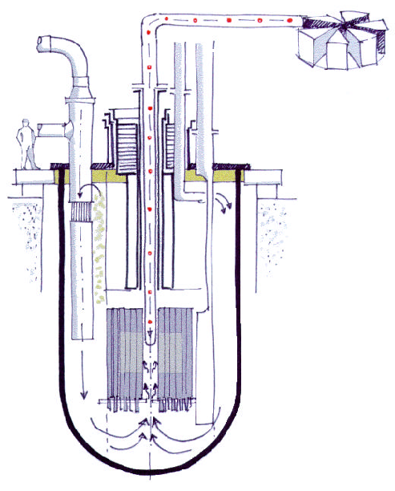
MYRRHA - Accelerator Driven System
Accelerator
(600 MeV - 4 mA proton)
Reactor
Subcritical or Critical modes
65 to 100 MWth
Spallation Source
Multipurpose
Flexible
Irradiation
Facility
Fast
Neutron
Source
Lead-Bismuth
coolant
3 L. Popescu (SCK•CEN) - Production of medical radioisotopes at MYRRHA

Slide 4
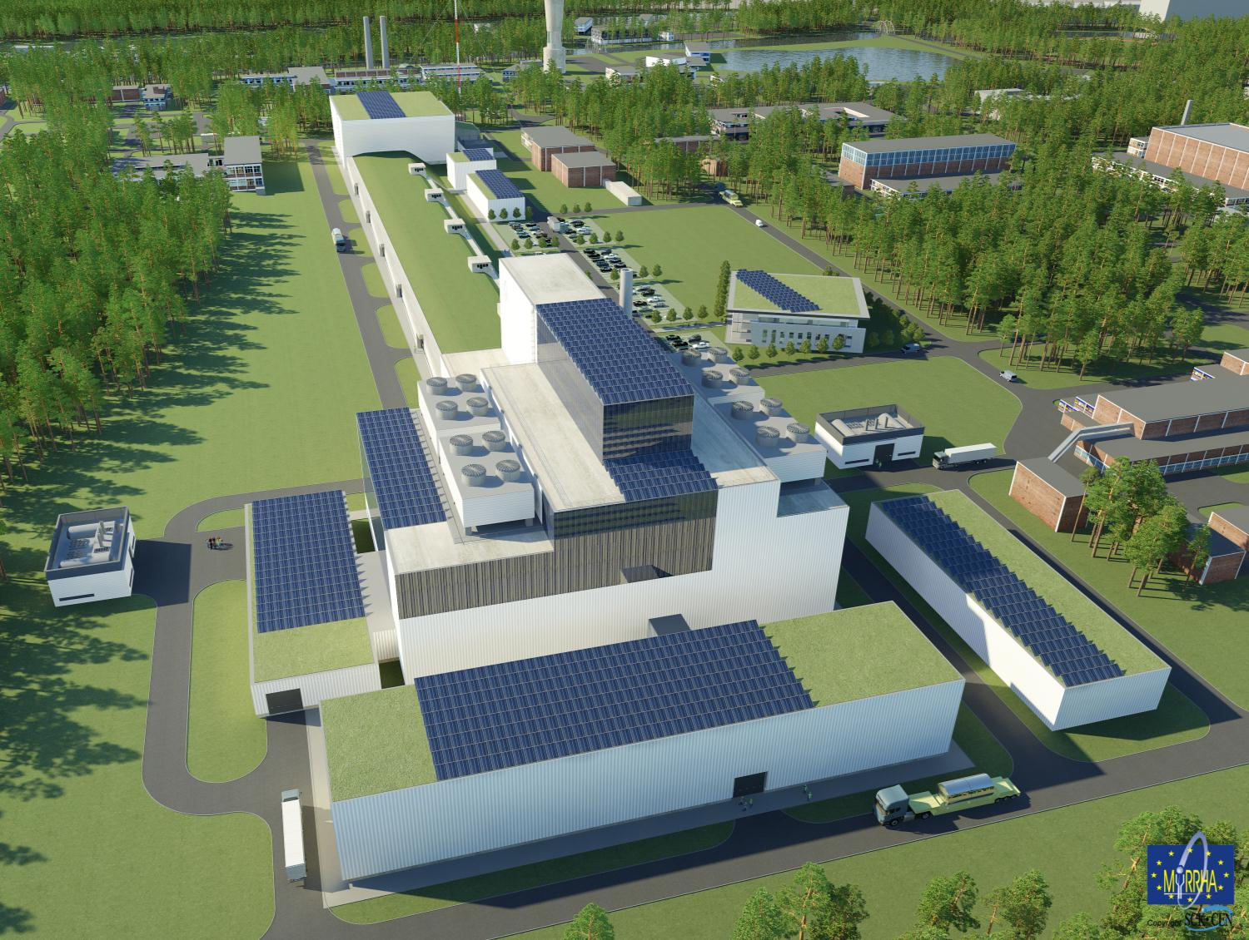


MYRRHA: EXPERIMENTAL ACCELERATOR DRIVEN SYSTEM
A pan-European, innovative and unique facility
4 L. Popescu (SCK•CEN) - Production of medical radioisotopes at MYRRHA

Slide 5
Outline
MYRRHA – Introduction
Production of reactor-based medical radioisotopes
The RIB facility: ISOL@MYRRHA
Medical applications of ISOL@MYRRHA
Conclusion

Slide 6
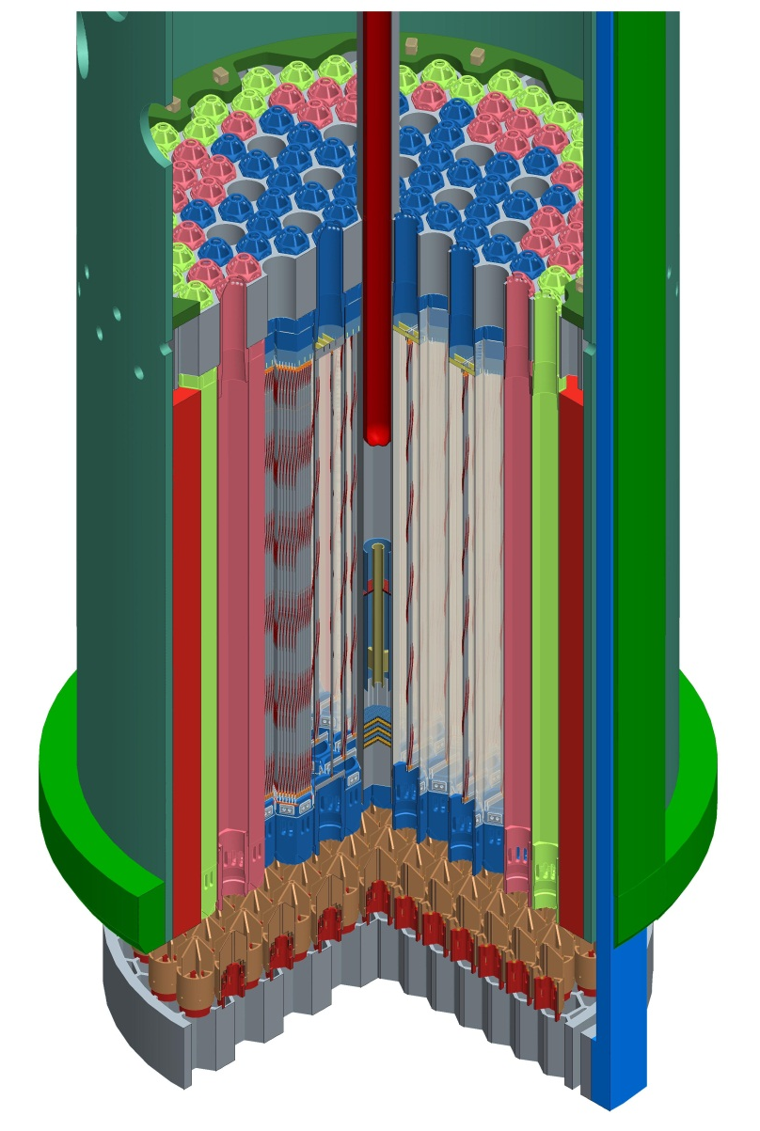
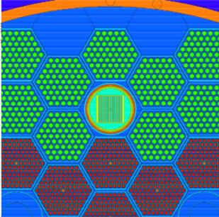
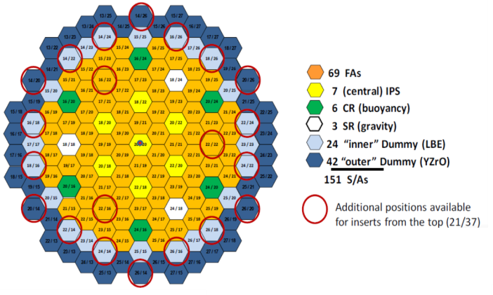
Production of radioisotopes in MYRRHA thermal-neutron flux traps
Core lay-out:
  In reflector positions
  Cooled by water
  In thermalized neutron field
  Transport by rabbit system
Target plates in IPS:

Slide 7
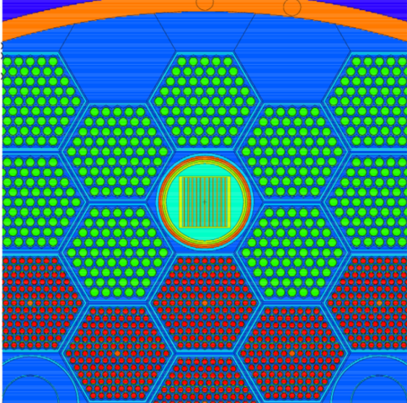

Radioisotope (Mo-99) production capability
Sub-critical @ 73 MW
Average specific power
173 W/cm²
184 W/cm²
171 W/cm²

Slide 8
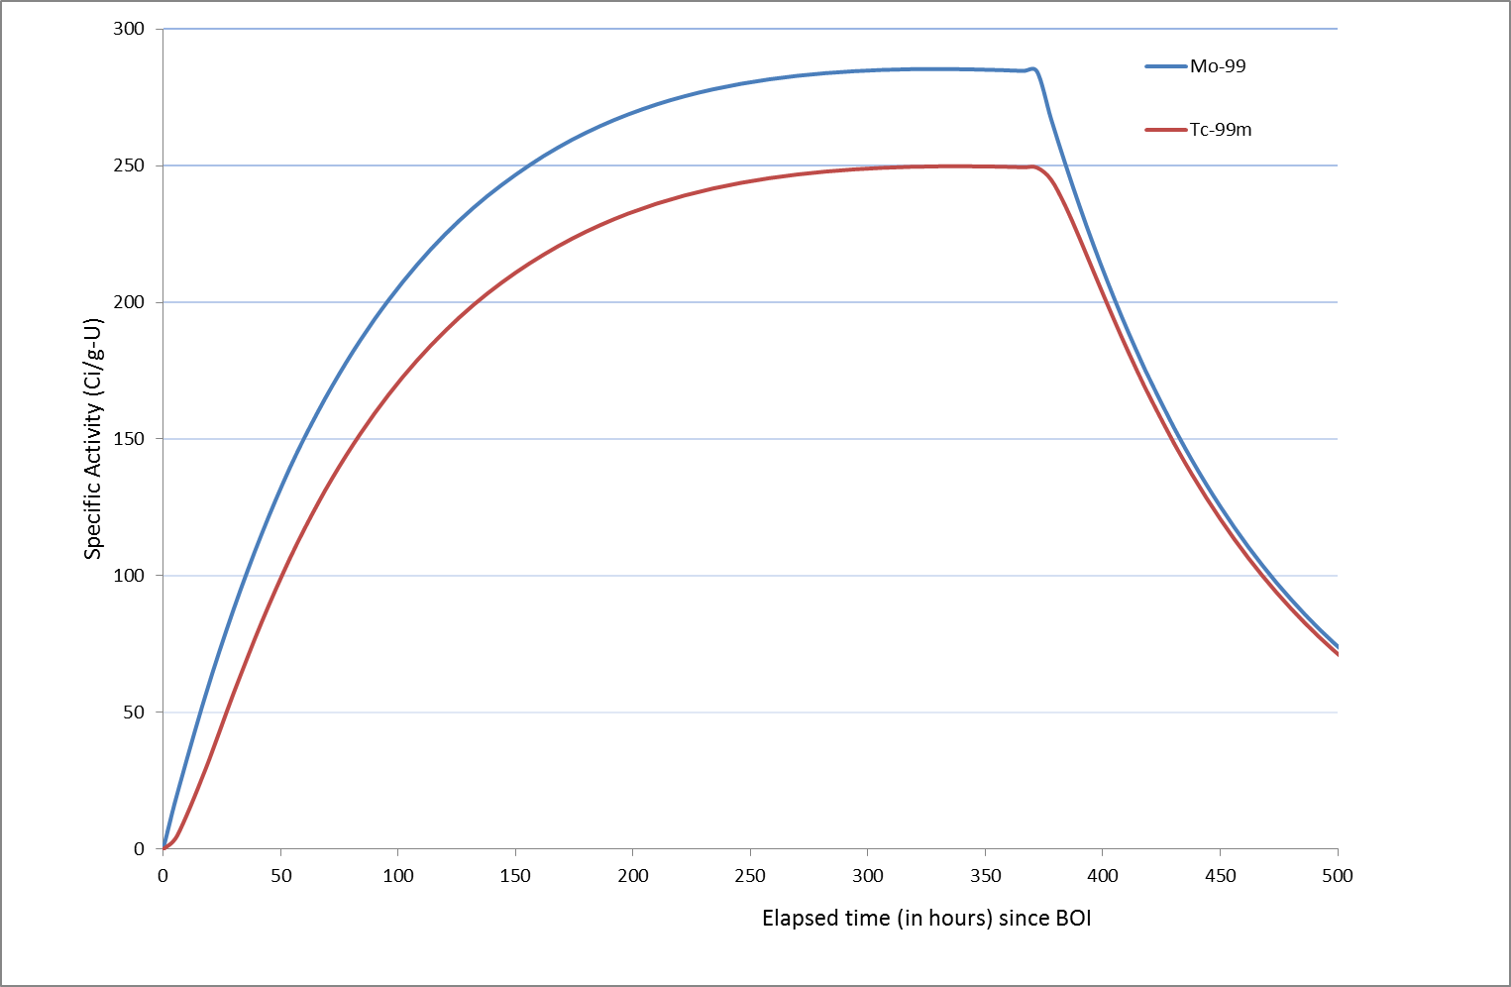
Radioisotope (Mo-99) production capability
Critical @ 100 MW
Heat flux ≤ 400 W/cm²

Slide 9
Outline
MYRRHA – Introduction
Production of reactor-based medical radioisotopes
The RIB facility: ISOL@MYRRHA
Medical applications of ISOL@MYRRHA
Conclusion

Slide 10
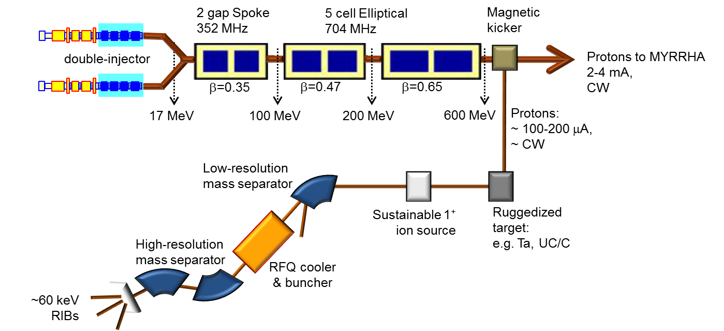
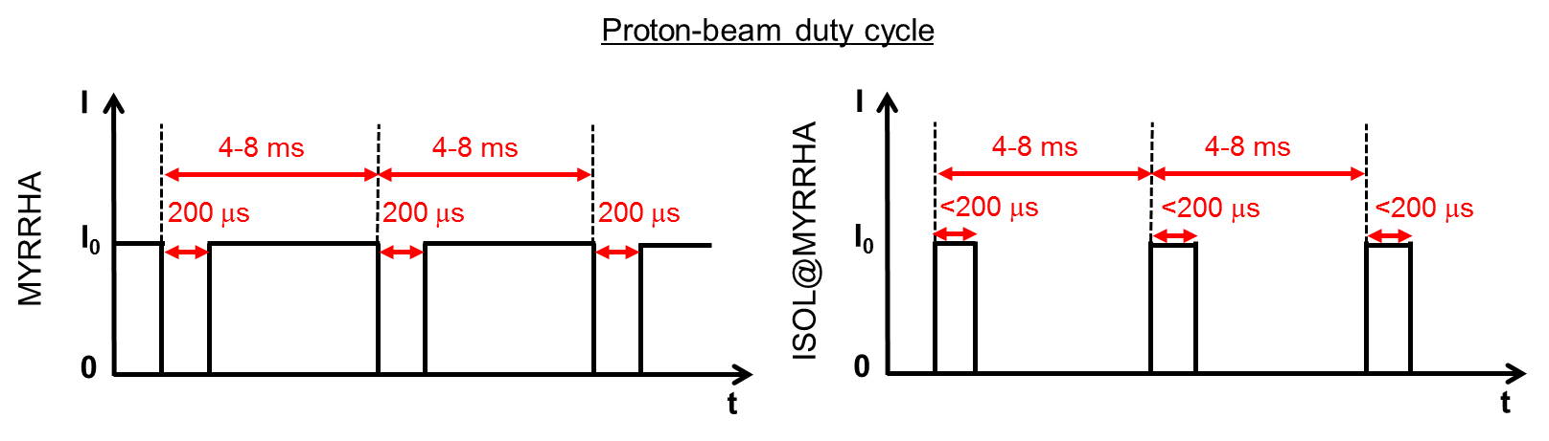
ISOL@MYRRHA - Concept
ECR 1+
Surface IS
RILIS
+ liquid targets

Slide 11
MYRRHA Accelerator Challenge
fundamental parameters (ADS)
particle | p
beam energy | 600 MeV
beam current | 4 mA
mode | CW
MTBF (failure = beam trip > 3 s) | > 250 h
challenge !
implementation
superconducting linac
frequency | 176.1 / 352.2 / 704.4 MHz
reliability = redundancy | double injector
 | “fault tolerant” scheme
MYRRHA accelerator – high reliability => Extended runs with stable operation at I@M

Slide 12
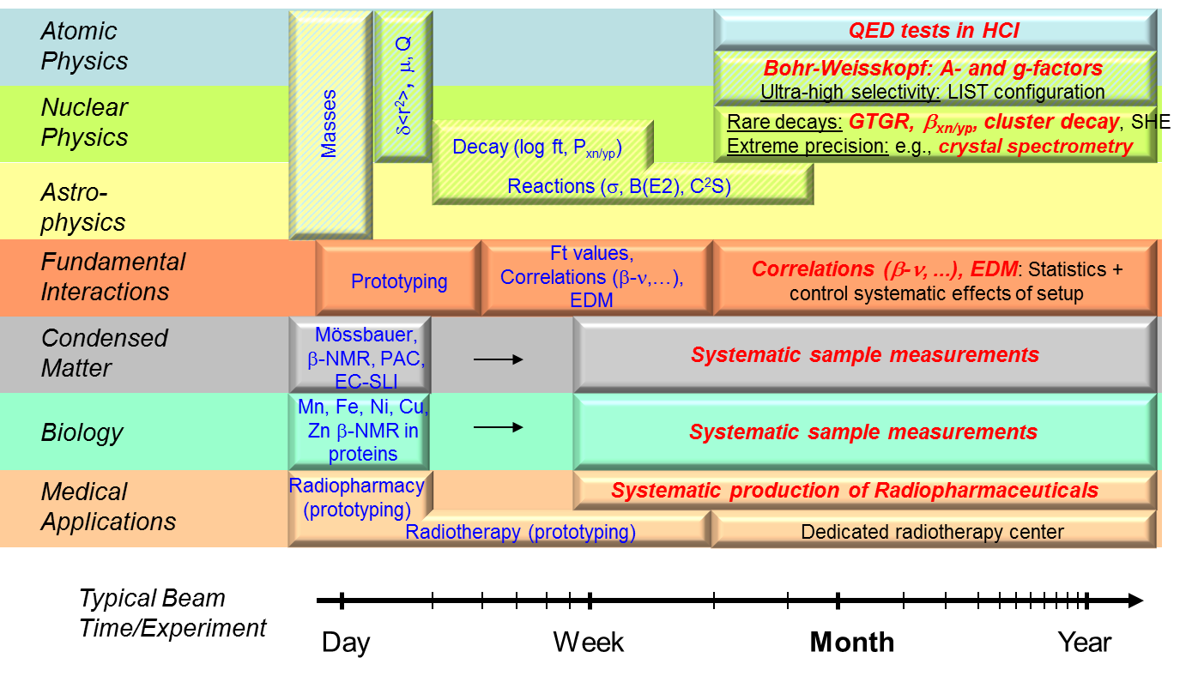
ISOL@MYRRHA Applications
ISOL@MYRRHA will prioritize experimental programmes which require of extended beam times with stable operation:
hunt for very rare phenomena
need high statistics
need many time-consuming systematic measurements
have inherent limited detection efficiency

Slide 13
Outline
MYRRHA – Introduction
Production of reactor-based medical radioisotopes
The RIB facility: ISOL@MYRRHA
Medical applications of ISOL@MYRRHA
Conclusion

Slide 14
ISOL@MYRRHA - Medical Applications
ISOL@MYRRHA can produce any radioisotope of medical interest (high purity!)
However, ISOL is an “expensive” production technique
ISOL@MYRRHA will focus mostly on innovative medical isotopes, that cannot be produced (with high purity) by classical methods
Other idea for MRI production: harvesting the beam-dump

Slide 15
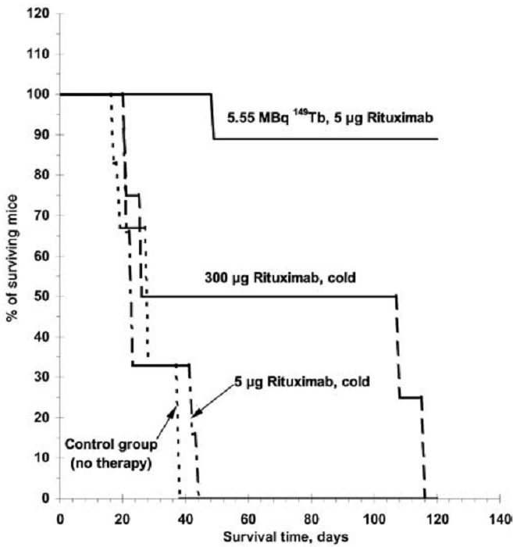
ISOL@MYRRHA - Medical Applications
Conventional cancer treatments:
Burkitt-lymphoma cancer study on mice:
Surgery
Radiation therapy
Combination of radiation and surgery
Chemotherapy
(G.J. Beyer et al., Eur. J. Nucl. Med. Mol. Imaging 31 (2004) 547)
Tumor-seeking tracer: Rituximab
Radio-isotope: ¹⁴⁹Tb
Beginning of:
Systematic radio-nuclide therapy
Tumor-seeking tracer labeled with α emitter
Range of α emitters: 30-80 μm (cell surgery)
Important criteria:
Half-life
Radio-toxicity of daughter isotopes
Bio-kinetics (in-vivo stability of tumor-seeking tracer)
Affordable production price
Reliable supply
70-kg patient sample (1 GBq):
0.6-GeV p + Ta: ~18 min/sample
1-GeV p + Ta: ~7 min/sample
rough
estimation

Slide 16
ISOL@MYRRHA – Unique Facility
Standard ISOL facility
Pure RIBs
Intense RIBs
Fundamental research
Fundamental interactions
Nuclear physics
Atomic physics
Biology
Condensed matter
Radio-pharmaceuticals
UC_{x} hp target develop.
Molten-metal target develop.
Hot-cell exp./infra.
Radio-chemistry labs
Radio-biology labs
Possible application
Radio-pharmaceuticals
SCK•CEN
Expertise
Infrastructure
Long beam times
Extra
pure RIBs
Extra intense RIBs
ISOL@MYRRHA

Slide 17

MYRRHA project schedule
2010-2014
Front End
Engineering
Design
2015
Tendering &
Procurement
2016-2018
Construction of
components &
civil engineering
2019
On site
assembly
2020-2022
Commissioning
2023
Progressive
start-up
2024-
Full
exploitation
Minimise technological risks
Secure the licensing
Secure a sound management and investment structure
PDP
preliminary
dismantling
plan
PSAR
preliminary
safety
assesment
EIAR
environmental impact
assesment
FEED
(Front End
Engineering
Design)
Central
Project
Team
Owner
Consortium
Group
Owner
Engineering
Team
2010-2014

Slide 18








ISOL@MYRRHA Project
  ISOL@MYRRHA Feasibility Study (pre-conceptual design and scientific case) carried out within BriX-IAP6 (2007-2012)
Technical & Scientific report submitted to NuPECC
➔ 2010 – Technical Design of ISOL@MYRRHA included in the long-range plan of NuPECC
  Detailing the Design, updating the Scientific Case and building the Users Group through a series of topical workshops - BriX-IAP7 (2012-2017)
Belgian EURISOL Consortium (BEC) – founded in 2013, in support of EURISOL & ISOL@MYRRHA
Aim:
  Coordinated RTD programme – ISOL developments
  Joining EURISOL collaboration (MOU signed in July 2014)

Slide 19
Conclusion
MYRRHA-ADS
  Continue the ⁹⁹Mo production presently ensured by BR2 reactor
  Allow the development of an ISOL facility sharing the p-beam
ISOL@MYRRHA
  RIBs production:
    High intensity (~ 100 x ISOLDE)
    High purity
    High reliability (long beam times with stable operation)
  Unique experimental programme
  Capability for systematic production of MRIs developed at MEDICIS

Slide 20
Copyright © 2014 - SCK•CEN
PLEASE NOTE!
This presentation contains data, information and formats for dedicated use ONLY and may not be copied, distributed or cited without the explicit permission of the SCK•CEN. If this has been obtained, please reference it as a “personal communication. By courtesy of SCK•CEN”.
SCK•CEN
Studiecentrum voor Kernenergie
Centre d'Etude de l'Energie Nucléaire
Belgian Nuclear Research Centre
Stichting van Openbaar Nut
Fondation d'Utilité Publique
Foundation of Public Utility
Registered Office: Avenue Herrmann-Debrouxlaan 40 – BE-1160 BRUSSELS
Operational Office: Boeretang 200 – BE-2400 MOL

