Slide 1
Transnational access to TRIGA _Mark III reactor
at Jožef Stefan Institute, Ljubljana

Slide 2
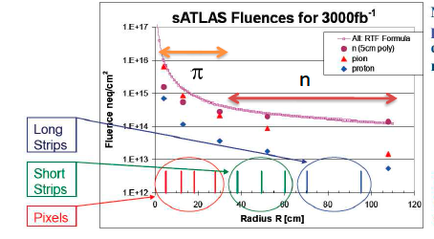
Why reactor?
neutrons cause damage also in HEP experiments!
NIEL concept is not valid!
high fluences possible at reactor

Slide 3
TRIGA reactor
Training Research Isotope General Atomics
Built in 1966 (General Atomics), reconstructed in 1991
250 kW maximum power, can be regulated to few W
flux scales with power
agreement between simulated and measured fluxes within few percents
measured damage factor for fast (> 0.1 MeV) neutrons is 0.90 ± 0.05
calculated damage factor is 0.88 ± 0.05
there are also epithermal and thermal neutrons (2-3 x flux of fast neutrons), contribution to NIEL only 1-2%
TID is about 1 kGray for 10¹⁴ n_{eq}cm⁻² at 250 kW
equivalent flux is 1.69 10¹² ncm⁻²s⁻¹ in small tube (10¹⁶ in 100 min)
equivalent flux flux is 3.05 10¹² ncm⁻²s⁻¹ in large tube
accuracy of equivalent fluence is ± 10%
maximum uninterrupted irradiation time is 16h.
highest fluence for AIDA 10¹⁷ cm⁻²
web page http://www-f9.ijs.si/~mandic/ReacSetup.html

Slide 4
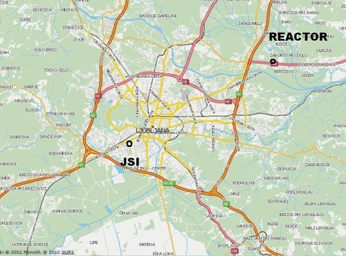
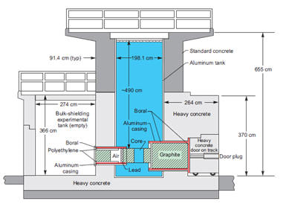
The reactor research centre is a part of Jožef Stefan Institute,

Slide 5
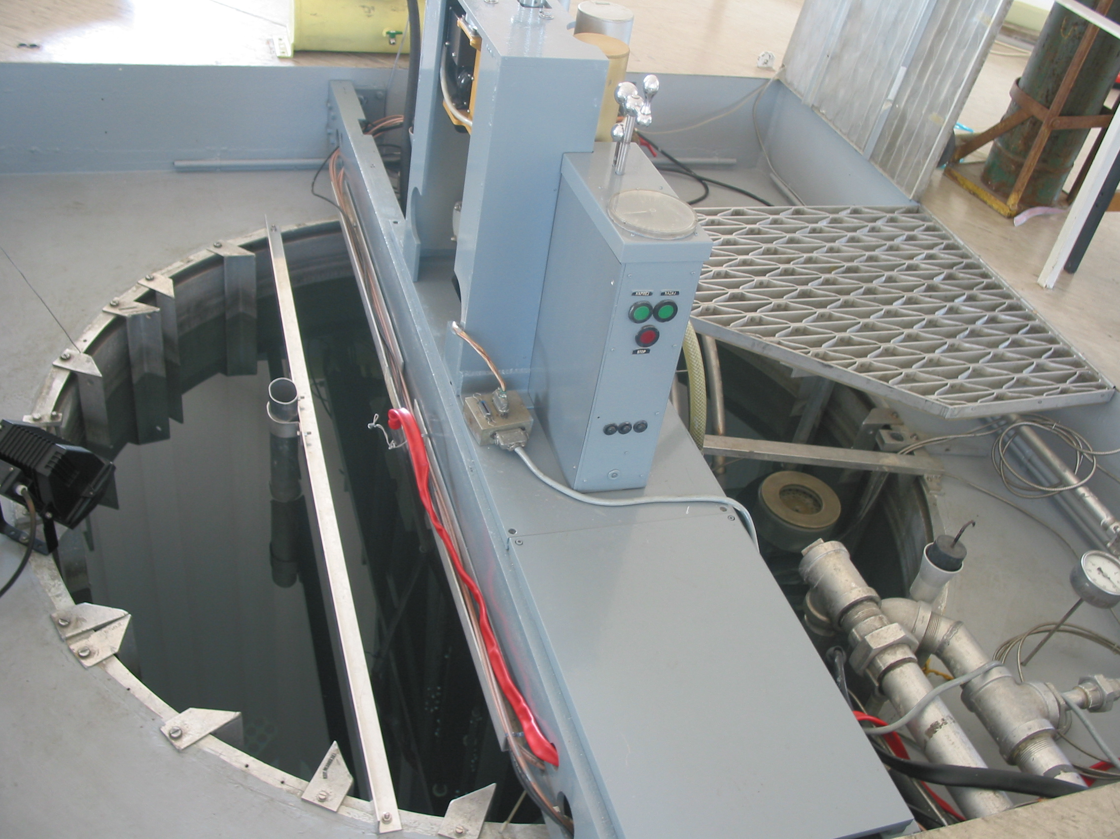
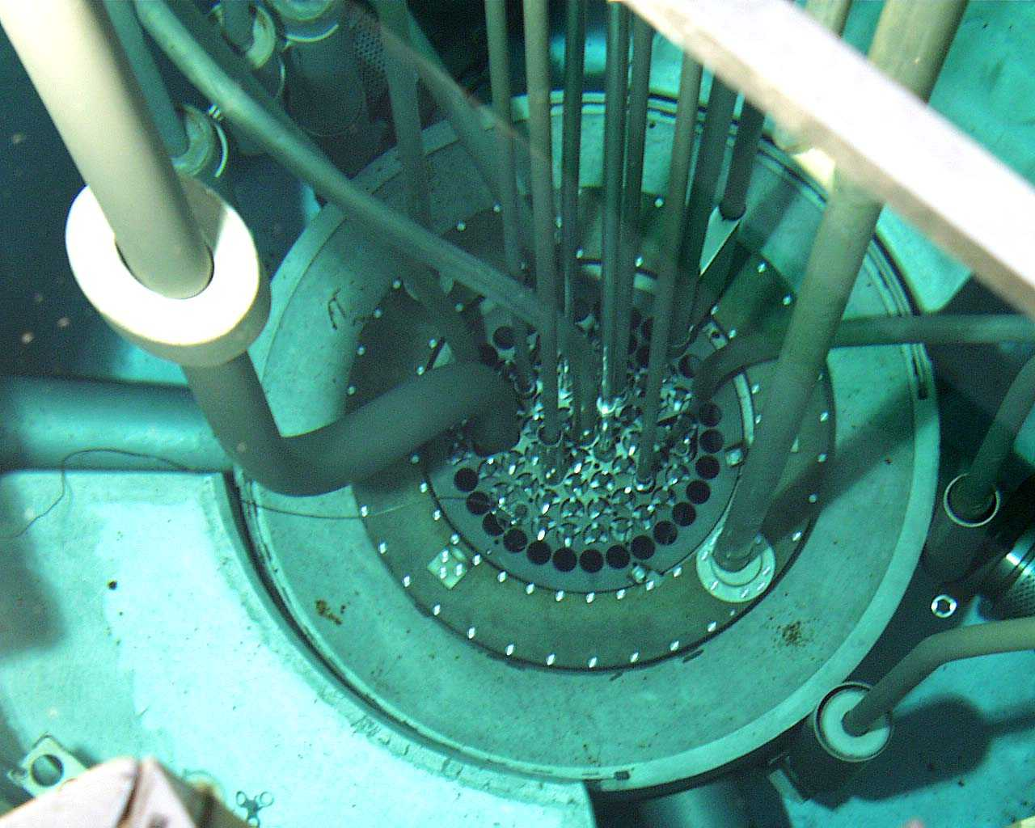
Large tube
Small tube

Slide 6
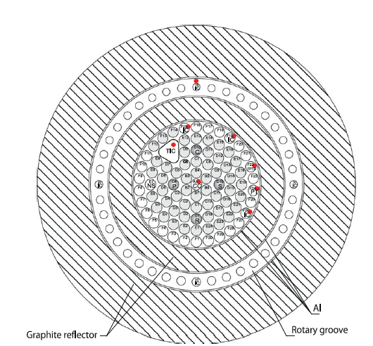
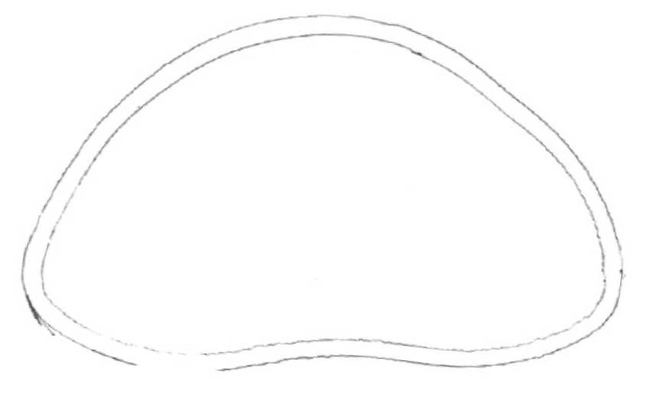
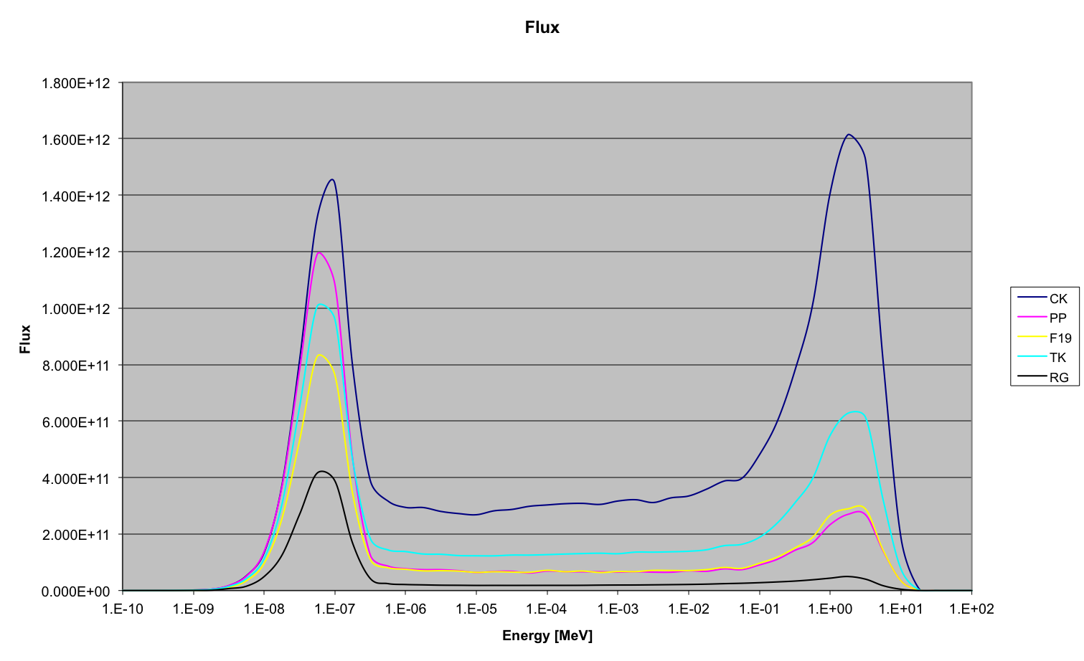
elliptic large tube (axis 7 x 5cm)
flux per unit of lethargy (➔ln E)
L. Snoj et al. Applied Radiaton and Isotopes 70 (2012) 483-488

Slide 7
Temperature during irradiation:
no cooling of samples during irradiation
water temperature stabilized to 20±2ºC
annealing times long compared to irradiation time

Slide 8
600 units delivered
389 irradiations

Slide 9
Sharing of reactor units between experiments
More than 30 publications related with AIDA irradiations at JSI published before March 2014

Slide 10
Conclusion:
reactor proved to be useful tool to study of radiation damage
plan for irradiations was 100% fulfilled

