Slide 1


Aida wg9.2
Gaseous detector infrastructure
I: TPC infrastructure: magnet, integration, cooling
U. Bonn, CERN, DESY, Lund, Nikhef, Saclay

Slide 2
Introduction
In EUDET, a magnet was offered by KEK, Japan and installed at DESY. But required weekly He supplies interrupting the operation for O(1day).
A field cage, an endplate and a trigger were built
ALTRO electronics was purchased and adapted to TPC readout. However with insufficient packing.
A new chip (Timepix) was designed (from Medipix 2) and a digital TPC was operated
This DESY TPC test beam facility was operated from 2008 on
In AIDA, task 9.2.1 was to improve this facility, task 9.2.2 was to provide manpower to make MPGD prototypes available from the CERN workshop (Rui de Olivera’s talk) and task 9.2.3 aimed at reading out an arbitrary number of Timepix and Timepix3 chips (M. Lupberger’s talk).

Slide 3

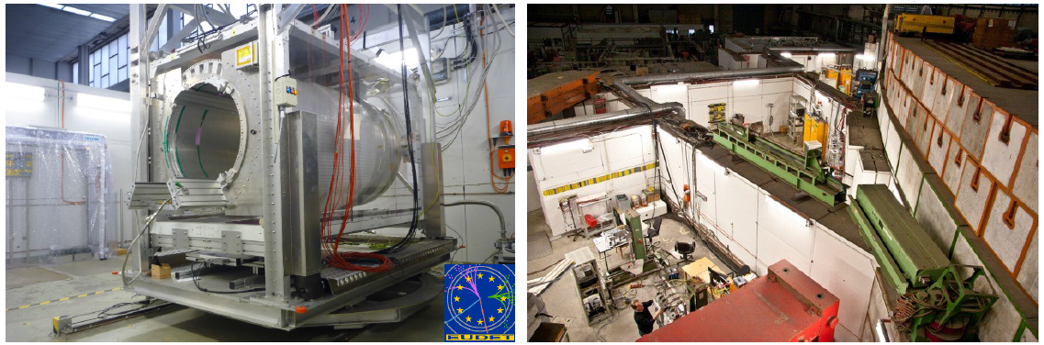
PCMAG MAGNET UPGRADE
Ralf Diener, AIDA meetings 2013, 2014
Improvement needed for the 1-6 GeV beam facility
Moved to KEK and Toshiba in 2011, back in 2012.
Received mechanics for moving in all degrees of freedom

Slide 4
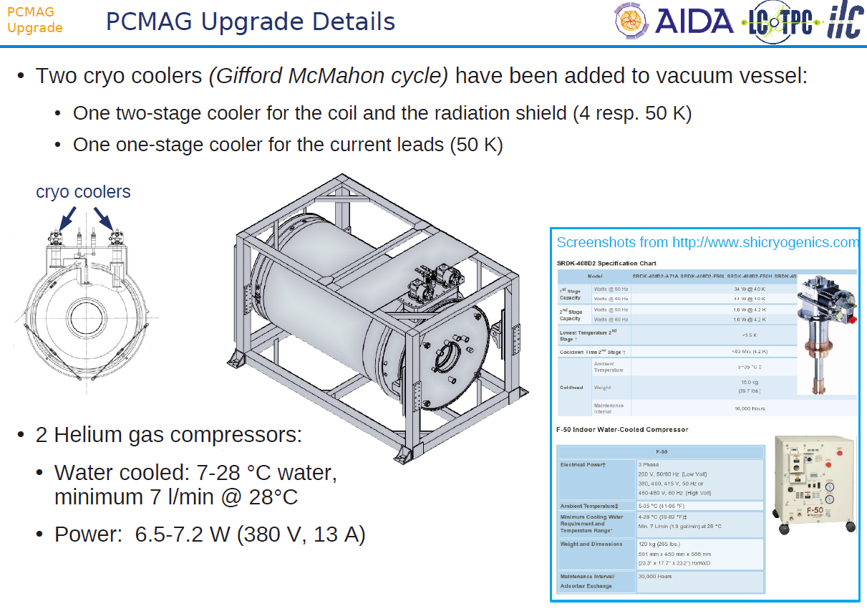

Slide 5
YEAR | MONTH | DURATION | COLLABORATION/EXPERIMENT | DESCRIPTION
2012 | Jul | 2 weeks | LCTPC | Test with 6 Micromegas TPC modules with integrated electronics
 | Sep | 3 weeks | LCTPC | Test with 3 GridGEM TPC modules
 | Nov-Dec | 3 weeks | LCTPC | Test of 3 SciEnergy GEM TPC modules
2013 | Jan-Feb | 2 weeks | LCTPC | Test with 7 Micromegas TPC modules with integrated electronics
 | Feb | 2 weeks | ATLAS | Measurement of Lorentz angle and charge collection efficiency of Si microstrip detectors
 | Feb-Mar | 4 weeks | LCTPC | Test with 3 GridGEM TPC modules
 | Mar-Apr | 2 weeks | LCTPC | Test with 2 TimePix TPC modules (GEM + Ingrid)
 | Apr | 1 week | ATLAS | Measurement of Lorentz angle and charge collection efficiency of Si microstrip detectors
 | Apr | 2 weeks | SBS | GEM Tracker Chambers
 | May | 1 week | ATLAS | Measurement of Lorentz angle and charge collection efficiency of Si microstrip detectors
 | Jun | 1 week | LCTPC | Micromegas TPC module with ALTRO readout electronics
 | Jun | 2 weeks | ATLAS | Micromegas chambers for ATLAS New Small Wheel (NSW)
 | Aug | 2 weeks | ATLAS | Measurement of Lorentz angle and charge collection efficiency of Si microstrip detectors
 | Oct-Nov | 5 weeks | ATLAS | Measurement of Lorentz angle and charge collection efficiency of Si microstrip detectors
 | Nov | 1 week | LCTPC | Laser calibration studies with GEM TPC modules
 | Nov-Dec | 6 weeks | BELLE II | Installation
2014 | Jan | 4 weeks | BELLE II | BELLE II: pixel and strip sensors vertex detector integration test including DAQ, slow control and cooling
 | Feb | 2 weeks | ATLAS | Measurement of Lorentz angle and charge collection efficiency of Si microstrip detectors
 | Feb | 2 weeks | LCTPC | Test with 7 Micromegas TPC modules with CO2 cooling including laser calibration measurements and a combined run with 2 TimePix/Ingrid TPC modules
This upgrade improved safety and reliability of operation.
The use of the facility goes far beyond LCTPC
(Belle, ATLAS, etc…)
First part of 2015 already fully booked

Slide 6
ELECTRONICS INTEGRATION
The EUDET electronics (ALTRO and S-ALTRO) and the Micromegas test electronics (AFTER from T2K TPC) needed better packing to increase the number of channels that can be read out
This forced to develop hardware and tools for a better integration (5 to 20 mm² by chanel)

Slide 7

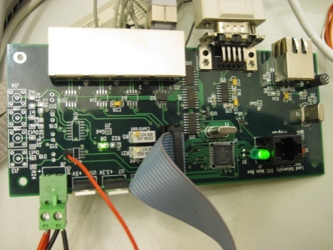
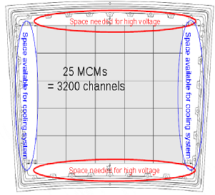
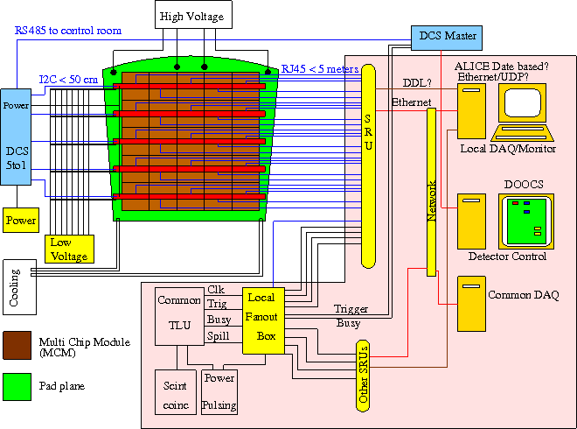
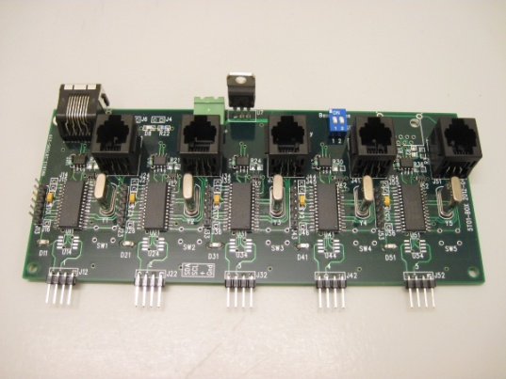
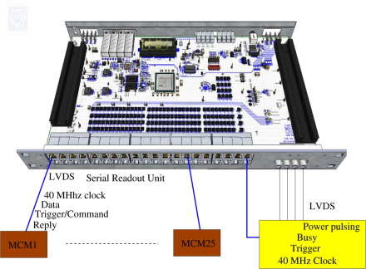
S-ALTRO electronics
LowVoltage boards attached
to one pad module
Detector Control System
– Master module
MultiChipModules on a pad module
Scalable Readout Unit (SRU)

Slide 8
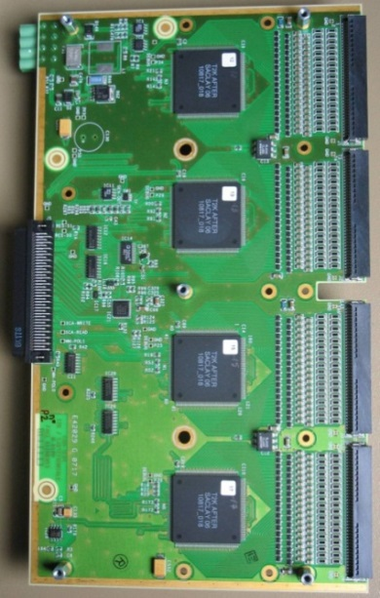
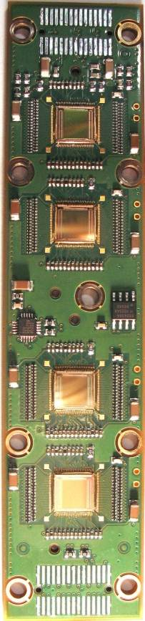
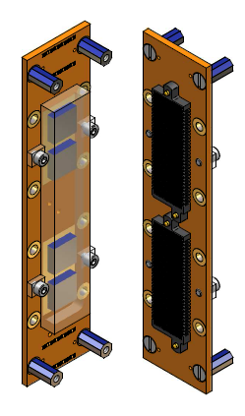
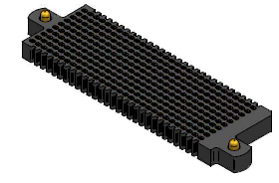
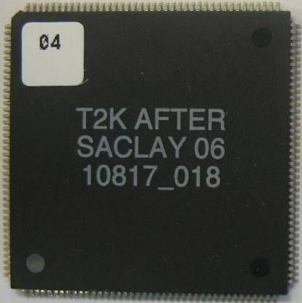
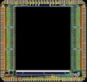
Integrated AFTER- based electronics
Remove packaging and protection diodes
Wire-bond AFTER chips
Use two 300-point connectors
Front-End Card
(FEC)
25 cm
4.5 cm
12.5 cm
14 cm
3.5 cm
2.8 cm
3.5 cm
0.78 cm
AFTER Chip
0.74 cm
  The resistive foil protects against sparks

Slide 9
Each module has 1728 pads and is connected by 3 cables :
HV, LV, optical fiber for DAC/signals. Total < 25% X°

Slide 10
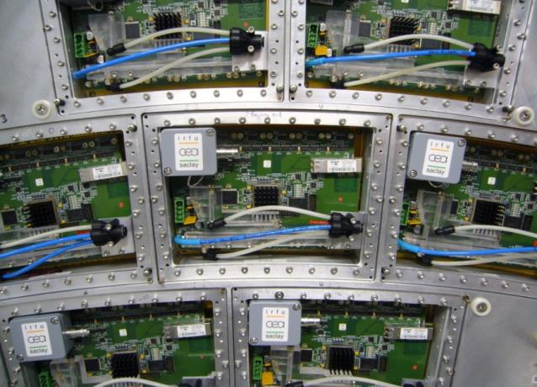
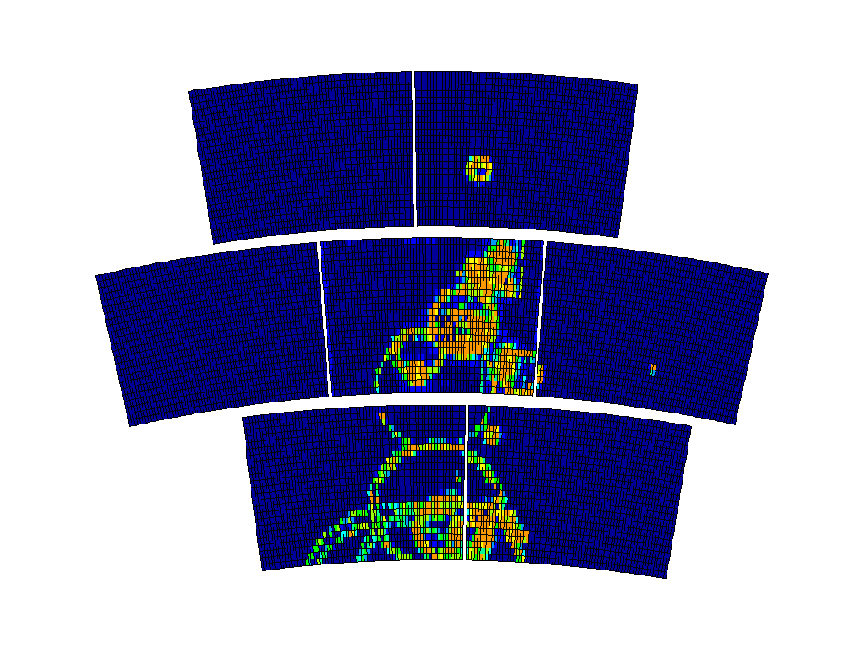
Data taken in 2013 and 2014 with 7 modules

Slide 11
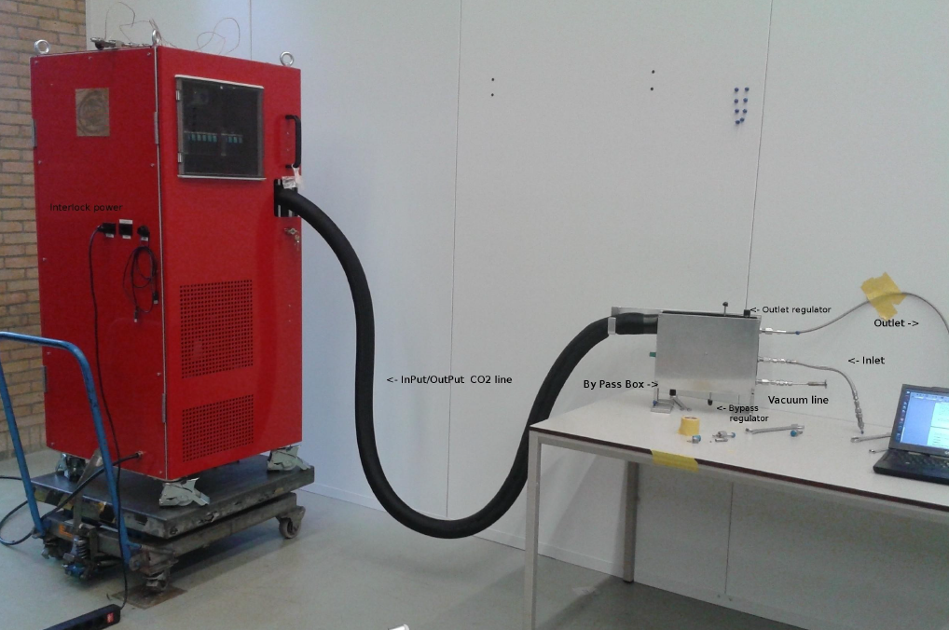
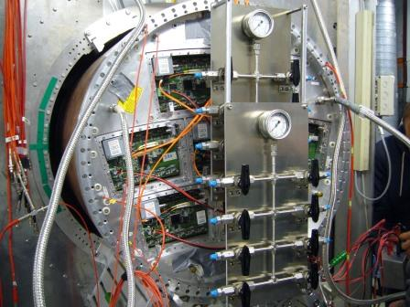
2 phase CO2 cooling
CO2 cooling allows efficient remo- val of heat at room temperature, with O(1mm pipes)
A TRACI system (AIDA development) was bought by KEK at Nikhef and adapted to the Micromegas fully equipped TPC (dec.6, 2013 at Nikhef and test at DESY in March 2014

Slide 12
Conclusions
All the AIDA funds have been spent (568.5 k€), plus about twice as much from various sources (Toshiba in-kind contribution, KEK, DESY, CEA, Bonn, etc… own funds)
The SALTRO project is not fully finished (it expanded a lot in the course of the development) but got very positive results (development of integration techniques, contact with industry)
All the initial goals have been reached (plus the CO2 cooling), and a lot has been done for the integration of electronics (contact with industry).
All milestones have been reached and deliverables sent
(D9.2, D9.3, D9.6)

