Slide 1

AIDA Final Meeting @ CERN
The new CERN IRRAD Facility and its user infrastructure
Maurice Glaser, Blerina Gkotse, Pedro Lima, Michael Moll, Federico Ravotti
CERN PH/DT, IRRAD Facility Team
… presenting the work of many contributors to the East Area Upgrade construction project at CERN
EN holds the overall projects leadership
Core teams: EA Upgrade Project: D. Brethoux, R. Froeschl, L. Gatignon, M. Lazzaroni, et al.
R2E Project: M. Brugger & J. Mekki, et al.
CERN groups:
EN-MEF and EN-STI (core teams), HSE and EN-HDO (Projects Safety), DGS-RP, EN-CV (EA-IRRAD ventilation), EN-HE (exp. areas transports), GS-ASE (access control), BE-BI and TE-CRG (EA-IRRAD cryogenic system), …

Slide 2
Contents
Overview (and evolution) of Irradiation Facilities at CERN
PS East Area Irradiation Facilities until 2012
New PS East Area Irradiation Facilities (EA-IRRAD)
  IRRAD Proton Facility
  CHARM Mixed-Field Facility
  IRRAD Proton Facility Layout
Conclusion

Slide 3
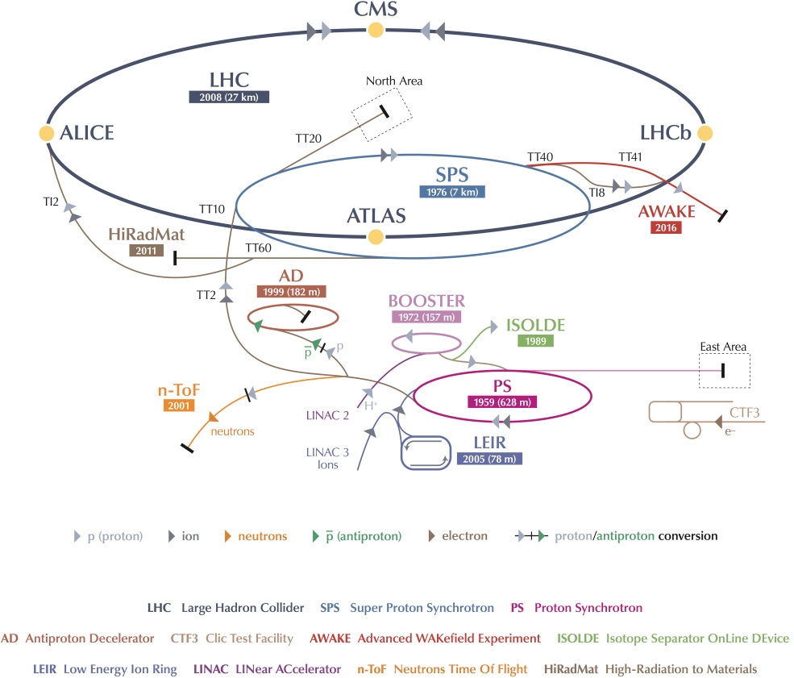
CERN Irradiation Facilities until 2012
SPS: H4IRRAD
mixed-field test area
Proton Energy
LHC 7 TeV
SPS 450 GeV
PS 23 GeV
PSB 1.4 GeV
Linac 50 MeV
SPS: CERF
CERN Reference Facility
mixed-field
(West Area)
CNRAD
mixed-field test area (parasitic operation)
GIF
Gamma Irradiation Facility (no more particle beam)
HiRadMat
proton test area, 440 GeV, fast extraction
PS: IRRAD
proton & mixed-field facilities, 24 GeV/c, slow extraction

Slide 4
CERN Irradiation Facilities from 2014
SPS: GIF++
new GIF with muon beam
Proton Energy
LHC 7 TeV
SPS 450 GeV
PS 23 GeV
PSB 1.4 GeV
Linac 50 MeV
SPS: CERF
CERN Reference Facility
mixed-field
HiRadMat
proton test area, 440 GeV, fast extraction
PS: IRRAD & CHARM
proton & mixed-field facilities, 24 GeV/c, slow extraction

Slide 5
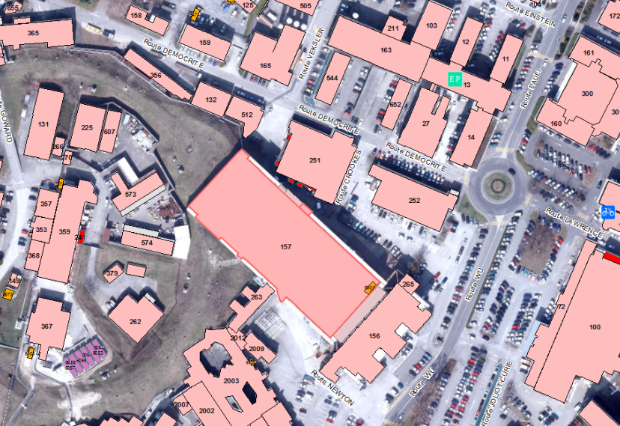
PS-EA Irradiation Facilities until 2012
PS
13
24 GeV/c protons
157
24 GeV/c protons
slow-extraction
(~400ms)
from 1992 - until 2012
Proton irradiations (T7)
  Primary 24 GeV/c proton beam
  (IRRAD1, IRRAD3, IRRAD5, …)
Mixed-field irradiations (T8)
  Mixed field produced in cavity after
  C (50cm) - Fe (30cm) - Pb (5cm) ‘target’ (IRRAD2)

Slide 6
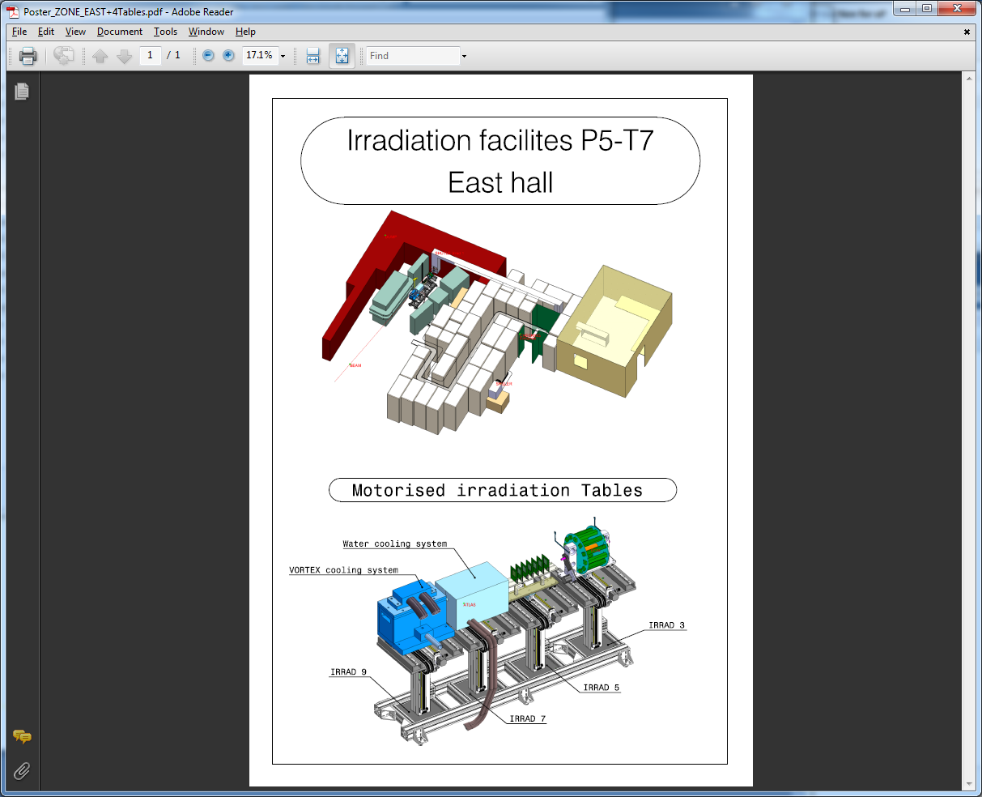
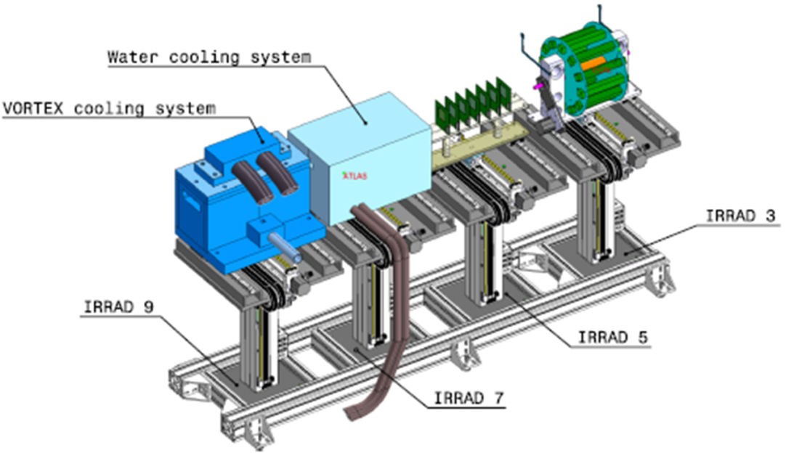
Proton Irradiation Facility (2012)
  Beam spot
  12×12 mm² (FWHM)
  Beam momentum
  24 GeV/c
  Proton flux
  ~1×10¹⁶ p ⋅ cm⁻² 20days⁻¹
  (year average)
Iron DUMP
Counting Room
p⁺ (T7)
IRRAD3, IRRAD5, … Tables
IRRAD1 Shuttle
Radiation Shielding
40×25cm², ~15m length
p⁺

Slide 7
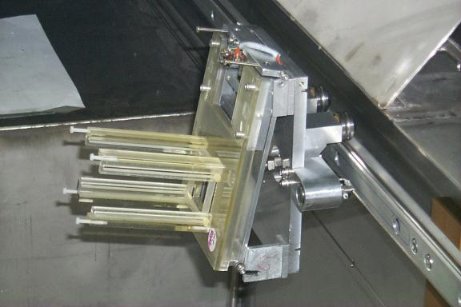
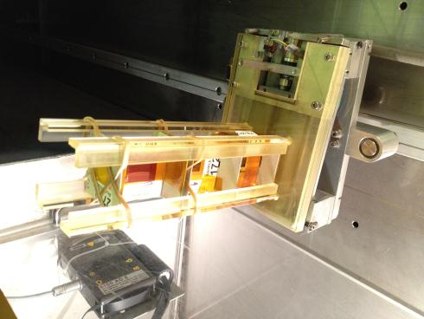
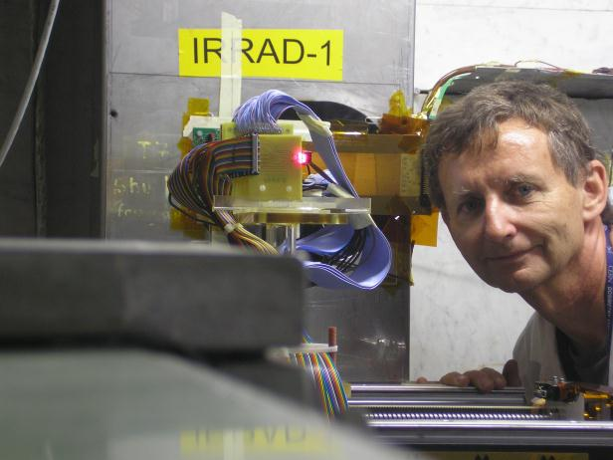
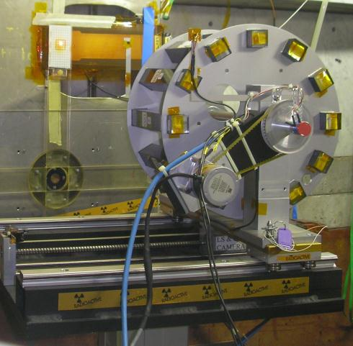
IRRAD1 Shuttle & IRRADx Tables
IRRAD1 Shuttle
V_{max}=5×5×15cm³
IRRAD3 & IRRAD7 Tables
V_{max}=20×20×50cm³
scanning over surface

Slide 8
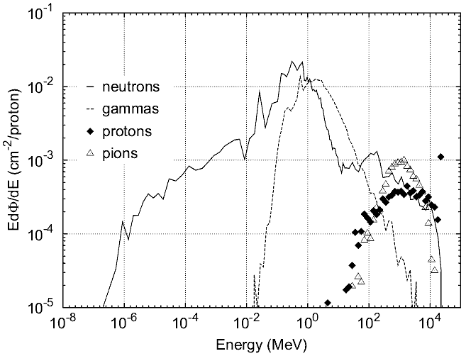
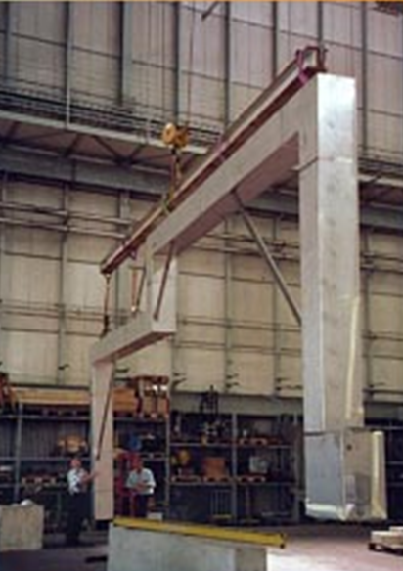
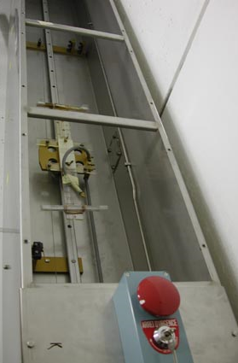
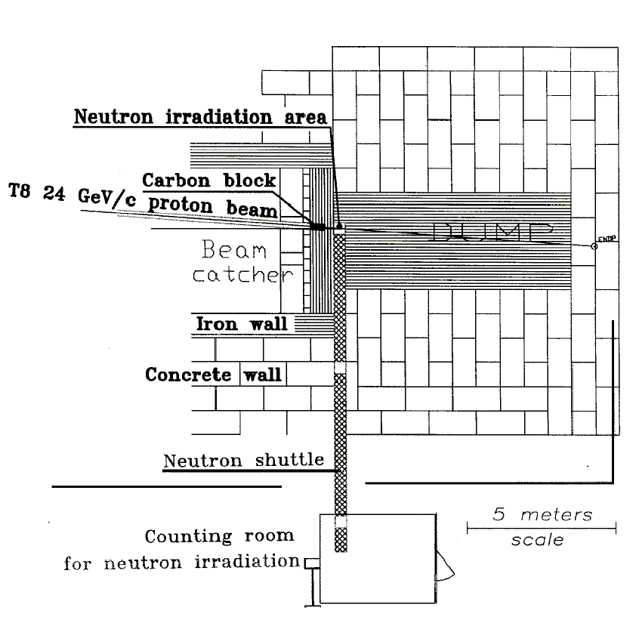
Mixed-field Irradiation Facility (2012)
Secondary particles in a cavity (IRRAD2)
  24 GeV/c proton beam on a C/Fe/Pb target
  Small volume (max ~30×30×30cm³) behind DIRAC
  Spectrum & flux of n, p⁺, π⁺, π⁻, γ simulated & measured
  ~1×10¹³ n_{(E>1MeV)} cm⁻² 5d⁻¹ @ 50cm from beam axis
Particle flux at 10cm [CMS-IN-2001/012]
p⁺
IRRAD2 Shuttle

Slide 9
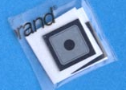
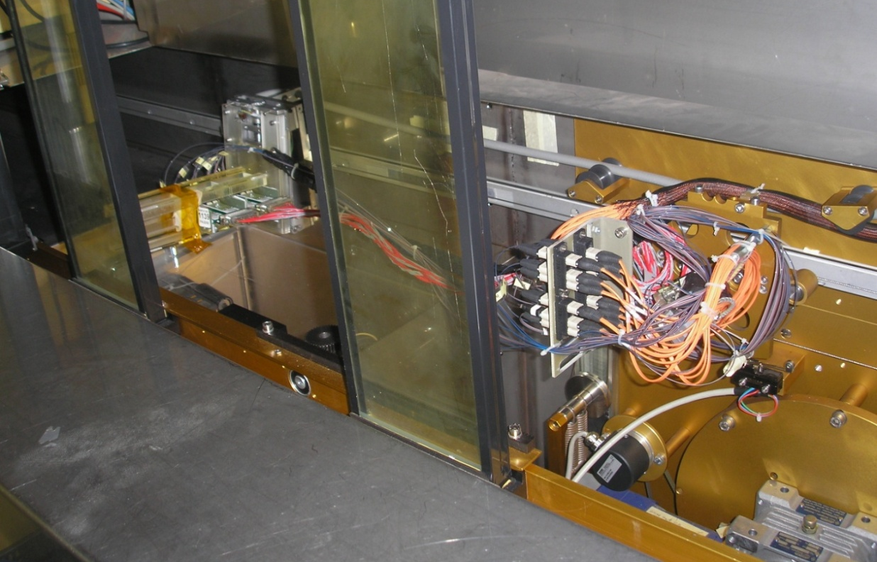
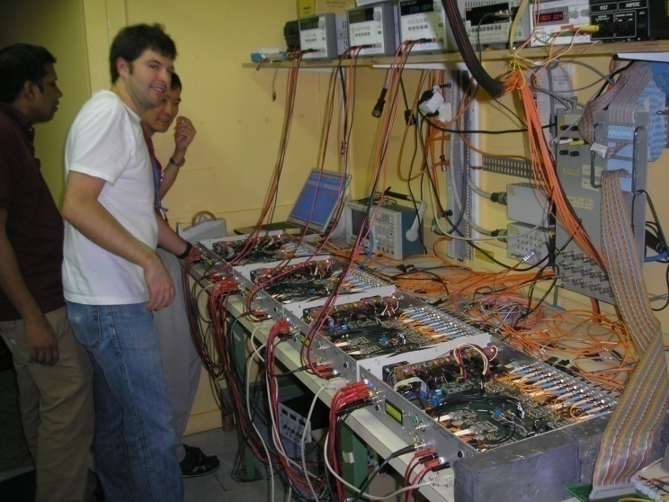
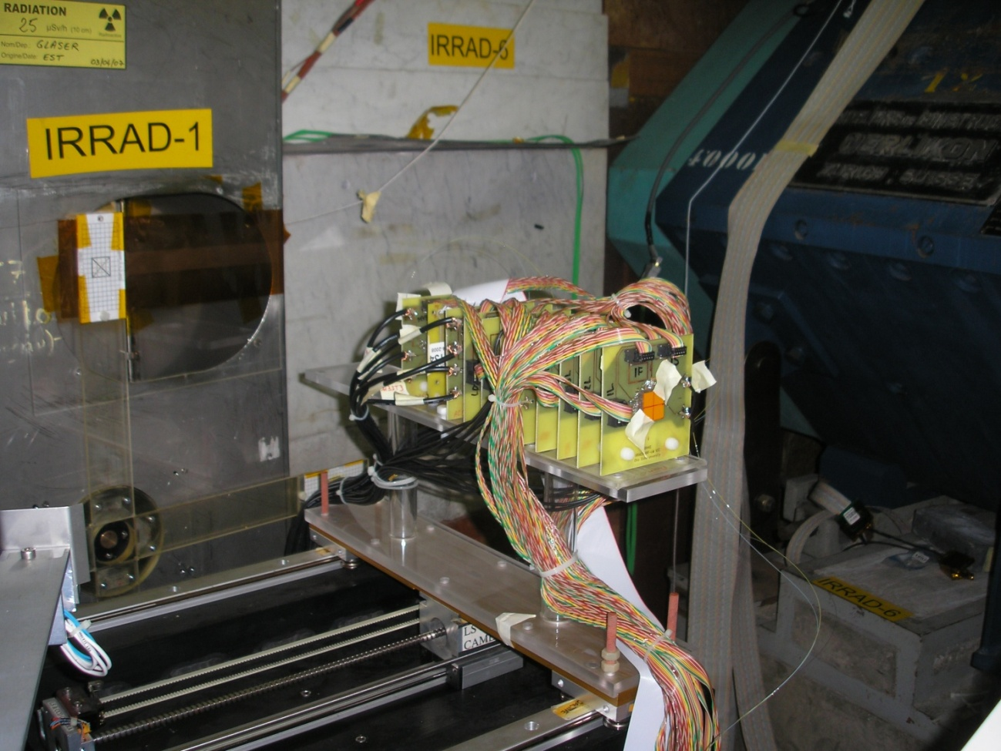
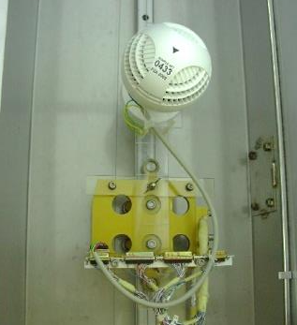
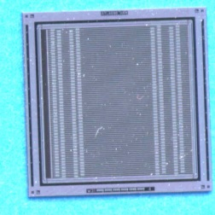
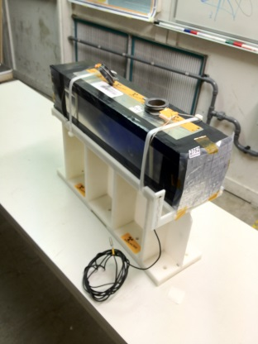
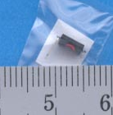
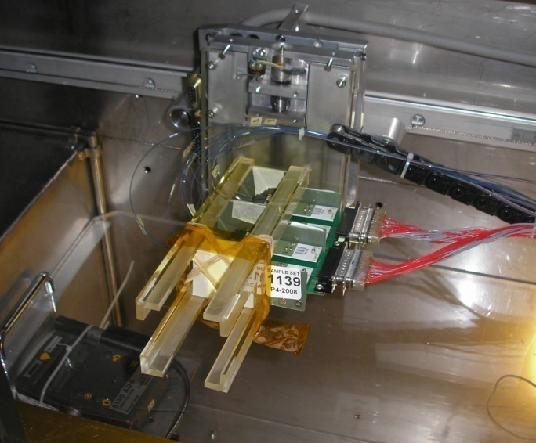
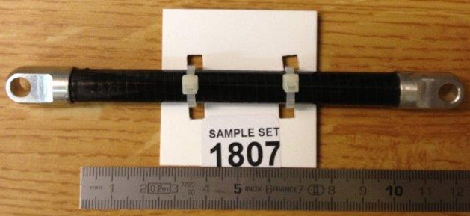
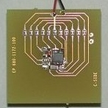
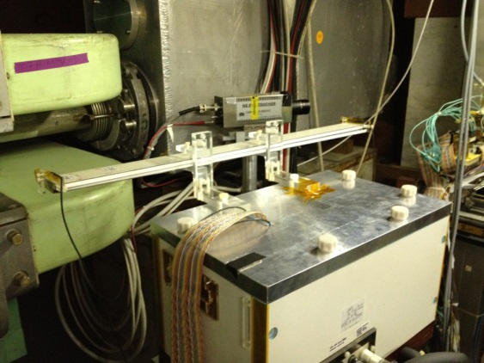
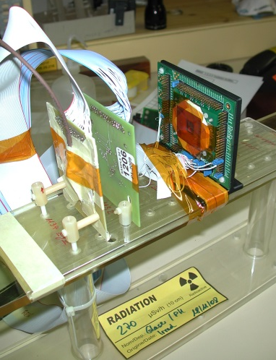
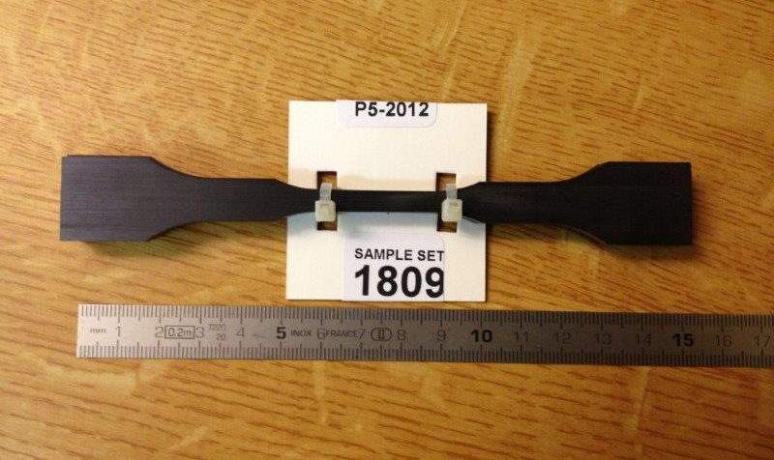
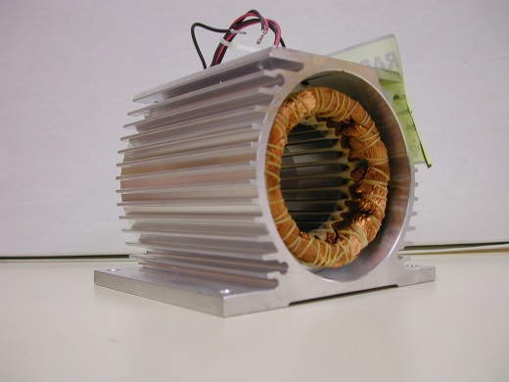
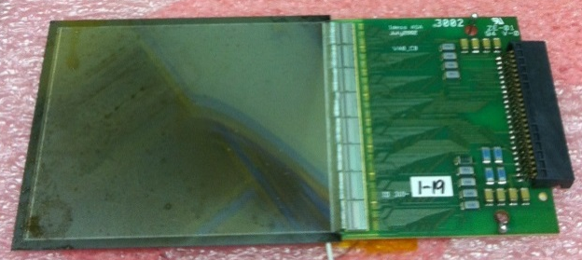
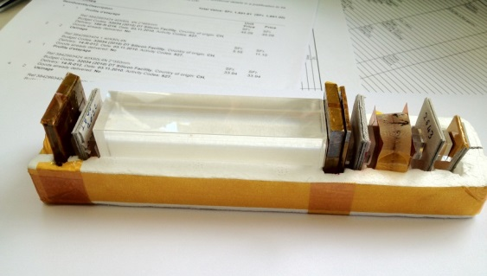
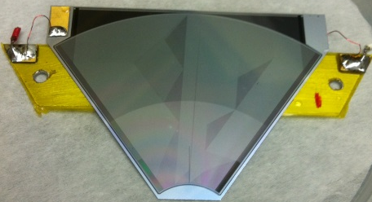
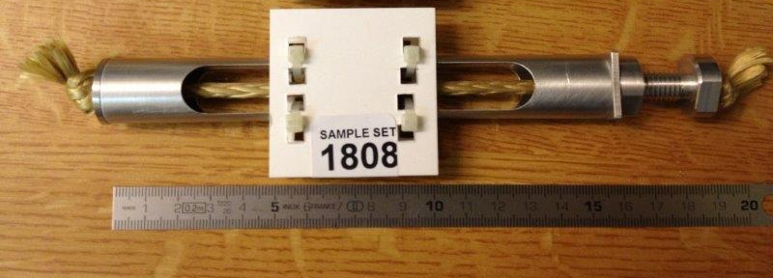
Past Irradiation Experiments
    © IRRAD user community!

Slide 10
Past Irradiation Experiments
IRRAD facilities in numbers …
  from 1999 to 2012 (no beam in 2005)
  more than 8300 “pieces” irradiated (~650 per year)!
  about 5800 dosimeters (Al foils) measured!
  Statistics for 2012 …
  40 users
  from 20 institutes belonging to several experiments/projects
  main users: ATLAS, CMS, LHCb, ALICE, RD39, RD50, LHC (BE and TE)
  649 objects irradiated
  358 dosimeters measured
  223 days of beam time (~8.5×10¹⁶ protons delivered to IRRAD)
    © IRRAD user community!

Slide 11
Drawbacks & Shortcomings
(of the old facilities / test areas with respect to future needs)
Proton IRRAD Facility
  Located in primary radiation area (limited access: stop all beam lines of East Area for access)
  Limited space (ALARA, difficult to scan beam over big objects, backscattered particles)
  Limited flux of primary protons (weakness of the shielding)
  Safety standards to be improved!
Mixed-field IRRAD Facility (behind DIRAC)
  No irradiation positions lateral to target (missing an important ‘particle mix’ component)
  Limited intensity (present flux not interesting for inner detector community)
  Too little space and limited accessibility (access only via shuttle system!)
  Parasitic to DIRAC operation
IRRAD Facilities were located in different beam lines: competing for beam!
Mixed-field H4IRRAD/CNRAD Test Areas
  CNRAD not operational after 2012
  Limited accessibility (“ad-hoc installations”, lack of flexibility, access required shielding removal)
  Limited control on beam intensity

Slide 12





Towards a new EA Irradiation Facility
2012: CERN management agrees on EA facilities upgrade
  CERN-EN is charged and funded to design and construct the irradiation beam line in the framework of the EA renovation plan during LS1 (PL: Lau Gatignon)
  CERN-PH through AIDA EU FP7-funded project (Task 8.3)
  19 Nov. 2012: first technical meeting on upgrade
    R2E project (LHC machine): Mixed-field facility & infrastructure design
    CERN-PH & AIDA: Proton facility & infrastructure design
26 Nov. 2012: last day of operation for the DIRAC experiment
July 2013: dismantling DIRAC & old IRRAD1 and IRRAD2 Facilities
Nov. 2013: removal of IRRAD2 target & beginning of construction
    R2E project: Cern High-energy AcceleRator Mixed-field facility (CHARM)
    CERN-PH & AIDA: proton IRRADiation facility (IRRAD)
10 Oct. 2014: first pilot beam in the new EA-IRRAD facility for commissioning
17 Nov. 2014: first irradiation experiments

Slide 13
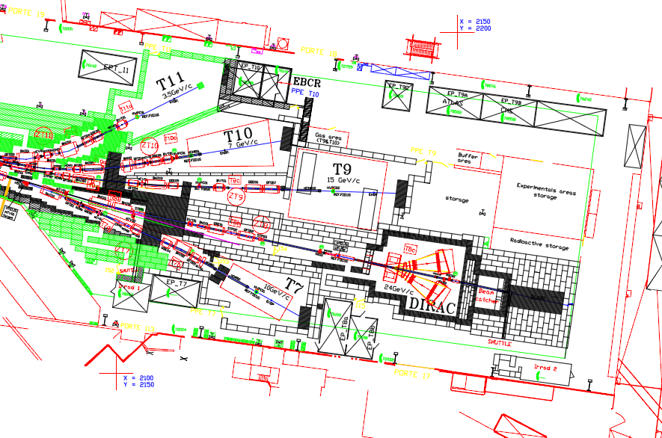
OLD East Area Layout
13
157

Slide 14
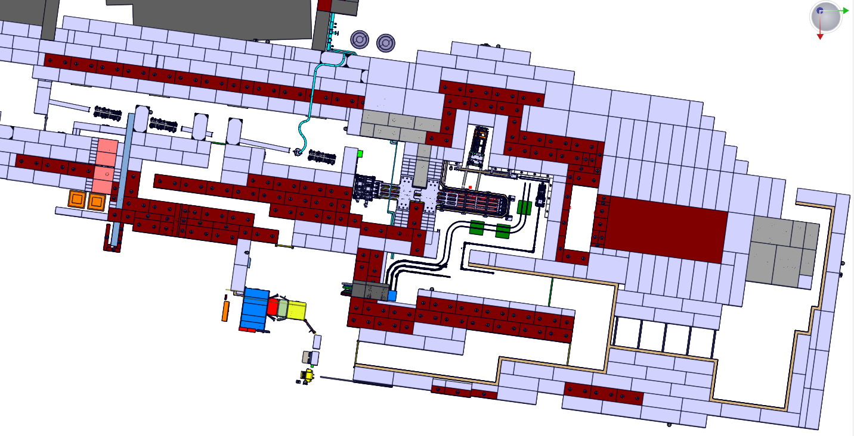
NEW East Area IRRAD Layout
Mixed-field Facility
(CHARM)
T8 beam line
Beam dump
Proton Facility
(IRRAD)
    © drawings provided by EN-MEF

Slide 15
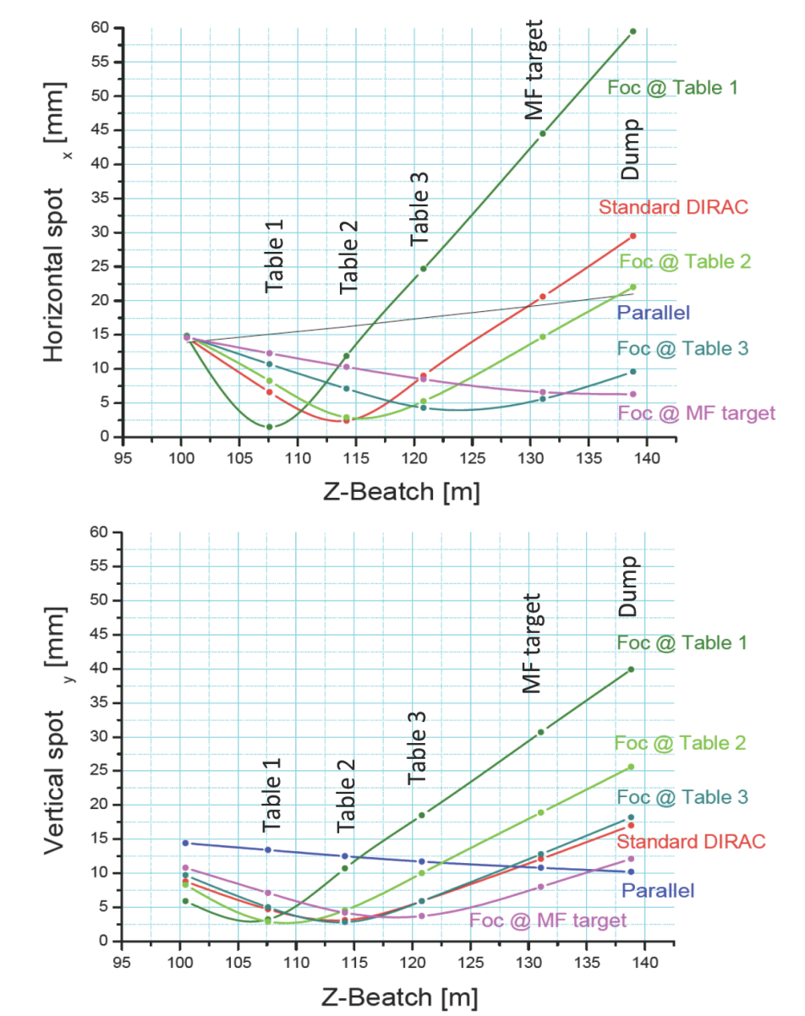
24 GeV/c Proton Beam Parameters
Beam dimensions
  several optic variants possible on T8
  standard size: 12x12 mm² (FWHM)
  spot size from 5x5 mm² to 20x20 mm² (FWHM)
Beam intensity (estimations)
  p⁺ are delivered in “spills” of ~5×10¹¹ p
  number of spills/frequency depends on CPS
  Typical CPS from 2014: 30s
  Typical figures (High Intensity): 3 spills per CPS
    ~1 × 10¹⁶ p cm⁻² 5days⁻¹ (12x12 mm² FWHM)
    ~4x more than the old facilities
  Design figures (maximum): 6 spills per CPS
    ~1 × 10¹⁷ p cm⁻² 4days⁻¹ (5x5 mm² FWHM)
IRRAD
CHARM
    © L. Gatignon, preliminary calculations (EDMS 1270807)
Here dimensions are mm (RMS)

Slide 16
Ventilation System
Ventilation system (CERN EN/CV)
  area confinement (under-pressure) for air activation, ozone formation, temp. control, etc.
  air re-circulated during operation (through filters) and flushed before access
  integration of ducts through the shielding:
    © drawings provided by EN-MEF
Ventilation Ducts
Ventilation Unit

Slide 17
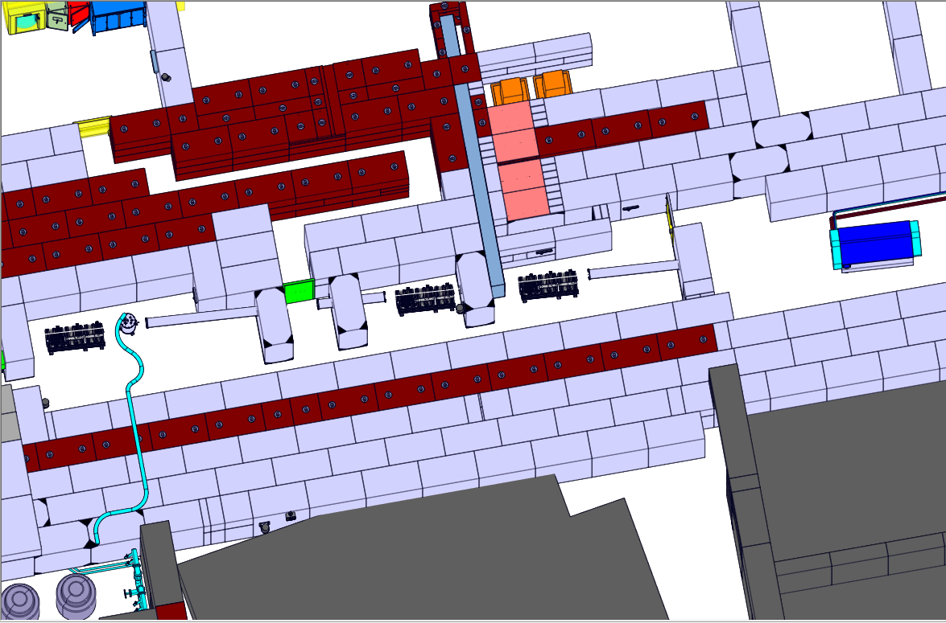
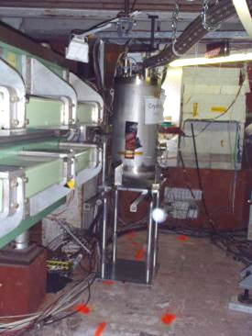
Proton IRRAD Facility (PH)
Counting Room
Access
Point
Shuttle System
Zone 4
Chicane
partially shielded
24GeV/c p+
detectors
electronics
Zone 1
calorimeter
samples
Zone 2
Zone 3
Cryogenic System
    © drawings provided by EN-MEF

Slide 18
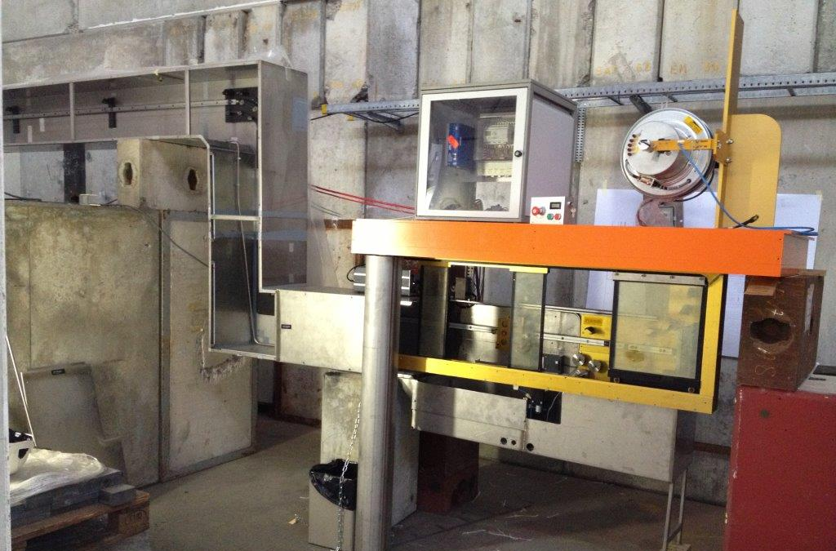
Proton IRRAD Shuttle System
mainly “passive” samples
possibility to irradiate samples under bias

Slide 19
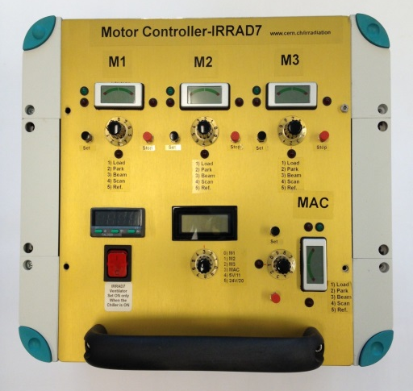
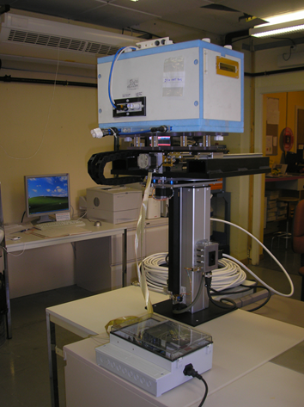
IRRAD Remote-controlled Tables
  3 tables per IRRAD zone; DUTs powered and cooled
  1 stand-alone control unit per table (on UPS)
V_{max}=10×10×30cm³
Temp. Control: -20 ºC / 40 ºC
Temp. Control: -20 ºC / RT
x
θ
beam
y
  cold boxes from AIDA (WP8.3.2 QMUL/Sheffield)
  prototype (AIDA MS31)

Slide 20
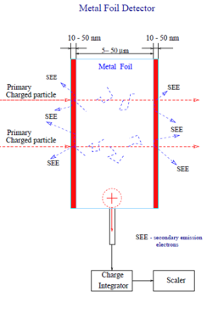
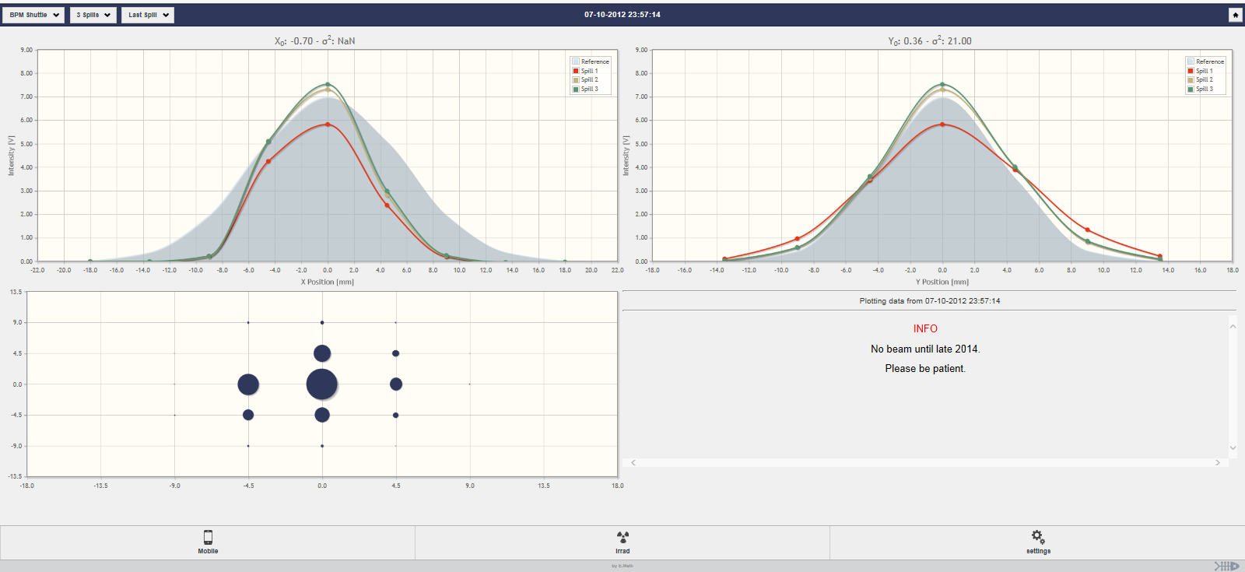
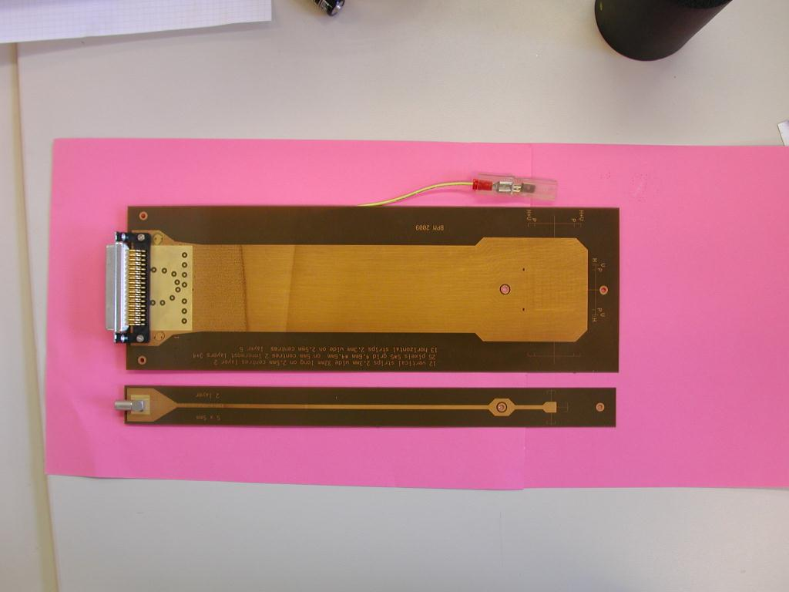
IRRAD Beam Instrumentation & DAQ
New Beam Position Monitors (Metal Foil Detectors)
New Web-application
  display Beam Profile Monitor data (for IRRAD users and CERN CCC)
  new database for data storage (ORACLE); can display multiple BPM devices
  flexible display also for other IRRAD data: SEC counters, table/shuttle positions, T., …
BPM Display
© E. Matli (BE-OP)

Slide 21
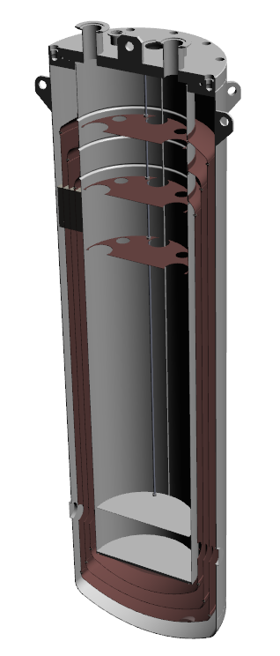
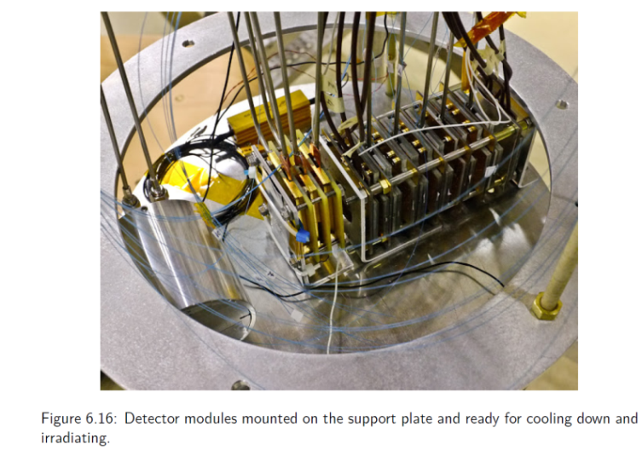
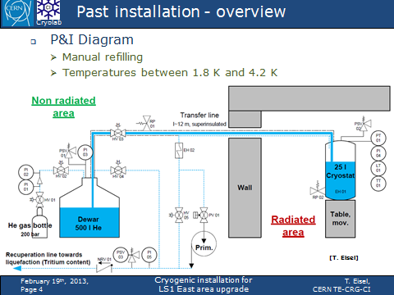

“CryoBLM” Setup
Setup for irradiation in cryogenic conditions (1.8K/4.2K)
  clone of the system used for “CryoBLM” (BE-BI) experiment in 2012
  cryogenic line “embedded” in the shielding; bigger cryostat
Cryogenic system operated by TE-CRG
  manual refilling; dewar outside rad. area
  installed on a movable irradiation table
Samples position
    © Bernd Dehning (BE-BI)
    Marcin Ryszard Bartosik (BE-BI)
    Christoph Kurfuerst
    Thomas Eisel and TE-CRG
p⁺

Slide 22
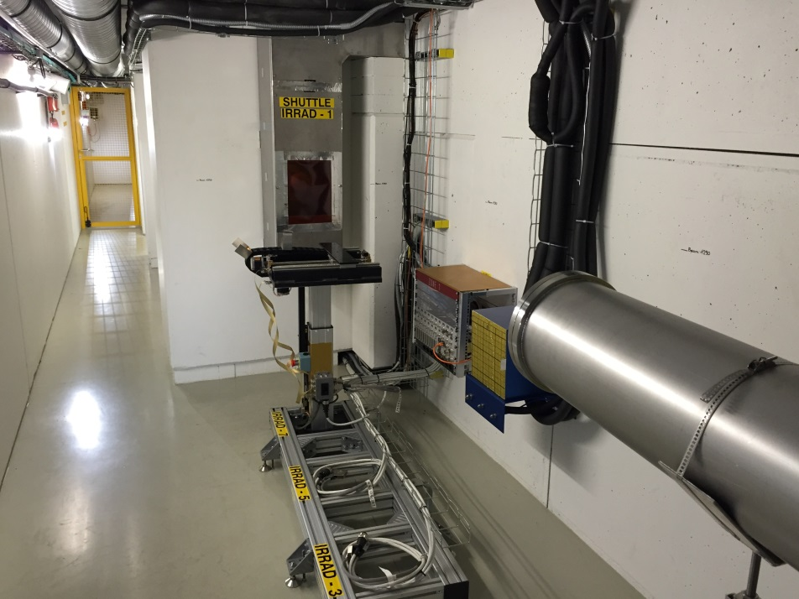
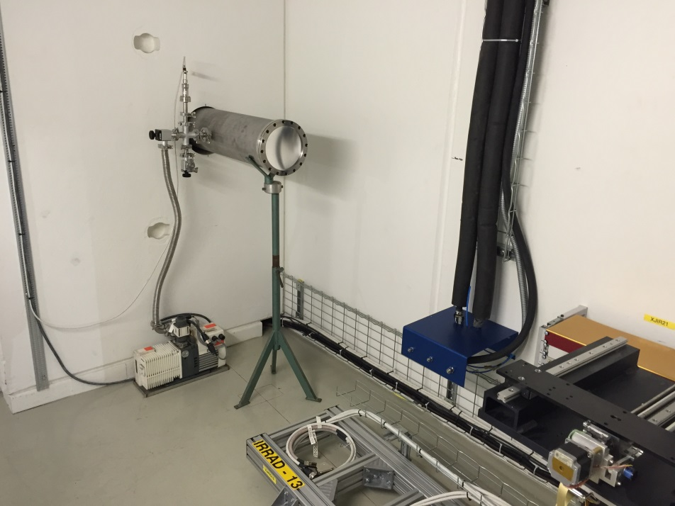
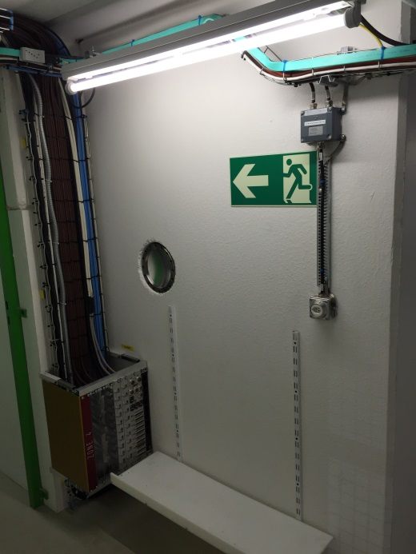
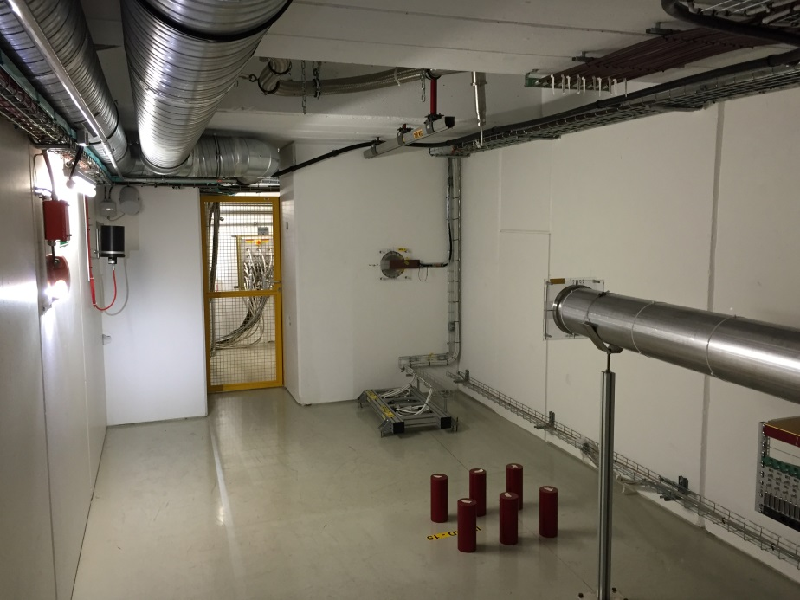
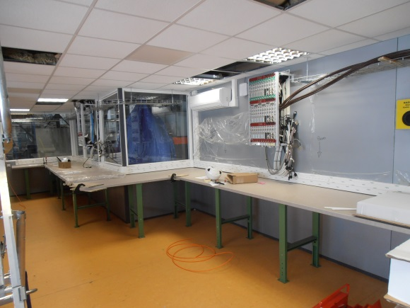
New IRRAD Facility
Zone 1
Zone 2
Counting Room
Zone 4
Zone 3

Slide 23
East Area EA-IRRAD Infrastructure
    © drawings provided by EN-MEF
IRRAD1B
Counting Rooms
24GeV/c p+
Storage Area
Buffer Zone
IRRAD
CHARM

Slide 24



Proton IRRAD Infrastructure
Storage area
  shielded zones for cool-down and storage at room and low temperature of IRRAD (and CHARM) irradiated equipment
  workspace to handle and perform (setup) measurements on irradiated equipment
Storage Areas
Chillers
Cables length from ~13m to ~20m
Fixed cabling/piping infrastructure
  4 Patch-Panels installed along IRRAD
  twisted-pairs, coaxial, power HV/LV, …
  space for custom users-cabling
  (optical fibers, etc..)
RP Buffer Zone
Workspace
IRRAD1 B

Slide 25

Mixed-field CHARM Facility (EN)
    © drawings provided by EN-MEF
Access chicane
Cablings
Hot
Buffer
Zone
Movable
shielding
Conveyer path
24GeV/c p+
Beam dump
Contacts
  www.cern.ch/charm
    Markus.Brugger@cern.ch (EN-STI)
    Julien.Mekki@cern.ch (EN-STI)
Beam
Catcher
Movable Target

Slide 26

EA-IRRAD Aerial View
Proton Facility
(IRRAD)
T8 beam line
Mixed-field Facility
(CHARM)

Slide 27



Summary
  New EA-IRRAD facility is now being commissioned (fully operational in 2015)
  Experimental community (PH): Proton facility (IRRAD)
  Accelerator community (EN): Mixed-field facility (CHARM)
  IRRAD Proton Facility in 2014
  2 Tables operational (no cooling): IRRAD 7 & IRRAD 9
  Limited time/space (16 experiments registered!)
  More to come in 2015
  IRRAD1 Shuttle System
  Additional tables, cooling systems
  Users space for testing irradiated samples
  Storage area being assembled
  …
  New web-site
  www.cern.ch/ps-irrad

Slide 28



Ongoing Experiments
Small samples (IRRAD7)
Detector Prototypes (IRRAD9)
CryoBLM experiment (IRRAD15)

