Slide 1
Remaining Projects
1) CERN (M. Campbell)
2) RAL/Uppsala (R. Brenner)
3) INFN/IPHC-IRFU (M. Kachel)
4) Bonn/CPPM
5) LAL/LAPP/LPNHE/MPP
6) MPP/GLA/LAL/LIV/LPNHE
7) UB

Slide 2
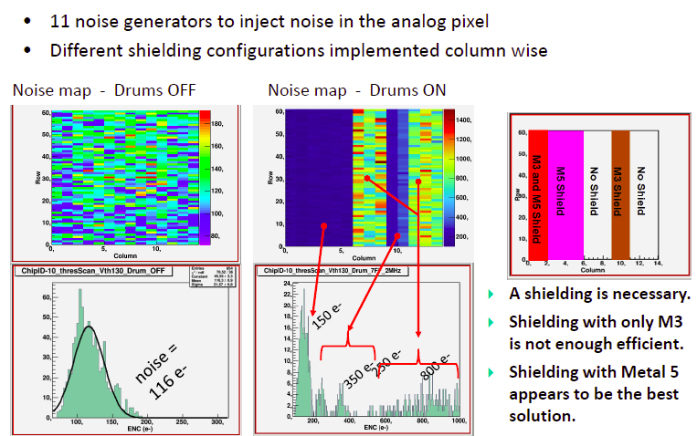
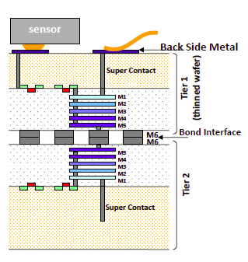
Bonn/CPPM
Test of a 3D version of the ATLAS FEI4 ASIC
Tezzaron via middle (first) technology
High density low diameter vias
Chip works with a performance similar to the original FEI4

Slide 3
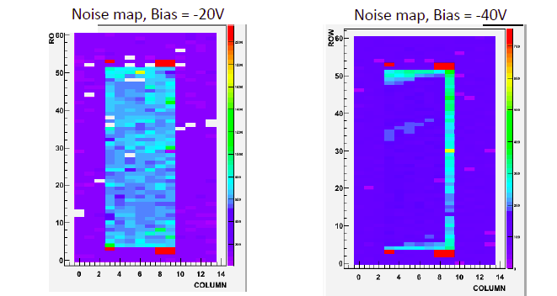
Bonn/CPPM
Assemblies with sensors under study
First results:
Connection to sensor successful
(noise decreases with increasing bias voltage)
Conclusion:
Tezzaron 3D technology works
However:
Long production time (5 years)
Low yield

Slide 4
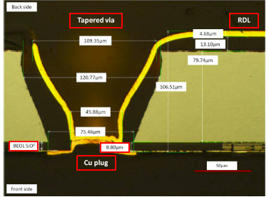
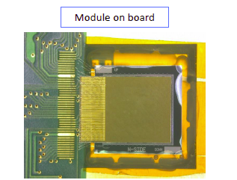
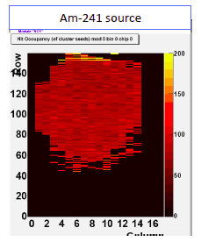
Bonn/CPPM
Pre-study:
Via last TSV in thinned (90µm) ATLAS FEI2/3 chip
TSVs in periphery for backside connectivity
Tapered vias of 100µm diameter & RDL
(redistribution layer on backside)
Processed by IZM, Berlin
Successful connection to sensors (standard flip chip to planar sensor)
No loss in performance compared to modules without TSV
Problems with bonding of thinned ASICs
(chips bowed => corners lift off)
Frontside processing needed

Slide 5
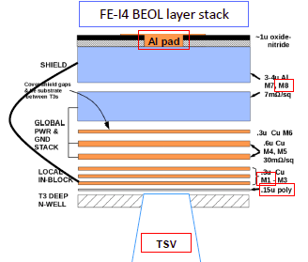
Bonn/CPPM
Extension to FEI4
Modification to avoid frontside processing: Metal 1 connected to I/O pad
Sufficient to etch TSV from backside to metal 1
Three wafers are at IZM for processing
Thinning to 150-200 µm (avoid bowing) &
Improved flip chip bonding (handle wafer)
In work, first results till February?

Slide 6
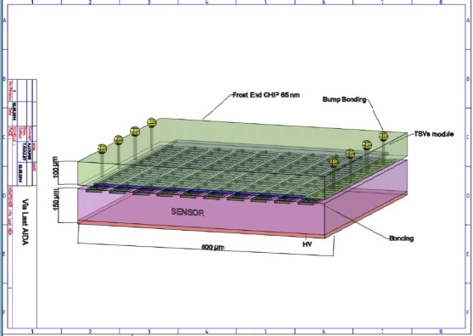
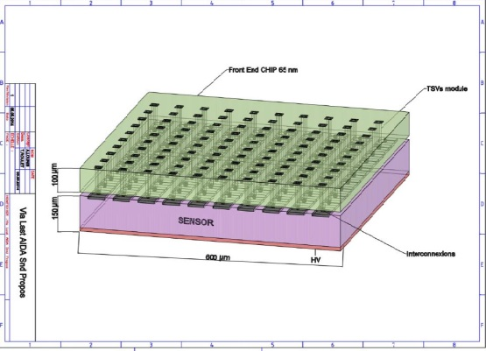
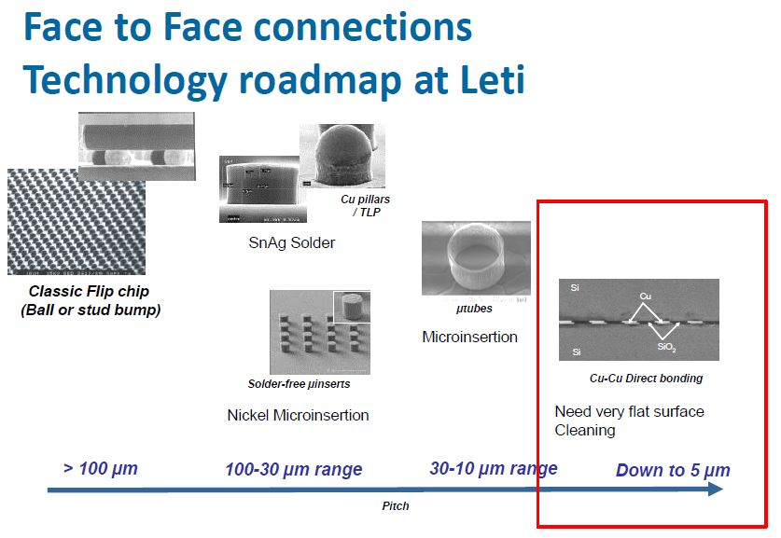
LAL/LAPP/LPNHE/MPP
Initial goal: 3D interconnection of 65nm ASICs at CEA-LETI
Conservative:
I/O vias at periphery
More challenging:
High density pixel by pixel TSVx
Sensors available for the project
5 x 5 mm² with 35 x 200 µm² pixel
Slim edge/edgless from CIS and VTT
Delayed due to late contracting of 65nm process at CERN

Slide 7
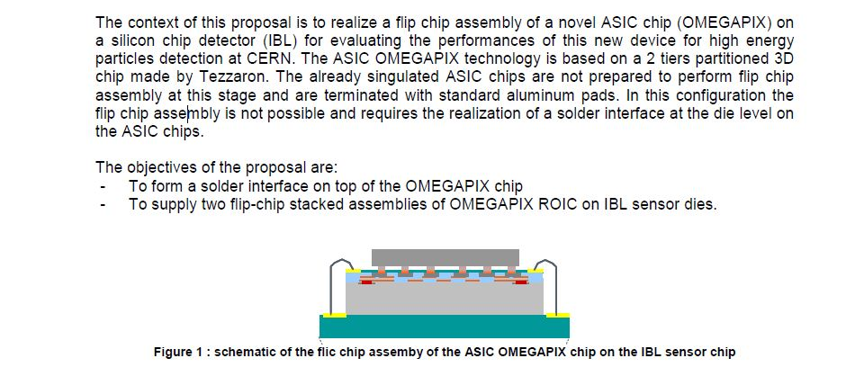
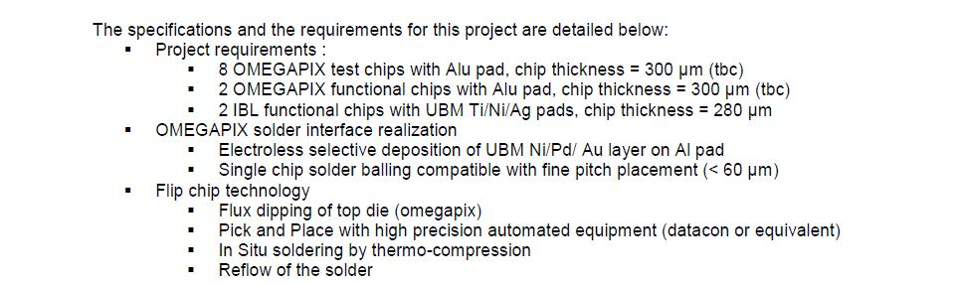
LAL/LAPP/LPNHE/MPP
Alternative project:
Interconnection of TEZZARON version 3D of OMEGAPIX with CEA-LETI solder bumps
Expected end of December

Slide 8
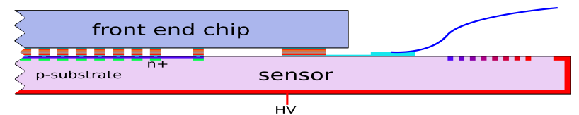
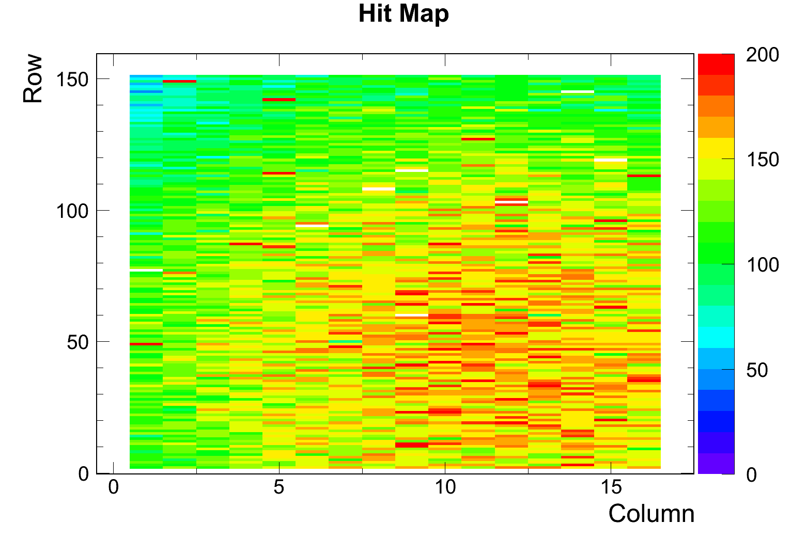
MPP/GLA/LAL/LIV/LPNHE
Pre-study:
Via last TSVs in periphery of FEI3 for backside connectivity
Similar to Bonn/CPPM
However:
Small vias (3 x 10 µm)
SLID interconnection (bumpless)
Potential for high density interconnection (20µm pitch)
Processed by Fraunhofer EMFT, Munich
SLID only
Good Charge Collection efficiency after irradiation up to 10¹⁶ n_{eq}/cm²
Number of unconnected channels stable after irradiation and multiple thermal cycles ( +20ºC → -50ºC)
2x10¹⁵ n_{eq}/cm²
All channels connected
Φ=2x10¹⁵ n_{eq}/cm²
SLID interconnection is radiation hard and withstands thermal cycling

Slide 9
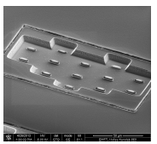
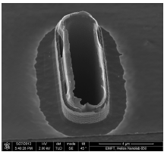
MPP/GLA/LAL/LIV/LPNHE
SLID interconnection works fine
Next step TSV etching
1) Tungsten filling of vias failed (no connectivity)
2) ASIC damaged by via processing (too high currents)

Slide 10
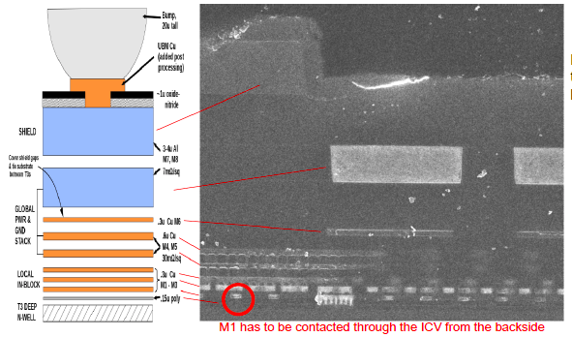
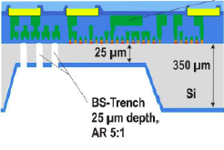
MPP/GLA/LAL/LIV/LPNHE
Extension to FEI4: narrow vias
Unlike in FEI3 no etching from frontside possible
Etching from backside to metal 1
Unlike in the similar Bonn/CPPM it is nor easy to etch to metal 1 in narrow, cylindrical TSVs:
Problems to remove SiO2 and poly layer under metal 1.
Solution: local thinning to reduce aspect ratio.
The project hast started and masks are produced, but no results yet (in work).
Conclusions:
Processing of via last high aspect ratio vias is difficult.
technical problems encountered at EMFT lead to considerable delays.

Slide 11
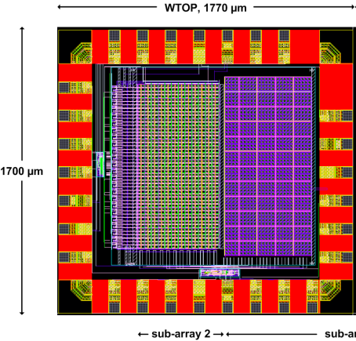
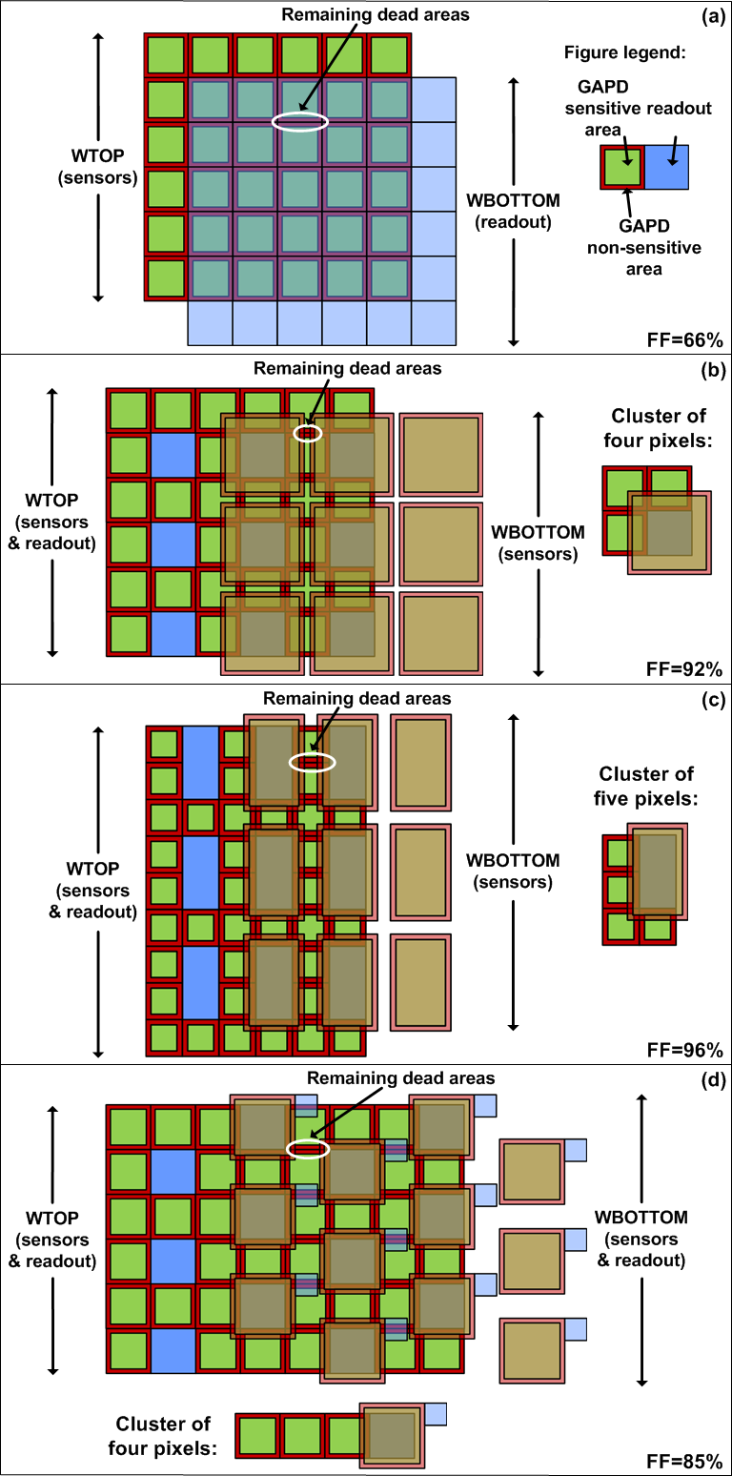
UB
Geiger APDs in CMOS have been demonstrated by UB
Normal pixel arrays with Geiger APDs have considerable dead area
Can be overcome using a double layer (need for high density interconnection)
UB designed an array of 48 rows x 48 columns with 96% of fill-factor
The array is operated in the time-gated mode with passive quenching and active recharge
Unfortunately there has been no opportunity to submit with Tezzaron

Slide 12
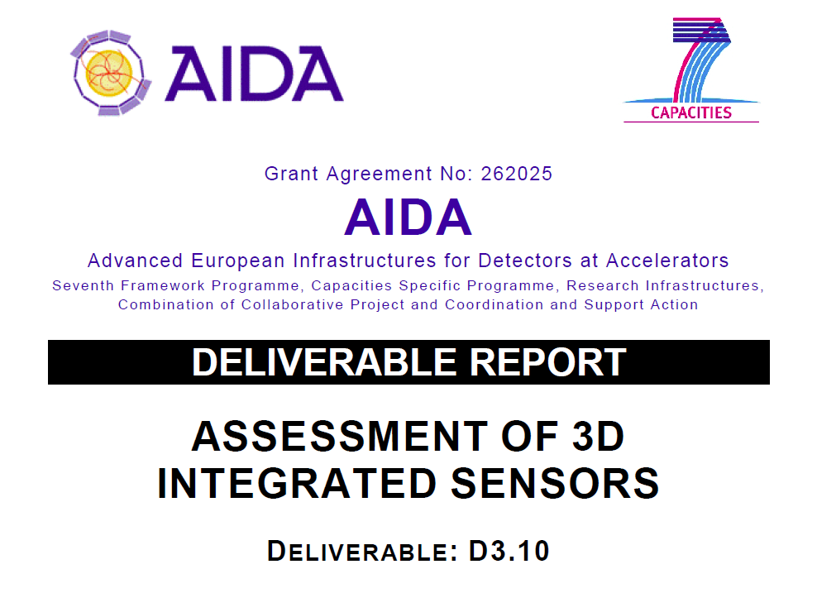
Status of D3.10

Slide 13

Assessment
The 'assessment' should not be limited to detector performance (compared to traditional devices) but also take into account the process of R&D and production:
cost, processing time
technological challenges
experience with industry and vendors
difficulties encountered
yield
recommendations for further R&D
Each subproject writes a report on its own project.
The report should cover the items mentioned above.
We then prepare a phone meeting about 2 weeks later to discuss the reports
Prepare draft report. In work, to be circulated soon
We will have a discussion in during the AIDA meeting at CERN (December 9-11).

Slide 14
Project Overview
3D interconnection be used twofold
Use TSV for backside connectivity in order to reduce dear areas
needs few TSVs on chip periphery
only large diameter, low aspect ratio vias needed (>50 µm, 2:1)
Chip sensor interconnection by solder bump bonding
(>50 µm pitch)
Use TSVs to interconnect different ASIC layers to reduce pixel size (keeping functionality)
needs TSVs in each pixel (many
small diameter, large aspect ratio vias needed (<25µm, > 5:1)
high density interconnection needed (bumpless)

Slide 15
Projects
project | TSV | Interconnect | Intermediate results | Final module | comment
Bonn/CPPM | Large/periphery | Solder bumps | Vias ok | In work
CERN | Large/periphery | Solder bumps | Ok | Ok | Fully accomplished
INFN/IPHC | Small, pixel (Tezzaron process); not investigated with IMS | SLID (Fraunhofer IMS), microbumps (T-Micro) | Several | In work | Project change due to Tezzaron delay Administrative problems with IMS
LAL/…. | None (high density vias in OMAGAPIX 3D) | Solder bumps |  | December 2014? | Originally TSMC 65nm (late). Use Tezzaron Omegapix instead
MPP/…. | Small/periphery | SLID | SLID ok Vias failed | Mask designed | Delayed due to technical problems at EMFT
UB | Small, pixel | Cu-Cu (Tezzaron) | - | - | Tezzaron process unavailable
RAL/Uppsala | Small/pixel | SLID | SLID ? VIAS ? | In work | Delay due to administrative & technical problems

Slide 16
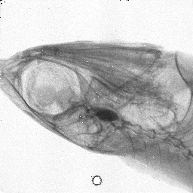
Conclusions: mature technologies
Large diameter TSVs with bump bonding interconnect (CERN, Bonn): the projects either achieved the goal (CERN) or could show successful intermediate results (Bonn).
It could be demonstrated that the goals (backside I/O) can be achieved without compromising the performance of the ASICs.
Can be used with standard ASICs (with slight modifications to allow access of via to I/O).
CEA-LETI Process openly available.

Slide 17
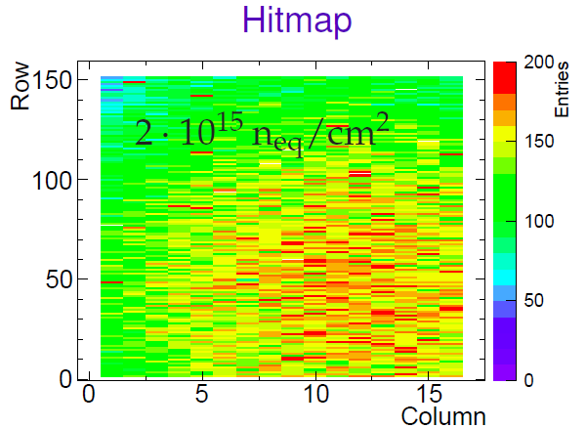
Conclusions: challenging technologies
Not unexpected those projects (INFN/IPHC, MPP; LAL, RAL/Upps, UB) had more difficulties.
None achieved the final goal (yet) but some ntermediate results could be obtained:
High density interconnections (SLID, T-Micro) work
TSVs: while RAL/Uppsala seemed to have got working TSVs from EMFT, the MPP project with EMFT failed in this respect. May be bad luck, but it could tell us something on the maturity of the process.
Tezzaron: Some chips could be produced and seem to work properly (from projects started before AIDA). However, the process became virtually unavailable (and probably still is) when AIDA projects needed it. UB hat to stop completely. Others (INFN/IPHC) had to look for alternative which caused considerable delay.

Slide 18
Schedule for D3.10
Status
Reports from the various subprojects exist
Based on these reports a first draft is being drafted (90% complete)
I first version will be circulated before X-mas.
Final version expected end of January
Do do:
More results should show up till January
Need more information on the performance of the 3D assemblies compared to the 2D versions
Direct comparison of pros & cons of the subprojects
Shall we report on the administrative problems some subprojects had and caused delays?
Since this is an EU project and should foster international projects within the EU I think: yes.
Include information from outside AIDA ?

