Slide 1
AIDA
(mini) Trigger/Timing Logic Unit
(mini TLU)
Introduction
Status
Plans
Summary

Slide 2
Introduction
Provide Simple Timing/Synchronisation Interface
  Builds on EUDET TLU
  Linked with Deliverable D8.2.2 (specification documents for the common DAQ)
New for AIDA – synchronous mode ( clock/trigger/busy ) for high trigger rate
Better performance than EUDET TLU
  Trigger rate > 1MHz sustained , > 10MHz instantaneous

Slide 3
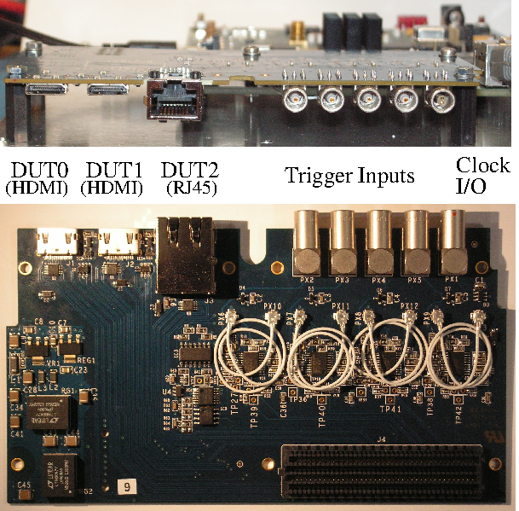
Hardware
Implemented as FPGA Mezzanine Card (FMC).
Plugs into off-the-shelf FPGA carrier
Four trigger inputs
  Software adjustable threshold
  Threshold and CFD
Three Device Under Test interfaces
  Can be fanned out to up to 30 DUT interfaces in synchronous mode with external fanout.
Open Hardware, Open Firmware: http://www.ohwr.org/projects/fmc-mtlu/wiki

Slide 4
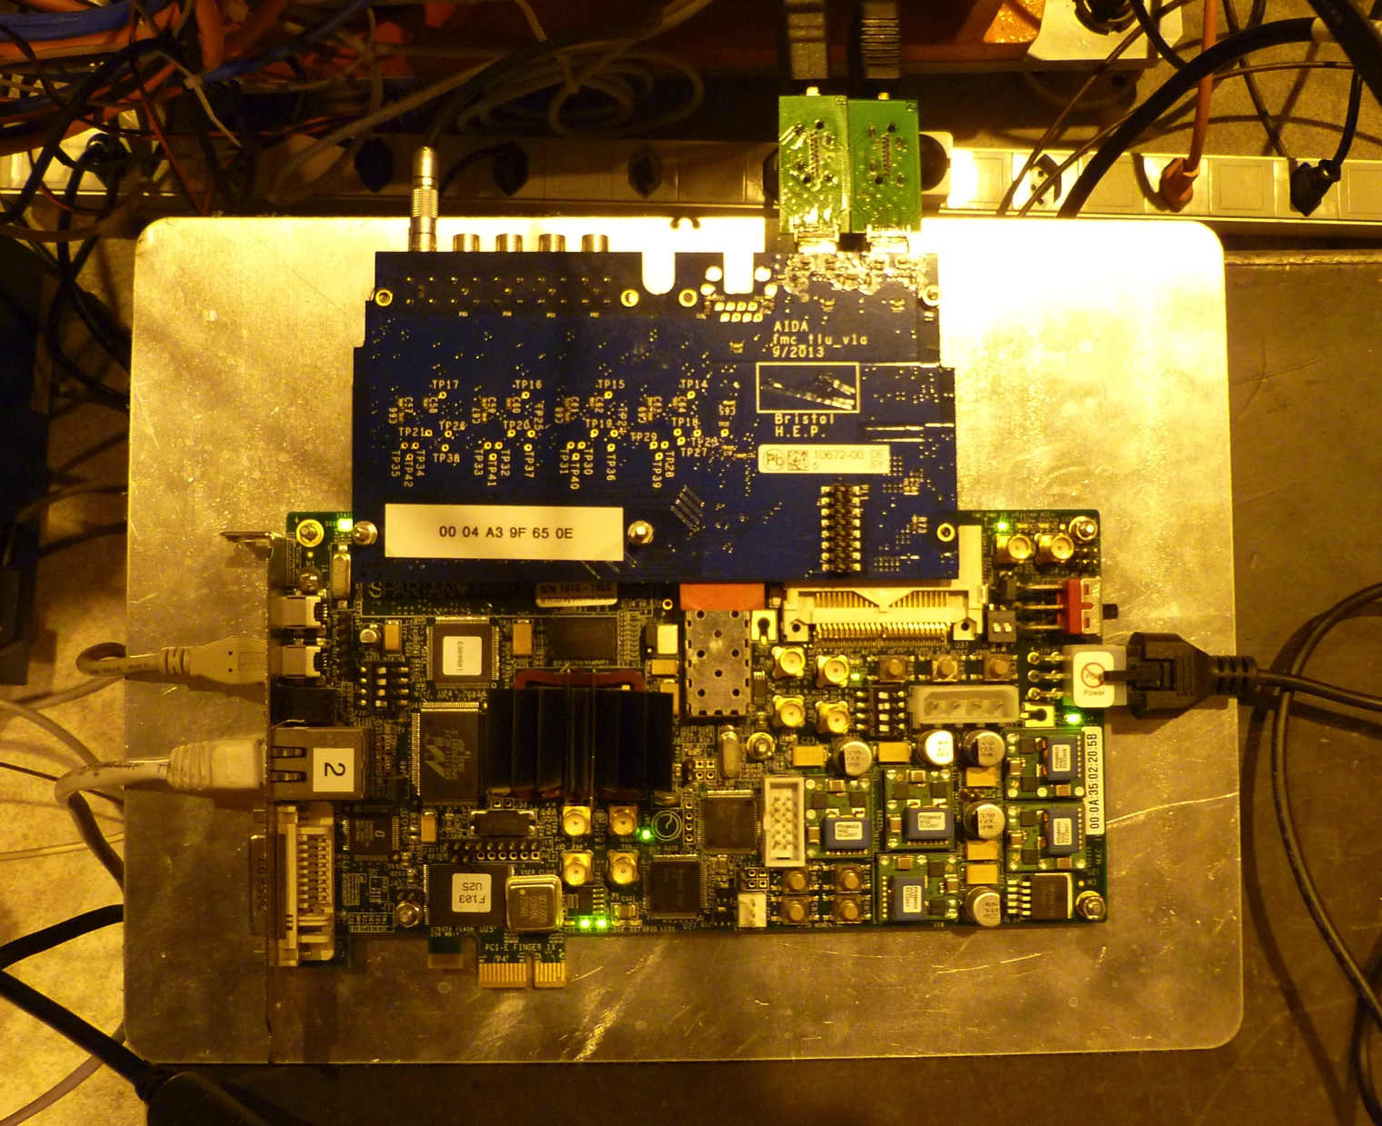
Hardware
Currently only as boards bolted to plate
Design for box in progress

Slide 5
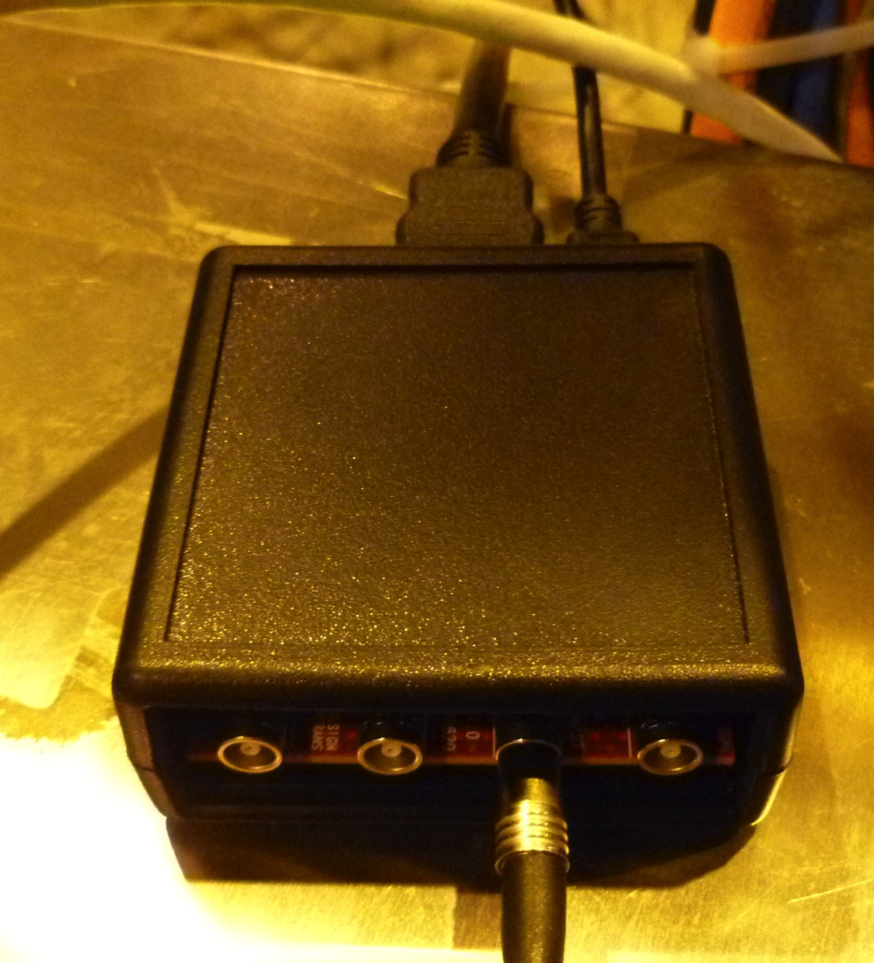
Hardware
LVDS → TTL converters exist.
This example from NIKHEF

Slide 6
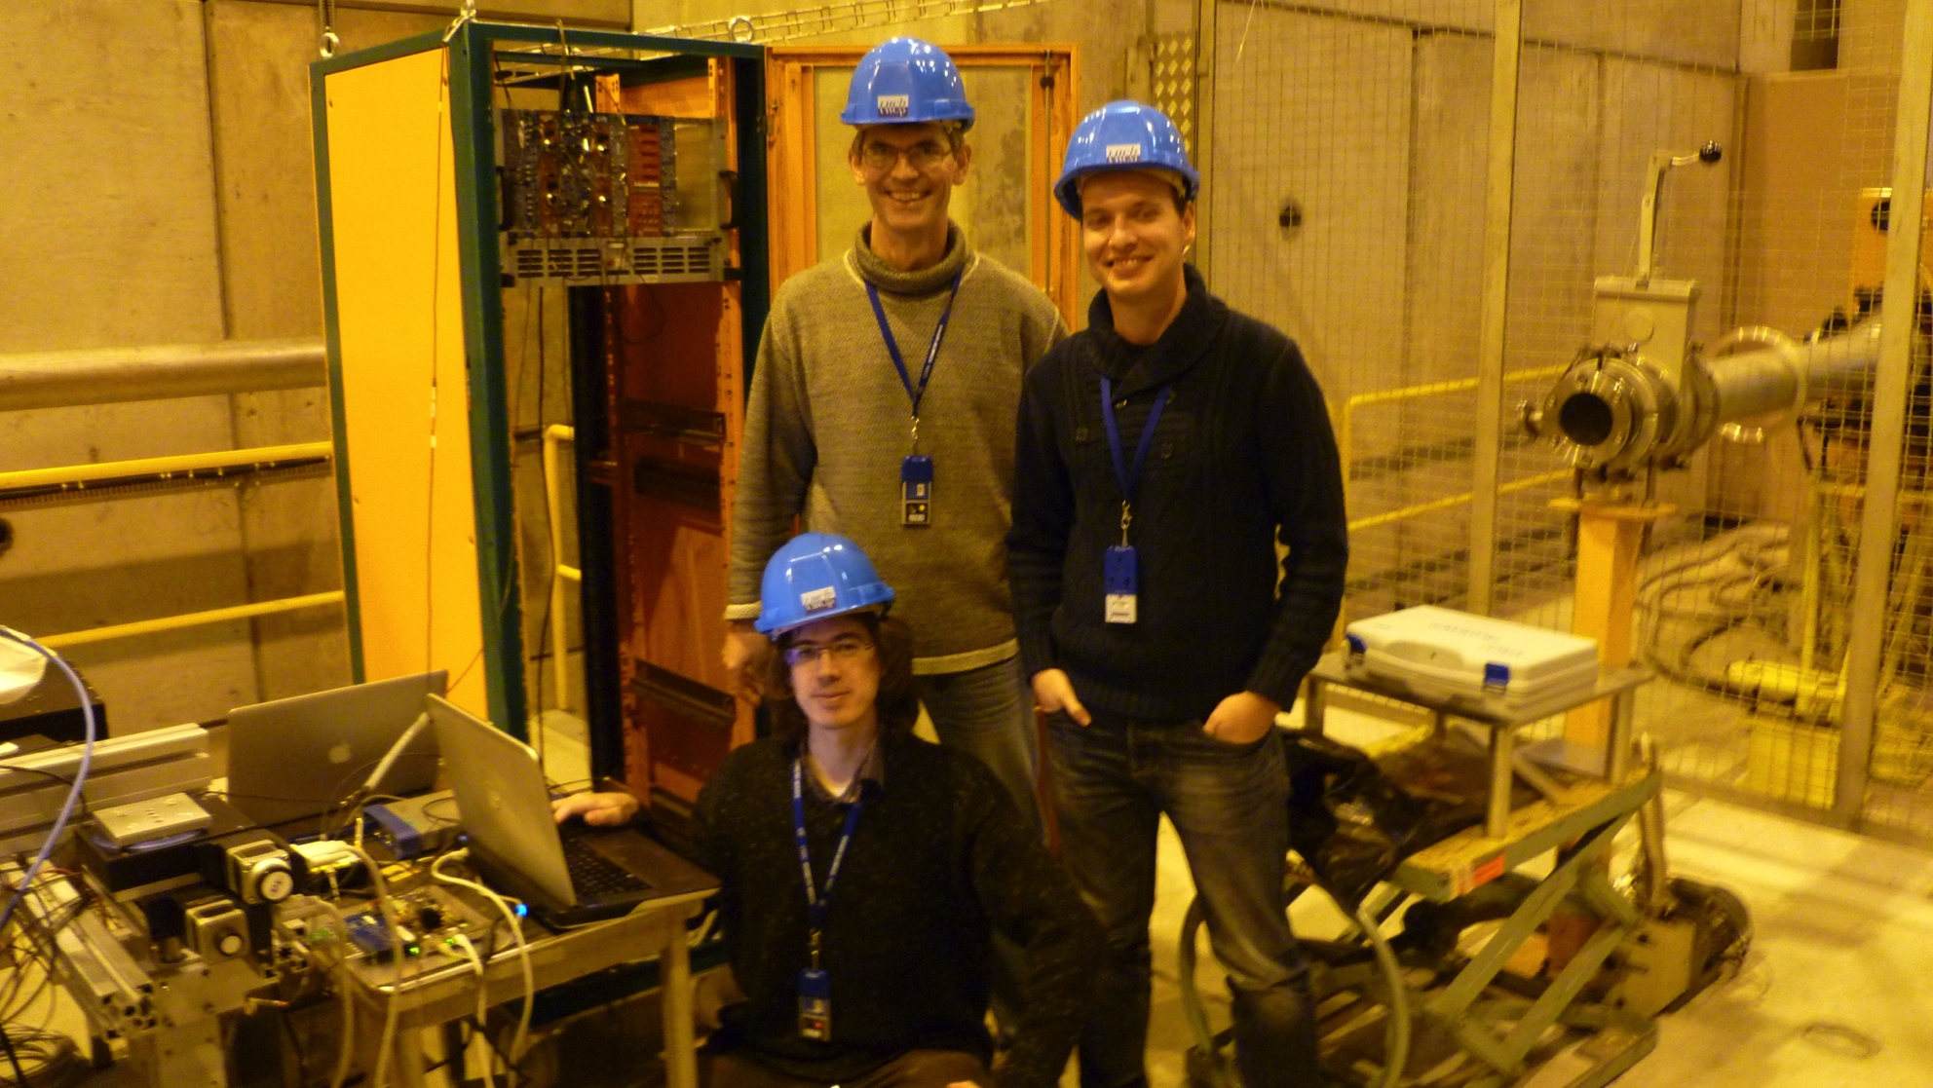
Development Team
David Cussans
( Bristol )
Hardware/Firmware
Alvaro Dosil
(Santiago de Compostela)
Firmware
Francesco Crescioli
( LPNHE )
Software

Slide 7
TLU in action
Debugging new interface with AIDA telescope
Operation with non-AIDA telescope:
  Interfacing TORCH ( LHCb upgrade proposal ) DAQ with LHCb TimePix3 telescope.
  Accepts clock and synchronization signals from LHCb telescope
  Provides “AIDA synchronous interface” to DUT

Slide 8
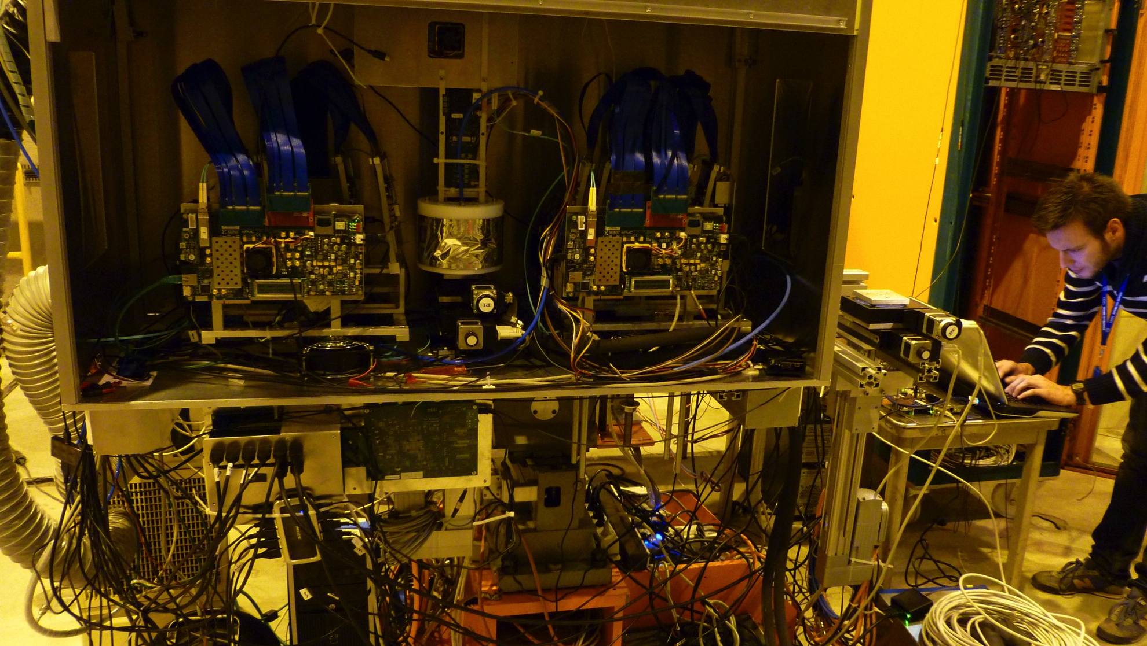
AIDA TLU with non-AIDA Beam-Telescope
LHCb Timepix3
Telescope
Telescope
Clock/Sync
Fanout
AIDA TLU

Slide 9
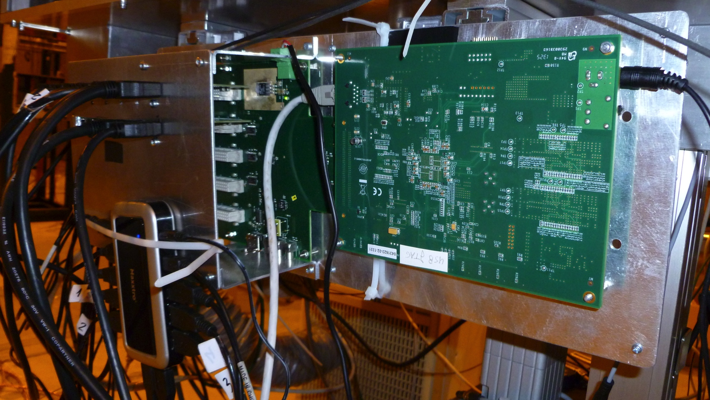
Clock/Syncronization Fanout
Up to 30 DUT
Compatible with miniTLU (in synchronous mode)

Slide 10
Status – Hardware
Ten AIDA miniTLU boards exist
  Production organized and paid by DESY
Minor hardware bugs
  correctable by external plug-in cable converter
Bug fixed design by end of AIDA

Slide 11
Status –
Firmware
Synchronous mode implemented
EUDET mode still in development
TDC functionality tested (and works)
  Granularity 780ps
  Separate timestamp for each trigger input
Basic coincidence logic exists. Being tested and improved

Slide 12
Status – Software
Producer for EUDAQ-2 written
  Basic Functionality Present
Sustained trigger rate of 1MHz measured
Debugging continues

Slide 13
Plans
Current team available until end March 2105
Aim to have “finished” TLU by then.
Longer term plans depend on outcome of AIDA-2020
  If no AIDA-2020 support on best-efforts basis
    Hardware, Firmware, Software all freely available
    ( Modifying PCB needs access to CERN CAD libraries )

Slide 14
Summary
Aim: Simple hardware unit to make common beam-tests easier.
  Basic functionality achieved
  Full functionality badly delayed but nearing completion
Existing TLU specification document will be uploaded as an AIDA note.

