Slide 1
WP4: Relation with Industry
Report
Last AIDA annual meeting
CERN 9th-11th December 2014

Slide 2
Agenda
WP4: Relation with industry
  Work completed
D4.1: Overall Industry Report
D4.2: Follow-up structure for the project

Slide 3
D4.1 Report: Content
Academia Industry Matching Events (AIME)
  Concept
  Statistics
  National events
  Analysis
Collaboration Spotting
  Concept and purpose
  Technology patterns
  Selecting attendance
  Event impact and follow-up
Conclusion and future plans

Slide 4
D4.1: AIME
Strategy
  Foster collaborations between Academia & Industry
Methodology
  AIME
    Topical Events
    Needs of communities (HEP and others)
    Capability of Industry
    Two half-day events with booths, posters, long coffee breaks
    Networking dinner
Statistics

Slide 5
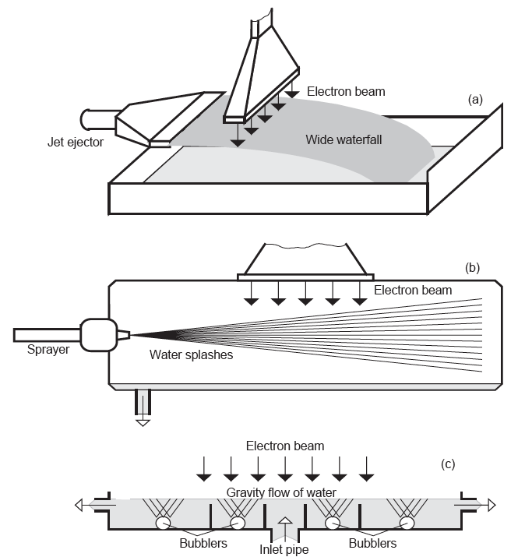
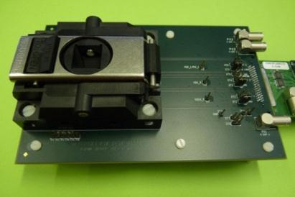
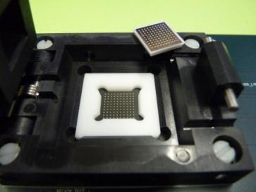
AIME’s scope
Enhance industry involvement in R&D for curiosity driven research
Foster collaborations between academia and industry
Promote the use of research results in other research disciplines and industrial applications
Pre-commercial procurement
Application oriented
3D-IC
Industrial
Applications
Accelerators
3D Interconnection event (Frascati)
5

Slide 6
Events for Industry Report
11 AIME events organised since 2011 (7 reported in D4.1)
  Si-Photomultipliers (CERN, Geneva, 2011) (AIDA kick-off, HEPTech)
  Vacuum & Cryogenics (GSI, Darmstadt, 2011) (Jointly organised with ASPERA)
  Position Sensitive Solid State Detectors (DESY, Hamburg, 2012)
  Beam monitoring (GSI, Darmstadt, 2012)
  Micro Pattern Gaseous Detectors (IN2P3/LAPP, Annecy, 2012)
  3D-IC (INFN, Frascati, 2013)
  Super conductivity (CIEMAT, Madrid, 2013) (HEPTech)
  Industrial applications of accelerators (STFC, Daresbury, 2013)
  Neutron detection with MPGDs (CERN, Geneva, 2013) (Jointly organised with RD-51)
  Control Systems (Demokritos, Athens, 2013)
  RPC and TGC (Vienna, 2014) (jointly organised with HEPTech)

Slide 7
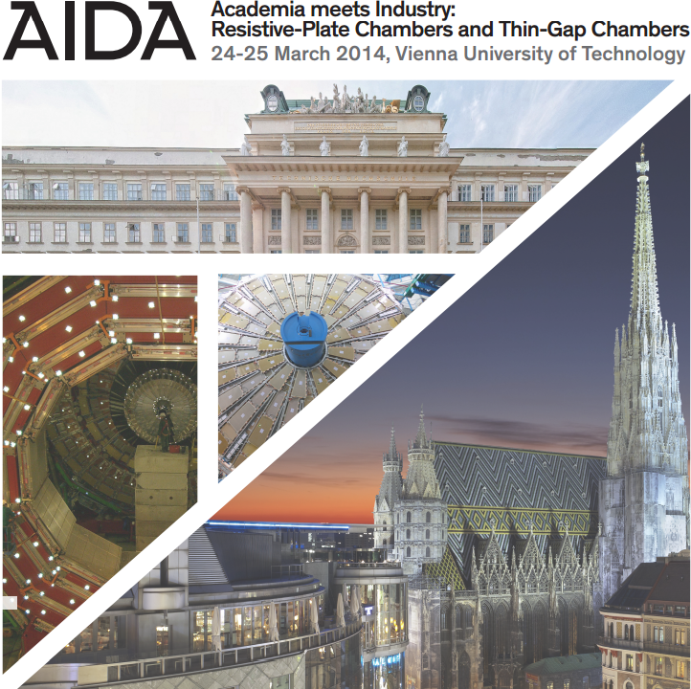
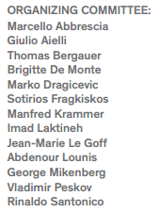

AIME RPC-TGC Report

Slide 8
D4.1: Events for Industry Report
National Events
  AIME-like event at Thessaloniki, 4-5/4/2011
    Implementation of informatics to the HEP research
    NTUA, NRSC “Demokritos”, SEPVE
  AIME-like event at Alexandroupolis, 26-27/11/2011
    Implementation of Advanced Electronics and Precise Mechanical Components to the HEP research
    NTUA, NRSC “Demokritos”
  Event organized by Ivan Vila in Seville, 24-25/6/2013
    CPAN Workshop on technology transfer at CNA

Slide 9
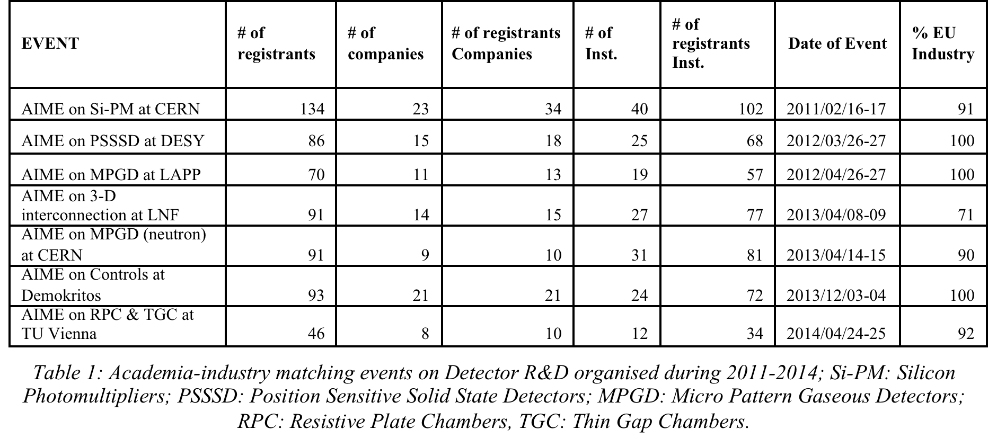
AIME: Statistics
611 people attended these events with an average of 87 participants per event
101 Companies attended the seven events for an average of 14 companies per event
  MPGD, RPC → Small industrial community supporting the activity
  Technologies where Europe could meet the needs of academia →EU industry is about 90% or above.
  Percentage goes down to 70% when the leading industry for a technology topic is in the US and/or Asia.
    3-D interconnections

Slide 10
D4.1 Report: AIME
Analysis
  Interactions between academia and industry strongly depend on the type and readiness level of the technology and its use in detectors.
  Early collaborations with industry are essential. But academic needs depend on the detector technology:
    Industry alone can manufacture critical components
      3D-interconnections, Position Sensitive Solid State Detectors
      →Development of an industrial process to meet physics requirements
        Prototypes, characterisation, academic feedback to industry
    Industry has developed technologies for commercial applications that can be used for detectors with some optimizations.
      RPC, TGC
      Ex: PCB, coolant in gas mixtures
      →Improvement of existing materials to meet physics requirements
        Specific production in limited quantities → Risk of cost increase

Slide 11
D4.1 Report: AIME
Analysis (continued)
  Early collaborations with industry are essential. But purpose depends on the detector technology:
    Industry alone can manufacture critical components
      3D-interconnections, Position Sensitive Solid State Detectors
      Aim at including our needs into processes that can address a larger market
    Manufacturing of very large detectors no longer possible without the involvement of industry
      RPC, TGC
      No market outside PP
      Applications outside PP are important to convince industry to invest in equipment (ex: Ore mining with TGC-based detectors)
      Interesting market for education

Slide 12
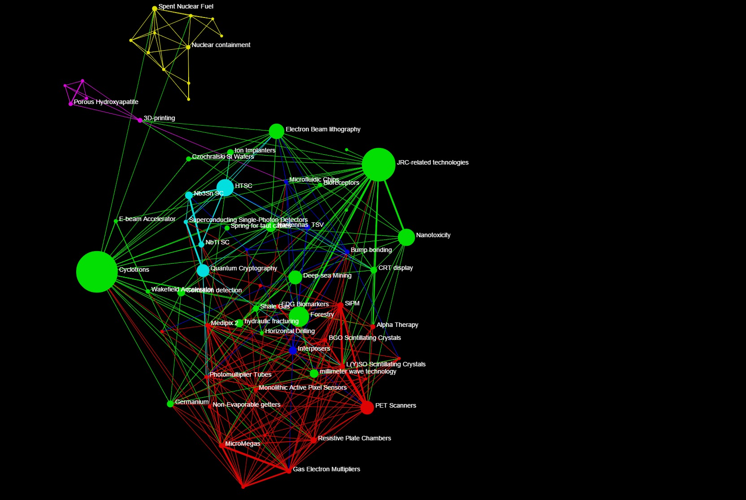
Collaboration Spotting

Slide 13
Formalism
Visualisation of large data sets as interactive graphs derived from metadata information
Underlying mathematical formalism to be published soon.
  Data Set
  Files containing structured data, documents, database tables, web pages
  Metadata set
  instances of metadata of various types pointing to data
  e.g. Publication metadata = (title, abstract, authors/org, subject categories, citations, DOI, etc.)
  Definitions
  Graph = nodes and edges showing features of metadata instances
  Node = an instance of metadata subtype or type
  Edge = metadata instances common to two nodes
  Graph navigation
    Within same data set, across a same landscape using different instances of
    metadata sub-types as nodes in graph
      e.g. Graph of subject categories ←→ Graph of organisations
    Across data sets with different metadata type using nodes graph to access another graph
      e.g. technology Node in the Technogram ←→ Graph of organisations

Slide 14
Data set navigation
Metadata 1 landscape
Metadata 1
sub-landscape X
Metadata 1
sub-landscape 2
Metadata 2 sub-landscape 1
Metadata 2
landscape
Data Set
Metadata 2 sub-landscape X
Metadata 1
Metadata 2
Metadata X
Metadata X sub-landscape 2
Metadata X sub-landscape 1
Metadata X landscape

Slide 15
Data sets
Monitoring of innovation and technological development
Data sets: patents databases, scientific publication databases
EPO, Thomson Innovation Scopus, WoS, ArXiv
Under development: input from experts and future users is key

Slide 16
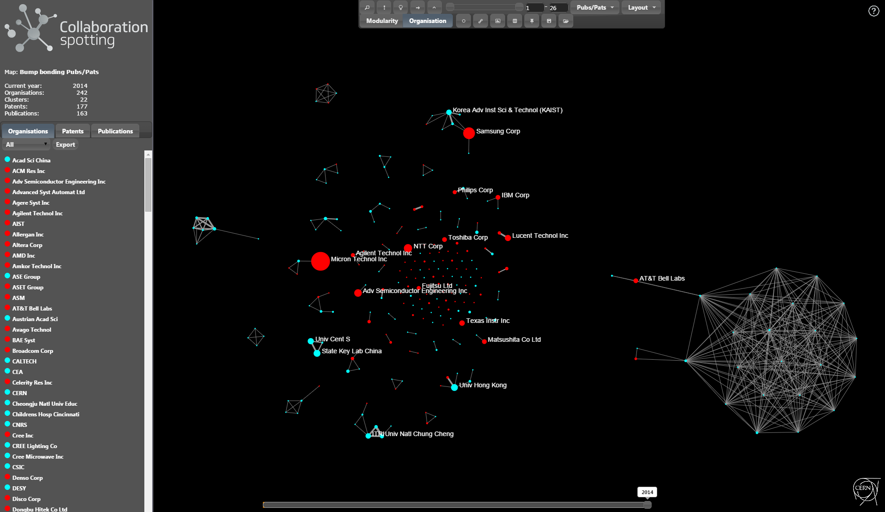
Technology patterns
Organisation landscape of the Bump Bonding technology. –
Red: Companies, Blue: Institutions

Slide 17
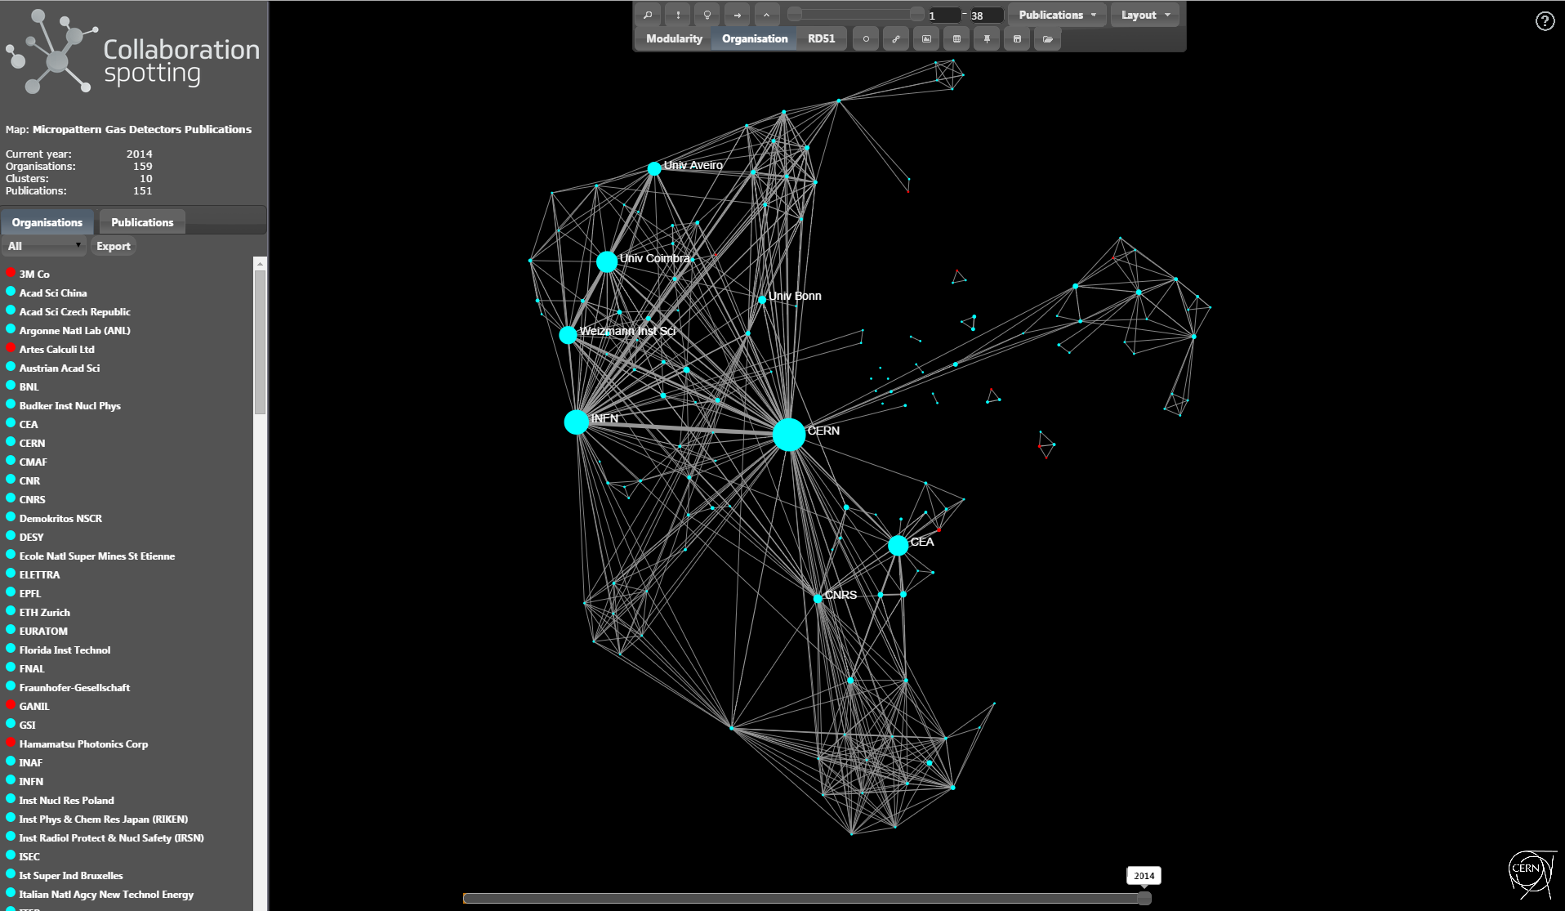
Technology patterns(cont.)
Organisation landscape of the MPGD technology

Slide 18
Technology patterns(cont.)
Organisation landscape of the Positron Emission Tomography (PET) technology

Slide 19
Technology patterns(cont.)
Subset of the PET scanner organisation landscape in 1998

Slide 20
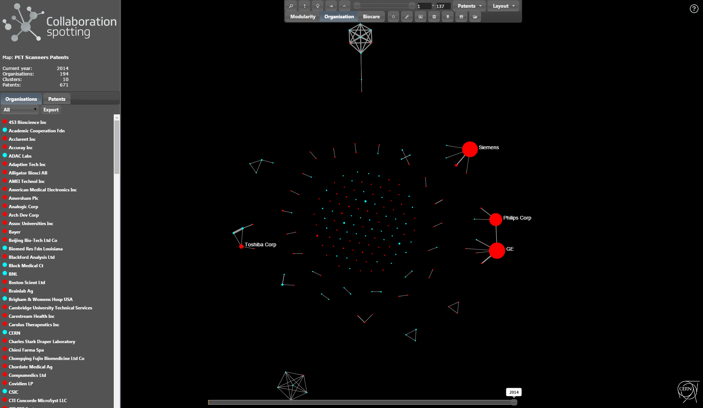
Technology patterns(cont.)
PET scanners organisation landscape with patents only

Slide 21
Selecting Attendance
We can use Collaboration Spotting to invite experts to attend AIME events
Example: 3-D interconnections
  Three main technologies identified by AIDA experts:
    Interposers
    Through Silicon Vias (TSV)
    Solid Liquid Inter-Diffusion (SLID)

Slide 22
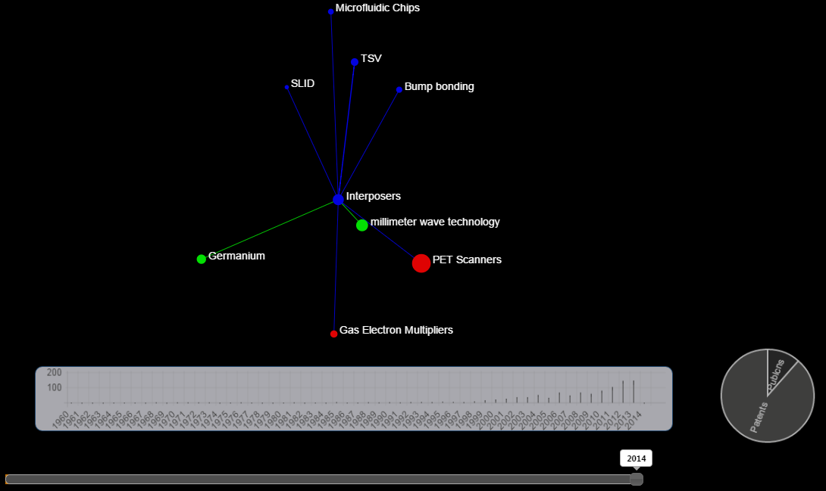
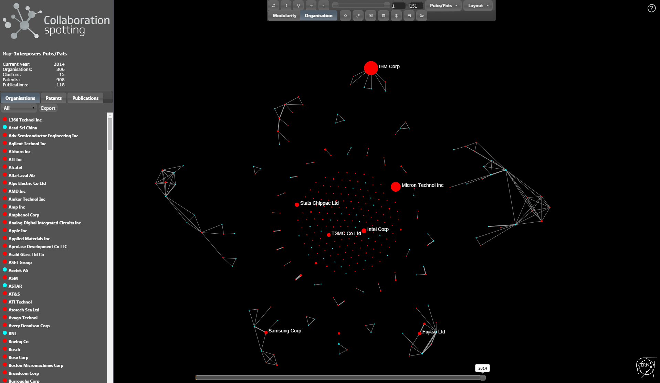
Selecting Attendance: Interposers

Slide 23
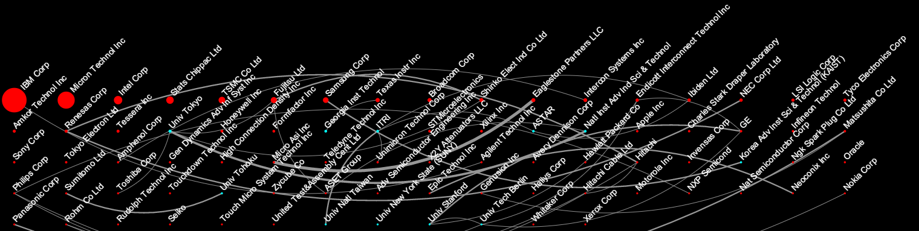
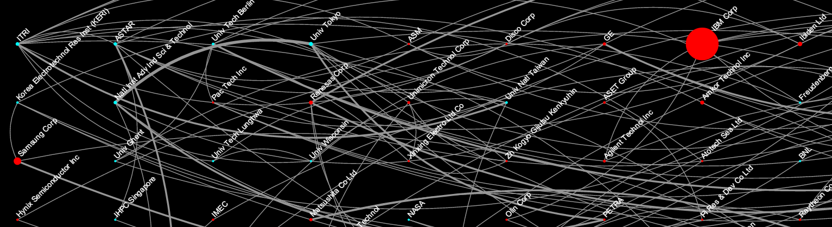
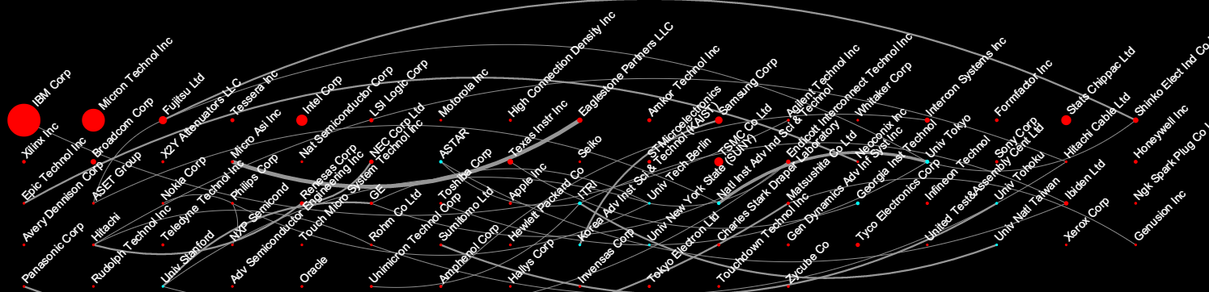
Selecting Attendance: Interposers

Slide 24
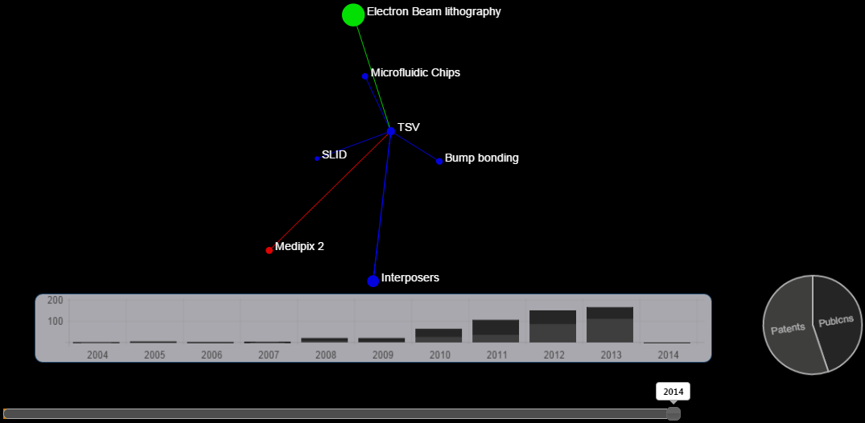
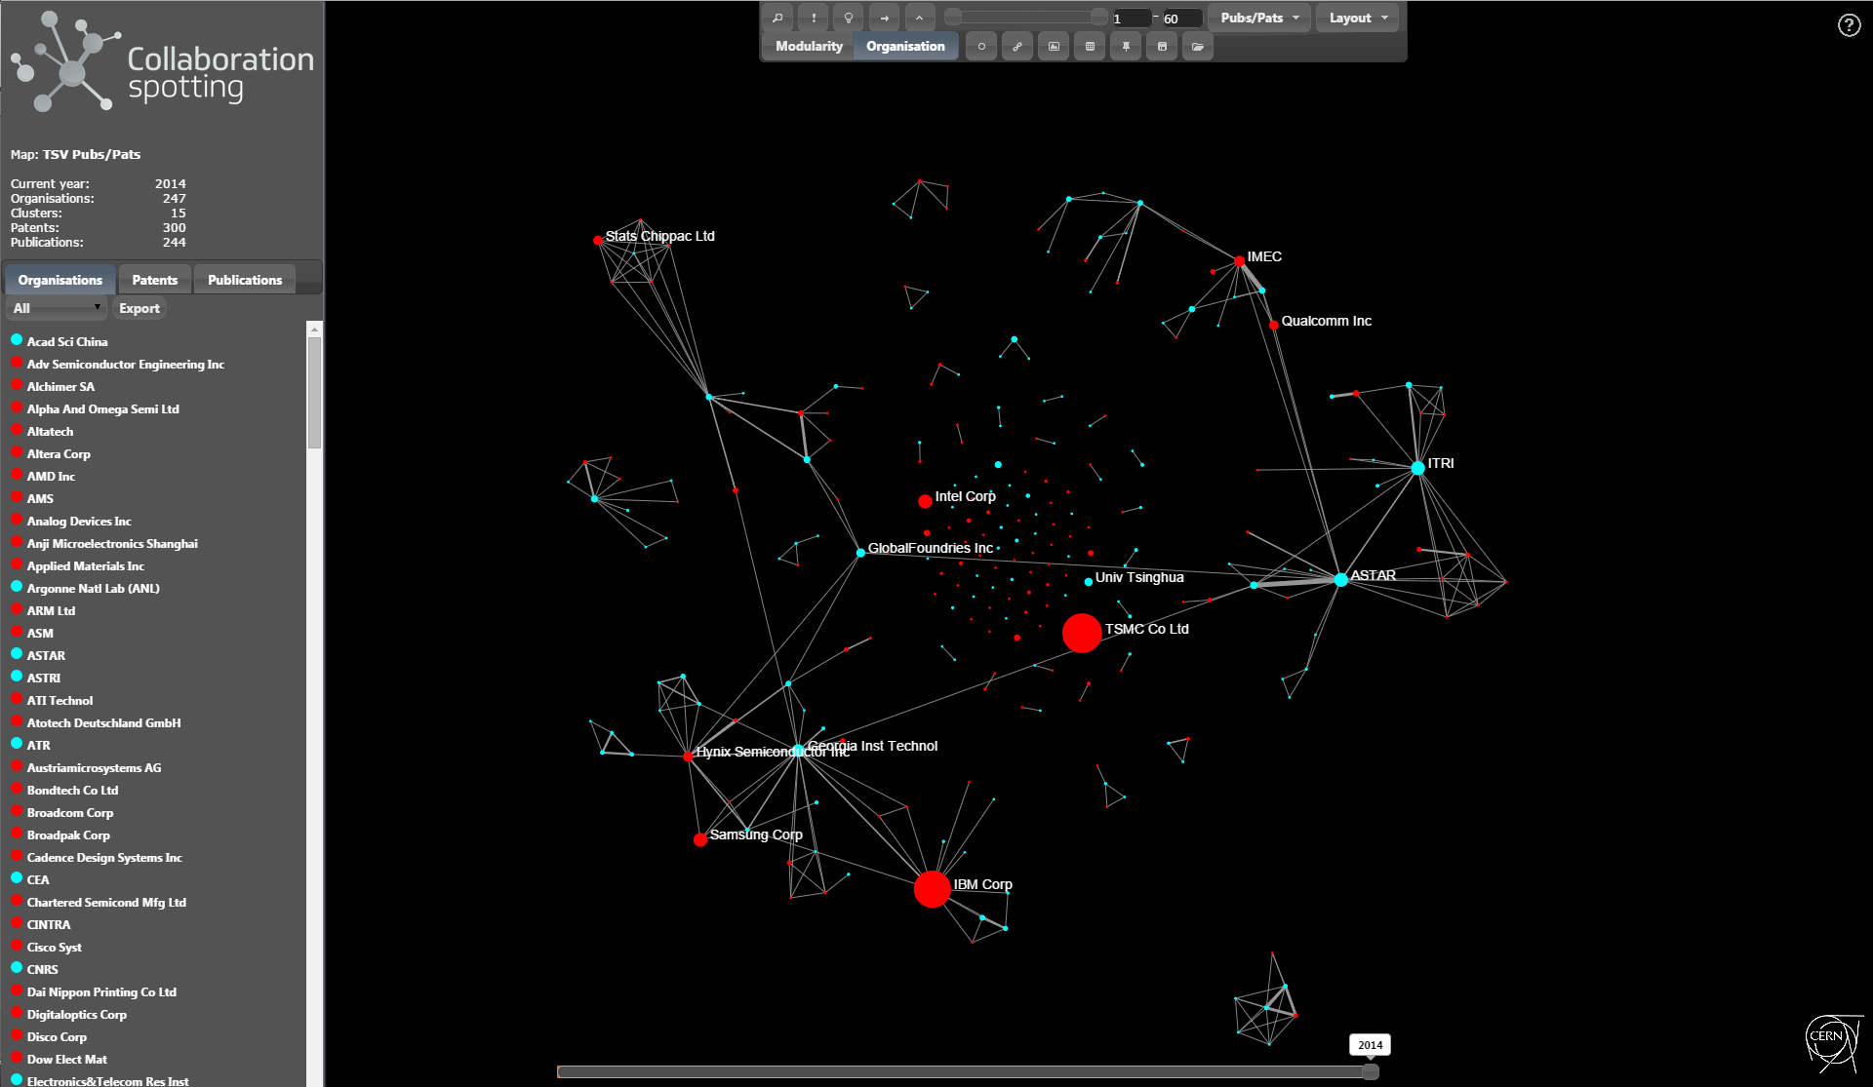
Selecting Attendance: TSV

Slide 25
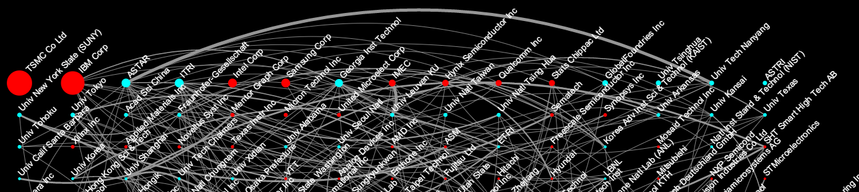
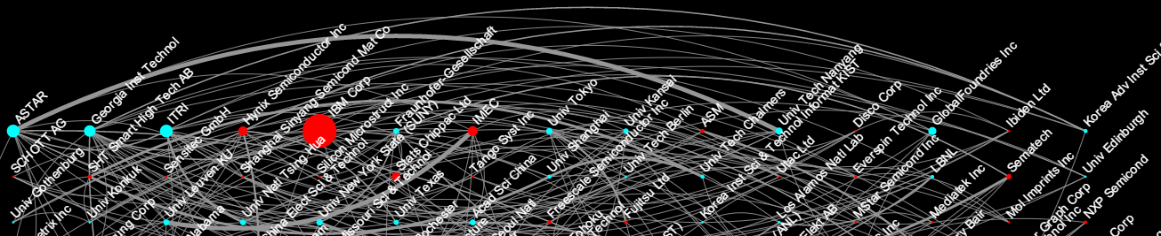
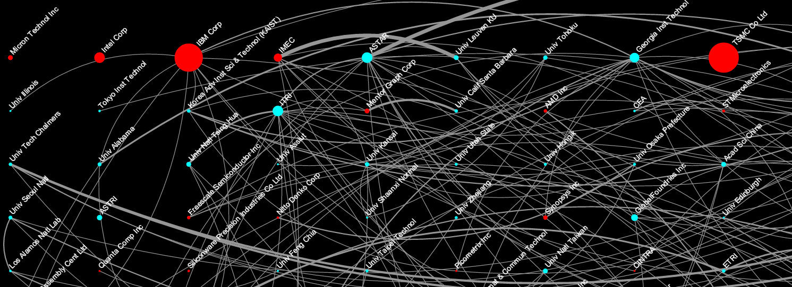

Slide 26
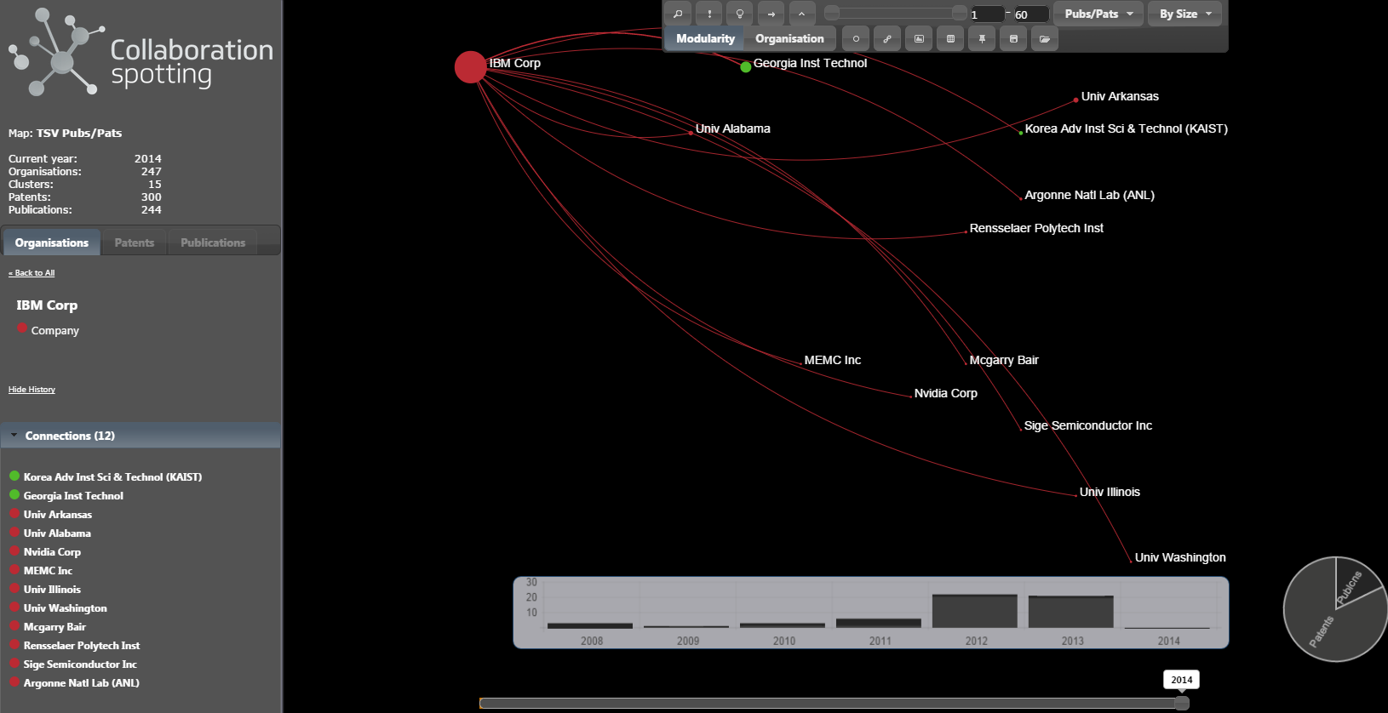
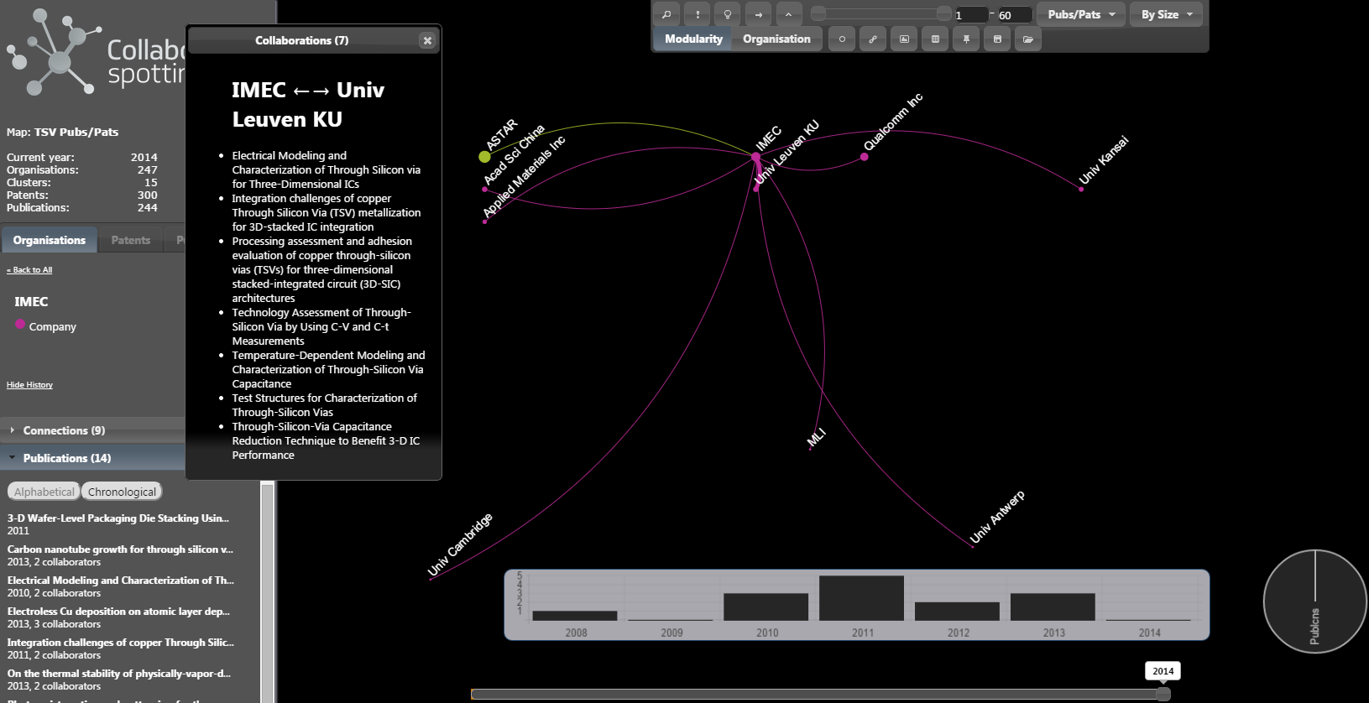
Selecting Attendance: TSV

Slide 27
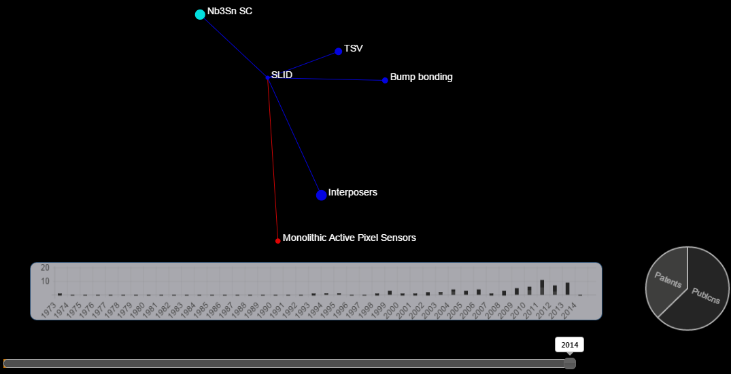
Selecting Attendance: SLID

Slide 28
Selecting Attendance:
(SLID) cont.

Slide 29
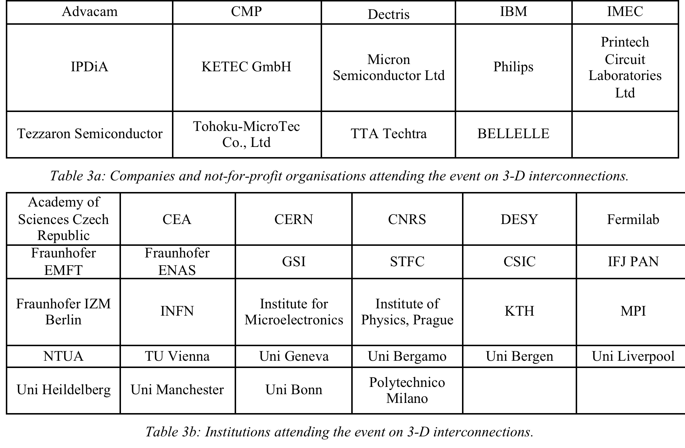
AIME: Attendance
Focus on Interposers and TSV. SLID not mature enough

Slide 30
The case of Tezzaron Semicond.
Tezzaron Semiconductor, one of the prominent industrial players in 3-D packaging does not appear in TSV, nor Interposers. When searching for this company specifically we found two publications and five patents related to 3-D packaging:
Publications:
  A novel chip-to-wafer (C2W) three-dimensional (3D) integration approach using a template for precise alignment
  Three-dimensional integrated circuits and the future of system-on-chip designs
Patents:
  Method for bonding wafers to produce stacked integrated circuits
  Fiducial scheme adapted for stacked integrated circuits
  NETWORK WITH PROGRAMMABLE INTERCONNECT NODES ADAPTED TO LARGE INTEGRATED CIRCUITS
  Method for bonding wafers to produce stacked integrated circuits
  3D INTEGRATED CIRCUIT PACKAGE AND METHOD OF FABRICATION THEREOF
None of these publications or patents can be found by looking for TSV or interposers. Indeed when looking into Tezzaron website one finds the following quotation: “These incredibly fine vertical connections are applied by the hundreds of thousands, allowing a single circuit to be spread vertically across multiple dies. They are so small we don’t even call them TSVs. They are SuperContacts™!” confirming the pertinence of this company in the TSV technology and indicating that there are other technologies close to TSV that should be included in the searches in relation with 3-D packaging.

Slide 31
Event impact & follow-up
Increasing attractiveness for attending industry
Representativeness of the attendance
Fostering collaborations

Slide 32
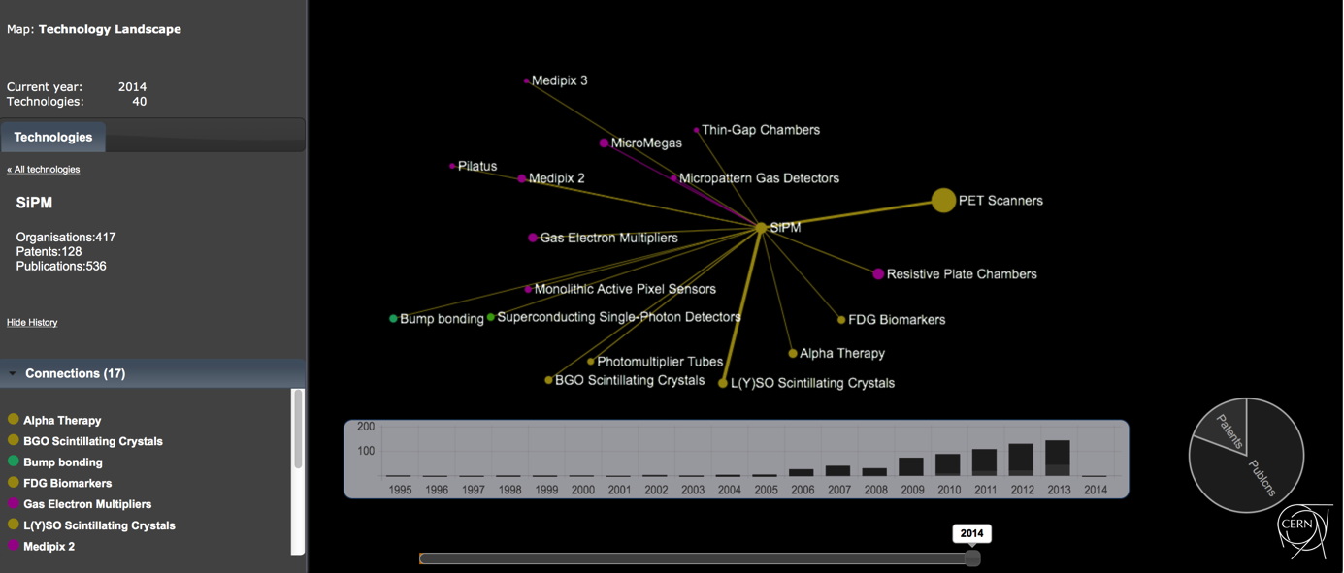
Increasing attractiveness
PET industry is considering the use of SiPM in conjunction with L(Y)SO scintillating crystals in the next generation of scanners. This combination of technology allows the use of PET scanners in strong magnetic fields such as those of Magnetic Resonance Imaging. The technology landscape for SiPM clearly indicates the links with PET scanners and L(Y)SO crystals. Contributions from the medical imaging community at the AIME event on SiPM can strengthen the interests of the manufacturers in developing the SiPM technology.

Slide 33
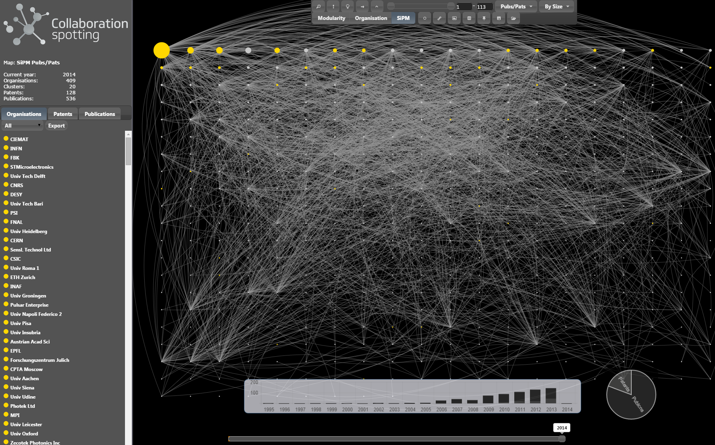
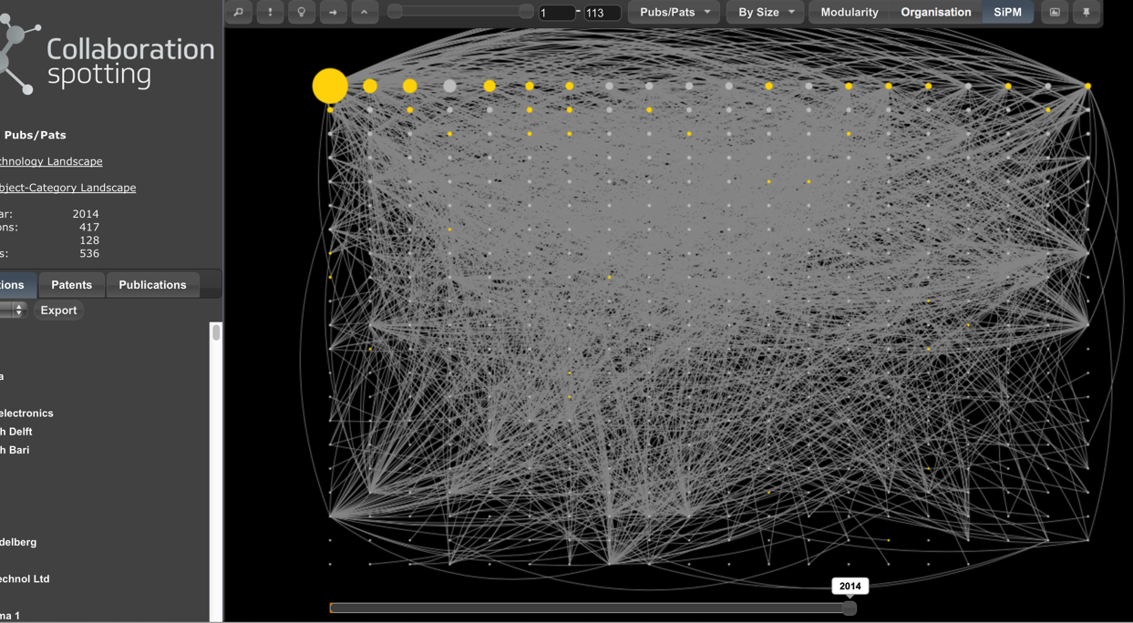
Representativeness of attendance
Organisation landscape of SiPM where organisations are ranked by size.
Organisations that attended the AIME event are coloured in gold.

Slide 34
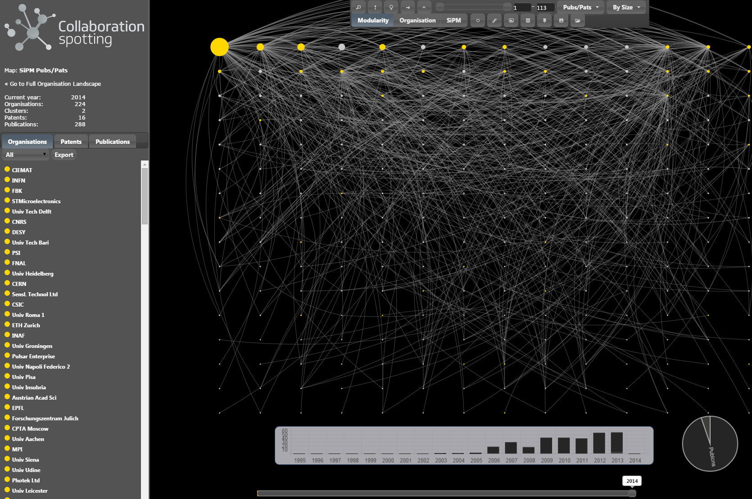
Representativeness of attendance(2)
Subset of the above representing the publications and patents of the attendees
and their collaborators

Slide 35
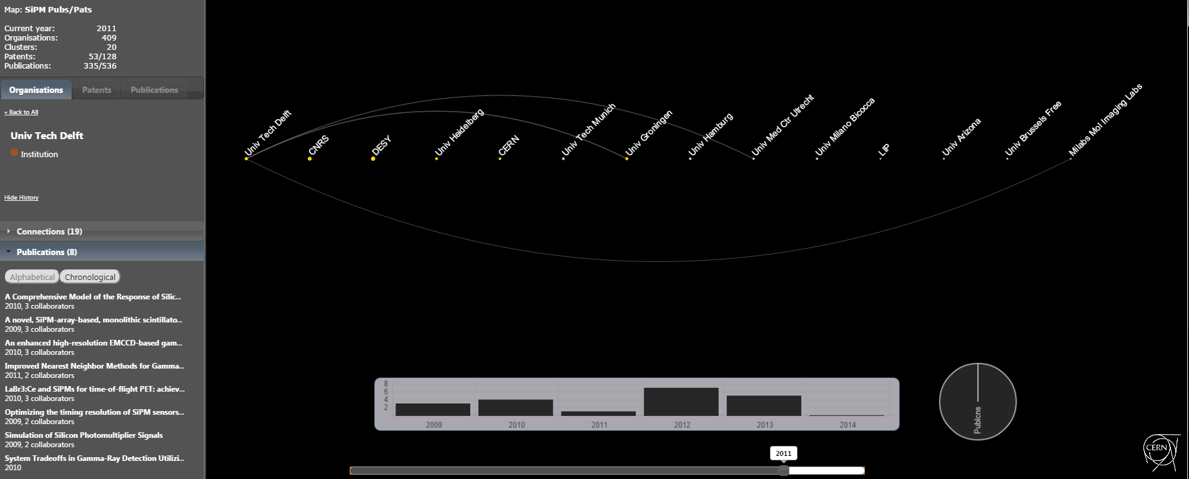
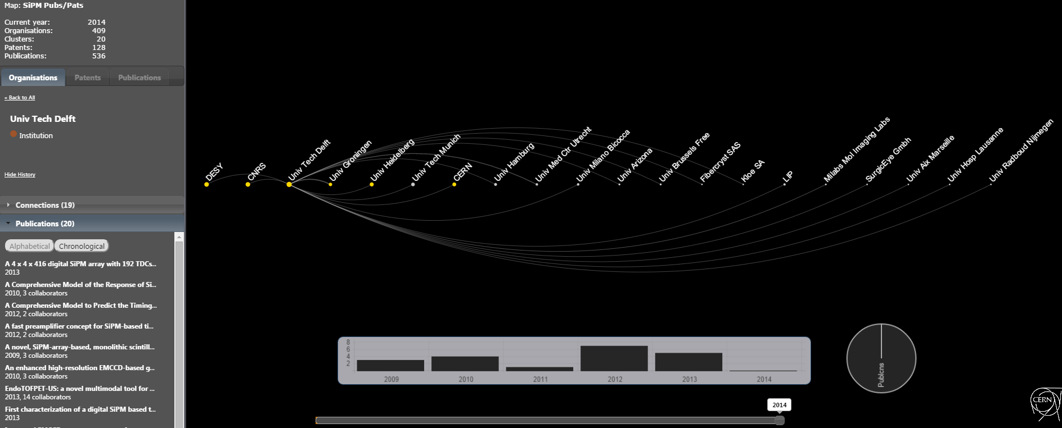
Fostering collaborations

Slide 36
Conclusions & future plans
AIME
  Efficient tool to bring industry closer to academia
    Ex: SI-PM: “Thanks to this event a company decited to enter the Si-PM business”
  Address all detector technologies
    Follow-ups
    Calorimetry (not specifically address in AIDA WP4)

Slide 37
Conclusions & future plans
Collaboration Spotting
  Valuable tool to understand the organisation landscape of individual technologies
  CERN-JRC collaboration for the development of a Technology Innovation Monitor
    Fields of activity of an organisation
    Evaluation of organisation’s excellence in a field
    Analysis of collaborations
    Monitoring technology lifecycle & detection of emerging technologies
    Assistance to decision makers
    Understanding the dynamic of innovation
  Extend the approach to other metadata
    Ex: projects

Slide 38
Agenda
AIME RPC-TGC Report
D4.1: Overall Industry Report
D4.2: Follow-up structure for the project

Slide 39
D4.2: Follow-up structure for the project
Moving from R&D to pre-construction
  Include the Detector dimension
Distinguish between
  HEP-driven developments (Ex: Gaseous detectors)
  Industry-driven developments (Ex: Silicon detectors)
Continue with AIME (Review format)
  Technology follow-up
    HEP community to propose topics requiring further AIMEs
    Suggest continuing AIMEs in collaboration with RD-51, HEPTech, etc. to reach the HEP community beyond AIDA
    For HEP-driven developments, include success stories to widen the market prospects for industry
  Technologies related to detector integration
    Adjust topics according to detector development needs
  Search for partners and Impact-assessment: Collaboration Spotting

Slide 40
Thank you for your attention

