Slide 1
ANSE and PhEDEx
Integrating Network-Awareness and Network-Management into PhEDEx

Slide 2
Introduction
Overview
Short PhEDEx intro
Current development efforts w.r.t. circuits and PhEDEx
  Where it can be integrated
  Description of various approaches
Circuit awareness PhEDEx
  Updated FileDownload agent
  ResourceManager
  Tests and results on testbed
Summary and future plans

Slide 3
PhEDEx Overview
The data management transfer tool for CMS
Loosely coupled set of agents written in Perl interacting via central DB
  central agents (ex. FileRouter agent)
  site agents running at various T1s and T2s (ex. FileDownload agent)
  each agent performs a independent single task
Site agents are not necessarily “near” the storage (i.e. same subnet)
When issuing a transfer user supplies:
  Dataset/block
  Destination site
FileRouter (central) agent builds transfer queue per destination
FileDownload (site) agent examines its queue, processes it & reports back
High level software … only knows about:
  datasets, blocks, files (names, sizes)
  Hostnames/IPs from URLs
  Path of files

Slide 4
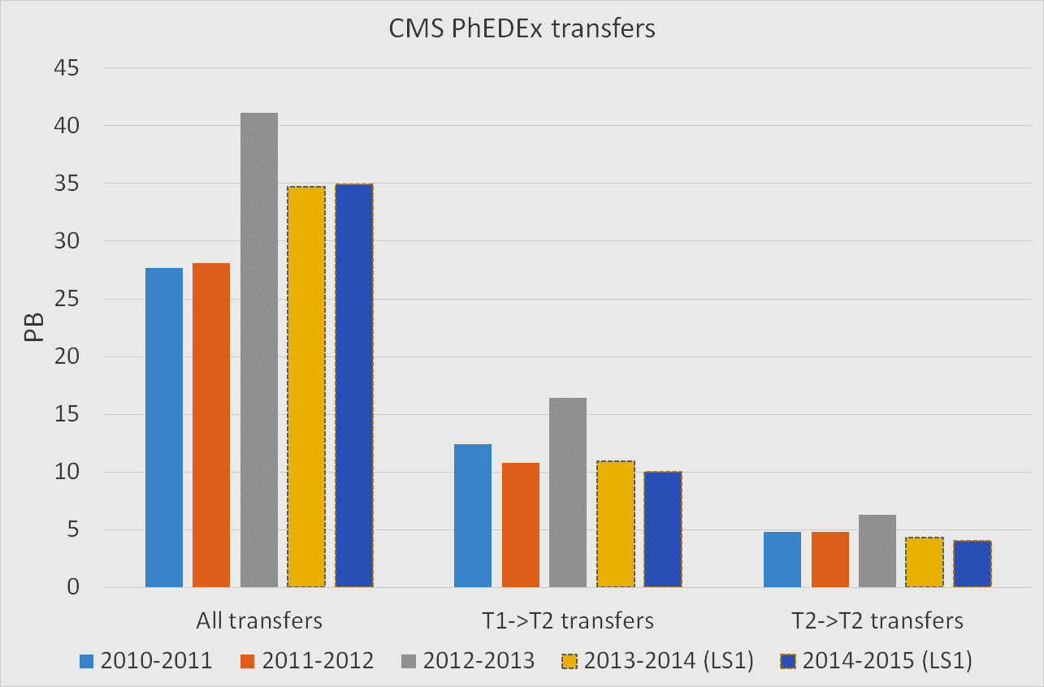
PhEDEx transfers over the past 5 years

Slide 5
ANSE & PhEDEx
Goals:
Enhance PhEDEx with circuit awareness capabilities
Provide a tool which can be used by others (ex. PanDA)
Motivation:
More deterministic transfers (schedule jobs with data)
Data prioritization over other traffic*
PhEDEx integration possibilities:
In the FileDownload agent (site level):
  Compromise between desired functionality and complexity
  Only has a local view
In the FileRouter agent (central level):
  Has a global view of the whole system
  Harder to implement and optimize
* When guaranteed BW is available

Slide 6
Integrating circuit awareness in the FileDownload agent – inner workings
Standard FileDownload agent:
Files from the transfer queue are grouped into transfer jobs
Jobs are handed to the transfer backend (FDT, FTS, etc…) for execution
Transfer backend reports back with transfer status
FileDownload agent reports back to DB
Updated FileDownload agent (CircuitAgent):
Determines whether a circuit is worthwhile and requests one if it is
Circuit request goes via the ResourceManager
When a new transfer job is ready to start
  Checks if a circuit is available (via ResourceManager)
  Updates job to use circuit instead of GPN
ResourceManager:
Interacts with PhEDEx via direct calls
Interacts with external programs via a REST interface
Handles the lifecycle of the circuit on behalf of those programs
Can handle different types of circuits (via plug-ins)
Notes:
(# of tasks/job varies)

Slide 7
Integrating circuit awareness in the FileDownload agent – inner workings
PhEDEx:
1) Determines whether a circuit is worthwhile* and requests one if it is
2) ResourceManager requests a circuit to its plugins
3) PhEDEx is informed and traffic is routed onto a circuit once it’s up
Circuit worthwhile:
Priority traffic
At least a few hours of transfer in queue
Significant gain expected from using it
Notes:
(# of tasks/job varies)

Slide 8
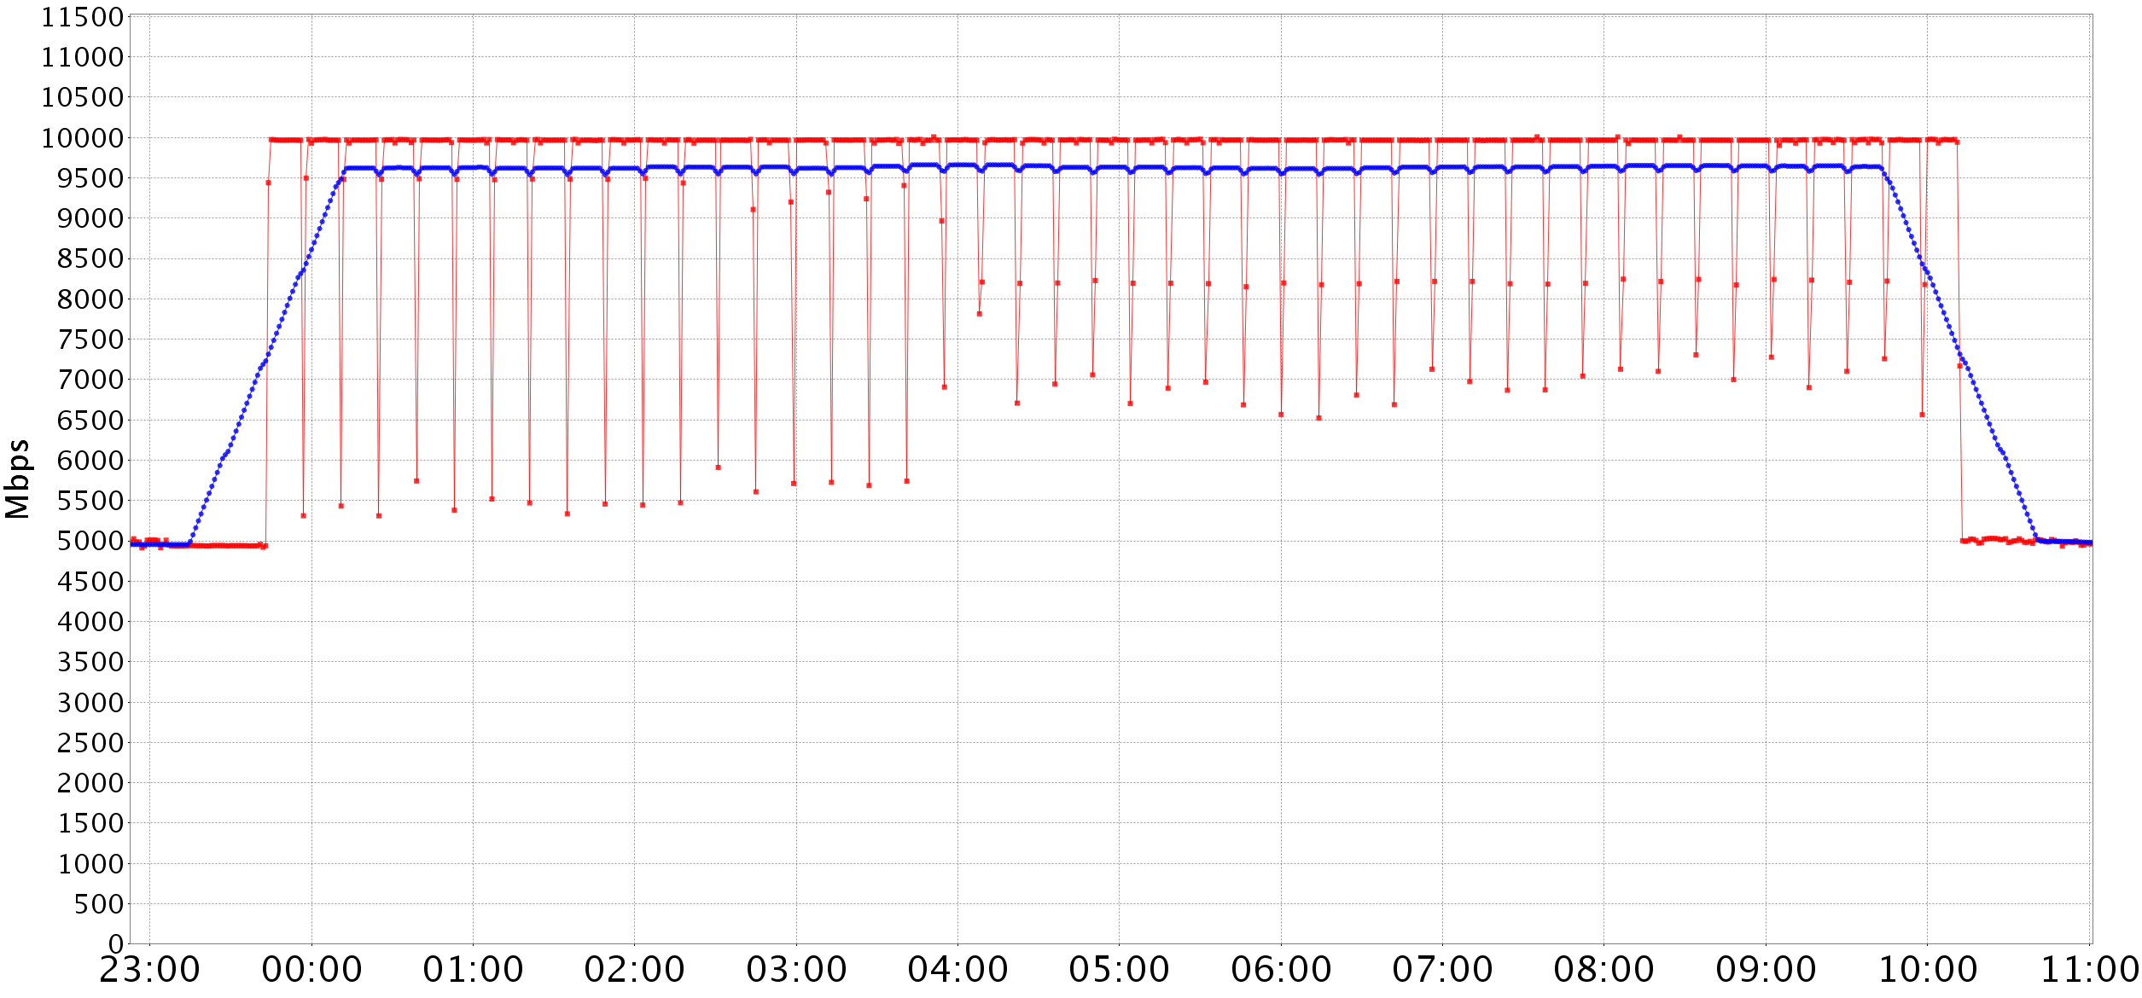
PhEDEx integration of BoD (initial results)
Using shared path
- Link throughput (data points @ 1 min)
- Moving average over 1h
Link saturation
Background Iperf traffic @ 5Gbit/sec

Slide 9
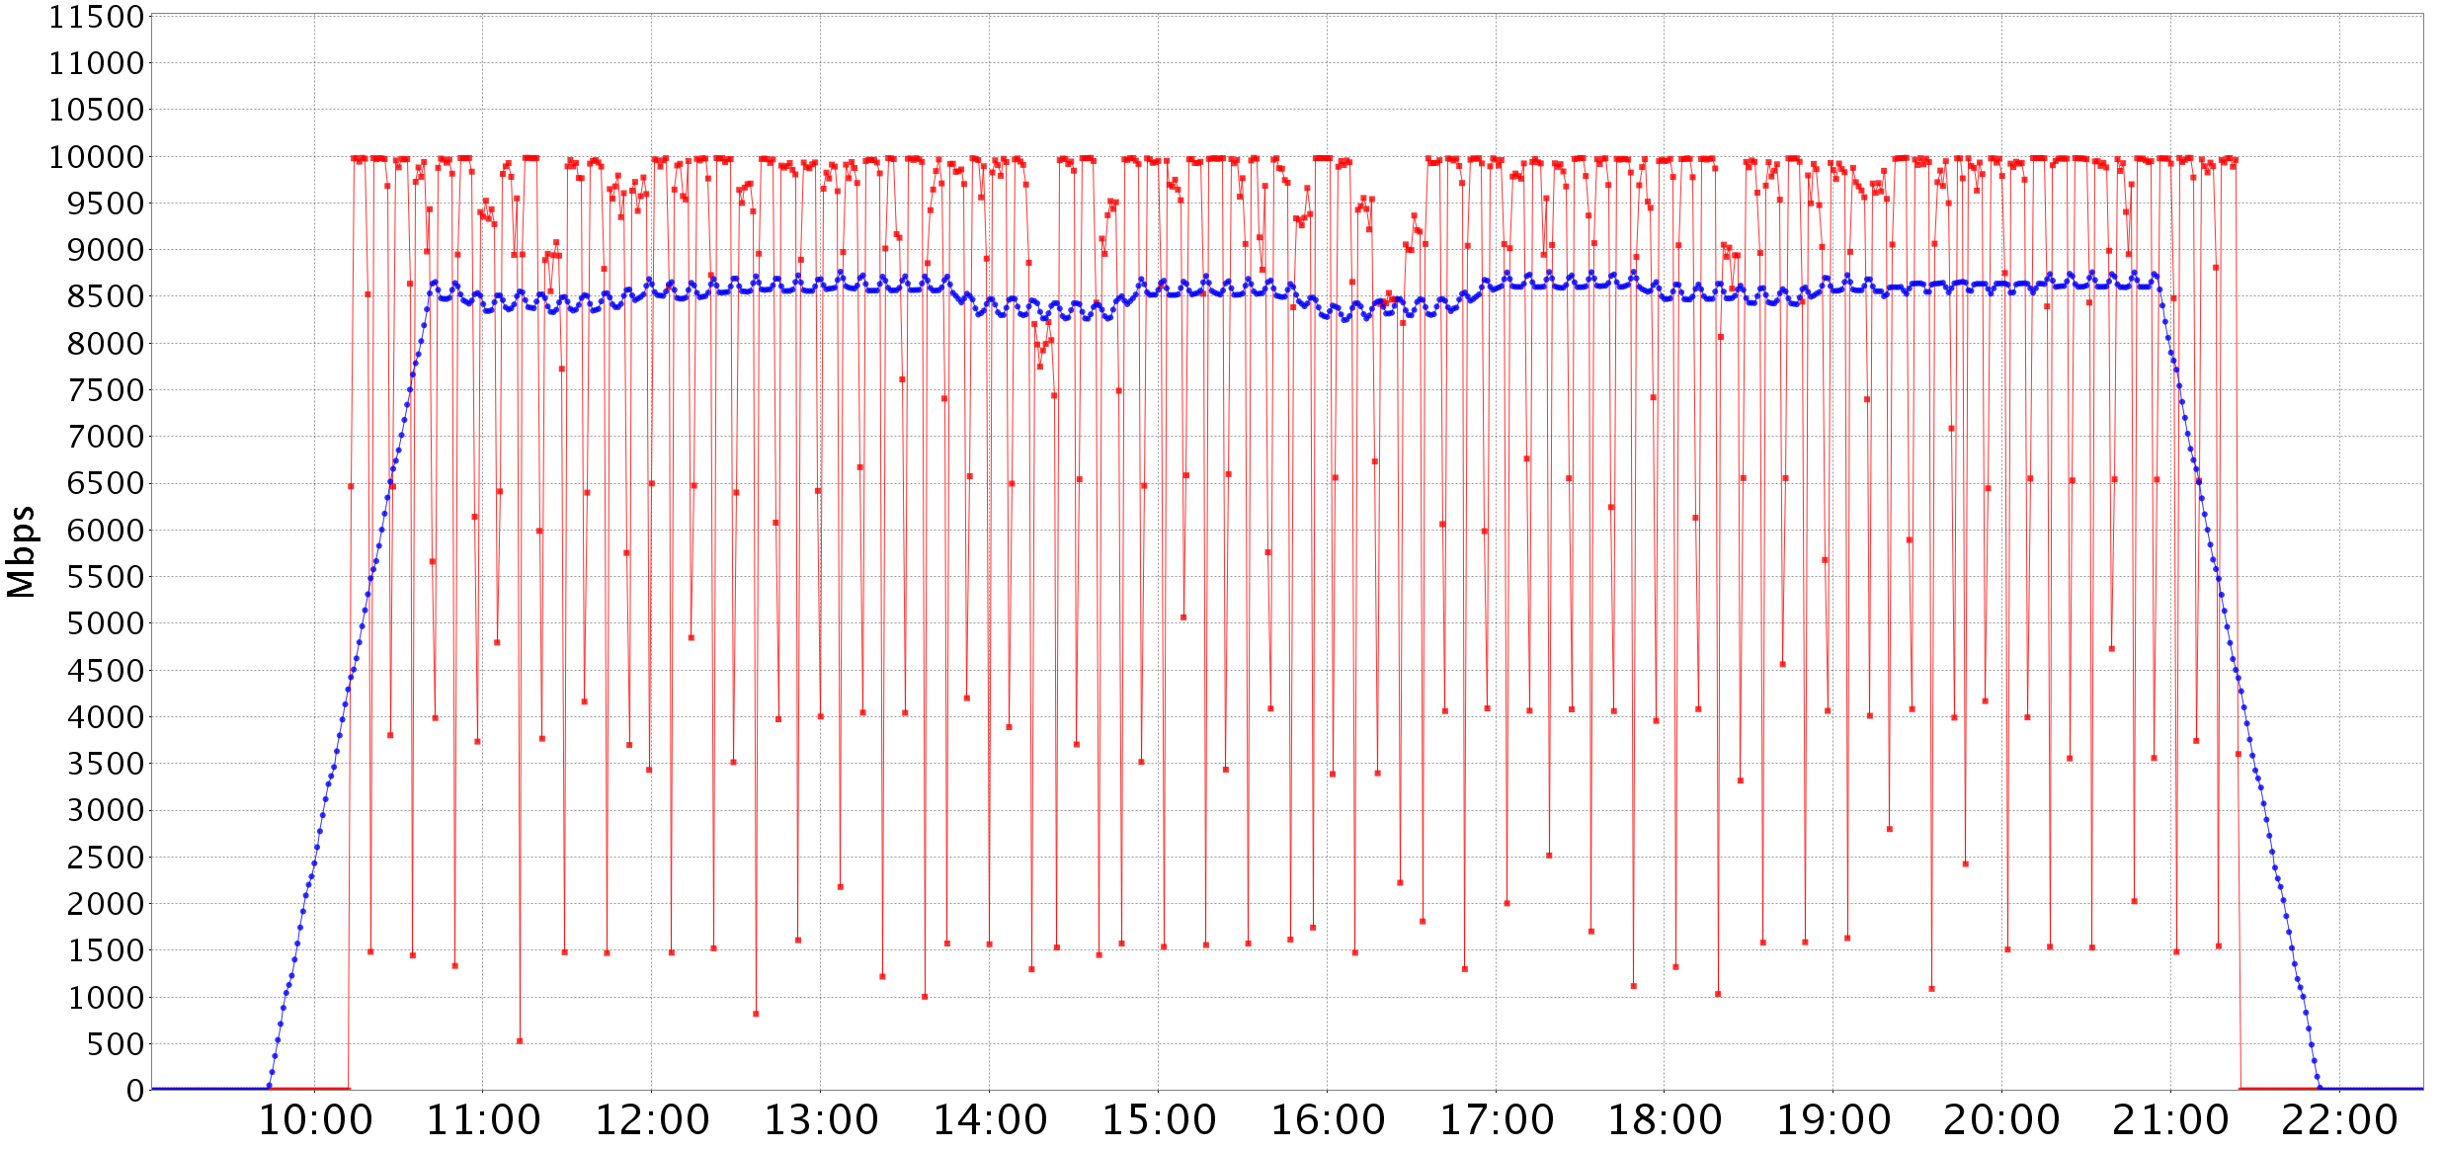
PhEDEx integration of BoD (initial results)
Using dedicated circuit
- Link throughput (data points @ 1 min)
- Moving average over 1h

Slide 10
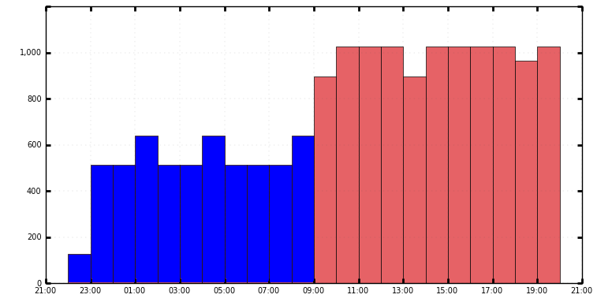
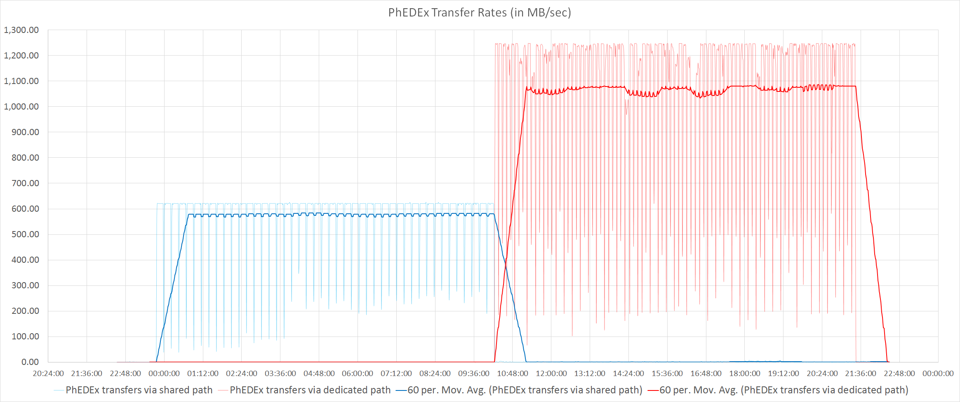
PhEDEx integration of BoD (initial results)
Seamless path switch
Per job link rates with PhEDEx traffic
  ~620MB/sec -> 1060 to 1250MB/sec
Average link rates with PhEDEx traffic
  ~570MB/sec -> ~1050MB/sec
Differences between per job and avg. rates
  Delay in starting jobs
  Sustained 10G to disk sometimes challenging
1200
Phedex reported rates
MB/sec
Limited by background traffic

Slide 11
Summary & future plans
PhEDEx is ready to use circuits when they are available
Software is backend agnostic
No modifications done to PhEDEx DB
Control logic is in the FileDownload agent
Lifecycle handled by the ResourceManager
Transparent for all other PhEDEx site agents
ResourceManager can be used as a 3rd party tool
Future plans:
Finish the creation of the NSI plug-in for PhEDEx
Solve the issue of how to route data once a circuit is active*
Demonstrate circuit management capabilities between select sites
Demonstrate improvement while using circuits
* More on that in my next presentation

Slide 12
Thank you

Slide 13
Class diagram

Slide 14
Sequence diagram

Slide 15
Integrating circuit awareness in the FileDownload agent – inner workings
More about the FileDownload agent:
Agents are event driven (POE)
Transfer tasks are assigned to it (one file = task)
Each task contains the source and destination PFNs
Tasks are bulked into transfer jobs (# of tasks/job varies)
This job is handed to the transfer backend (FDT, FTS, etc…)
Each task in the job goes through the following flow
  start_task: starts the transfer workflow for a task
  transfer_task: marks a task as ready to transfer
  transfer_done: saves task status and transfer info
  finish_task: marks task as completed
When all tasks in a job pass “transfer_task”, the backend begins transfer
Backend reports back with transfer status
If we want to use other paths for transfers, we need to modify the PFNs*
best place to do that is to insert our code into transfer_task
*PFN = protocol://hostname[:port]/[partial_path_to_root]/LFN

Slide 16
Initial results
Two 10G links/circuits:
Link1: shared path
  Background traffic @ 5Gbit/sec UDP generated by Iperf
Link2: dedicated circuit for PhEDEx
Sandy01 gva/ams:
dual cpu E5-2670 (2x8 physical cores with HT)
64GB ram
2 LSI controllers with 8 SSDs each
  4 x 4 SSD RAID 0 arrays
  1 LSI controller (2x4 SSDs) used for ANSE tests
Monitoring link performance with MonALISA

Slide 17
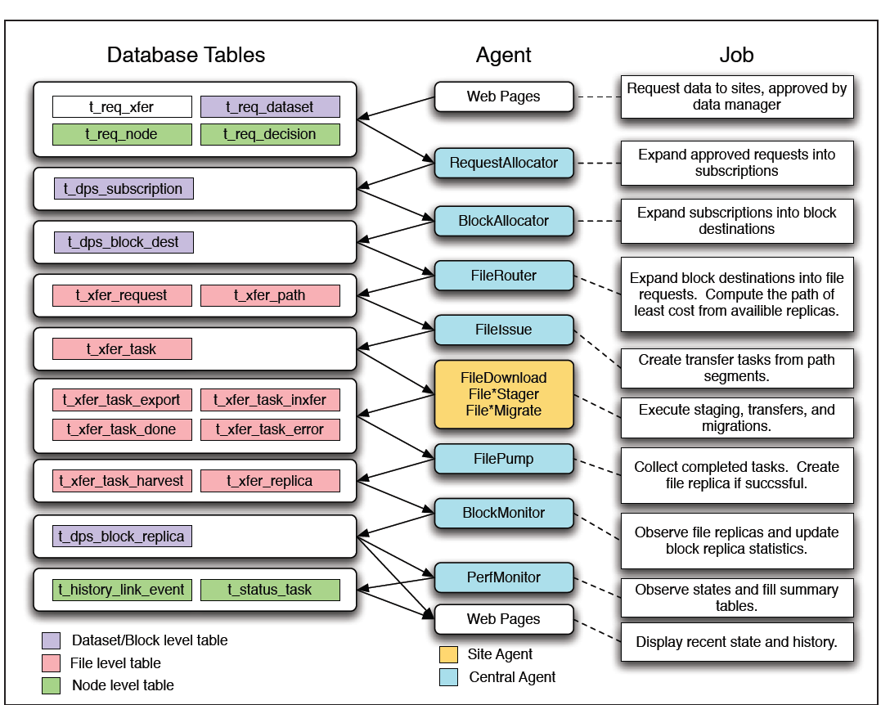
PhEDEx workflow

