Slide 1

Neutron Converting Thin Films
Activities in Linköping
PVD of ¹⁰B₄C
CVD of B₄C
Coating production
Gd thin film work so far
Carina Höglund
carina.hoglund@esss.se

Slide 2
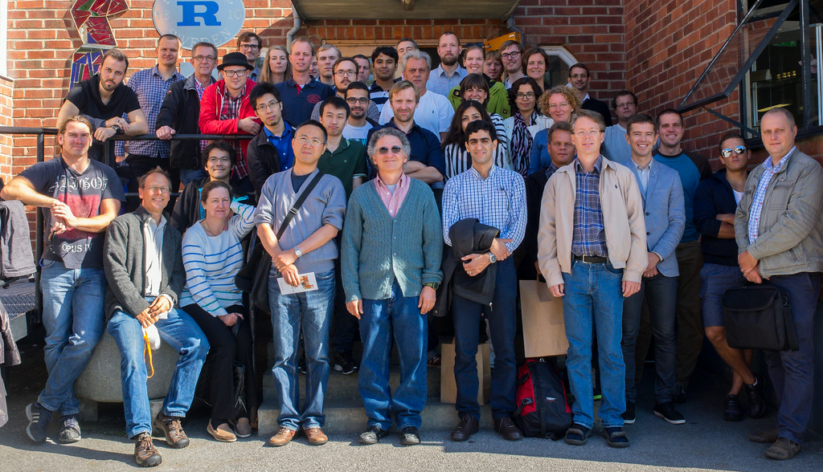
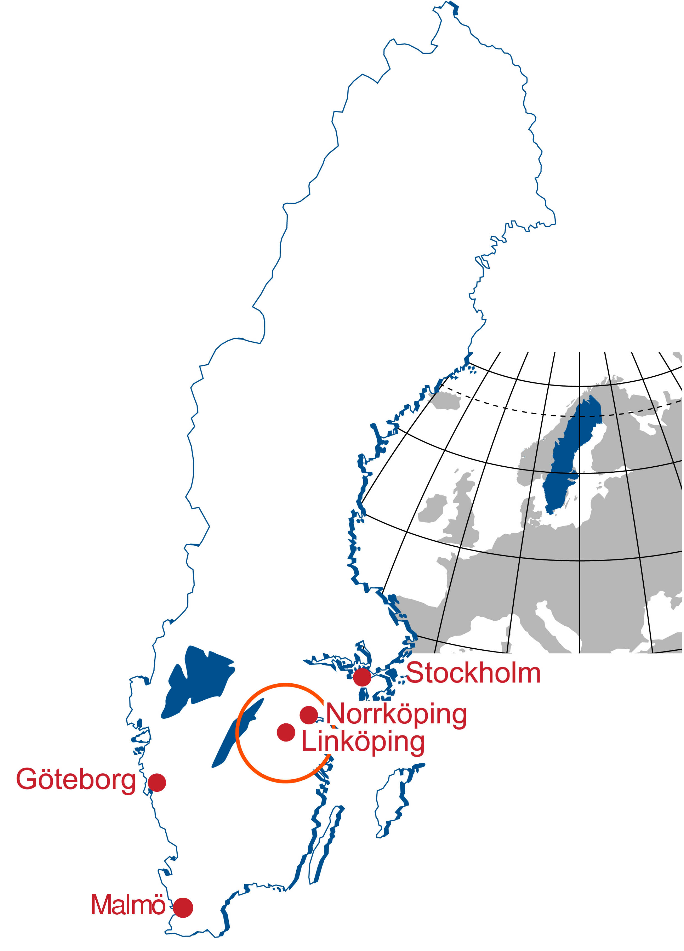
Thin films at Linköping University
2
Thin Film Physics division in Linköping:
~60 persons (26 PhD students)
  Hard and low-friction coatings
  Energy materials
  Power electronics & wide-band semiconductors
  Gas and chemical sensors
  Conducting polymers
  Neutron-detecting films
State-of-the-art laboratories
Integrating experiments,
theory, and modeling
Spin-offs include Ion Bond, Thin Film
Electronics, Impact Coatings, n-Works
Materials Research at IFM
(~250 persons)
Interdisciplinary, involving
industry and institutes
Analysis techniques:
TEM, SEM, EDX, XRD, ERDA, RBS, AES, XPS, ToF-SIMS, AFM, STM, etc…

Slide 3
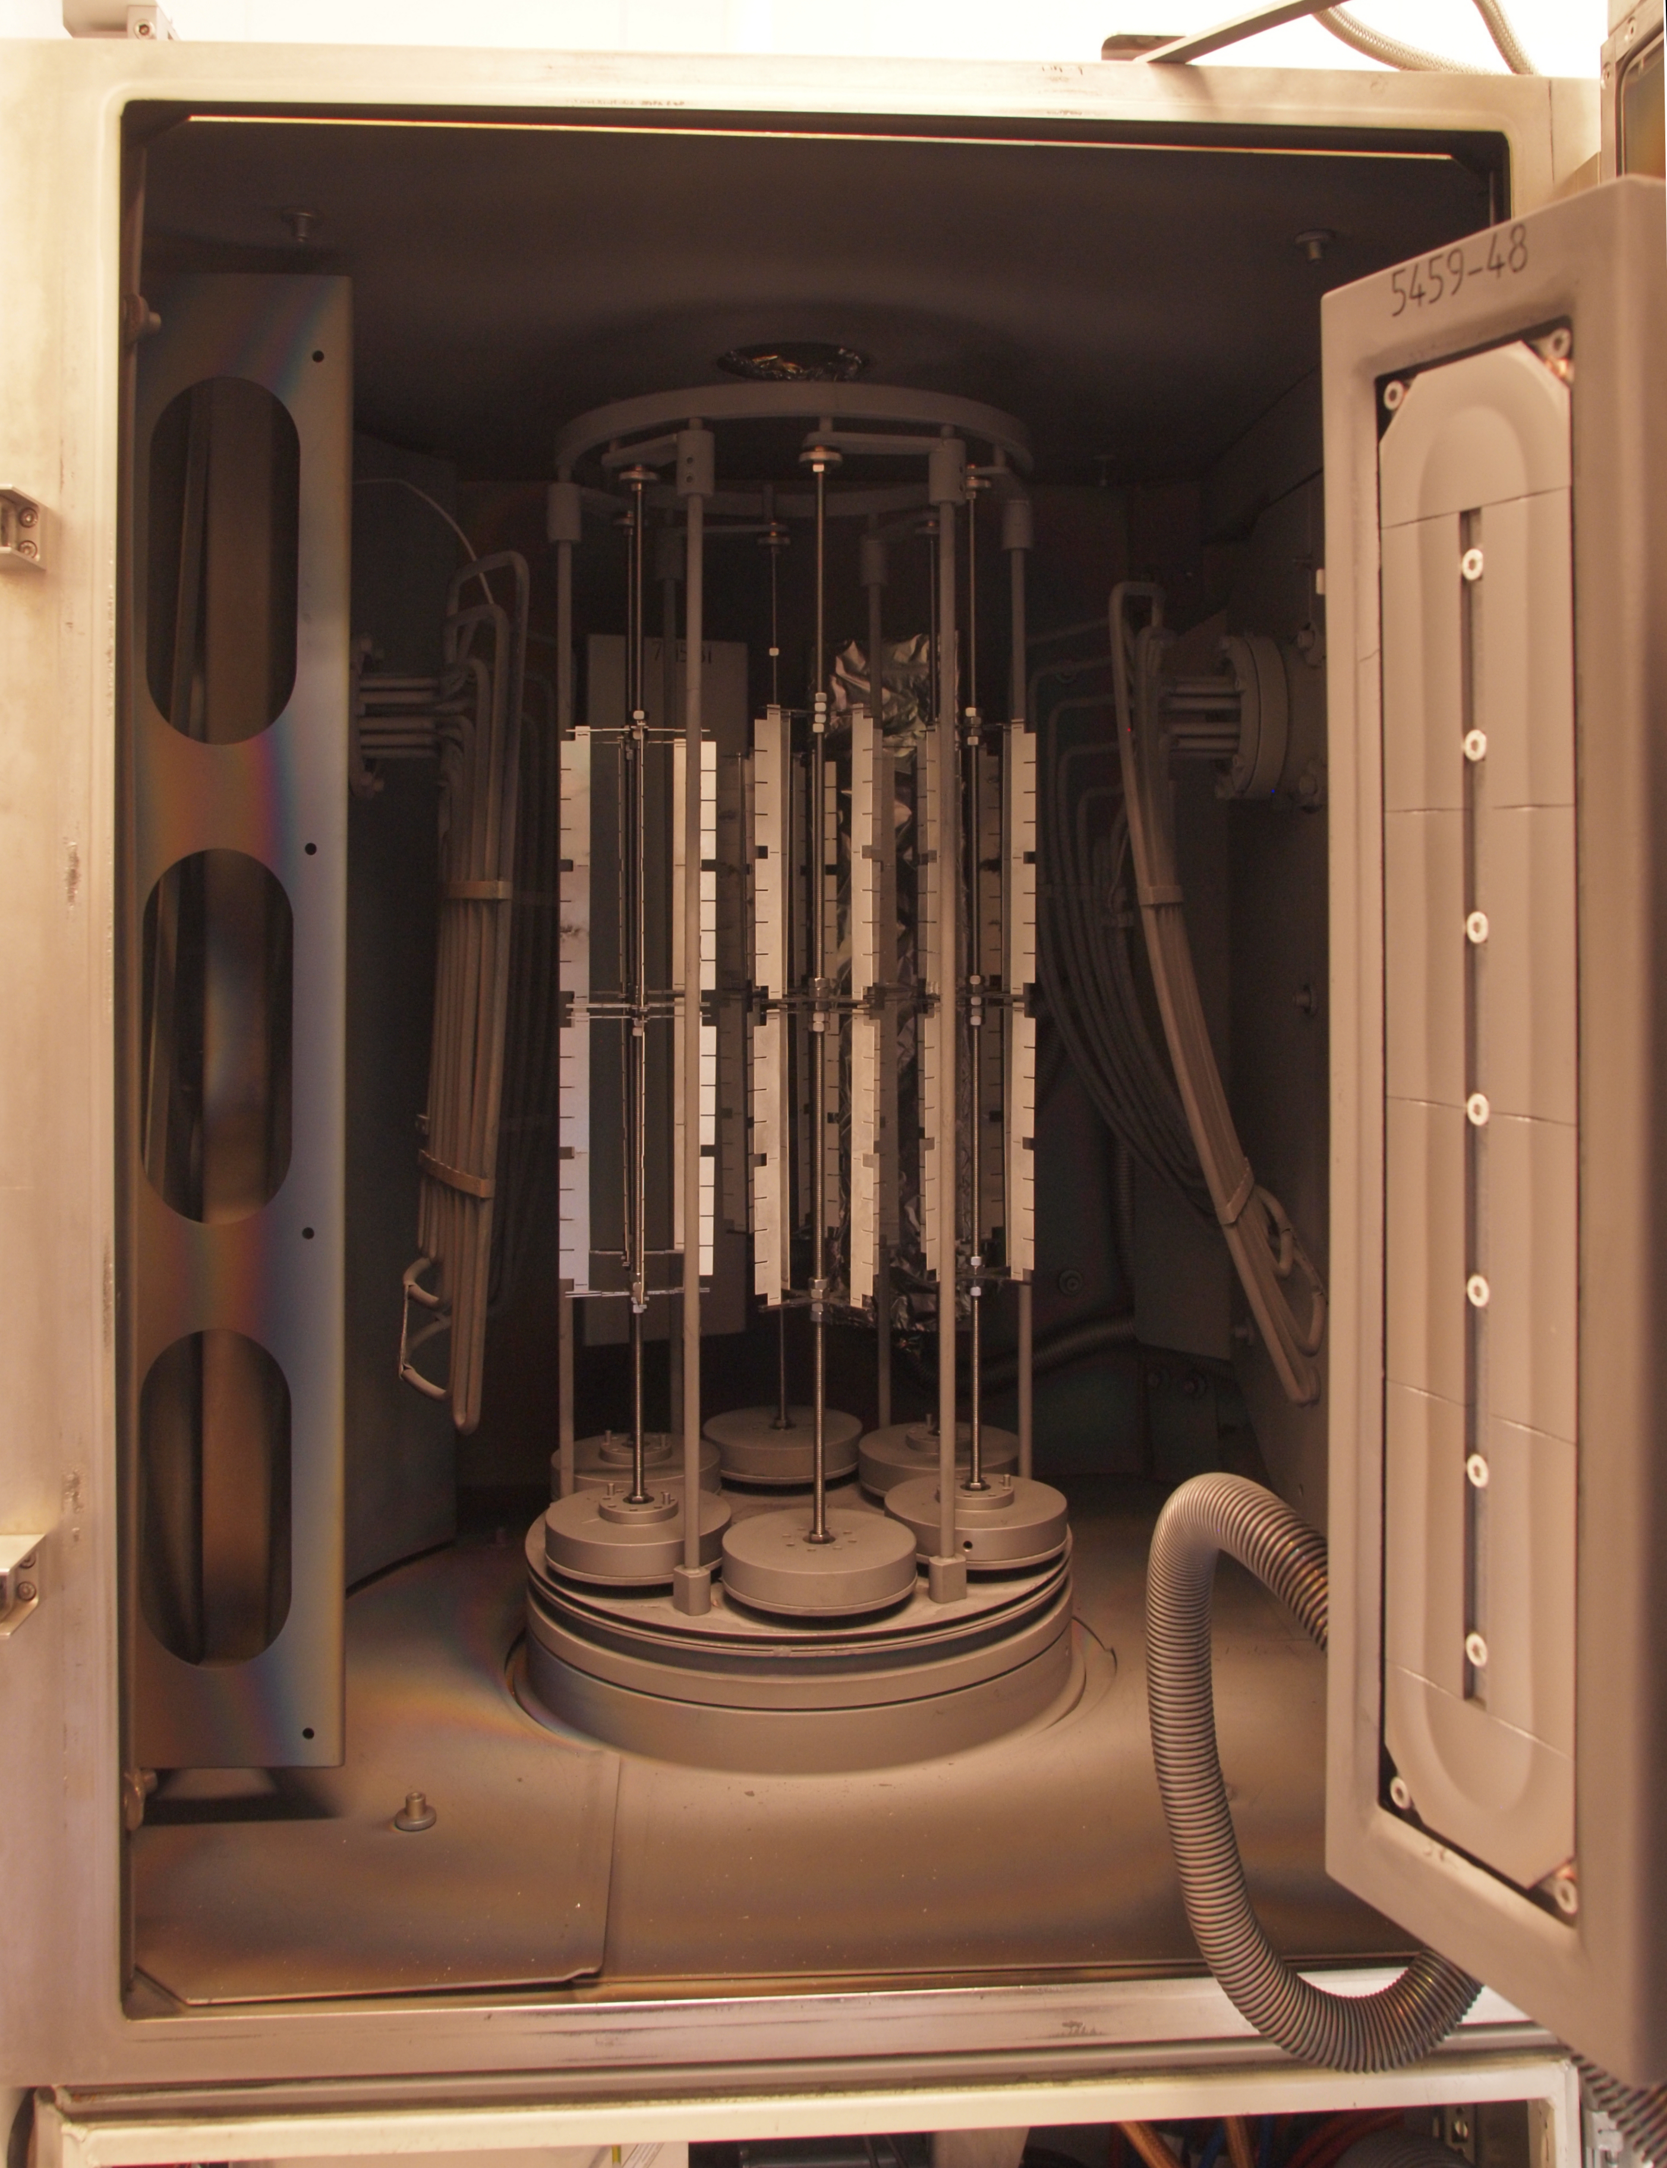
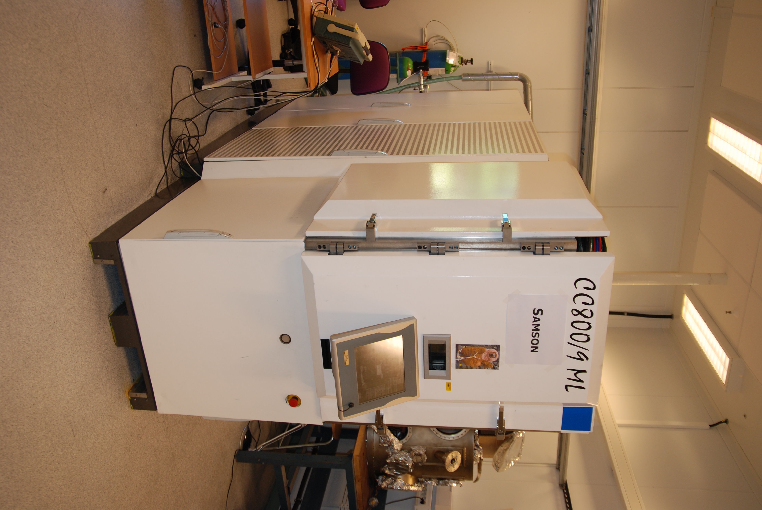
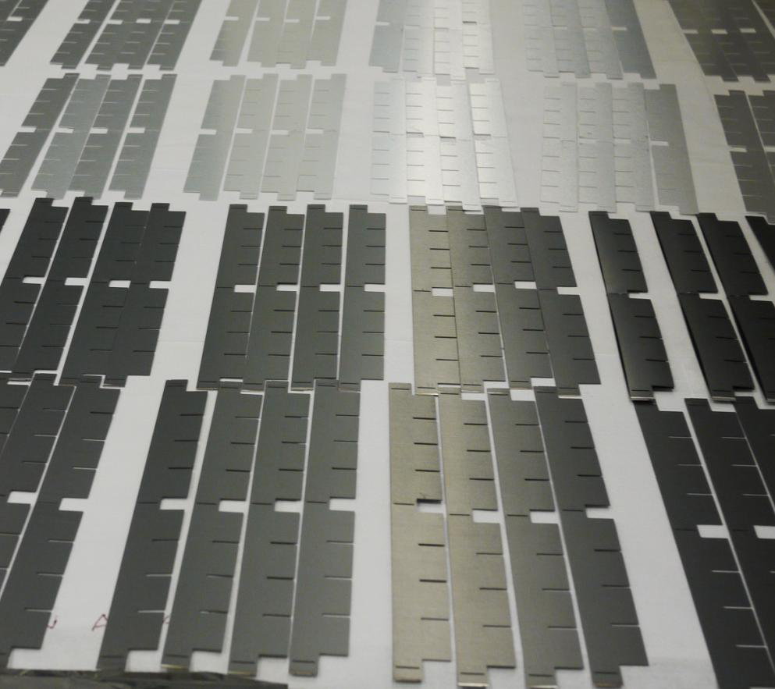
Magnetron sputtering of ¹⁰B₄C
3
2-side coated substrates ➔ 3-fold rotation
Good adhesion on Al, Si... ➔ >1 μm on Al, Si, Al₂O₃, etc
High density ➔ 97% of bulk
Maximize amount of ¹⁰B ➔79.3 at.% of ¹⁰B
Minimal amount of impurities ➔ H + N + O only ~1 at.%
Thickness control and uniformity ➔ Understood and under control
Neutron radiation hard ➔ Survive 10¹⁴ neutrons/cm²
Large area depositions ➔ Coated >100 m² in May 2014 for IN5 demo
SEM
ToF-ERDA
¹⁰B₄C
Si
1 μm

Slide 4
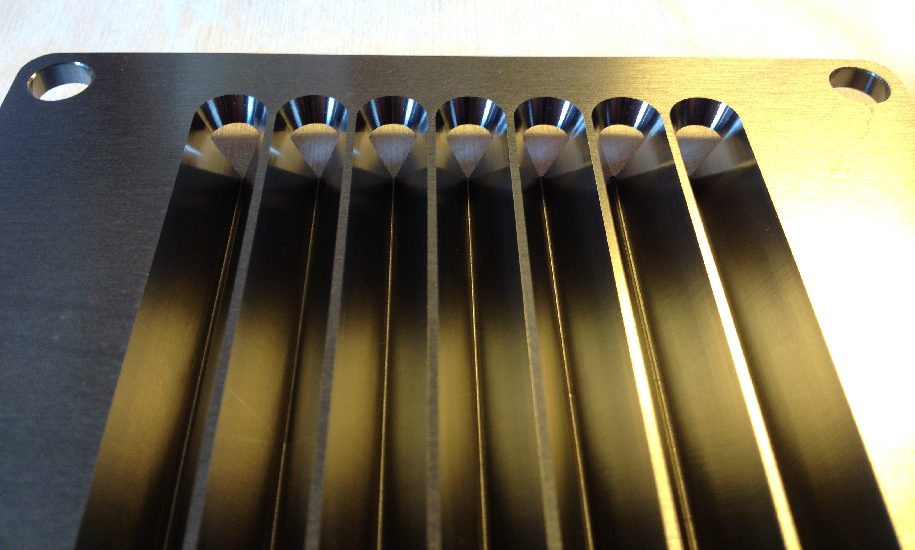
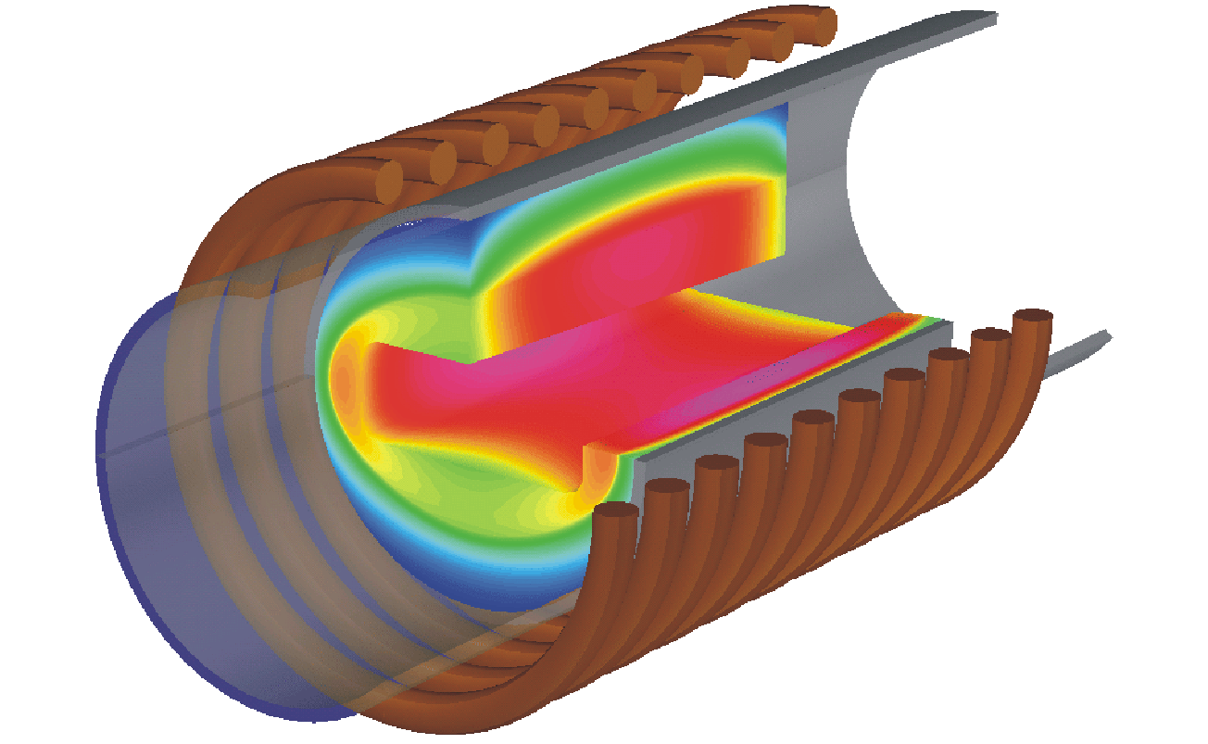
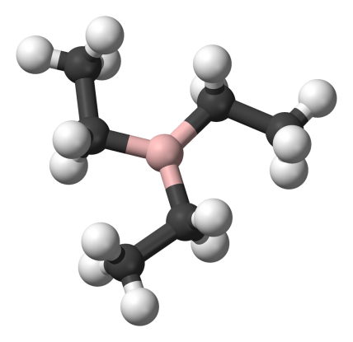
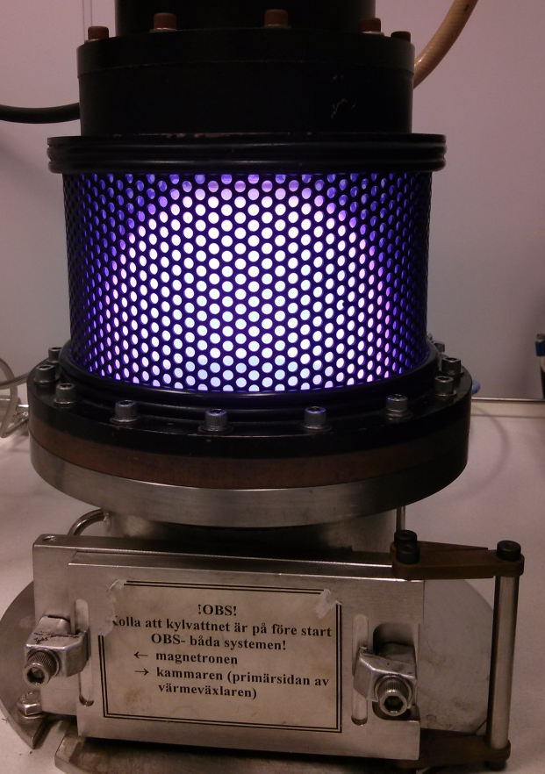
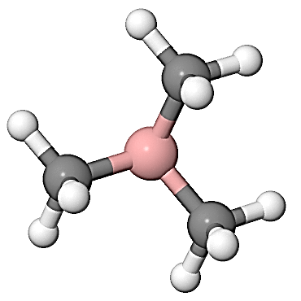
CVD of B₄C
Not a line of sight technique ➔ Complex geometries
Demands on a CVD process:
Low temperature, < 600 °C
No corrosive gases
Easy up scaling
Organoboranes:
Very reactive – low process temperature!
- Trimethyl borane (TMB): B(CH₃)₃
- Triethyl borane (TEB): B(C₂H₅)₃
Al-substrates
Thermal CVD
Plasma enhanced CVD
TEB
Carrier gas
(H₂ or Ar)
TMB
Ar carrier gas/plasma gas
H. Pedersen, C. Höglund et al., Chem. Vap. Dep. 18, 221 (2012)

Slide 5
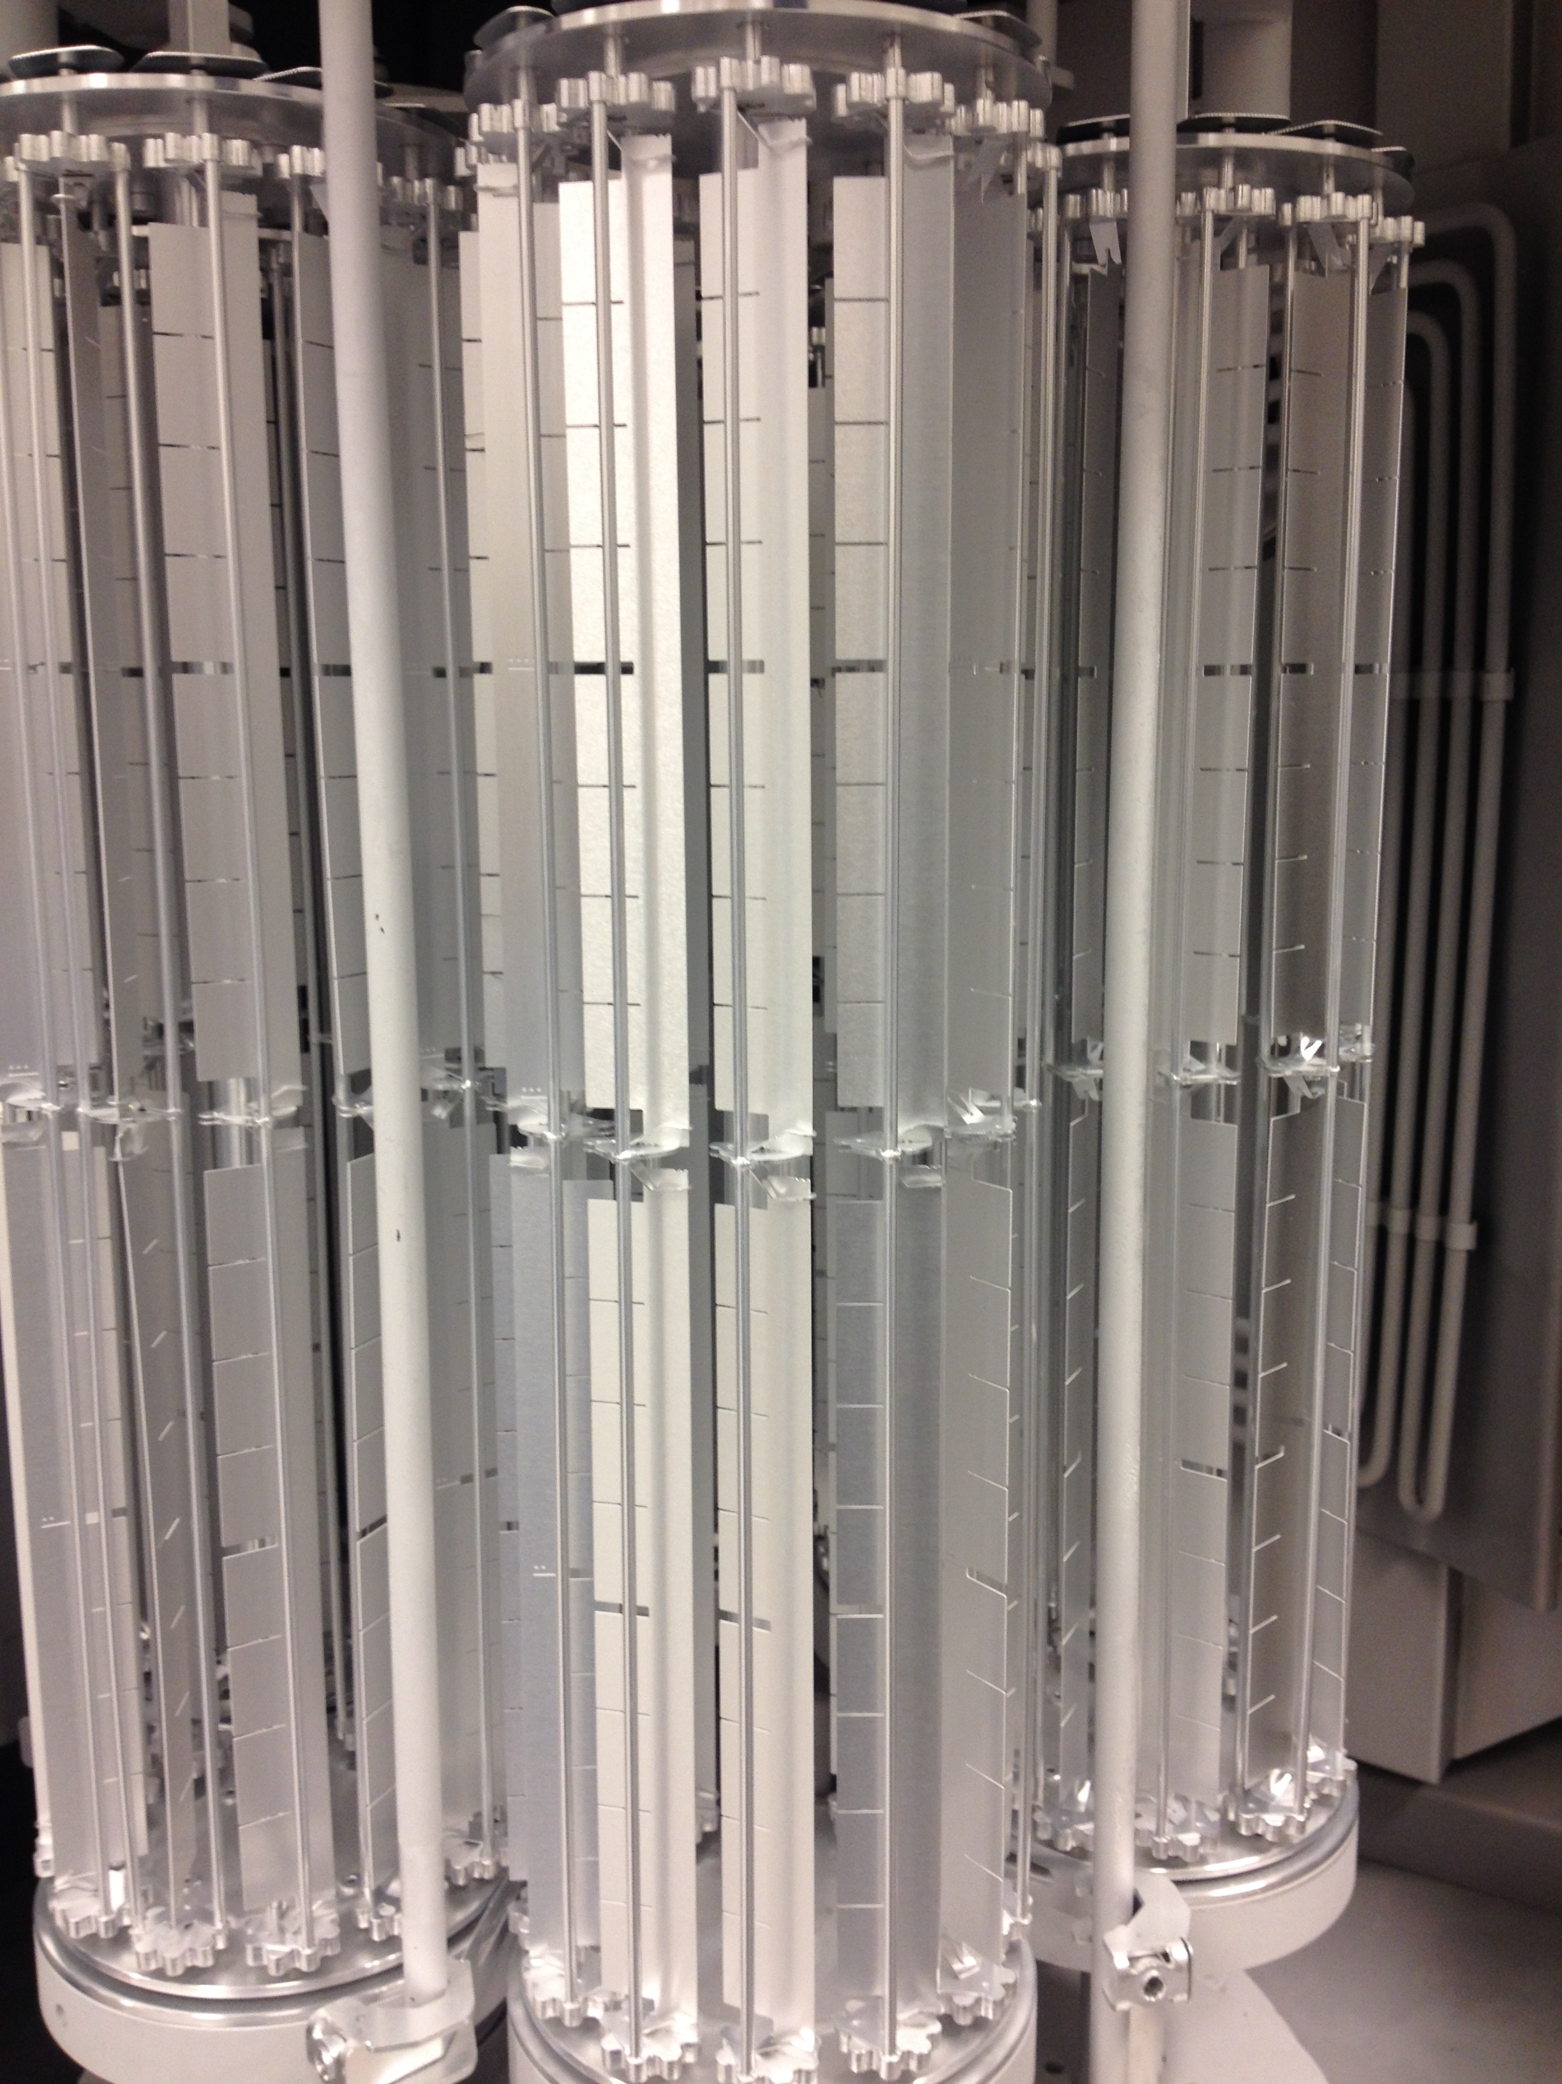
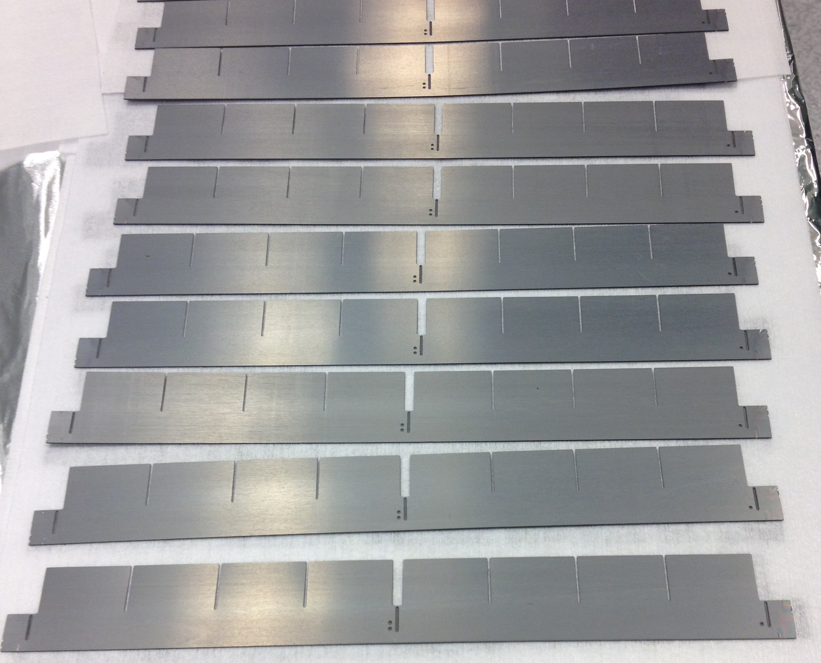
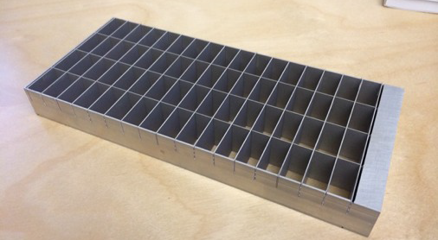
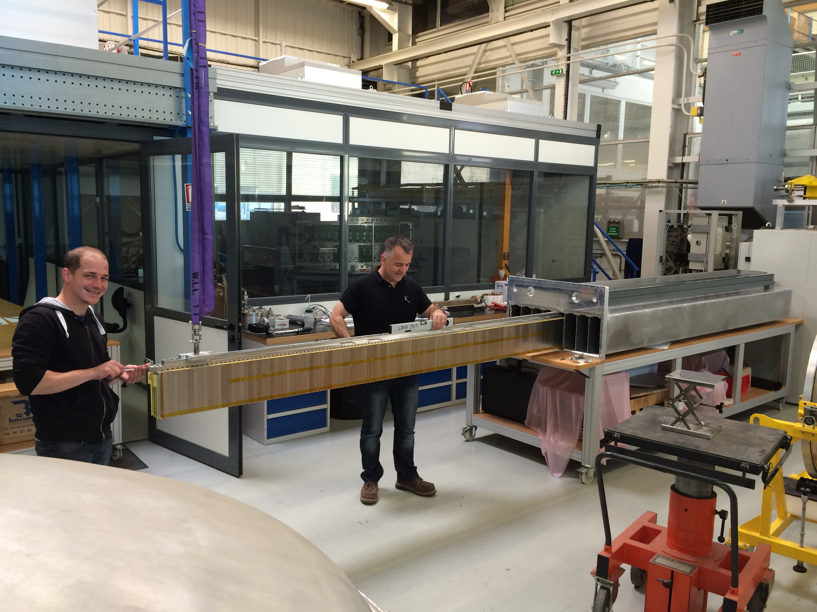
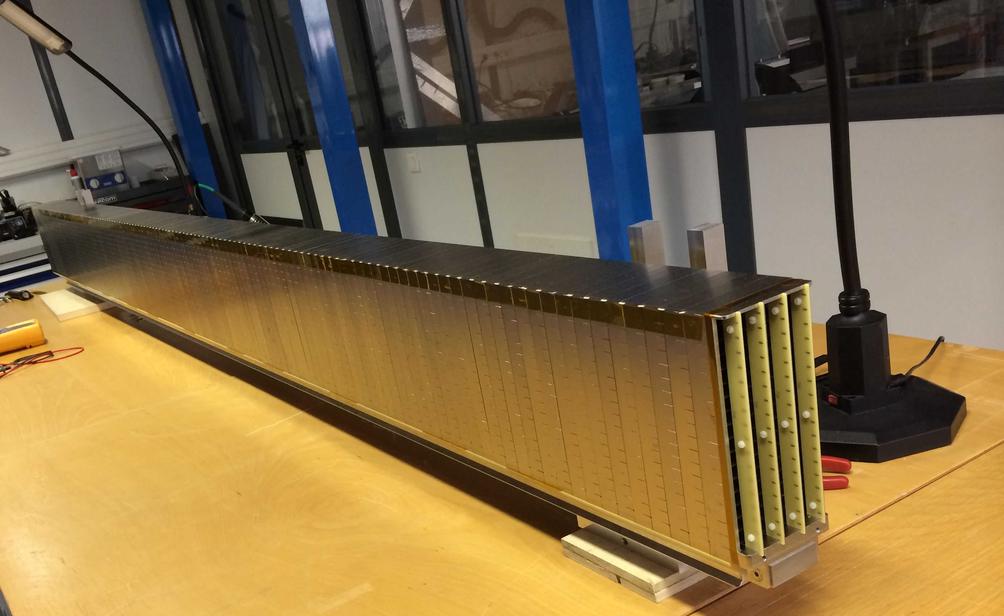
IN5 segment
5
Collaboration ESS – LiU – ILL
0.8 x 3 m² detector area
27 000 blades with ¹⁰B₄C (>100 m²)
Expect 60% efficiency @2.5 Å
Deadline September 2014
➔ Mass production test!

Slide 6
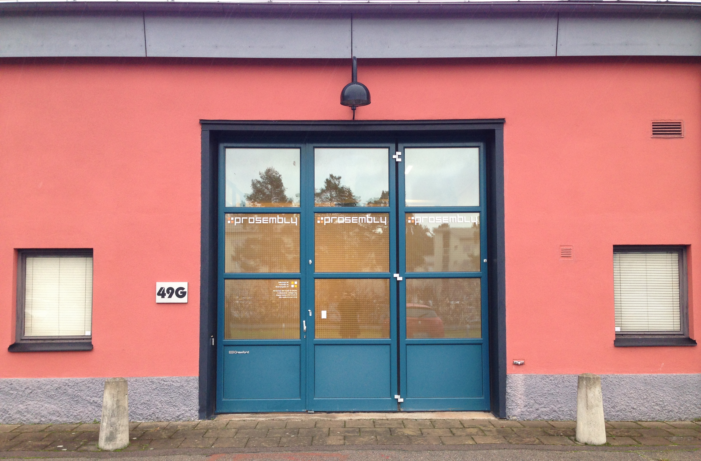
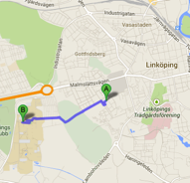

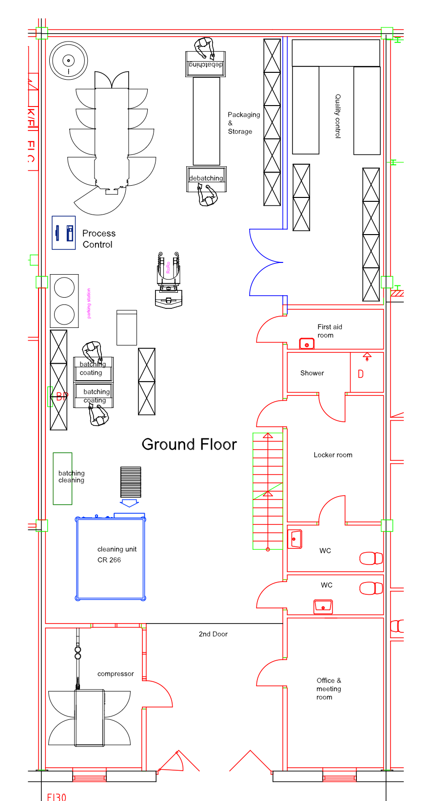
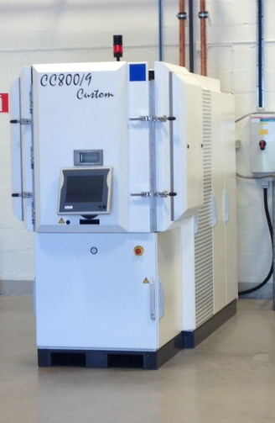

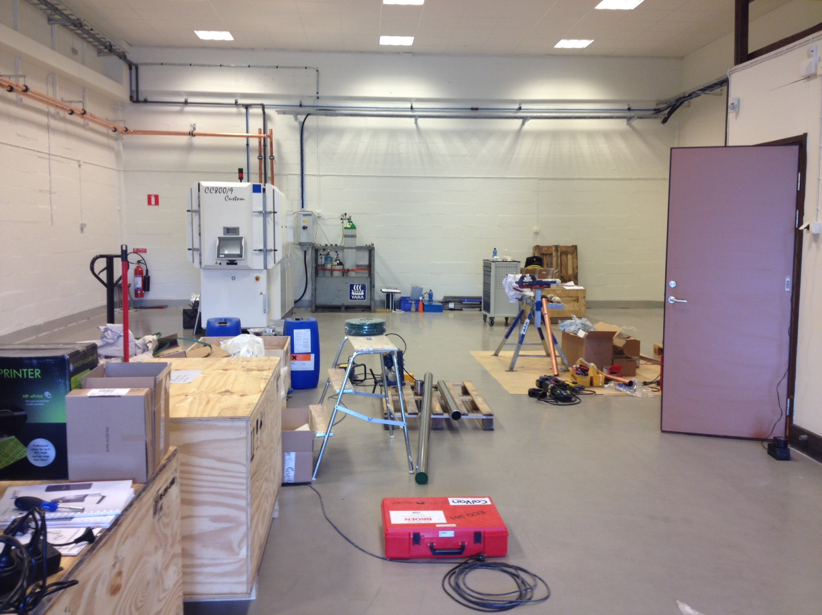
Coating production
6
”ESS”
LiU
New facility
New colleague - Linda
2014-2016: Up-scaling
Capacity for >1000 m² of ¹⁰B₄C per year
(ESS needs >6000 m²)

Slide 7
Gd compounds for n-detection
7
Problem: Oxidization
Can we find a stable and conducting compound?
Gd is known to oxidize severely
A GdN thin film of ~200 nm is fully oxidized within 12 h
Possible solution:
Stabilize GdN by alloying with a chemically, mechanically,
and/or thermally more stable nitride!
Consider TM_{1−x}Gd_{x}N, with TM = Ti, Zr, Hf

Slide 8
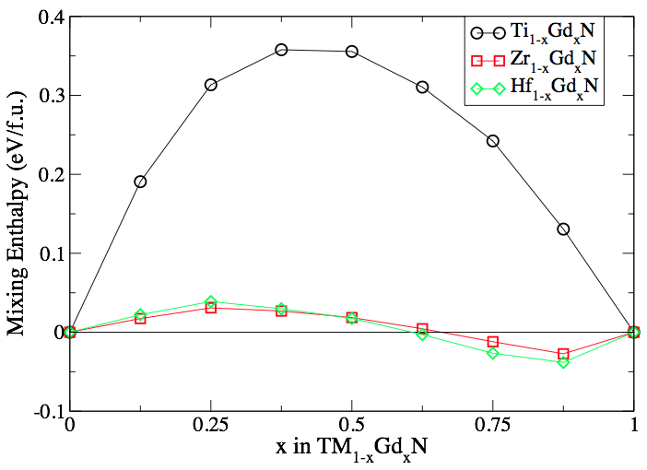
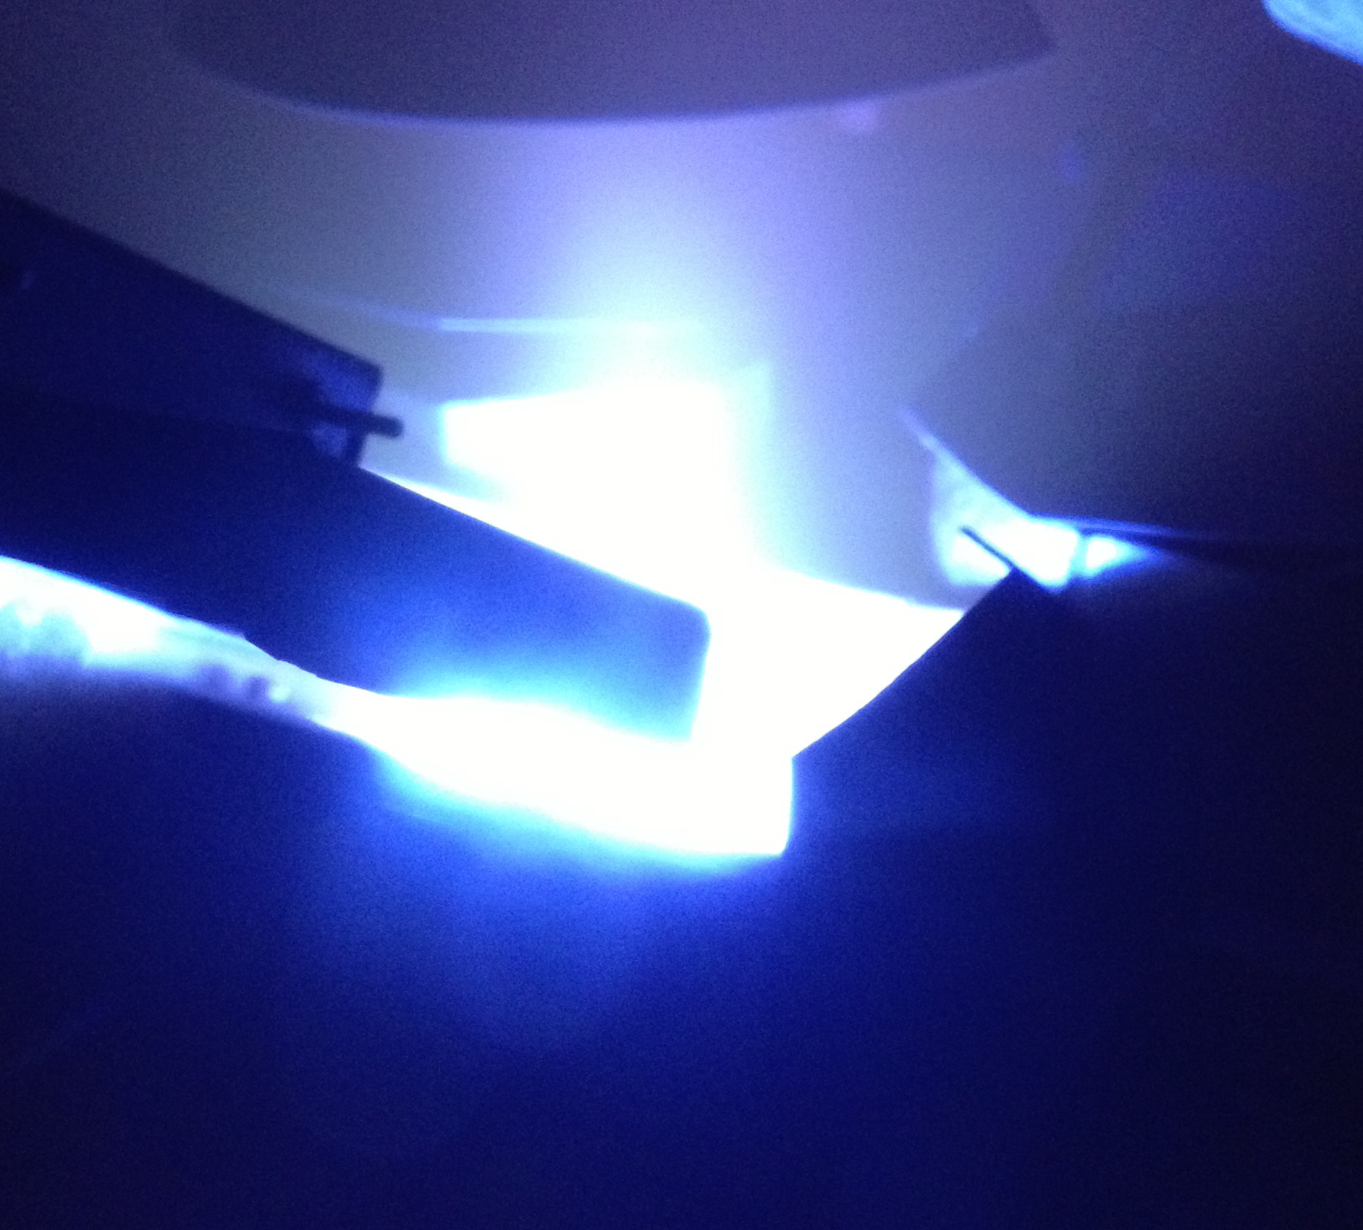
TM_{1−x}Gd_{x}N from first principles
(TM = Ti, Zr, Hf)
8
Ti → Phase separation
Zr, Hf → Readily mix
Magnetron sputtering
Solid solution of Zr_{1-x}Gd_{x}N?
Oxidation resistance?
Material to consider for neutron detectors?
B. Alling, C. Höglund et al., Appl. Phys. Lett. 98, 241911 (2011)

Slide 9
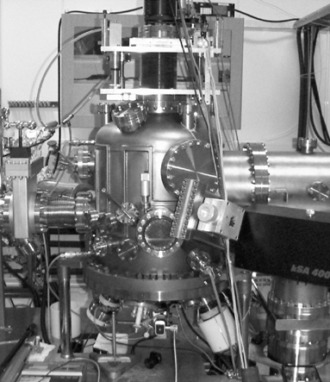
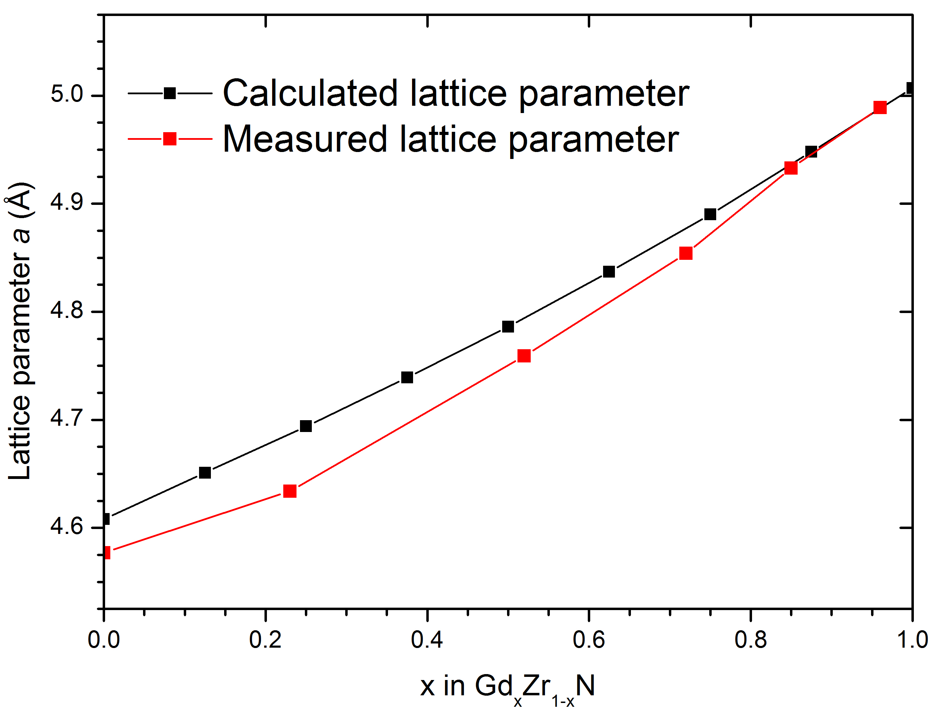
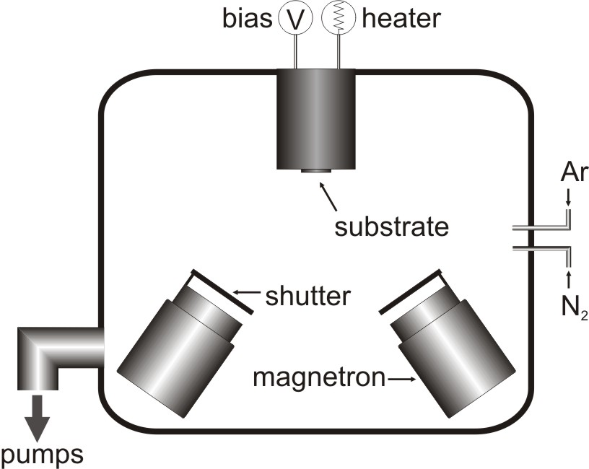
Deposition of Zr_{1-x}Gd_{x}N
9
Reactive magnetron sputter epitaxy (MSE)
UHV conditions: p_{base} = ~10⁻⁸ Torr
Seed and capping layers (when used): ZrN

Slide 10
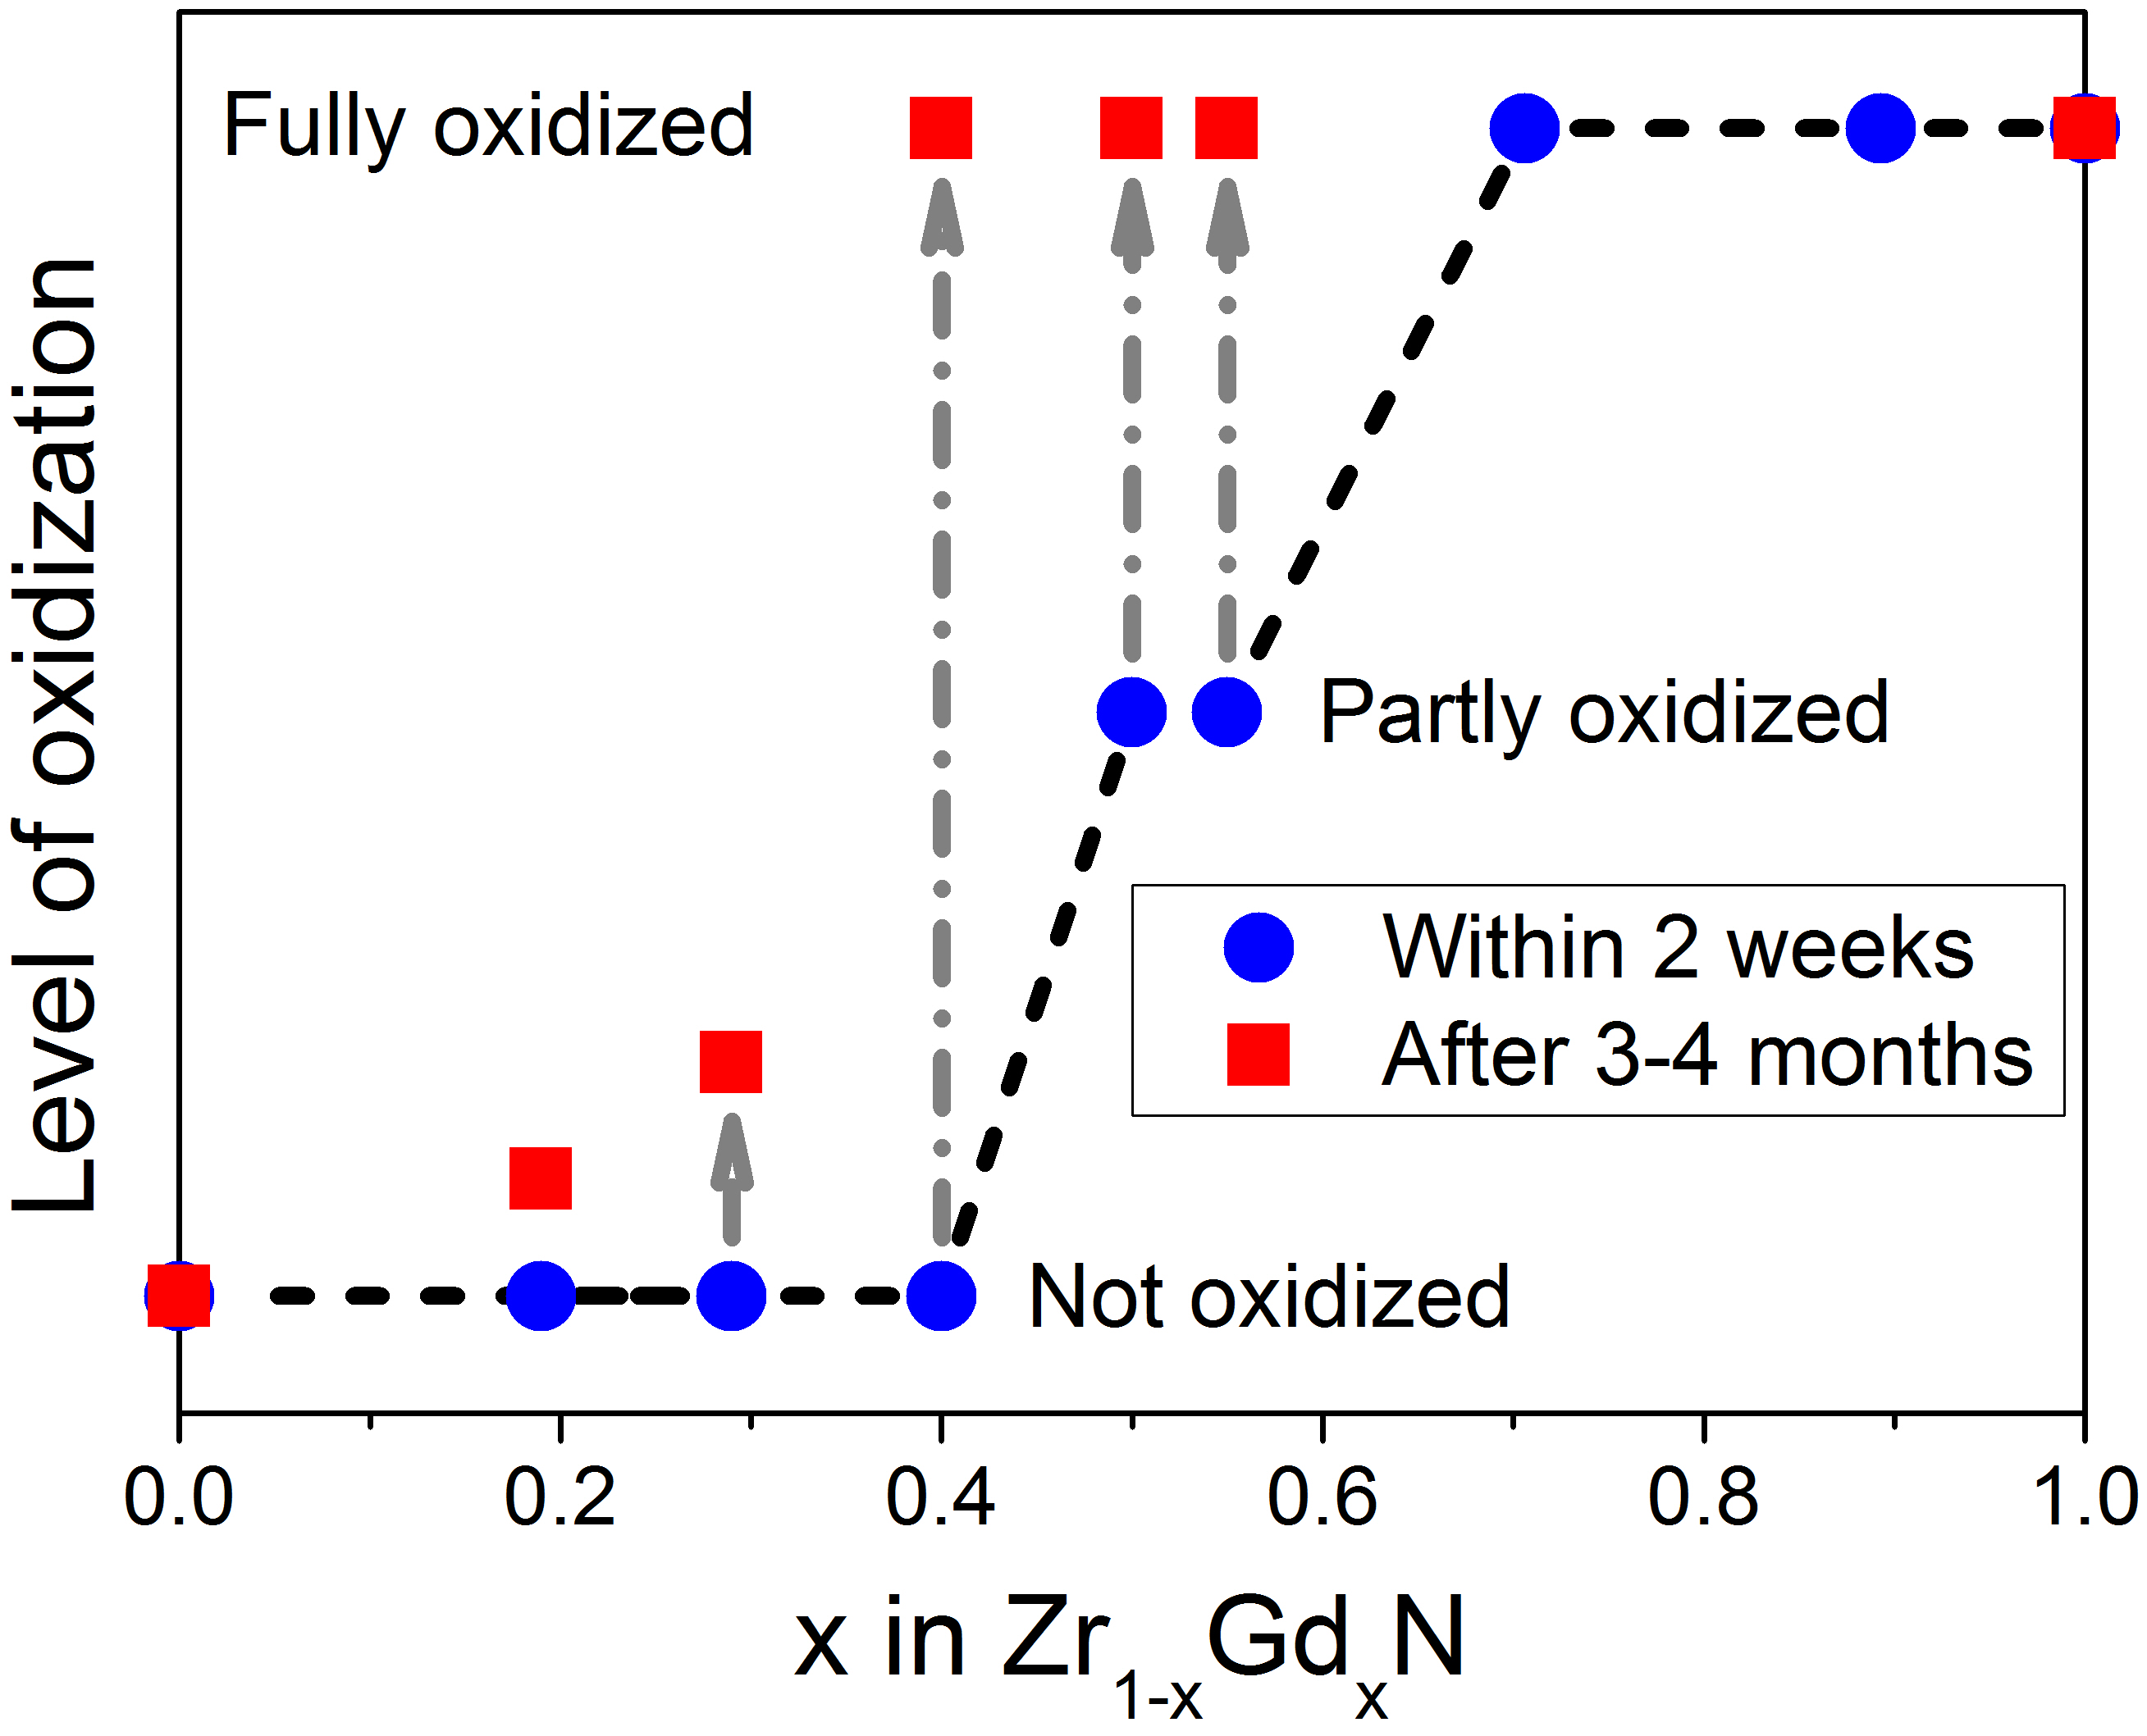
Zr_{1-x}Gd_{x}N solid solution
Oxidization
10
No capping or seed layer
Substrate temperature 400 °C
Oxidization level measured
with RBS after:
⬥ <2 weeks
⬥ 3-4 months
Very little Gd results in oxidization
Capping and seed layer needed
for long time stability

Slide 11

Thank you
for your
attention!
carina.hoglund@esss.se

