Slide 1
Coping with Emittance Measurement Challenges in the LHC after LS1
Gentner Day October 2014
An Overview of Control and Data Flow Related to LHC Emittance Measurements
Maria Kuhn – October 15, 2014

Slide 2
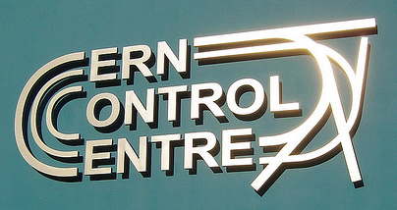
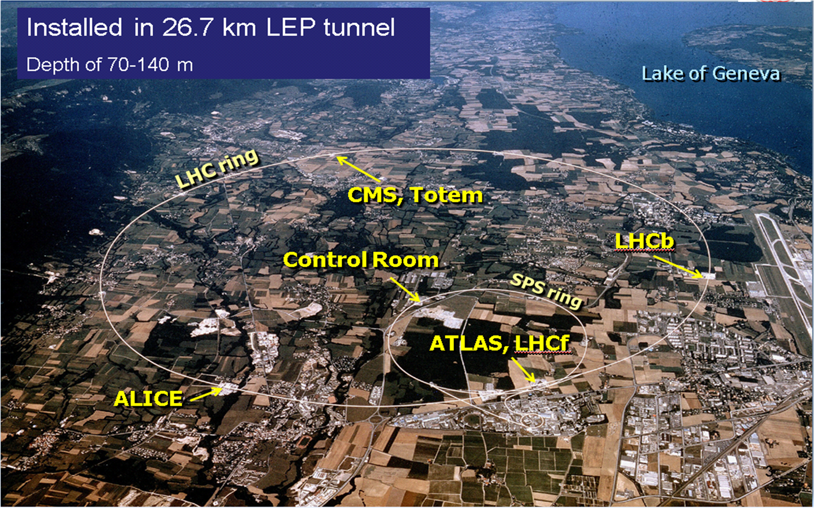
My Background
Accelerator physicist from University of Hamburg
  Technical student at CERN in 2012
Enrolled in the Gentner Program since May 2013
Working in BE-OP-LHC:
Emittance Preservation at the LHC

Slide 3
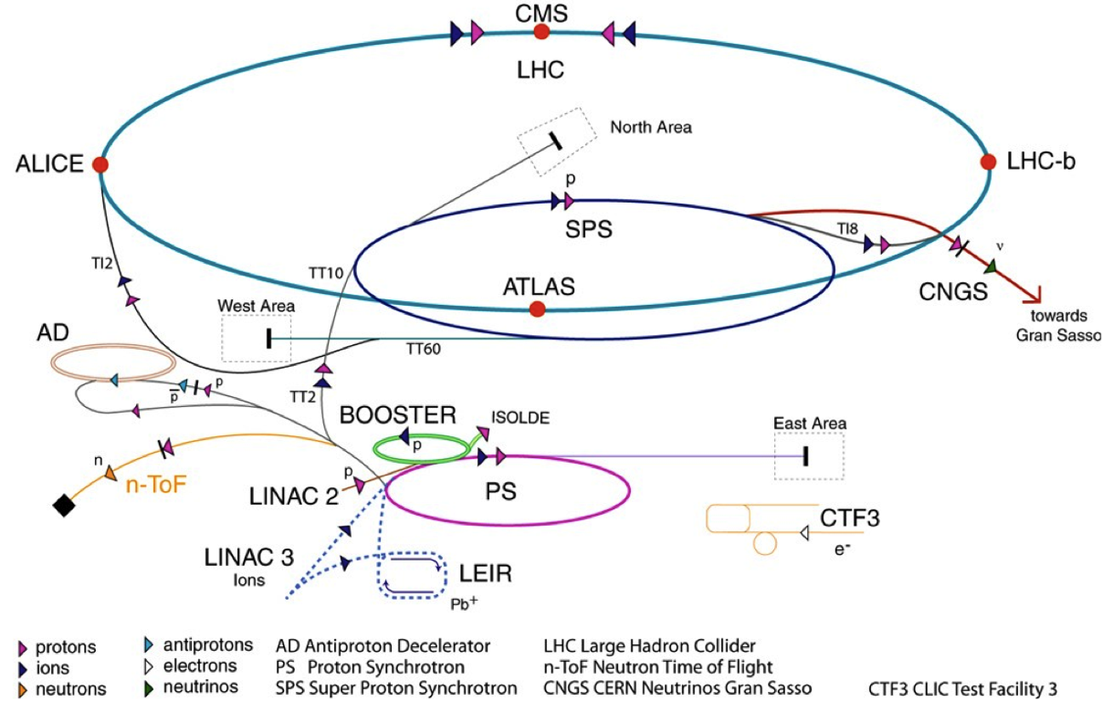
CERN Accelerator Complex
Beam 1
Beam 2
TI2
TI8
LHC proton path
The LHC needs most of the CERN accelerators...

Slide 4
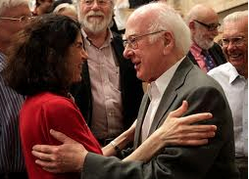

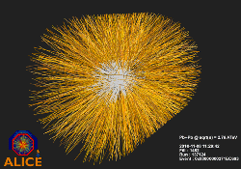

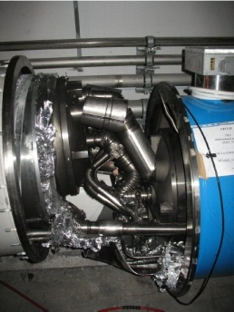
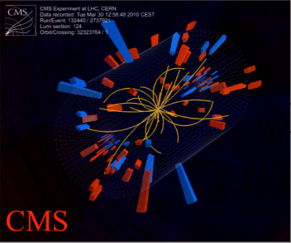
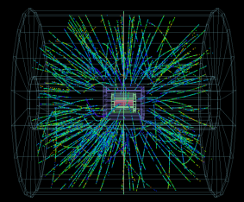
The LHC Timeline
After a successful LHC Run 1 the machine is currently shut down until 2015
  Now preparing for LHC Run 2
March 2015
LHC Restart
November 7, 2010
First ion collisions
July 4, 2012
Higgs like discovery
October 8, 2013
Nobel Price
Sept 10, 2008
First beams around
2008
2009
2010
2011
2012
2013
2014
2015
Sept 19, 2008
Disaster
Acci-
dental release of 600 MJ
March 30, 2010
First collisions at 3.5 TeV
June 28, 2011
1380 bunches
March 14, 2013
Higgs discovery
Long Shutdown 1 (LS1) until 2015
After LS1:
Higher collision energy (6.5 TeV)
Sept 13, 2012
First p - Pb collisions
1380
March 13, 2012
First collisions at 4 TeV

Slide 5
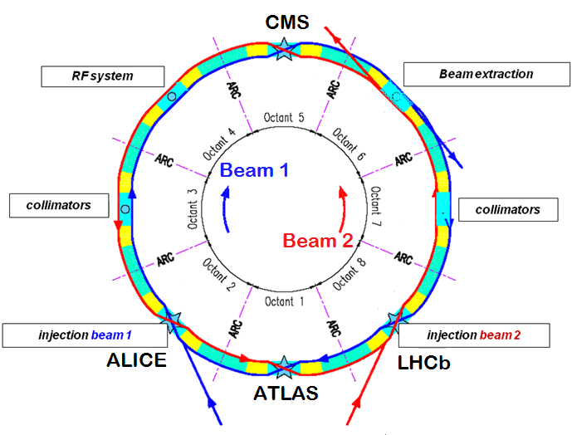
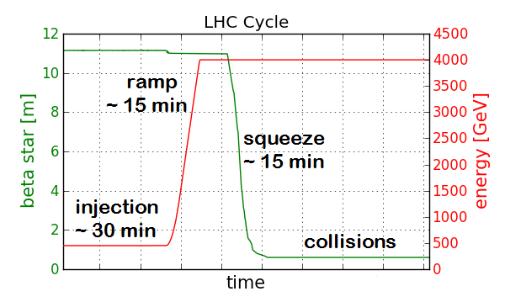
The LHC Layout and the LHC Cycle
2015 LHC cycle (preliminary):
6.5 TeV collision energy
Longer ramp (~ 20 min)
25 ns bunch spacing
More bunches in the machine (~ 2800)
2012 LHC cycle:
4 TeV collision energy
11 to 0.6 m β* squeeze
at ATLAS/CMS
50 ns bunch spacing
1380 bunches per beam
Collisions in 4 points in the LHC. ATLAS & CMS are the 2 large multi purpose detectors.
Injection energy: 450 GeV

Slide 6

Introduction: Luminosity
Performance of a collider is measured in luminosity
  Combines cross section and number of interactions per second
    Assuming two identical Gaussian shaped beams that collide head on
To maximize luminosity a small transverse emittance is needed!
Injectors produce high brightness beams with small emittances.
Goal: preserve emittance in the LHC!
  In 2012 the emittance could not preserved during the LHC cycle
  Sources and solutions of emittance blow-up could only partly be tackled due to problems with beam instrumentation
$$L= \frac{k N^{2} f γ}{4 π{ β}^{∗} ε}∙F$$
k …. Number of bunches
N …. Number of protons per bunch
f …. Revolution frequency
γ …. Relativistic gamma (beam energy)
F …. Luminosity reduction factor
β*…. Beta function at interaction point
ε …. Normalized transverse emittance

Slide 7
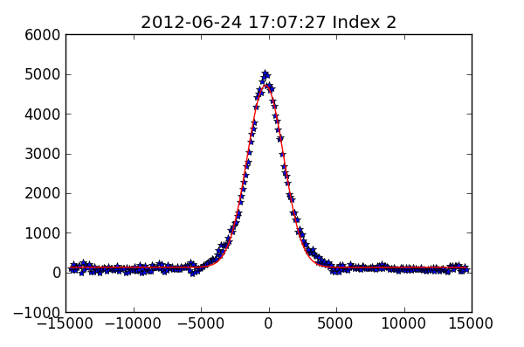
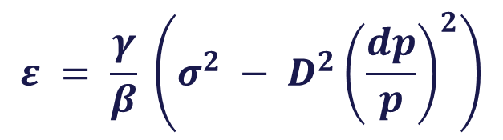
Transverse Emittance
Normalized transverse emittance:
β function is measured during the LHC cycle
Transverse profiles are obtained for instance from wire scanners
  A carbon wire passes through the beam and measures the bunch-by-bunch transverse profiles
  In the LHC: 4 operational wire scanners B1H, B1V, B2H, B2V
Beam energy
$$ε = \frac{γ}{β} \left(σ^{2} − D^{2}{\left(\frac{dp}{p}\right)}^{2}\right)$$
Amplitude [a.u.]
(at location of transverse profile monitors in the LHC)
dispersion negligible
Position [μm]
Machine parameter: β fct. at location of profile monitor
Beam parameter: beam size from Gaussian fit to transverse profile (5 parameter Gauss fit)

Slide 8
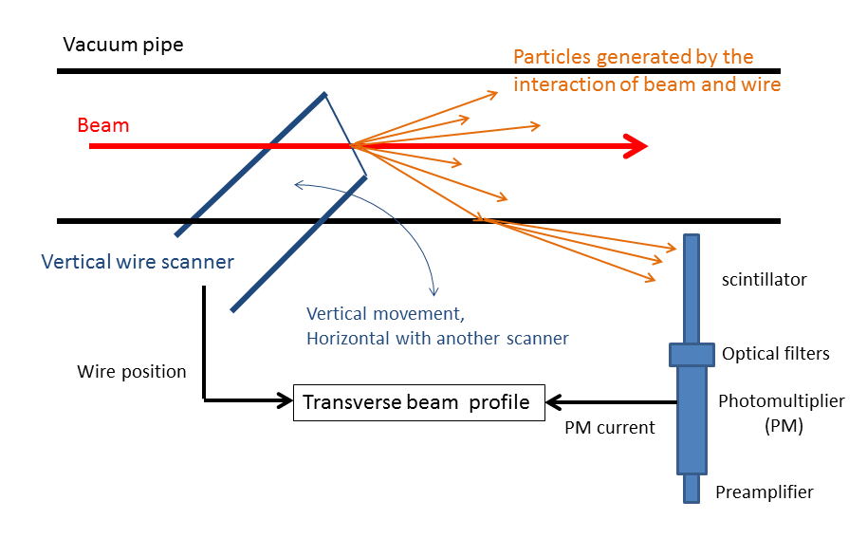
LHC Wire Scanner
Voltage on wire
Device properties accessed by the operator in the control room
Acquired data displayed in the control room

Slide 9
Operational Tools
An operator in the control room needs a tool to communicate easily with the wire scanner ➔ wire scanner application
Objectives:
Set scanner properties: voltage on wire and optical filter
Perfom scan
Constantly monitor the status of the wire scanners
  Wire position and voltage, filter, ...
Acquire scan data
  Display transverse profiles
  analyse scans: fit profiles
Send data to logging DB and LHC logbook
Get data from logging DB
...

Slide 10
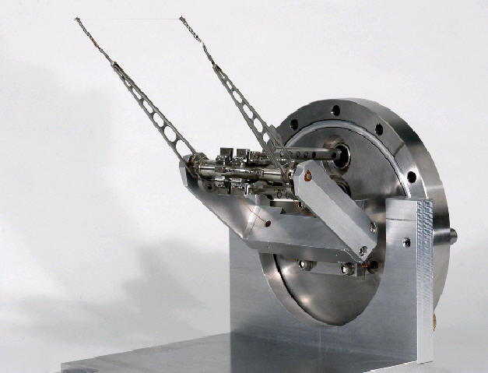
Control System and Data Acquisition
BE-CO maintains CERN accelerator control system
Controls software infrastructure:
Wire Scanner Application
Graphical interactive applications, fixed displays
Presentation Layer
General purpose and specific application servers
➔ accelerator control, monitoring & diagnostics, machine protection
Business Layer
Front End Layer (FE)
Device servers
➔ equipment integration
Wire scanner in the LHC ring

Slide 11
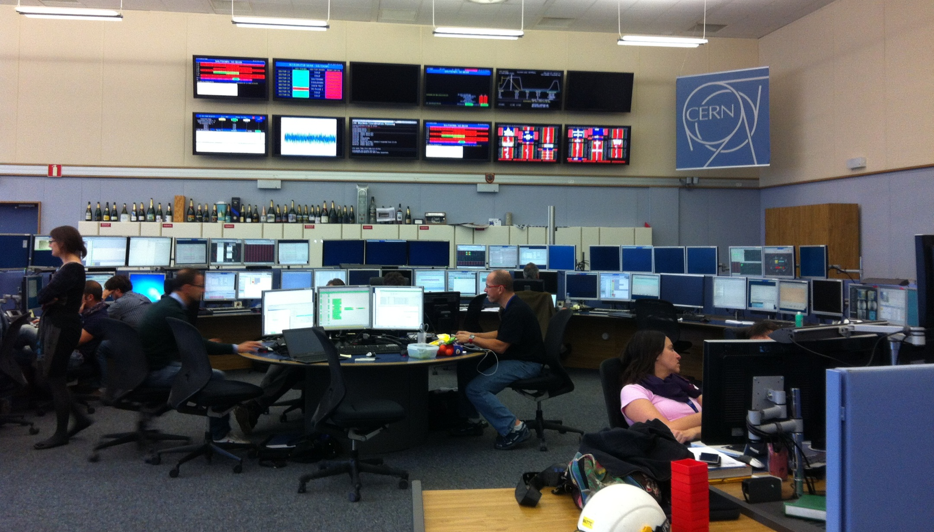
CERN Control Center – LHC Island
Fixed Displays
Operational Consoles

Slide 12
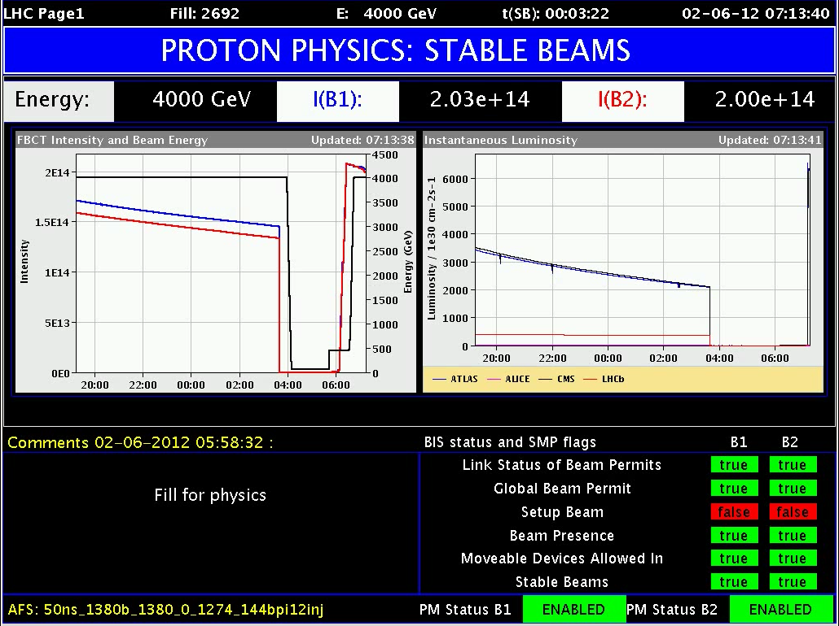
Fixed Display: LHC Page 1

Slide 13
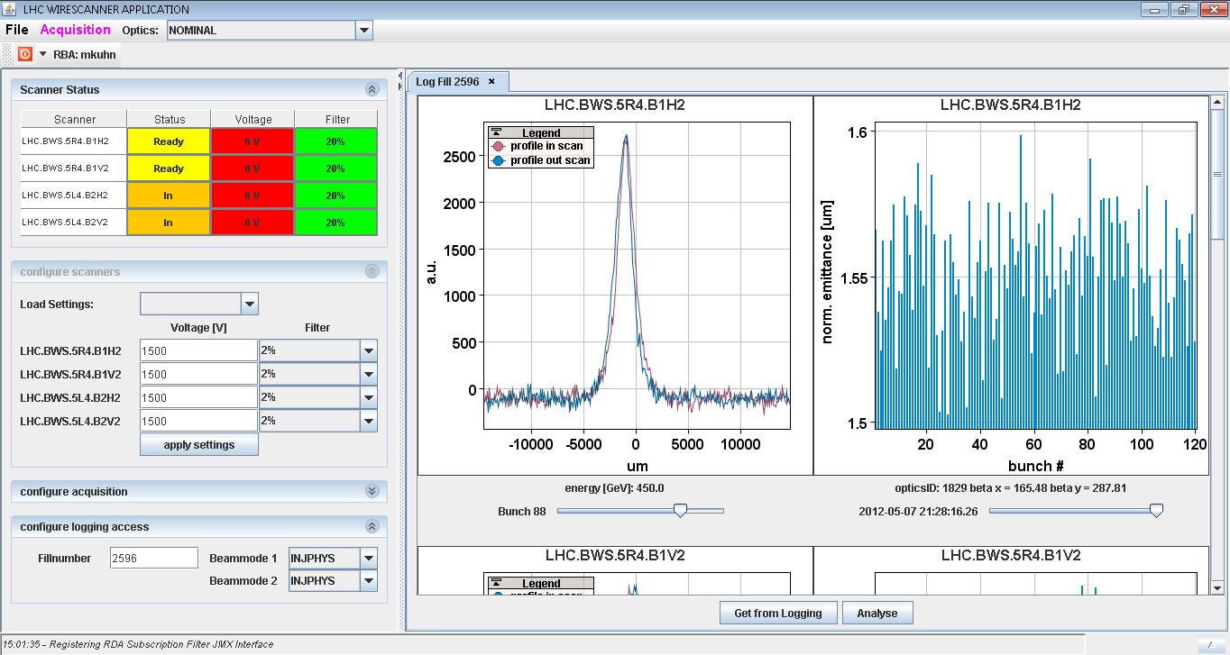
Control and Data Flow
Application:
Set properties
Get information
Presentation Layer
CCC applications (Java)
Business Layer
LHC Software Architecture (C/C++)
➔ Settings management system
Front End Layer (FE)
Front End Software Architecture (FESA)
➔Integrates the equipment into control system
Wire scanner in the LHC ring

Slide 14
Key Points For LHC Applications
User friendly applications
  No expert knowledge needed
  Everyone in the control room should be able to use it
Time is precious
  Be prepared – know “good” wire scanner settings
  Setting scanners and performing scans needs to be quick
Online analysis
  Quality of measurements can be judged immediately
Avoid breaking wires!
  Cannot extensively use wire scanners
  Only scan at low intensity (very few bunches in the machine)
Do not disturb the beam or cause beam dumps!
  Application needs to be linked to machine protection

Slide 15
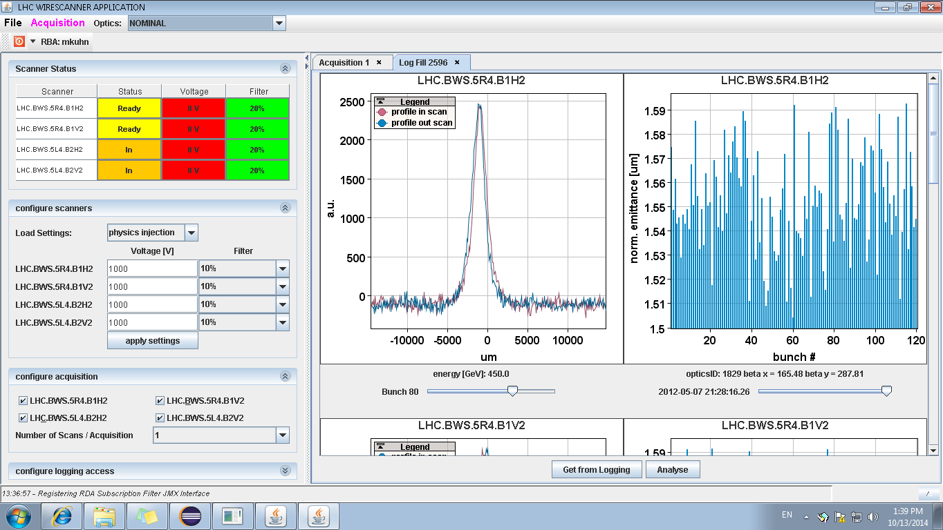
Wire Scanner Application
Main improvements:
Monitor wire position, voltage and filter
  Display saturation information
Load settings for certain scenarios
  To avoid saturated profiles
Scanners are launched automatically in series, multiple scans possible
Online analysis

Slide 16
Summary & Conclusion
Working in LHC operations is challenging but very interesting
Problems with measuring beam sizes and beta functions dominated the emittance analysis in 2012
  The transverse normalized emittance was not preserved during the LHC cycle in 2012!
  Not all causes for emittance blow-up could be discovered and eliminated
During LS1 intensive work was done to improve transverse profile monitors and beta function measurements
  Improved algorithms
  New operational applications
    Simplifies operation of the devices
    Shorter measurement periods
    Online analysis
We are well prepared for emittance measurements in 2015!

Slide 17
Additional Slides

Slide 18
Reminder: Emittance Preservation
Liouville’s Theorem:
  Normalized emittance is conserved during acceleration!
Effects that can cause emittance growth (in a hadron collider):
  Mismatch at injection
  Intra beam scattering (IBS)
  Noise
  Instabilities
  Coupling between horizontal and vertical plane
  Collective effects, e.g. electron cloud, impedance
  Beam-beam effects
  Wake fields
  Space charge effects
  …

Slide 19
Previous Problems and Improvements
Problems | Improvements
Saturated profiles Wire voltage and photomultiplier filters influenced the measured beam size | Monitor wire voltage and filter Have saturation information displayed before the scan
Voltage and filter always set manually Operators didn‘t know „good“ settings | Load settings for certain scenarios To avoid saturated profiles
Every scanner was launched individually Time consuming | Scanners are launched automatically in series, also multiple scans possible
Offline analysis | Online analysis Time evolution of scans, fitting, saturation information

