Slide 1
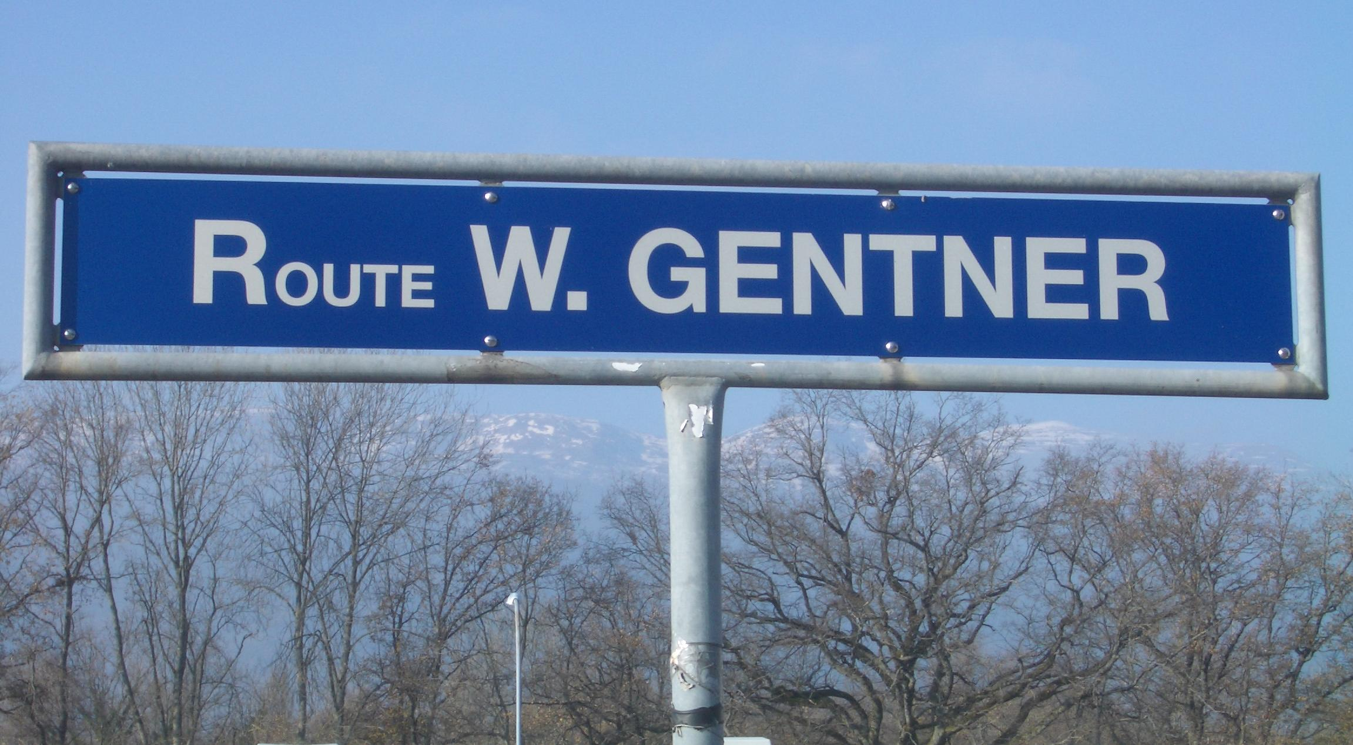
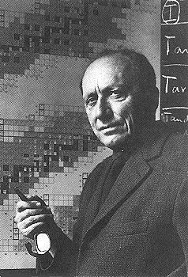
The Wolfgang-Gentner-Programme for Technical Doctoral Students at CERN
1965
Wolfgang Gentner 1906-1980
CERN Research Director 1954-59
First Director of Max-Planck-Insititut
für Kernphysik Heidelberg 1959-73
President of CERN Council 1972-74

Slide 2
German Special Programme
Spring 2007: CERN visit of State Secretary Meyer-Krahmer from BMBF (German Ministry for Education and Research)
  result of visit
    “CERN Nutzungsinitiative” initiated to support better usage of CERN by Germany
  part of “CERN Nutzungsinitative”: new German special programme for technical Doctoral Students (Wolfgang-Gentner-Programme)
    in addition to the existing CERN Doctoral Student Programme
    (almost) identical conditions
    difference: funding (subsistence) by BMBF, also extra funds for travel to Germany
  mid- and long term goals:
    better usage of CERN resources by Germany
    better connection between German Universities and CERN
    more German staff at CERN (long term)
      presently only ~7.3% German staff (but ~20% contribution of Germany to CERN budget)
Start: October 2007
    after ~3 years steady state of about ~40 – 45 German Doctoral Students (out of ~180 total)
Teil der CERN Nutzungsinitiative des BMBF 2007
  Neues deutsches technisches Doktorandenprogramm am CERN (Wolfgang-Gentner-Stipendien)
    Zusatzprogramm zum existierenden CERN Doctoral Student Programme
    (fast) gleiche Bedingungen wie existiendes CERN Doktoranden-Programm
    Unterschied: Finazierung der Aufenthaltskosten am CERN durch BMBF
  Mittel-/langfristige Ziele:
    Bessere Nutzung der CERN Resourcen
    Erhöhung des Anteils an deutschen CERN-Mitarbeitern
Start: Oktober 2007
Volumen: bis zu 2 Mill. Euro/Jahr
  ausreichend für bis zu ca. 20 Doktoranden pro Jahr bei 2 – 3 Jahren Aufenthaltsdauer
    = nach 3 Jahren ca. 50 – 60 zusätzliche deutsche Doktoranden am CERN
    Anfangsziel: 10 Doktoranden im ersten Jahr des Gentner-Programms

Slide 3
Expenditures
BMBF
  funding of subsistence at CERN
    grant of up to 36 months (6 + 12 + 12 + 6 months), maximum 4 consecutive years (unpaid special leave for professional reasons of up to 12 months possible)
    basic monthly subsistence 3679 CHF (single, no family, no children, ~3000 EUR)
      tax free, 4.7% deduction for health insurance, + additional family + children allowances
  travel reimbursements
    travel to home university
    travel to annual national meetings of relevant German association (DPG etc.)
    travel of German supervisor to CERN (e.g. Gentner Day)
CERN (group)
  integration costs
    language course (typically 1 French or English course)
    tools needed for work (PC, notebook etc.)
  travel reimbursements
    travel to international conference with presentation (talk or poster)
    invitation of German supervisor to CERN

Slide 4
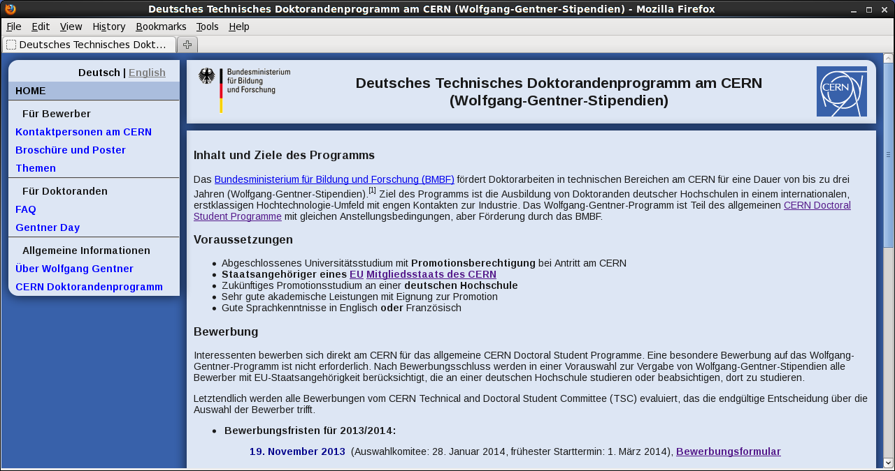
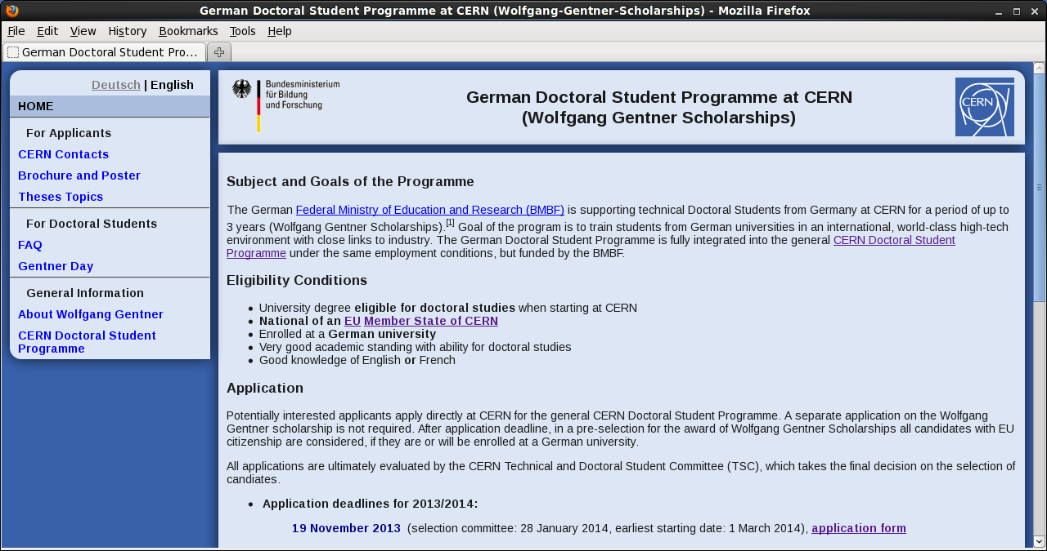
Web Page (German + English version)
  https://cern.ch/wolfgang-gentner-stipendien/

Slide 5
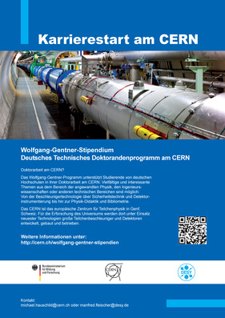

Brochure and Poster (A3)
Prepared by DESY
Brochure
  preface by Rolf Heuer + Georg Schütte (BMBF State Secretary)
  CERN Overview
  statements and photos of 8 active or former Gentner Doctoral Students
  thesis topics + contact persons
  programme information + how to apply

Slide 6
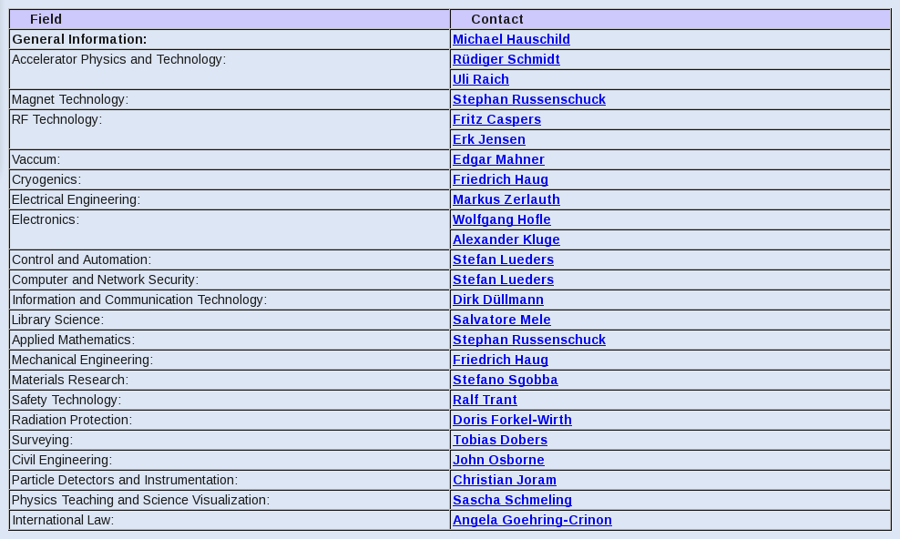
Contact Persons at CERN

Slide 7
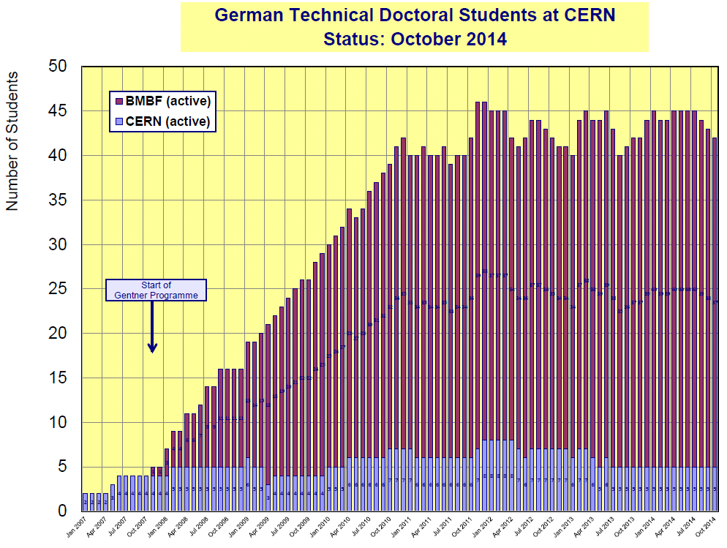
Evolution of German Doctoral Students

Slide 8
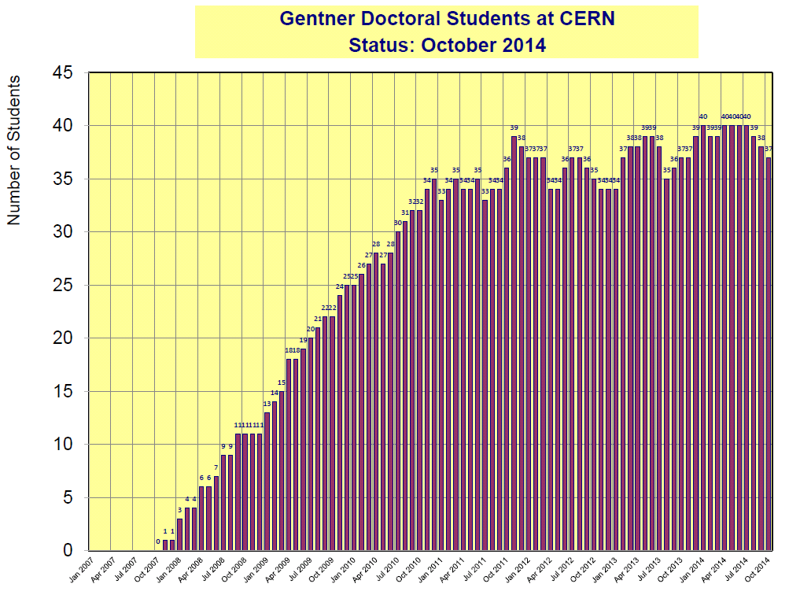
Evolution of Gentner Students

Slide 9
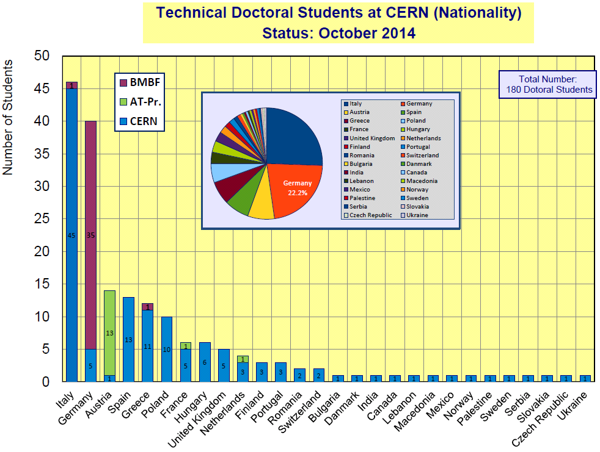
Doctoral Students by Nationality + Programme

Slide 10
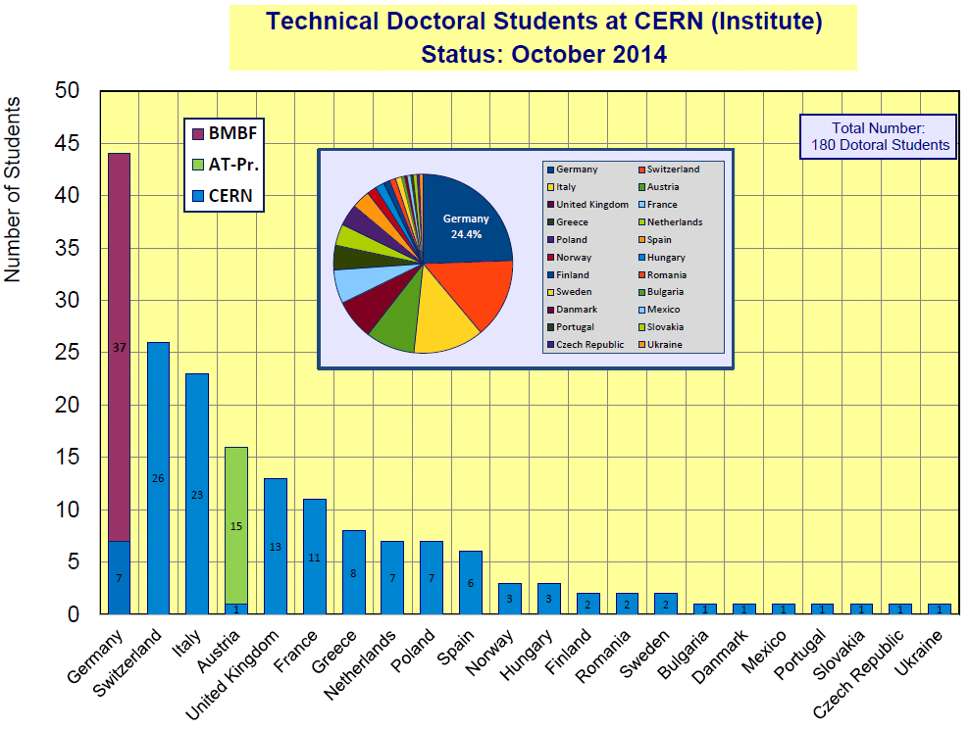
Doctoral Students by Institute Country + Programme

Slide 11
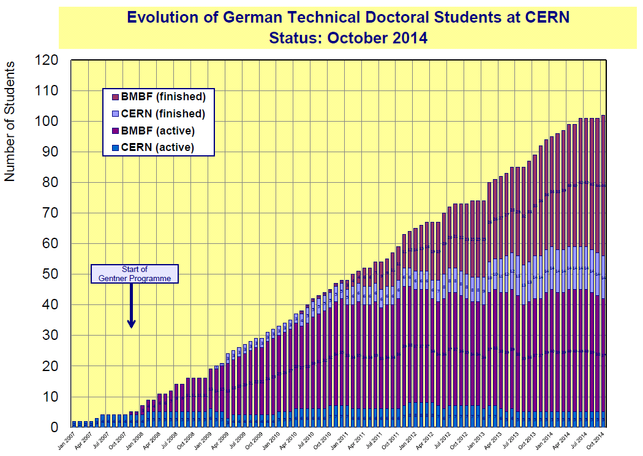
Evolution

Slide 12
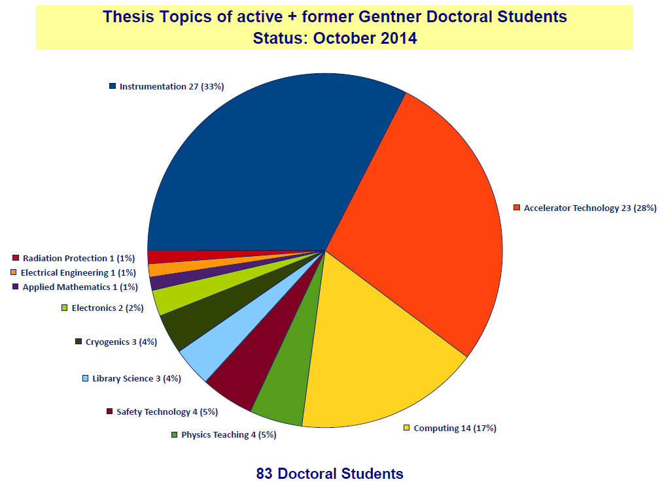
Thesis Topics

Slide 13
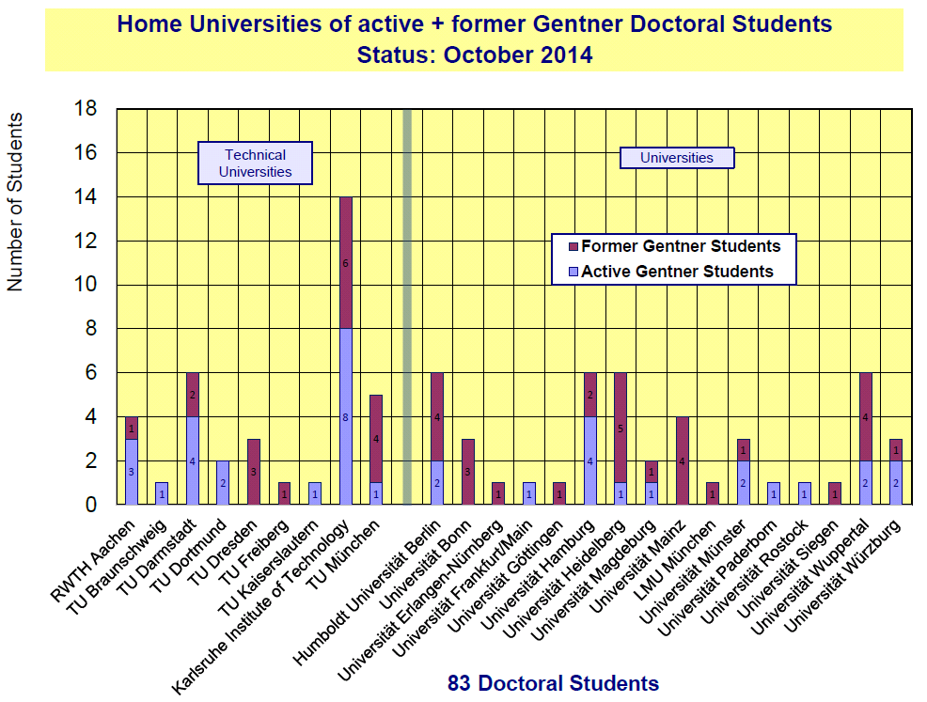
Home Universities

Slide 14
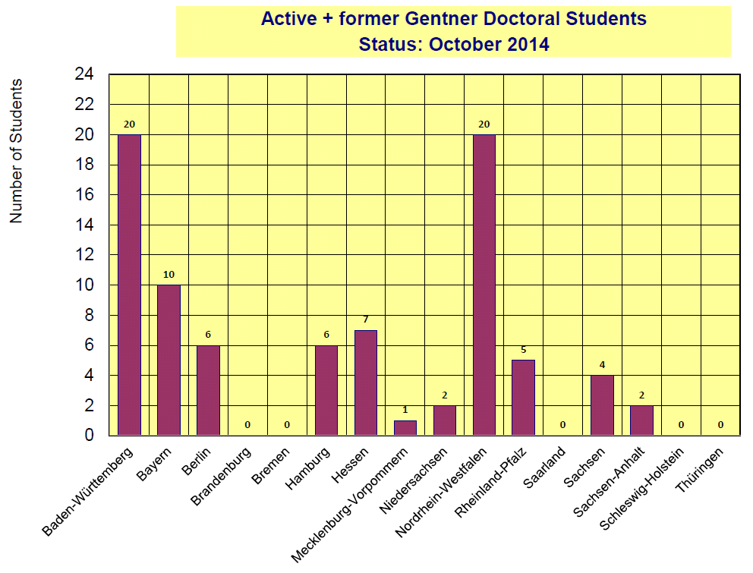
Bundesländer (German States)

Slide 15
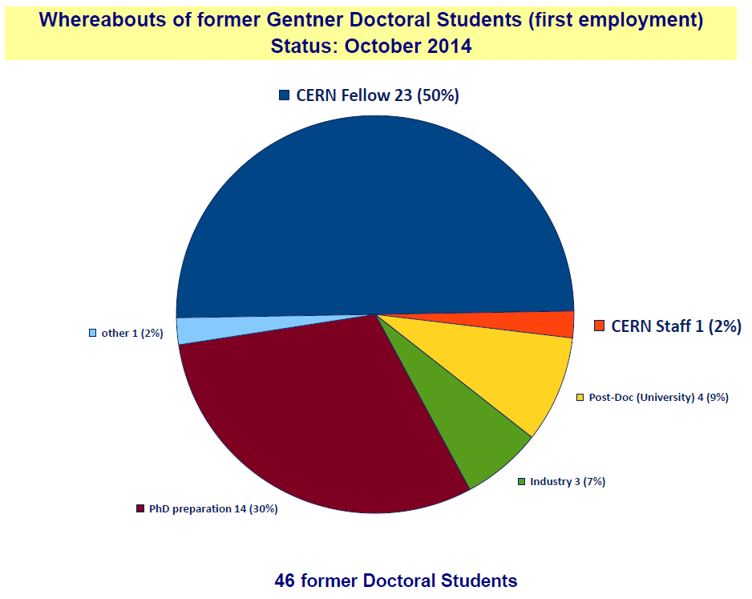
Whereabouts I

Slide 16
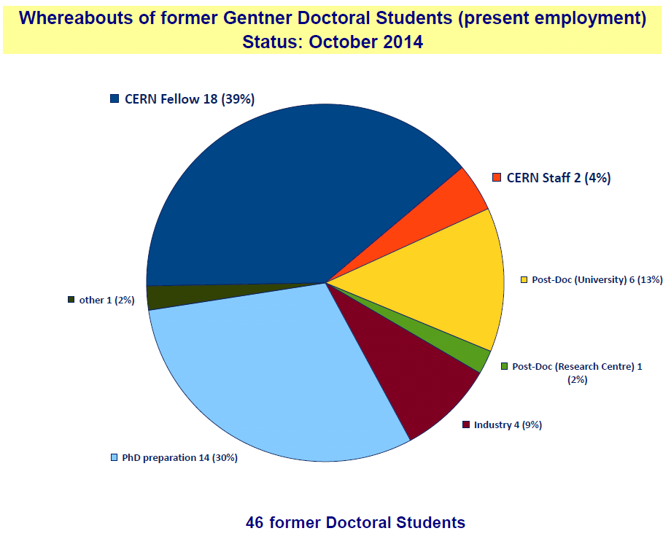
Whereabouts II

Slide 17
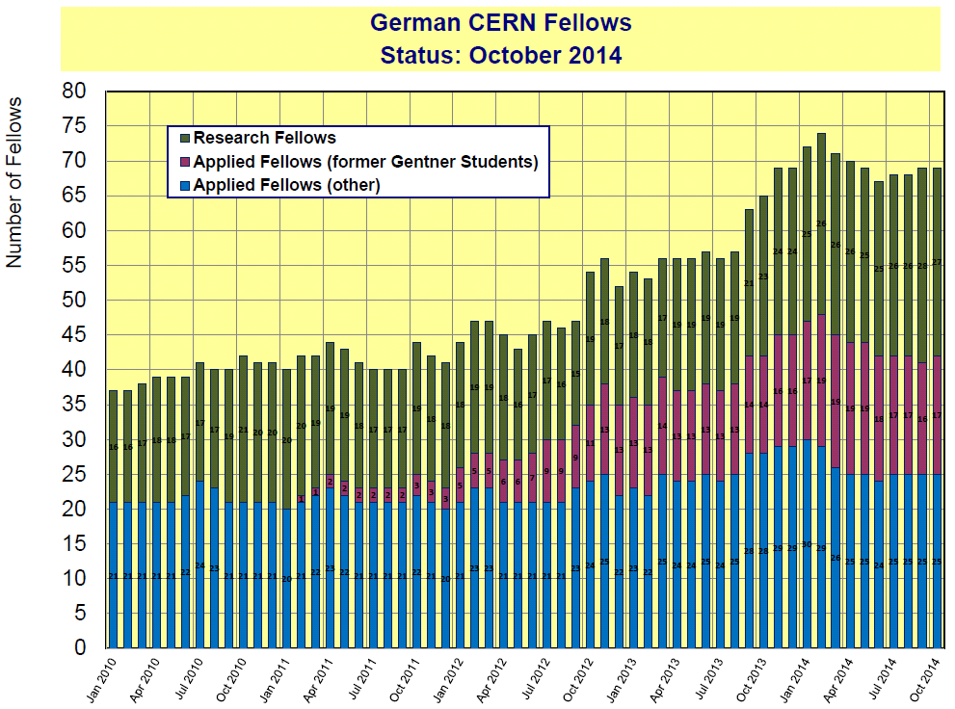
Evolution of German Fellows I

Slide 18
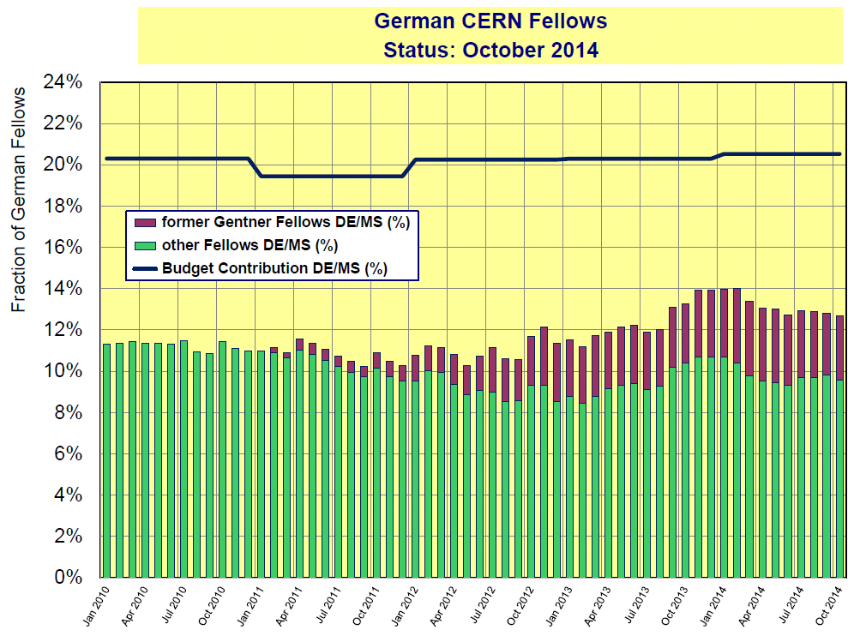
Evolution of German Fellows II

Slide 19
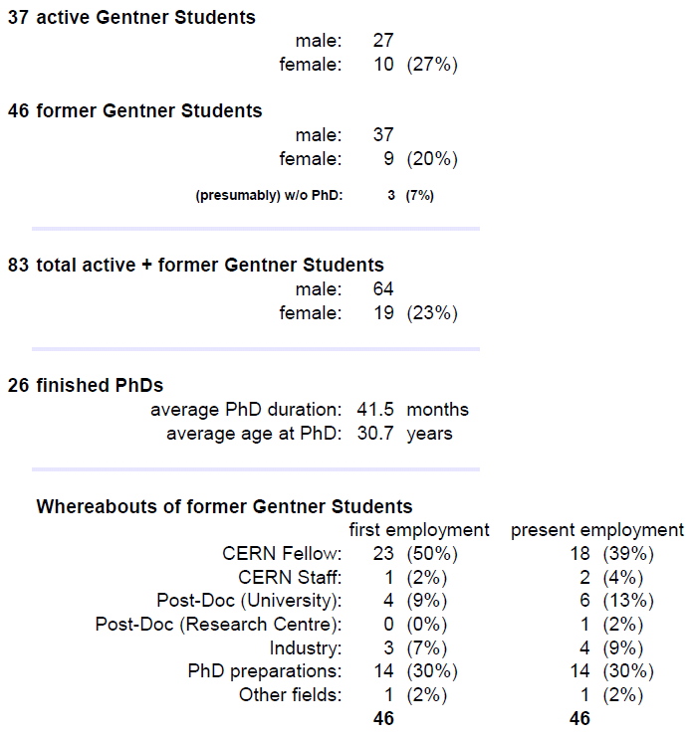
Gentner Programme Summary
Physics Students in Germany
fraction of female Students: 20%
duration of PhD: 48 months
age when obtaining PhD: 30.6 years
CERN Fellows
≈ 40% of German applied Fellows
are former Gentner Students

