Slide 1


CERN CLIC
Machine Protection Studies
Lutz Matthias Hein
CERN, TE-MPE-PE

Slide 2
Machine Protection
Why ??

Slide 3
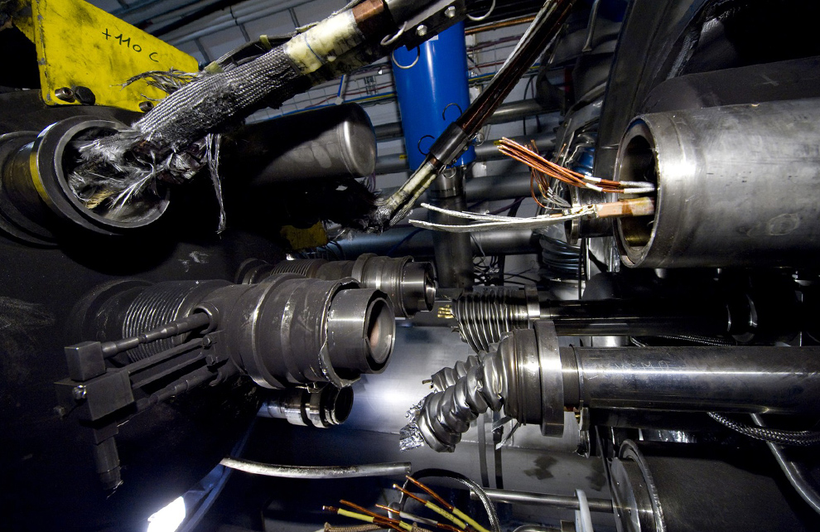
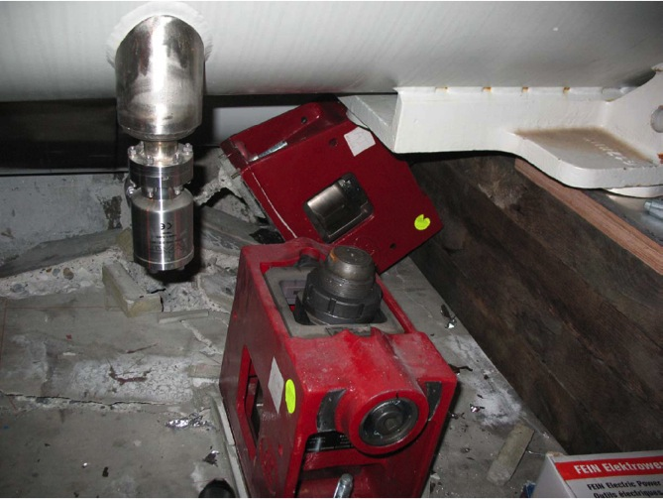
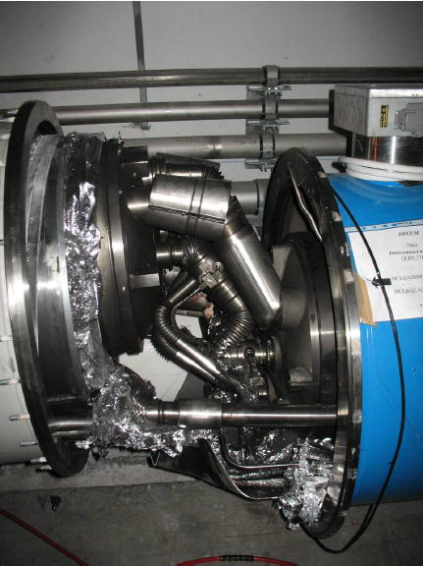
Machine Protection
No Beam
Arcing in the interconnection
Magnet displacement
courtesy
Prof. Rüdiger Schmidt (CERN)
Over-pressure

Slide 4
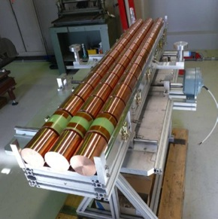
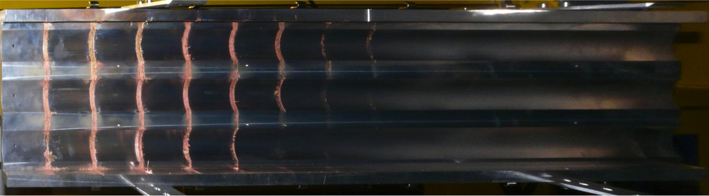
Machine Protection
With Beam
SPS – Beam 450 GeV on Copper
Courtesy: Florian Burkhart (CERN)
144b, σ = 0.2mm
1
2
3
4
5
6
7
8
9
80 < penetration depth < 90 cm
7
8
108b, σ = 0.2mm
70 < penetration depth < 80 cm
144b, σ = 2mm
5
6
50 < penetration depth < 60 cm

Slide 5
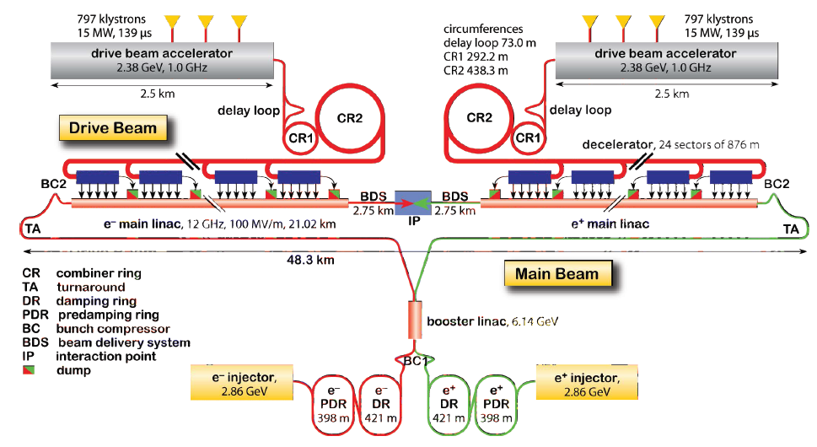
Recapitulation

Slide 6
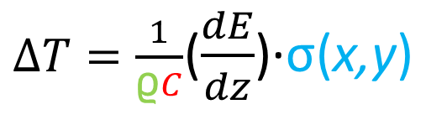
What is the Damage Limit?
Yield Temperatur: – max. instant. Temp.Rise
$∆T=\frac{1}{\text{ϱ}C}$($\frac{dE}{dz}$)·σ(x,y)
material density
heat capacity
beam density
Energy Density = BeamCharge × BeamSize⁻¹ × dE/dx (ionisation loss)
Destructive capacity: determined by BeamCharge × BeamSize⁻¹ not Beam Power.
Safe Beam: yield limit in copper (62 J g⁻¹)
Main Beam : 10000 × ‘safe beam’
Drive Beam : 100 × ‘safe beam’
Charge Density LIMIT
3.94E-04 nC/µm²
Courtesy M.Jonker

Slide 7
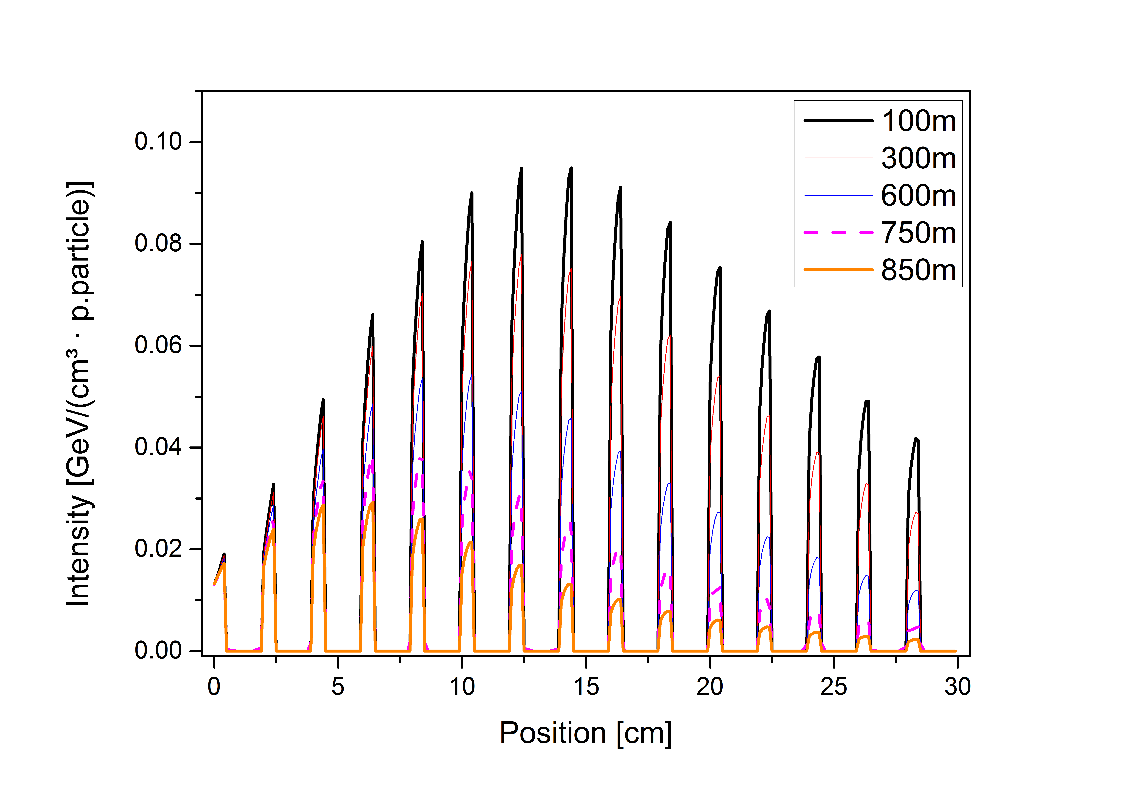
What is the Damage Limit?
Charge enhancement by Pair-Production etc.
Fluka Simulation
Beam Impact on Copper plates
Charge Density LIMIT
3.94E-04 nC/µm²
8

Slide 8
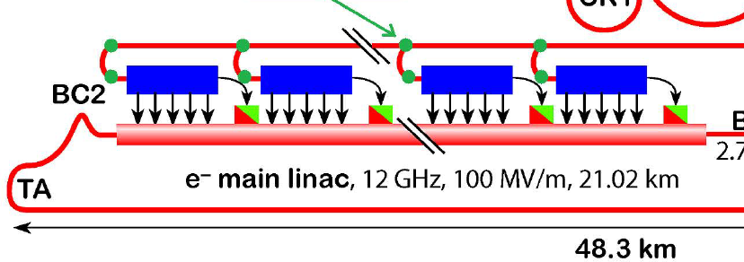
24 Types of Decelerator
1
2
23
24
6.14GeV
1500GeV
Stronger quadrupoles required
-> Skip cavities for quadrupoles
-> 24 different Decelerator Lattices
(830m)
(1040m)

Slide 9
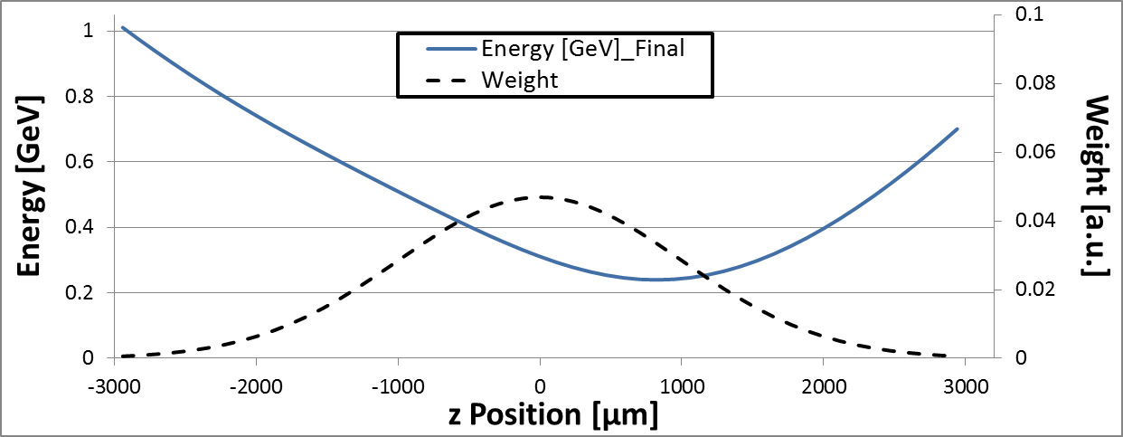
Beam Dynamics
FODO – Lattice:
Phase advance (E_{min}): 90 deg
1
2
3
875
876
!! Used to decelerate !!
2.4 GeV -> 240MeV

Slide 10
Results of the Energy Spread
I) Kick itself
Low Energy
F
High Energy
-> Filamentation &
Emittance Growth
II) Chromaticity
Focus
F
High Energy
Low Energy

Slide 11
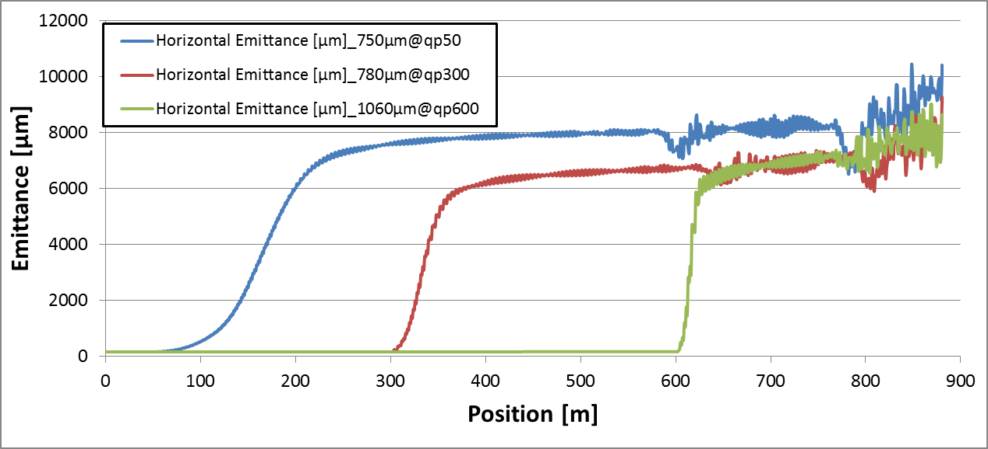
Filamentation Speed
Energy and Phase Advance -> ‘speed‘ of the Filamentation

Slide 12
Multiple Kicks
Estimate Limits of Multiple Quadrupole Offsets
Decelerator Nr. 11 (with 876 Quadrupoles):
1
2
3
875
876
Misalign of several Quadrupoles:
1
2
3
875
876
Can we simply add qp-kick up into sequences?
Under which circumstances is structural damage espected?

Slide 13
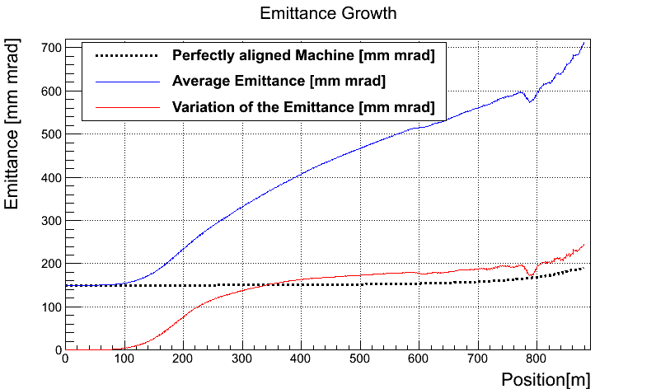
Multiple Kicks

Slide 14
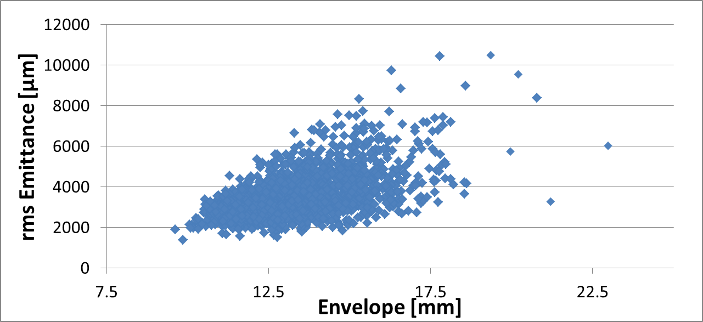
Multiple Kicks
Random Seeded Quadrupole Alignment Errors
Inside

Slide 15
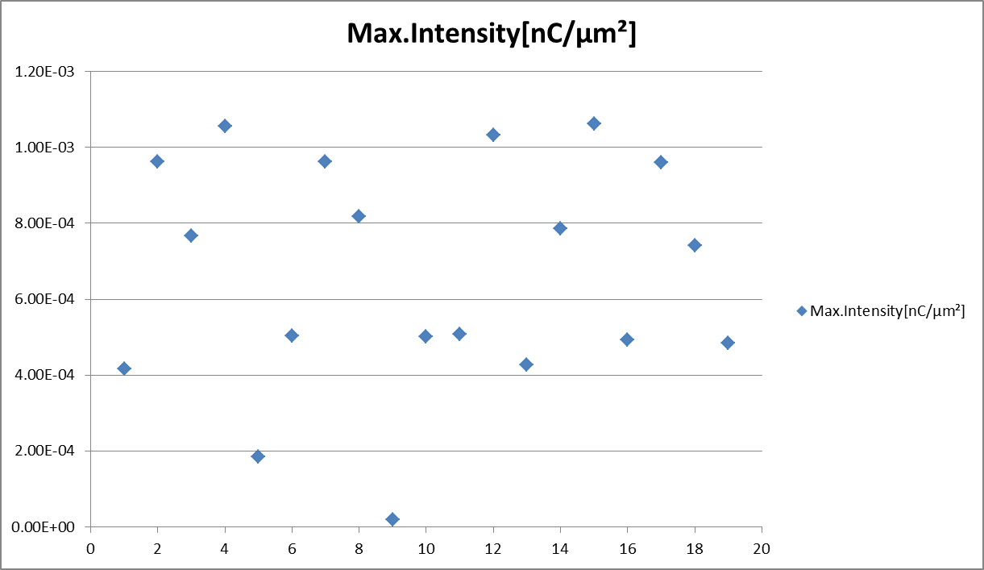
Multiple Kicks
Random Seeded Quadrupole Alignment Errors
SAFE

Slide 16
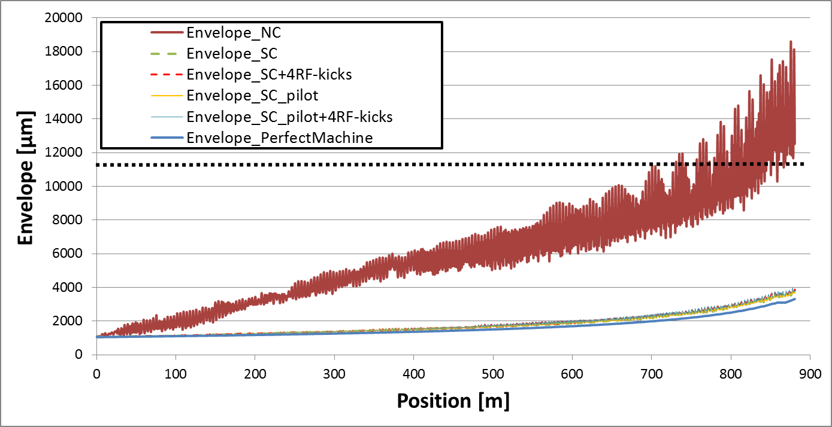
Multiple Kicks
Envelope
Intensity: 10.6 · 10⁻⁴ nC/µm² -> 0.0
T:\Decelerator\KickStudies\Decelerator11-872m1488PETS\DoubleKicks\RandomRF4\Run2_447EmitFiles.xlsx
Experimental demonstration of a global dispersion-free steering
correction at the new linac test facility at SLAC
A. Latina et. al.

Slide 17
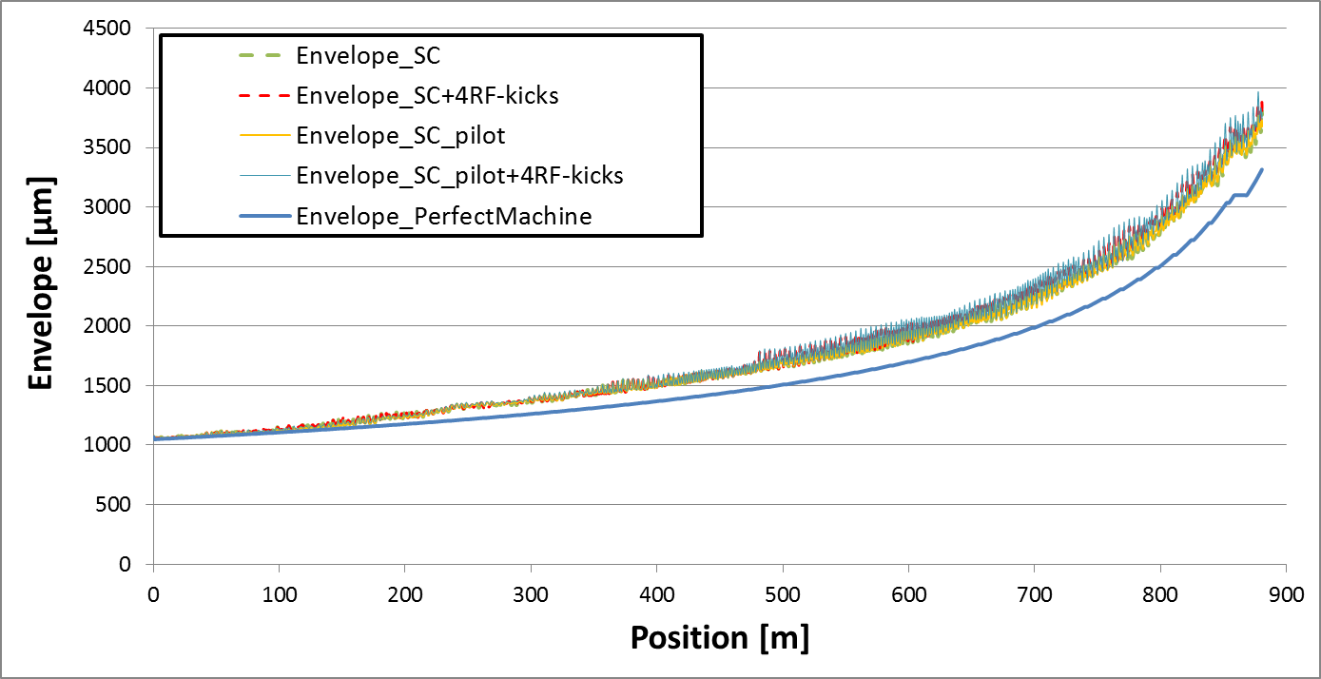
Multiple Kicks
Envelope
Intensity: 10.6 · 10⁻⁴ nC/µm² -> 0.0
T:\Decelerator\KickStudies\Decelerator11-872m1488PETS\DoubleKicks\RandomRF4\Run2_447EmitFiles.xlsx
Experimental demonstration of a global dispersion-free steering
correction at the new linac test facility at SLAC
A. Latina et. al.

Slide 18
Single Kicks
Estimate Limits of Single Quadrupole Offsets
Decelerator Nr. 11 (with 876 Quadrupoles):
1
2
3
875
876
Misalign single Quadrupole:
1
2
3
875
876
!! There are differences between focusing and defocusing Quadrupoles !!
(σ_{pq} ≈ 20µm)

Slide 19
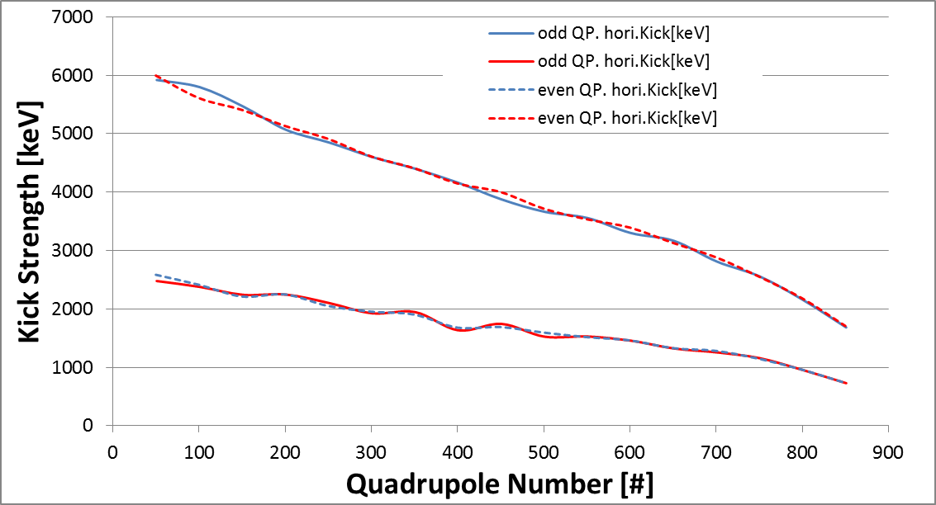
Single Kicks
Step2 – Damage:
When do we „hit“ the aperture?

Slide 20
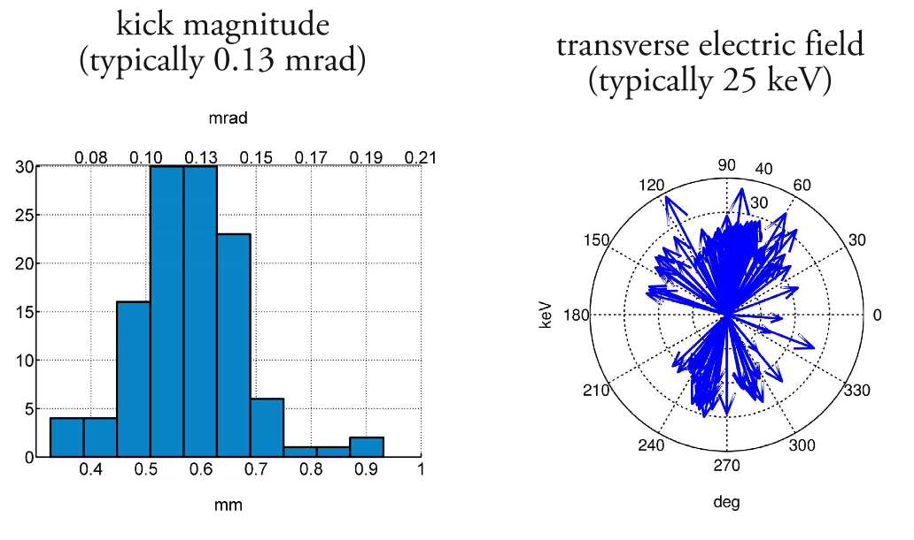
Single Kicks
Step2 – Damage:
Kick Limits: 1000keV .. 6000keV
QP-Movements:
10 µm Offsets = 36.3keV .. 3.63 keV
RF-Kicks:
Wilfrid Farabolini
Andrea Palaia
IPAC-2012-MOEPPB001

Slide 21
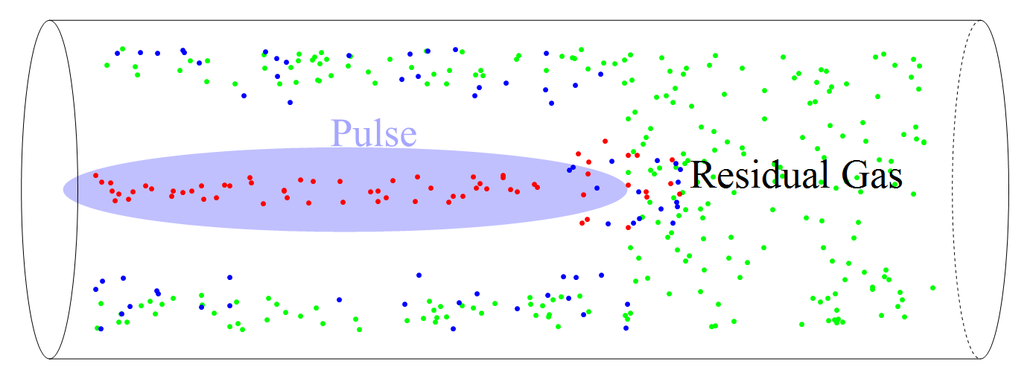
Residual Gas Scattering
Halo and Tail generator HTGEN, H. Burkhardt
Placet, A.Latina, D. Schulte et. al.

Slide 22
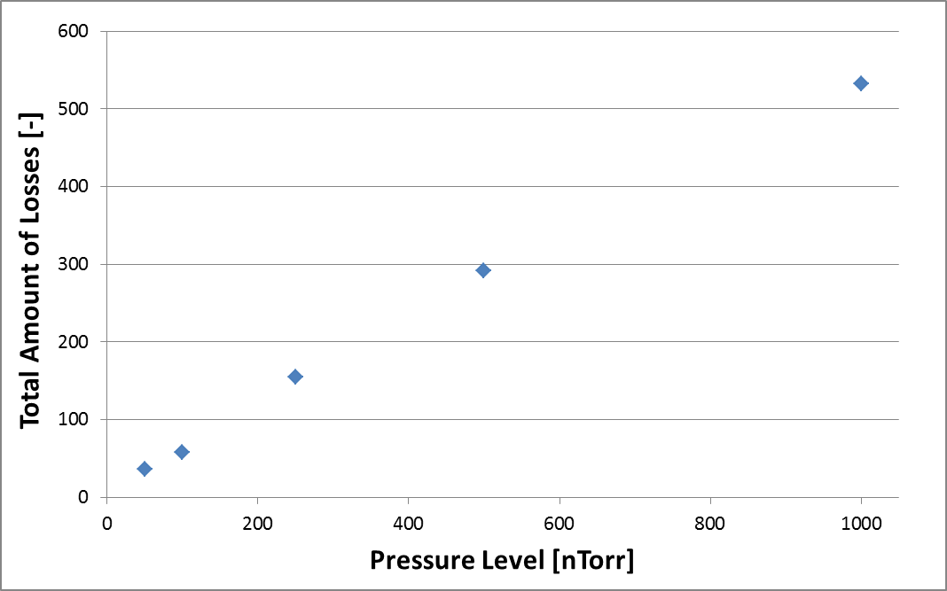
Residual Gas Scattering
Scaling: Pressure Vs. Losses
Residual Gas
Z=7, N=14
nitrogen

Slide 23
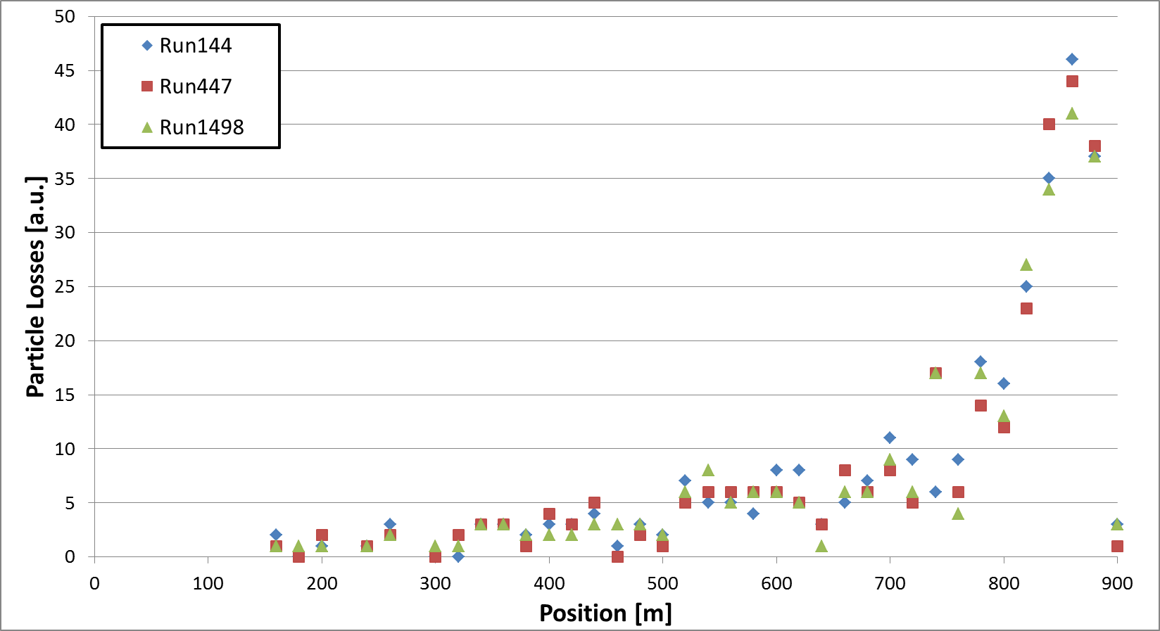
Residual Gas Scattering
Locations of Losses

Slide 24
Residual Gas Scattering
Locations of Losses
Fluka Simulations needed

Slide 25
Conclusion
Damage Limits strongly dependent on Particle Energy
Uncorrected Machines
  Particle Losses are very likely
  Damage Threshold likely exceeded
Corrected Machine
  Losses by residual gas scattering (further studies ongoing)
Threshold for isolated disturbances ≈ 100 x keV

Slide 27
Back Ups

Slide 28
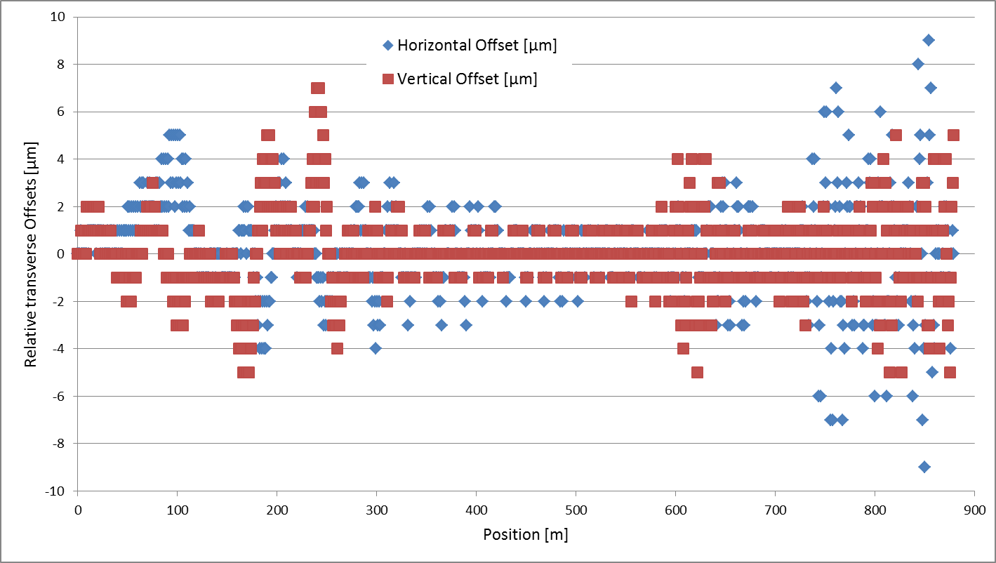
Multiple Kicks
Envelope
Intensity: 10.6 · 10⁻⁴ nC/µm² -> 0.0
T:\Decelerator\KickStudies\Decelerator11-872m1488PETS\DoubleKicks\RandomRF4\Run2_447EmitFiles.xlsx

Slide 29
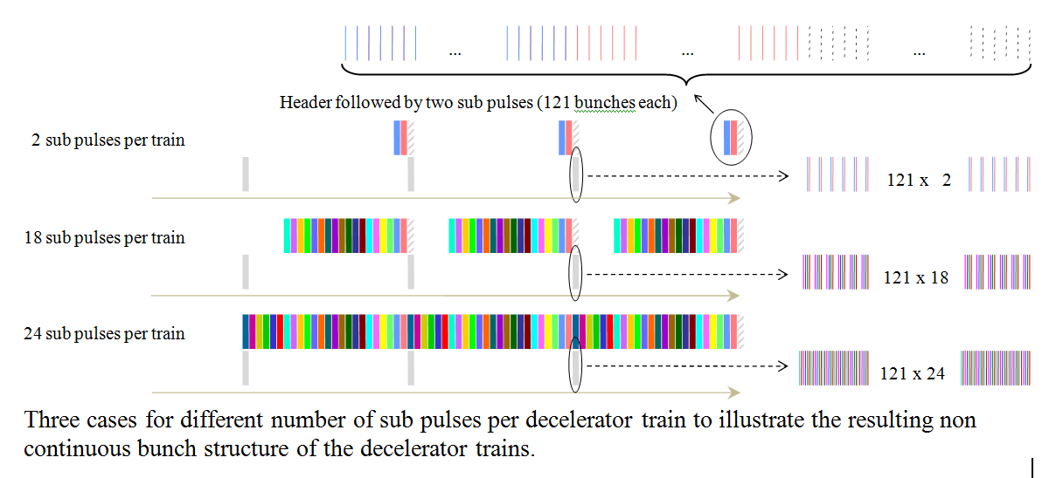
Drive Beam: 100 × Safe Beam
(for a single train out of 24)
One train = 24*121 bunches ⇒ safe beam is 30 Bunches.
Full drive beam: 1+24x24 sub-pulses (1SP = 121b). Header is dumped, remaining 24x24 sub-pulses
are arranged in combiner complex in 24 “trains”, of 24x121 bunches @ 12 GHz
Strategy to ramp intensity :
Gradually add bunches to the end of the full drive beam
CR1
CR2
30b, 60b, 1SP, 2SP, 2SP+30b, … 24SP (48 steps) ⇒ Recombination complex and decelerator 1 tested
1T+ 30B, 1T+ 60B, 1T+ 1SP, 1T+2SP... (18? steps) ⇒ Decelerator 2 tested
2T+ above program for third train ⇒ Decelerator 3 tested
Etc…Total 48+23*18 =462 pulse combinations to test full circuit (10 seconds if all goes well).
need strategy to intensity ramp trains in parallel (1 second if all goes well)
Notes:
Comment on BPM performance

