Slide 1
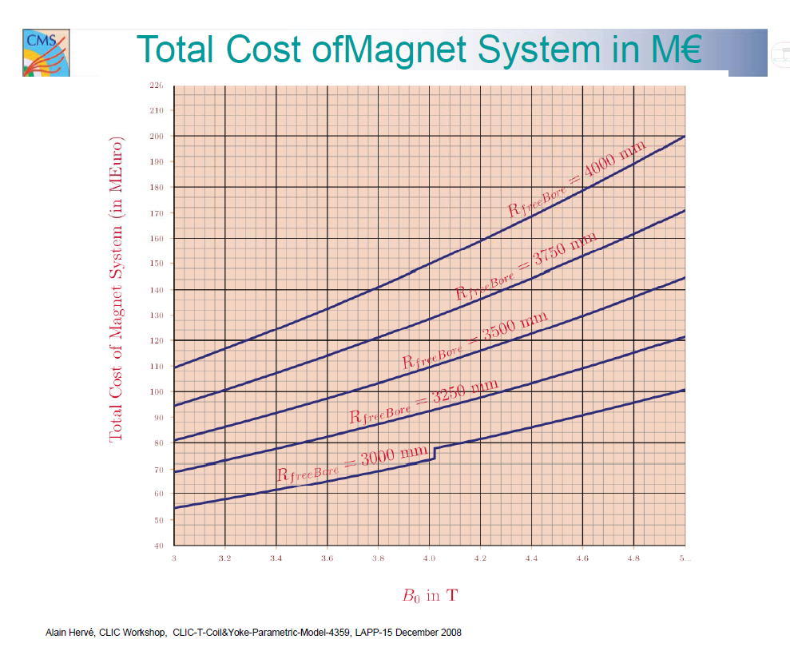
CLIC_ILD
“CDR”
CMS
CLIC_SiD
note “zero suppressed” !

Slide 2
new Fe-Calo: 3.4 m
new W-Calo: 3.0 m
CLIC_ILD
“CDR”
CMS
CLIC_SiD
note “zero suppressed” !

Slide 3
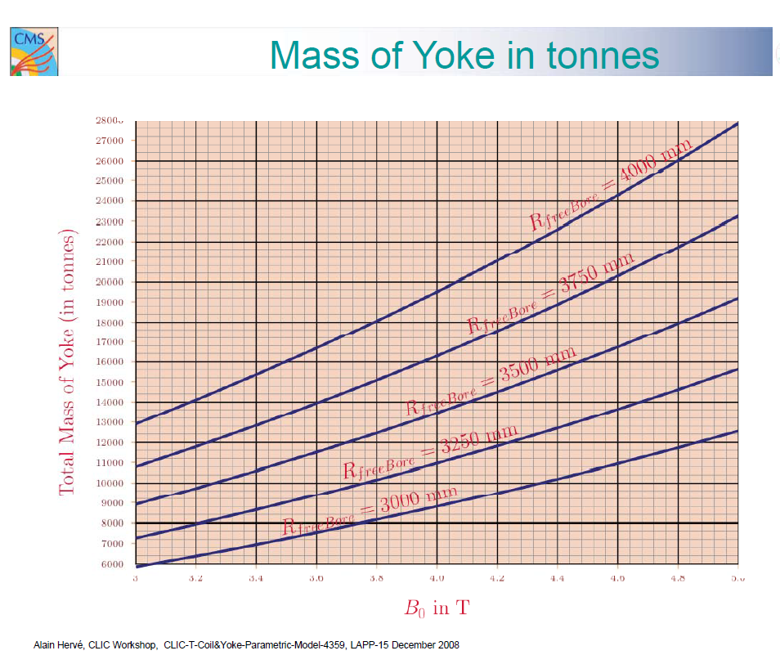
CLIC_ILD
CLIC_SiD
CMS

