Slide 1


Potential Performance for p-p, Pb-Pb
and p-Pb collisions in FCC-hh
Michaela Schaumann
(CERN, RWTH Aachen)
In collaboration with J.M. Jowett (CERN)
2nd October 2014
FCC-hh Collaboration Meeting, CERN

Slide 2
Outline
General assumptions (lattice and beam parameters)
Estimates for:
  IBS and radiation damping
  Luminosity and beam evolution
  Beam-beam tune shift
in p-p, Pb-Pb and p-Pb collisions.
Conclusions

Slide 3
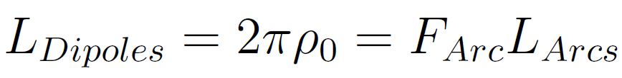
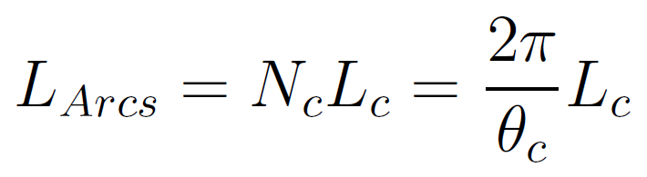
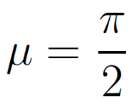
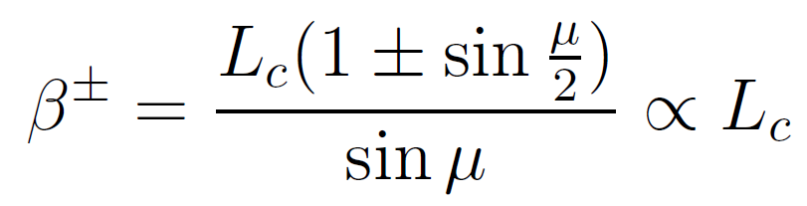

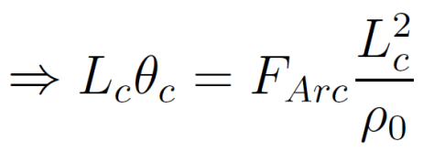
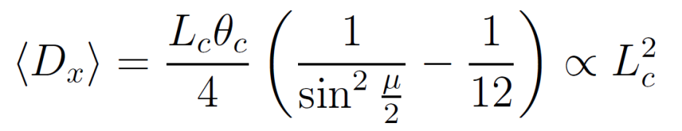
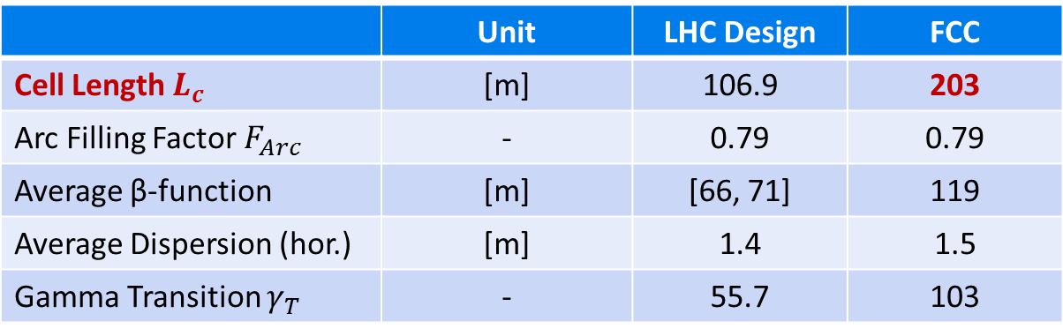

Smooth Lattice Approximation
Approximations for smooth lattice functions are used where necessary.
100km Circumference
Cell Length from aperture constraints
$L_{c}=\left[1, 2\right]{ L}_{c,LHC}$ → 203m
Assume FODO cell with
 | Unit | LHC Design | FCC
Cell Length $L_{c}$ | [m] | 106.9 | 203
Arc Filling Factor $F_{Arc}$ | - | 0.79 | 0.79
Average β-function | [m] | [66, 71] | 119
Average Dispersion (hor.) | [m] | 1.4 | 1.5
Gamma Transition $γ_{T}$ | - | 55.7 | 103

Slide 4
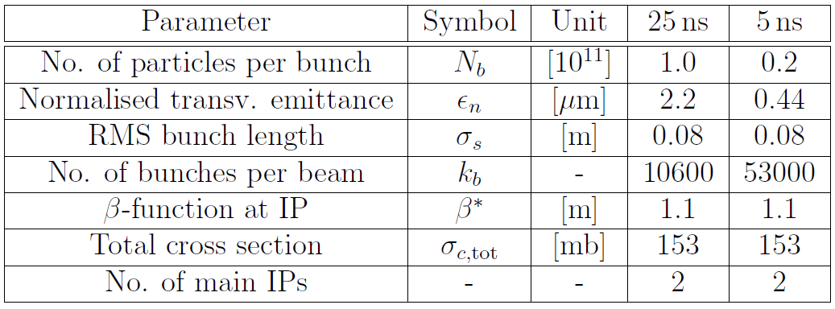
Beam Parameters
Protons
Heavy-Ions
Pb-Pb | p-Pb
0.0014 | 0.115
1.5 | 3.75
0.08 | 0.08
432 | 432
1.1 | 1.1
597000 | 2000
1 | 1
Proton baseline parameters taken from
FCC-ACC-SPC-0001, Date 2014-02-11
Average Pb parameters from 2013 are assumed as VERY conservative baseline for FCC-hh!
→ Improvements are already under study for HL-LHC!

Slide 5

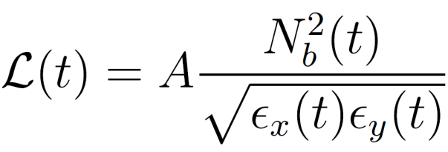






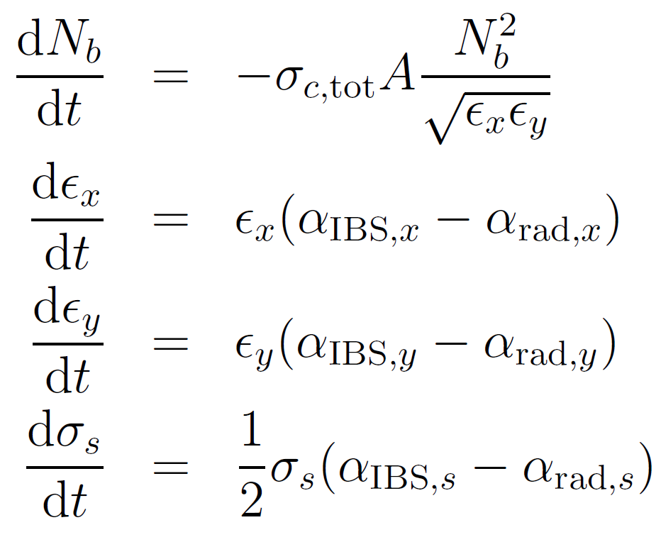


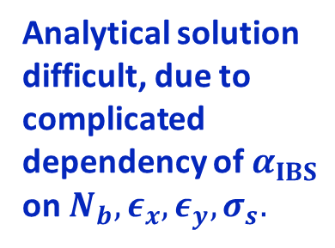
Beam and Luminosity Evolution
During the beams are in collision the instantaneous value of the luminosity will change:
with
: revolution freq.
: no. bunches/beam
: β-function at IP
: no. particles/bunch
: geom. emittances
: bunch length
: total cross-section
: IBS growth rate
: rad. damping rate
The beam evolution with time is obtained by solving a system of four differential equations:
Intensity
Hor. Emittance
Ver. Emittance
Bunch Length
Analytical solution difficult, due to complicated dependency of $α_{IBS}$ on $N_{b},ε_{x}, ε_{y}, σ_{s}.$

Slide 6
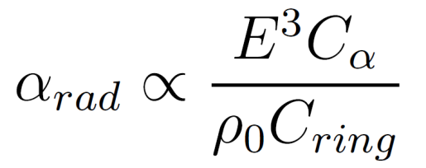
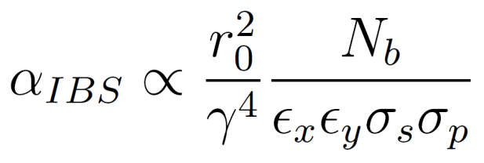
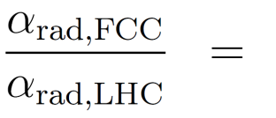
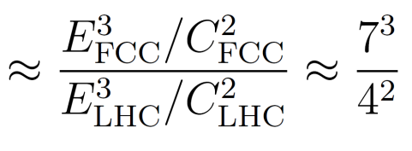
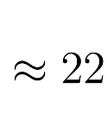
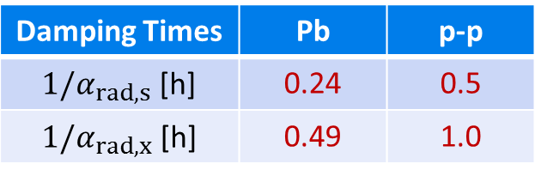
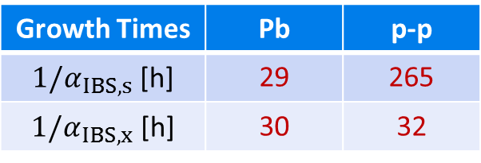
Effects on the Emittance – a new regime
Intra-Beam Scattering (IBS)
(Synchrotron) Radiation Damping
Emittance Growth
Emittance Shrinkage
Growth rate dynamically changing with beam properties:
Damping rate is constant for a given energy:
IBS is weak for initial beam parameters, but increases with decreasing emittance .
Growth Times | Pb | p-p
$1/α_{IBS,s}$ [h] | 29 | 265
$1/α_{IBS,x}$ [h] | 30 | 32
Damping Times | Pb | p-p
$1/α_{rad,s}$ [h] | 0.24 | 0.5
$1/α_{rad,x}$ [h] | 0.49 | 1.0
Fast emittance decrease at the beginning of the fill,
until IBS becomes strong enough to counteract the radiation damping.

Slide 7
Proton-Proton
Operation

Slide 8
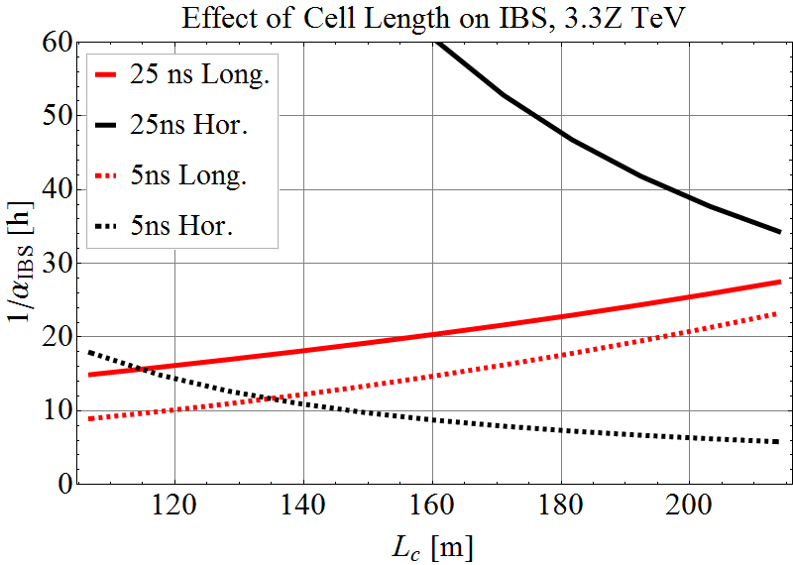
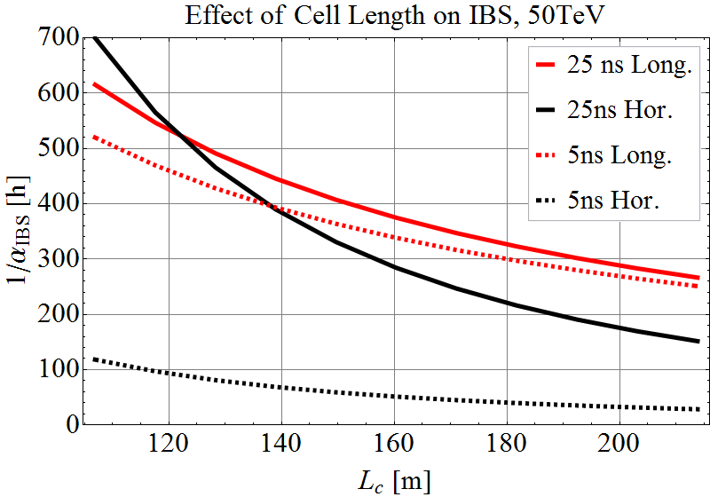
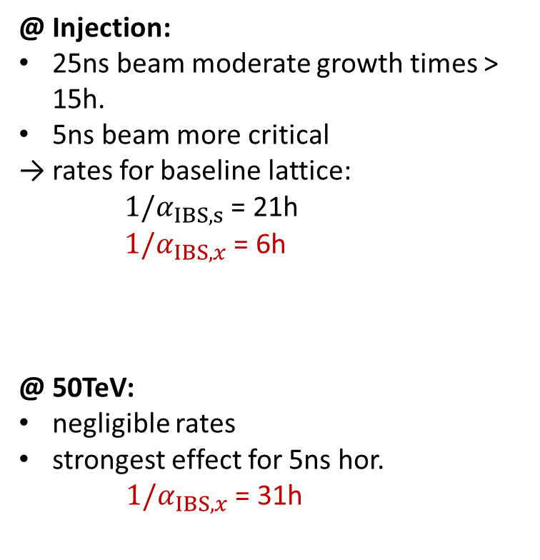
p-p: Intra-Beam Scattering
Variation of IBS growth times for initial beam conditions with FODO cell length.
@ Injection:
25ns beam moderate growth times > 15h.
5ns beam more critical
→ rates for baseline lattice:
$1/α_{IBS,s}$ = 21h
$1/α_{IBS,x}$ = 6h
@ 50TeV:
negligible rates
strongest effect for 5ns hor.
$1/α_{IBS,x}$ = 31h
Baseline
Baseline

Slide 9
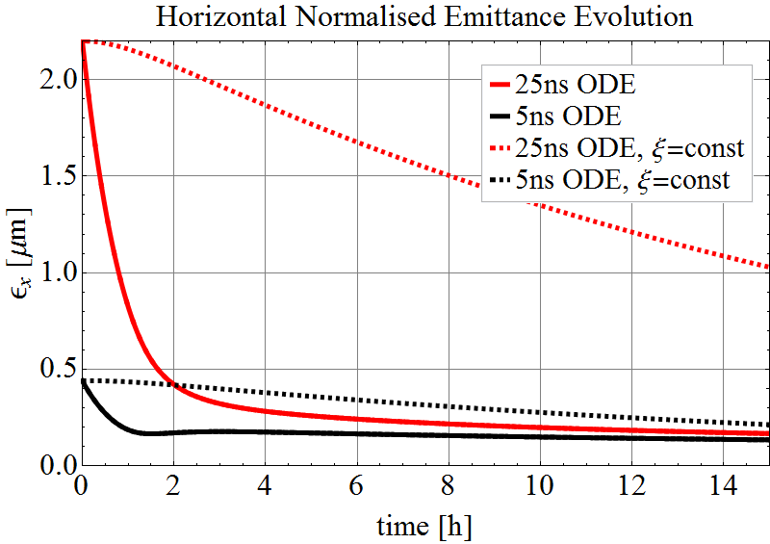
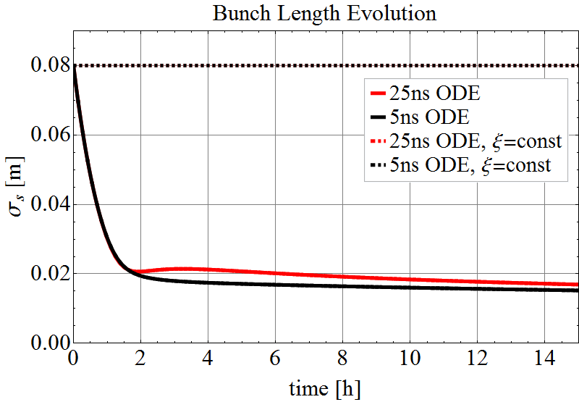
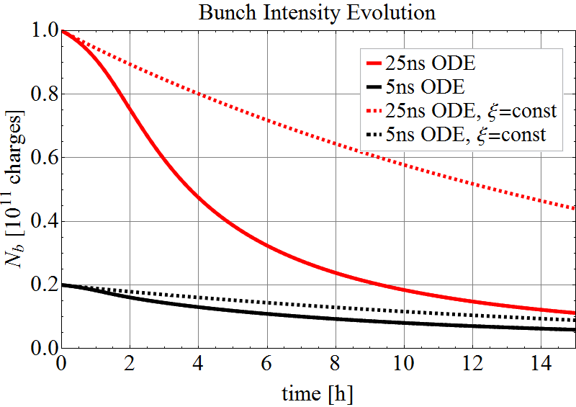
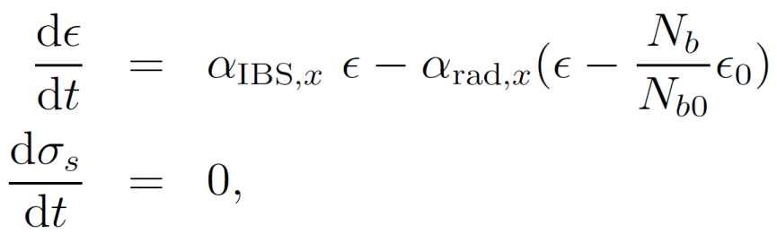
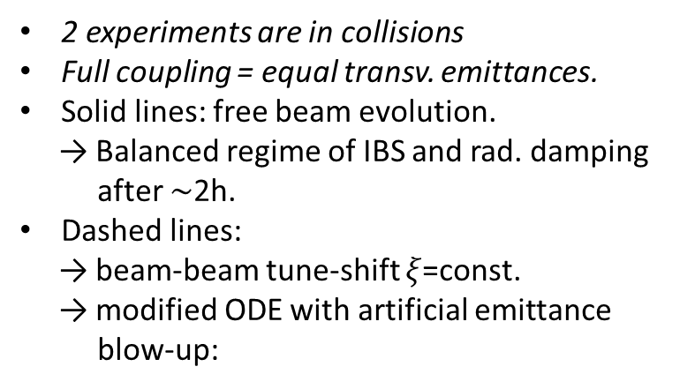
p-p: Beam Evolution
Emittance
Bunch Length
2 experiments are in collisions
Full coupling = equal transv. emittances.
Solid lines: free beam evolution.
→ Balanced regime of IBS and rad. damping after $\sim$2h.
Dashed lines:
→ beam-beam tune-shift $ξ$=const.
→ modified ODE with artificial emittance blow-up:
Intensity

Slide 10
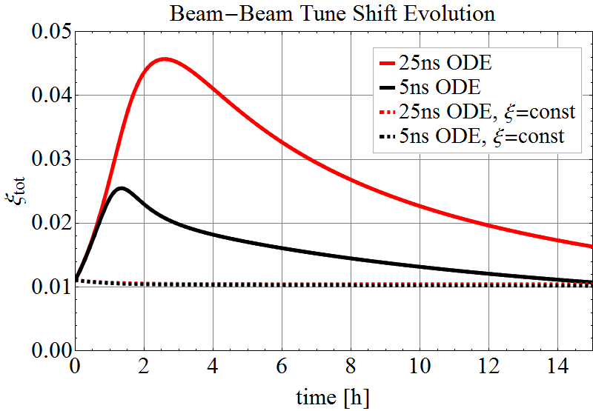
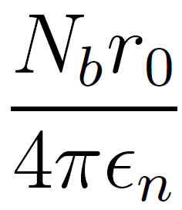

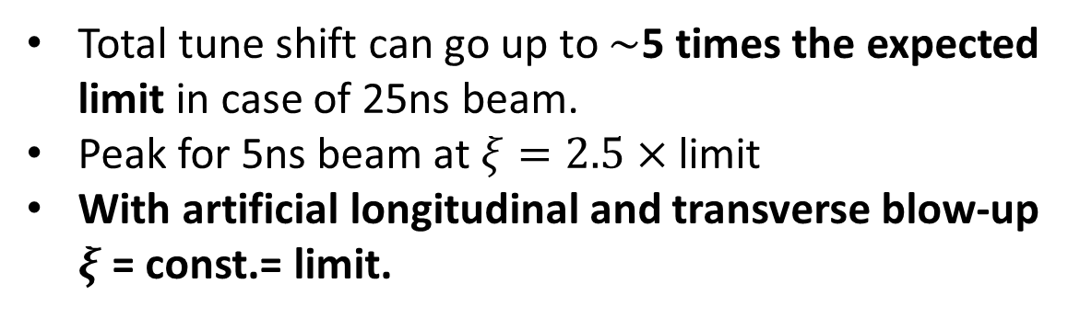
p-p: Beam-Beam Tune Shift
Beam-beam tune shift per experiment:
with 2 experiments in collisions
Total tune shift can go up to $\sim$5 times the expected limit in case of 25ns beam.
Peak for 5ns beam at $ξ=2.5×$ limit
With artificial longitudinal and transverse blow-up $ξ$ = const.= limit.

Slide 11
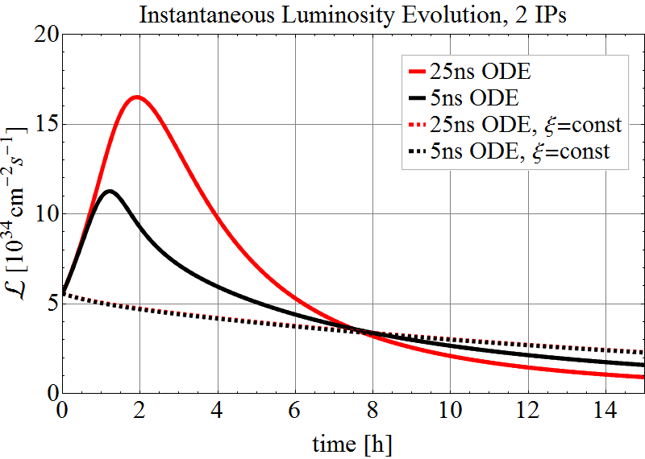
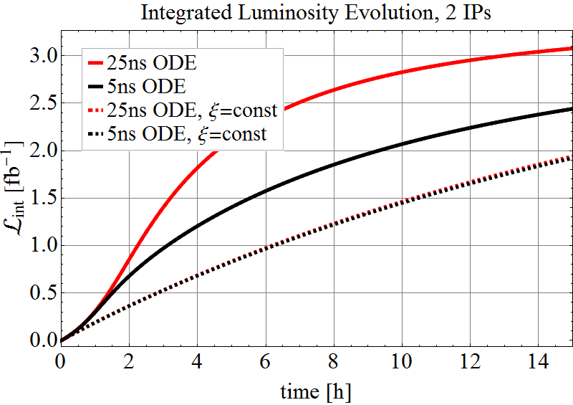
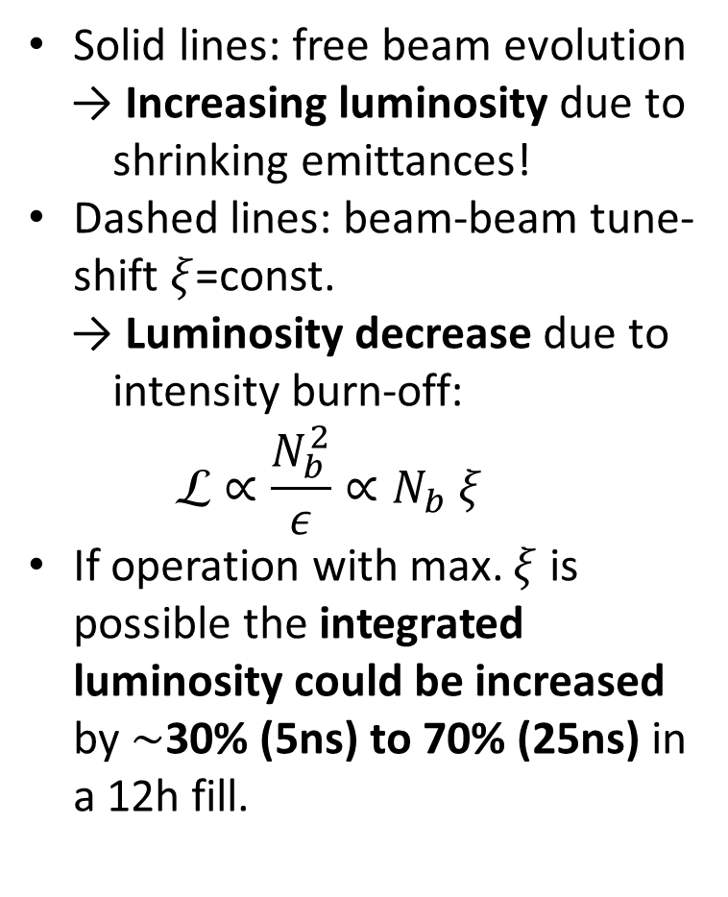
p-p: Luminosity Evolution
Solid lines: free beam evolution
→ Increasing luminosity due to shrinking emittances!
Dashed lines: beam-beam tune-shift $ξ$=const.
→ Luminosity decrease due to intensity burn-off:
$$☹∝{\frac{N_{b}^{2}}{ε}∝N}_{b} ξ$$
If operation with max. $ξ$ is possible the integrated luminosity could be increased by $\sim$30% (5ns) to 70% (25ns) in a 12h fill.
Inst. Luminosity
Int. Luminosity

Slide 12
Heavy-Ion
Operation

Slide 13
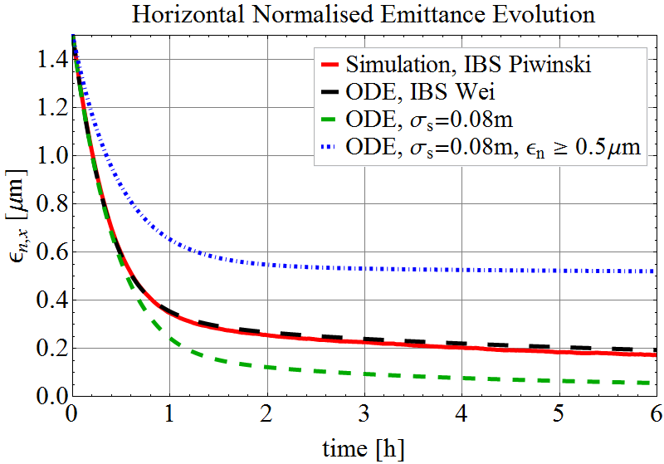
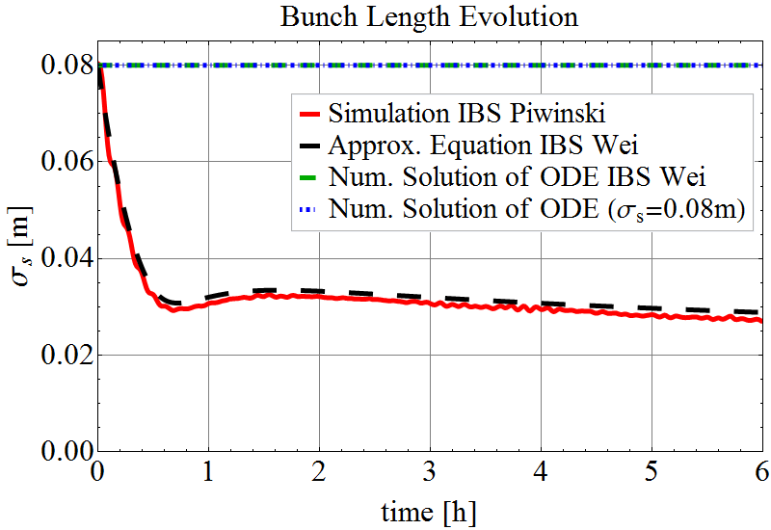
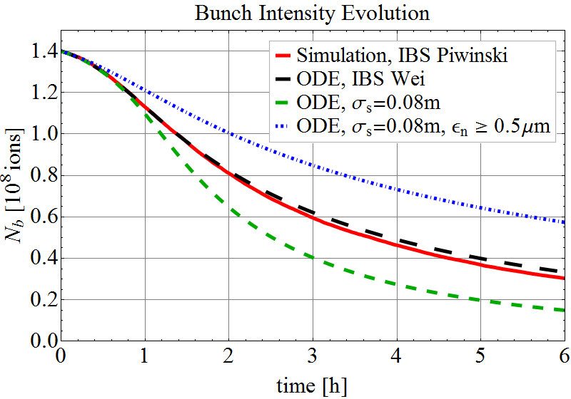
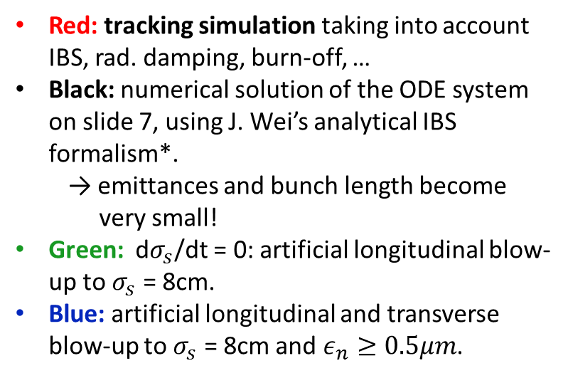
Pb-Pb: Beam Evolution (1 Experiment)
Transverse Emittance
Bunch Length
Red: tracking simulation taking into account IBS, rad. damping, burn-off, …
Black: numerical solution of the ODE system on slide 7, using J. Wei’s analytical IBS formalism*.
→ emittances and bunch length become very small!
Green: d$σ_{s}$/dt = 0: artificial longitudinal blow-up to $σ_{s}$ = 8cm.
Blue: artificial longitudinal and transverse blow-up to $σ_{s}$ = 8cm and $ε_{n}≥0.5μm$.
Intensity
*J. Wei: Evolution of Hadron Beams under Intrabeam Scattering, Conf.Proc. C930517 (1993) 3651-3653, PAC 1993.

Slide 14
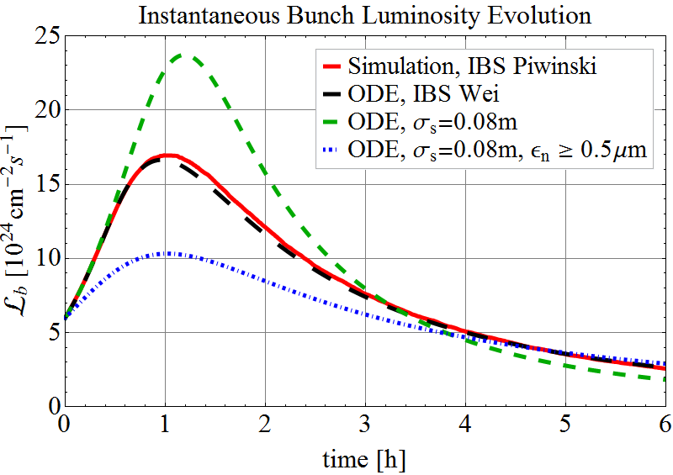
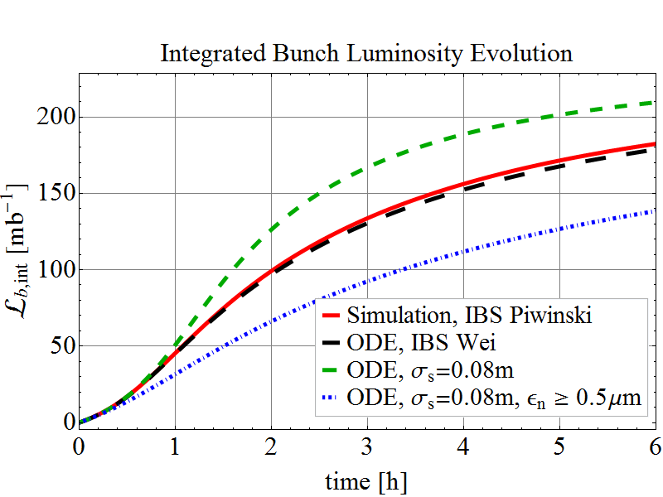
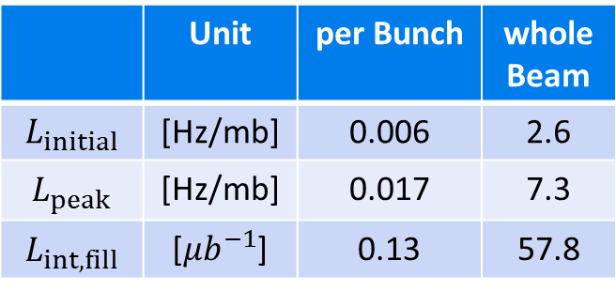
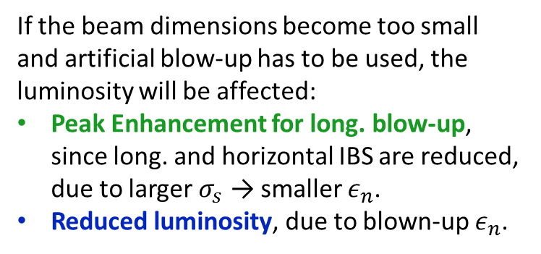
Pb-Pb: Luminosity Evolution (1 Experiment)
If the beam dimensions become too small and artificial blow-up has to be used, the luminosity will be affected:
Peak Enhancement for long. blow-up, since long. and horizontal IBS are reduced, due to larger $σ_{s}$ → smaller $ε_{n}$.
Reduced luminosity, due to blown-up $ε_{n}$.
Summary for free beam evolution (no artificial blow-up)
 | Unit | per Bunch | whole Beam
$$L_{initial}$$ | [Hz/mb] | 0.006 | 2.6
$$L_{peak}$$ | [Hz/mb] | 0.017 | 7.3
$$L_{int,fill}$$ | [${μb}^{−1}$] | 0.13 | 57.8

Slide 15
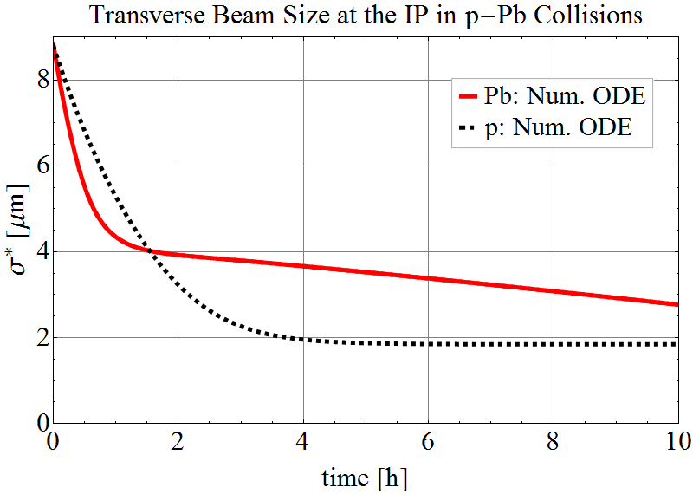
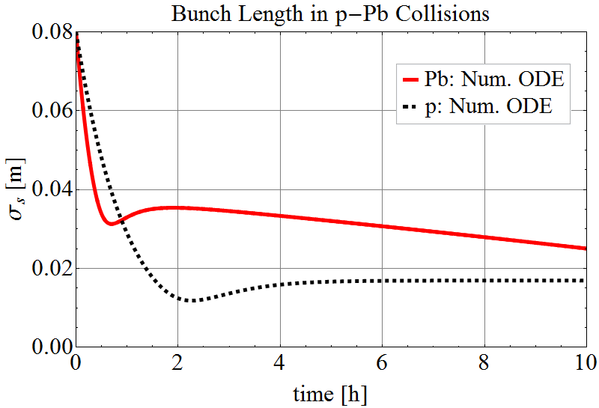
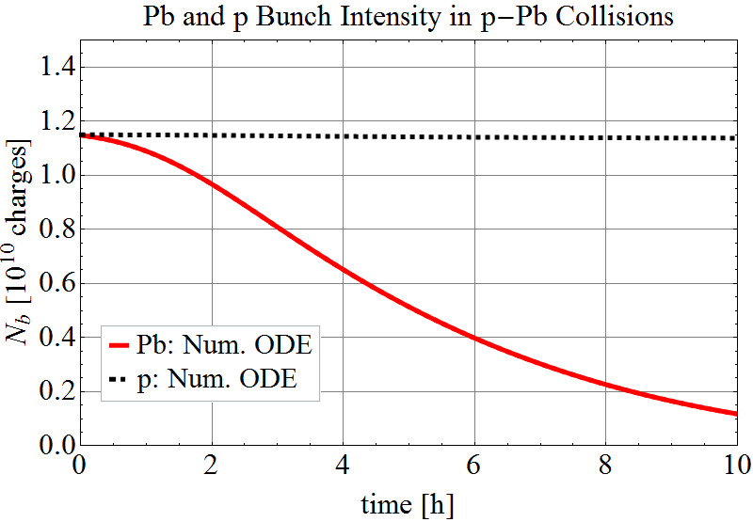


p-Pb: Beam Evolution (1 Experiment)
Beam Size
Bunch Length
Initial conditions:
Pb-beam as for Pb-Pb operation.
Equal beam sizes, σ*, for p and Pb.
Rad. damping $≈2$
→ ${2α}_{rad}\left(p\right)$ $≈$ $α_{rad}\left(Pb\right)$
IBS scales with $N_{b}$
$N_{b}\left(p\right)≈100 N_{b}(Pb)$
→ Fast Pb burn-off, while
$N_{b}\left(p\right)$ $≈$ const.
Intensity

Slide 16
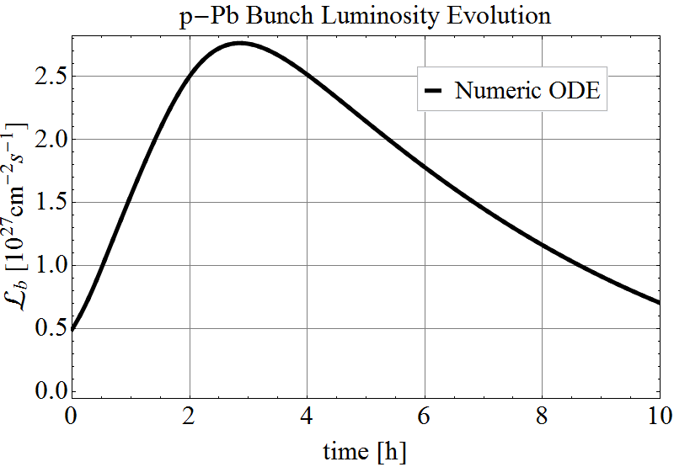
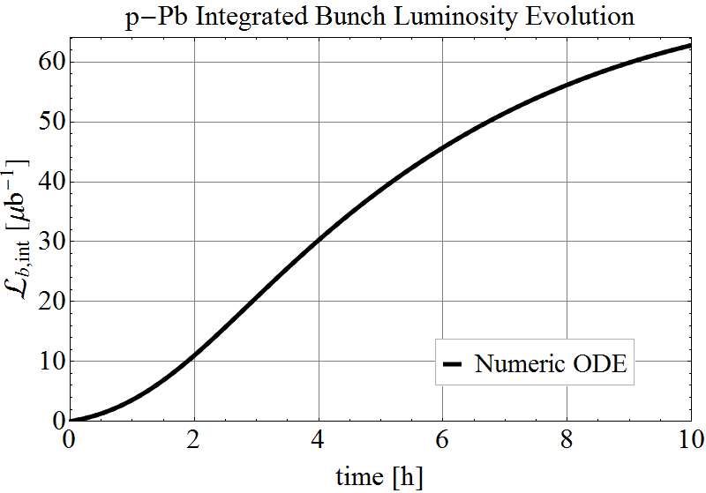
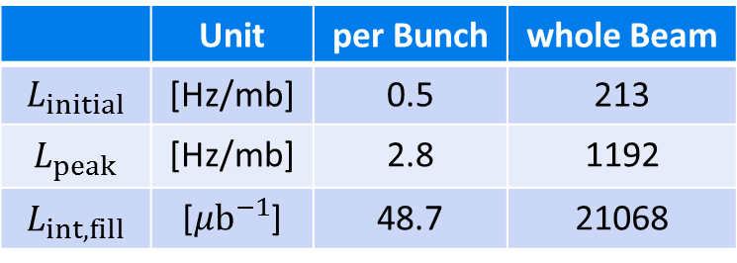

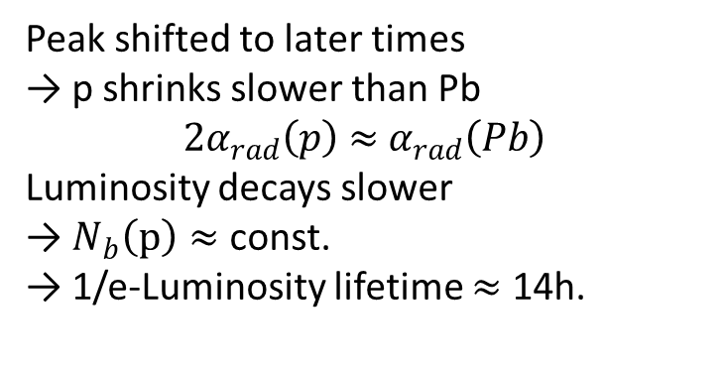
p-Pb: Luminosity Evolution (1 Experiment)
Peak shifted to later times
→ p shrinks slower than Pb
${2α}_{rad}\left(p\right)$ $≈$ $α_{rad}\left(Pb\right)$
Luminosity decays slower
→ $N_{b}\left(p\right)≈$ const.
→ 1/e-Luminosity lifetime $≈$ 14h.
 | Unit | per Bunch | whole Beam
$$L_{initial}$$ | [Hz/mb] | 0.5 | 213
$$L_{peak}$$ | [Hz/mb] | 2.8 | 1192
$$L_{int,fill}$$ | [${μb}^{−1}$] | 48.7 | 21068

Slide 17
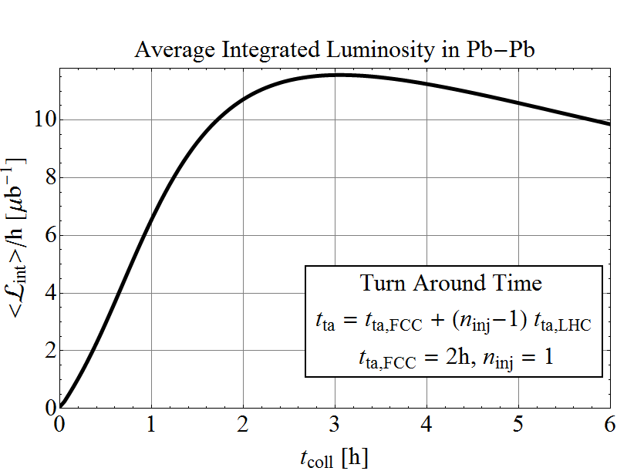
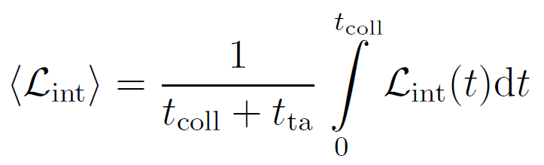
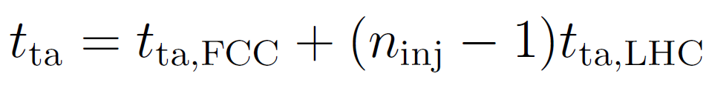


Average Luminosity
Average Luminosity per hour:
Max. at $t_{coll}≈3h$
inst
$t_{coll}$ = time in collisions → to be optimised
= turn-around time
= time dump → next collisions
Assumption $t_{ta,FCC}=2h$ (cycle time FCC, without injections)
$n_{inj}=1$ (no. injections from LHC)
For free beam parameter evolution, red case in Pb-Pb

Slide 18





Heavy-Ion Integrated Luminosity per Run
Consider more LHC injections:
→ max. $n_{inj}=4$ (= FCC Length)
→ Dwell time at FCC inj. plateau
→ lengthen
→ Particle losses (& emittance growth)
→ Loss rate of Pb at injection:
→ Total beam intensity:
→ <$☹_{int}$>  ${{(N}_{beam}\text{/}k_{b}N_{b})}^{2}×$<$☹_{int}$>
Optimised fill length ($n_{inj}=1$):
  Pb-Pb: 3h → <$☹_{int}$>/run $≈$ 8$nb^{−1}$
  p-Pb: 6.5h → <$☹_{int}$>/run $≈$ 1700$nb^{−1}$
Uncertainty on prediction significantly enhanced for $n_{inj}>1$
→ Early beam aborts and longer inj. times
Pb-Pb
p-Pb

Slide 19

Conclusions
Strong rad. damping: small emittances and bunch length
→ Effective intensity burn-off.
  → But high beam-beam tune shift in p-p ($5×limit$).
  → Artificial blow-up could be used as levelling method to keep beam-beam tune shift below limit, but significant reduction of potential luminosity outcome.
  → If operation with max. beam-beam tune shift is possible int. luminosity +70% with equal initial beam parameters.
  Reduce turn around time!
  → Significant luminosity increase for heavy-ion operation

Slide 20
Potential performance of Pb-Pb and p-Pb presented at:
Ions at the Future Hadron Collider, 16-17 Dec. 2013, CERN.
→ https://indico.cern.ch/event/288576/timetable/#20131216
FCC Study Kickoff Meeting, 12-15 Feb. 2014, Geneva.
  → https://indico.cern.ch/event/282344/timetable/#20140212
Ions at the Future Circular Collider, 22-23 Sep. 2014, CERN.
→ https://indico.cern.ch/event/331669/timetable/#20140922
Report covering Pb-Pb, p-Pb and p-p is in preparation…

Slide 21
Thank you
for your attention

Slide 22

FCC-hh Storage Ring Parameters

Slide 23

Heavy-Ion Beam Parameter Summary

Slide 24

Heavy-Ion Luminosity Summary

Slide 25








Intra-Beam Scattering
A. Piwinski Formalism for IBS growth rates:
Particle Type
Beam
properties
Energy
IBS strength changes dynamically with beam properties.
Lattice and beam sizes
Handbook of Accelerator Physics and Engineering, 1st Edition, 3rd Print, pp. 141

Slide 26




Pb: Intra-Beam Scattering
Variation of IBS growth times for initial beam conditions with FODO cell length.
Collision Energy
Baseline
Baseline
Injection
Baseline
Effect of long. (hor.) IBS decreases (increases) with increasing cell length at injection energy.
At collision energy, IBS is weak for initial beam parameters.
Growth Times | Unit | LHC Design | FCC injection | FCC collision
$$1/α_{IBS,s}$$ | [h] | 7.7 | 10.0 | 30.3
$$1/α_{IBS,x}$$ | [h] | 13 | 6.2 | 29.2

Slide 27






Radiation Damping
Damping Rates
Handbook of Accelerator Physics and Engineering, 1st Edition, 3rd Print,
pp. 210
Energy
Particle Type
Ring
Constant depending on particle’s mass and charge
Radiation Integrals
Isomagnetic ring with separated function magnets & $D_{y}=0$

Slide 28




Heavy-Ion: Beam-Beam Tune Shift
Beam-beam tune shift per experiment:
Beam m receives kick from Beam n
u,v =x, y
p-Pb
Pb-Pb
Beam-Beam Parameter per Experiment | Unit | LHC Design p-p | LHC Design Pb-Pb | FCC Pb-Pb | FCC p-Pb
Initial | [${10}^{−3}]$ | 3.7 | 0.18 | 0.37 | 0.37
Peak | [${10}^{−3}]$ | 3.7 | 0.18 | 1.4 | 8.3
The tune shift due to beam-beam interactions remains well below assumed limit for Pb-Pb, but comes close to the limit for Pb in p-Pb collisions.

Slide 29





BFPP Beam Power
Main contribution to fast Pb-Pb burn-off:
FCC-PbPb
peak $P_{BFPP} ≈1.7kW$
Example: LHC Pb beam right of IP2
Main: 208-Pb-82+
BFPP1: 208-Pb-81+
BFPP2: 208-Pb-80+
EMD1: 207-Pb-82+
EMD2: 206-Pb-82+
Countermeasures (e.g., DS collimators) have to be considered in initial lattice & hardware design.
LHC

Slide 30

Smaller Z Ions – Impact on Luminosity
New ions source & injectors  possibly higher $N_{b}$ are available.
  No studies on improved heavy ion injectors done yet!
Contribution of ultra-peripheral electromagnetic processes to the total cross-section would be reduced:
  $σ_{BFPP}∝Z^{7}$
  $σ_{EMD}∝Z^{4}$
  Increased luminosity lifetime, more particles available for hadronic interactions.
  Reduced secondary beam power emerging from collision point.
Radiation damping rate does not change much for Z>60:
  $α_{rad}∝ Z^{5}/A^{4}$

