Slide 1
Baseline Layout
D. Schulte

Slide 2
The Problem
Need to define the FCC integration into the Geneva area
Limitations exist
  E.g. problems with tunnel under the Jura
  Connection to the LHC as injector
Need to provide first layout of the machine now
  Cannot wait for the lattice design to finish
  We will iterated later on
Have to make educated guesses on the layout to decouple the work of the civil engineering and the lattice design

Slide 3
The Solution
Michael suggested to explore rings with 3.0, 3.25, 3.5, 3.75 and 4.0 times the LHC circumference
  Fine
Define straight lines
  Four experimental lines
  Two for injection
  Two for extraction
  Two for collimation
  Everything else (e.g. RF) is integrated in these lines as well
Define the length of the straight lines
  1400m scaling from LHC with sqrt(Energy) for all lines
  Except for the collimation: 2800m each based on Rogelio’s first guess of 3.1km
Now we can calculate the total length of all arcs
Need now to define positions of straight lines

Slide 4
Inj1
Exp4
Inj2
Insertion | Length
Exp1 | 1.4 km
Exp2 | 1.4 km
Exp3 | 1.4 km
Exp4 | 1.4 km
Coll1 | 2.8 km
Coll2 | 2.8 km
Inj1 | 1.4 km
Inj2 | 1.4 km
Extr1 | 1.4 km
Extr2 | 1.4 km
S3
S4
“Round Racetrack”
The baseline
L_{arc}=0.25 (C-16.8km-4*L_{S}-16*L_{disp})
R_{arc}=(C-16.8km-16*(1-a)*L_{disp})/(2π)
L_{S}=0.8km
R_{S}=R_{arc}
L_{disp}=0.4km
R_{disp}=R_{arc}/a
a=0.75
Coll1
Coll2
Extr1
Extr2
Note:
Dispersion suppressors
Bends between experiments
Spacing between Inj1+2 for LHC
S1
S2
Exp1
Exp3
Exp2

Slide 5
Inj2
Exp1
“LHC-type”
Not the baseline
Insertion | Length
Exp1 | 1.4 km
Exp2 | 1.4 km
Exp3 | 1.4 km
Exp4 | 1.4 km
Coll1 | 2.8 km
Coll2 | 2.8 km
Inj1 | 1.4 km
Inj2 | 1.4 km
Extr1 | 1.4 km
Extr2 | 1.4 km
Inj1
Extr1
L_{arc}=0.1 (C-16.8km-4*L_{S}-20*L_{disp})
R_{arc}=(C-16.8km-20*(1-a)*L_{disp})/(2π)
L_{disp}=0.4km
R_{disp}=R_{arc}/a
a=0.75
Coll1
Coll2
Extr2
Exp4
Exp2
Exp3

Slide 6
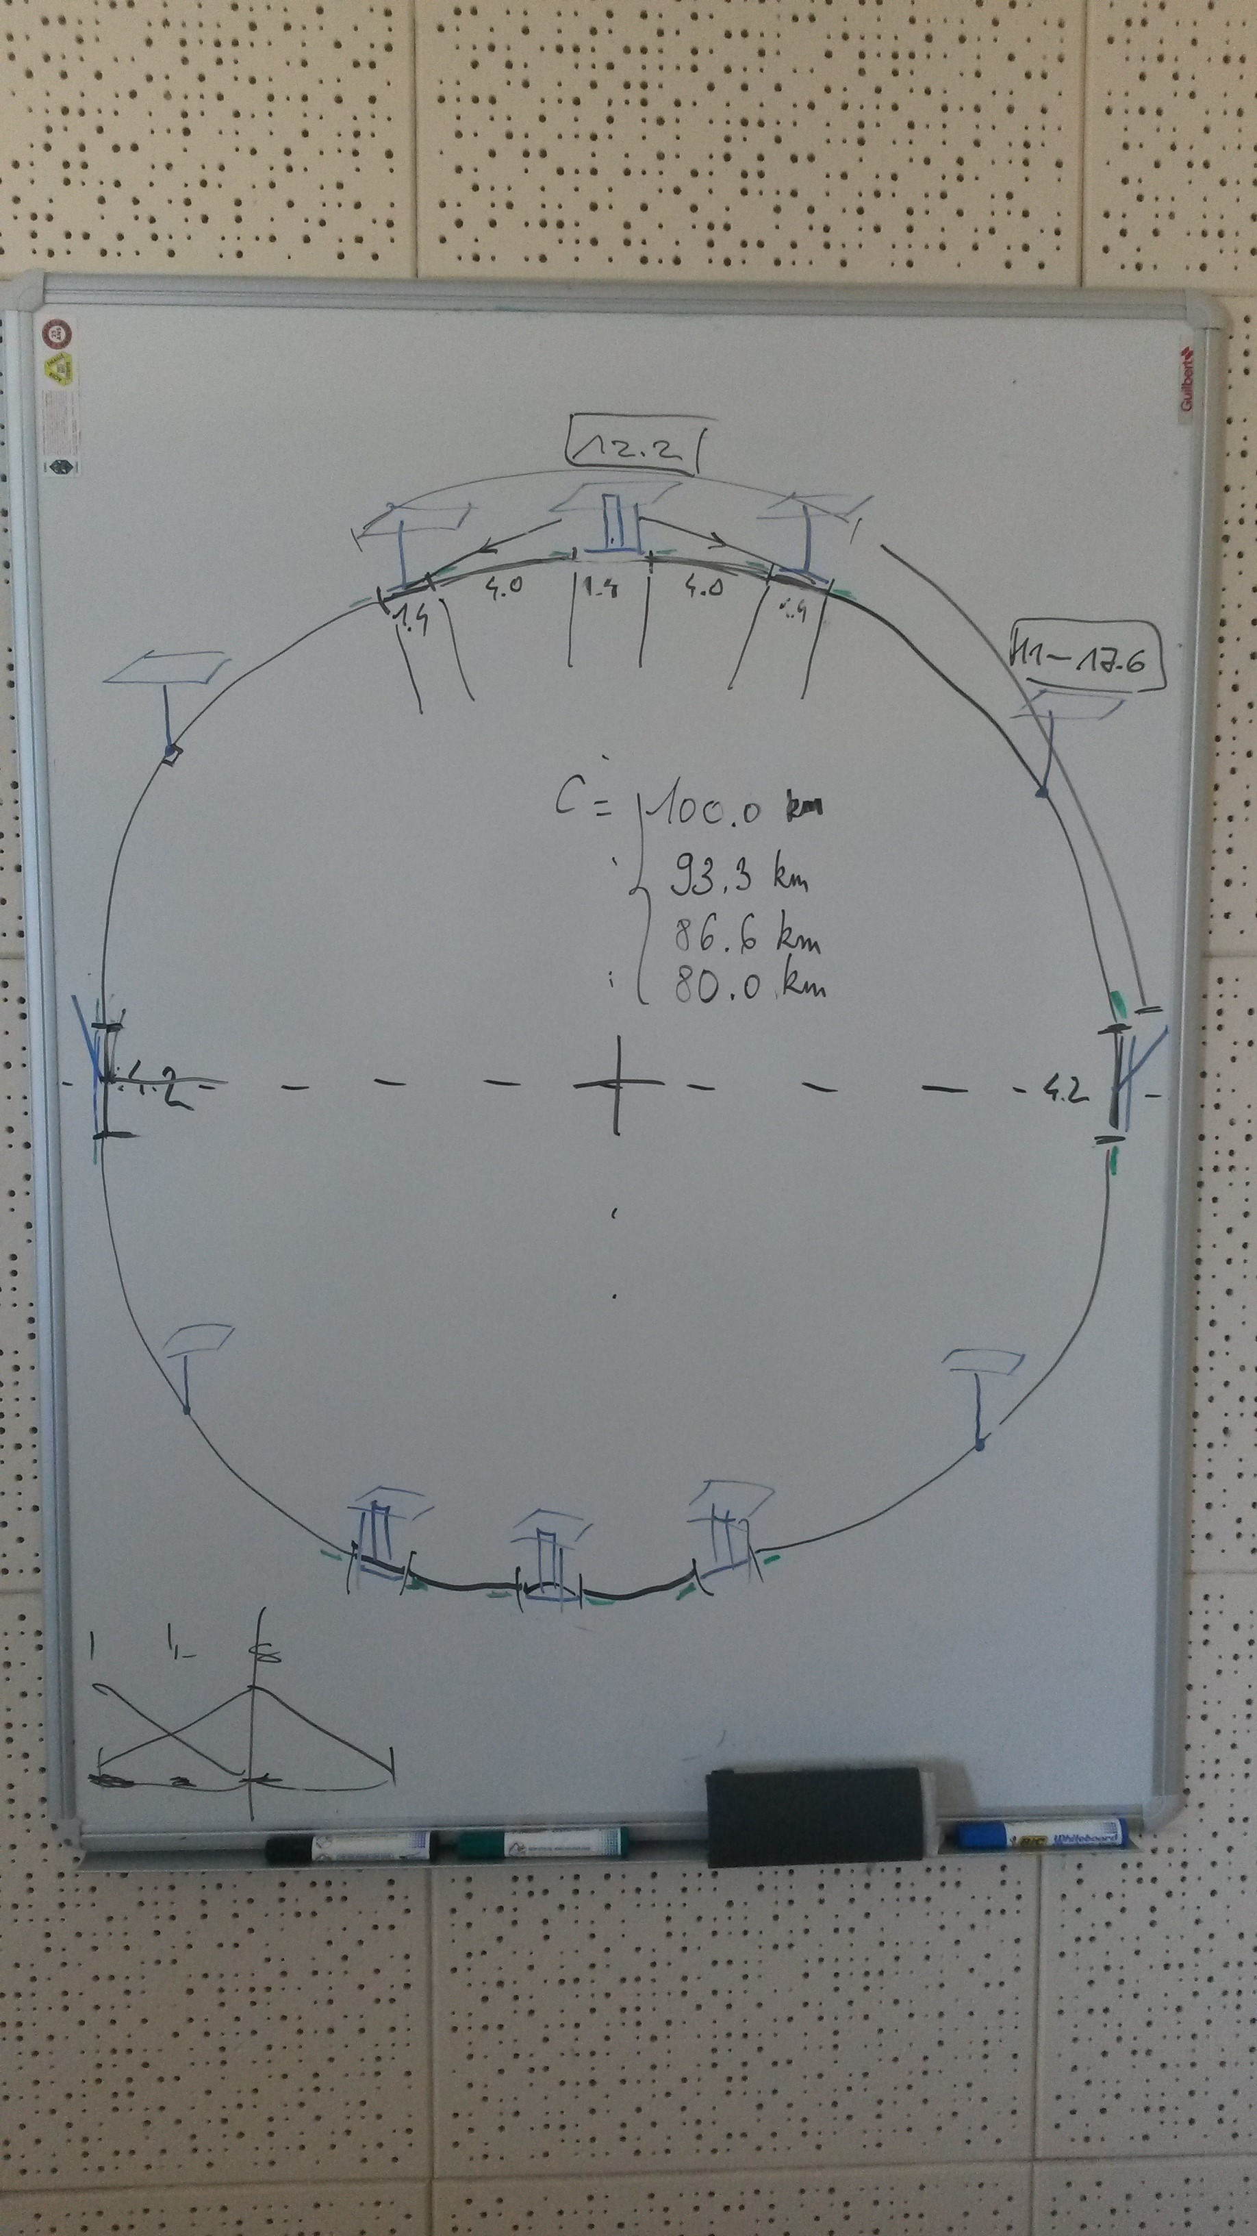
First Discussion Result
Ph. Lebrun
et al.
M. Benedikt, J. Osborn, Ph. Lebrun, J. Wenninger, B. Goddard, D. Schulte
No objection from the FCC-ee design
Can have four RF stations
Injection from LHC might require 10km between the centres of Inj1 and Inj2

Slide 7
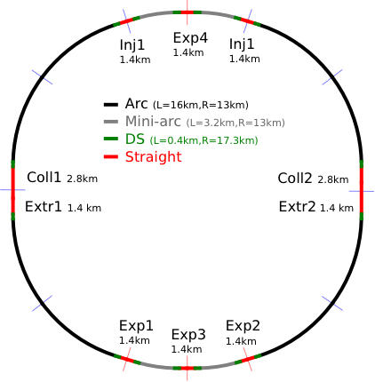
Overall Sketch
Straight sections are in red
Dispersion suppressors are in green
Arcs are in black
The short arcs between the experiments are in grey
Shafts are marked with blue lines
C=100km circumference example is shown
Plot by X. Buffat
L_{arc}=0.25 (C-16.8km-4*L_{S}-16*L_{disp})
R_{arc}=(C-16.8km-16*(1-a)*L_{disp})/(2π)
L_{S}=0.8km
R_{S}=R_{arc}
L_{disp}=0.4km
R_{disp}=R_{arc}/a
a=0.75

Slide 8
Conclusion
Have a suggestion for the baseline layout
  Actually with different lengths
Please confirm that you see no problem with the current proposal
  We will iterate based on better knowledge in any case

