Slide 1
Half-day Excursion
Saturday 14 March

Slide 2
Two options
Either visit Ibarra city centre in the afternoon, leaving the hacienda after lunch at 13h45
  Free time in Ibarra from about 14h15 to 16h30
    Sightseeing, etc.
Or stay at the hacienda in the afternoon, leaving the hacienda at 16h00
In both cases, we will reach the restaurant in the hills above Ibarra at about 17h00
  Enjoy the view before sunset
  Early dinner starting at about 18h15
  Return to hacienda at about 20h00
  Taverna will be open in the evening

Slide 3
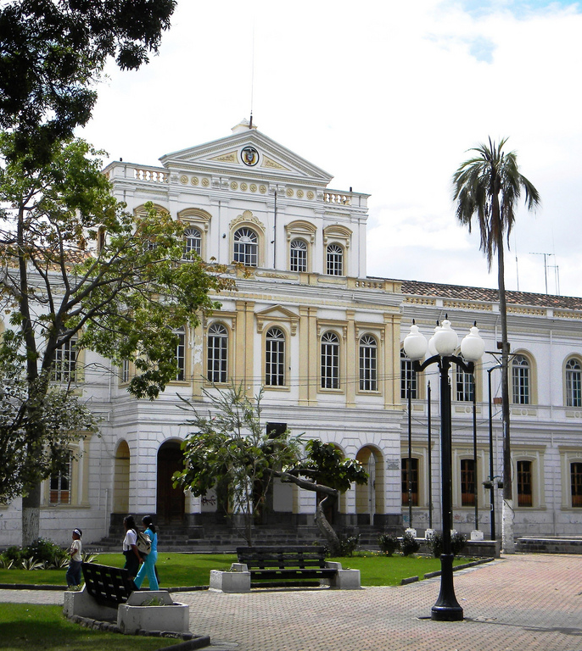
Ibarra city
Lonely Planet guide says…
Known as la ciudad blanca (the white city), Ibarra's downtown streets are lined with finely detailed, whitewashed colonial architecture. Although most of the building's ground floors have been turned into ordinary shops and there's a bustling commercial atmosphere, several quite beautiful plazas with towering palms and baroque churches lend it a distinctively sophisticated feel.

Slide 4
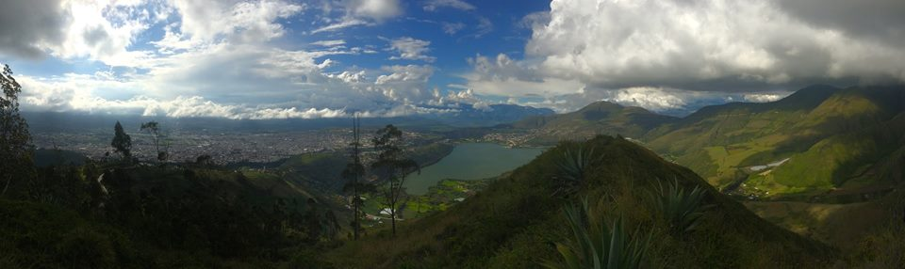
Restaurant
The restaurant is in the hills above Ibarra
There is a very nice view looking down onto the city and the lake

Slide 5
Bookings made for everyone
We expect essentially all of the participants to go to the restaurant
  Please contact Kate now if you cannot go because of exceptional circumstances
  No dinner arranged at the hacienda if you miss the bus to the restaurant!
Also, please could everybody indicate on the sheets that Kate has posted which option they want, i.e. leave hacienda at 13h45 or at 16h00
  Please do this now!
  If you don’t do it before 15h30, we will make the choice for you!

Slide 6
Other points
Project presentations on Sunday evening
Dinner and farewell party on Monday evening
  Performance of traditional dancing after dinner, then student responsible to provide the music!
    Connect laptop to sound system
  Please don’t bring drinks bought outside the hacienda to the party
    We will be providing some free drinks
    If/when they run out, you will be able to buy more from the hacienda
Assume that all departures have now been checked

