Slide 1
Full-day Excursion
Wednesday 11 March

Slide 2
Timetable (note early start, sorry!)
Breakfast 7h15-8h00
Buses leave at 8h15 sharp
Seven Waterfalls Park ~ 9h30 – 12h30
Lunch in town of Salinas ~ 14h00 – 15h00
Chachimbiro thermal baths ~ 16h00
Buses leave Chachimbiro at 19h00 sharp!
Dinner back at Hacienda Chorlavi ~ 20h00

Slide 3
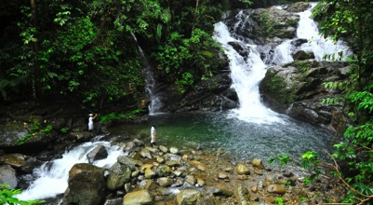
Seven Waterfalls
This park is a natural reserve and the weather will be warm and humid
  Slightly lower altitude than Ibarra
Guided walking tour visiting the different waterfalls and discovering the flora and fauna of the Ecuadorian tropical forests
The paths that we will take to visit the waterfalls will be uneven and rocky, and can be muddy in places
  Take care not to slip
If you want you can swim in the natural pools
You need to bring:
  Comfortable clothes for walking
  A change of clothes for after the visit (you may get wet and muddy!)
  Sports/walking shoes (can rent at Seven Waterfalls reserve)
  Hat
  Sunscreen
  Bathing suit or suitable clothes for swimming in natural pools
  Towel (can borrow from hotel reception this afternoon)
  Insect repellent
  Plastic storage for wet clothes
  Bottle of water

Slide 4
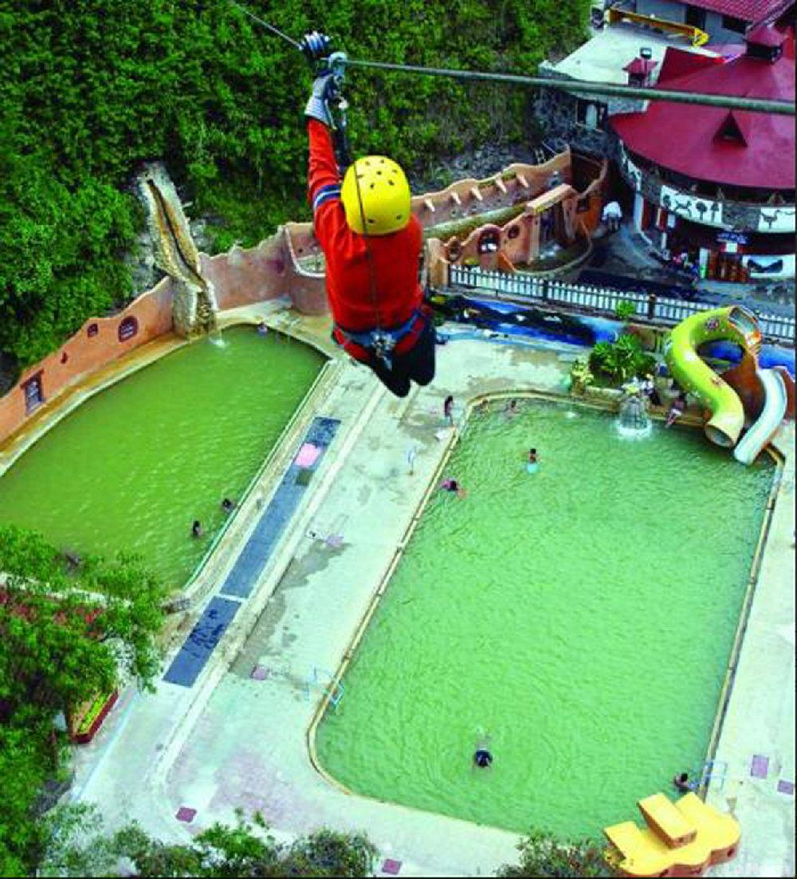
Termas Santa Agua Chachimbiro
After eating lunch in the town of Salinas, we go on to the thermal baths at Chachimbiro, including:
  Complex of swimming pools and spas
  Hydro-massage
  Sauna
  Turkish baths
  Bar
Need to pay for extras such as the zip line, horse riding, etc.

Slide 5
Bookings made for everyone
We expect essentially all of the participants to go on the excursion
  Please contact Kate now if you cannot go because of exceptional circumstances
  No lunch arranged at the hotel if you miss the bus in the morning!
If you miss the bus for the return journey, it’s your problem to get back to the hacienda at your own expense

