Slide 1
Update on Field Quality Specifications for the New IR Magnets of HL-LHC
Yuri Nosochkov (SLAC)
Y. Cai (SLAC)
S. Fartoukh, M. Giovannozzi, R. de Maria, E. McIntosh (CERN)
37th HiLumi WP2 Task Leader Meeting 7 November 2014

Slide 2
Outline and tracking set-up
DA studies with updated estimated field quality of the new IR magnets:
Nb-Ti 105 mm D2 separation dipoles
Nb₃Sn 150 mm aperture IT quadrupoles
Nb-Ti 90 mm Q4 quadrupoles
Lattice set-up:
collision optics with β*= 15 cm at IP1/IP5 and E = 7 TeV
injection optics with β*= 5.5 m and E = 450 GeV
Tracking simulations set-up:
10⁵ turns, 60 random error seeds, 30 particle pairs per amplitude step (2σ), 11 x-y angles
Beam energy: 7 TeV (collision), 450 GeV (injection)
Initial Δp/p: 2.7e-4 (collision), 7.5e-4 (injection)
Nominal tune: 62.31, 60.32 (collision), 62.28, 60.31 (injection)
Normalized emittance = 3.75 μm-rad
Arc errors and the standard correction systems are always included
IT non-linear correctors of order n=3-6 are used in the collision optics
Field coefficients:

Slide 3
Updated estimate of D2 field quality at collision energy (r₀ = 35 mm)
Previous specification: “D2_errortable_v4_spec”.
New estimate: “D2_errortable_v5”. New estimates are indicated in green below: b3m (1.5 -> 1.0), b3u,b3r (1.5 -> 1.667), b4m (1.0 -> -3.0), b4u,b4r (0.2-> 0.6), b6m (0 -> 2.0), b7m (-0.2 -> 2.0), b8m (0 -> 1.0), b9m (0.09 -> 0.5). In tracking b2 = 0.
skew | mean | uncertainty | random |  | normal | mean | uncertainty | random
a2 | 0 | 0.679 | 0.679 |  | b2 | ±1.00 | 1.000 | 1.000
a3 | 0 | 0.282 | 0.282 |  | b3 | 1.00 | 1.667 | 1.667
a4 | 0 | 0.444 | 0.444 |  | b4 | ±3.00 | 0.600 | 0.600
a5 | 0 | 0.152 | 0.152 |  | b5 | -1.00 | 0.500 | 0.500
a6 | 0 | 0.176 | 0.176 |  | b6 | ±2.00 | 0.060 | 0.060
a7 | 0 | 0.057 | 0.057 |  | b7 | 2.00 | 0.165 | 0.165
a8 | 0 | 0.061 | 0.061 |  | b8 | ±1.00 | 0.027 | 0.027
a9 | 0 | 0.020 | 0.020 |  | b9 | 0.50 | 0.065 | 0.065
a10 | 0 | 0.025 | 0.025 |  | b10 | 0 | 0.008 | 0.008
a11 | 0 | 0.007 | 0.007 |  | b11 | 0.03 | 0.019 | 0.019
a12 | 0 | 0.008 | 0.008 |  | b12 | 0 | 0.003 | 0.003
a13 | 0 | 0.002 | 0.002 |  | b13 | 0 | 0.006 | 0.006
a14 | 0 | 0.003 | 0.003 |  | b14 | 0 | 0.001 | 0.001
a15 | 0 | 0.001 | 0.001 |  | b15 | 0 | 0.002 | 0.002

Slide 4
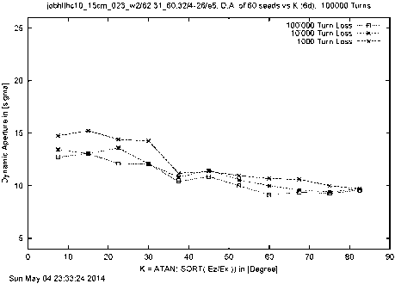
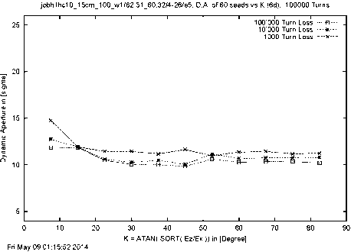
DA at collision energy with updated D2 field quality
The other magnets: “IT_errortable_v3_spec”, D1_errortable_v1_spec”, “Q4_errortable_v1_spec”, “Q5_errortable_v0_spec”.
D2_errortable_v4_spec
DAave = 11.07σ, DAmin = 9.14σ
D2_errortable_v5
DAave = 12.47σ, DAmin = 9.85σ
The field quality of “D2_errortable_v5” at collision is acceptable.

Slide 5
Updated estimate of D2 field quality at injection energy (r₀ = 35 mm)
Previous specification: “D2_errortable_v4_spec”.
New estimate: “D2_errortable_v5”. New estimates are indicated in green below: b2m (0 -> -5.0), b3m (3.8 -> -19.0), b4m (-8.0 -> 2.0), b6m (0-> 2.0), b6m (0 -> 2.0), b7m (0.1 -> 1.3), b8m (0 -> 1.0), b9m (0.02 -> 0.52). In tracking b2 = 0.
skew | mean | uncertainty | random |  | normal | mean | uncertainty | random
a2 | 0 | 0.679 | 0.679 |  | b2 | ±5.00 | 0.200 | 0.200
a3 | 0 | 0.282 | 0.282 |  | b3 | -19.00 | 0.727 | 0.727
a4 | 0 | 0.444 | 0.444 |  | b4 | ±2.00 | 0.126 | 0.126
a5 | 0 | 0.152 | 0.152 |  | b5 | 3.00 | 0.365 | 0.365
a6 | 0 | 0.176 | 0.176 |  | b6 | ±2.00 | 0.060 | 0.060
a7 | 0 | 0.057 | 0.057 |  | b7 | 1.30 | 0.165 | 0.165
a8 | 0 | 0.061 | 0.061 |  | b8 | ±1.00 | 0.027 | 0.027
a9 | 0 | 0.020 | 0.020 |  | b9 | 0.52 | 0.065 | 0.065
a10 | 0 | 0.025 | 0.025 |  | b10 | 0 | 0.008 | 0.008
a11 | 0 | 0.007 | 0.007 |  | b11 | 0 | 0.019 | 0.019
a12 | 0 | 0.008 | 0.008 |  | b12 | 0 | 0.003 | 0.003
a13 | 0 | 0.002 | 0.002 |  | b13 | 0 | 0.006 | 0.006
a14 | 0 | 0.003 | 0.003 |  | b14 | 0 | 0.001 | 0.001
a15 | 0 | 0.001 | 0.001 |  | b15 | 0 | 0.002 | 0.002

Slide 6
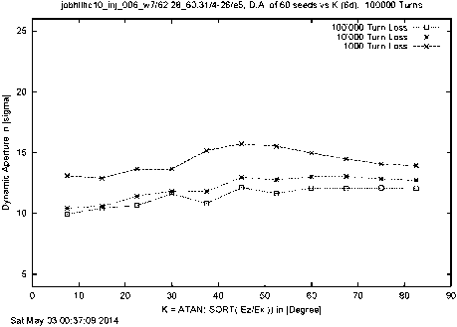
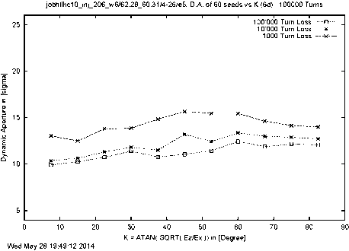
DA at injection energy with updated D2 field quality
The other magnets: “IT_errortable_v3_spec”, D1_errortable_v1_spec”, “Q4_errortable_v1_spec”, “Q5_errortable_v0_spec”.
D2_errortable_v4_spec
DAave = 10.46σ, DAmin = 9.95σ
D2_errortable_v5
DAave = 10.40σ, DAmin = 9.92σ
The field quality of “D2_errortable_v5” at injection is acceptable.
Hence, it becomes the specification table “D2_errortable_v5_spec”.

Slide 7
Updated estimate of IT field quality at collision energy (r₀ = 50 mm)
Previous specification: “IT_errortable_v3_spec” (same as “IT_errortable_v66”).
New reference: “IT_errortable_v66_4” (based on the new estimate in “IT_errortable_v4” combined with previously optimized terms (in red below) in “IT_errortable_v3_spec”). New estimates are indicated in green. Reduced b6m (0.8 -> 0.4), but significantly increased b10m (0.075 -> -0.39) and b14m (-0.02 -> -0.67).
skew | mean | uncertainty | random |  | normal | mean | uncertainty | random
a3 | 0 | 0.800 | 0.800 |  | b3 | 0 | 0.820 | 0.820
a4 | 0 | 0.650 | 0.650 |  | b4 | 0 | 0.570 | 0.570
a5 | 0 | 0.430 | 0.430 |  | b5 | 0 | 0.420 | 0.420
a6 | 0 | 0.310 | 0.310 |  | b6 | 0.40 | 0.550 | 0.550
a7 | 0 | 0.152 | 0.095 |  | b7 | 0 | 0.095 | 0.095
a8 | 0 | 0.088 | 0.055 |  | b8 | 0 | 0.065 | 0.065
a9 | 0 | 0.064 | 0.040 |  | b9 | 0 | 0.035 | 0.035
a10 | 0 | 0.040 | 0.032 |  | b10 | -0.39 | 0.100 | 0.100
a11 | 0 | 0.026 | 0.0208 |  | b11 | 0 | 0.0208 | 0.0208
a12 | 0 | 0.014 | 0.014 |  | b12 | 0 | 0.0144 | 0.0144
a13 | 0 | 0.010 | 0.010 |  | b13 | 0 | 0.0072 | 0.0072
a14 | 0 | 0.005 | 0.005 |  | b14 | -0.67 | 0.0115 | 0.0115

Slide 8
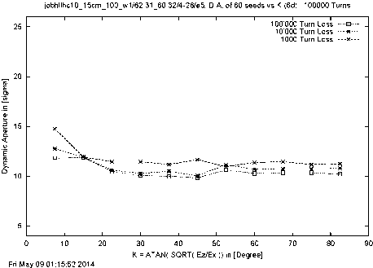
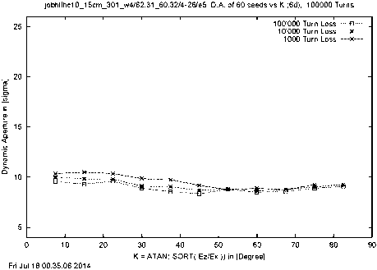
DA at collision energy with updated IT field quality
The other magnets: D1_errortable_v1_spec”, “D2_errortable_v5_spec”, “Q4_errortable_v1_spec”, “Q5_errortable_v0_spec”.
IT_errortable_v3_spec
DAave = 12.47σ, DAmin = 9.85σ
IT_errortable_v66_4
DAave = 9.65σ, DAmin = 8.34σ
Significantly reduced DA at collision with the field quality of “IT_errortable_v66_4”.
Next step: scan and optimize the b10m and b14m terms.

Slide 9
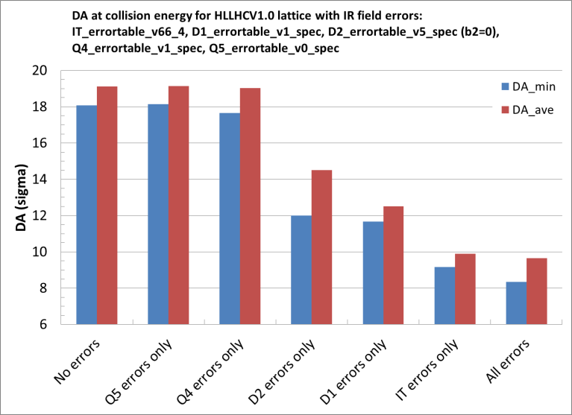
Impact of “IT_errortable_v66_4” relative to errors in other IR magnets

Slide 10
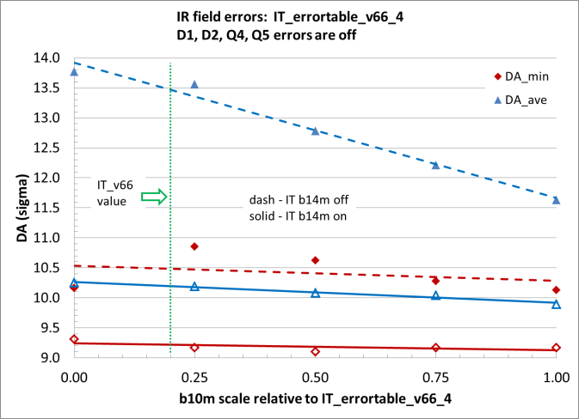
Scan of b10m (with other IR magnet errors off)
Minimum DA is not very sensitive to b10m

Slide 11
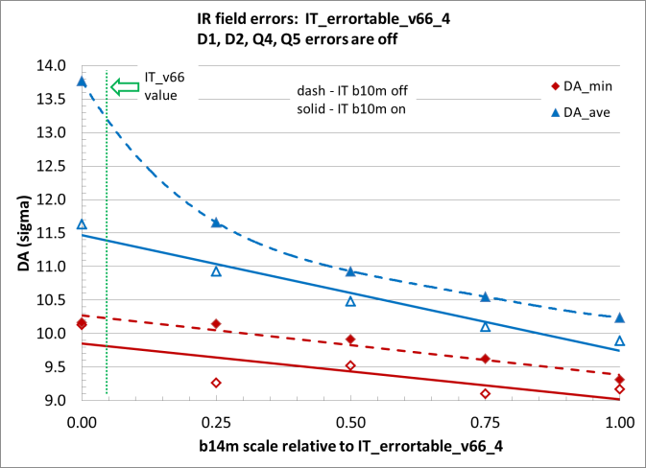
Scan of b14m (with other IR magnet errors off)
Strong DA dependence on b14m

Slide 12
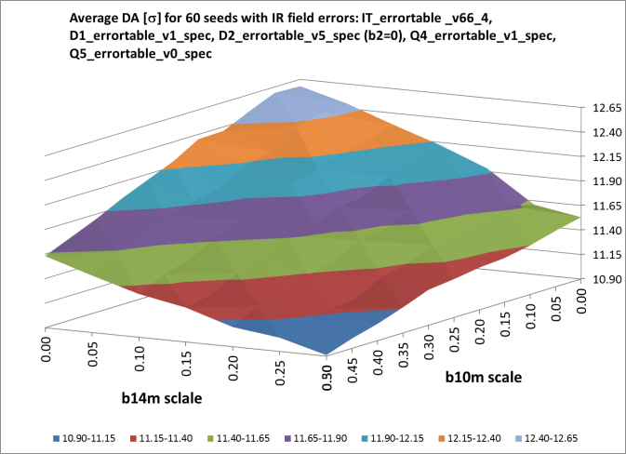
2D scan of average DA versus b10m, b14m (1)
The average DA is smoothly reduced with both b10m and b14m.
The b14m needs to be scaled more down than b10m for the same DA.

Slide 13
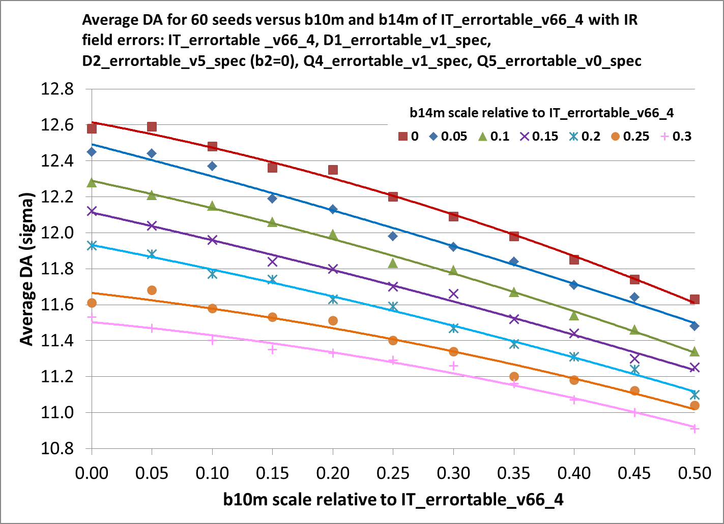
2D scan of average DA versus b10m, b14m (2)
Smooth dependence of average DA on b10m and b14m.

Slide 14
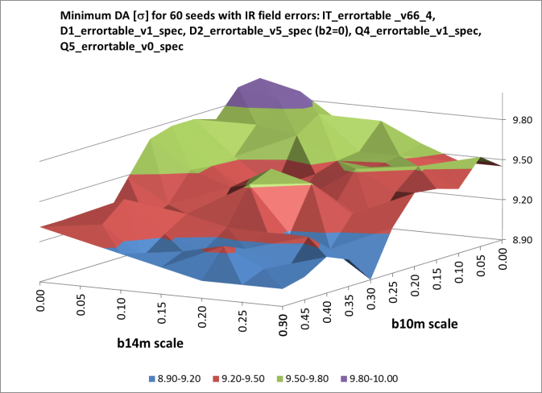
2D scan of minimum DA versus b10m, b14m (1)
There is fluctuation of minimum DA versus b10m and b14m.
This is influenced by the random field errors in the worst seed.

Slide 15
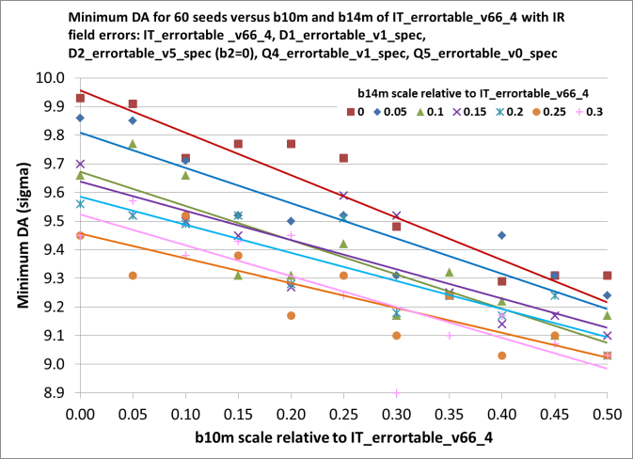
2D scan of minimum DA versus b10m, b14m (2)
Dependence of minimum DA on b10m and b14m is not monotonic.

Slide 16
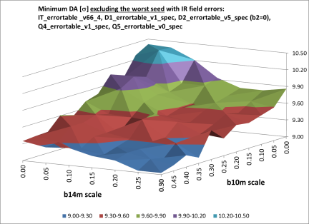
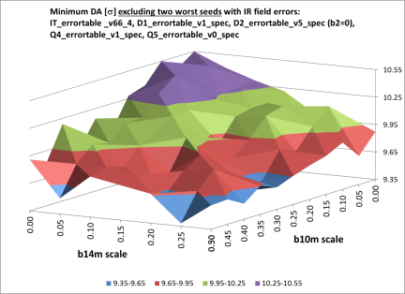
Impact of the worst seeds on minimum DA with the “IT_errortable_v66_4” (1)
DAmin1 w/o the worst seed
DAmin2 w/o two worst seeds
The dependence of minimum DA on b10m and b14m without one worst seed or two worst seeds is still not monotonic.
It was determined that the minimum DA in this scan is determined by the same bad seed.

Slide 17
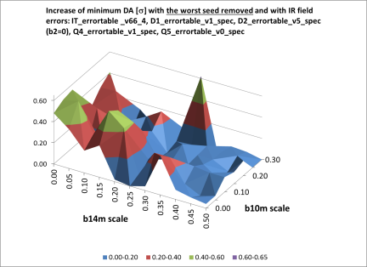
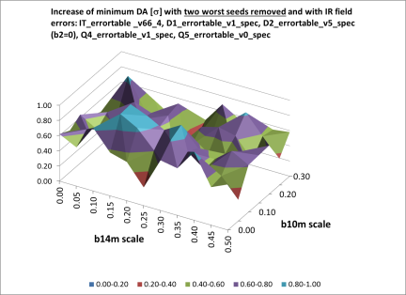
Impact of the worst seeds on minimum DA with the “IT_errortable_v66_4” (2)
DAmin1 - DAmin
DAmin2 - DAmin
Removing one bad seed (for 98.3% remaining seeds) increases minimum DA in the range from 0 to 0.5σ. Removing the 2nd bad seed (for 96.7% seeds) increases the minimum DA from 0.5σ to 1σ (for most points).

Slide 18
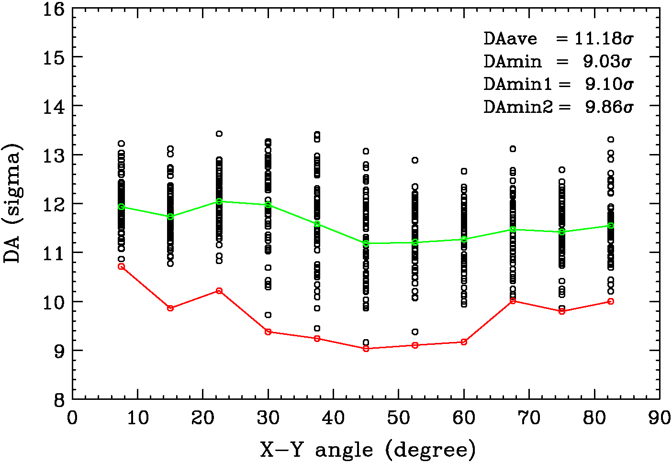
DA at collision energy with b10m*0.4 and b14m*0.25 of the “IT_errortable_v66_4”
The other magnets: D1_errortable_v1_spec”, “D2_errortable_v5_spec”, “Q4_errortable_v1_spec”, “Q5_errortable_v0_spec”.
Realistically, the b10m, b14m cannot be too small. We set them to b10m*0.4 and b14m*0.25. The resulting minimum DA is strongly influenced by two bad seeds (number 60 and 46). Without these two seeds, the DA is acceptable.

Slide 19
Updated estimate of IT field quality at injection energy (r₀ = 50 mm)
Previous specification: “IT_errortable_v3_spec”.
New estimate: “IT_errortable_v4” or “IT_errortable_v66_4” (same injection terms).
New estimates are indicated in green below. Slightly reduced b6m (-16 -> -15.8) and b10m (4.15 -> 3.63), but significantly increased b14m: -0.04 -> -0.6.
skew | mean | uncertainty | random |  | normal | mean | uncertainty | random
a3 | 0 | 0.800 | 0.800 |  | b3 | 0 | 0.820 | 0.820
a4 | 0 | 0.650 | 0.650 |  | b4 | 0 | 0.570 | 0.570
a5 | 0 | 0.430 | 0.430 |  | b5 | 0 | 0.420 | 0.420
a6 | 0 | 0.310 | 0.310 |  | b6 | -15.8 | 1.100 | 1.100
a7 | 0 | 0.190 | 0.190 |  | b7 | 0 | 0.190 | 0.190
a8 | 0 | 0.110 | 0.110 |  | b8 | 0 | 0.130 | 0.130
a9 | 0 | 0.080 | 0.080 |  | b9 | 0 | 0.070 | 0.070
a10 | 0 | 0.040 | 0.040 |  | b10 | 3.63 | 0.200 | 0.200
a11 | 0 | 0.026 | 0.026 |  | b11 | 0 | 0.026 | 0.026
a12 | 0 | 0.014 | 0.014 |  | b12 | 0 | 0.018 | 0.018
a13 | 0 | 0.010 | 0.010 |  | b13 | 0 | 0.009 | 0.009
a14 | 0 | 0.005 | 0.005 |  | b14 | -0.6 | 0.023 | 0.023

Slide 20
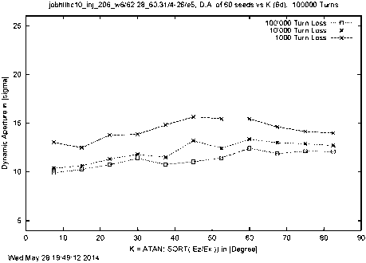
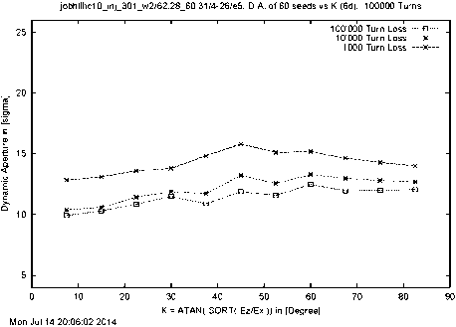
DA at injection energy with updated IT field quality
The other magnets: D1_errortable_v1_spec”, “D2_errortable_v5_spec”, “Q4_errortable_v1_spec”, “Q5_errortable_v0_spec”.
IT_errortable_v3_spec
DAave = 10.40σ, DAmin = 9.92σ
IT_errortable_v66_4
DAave = 10.40σ, DAmin = 9.93σ
The field quality of “IT_errortable_v4” (“IT_errortable_v66_4”) at injection is acceptable.

Slide 21
Updated estimate of Q4 field quality at collision energy (r₀ = 30 mm)
Previous specification: “Q4_errortable_v1_spec”. New estimate: “Q4_errortable_v2”. All coefficients are updated. Most of the low order terms are increased, while the high order terms (n > 9) are significantly reduced. New non-zero b6m and b14m. Cancellation of b6u,b6r, b10u,b10r, and b14u,b14r.
skew | mean | uncertainty | random |  | normal | mean | uncertainty | random
a3 | 0 | 1.793 | 1.793 |  | b3 | 0 | 1.793 | 1.793
a4 | 0 | 1.158 | 1.158 |  | b4 | 0 | 1.158 | 1.158
a5 | 0 | 0.748 | 0.748 |  | b5 | 0 | 0.748 | 0.748
a6 | 0 | 0.483 | 0.483 |  | b6 | -0.05 | 0 | 0
a7 | 0 | 0.312 | 0.312 |  | b7 | 0 | 0.312 | 0.312
a8 | 0 | 0.202 | 0.202 |  | b8 | 0 | 0.202 | 0.202
a9 | 0 | 0.130 | 0.130 |  | b9 | 0 | 0.130 | 0.130
a10 | 0 | 0.084 | 0.084 |  | b10 | 0 | 0 | 0
a11 | 0 | 0.054 | 0.054 |  | b11 | 0 | 0.054 | 0.054
a12 | 0 | 0.035 | 0.035 |  | b12 | 0 | 0.035 | 0.035
a13 | 0 | 0.023 | 0.023 |  | b13 | 0 | 0.023 | 0.023
a14 | 0 | 0.015 | 0.015 |  | b14 | 1.50 | 0 | 0
a15 | 0 | 0 | 0 |  | b15 | 0 | 0 | 0

Slide 22
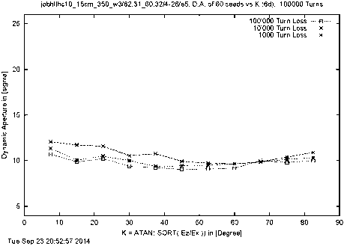
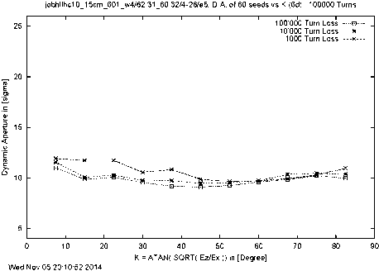
DA at collision energy with updated Q4 field quality
The other magnets: “IT_errortable_v66_4” (b10m*0.4, b14m*0.25), “D1_errortable_v1_spec”, “D2_errortable_v5_spec”, “Q5_errortable_v0_spec”.
Q4_errortable_v1_spec
DAave = 11.18σ, DAmin = 9.03σ, DAmin2 = 9.86σ
Q4_errortable_v2
DAave = 11.16σ, DAmin = 9.10σ , DAmin2 = 9.52σ
The impact of the “Q4_errortable_v2” at collision energy is relatively small. It may be acceptable.

Slide 23
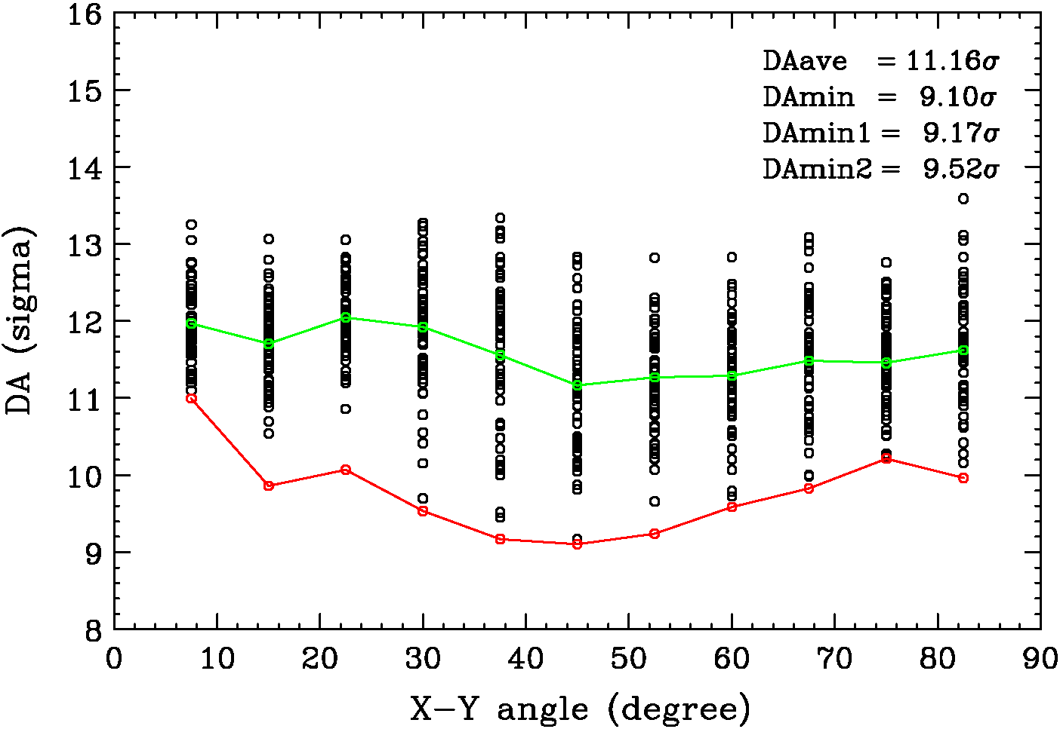
DA at collision energy with updated field of D2 and Q4 and optimized “IT_errortable_v66_4”
Magnet errors: “IT_errortable_v66_4” (b10m*0.4, b14m*0.25), “D1_errortable_v1_spec”, “D2_errortable_v5_spec”, “Q4_errortable_v2”, “Q5_errortable_v0_spec”.
The minimum DA at collision energy is influenced by two bad seeds. Without these two seeds, the DA looks acceptable.

Slide 24
Updated estimate of Q4 field quality at injection energy (r₀ = 30 mm)
Previous specification: “Q4_errortable_v1_spec”. New estimate: “Q4_errortable_v2”. All coefficients are updated. Most of the low order terms are increased, while the high order terms (n > 9) are significantly reduced. New non-zero b10m and b14m. Cancellation of b6u,b6r, b10u,b10r, and b14u,b14r.
skew | mean | uncertainty | random |  | normal | mean | uncertainty | random
a3 | 0 | 1.793 | 1.793 |  | b3 | 0 | 1.793 | 1.793
a4 | 0 | 1.158 | 1.158 |  | b4 | 0 | 1.158 | 1.158
a5 | 0 | 0.748 | 0.748 |  | b5 | 0 | 0.748 | 0.748
a6 | 0 | 0.483 | 0.483 |  | b6 | -11.45 | 0 | 0
a7 | 0 | 0.312 | 0.312 |  | b7 | 0 | 0.312 | 0.312
a8 | 0 | 0.202 | 0.202 |  | b8 | 0 | 0.202 | 0.202
a9 | 0 | 0.130 | 0.130 |  | b9 | 0 | 0.130 | 0.130
a10 | 0 | 0.084 | 0.084 |  | b10 | 1.00 | 0 | 0
a11 | 0 | 0.054 | 0.054 |  | b11 | 0 | 0.054 | 0.054
a12 | 0 | 0.035 | 0.035 |  | b12 | 0 | 0.035 | 0.035
a13 | 0 | 0.023 | 0.023 |  | b13 | 0 | 0.023 | 0.023
a14 | 0 | 0.015 | 0.015 |  | b14 | 1.50 | 0 | 0
a15 | 0 | 0 | 0 |  | b15 | 0 | 0 | 0

Slide 25
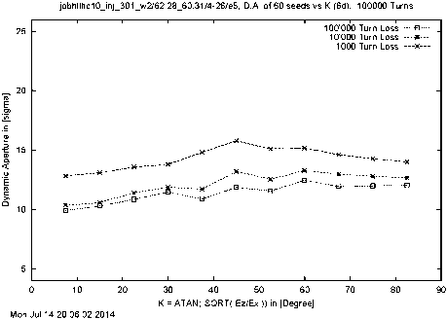
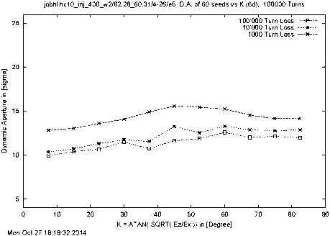
DA at injection energy with updated Q4 field quality
The other magnets: “IT_errortable_v66_4”, “D1_errortable_v1_spec”, “D2_errortable_v5_spec”, “Q5_errortable_v0_spec”.
Q4_errortable_v1_spec
DAave = 10.40σ, DAmin = 9.93σ
Q4_errortable_v2
DAave = 10.40σ, DAmin = 9.94σ
The impact of the “Q4_errortable_v2” at injection energy is negligible.
Hence, this field quality should be acceptable.

Slide 26
Conclusions
The latest estimate of field quality of D2 magnets (“D2_errortable_v5”) improves DA at collision energy while having no impact at injection energy. Hence, it is acceptable and becomes a new specification table.
The updated estimate of IT field quality (“IT_errortable_v66_4”) required optimization of b10m, b14m terms at collision energy. The minimum DA at collision was also found to be sensitive to bad seeds. With the above optimization and without the bad seeds, the DA at collision appears acceptable. At injection energy, the impact of the “IT_errortable_v66_4” is negligible and therefore this field quality at injection is acceptable.
The updated estimate of Q4 field quality (“Q4_errortable_v2”) has minor impact on the DA and therefore may be acceptable.

