Slide 1
Trends in
MONOLITHIC DETECTORS and
ADVANCED CMOS MANUFACTURING
W. Snoeys
ESE Seminar October 14th 2014
walter.snoeys@cern.ch, PH-ESE-ME, CERN

Slide 2
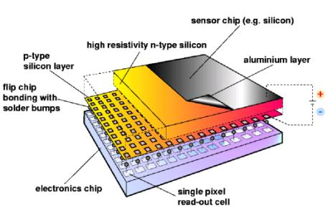
MONOLITHIC DETECTORS : definition
Readout circuit
Collection electrode
Sensitive layer
High energy particle
yields 80 e-/h+ pairs/μm in Si
Integrate readout with the silicon sensor
  Advantages in integration, cost, potentially strong impact on power consumption and material budget
  in two experiments: DEPFET in Belle-II and MAPS in STAR
  not yet in LHC, adopted for ALICE ITS upgrade, considered for CLIC/ILC

Slide 3
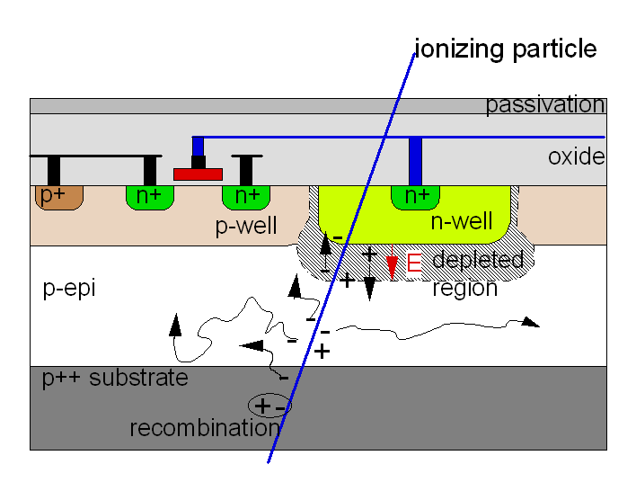
Traditional Monolithic Active Pixel Sensors
    Commercial CMOS technologies
    No reverse substrate bias:
      Signal charge collection mainly by diffusion
      more sensitive to displacement damage
    Only one type of transistor in pixel (twin well)
    Rolling shutter readout
      very simple in-pixel circuit (3 or 4 transistors)
      pixel size: 20 x 20 μm² or lower
      serial, row-by-row, not very fast
cfr. M. Winter et al
Example: three transistor cell
RESET
ROW
SELECT
  Main challenge for improvement: need combination of:
  tolerance to displacement damage (depletion)
  integration of complex circuitry without efficiency loss
  commercial technology
COLUMN BUS

Slide 4
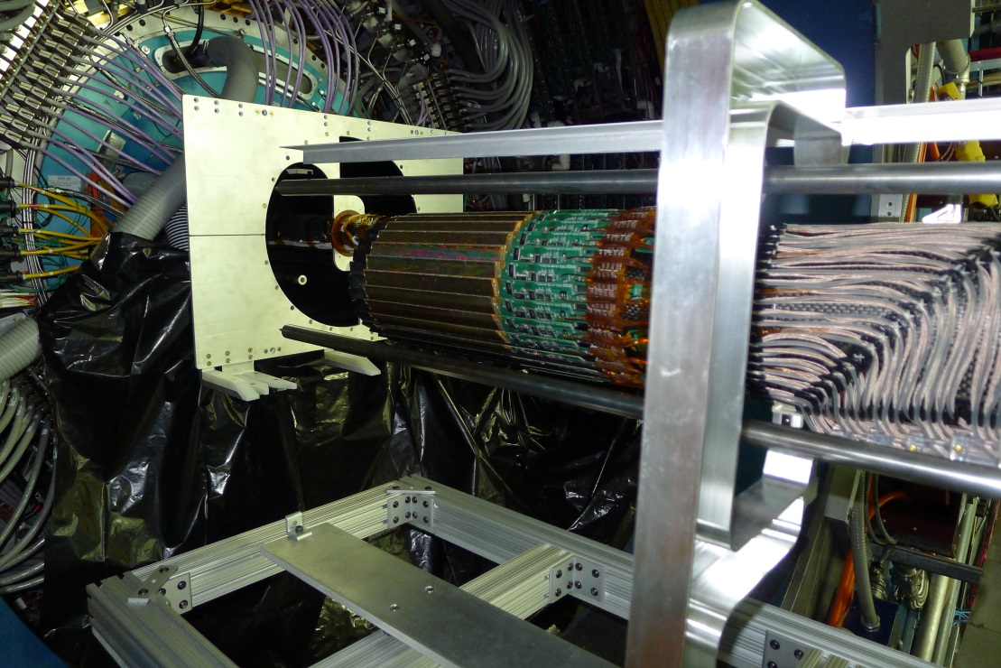
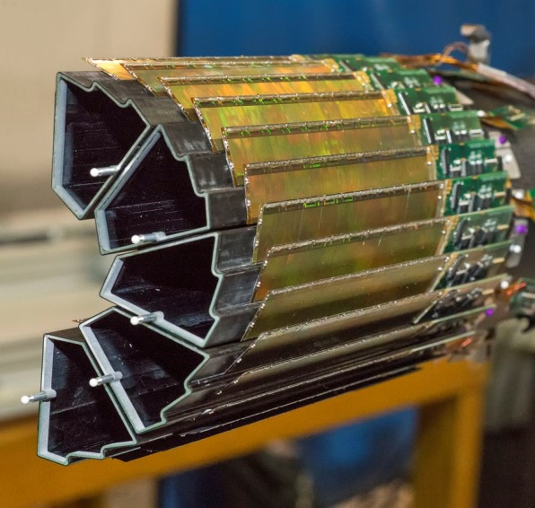
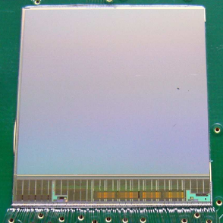
MAPS SENSOR CHIP in STAR experiment
Data taking March-June 2014
First MAPS system in HEP
MIMOSA28 (ULTIMATE) chip
IPHC Strasbourg :
Twin well 0.35 μm CMOS
High resistivity (> 400 Ωcm) 15 μm epi
Readout time 190 μs
TID 150 krad
NIEL few 10¹² 1 MeV n_{eq}/cm²
MIMOSA28
(ULTIMATE)

Slide 5
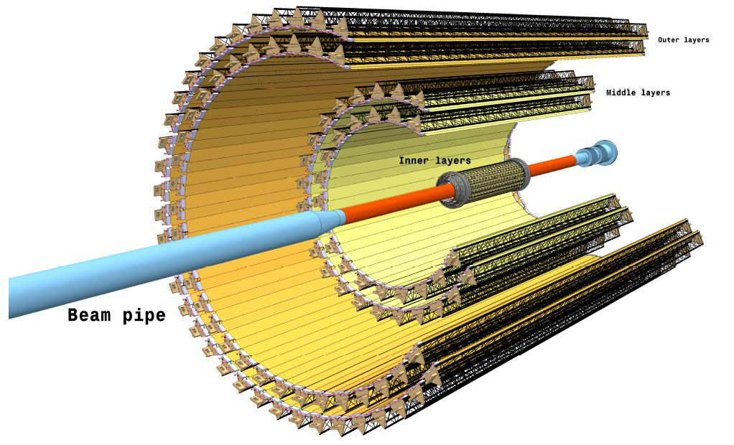
THE ALICE ITS UPGRADE PROJECT
Replace the inner tracking system with an entirely new detector in 2017-2018
Improve
  impact parameter resolution by a factor 3 in rφ, 5 in z
  standalone tracking resolution and p_{T} resolution at low p_{T}
  New Layout 7 layers, 12.5 Gpixels in ~ 10 m²
  X/X₀ 0.3 %
  Pixel size: O(30x30) μm²
  Inner layer radius 22 mm
Parameters
  Chip: 15 mm x 30 mm x 50 μm
  Spatial resolution ~ 5 μm
  Power density < 100 mW/cm²
  Integration time < 30 μs
  Max required radiation tolerance : TID 700 krad & NIEL10¹³ 1 MeV n_{eq}/cm²
ALICE-TDR-17/CERN-LHCC-2013-024
Thin sensors, high granularity, large area, moderate radiation
➔ Monolithic silicon pixel sensors

Slide 6
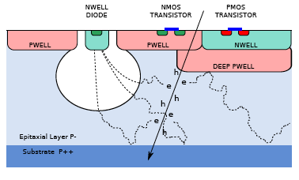
ALICE MONOLITHIC ACTIVE PIXEL SENSOR
Technology choice
TJ 180 nm CMOS imaging process
Deep Pwell
Gate oxide < 4 nm good for TID
6 metal layers
  15…40 μm 1…8 kΩcm epitaxial layer
  Epi not fully depleted unless …
  (AC coupling, high fields, Dulinski, Kachel et al)
Chip development
Since end 2011, 4 MPWs and 3 engineering runs, 4th submitted now.
Two internal pixel chip architectures: ALPIDE and MISTRAL
Small scale prototypes for sensor optimization and radiation tolerance verification Full scale prototypes recently fabricated: lab and beam tests ongoing also on:
      irradiated
      thinned (50 μm) devices
      thinned devices mounted on flex

Slide 7
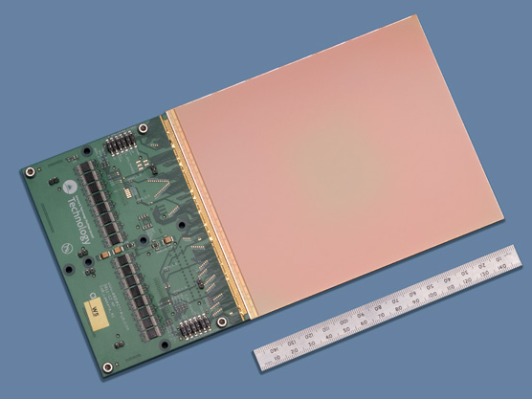
NOTE: WAFER SCALE INTEGRATION by STITCHING
Courtesy: N. Guerrini & R. Turchetta, Rutherford Appleton Laboratory
RAL group designed many sensors in this technology
For the moment stitching not exploited for the ALICE ITS upgrade

Slide 8
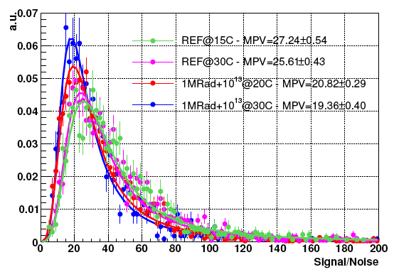
RADIATION TOLERANCE
Example: SNR of seed pixel measured with MIMOSA-32 ter at the CERN-SPS
at two operating temperatures, before and after irradiation
with the combined load of 1 Mrad and 10¹³ 1 MeV n_{eq}/cm²

Slide 9
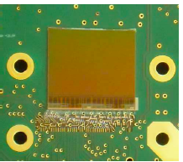
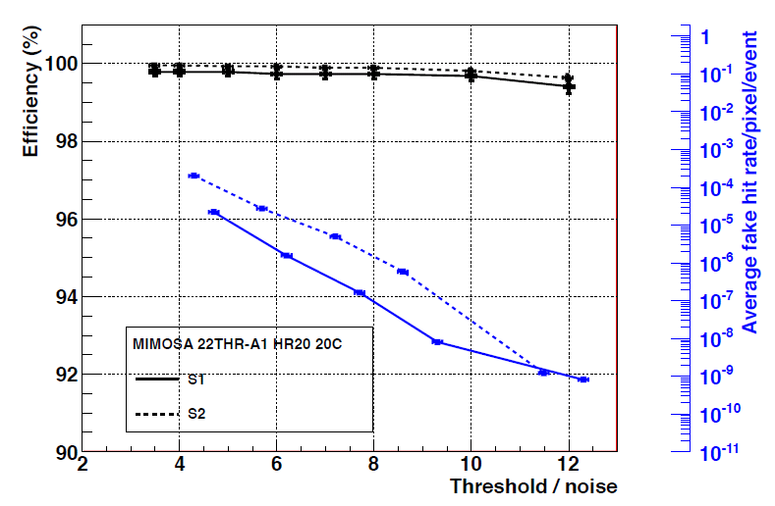
MISTRAL
Rolling shutter: evolution of STAR like development
FSBB/MISTRAL functional
  lab tests promising, ENC 15-20e
  preparing for test beam
Beam test results from smaller scale prototype:
FSBB/MISTRAL
Efficiency above 99 % with fake hit rate below 10⁻⁵ achievable

Slide 10
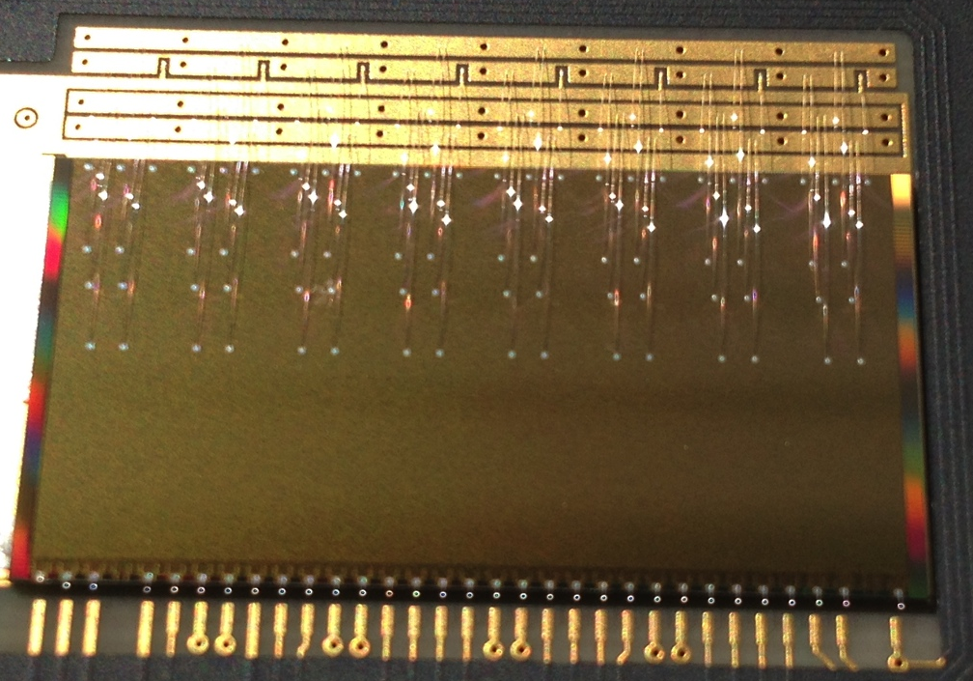
ALPIDE
  In-pixel amplifier/comparator ~ 40nW (~5mW/cm²) allows architectures other than rolling shutter
  Hit driven readout (priority encoder)
  Full scale prototype for the ALICE ITS: chip size: 3 x 1.53 cm²
                ~ 500 000 pixels of 28 x 28 μm²
1.53 cm
3 cm

Slide 11
ALPIDE: priority encoder
0
511 double columns
STATE
STATE
STATE
STATE
512
512
512
512
512 rows
RESET
Zero-suppression
RESET
RESET
RESET
Zero-suppression
PIXEL Front-end
PIXEL Front-end
.…..
PIXEL Front-end
PIXEL Front-end
512
512
512
512
DACs
10
10
ADDRESS
ADDRESS
VALID
VALID
SYNC
SYNC
Periphery Digital Readout
BAIS
Pulse
CLOCK
DATA
TRIGGER

Slide 12
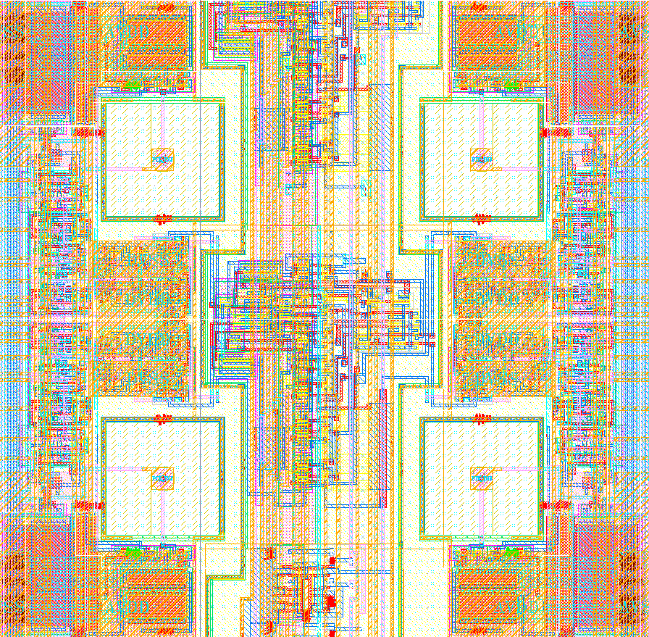
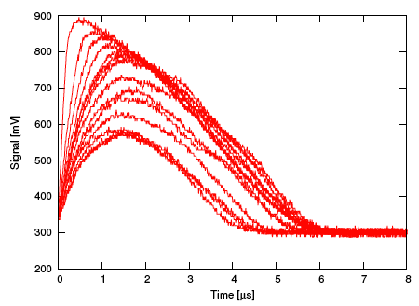
ALPIDE pixel
28μm
Sensor
28μm
Analogue output of one pixel under ⁵⁵Fe
11 µm
Front-end
(result from small scale prototype)
~ 600 mV
Shaping time ~ 2 μm
Priority encoder
Pixel layout

Slide 13
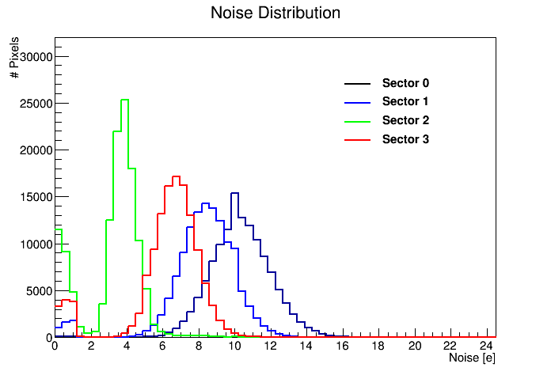
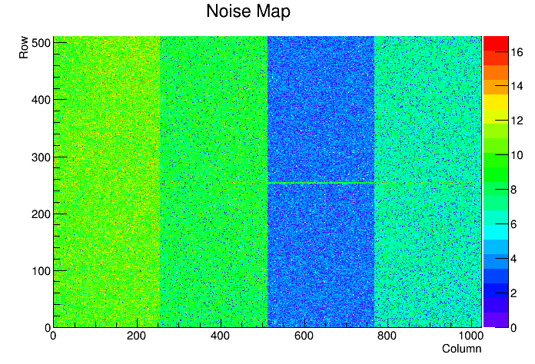
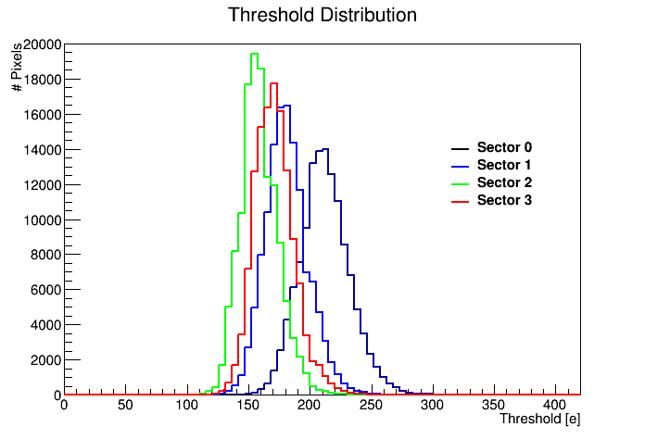
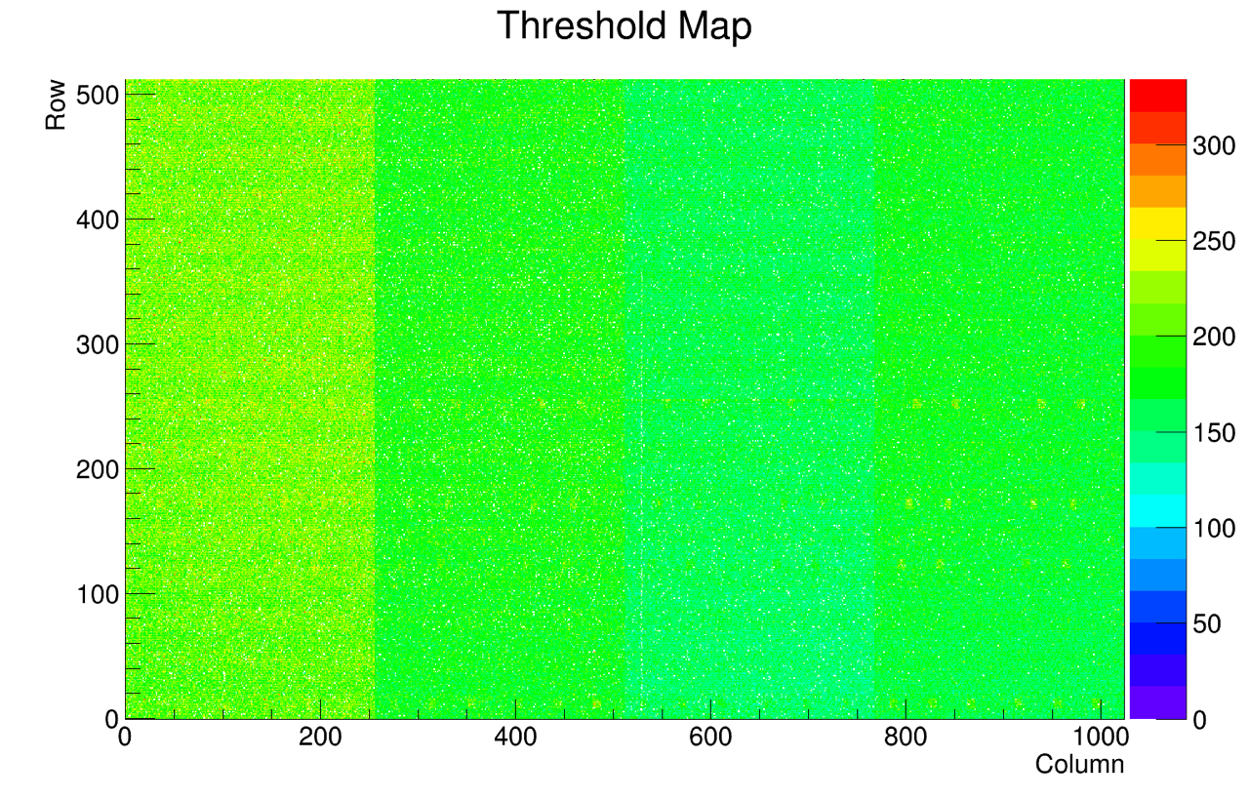
THINNED ALPIDE SOLDERED ON FLEX
Thinning and soldering do not affect the performance of the chip
Band structure reflects different design options in the prototype chip
Noise << Threshold spread ~ 18 e

Slide 14
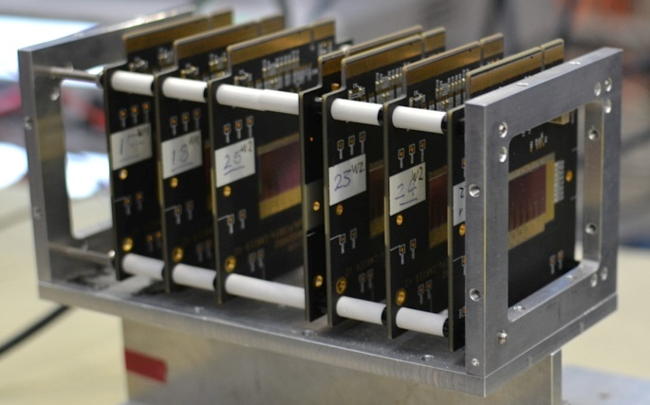
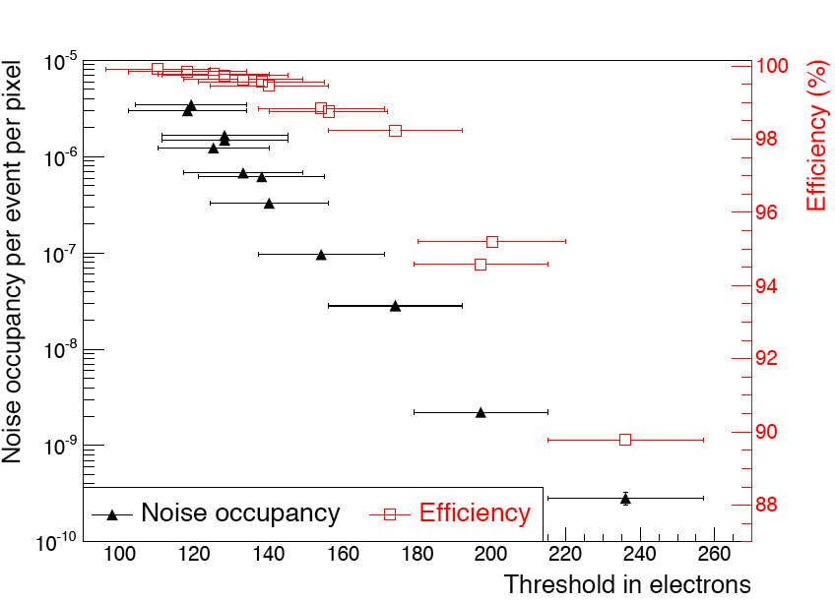
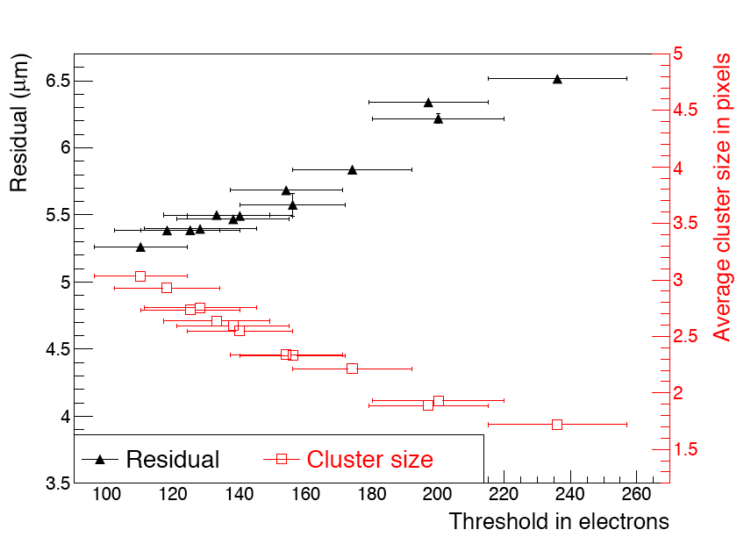
ALPIDE test beam results
5 – 7 GeV pions at CERN PS
Telescope of 7 planes
Zero substrate bias
Sector 2 (diode reset and 2 μm spacing)
99% efficiency at fake hit rate of 10⁻⁵ achievable (only 20 pixels masked)
~ 5.5 μm spatial resolution (including tracking error of ~ 3 μm)

Slide 15
SENSOR OPTIMIZATION: IMPORTANCE OF Q/C
If thermal noise from the input transistor dominant, for a given S/N and bandwidth:
m = 2 for weak inversion
P = analog power
Q = collected signal charge
C = input capacitance
Q/C is THE figure of merit for a sensor
Changes with different design options in the sensor
Has a direct system impact, more margin with back bias

Slide 16
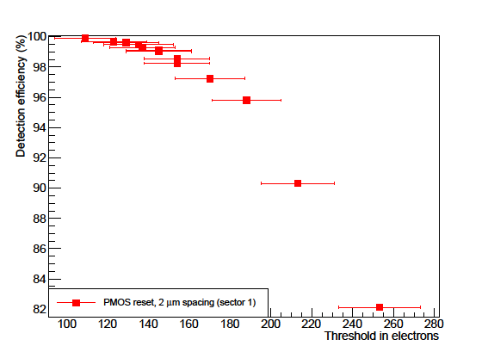
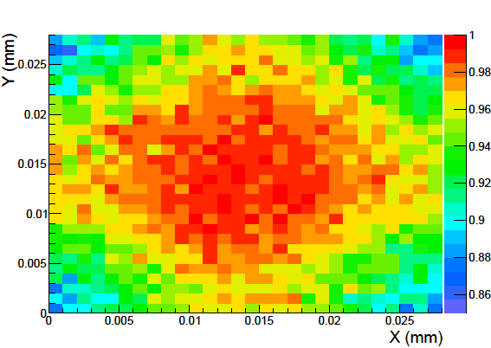
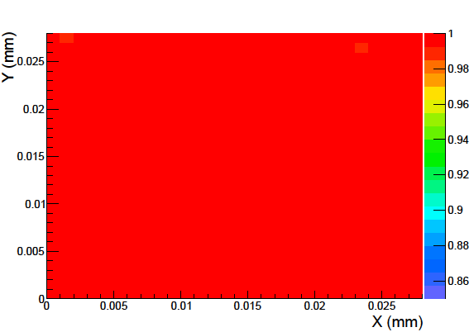
DETECTION EFFICIENCY AS A FUNCTION OF HIT LOCATION WITHIN PIXEL
Better efficiency for lower threshold
Lower efficiency for higher threshold, start losing hits in the pixel corners

Slide 17
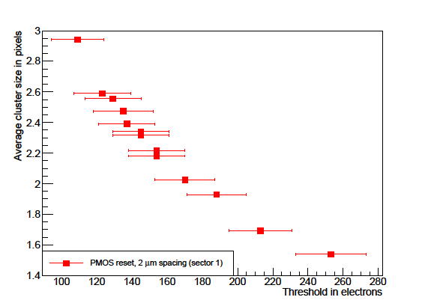
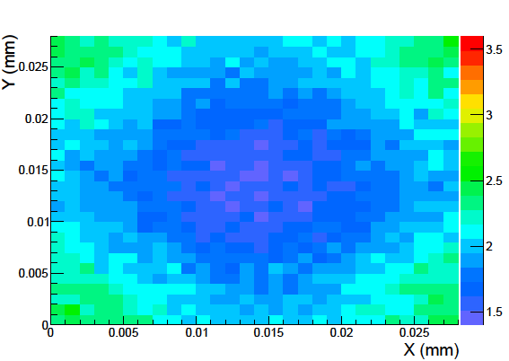
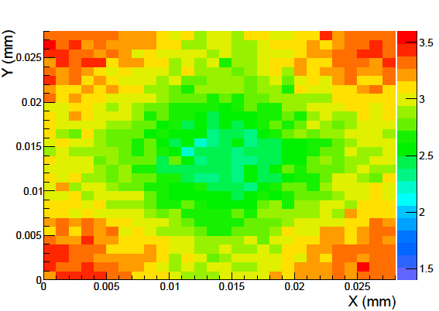
CLUSTER SIZE AS A FUNCTION OF HIT LOCATION WITHIN PIXEL
Larger cluster size for lower threshold
Smaller cluster size for higher threshold, charge sharing starts in the corners
Good telescope resolution needed for these plots

Slide 18
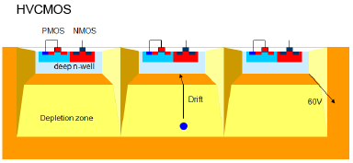
FULL DEPLETION FOR RADIATION HARDNESS
NMOS in Pwell
PMOS in Nwell
Pwell
Deep Nwell collection electrode
P-substrate
I. Peric
All circuitry in the collection electrode
  Can be done in any CMOS technology with deep Nwell (triple well)
  Apply high reverse substrate voltage (eg -60 V)
  Well protects transistors from HV
  Charge is collected by drift, good for radiation tolerance
  Risk of coupling circuit signals into input
In-pixel circuit simple in small collection electrode for low C by
    ‘rolling shutter’ readout as in MAPS,
    special architectures (eg LePIX), or
    use it as smart detector in hybrid solution (cfr ATLAS, I. Peric)

Slide 19
CAPACITIVELY COUPLED PIXEL DETECTOR (CCPD)
I. Peric
Early example next page
Now versions with FEI4 (eg CPPM GF)

Slide 20
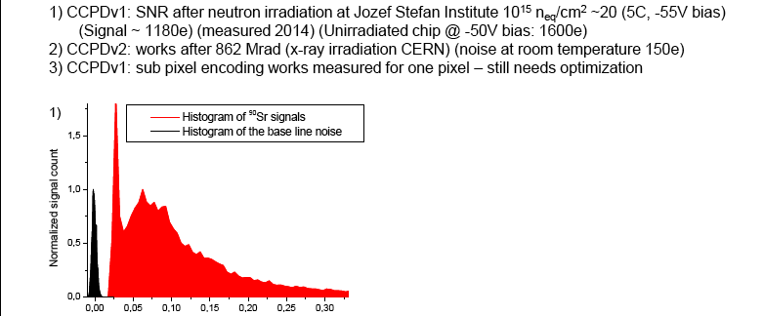
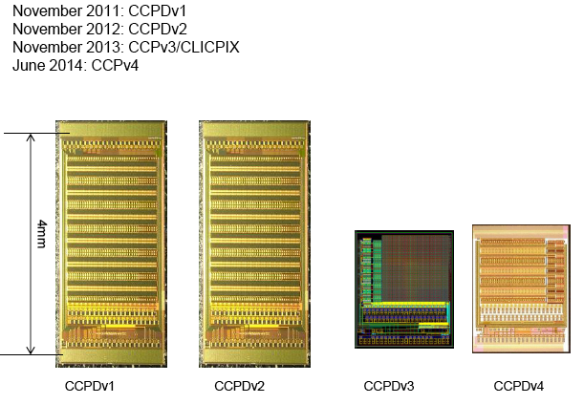
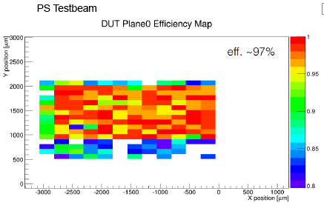
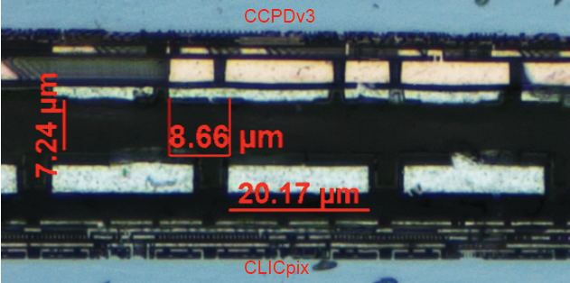
EFFICIENCY and RADIATION TOLERANCE OF CCPD
I. Peric, CPIX14
CLICPIX: M. Benoit, CPIX14
Similar developments: SLAC/UCSC (0.35 μm) J. Segal et al.

Slide 21
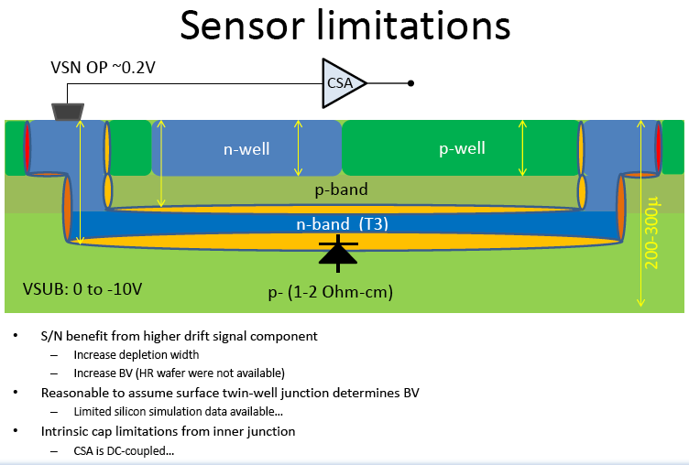
Deep N-band as collection electrode
Better shielding from circuit, but large C
Dario Gnani LBNL

Slide 22
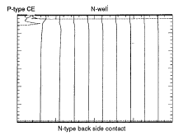
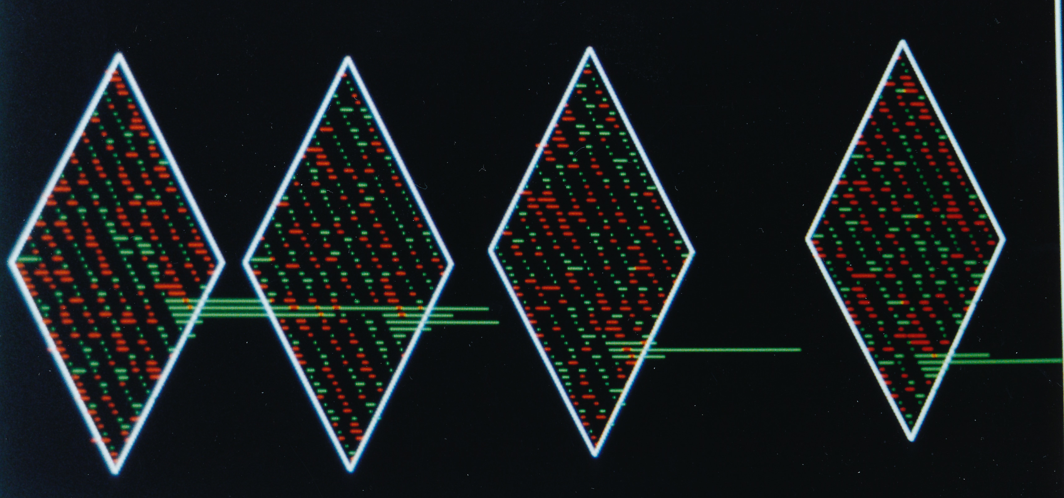
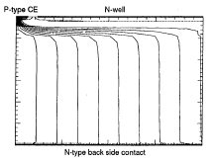
FULL DEPLETION WITH JUNCTION ON THE BACK
Pwell Collection Electrode
Only a few V on the Nwell diverts the flow lines to the collection electrode
Nwell with circuitry
Psubstrate
Back side N diffusion
Need full depletion
Double-sided process for junction termination, not really compatible with standard foundries
Vnwell = 0 V
C. Kenney, S. Parker (U. of Hawaii),
W. Snoeys, J. Plummer (Stanford U) 1992
Vnwell = 2 V

Slide 23
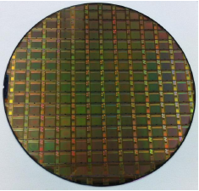
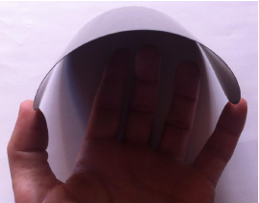
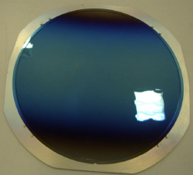
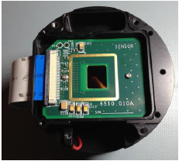
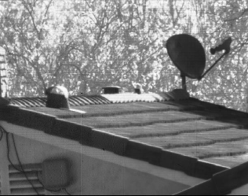
OTHER WAYS TO OBTAIN JUNCTION ON THE BACK
Finished CMOS wafer on high resistivity
Wafer thinned to 50 um
Thinned wafer with anti-reflective coating
Chip mounted in camera
Example: post CMOS wafer thinning & back-side processing
S. Lauxterman CPIX14
Image (raw data)
Several other developments (eg T. Obermann(Bonn) with ESPROS)
Also epitaxial layer and substrate of opposite type (R. Turchetta)
In general:
      Watch die edge/junction termination
      Radiation tolerance to be investigated/confirmed

Slide 24
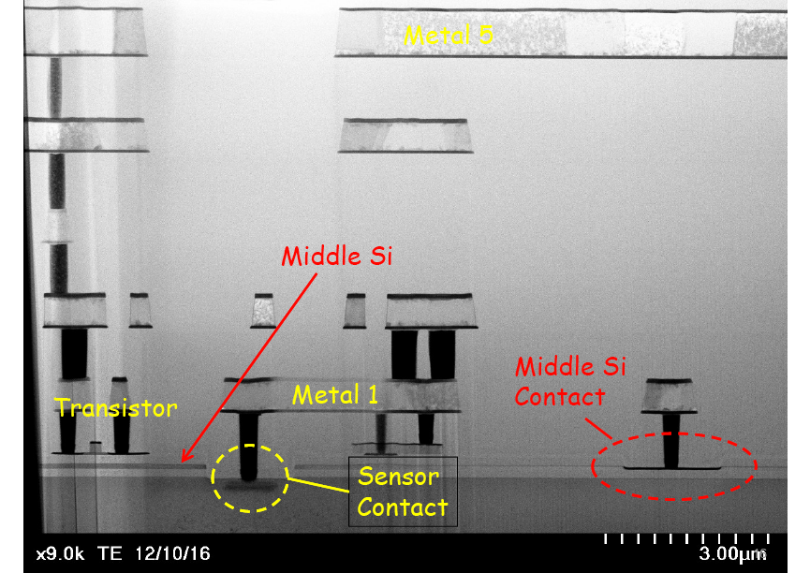
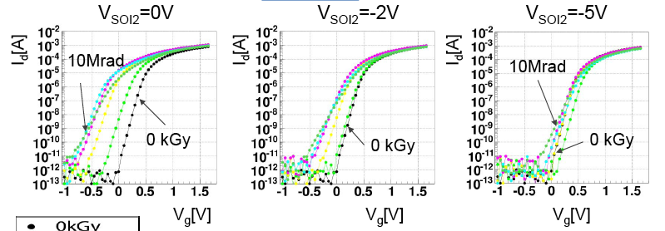
Silicon On Insulator (SOI) Y. Arai et al.
  Impressive development
  Now looking at double SOI for radiation tolerance and better back gating properties
  Bias on middle silicon can be used to compensate radiation induced threshold shifts (to 10 Mrad)
  New people in the collaboration:
  N. Teranishi, S. Kawahito, I. Kurachi
  Other presentation on SOI: T. Kishishita, CPIX14 (rad tol transistors ok, leakage current issue)

Slide 25
CONCLUSIONS and OUTLOOK
  Radiation tolerant particle sensors can now be produced in CMOS technologies at lower cost than traditional sensors
  Analog active sensor and modified digital readout chip
    cfr ATLAS HV/HR CMOS collaboration
    maintain high Q/C, minimize cross-talk and increase density
    can choose a different CMOS technology for both
    cheap bonding or gluing in combination with capacitive coupling
    Rad tolerant to 10¹⁵ n_{eq}/cm², more development needed
  Integrate the full readout into the sensor:
    further advantages in terms of assembly, production cost and Q/C
    adopted for ALICE ITS upgrade with full-scale prototypes in test:
      MISTRAL: rolling shutter, more conservative and mature
      ALPIDE: front-end with data driven readout, more aggressive
        Perspective for 20-30 mW/cm² and a few μs integration time
      Beam tests: good position resolution and detection efficiency
      Tests on irradiated devices ongoing, expect to meet requirements

Slide 26
CONCLUSIONS and OUTLOOK
  Full depletion for higher radiation tolerance
    Junction on the front: in principle possible, but requires high circuit well voltage and ac coupling. Easier with simple circuit.
    Circuit in collection electrode: radiation tolerance demonstrated to ~ 10¹⁵ n_{eq}/cm², but need simple circuit to maintain reasonable C.
    Junction on the back side: need full depletion, but double sided processing incompatible with standard foundries. Some processing alternatives become available, but radiation tolerance still needs verification
  Power consumption
    ALPIDE prototype reaches about 100 mV divided over a few pixels
    ~ 300 mV on a single pixel would practically eliminate analog power: it would be sufficient to “turn on” a transistor
    Need more work on architectures to reduce digital power
    Power for transmission of data off-chip may well become dominant

Slide 27
    THANK YOU and also to ALICE ITS and CERN collegues and to people providing material and suggestions for this presentation
    More on ESSCIRC/ESSDERC later
    Presentations in Bonn CPIX14.org
walter.snoeys@cern.ch, PH-ESE-ME, CERN

