Slide 1

The IASA/UoA outreach team:
Christine Kourkoumelis
Dimitris Fassouliotis
Stelios Vourakis
University of Athens
EU educational projects: Go-lab and ISE
Introducing HEP to students through web based simple hands-on
analysis

Slide 2
Introduction: High school activities
How can we attract students interest in science education (STEM)?
(Their interest is decreasing with age)
In general:
Train teachers in intergrading IBSE in the classrooms
-> gradually change their teaching approach
Promote use of existing ICT, new methodologies and new
eLearning tools ready to be used in the classroom
Resources should be linked to the curricula
Build teacher communities
Engage learner in scientifically oriented questions

Slide 3
The HEP main challenge:
How can we provoke students’ curiosity for HEP?
(which in most countries is absent from the national
curricula)
So far a lot activities for high school students (IPPOG’s International Masterclasses, mini-masterclasses, virtual visits to the experiments, etc etc)
The students get engaged in hands-on experimentation directly connected to top-level real-time research and discoveries
EU outreach projects developed a lot of material which is ready to be used in the interval of a school lesson

Slide 4


The running EU outreach projects + CREATIONS
Go-Lab (Nov. 2012 - Nov.2016, 19 partners)
Online science laboratories for the large-scale use in schools
http://www.go-lab-project.eu/
161 on-line labs
152 Inquiry Learning Spaces
34 Apps (tools)
In all STEM curricula subjects in 10 languages
Inspiring Science Education (ISE) (April 2013 + 40mo, 31 partners)
eLearning tools for 5,000 schools in 14 countries
http://inspiring-science-education.org/
120 Demonstrators (in all STEM curricula subjects)
+Harvested existing repositories with 278,000 educational resources (mainly ODS and DtC)
In two years has reached 2750 schools

Slide 5
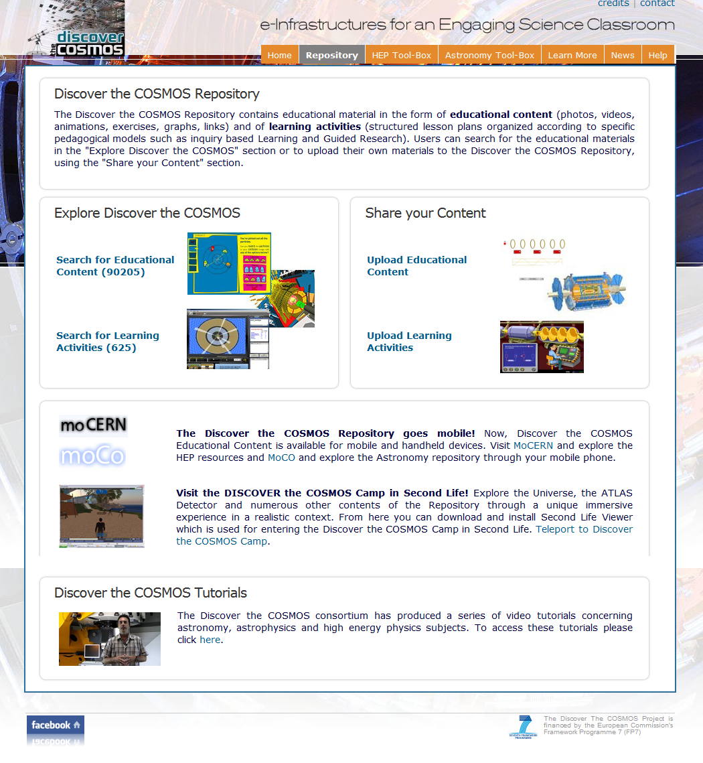
Content of Discover the COSMOS repository/Activities
~ 95,000 items in
Educational content
~ 630 educational scenaria
(HEP/Astronomy)
HEP tool-box
HYPATIA
MINERVA
CAMELIA
CERNland
LHCgame
5,000 teachers and
31,000 students reached
850 impl.activities in schools
2,000 schools continuing

Slide 6

HEP applications
The main tool: HYPATIA
Best practice
Offline version used by IPPOG’s Z-path http://hypatia.phys.uoa.gr/
Online version http://hypatia.iasa.gr/
has been used since 2010 in about 100 Greek schools across the country
Local Masterclasses, e-Masterclasses & Virtual Visits
    Students learn “how actually science works” (half day)
    Listen to lectures
    Follow a virtual visit to ATLAS control room
    Analyse events with the HYPATIA on-line tool

Slide 7
Example of four HYPATIA lesson plans (ILSs) developed
for Go-lab using the full Inquiry Based path :
Orientation, Conceptualization, Investigation,
Conclusion, Discussion
Conservation of momentum
http://www.golabz.eu/spaces/conservation-momentum-particle-colisions
Measurement of the magnetic field using the giant
ATLAS detector
http://www.golabz.eu/spaces/measurement-magnetic-field
3) Hunt for the Higgs boson
http://www.golabz.eu/spaces/discover-higgs-boson
4) Discover the Z boson
http://www.golabz.eu/spaces/discover-z-boson
Direct relation
with school curricula

Slide 8
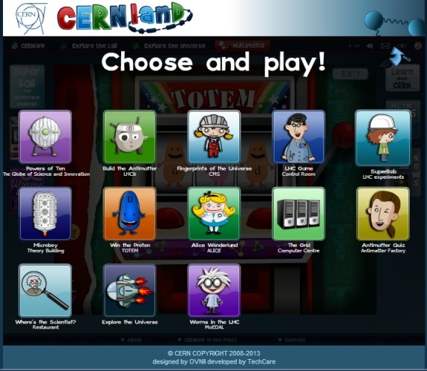
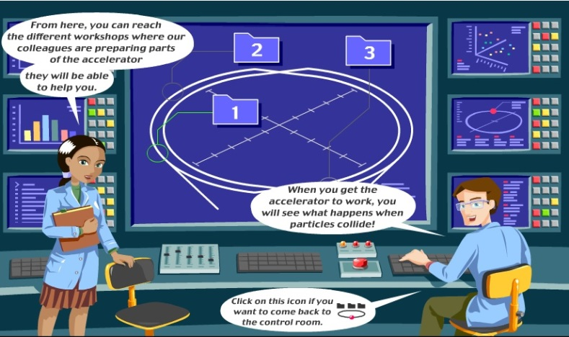
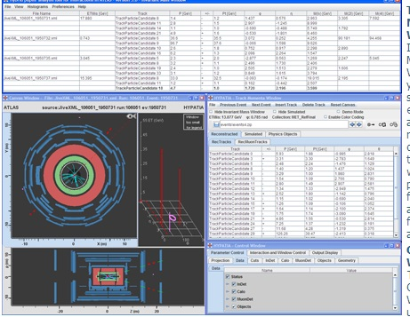
Analysis: Big Ideas of Science
the continuity
#1. All material in the Universe is made of very small particles
CERN Land
6-9, 9-12
LHC Game
12-15
Hypatia
15-18

Slide 9
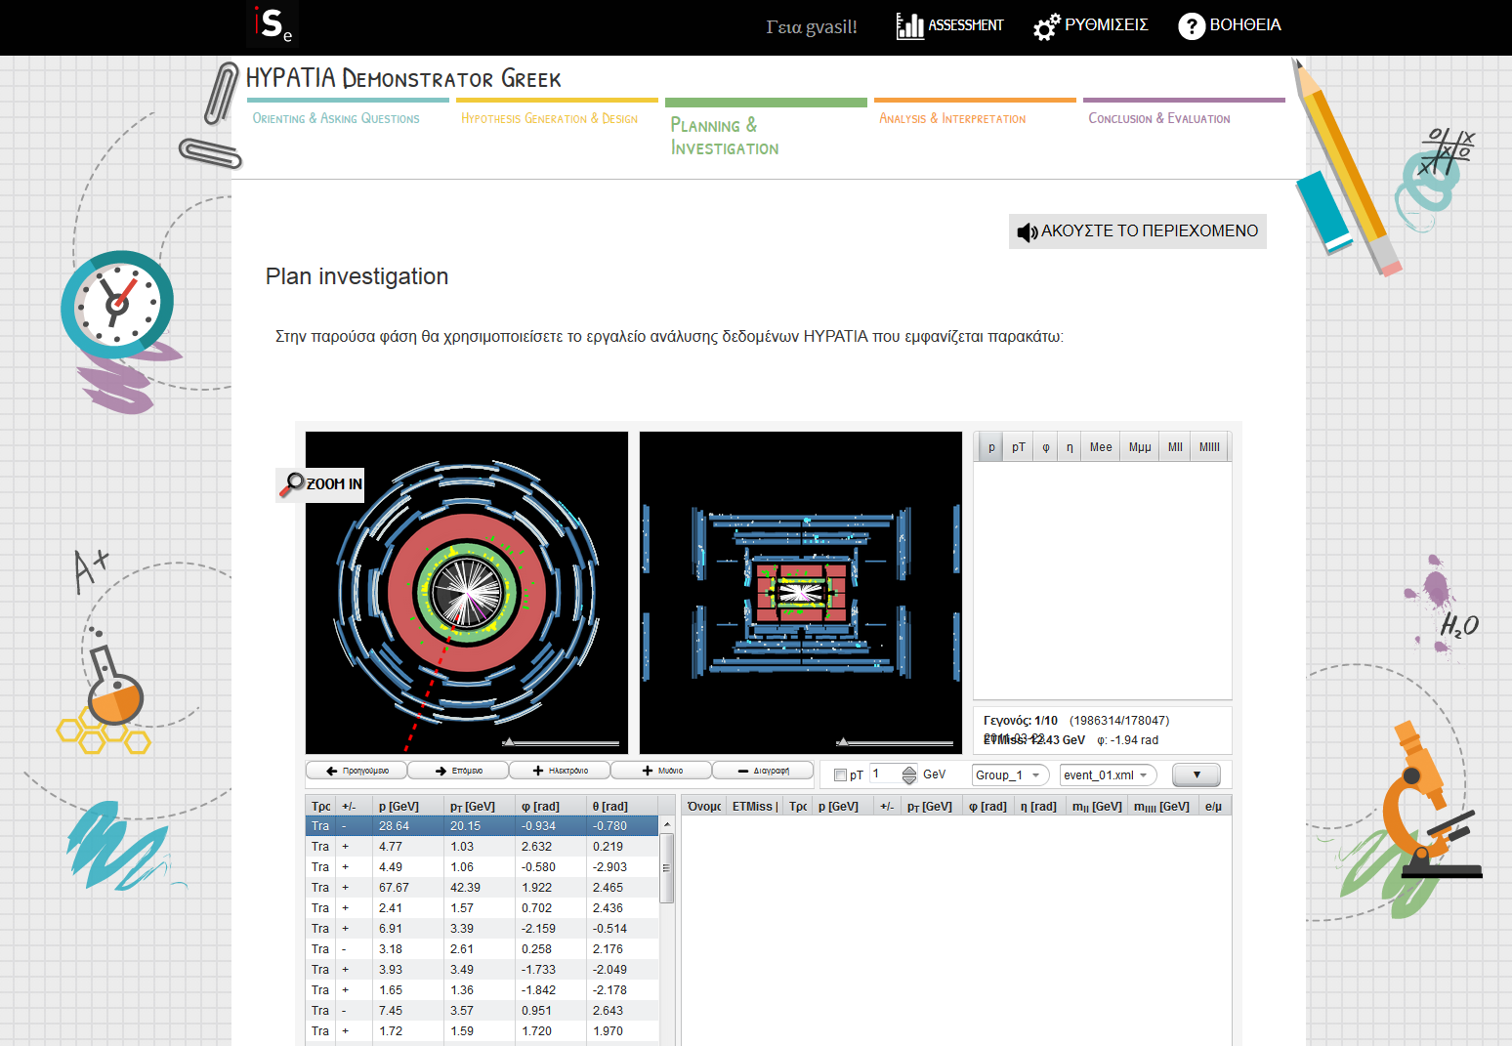
ISE HYPATIA demonstrator +PISA assessment questions
Orienting & Asking questions
Planning & Investigation
Analysis & Interpre-tation
Conclusion & Evaluation
Hypothesis generation & Design

Slide 10
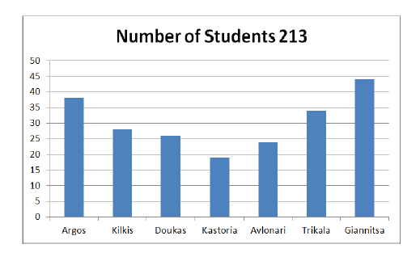
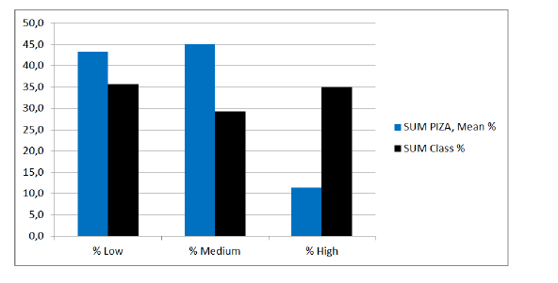
Tested demonstrator (February 2015-July 2015) in 26 schools at seven different locations
Problem solving competence
-> Higher than “PISA”

Slide 11
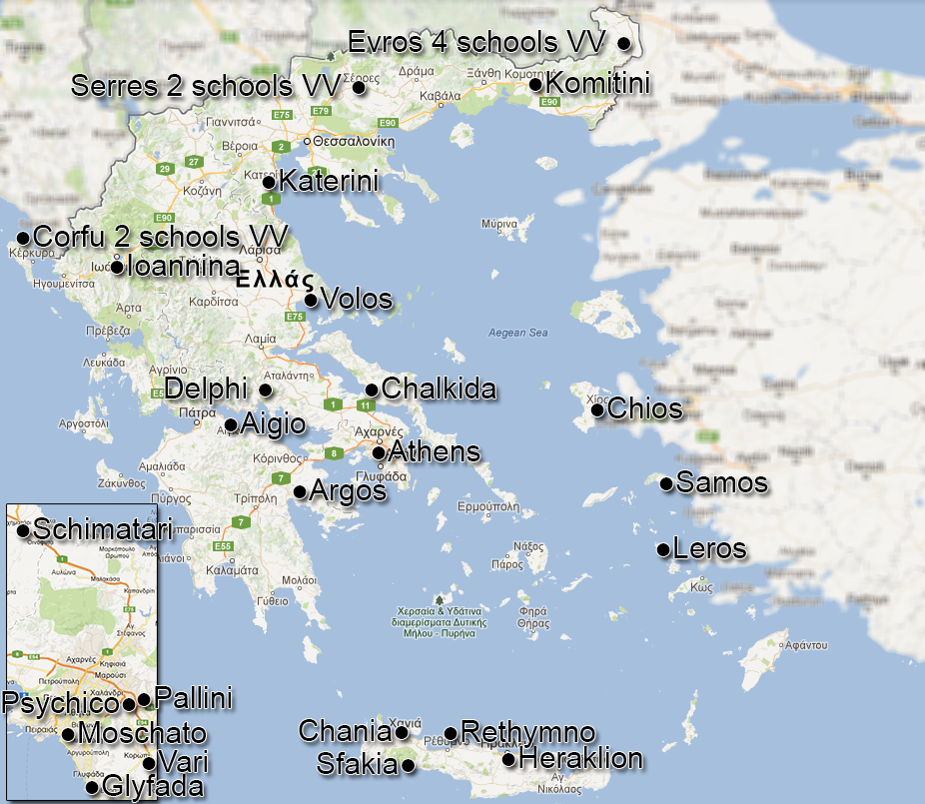
Masterclasses and VV in Greece (last two years)
~80 schools
pisa
pisa

Slide 12
BUT most developed material is for high school ages
Decided to target University students
Up to now very few universities had such lab courses addressed to their students
University of Athens has been one of the few, BUT is using small set of ATLAS data
Need experimental data (real and MC)
Multiple groups have shown interest in obtaining larger datasets
So an effort was launched by a ATLAS Outreach Data and Tools group to define the data and get approval for larger datasets (an ATLAS note under preparation)

Slide 13
University Student analysis using HYPATIA (1)
Use the large datasets to process events in batch mode for:
  for teaching data analysis strategies such as selection optimization, histogramming and statistics
  detector and accelerator physics
  HYPATIA has been running on event-by-event display mode ->modification to run large datasets

Slide 14
University Student analysis using HYPATIA (2)
After visually inspecting some events
Process many events in batch jobs (which have some minimum defaults cuts)
A GUI opens to set manually cuts like p_{T}, d0, |z0-vrtx|, isolation , invariant mass range
Inspect histos (signal/real data and MC) ->rerun, etc
  Run on 2 leptons (look for J/ψ, Y, Z, Z’)
  Run on four leptons (Higgs)

Slide 15
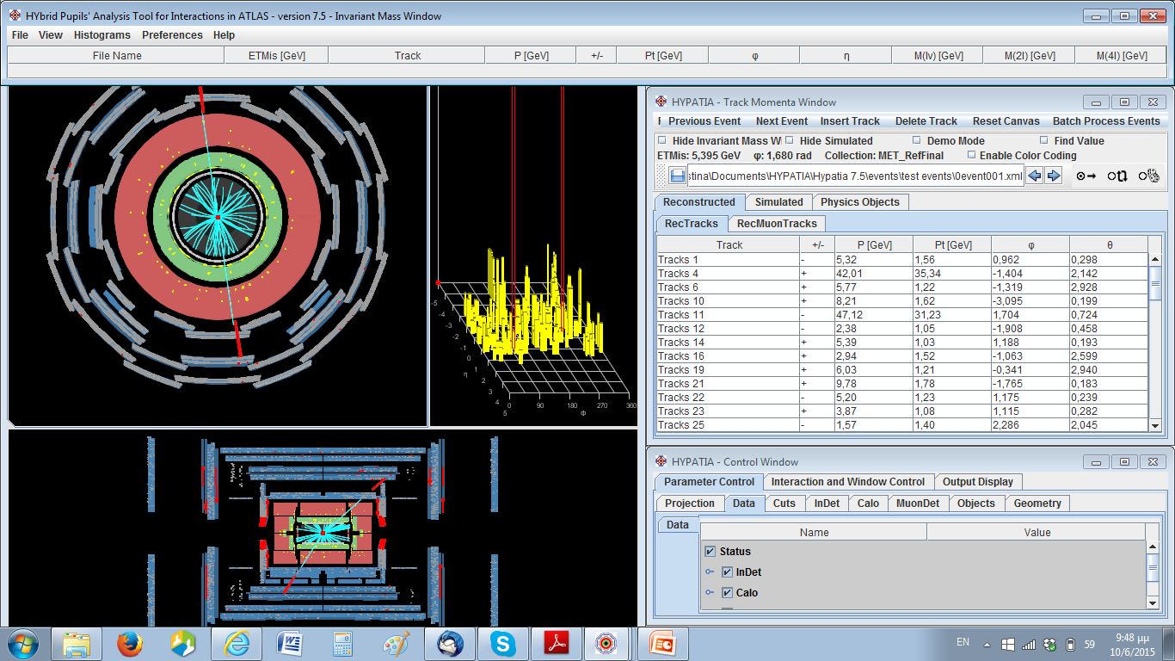
1) “Standard” version of offline HYPATIA
NEW

Slide 16
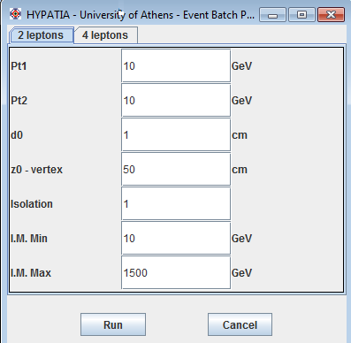
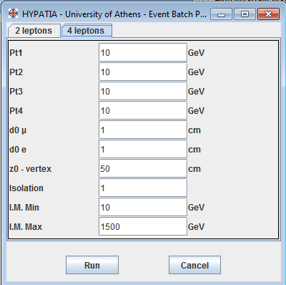
2 leptons ( J/ψ, Y, Z, Z’)
4 leptons ( Higgs)
Needs xml files (big)
Can process any .xml file
ATLANTIS is slow in loading events

Slide 17
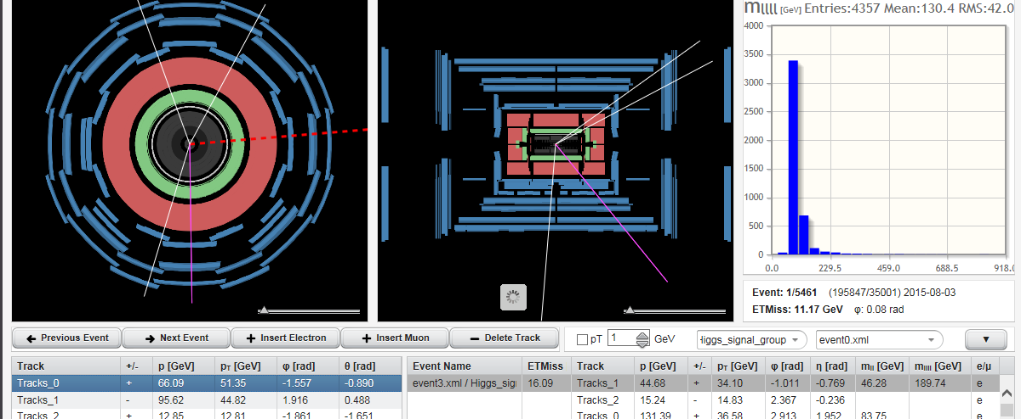
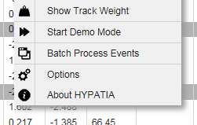
2) Implemented in the online HYPATIA
Event files are built-in (converted from xml) but much smaller
Only works with the built-in event files
Runs VERY fast

Slide 18
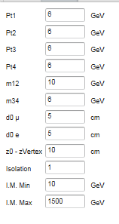
Higgs 4l analysis (MC signal and bkg files)
Possible cuts (as in real analysis)
P_{T1,2,3,4}
m₁₂ 1st pair closest to Z mass
m₂₃ 2nd pair closest to Z mass
Impact parameters for muon, electron (d₀) and z₀
Isolation of each lepton
Minimum (and maximum) invariant mass of 4 leptons
Optimize cuts by “N-1” method
Apply all cuts except the one under study and plot its distribution
Determine the optimum cut value (where significance is max)
Iterate for all cuts
Plot invariant mass of 4 leptons and try to maximize signal/bkg

Slide 19
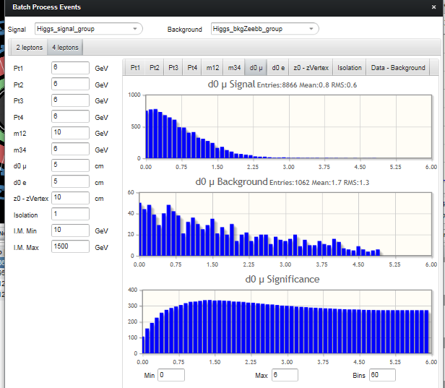
Optimization of each cut
Signal (MC)
Bkg Zbb
Signal /sqrt(Bkg)

Slide 20
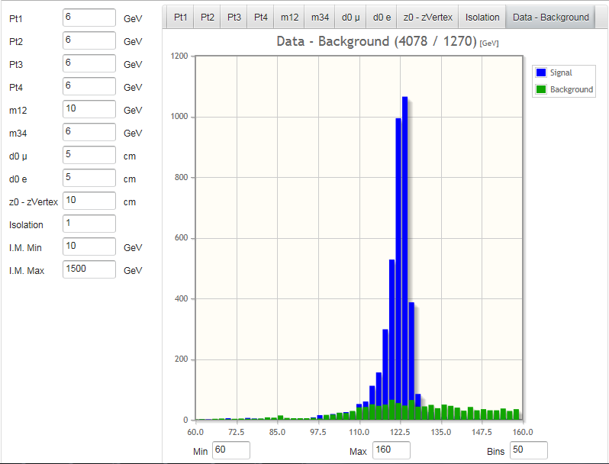
How the four lepton invariant mass looks after imposing some cuts

Slide 21
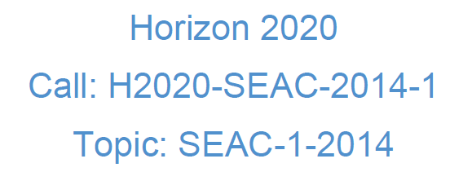
FUTURE
Developing an Engaging Science Classroom
36 months
1,8ME
7 WPs
Coordinator: University of Bayreuth
Partners
(CERN, UoB, IASA,
STFC etc) +
Quarknet

Slide 22
CONCLUSIONS
A lot of resources for introducing HEP already available
Number of labs/resources for University students increasing
EU very interested in funding outreach projects for STEM
(school of tomorrow.. )
New calls coming (ex. science with and for Society)
Tomorrow there is a public event/science fair in Chania
H-P Beck is ready to answer all questions !!
And lectures for the public in the evening (in Greek)

Slide 23
Back-up

Slide 24
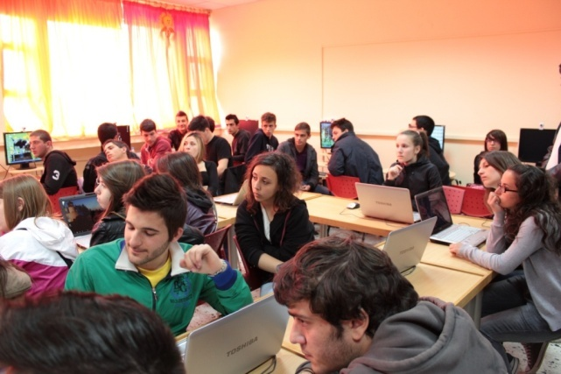
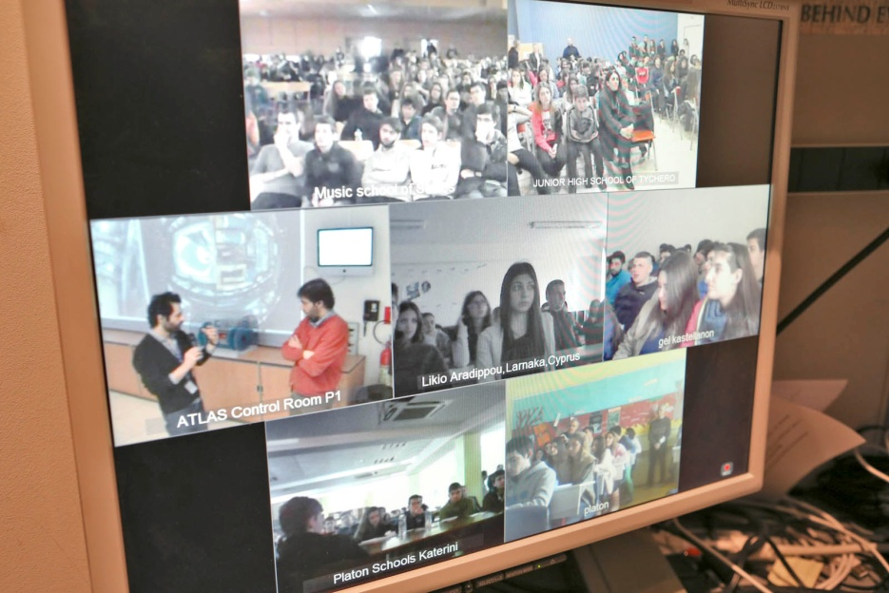



Best practices:
Local Masterclasses, e-Masterclasses & Virtual Visits
Masterclasses @schools (“mini” ones)
  ~ 80 schools all over Greece (Komotini to Crete)
    Students learn how actually science goes”
    Listen to lectures
    Follow a virtual visit to ATLAS control room
    Analyse events with the HYPATIA on-line tool
e-Masterclasses
  Dutch (9) & Polish (43) students (Nov12)
    “Learn how actually science goes”
    Teachers’ role (e.g. HST12 participants)
    Targeting extended group visits
    Synergies with local-level MCs
    + CERN Hangouts (Polish students)
    + CERN Mini Expo (Santiago de Compostela
VV with a cluster of schools
  CMS (10), ATLAS (10+2 from Cyprus)
…

Slide 25
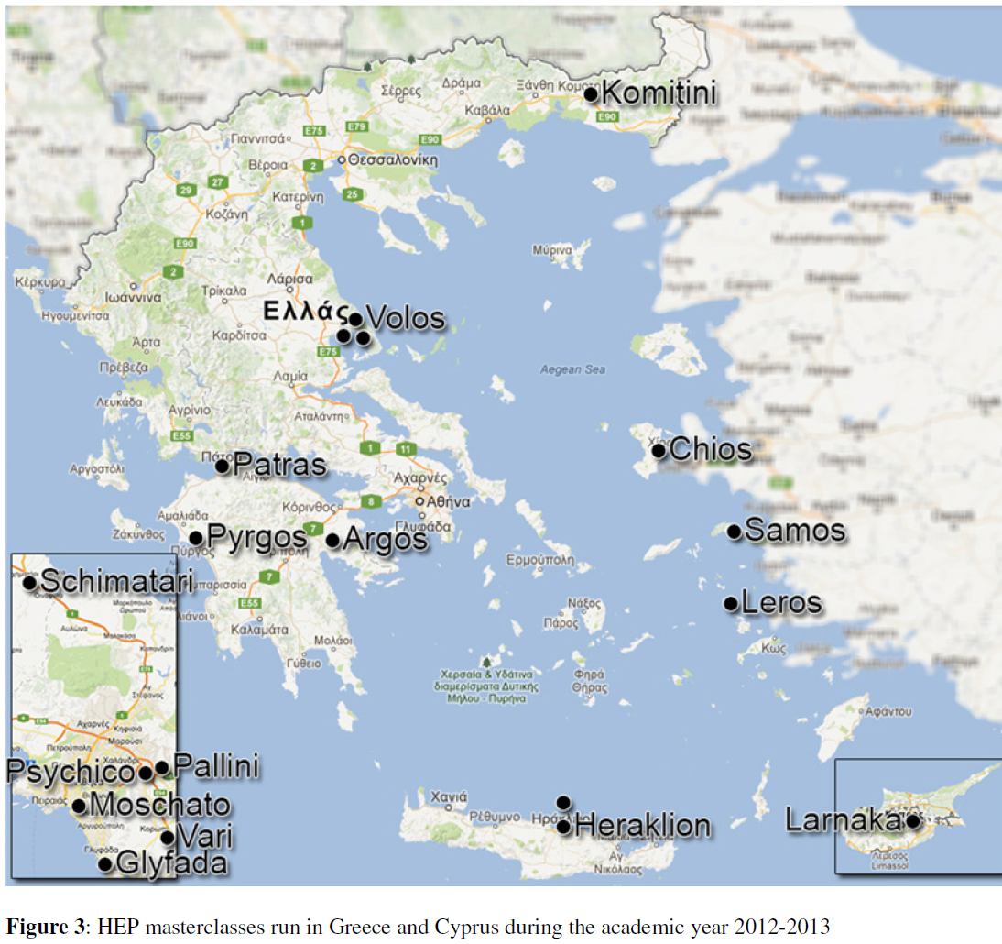
Implementation in Greek schools 2012-2013

Slide 26
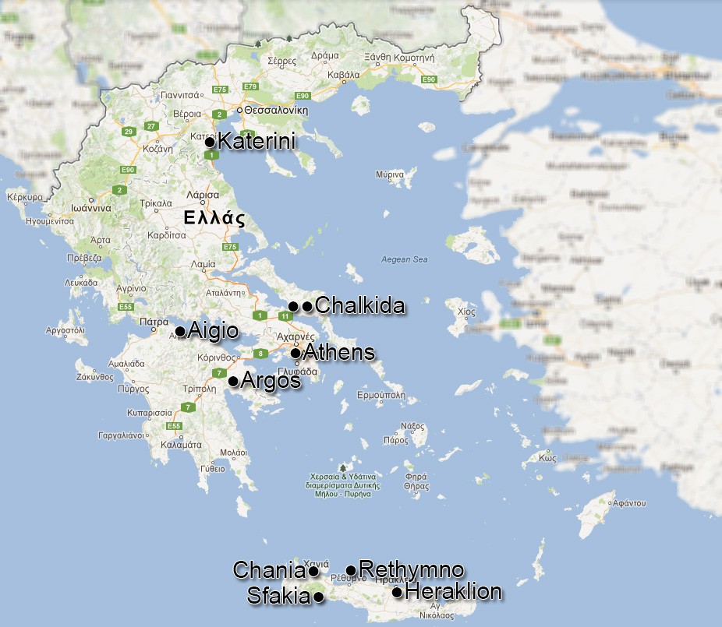
Implementation in Greek schools 2013-2014

Slide 27
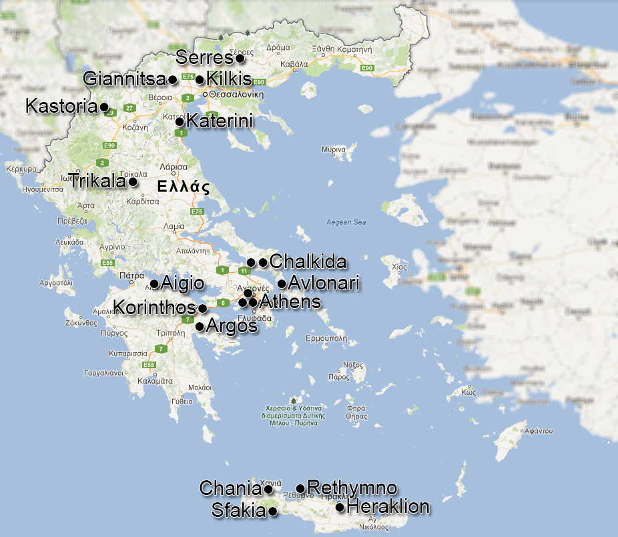
Implementation in Greek schools 2014-2015

