Slide 1



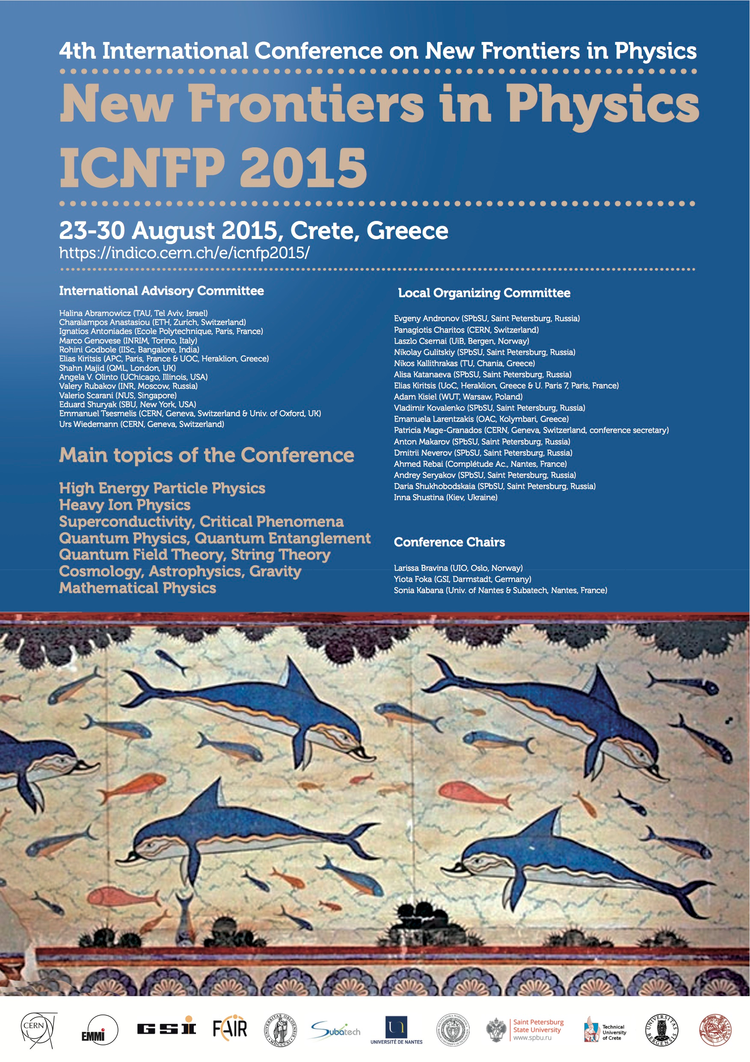
Supersymmetry, Cosmological Constant & Inflation:
Towards a fundamental cosmic picture via ``running vacuum’’
Nick E. Mavromatos
King’s College London &
CERN/PH-TH
London Centre
for Terauniverse
Studies (LCTS)
AdV 267352

Slide 2




2015:
100 anniversary of the (classical) theory of General relativity
Year of Light
Use Cosmic light to probe / falsify:
Cosmology models : (current) energy budget of Cosmos
Inflation
Evolution of Universe

Slide 3
Fundamental Questions (still unanswered) in Cosmology
100 years after Einstein
How did the Universe begin? is there something before Big Bang?
Is there inflation (as it seems) and if yes what is its microscopic mechanism?
Exit from Inflation into Radiation phase , reheating of the Universe?
Why is the cosmological constant so small today, despite the fact
that there is > 70% dark energy ?
Why Dark Matter? what is it, if there?
ARE EINSTEIN EQUATIONS CORRECT WHEN WE DEAL
WITH LARGE COSMOLOGICAL (GLOBAL) SCALES ?
How we connect inflation to current small cosmological constant ``vacuum’’?

Slide 4
Fundamental Questions (still unanswered) in Cosmology
100 years after Einstein
How did the Universe begin? is there something before Big Bang?
Is there inflation (as it seems) and if yes what is its microscopic mechanism?
Exit from Inflation into Radiation phase , reheating of the Universe?
Why is the cosmological constant so small today, despite the fact
that there is > 70% dark energy ?
Why Dark Matter? what is it, if there?
ARE EINSTEIN EQUATIONS CORRECT WHEN WE DEAL
WITH LARGE COSMOLOGICAL (GLOBAL) SCALES ?
How we connect inflation to current small cosmological constant ``vacuum’’?

Slide 5
Fundamental Questions (still unanswered) in Cosmology
100 years after Einstein
How did the Universe begin? is there something before Big Bang?
Is there inflation (as it seems) and if yes what is its microscopic mechanism?
Exit from Inflation into Radiation phase , reheating of the Universe?
Why is the cosmological constant so small today, despite the fact
that there is > 70% dark energy ?
Why Dark Matter? what is it, if there?
ARE EINSTEIN EQUATIONS CORRECT WHEN WE DEAL
WITH LARGE COSMOLOGICAL (GLOBAL) SCALES ?
How we connect inflation to current small cosmological constant ``vacuum’’?
An attempt to join these issues within
a VERY SIMPLE Supergravity Model
& the ``running vacuum” concept

Slide 6

OUTLINE
Overview of current astrophysical/cosmological Data (Supernovae, Baryon Acoustic Oscillations, CMB-Planck 2015) on Cosmological constant – Dark Matter Model (ΛCDM) and Inflation
PLANCK favourable inflation models: Starobinsky , -like
Low-scale (compared to Planck scale) for Inflation → why? SUPERSYMMETRY?
A minimal Inflationary Scenario in Supergravity:
dynamically broken N=1 D=4 SUGRA via gravitino condensation
Broken SUSY + SUGRA → SUPER-HIGGS EFFECT revisited
Starobinsky’ type inflation in massive gravitino/broken SUGRA phase
→ Gravitino is GUT scale massive , NOT the dark matter
Data Phenomenology – compatibility with Planck
``Running Vacuum’’ concept applied to SUGRA models: a consistent cosmic picture – from inflation to ΛCDM

Slide 7
PART I
Astro/Cosmological
Phenomenology

Slide 8
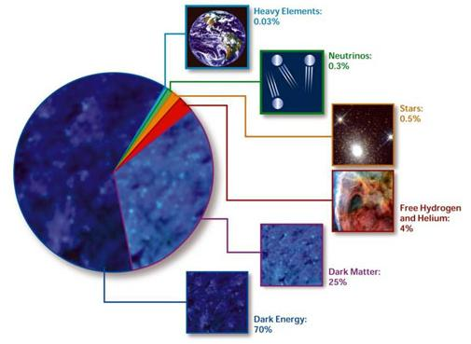

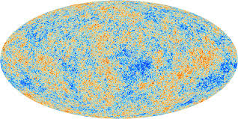
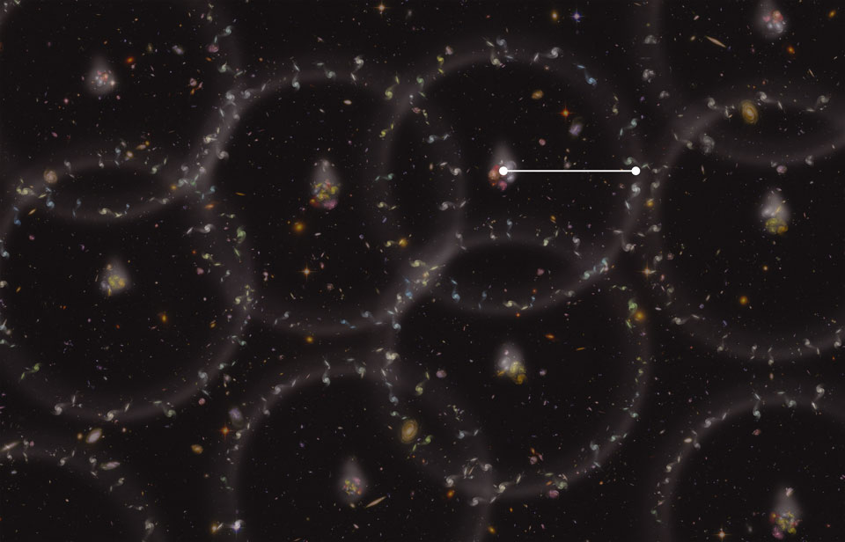
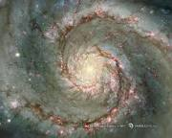
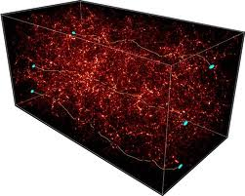

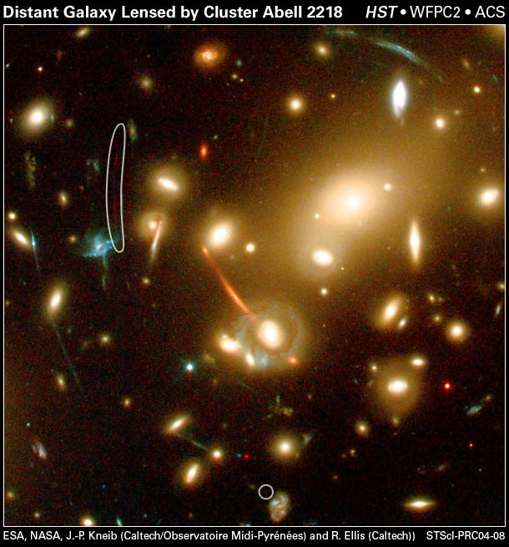
THE DARK SECTOR OF THE UNIVERSE
Current (100 yrs after Einstein GR) Energy Budget of the Cosmos
Observations from:
Supernovae Ia
CMB
Baryon Acoustic
Oscillations
Galaxy Surveys
Structure Formation data
Strong & Weak
lensing
Active ν

Slide 9
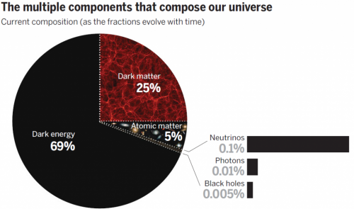
Energy Budget of the Cosmos after Planck 2015
http://www.cosmos.esa.int/web/planck/publications#Planck2015

Slide 10

SCALAR-FIELD INFLATION PHENOMENOLOGY
EINSTEIN’S EQS in the presence of a scalar field
whose potential terms dominate kinetic ones
Slow roll
Classical General Relativity

Slide 11











SCALAR-FIELD INFLATION PHENOMENOLOGY
V’ = dV(φ) / dφ
Scalar spectral index
Tensor-to-scalar ratio
number of e-foldings
-
Running scalar
spectral index
Power spectrum
₀
WMAP constraint from measured primordial density flcts:

Slide 12
SCALAR-FIELD INFLATION PHENOMENOLOGY
V’ = dV(φ) / dφ
Scalar spectral index
Tensor-to-scalar ratio
number of e-foldings
-
Running scalar
spectral index
Power spectrum
₀
WMAP constraint from measured primordial density flcts:

Slide 13
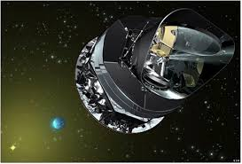

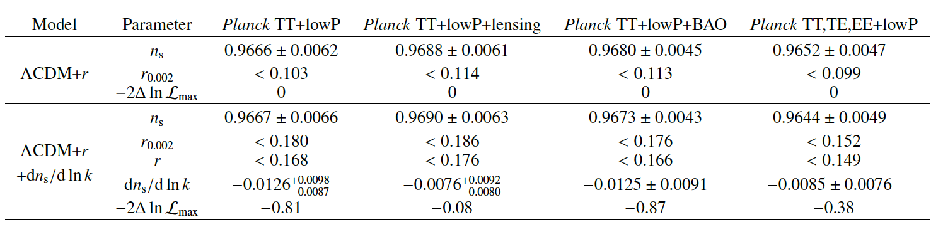
PLANCK 2015 RESULTS ON INFLATION
}
Planck Coll: Ade et al. arXiv:1502.02114
Scalar spectral index η_{s}
Running scalar spectral index
Tensor to scalar ratio
@

Slide 14
PLANCK 2015 RESULTS ON INFLATION
}
Planck Coll: Ade et al. arXiv:1502.02114
Scalar spectral index η_{s}
Running scalar spectral index
Tensor to scalar ratio
@

Slide 15
PLANCK 2015 RESULTS ON INFLATION
}
Planck Coll: Ade et al. arXiv:1502.02114
Scalar spectral index η_{s}
Running scalar spectral index
Tensor to scalar ratio
@
No evidence for primordial gravitational waves
due to Joint BICEP2/KECK Array & Planck
2015 Analysis arXiv:1502.00612
previous claims of BICEP2 attributed to dust

Slide 16
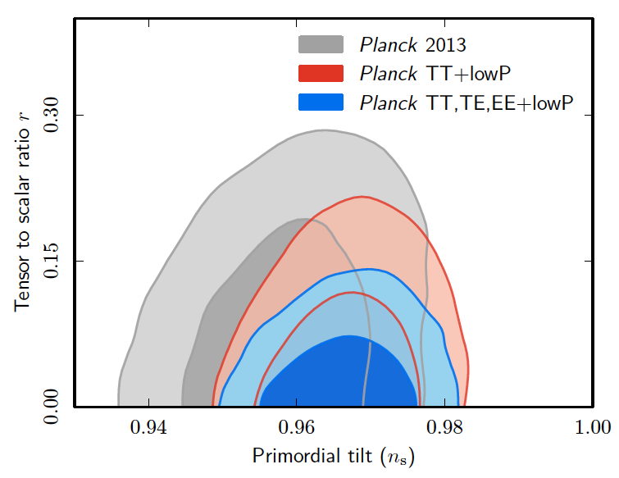
PLANCK 2015 RESULTS ON INFLATION
Planck Coll: Ade et al. arXiv:1502.02114

Slide 17
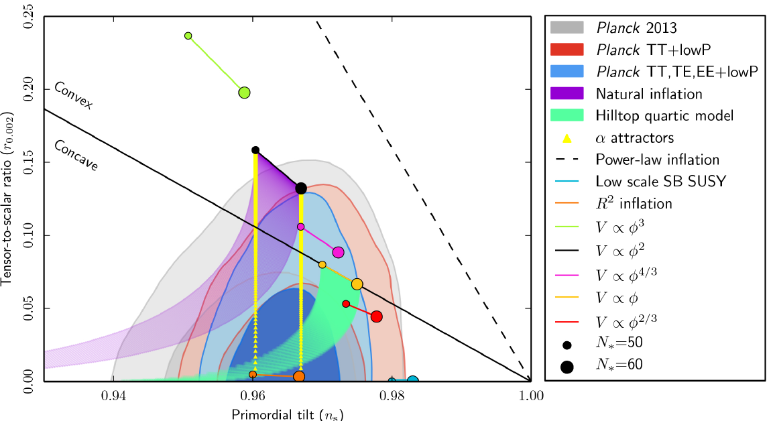
PLANCK 2015 RESULTS ON INFLATION
Planck Coll: Ade et al. arXiv:1502.02114
Models

Slide 18

PLANCK 2015 RESULTS ON INFLATION
Planck Coll: Ade et al. arXiv:1502.02114
Models
Most monomial single field inflation potentials excluded

Slide 19
PLANCK 2015 RESULTS ON INFLATION
Planck Coll: Ade et al. arXiv:1502.02114
Models
Most monomial single field inflation potentials excluded
X

Slide 20

PLANCK 2015 RESULTS ON INFLATION
Planck Coll: Ade et al. arXiv:1502.02114
Models
Starobinsky Model Excellent Fit !
✓

Slide 21


STAROBINSKY’s MODEL ≅ R² INFLATION
A.A. Starobinsky (1980)
Induced by quantum fluctuations
of conformal (massless) matter
(e.g. high energy matter) in early
Universe, after integrating it out
in a path integral …

Slide 22
STAROBINSKY’s MODEL ≅ R² INFLATION
A.A. Starobinsky (1980)
Induced by quantum fluctuations
of conformal (massless) matter
(e.g. high energy matter) in early
Universe, after integrating it out
in a path integral …
Conditions for inflation and study of tensor-to-scalar metric fluctuations
in this scenario have been computed by Mukhanov and Starobinsky

Slide 23
STAROBINSKY’s MODEL ≅ R² INFLATION
A.A. Starobinsky (1980)
Induced by quantum fluctuations
of conformal (massless) matter
(e.g. high energy matter) in early
Universe, after integrating it out
in a path integral …
Conditions for inflation and study of tensor-to-scalar metric fluctuations
in this scenario have been computed by Mukhanov and Starobinsky
Phenomenologically acceptable inflation for scale M ≈ 2.5 x 10⁻⁵ M_{Pl} & N ≈ 55 e-foldings
n_{s} = 0.965, r = 0.0035

Slide 24
STAROBINSKY’s MODEL ≅ SINGLE SCALAR FIELD INFLATION
B. Whitt (1984),
K. Stelle (1978)
Linearise by means of
Lagrange multiplier field
non-canonically normalised
Einstein term
Make it canonical by a
conformal transformation of metric

Slide 25



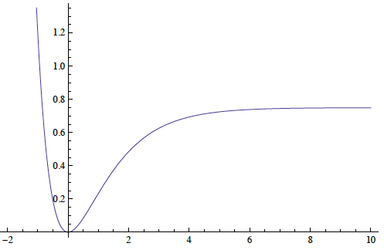
STAROBINSKY’s MODEL ≅ SINGLE SCALAR FIELD INFLATION
Conformal Transformation
→
+
Linearise by means of
Lagrange multiplier field
←
Planck
V
slow roll
phase
large field
values →
Single-field inflation consistent with Planck data
- - - - - - -
last e-foldings: N = 55,
= 5.35

Slide 26





SLOW-ROLL PARAMETERS IN STAROBINSKY MODELS
DURING SLOW-ROLL PHASE, POTENTIAL APPROXIMATED BY
Requiring
Highly consistent with Planck Data

Slide 27
PART II
Inflation
&
Supersymmetry

Slide 28
INFLATION & SUPERSYMMETRY
Small scale of inflation H_{I} = 10⁻⁵ M_{Pl} compared to
Planck mass may be explained by SUSY
Ellis, Nanopoulos,
Olive, Tamvakis (1982)

Slide 29


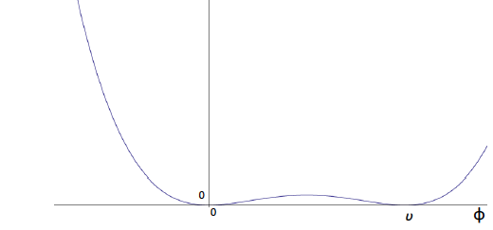



INFLATION & SUPERSYMMETRY
Small scale of inflation H_{I} = 10⁻⁵ M_{Pl} compared to
Planck mass may be explained by SUSY
Croon, Ellis, NEM
PLB 724, 165 (2013)
arXiv: 1303.6253.
Link SUSY breaking with Inflation:
SIMPLEST WESS-ZUMINO (WZ) MODEL
THAT ALSO FITS THE PLANCK DATA
Superpotential
complex
chiral superfield
Φ =φ e^{i θ}
slow roll
phase
→
Scalar potential

Slide 30




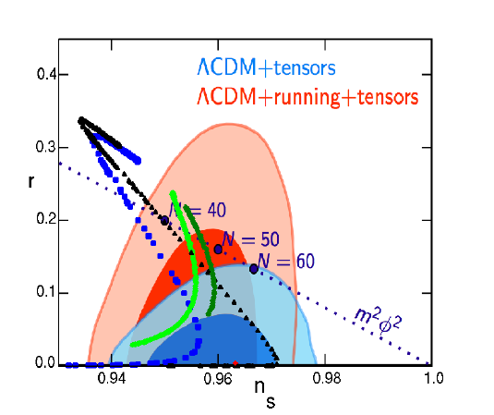
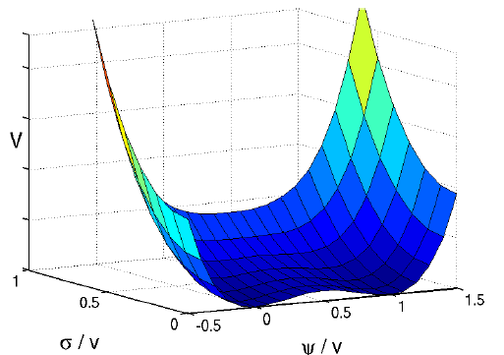
J.ELLIS, NEM, D. MULRYNE 1401.6078
EXPLORING TWO-FIELD INFLATION IN WZ MODELS
*
.
⏏
PREDICTIONS FOR SUPPRESSED NON-GAUSSIANITIES

Slide 31



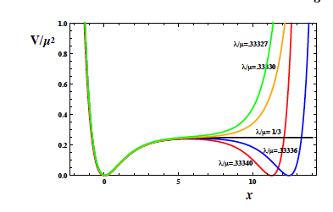

EMBED WZ MODEL in NO-SCALE SUGRA (NSWZ)
→ SUSY EXTENSION OF STAROBINSKY
Ellis, Nanopoulos, Olive
arXiv~: 1305.1247 (PRL)
& 1307.3537
Scalar potential
Kahler function
holomorphic
superpotential
Fix y =0
Starobinsky !

Slide 32
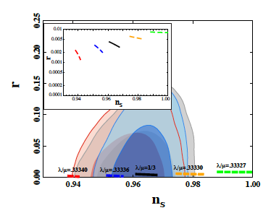
PLANCK DATA COMPATIBILITY
OF NSWZ MODEL
Ellis, Nanopoulos, Olive
arXiv~: 1305.1247 (PRL)
& 1307.3537

Slide 33
PLANCK DATA COMPATIBILITY
OF NSWZ MODEL
SEVERAL OTHER MODELS
(CONFORMAL) FOUND
COMPATIBLE WITH
PLANCK DATA & EQUIVALENT
(MORE OR LESS) TO
STAROBINSKY’s MODEL …
Yanagida, Nakayama, Takahashi, Buchmueller et al., Linde, Kallosh, Kiritsis, Ferrara, F. Farakos, Kehagias, Riotto, …
Generalisations to dilaton
dynamics in string-brane theory
J Ellis, NEM, D. Nanopoulos

Slide 34
PART III
DYNAMICALLY BROKEN
LOCAL SUPERSYMMETRY/SUPERGRAVITY
&
INFLATION

Slide 35


TRULY MINIMAL SUGRA INFLATION
Ellis, NEM, arXiv:1308.1906 (PRD)
VIEW INFLATON NOT AS FUNDAMENTAL FIELD
BUT COMPOSITE → e.g. associate it
with GRAVITINO CONDENSATES (to be explained)
IN DYNAMICALLY BROKEN SUGRA MODELS

Slide 36



TRULY MINIMAL SUGRA INFLATION
Ellis, NEM, arXiv:1308.1906 (PRD)
VIEW INFLATON NOT AS FUNDAMENTAL FIELD
BUT COMPOSITE → e.g. associate it
with GRAVITINO CONDENSATES (to be explained)
IN DYNAMICALLY BROKEN SUGRA MODELS
Super-Higgs effect associated with
global SUSY breaking essential
Inflation linked to
scale of SUSY breaking

Slide 37

TRULY MINIMAL SUGRA INFLATION
Ellis, NEM, arXiv:1308.1906 (PRD)
VIEW INFLATON NOT AS FUNDAMENTAL FIELD
BUT COMPOSITE → e.g. associate it
with GRAVITINO CONDENSATES (to be explained)
IN DYNAMICALLY BROKEN SUGRA MODELS
Examine first: Condensate
Formation →
dynamical generation of
gravitino mass
Super-Higgs effect associated with
global SUSY breaking essential
Inflation linked to
scale of SUSY breaking
© Copyright Showeet.com
© Copyright Showeet.com
© Copyright Showeet.com
Alexandre, Houston, NEM
arXiv: 1310.4122 (PRD)

Slide 38


SUPER-HIGGS EFFECT & DYNAMICAL BREAKING OF N=1, D=4 SUGRA
Deser-Zumino PRL 38 (1977)
Global SUSY (F-term) breaking at a scale
Generator of
SUSY is fermionic
field → Goldstone
particle = fermion
GOLDSTINO =
Majorana spin ½
fermion
© Copyright Showeet.com

Slide 39



SUPER-HIGGS EFFECT & DYNAMICAL BREAKING OF N=1, D=4 SUGRA
Deser-Zumino PRL 38 (1977)
Global SUSY (F-term) breaking at a scale
Volkov-Akulov (V-A) Lagrangian
Generator of
SUSY is fermionic
field → Goldstone
particle = fermion
GOLDSTINO =
Majorana spin ½
fermion
SUSY trnsf
© Copyright Showeet.com

Slide 40
SUPER-HIGGS EFFECT & DYNAMICAL BREAKING OF N=1, D=4 SUGRA
Deser-Zumino PRL 38 (1977)
Global SUSY (F-term) breaking at a scale
Volkov-Akulov (V-A) Lagrangian
Generator of
SUSY is fermionic
field → Goldstone
particle = fermion
GOLDSTINO =
Majorana spin ½
fermion
SUSY trnsf
© Copyright Showeet.com
negative cosmological
constant

Slide 41




COUPLING V-A LAGRANGIAN TO N=1, D=4 SUGRA
Particle content : spin-2 graviton
spin-3/2 gravitino
Local SUSY
trnsf
+

Slide 42

COUPLING V-A LAGRANGIAN TO N=1, D=4 SUGRA
Particle content : spin-2 graviton
spin-3/2 gravitino
Local SUSY
trnsf
+
GOLDSTINO CAN BE GAUGED AWAY & CAN BE ABSORBED IN
A REDEFINITION OF
GRAVITINO (``EATEN ‘’ SO THAT GRAVITINO BECOMES MASSIVE’’)
GAUGE CONDITION
© Copyright Showeet.com
© Copyright Showeet.com

Slide 43
COUPLING V-A LAGRANGIAN TO N=1, D=4 SUGRA
Particle content : spin-2 graviton
spin-3/2 gravitino
Local SUSY
trnsf
+
GOLDSTINO CAN BE GAUGED AWAY & CAN BE ABSORBED IN
A REDEFINITION OF
GRAVITINO (``EATEN ‘’ SO THAT GRAVITINO BECOMES MASSIVE’’)
GAUGE CONDITION
© Copyright Showeet.com
© Copyright Showeet.com

Slide 44

COUPLING V-A LAGRANGIAN TO N=1, D=4 SUGRA
Particle content : spin-2 graviton
spin-3/2 gravitino
Local SUSY
trnsf

Slide 45

COUPLING V-A LAGRANGIAN TO N=1, D=4 SUGRA
Particle content : spin-2 graviton
spin-3/2 gravitino
Local SUSY
trnsf
gauge-fixing ghosts

Slide 46
COUPLING V-A LAGRANGIAN TO N=1, D=4 SUGRA
Particle content : spin-2 graviton
spin-3/2 gravitino
Local SUSY
trnsf
gauge-fixing ghosts
Torsion due to gravitino:

Slide 47
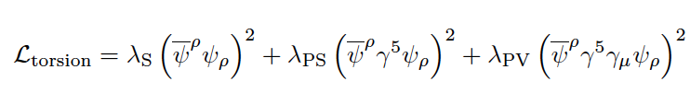


TORSION-INDUCED FOUR-GRAVITINO SELF-INTERACTIONS
NB: Fierz ambiguities
ambiguous coefficients
can be determined only non perturbatively

Slide 48


Bypass such ambiguities → CONFORMAL SUGRA MODELS
Ferrara, Kallosh, Linde, Marrani, van Proyen
arXiv: 1004.0712 (PRD)
Jordan Frame SUGRA

Slide 49

Bypass such ambiguities → CONFORMAL SUGRA MODELS
Ferrara, Kallosh, Linde, Marrani, van Proyen
arXiv: 1004.0712 (PRD)
Jordan Frame SUGRA
auxiliary
vector field
containing
only bosons

Slide 50
Bypass such ambiguities → CONFORMAL SUGRA MODELS
Ferrara, Kallosh, Linde, Marrani, van Proyen
arXiv: 1004.0712 (PRD)
Jordan Frame SUGRA

Slide 51

Bypass such ambiguities → CONFORMAL SUGRA MODELS
Ferrara, Kallosh, Linde, Marrani, van Proyen
arXiv: 1004.0712 (PRD)
Jordan Frame SUGRA
V breaks conformal
symmetry via v.e.v. of Φ
e.g.

Slide 52
Bypass such ambiguities → CONFORMAL SUGRA MODELS
Ferrara, Kallosh, Linde, Marrani, van Proyen
arXiv: 1004.0712 (PRD)
Jordan Frame SUGRA
Frame function: may be dilatons…

Slide 53

Bypass such ambiguities → CONFORMAL SUGRA MODELS
Ferrara, Kallosh, Linde, Marrani, van Proyen
arXiv: 1004.0712 (PRD)
Jordan Frame SUGRA
Frame function: may be dilatons or contain NMSSM (super)fields
e.g.

Slide 54
Bypass such ambiguities → CONFORMAL SUGRA MODELS
Ferrara, Kallosh, Linde, Marrani, van Proyen
arXiv: 1004.0712 (PRD)
Jordan Frame SUGRA
+ ……

Slide 55

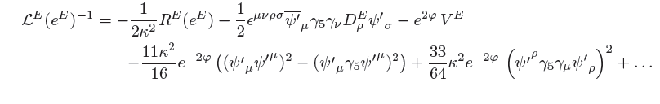
CONFORMAL SUGRA IN EINSTEIN FRAME
Redefine metric so that canonically
normalised Einstein-Hilbert scalar curvature term
Assume Φ is stabilised through a
minimum of its potential to a v.e.v. <Φ> = e^{-φ}

Slide 56
CONFORMAL SUGRA IN EINSTEIN FRAME
Redefine metric so that canonically
normalised Einstein-Hilbert scalar curvature term
Assume Φ is stabilised through a
minimum of its potential to a v.e.v. <Φ> = e^{-φ}

Slide 57

CONFORMAL SUGRA IN EINSTEIN FRAME
Redefine metric so that canonically
normalised Einstein-Hilbert scalar curvature term
Assume Φ is stabilised through a
minimum of its potential to a v.e.v. <Φ> = e^{-φ}
``Effective ‘’ gravitational
coupling ``seen’’ by gravitinos

Slide 58
CONFORMAL SUGRA IN EINSTEIN FRAME
Redefine metric so that canonically
normalised Einstein-Hilbert scalar curvature term
Assume Φ is stabilised through a
minimum of its potential to a v.e.v. <Φ> = e^{-φ}
``Effective ‘’ gravitational
coupling ``seen’’ by gravitinos
such terms may then
be combined with Fierz
ambiguities in scalar
channel to fix them
Can be
so fermionic parts dominate the one-loop quantum corrections

Slide 59



TORSION-INDUCED FOUR-GRAVITINO SELF-INTERACTIONS
CONCENTRATE ON SCALAR GRAVITINO CONDENSATES
λ_{S} →
Condensate formation
→ gravitino mass
Tree-level cosmological constant

Slide 60
ONE-LOOP PARTITION FUNCTION
Alexandre, Houston, NEM
arXiv: 1310.4122 (PRD)
One-Loop Partition Functions :
Integrate over quantum fluctuations
of metric around de Sitter background
with cosmological constant Λ > 0
& of gravitino field
Take the limit Λ → 0 to define gravitino mass
properly in Minkowski space-time
For consistency one-loop effective potential
must vanish at the non-trivial minima
of gravitino condensate σ_{c}≠ 0
© Copyright Showeet.com

Slide 61

ONE-LOOP EFFECTIVE POTENTIAL
effective action
INTEGRATE OUT Metric (bosonic, spin-2 ) and
Gravitino (spin 3/2) Fields
in a given gauge and de Sitter background

Slide 62




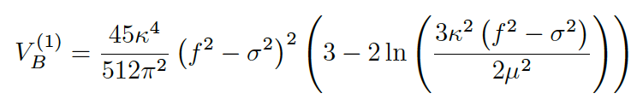

ONE-LOOP EFFECTIVE POTENTIAL
μ = short-distance (proper time)
cut-off to regularize UV divergencies

Slide 63

ONE-LOOP EFFECTIVE POTENTIAL
only from spin-2 parts
Imaginary Parts
unless …..
Importance
of super-Higgs
effect for
stability of
broken symmetry
phase
μ = short-distance (proper time)
cut-off to regularize UV divergencies

Slide 64
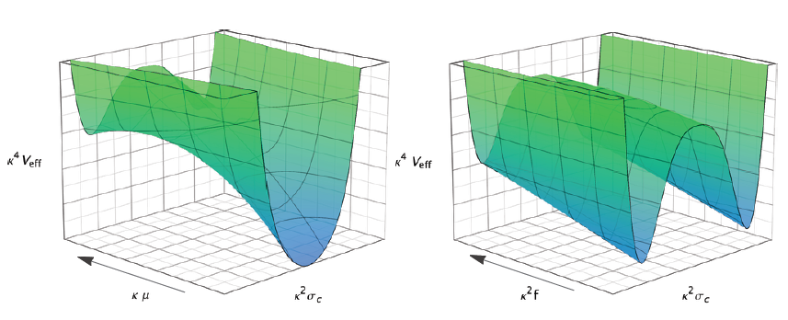
Dynamical Gravitino Mass Generation occurs as we flow from UV → IR
For our purposes we shall fix the UV RG scale to

Slide 65

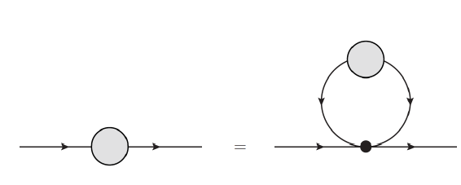
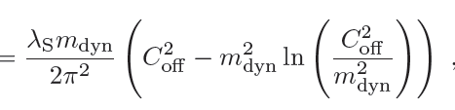




WAVE-FUNCTION RENORMALIZATION
Important:
canonically
normalise
the condensate
due to non-trivial
wave-function
renormalisation
Ellis, NEM, arXiv: 1308.1906 (PRD)
Estimate in flat space-time
© Copyright Showeet.com
λ_{S} = dimensionful coupling of four gravitin interactions, proportional to

Slide 66
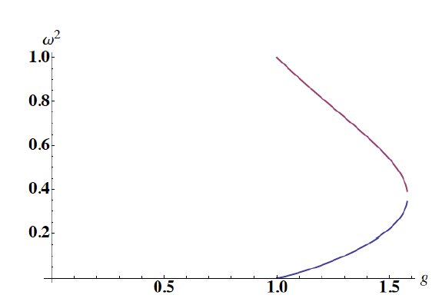
WAVE-FUNCTION RENORMALIZATION
Physical curve in
massive gravitino phase
= O(1) in massive
broken SUGRA phase

Slide 67
CONFORMAL SUGRA IN EINSTEIN FRAME
By appropriately choosing
parameters of dilaton
potential

Slide 68
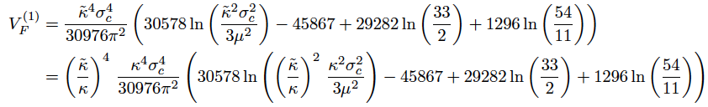
CONFORMAL SUGRA IN EINSTEIN FRAME
In this case the spin-2 contributions
are negligible
Alexandre, Houston, NEM
arXiv: 1310.4122 (PRD)

Slide 69
CONFORMAL SUGRA IN EINSTEIN FRAME
In this case the spin-2 contributions
are negligible
NB: The imaginary
parts in V_{B}
still remain
though and their absence
at σ_{c} reauires
Alexandre, Houston, NEM
arXiv: 1310.4122 (PRD)
© Copyright Showeet.com

Slide 70
CONFORMAL SUGRA IN EINSTEIN FRAME
In this case the spin-2 contributions
are negligible
NB: The imaginary
parts in V_{B}
still remain
though and their absence
at σ_{c} reauires
gravitino (torsion) driven 1-loop parallelism
Alexandre, Houston, NEM
arXiv: 1310.4122 (PRD)
© Copyright Showeet.com

Slide 71
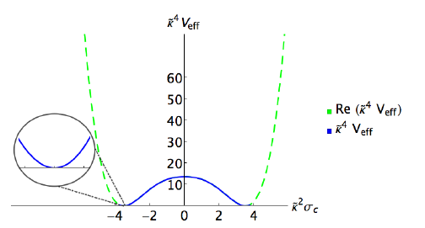



CONFORMAL SUGRA IN EINSTEIN FRAME
Alexandre, Houston, NEM
arXiv: 1310.4122 (PRD)
By appropriately choosing
parameters of dilaton
potential
Phenomenologically Realistic scales involved

Slide 72
Connections
to Inflation

Slide 73

Small-field Gravitino condensate Inflation Parameters
Hill-top inflation?
transmutation
mass near
the origin
If slow-roll, then must have:
ε, η, ξ << 1

Slide 74
Small-field Gravitino condensate Inflation Parameters
Hill-top inflation?
transmutation
mass near
the origin
Need Z f² >> M⁴_{Pl} to ensure slow roll → transmutation mass must be practically zero !

Slide 75
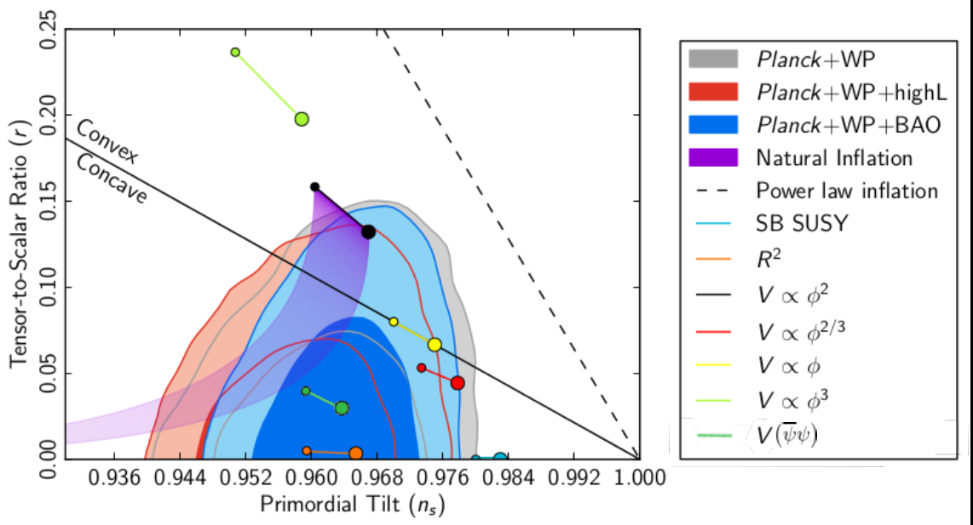
e.g. for
Z f²/M⁴_{Pl} = O(10³)
can give Planck-friendly results
compatible with a GUT value for the SUSY breaking scale √f

Slide 76

Small-field Gravitino condensate Inflation Parameters
Hill-top inflation?
But no natural
(too fine-tuned)
Inflation….
transmutation
mass near
the origin
Z f²/M⁴_{Pl} = O(10³)
Need Z f² >> M⁴_{Pl} to ensure slow roll → transmutation mass must be practically zero !

Slide 77
BUT…
SO FAR WE HAVE CONSIDERED
THE DYNAMICALLY BROKEN
PHASE AS COINCIDING WITH
FLAT SPACE-TIME LIMIT (Λ=0)
FURTHER IDEAS

Slide 78
BUT…
SO FAR WE HAVE CONSIDERED
THE DYNAMICALLY BROKEN
PHASE AS COINCIDING WITH
FLAT SPACE-TIME LIMIT (Λ=0)
WHAT ABOUT CONSIDERING A SMALL
BUT NON-VANISHING DE SITTER
PHASE (Λ> 0) AT THE NON-TRIVIAL
(BROKEN SUGRA) MINIMUM.
IN SUCH A CASE, INTEGRATING OUT MASSIVE GRAVITINO FIELDS (& MASSLESS GRAVITON FLCTS) ONE MAY
OBTAIN AN INFLATIONARY
PHASE IN THE BROKEN SUGRA PHASE
OF STAROBINSKY TYPE …
FURTHER IDEAS

Slide 79
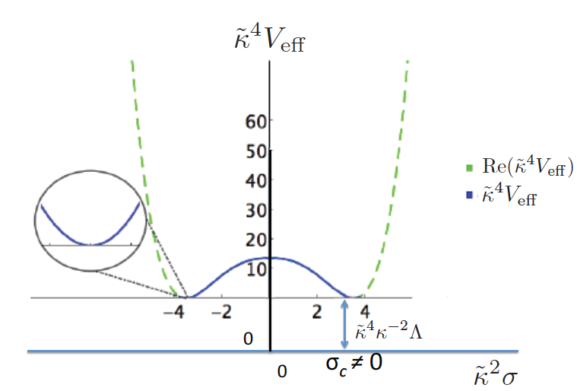
CONFORMAL SUGRA IN EINSTEIN FRAME
Alexandre, Houston, NEM
arXiv: 1312.5197 (PRD)
Phenomenologically Realistic scales involved

Slide 80

CONFORMAL SUGRA IN EINSTEIN FRAME
Alexandre, Houston, NEM
arXiv: 1312.5197 (PRD)
Starobinsky inflationary
phase (Λ≠0) due to
gravitino quantum flcts ?
Phenomenologically Realistic scales involved

Slide 81

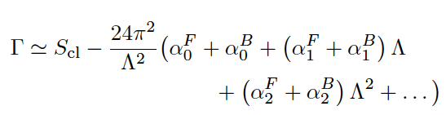
COMPUTE ONE-LOOP EFFECTIVE ACTION
AFTER GRAVITON & GRAVITINO FLCTS WITH Λ ≠ 0
J Alexandre, N Houston & NEM, 1312.5197 (PRD)
In the presence of small Λ ≠ 0 same computations as above yield the following
structure of the effective action
F= gravitino integrated out
B= graviton integrated out

Slide 82

COMPUTE ONE-LOOP EFFECTIVE ACTION
AFTER GRAVITON & GRAVITINO FLCTS WITH Λ ≠ 0
J Alexandre, N Houston & NEM, 1312.5197 (PRD)
In the presence of small Λ ≠ 0 same computations as above yield the following
structure of the effective action
F= gravitino integrated out
B= graviton integrated out

Slide 83

COMPUTE ONE-LOOP EFFECTIVE ACTION
AFTER GRAVITON & GRAVITINO FLCTS WITH Λ ≠ 0
J Alexandre, N Houston & NEM, 1312.5197 (PRD)
In the presence of small Λ ≠ 0 same computations as above yield the following
structure of the effective action
F= gravitino integrated out
B= graviton integrated out

Slide 84
COMPUTE ONE-LOOP EFFECTIVE ACTION
AFTER GRAVITON & GRAVITINO FLCTS WITH Λ ≠ 0
J Alexandre, N Houston & NEM, 1312.5197 (PRD)
In the presence of small Λ ≠ 0 same computations as above yield the following
structure of the effective action
F= gravitino integrated out
B= graviton integrated out
Background
Curvature

Slide 85

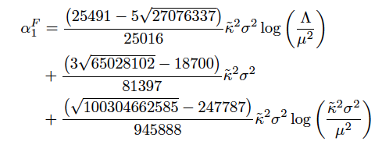
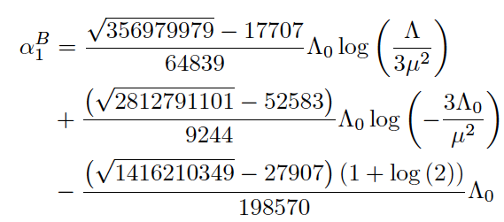
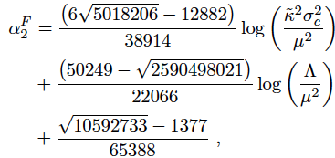
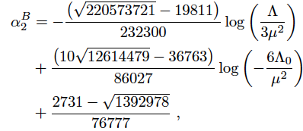


B= graviton flcts
F = gravitino flcts

Slide 86

COMPUTE ONE-LOOP EFFECTIVE ACTION
AFTER GRAVITON & GRAVITINO FLCTS WITH Λ ≠ 0
J Alexandre, N Houston & NEM, 1312.5197 (PRD)
In the presence of small Λ ≠ 0 same computations as above yield the following
structure of the effective action

Slide 87
COMPUTE ONE-LOOP EFFECTIVE ACTION
AFTER GRAVITON & GRAVITINO FLCTS WITH Λ ≠ 0
J Alexandre, N Houston & NEM, 1312.5197 (PRD)
In the presence of small Λ ≠ 0 same computations as above yield the following
structure of the effective action
Impose
cancellation
= 0

Slide 88

COMPUTE ONE-LOOP EFFECTIVE ACTION
AFTER GRAVITON & GRAVITINO FLCTS WITH Λ ≠ 0
J Alexandre, N Houston & NEM, 1312.5197 (PRD)
In the presence of small Λ ≠ 0 same computations as above yield the following
structure of the effective action
Impose
cancellation
= 0
consistent
with
minimization
of Γ

Slide 89

COMPUTE ONE-LOOP EFFECTIVE ACTION
AFTER GRAVITON & GRAVITINO FLCTS WITH Λ ≠ 0
J Alexandre, N Houston & NEM, 1312.5197 (PRD)
In the presence of small Λ ≠ 0 same computations as above yield the following
structure of the effective action
Starobinsky scale

Slide 90
B= graviton flcts
F = gravitino flcts

Slide 91
B= graviton flcts
F = gravitino flcts

Slide 92

RESULTS
J Alexandre, N Houston &
NEM, 1312.5197 (PRD)
Λ << 1
phenomenologically good
Starobinsky scale
Gravitino
condensate
at GUT scale
Planck-data best-fit value

Slide 93
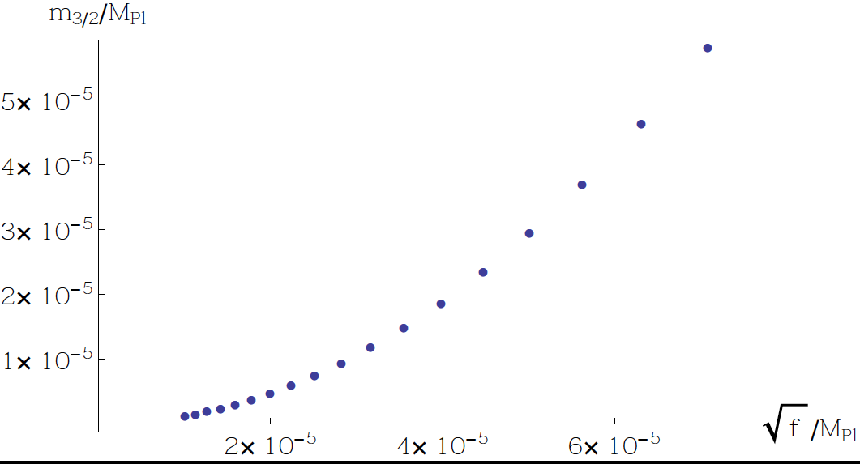

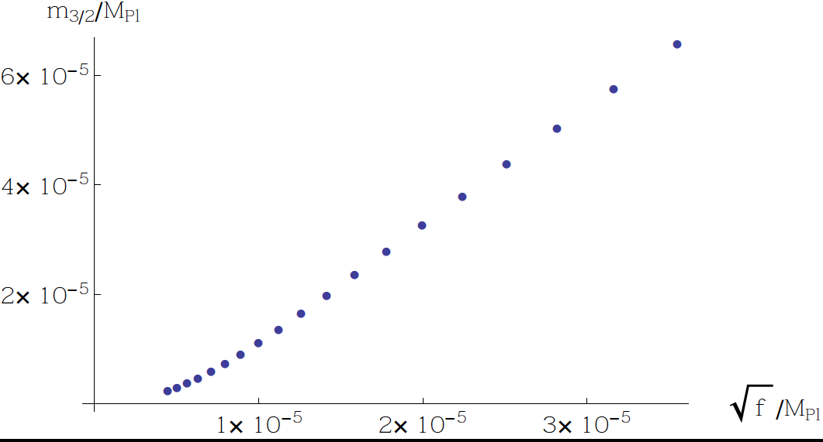
J Alexandre, N Houston &
NEM, 1312.5197 (PRD)

Slide 94
RESULTS
J Alexandre, N Houston &
NEM, 1312.5197 (PRD)
Λ << 1
phenomenologically good
Starobinsky scale
✓
Gravitino
condensate
at GUT scale
Planck-data best-fit value

Slide 95
PLANCK 2015 RESULTS ON INFLATION
Planck Coll: Ade et al. arXiv:1502.502114
GRAVITINO CONDENSATE MODEL-STAROBINSKY INFLATION

Slide 96
PART IV
``Running Vacuum’’ Concept:
from SUGRA-Starobinsky
Inflation to ΛCDM
(current small cosmological
constant model)

Slide 97

The ``Running Vacuum (RV)’’ : A Model for
the decay of effective vacuum energy
Sola (2008), Shapiro,
Stefancic, Gomez-Valent
The Effective vacuum energy ρ_{Λ} (t) at any given era (cosmic time t) is a function of
an appropriate `mass scale’’ μ_{c} (t), which can be identified with the Hubble scale H.
The RV Model postulates that the cosmic time dependence (decay) of the vacuum
energy resembles that of a renormalization-group β-function equation (RGE), and
is expressed (for general covariance reasons) in even integer powers of H(t)
Dimensionless coefficients, receiving contributions
from loop quantum corrections by integrating out
boson and fermion fields with masses M_{i}
NB: If evolution of the Universe is restricted at or below the GUT era,
then H⁶ and higher-order terms are negligible

Slide 98




Integrating the RGE yields the vacuum energy at any time t , up to a constant c₀
Gravitational
constant
κ² =8πG= 1/M_{Pl}²
Hubble scale
during inflation
Important feature of RV : Equation of state : p_{Λ} (t) = - ρ_{Λ} (t)
Can use the RV Model to reproduce smooth evolution of the Universe
from current era (with small cosmological constant (to be identified with c₀))
to inflationary era ....
Basilakos, NEM, Sola, arXiv:1505.04434

Slide 99



Basilakos, NEM, Sola, arXiv:1505.04434
Current era:
matter,
or radiation
Running Vacuum
contribution ρ_{Λ} = Λ(t)/κ²

Slide 100



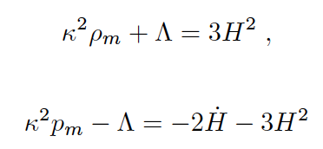

Basilakos, NEM, Sola, arXiv:1505.04434
Current era:
p_{m} = ω_{m} ρ_{Λ}

Slide 101

Basilakos, NEM, Sola, arXiv:1505.04434
Current era:

Slide 102

Basilakos, NEM, Sola, arXiv:1505.04434
Current era:
RVM
Evolution
Equation

Slide 103
SOLUTIONS CORRESPONDING TO VARIOUS UNIVERSE ERAS

Slide 104

SOLUTIONS CORRESPONDING TO VARIOUS UNIVERSE ERAS
(i) De Sitter (Inflation): Constant H with c₀ << H²

Slide 105

SOLUTIONS CORRESPONDING TO VARIOUS UNIVERSE ERAS
(i) De Sitter (Inflation): Constant H with c₀ << H²
neglecting matter
& cosmological constant
components in
we get

Slide 106
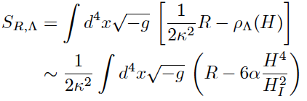
SOLUTIONS CORRESPONDING TO VARIOUS UNIVERSE ERAS
(i) De Sitter (Inflation): Constant H with c₀ << H²
neglecting matter
& cosmological constant
components in
we get
X
X

Slide 107
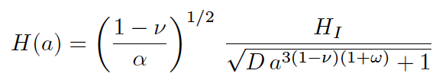
SOLUTIONS CORRESPONDING TO VARIOUS UNIVERSE ERAS
(i) De Sitter (Inflation): Constant H with c₀ << H²
(ii) Early Universe radiation era,
still with c₀ << H² with ω=1/3

Slide 108
SOLUTIONS CORRESPONDING TO VARIOUS UNIVERSE ERAS
(i) De Sitter (Inflation): Constant H with c₀ << H²
(ii) Early Universe radiation era,
still with c₀ << H² with ω=1/3
scale
factor
integration
constant

Slide 109


SOLUTIONS CORRESPONDING TO VARIOUS UNIVERSE ERAS
(i) De Sitter (Inflation): Constant H with c₀ << H²
(ii) Early Universe radiation era,
still with c₀ << H² with ω=1/3
NB: exit from inflation
standard radiation dominance
scale
factor
integration
constant

Slide 110



SOLUTIONS CORRESPONDING TO VARIOUS UNIVERSE ERAS
(i) De Sitter (Inflation): Constant H with c₀ << H²
(ii) Early Universe radiation era,
still with c₀ << H² with ω=1/3
NB: exit from inflation
standard radiation dominance
critical density
during Inflation
Finite
as a → 0
radiation

Slide 111


SOLUTIONS CORRESPONDING TO VARIOUS UNIVERSE ERAS
(i) De Sitter (Inflation): Constant H with c₀ << H²
(ii) Early Universe radiation era,
still with c₀ << H² with ω=1/3
NB: exit from inflation
standard radiation dominance
critical density
during Inflation
Finite
as a → 0
radiation
(iii) Current era (small Vacuum energy (ΛCDM): c₀ /H² > α (Η/Η_{Ι})²
vacuum cosmological constant
can be assumed small

Slide 112
RUNNING VACUUM:
From
STAROBINSKY - BROKEN SUGRA PHASE
to
ΛCDM Model today

Slide 113
Starting Point: One-loop SUGRA effective action contains terms
logarithmic in Λ – for covariance reasons
assume such terms provide the (fixed at Λ≈ 3 Η_{Ι}²)
``Renormalization-Group scale’’ dependence, not
to be ideotified with curvature ln(R) terms

Slide 114
Starting Point: One-loop SUGRA effective action contains terms
logarithmic in Λ – for covariance reasons
assume such terms provide the (fixed at Λ≈ 3 Η_{Ι}²)
``Renormalization-Group scale’’ dependence, not
to be ideotified with curvature ln(R) terms

Slide 115
Starting Point: One-loop SUGRA effective action contains terms
logarithmic in Λ – for covariance reasons
assume such terms provide the (fixed at Λ≈ 3 Η_{Ι}²)
``Renormalization-Group scale’’ dependence, not
to be ideotified with curvature ln(R) terms

Slide 116
Starting Point: One-loop SUGRA effective action contains terms
logarithmic in Λ – for covariance reasons
assume such terms provide the (fixed at Λ≈ 3 Η_{Ι}²)
``Renormalization-Group scale’’ dependence, not
to be ideotified with curvature ln(R) terms
PREVIOUSLY
CANCELLATION WAS
IMPOSED IN INFLATIONARY
PHASE → STAROBINSKY

Slide 117
Starting Point: One-loop SUGRA effective action contains terms
logarithmic in Λ – for covariance reasons
assume such terms provide the (fixed at Λ≈ 3 Η_{Ι}²)
``Renormalization-Group scale’’ dependence, not
to be ideotified with curvature ln(R) terms
PREVIOUSLY
CANCELLATION WAS
IMPOSED IN INFLATIONARY
PHASE → STAROBINSKY
CANCELLATION MAY NOT BE COMPLETE
BUT LEAVE BEHIND A SMALL CONSTANT

Slide 118
Starting Point: One-loop SUGRA effective action contains terms
logarithmic in Λ – for covariance reasons
assume such terms provide the (fixed at Λ≈ 3 Η_{Ι}²)
``Renormalization-Group scale’’ dependence, not
to be ideotified with curvature ln(R) terms
PREVIOUSLY
CANCELLATION WAS
IMPOSED IN INFLATIONARY
PHASE → STAROBINSKY
CANCELLATION MAY NOT BE COMPLETE
BUT LEAVE BEHIND A SMALL CONSTANT
THIS IS AN ASSUMPTION, HENCE ALTHOUGH
A SMALL COSMOLOGICAL CONSTANT IN CURRENT
ERA CAN BE ACOMMODATED THE SMALL
VACUUM ENERGY TODAY ISSUE IS NOT SOLVED

Slide 119


Starting Point: One-loop SUGRA effective action contains terms
logarithmic in Λ – for covariance reasons
assume such terms provide the (fixed at Λ≈ 3 Η_{Ι}²)
``Renormalization-Group scale’’ dependence, not
to be ideotified with curvature ln(R) terms

Slide 120

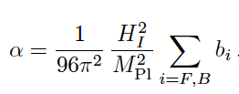

Starting Point: One-loop SUGRA effective action contains terms
logarithmic in Λ – for covariance reasons
assume such terms provide the (fixed at Λ≈ 3 Η_{Ι}²)
``Renormalization-Group scale’’ dependence, not
to be ideotified with curvature ln(R) terms
From RV Model

Slide 121
Starting Point: One-loop SUGRA effective action contains terms
logarithmic in Λ – for covariance reasons
assume such terms provide the (fixed at Λ≈ 3 Η_{Ι}²)
``Renormalization-Group scale’’ dependence, not
to be ideotified with curvature ln(R) terms
From RV Model
and the broken SUGRA phase generic values

Slide 122


Starting Point: One-loop SUGRA effective action contains terms
logarithmic in Λ – for covariance reasons
assume such terms provide the (fixed at Λ≈ 3 Η_{Ι}²)
``Renormalization-Group scale’’ dependence, not
to be ideotified with curvature ln(R) terms
From RV Model

Slide 123
Starting Point: One-loop SUGRA effective action contains terms
logarithmic in Λ – for covariance reasons
assume such terms provide the (fixed at Λ≈ 3 Η_{Ι}²)
``Renormalization-Group scale’’ dependence, not
to be ideotified with curvature ln(R) terms
From RV Model

Slide 124

Starting Point: One-loop SUGRA effective action contains terms
logarithmic in Λ – for covariance reasons
assume such terms provide the (fixed at Λ≈ 3 Η_{Ι}²)
``Renormalization-Group scale’’ dependence, not
to be ideotified with curvature ln(R) terms
× ×
Inflation
Correspondence with Starobinsky-like inflationary broken-SUGRA phase

Slide 125


Open Issues: incorporate
appropriately matter sector
in phenomenologically realistic models
Study coupling of gravitino to
matter/radiation and hence study
exit from Inflation/reheating by
coherent oscillations of gravitino condensate
& decay into radiation
Dark matter (DM): several candidates ,
from SUSY matter partners and/or axion
fields....Nothing
new to be added except that in
the simplest case of a very massive (GUT scale)
gravitino, studied here, this is not the DM
as it will quickly decay away

Slide 126
CONCLUSIONS – OUTLOOK
DISCUSSED MODELS OF INFLATION FITTING PLANCK DATA AFTER BICEP2/KECK/Planck 2015 analysis
SUGRA MODELS provide natural explanation of low scale of inflation fitting the data (in the sense of Starobinsky inflation)
PROPOSED A TRULY MINIMAL MODEL FOR INFLATION where Starobinsky inflation occurs in condensed gravitino phase- REALISTIC SUSY PHENOMENOLOGY only for conformal SUGRA models with GUT SCALE MASSIVE gravitinos
Link of INFLATION SCALE TO global scale of SUSY BREAKING via SUPER-HIGGS effect
Model fits excellently PLANCK DATA
Running vacuum concept: smooth connection of broken SUGRA phase to ΛCDM model today
More realistic phenomenology needed including NMSSM matter that is embedded in conformal SUGRA

Slide 127
CONCLUSIONS – OUTLOOK
DISCUSSED MODELS OF INFLATION FITTING PLANCK DATA AFTER BICEP2/KECK/Planck 2015 analysis
SUGRA MODELS provide natural explanation of low scale of inflation fitting the data (in the sense of Starobinsky inflation)
PROPOSED A TRULY MINIMAL MODEL FOR INFLATION where Starobinsky inflation occurs in condensed gravitino phase- REALISTIC SUSY PHENOMENOLOGY only for conformal SUGRA models with GUT SCALE MASSIVE gravitinos
Link of INFLATION SCALE TO global scale of SUSY BREAKING via SUPER-HIGGS effect
Model fits excellently PLANCK DATA
Running vacuum concept: smooth connection of broken SUGRA phase to ΛCDM model today
More realistic phenomenology needed including NMSSM matter that is embedded in conformal SUGRA
Reheating by coherent oscillations of
massive gravitino condensate
around its non-trivial
minimum & mechanism
for exit from inflationary phase
need to be studied in detail….
© Copyright Showeet.com

Slide 128
CONCLUSIONS – OUTLOOK
DISCUSSED MODELS OF INFLATION FITTING PLANCK DATA AFTER BICEP2/KECK/Planck 2015 analysis
SUGRA MODELS provide natural explanation of low scale of inflation fitting the data (in the sense of Starobinsky inflation)
PROPOSED A TRULY MINIMAL MODEL FOR INFLATION where Starobinsky inflation occurs in condensed gravitino phase- REALISTIC SUSY PHENOMENOLOGY only for conformal SUGRA models with GUT SCALE MASSIVE gravitinos
Link of INFLATION SCALE TO global scale of SUSY BREAKING via SUPER-HIGGS effect
Model fits excellently PLANCK DATA
Running vacuum concept: smooth connection of broken SUGRA phase to ΛCDM model today
More realistic phenomenology needed including NMSSM matter that is embedded in conformal SUGRA
Reheating by coherent oscillations of
massive gravitino condensate
around its non-trivial
minimum & mechanism
for exit from inflationary phase
need to be studied in detail….
THANK YOU
© Copyright Showeet.com

Slide 129
SPARES

Slide 130
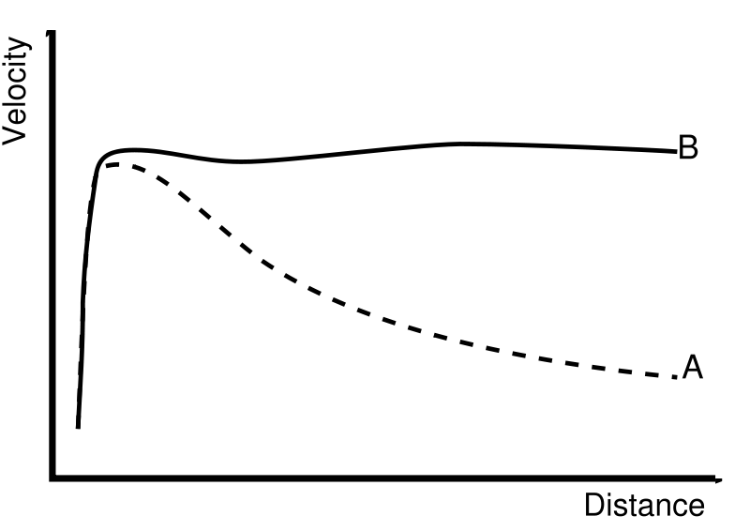
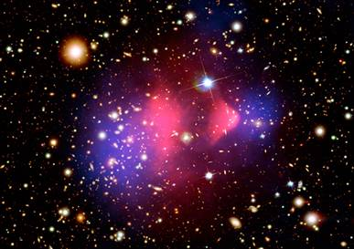
Note on Dark Matter
DARK MATTER (DM):
CURRENT EVIDENCE
Arguments in Favour
TYPES OF DM: hot, warm, cold
ASTROPHYSICAL CONSTRAINTS
(MODEL INDEPENDENT)
INDIRECT SEARCHES:
collider (LHC & beyond) searches
photons, neutrinos,
matter-antimatter asymmetries
(electron-positron, proton-antiproton)
Rotational Curves of
galaxies,
gravitational lensing
growth of structure
Baryon-only
Models, without
Dark Matter

Slide 131
Note on Dark Matter
DARK MATTER (DM):
CURRENT EVIDENCE
Arguments in Favour
TYPES OF DM: hot, warm, cold
ASTROPHYSICAL CONSTRAINTS
(MODEL INDEPENDENT)
INDIRECT SEARCHES:
collider (LHC & beyond) searches
photons, neutrinos,
matter-antimatter asymmetries
(electron-positron, proton-antiproton)
THEORETICAL SCENARIOS
SUPERSYMMETRY neutralino
SUPERGRAVITY gravitino (if sufficiently light)
AXIONS (standard QCD or stringy)
STERILE NEUTRINOS

Slide 132

Note on Dark Matter
Most difficult to
Detect /constrain
Astrophysically or otherwise
DARK MATTER (DM):
CURRENT EVIDENCE
Arguments in Favour
TYPES OF DM: hot, warm, cold
ASTROPHYSICAL CONSTRAINTS
(MODEL INDEPENDENT)
INDIRECT SEARCHES:
collider (LHC & beyond) searches
photons, neutrinos,
matter-antimatter asymmetries
(electron-positron, proton-antiproton)
THEORETICAL SCENARIOS
SUPERSYMMETRY neutralino
SUPERGRAVITY gravitino (if sufficiently light)
AXIONS (standard QCD or stringy)
STERILE NEUTRINOS

Slide 133
Note on Dark Matter
DARK MATTER (DM):
CURRENT EVIDENCE
Arguments in Favour
TYPES OF DM: hot, warm, cold
ASTROPHYSICAL CONSTRAINTS
(MODEL INDEPENDENT)
INDIRECT SEARCHES:
collider (LHC & beyond) searches
photons, neutrinos,
matter-antimatter asymmetries
(electron-positron, proton-antiproton)
THEORETICAL SCENARIOS
SUPERSYMMETRY neutralino
SUPERGRAVITY gravitino (if sufficiently light)
AXIONS (standard QCD or stringy)
STERILE NEUTRINOS
Theoretical Model dependence
in deriving bounds in experimental searches

Slide 135







B-modes correlations in the sky: difficult to measure
If measured may
be signal of
primordial tensor
density perturbations
gravitational wave (traceless, transverse) perturbations
2 polarizations: X, +, h₀₀ = h_{0i} =0
in standard
Cosmology
tensor
spectrum
scalar
spectrum

Slide 136
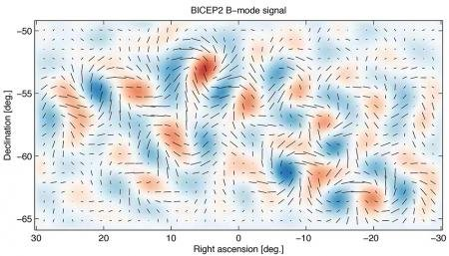
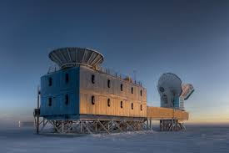
BICEP2 2014 Data on tensor perturbations
Detection of
B-modes in
CMB polarization

Slide 137
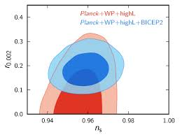

BICEP2 2014 Data on tensor perturbations
Detection of
B-modes in
CMB polarization
If true would imply a much larger
value for tensor-to-scalar ratio r
than anticipated by PLANCK 2013

Slide 138
Detection of
B-modes in
CMB polarization
But proved incorrect
(as being primordial gravitational waves)
due to Joint BICEP2/KECK Array & Planck
2015 Analysis arXiv:1502.00612
If true would Implies a much larger
value for tensor-to-scalar ratio r
than anticipated by PLANCK 2013

Slide 139
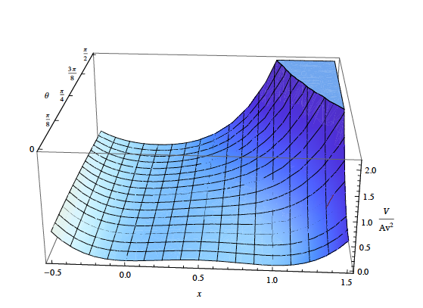

WZ INFLATION & PLANCK DATA 2013
Croon, Ellis, NEM
PLB 724, 165 (2013)
arXiv: 1303.6253.

Slide 140

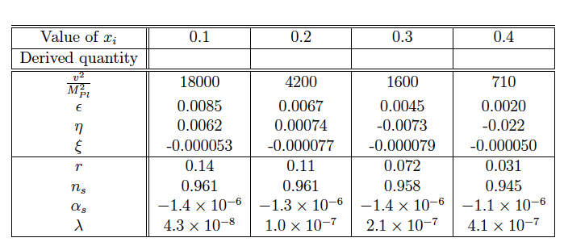
WZ INFLATION & PLANCK DATA 2013
Croon, Ellis, NEM
PLB 724, 165 (2013)
arXiv: 1303.6253.
examined limit
N = 50

Slide 141
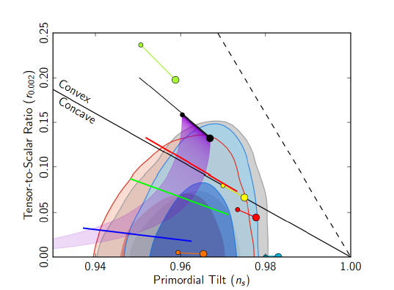
WZ INFLATION & PLANCK DATA 2013
Croon, Ellis, NEM
PLB 724, 165 (2013)
arXiv: 1303.6253.

Slide 142
WZ INFLATION & PLANCK DATA 2013
Croon, Ellis, NEM
PLB 724, 165 (2013)
arXiv: 1303.6253.
Minimal WZ
model can be
combined with
minimal SUSY
seesaw model

Slide 143
WZ INFLATION & PLANCK DATA 2013
Croon, Ellis, NEM
PLB 724, 165 (2013)
arXiv: 1303.6253.
examined limit
Smaller field values
also compatible with
BICEP2 Data
N = 50

Slide 144


EXPLORING TWO-FIELD INFLATION IN WZ MODELS
J.ELLIS, NEM, D. MULRYNE 1401.6078

Slide 145
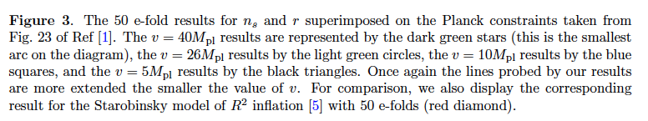
J.ELLIS, NEM, D. MULRYNE 1401.6078

Slide 146

J.ELLIS, NEM, D. MULRYNE 1401.6078
NB: Transplanckian
inflaton v.e.v.s
BICEP2

Slide 147
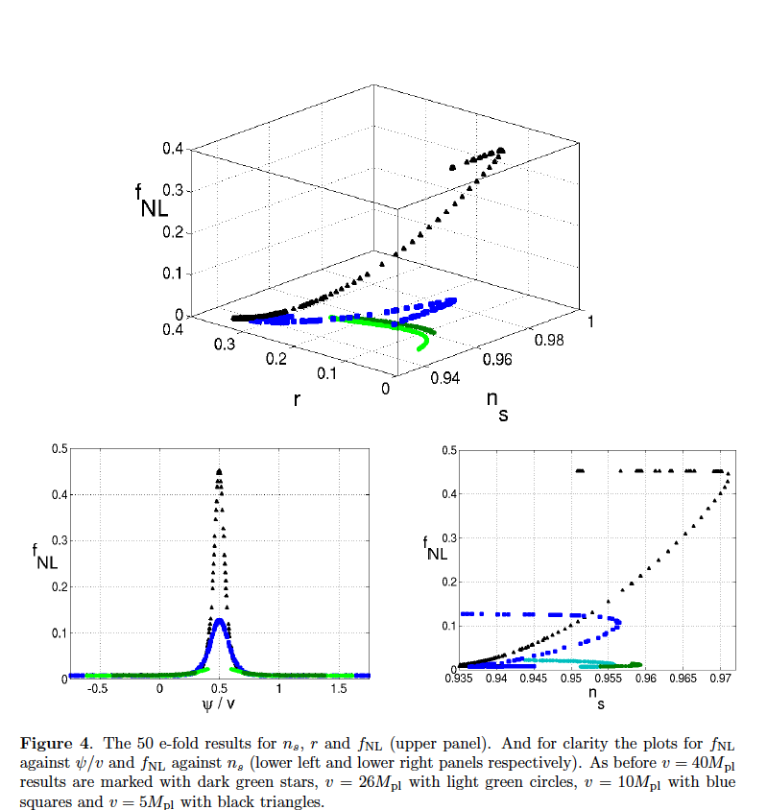
PREDICTIONS FOR NON-GAUSSIANITIES
J.ELLIS, NEM, D. MULRYNE 1401.6078

